Slide 1
Contemporary Views Along the
First Transcontinental Railroad
Richard Koenig
Kalamazoo College
rkoenig@kzoo.edu

Slide 2
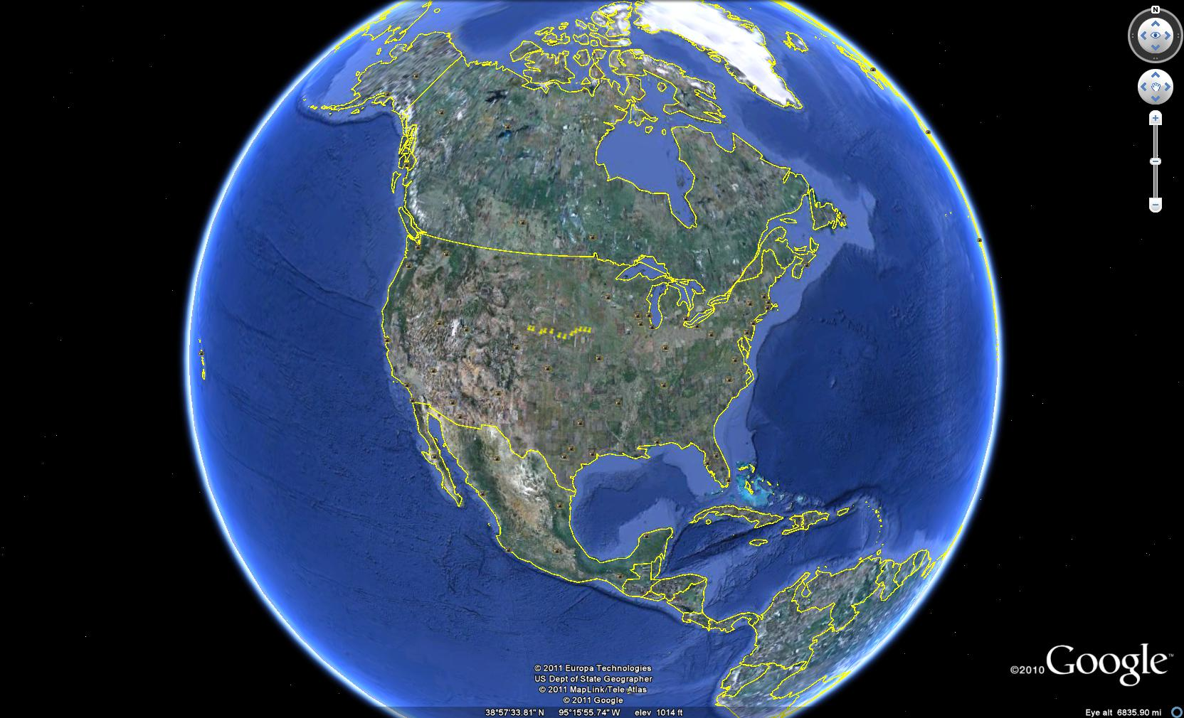
Nebraska Route, global view

Slide 3
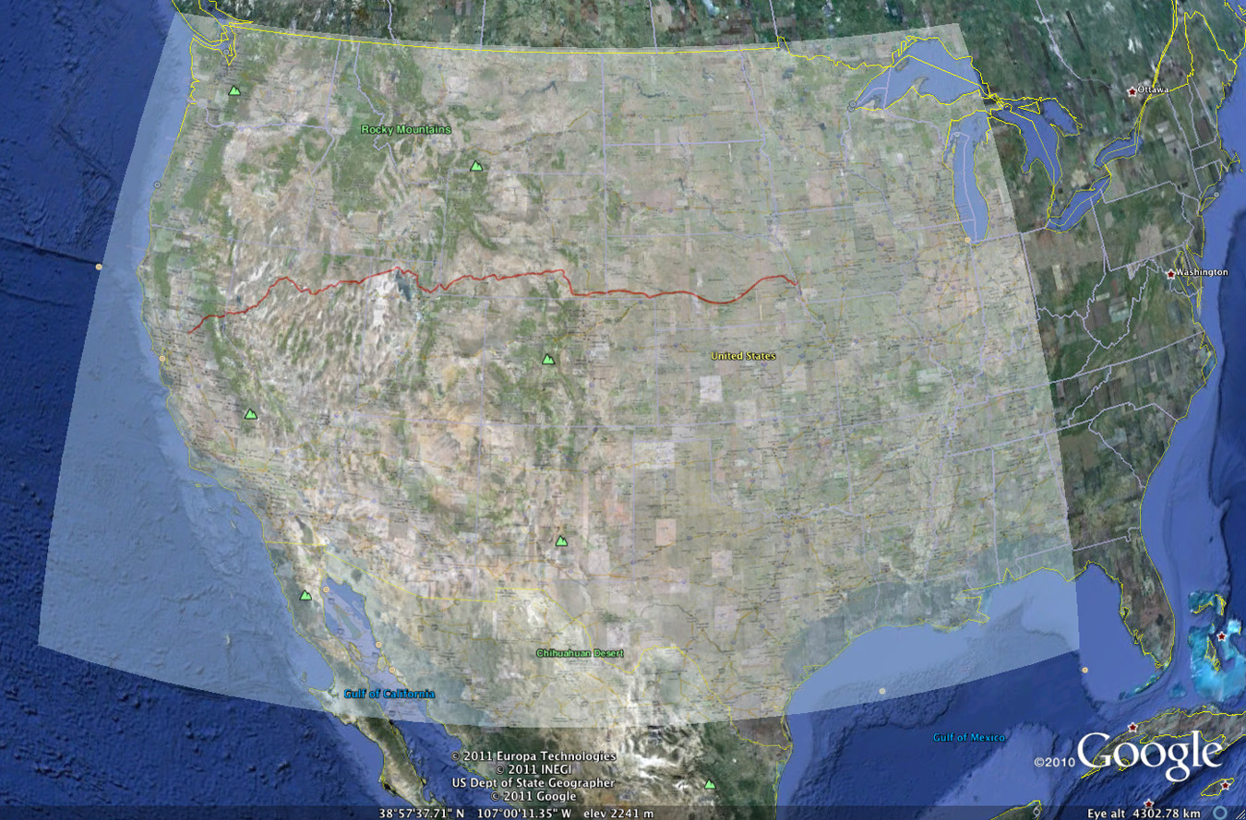
Transcontinental Route in Red
Note alignment with Interstate routes, and hence, often with rivers.

Slide 4
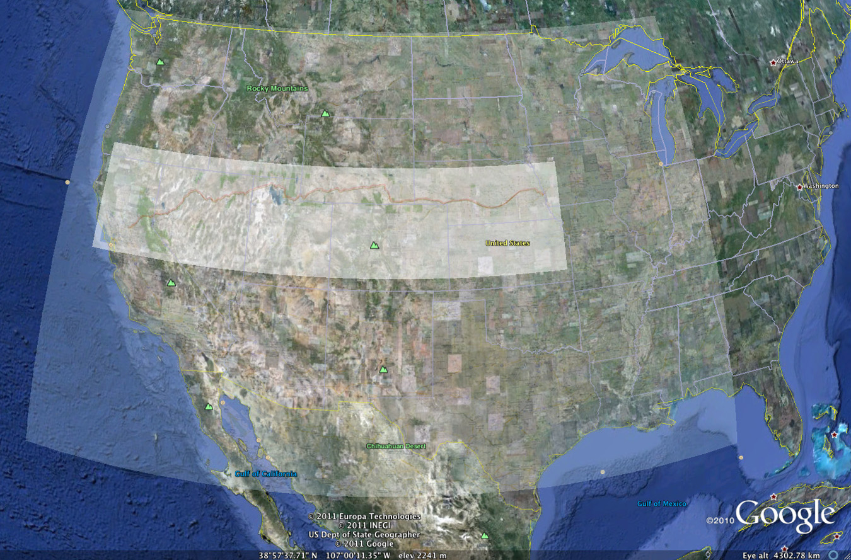
Strip map emphasizes route—alignment takes advantage of transparency setting in Google Earth

Slide 5
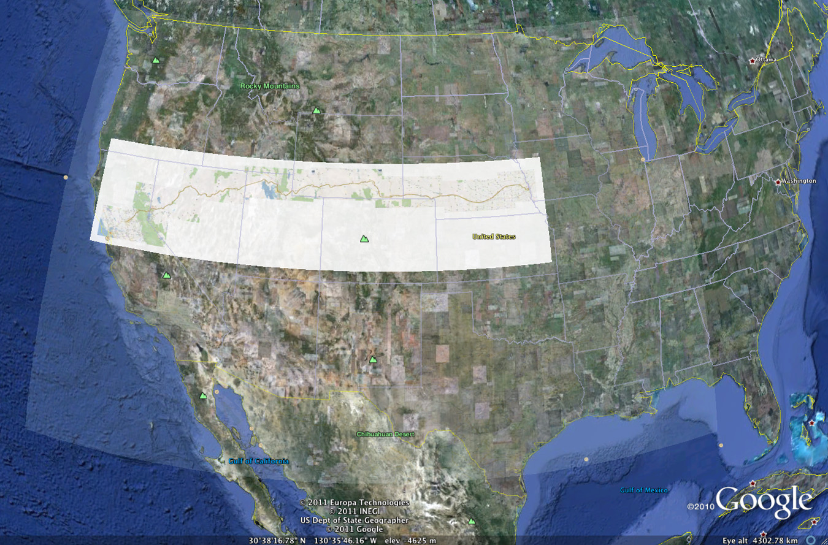
Opaque strip map

Slide 6
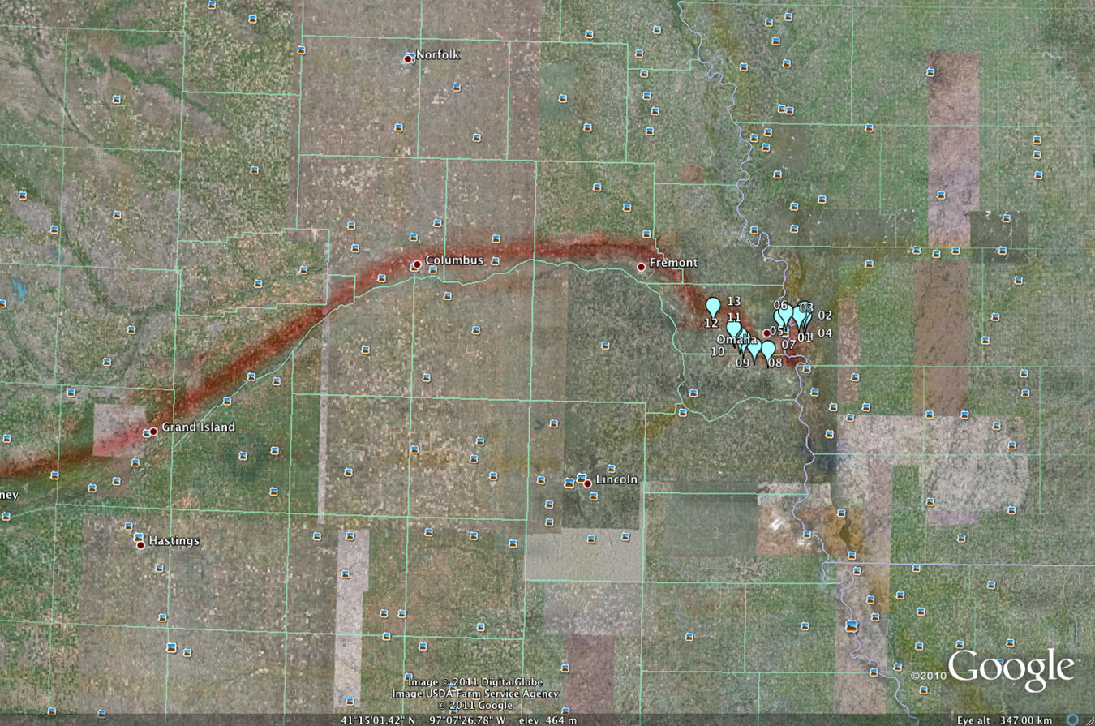
Animation, with thirteen points, along the so-called “Ox-Bow” south of Omaha

Slide 7
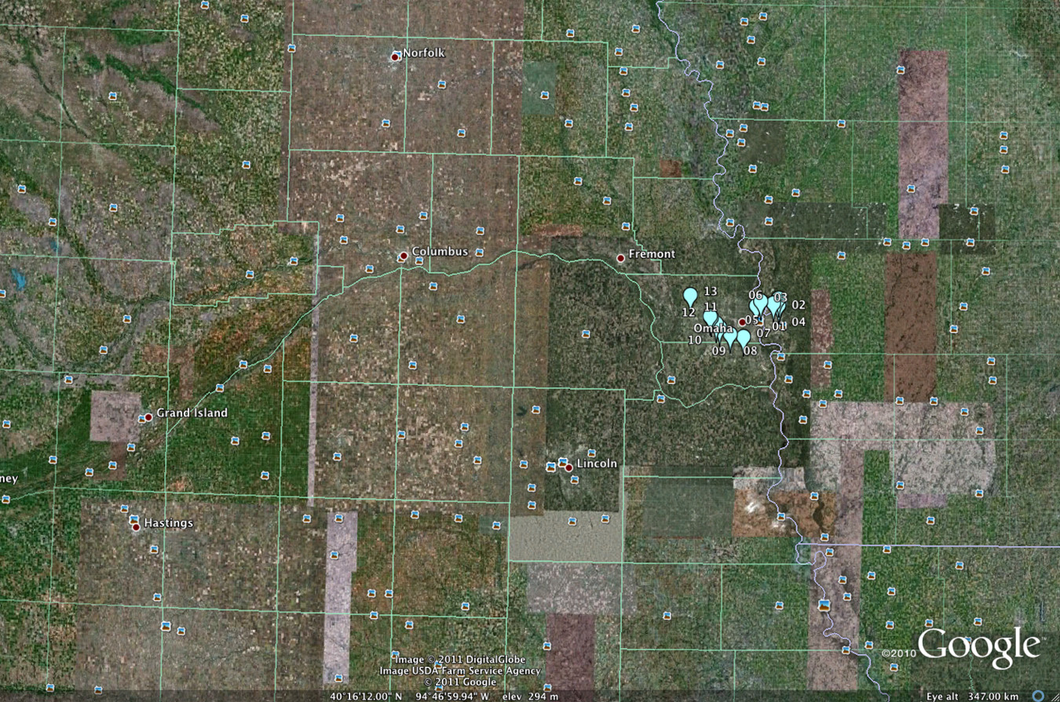
Animation with map removed—emphasizes underlying terrain and associated features

Slide 8
Along the way in Nebraska:
Street Views from Google Earth offer one way to capture elements in the landscape along the path of the railroad. These views, however, are broad in context and not specifically tied to the Transcontinental Railroad.
What follows is first an inventory of the sort of image already present in
Google Earth and then a selection of photos taken by the author.
Place names on the historical map do not necessarily align with corresponding names in Google Earth.
Field checking, using a GPS should be helpful.

Slide 9
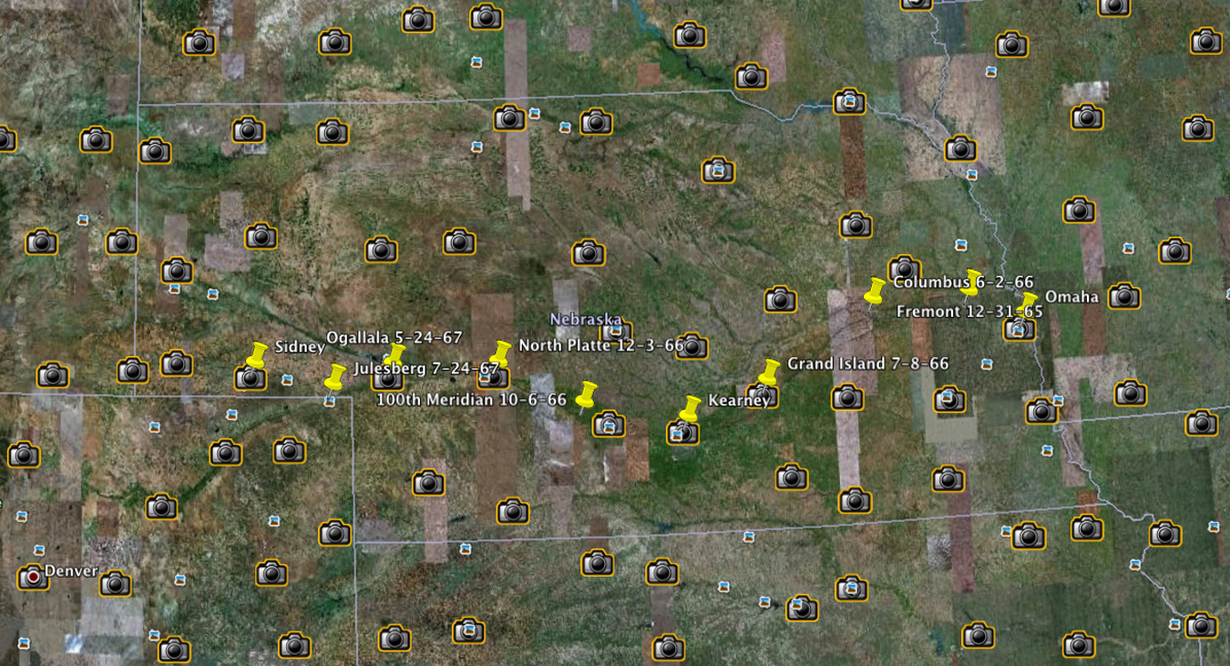
Street views along the way (camera icons)

Slide 10
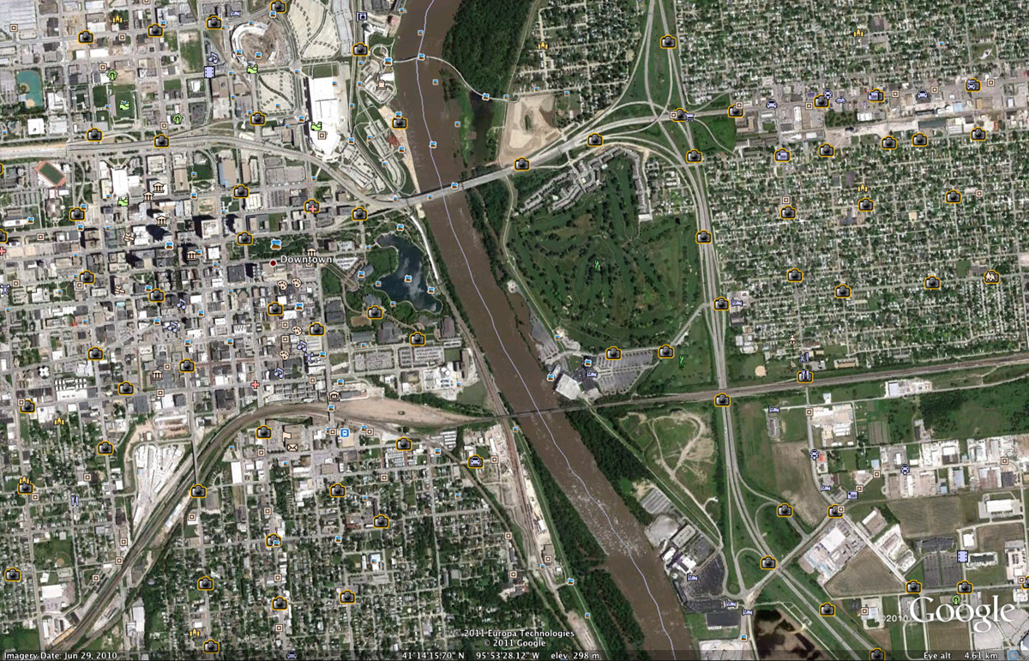
Omaha

Slide 11
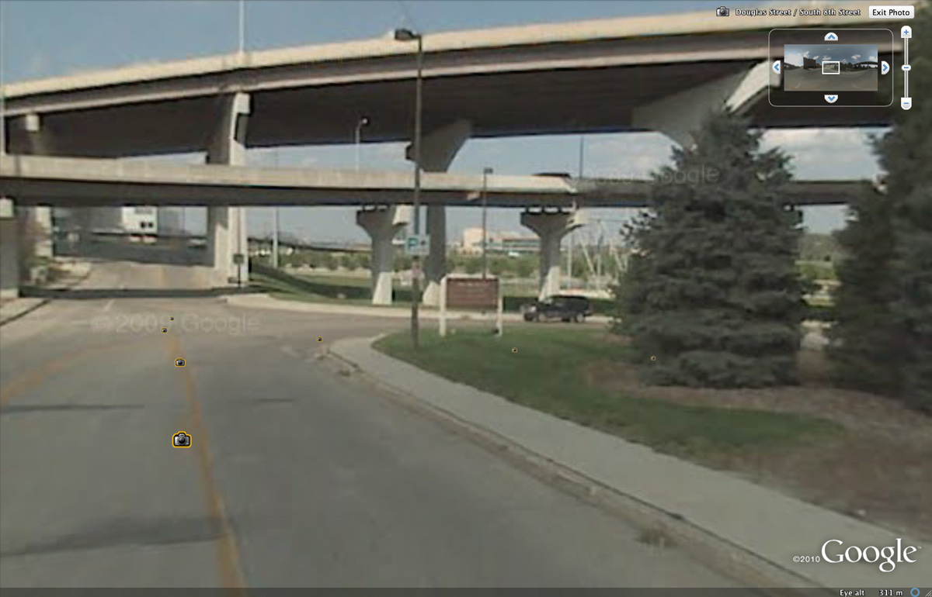
Associated Street View: Omaha

Slide 12
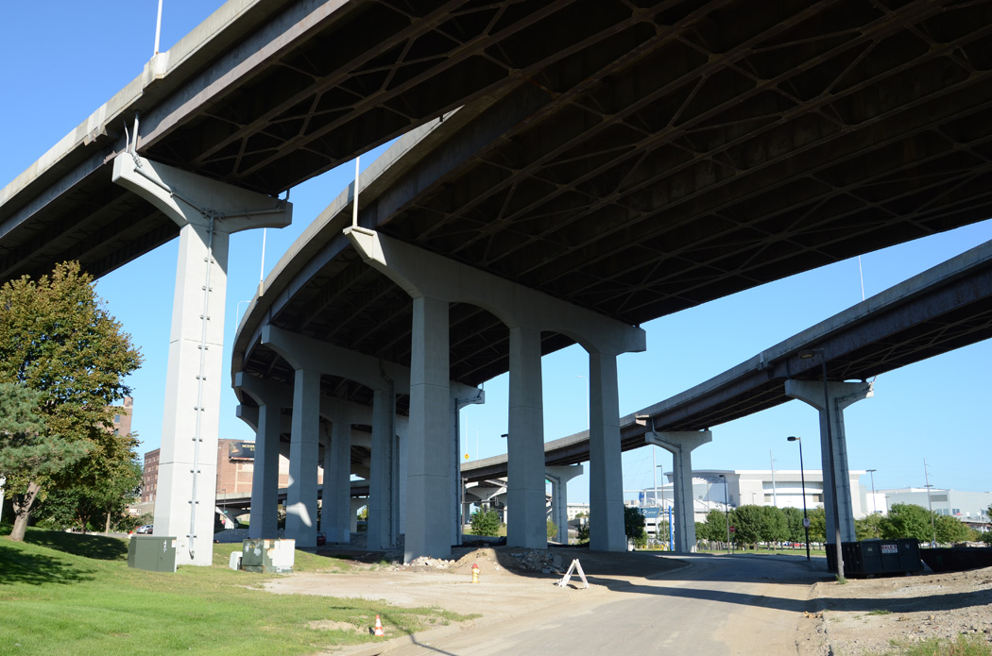
Omaha, where ground was broken by the Union Pacific

Slide 13
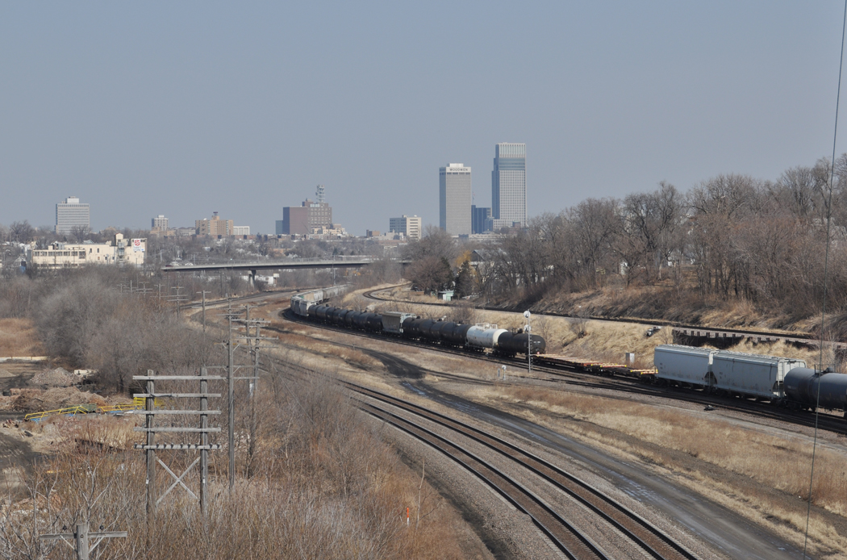
Ox-bow: downtown Omaha from Martha Street

Slide 14
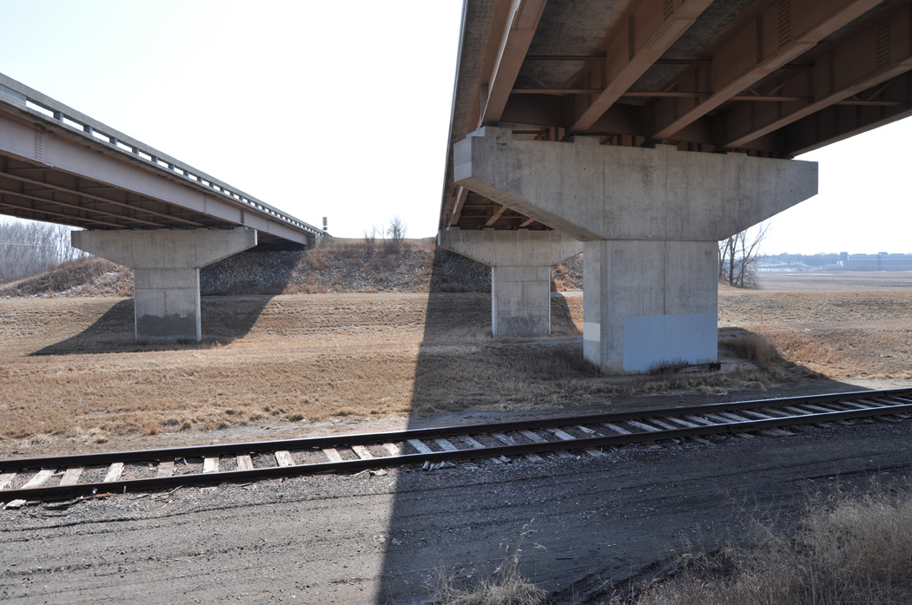
Ox-bow: tracks, off 15th Street, under Kennedy Freeway

Slide 15
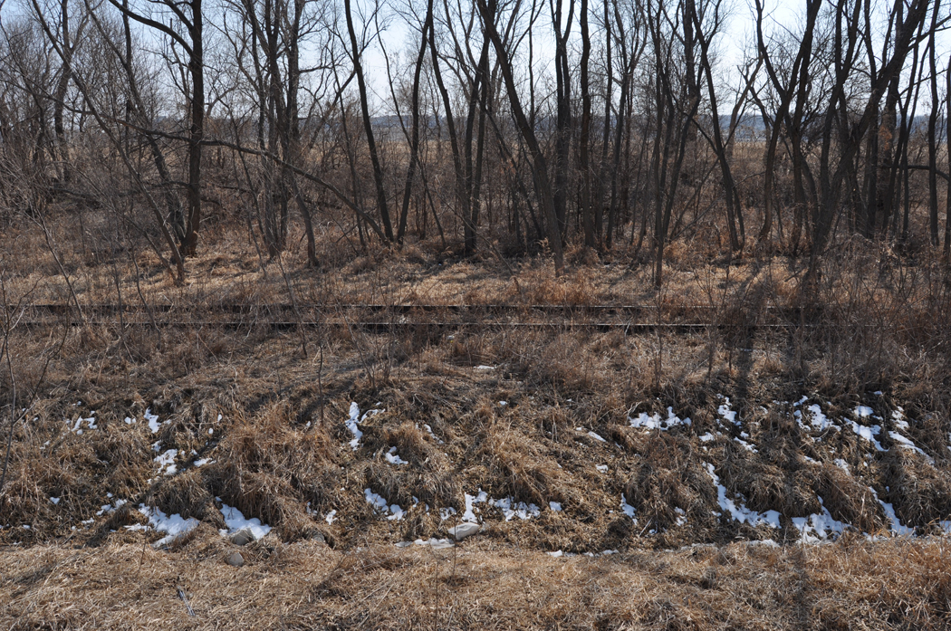
Ox-bow: last remaining tracks on east side, off County Road G42

Slide 16
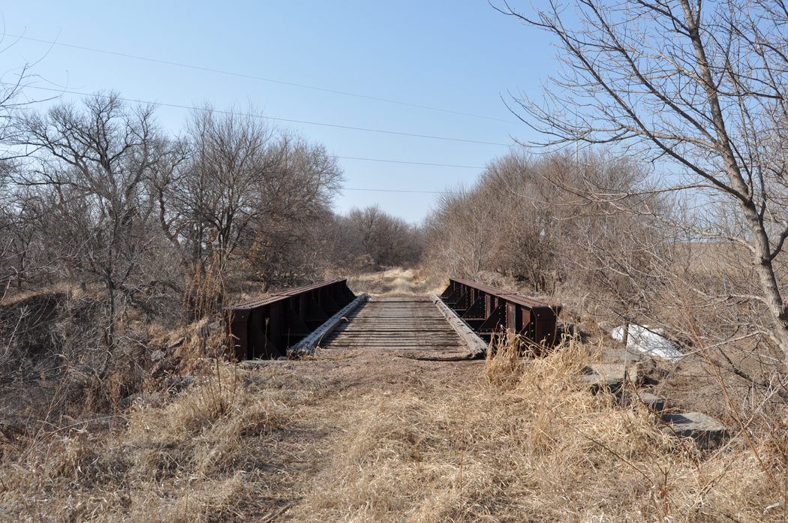
Ox-bow: bridge, just off Harry Anderson Avenue, near 108th Street

Slide 17
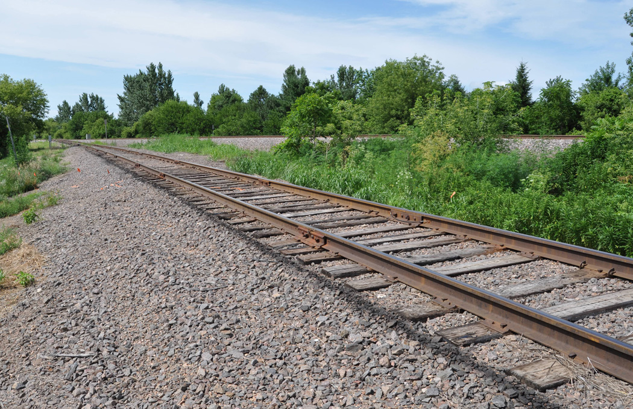
Ox Bow, Lane

Slide 18
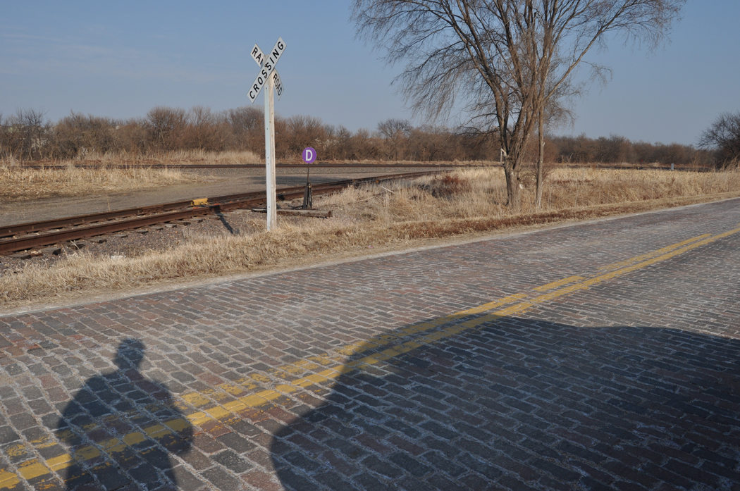
Tracks along side Old Lincoln Highway between 168th and 180th

Slide 19
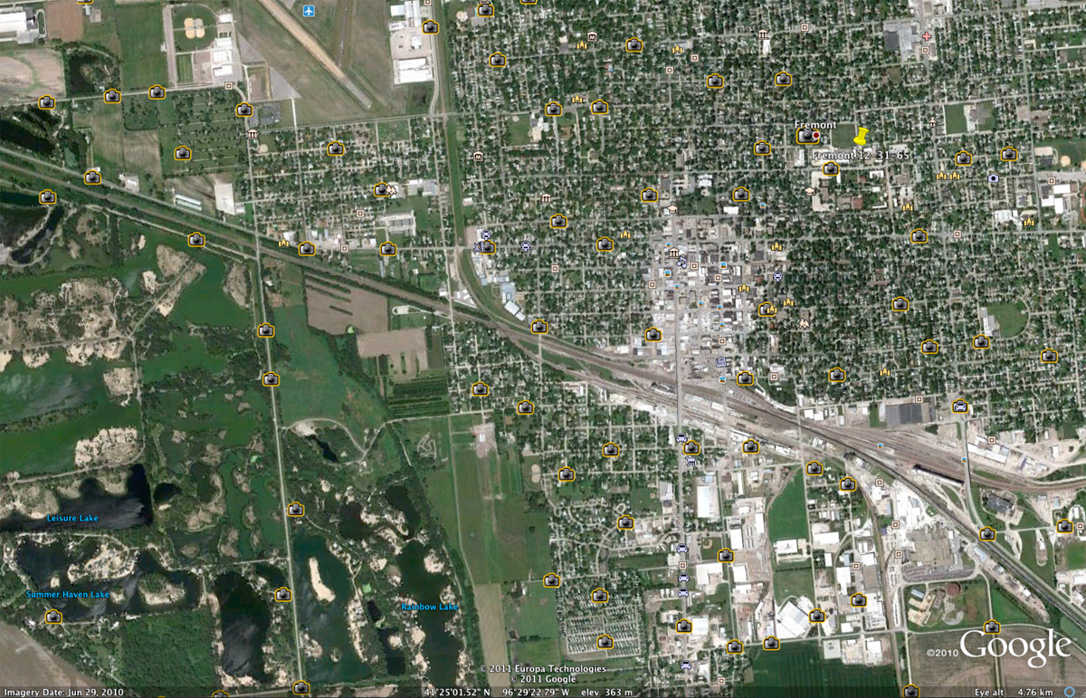
Fremont

Slide 20
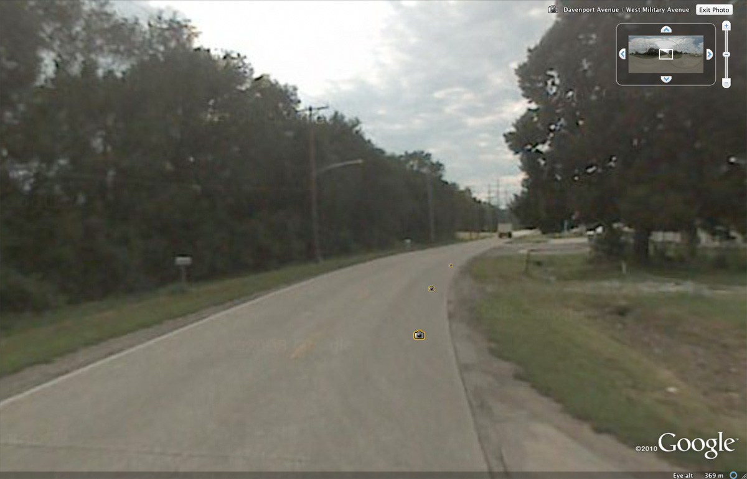
Associated Street View: Fremont

Slide 21
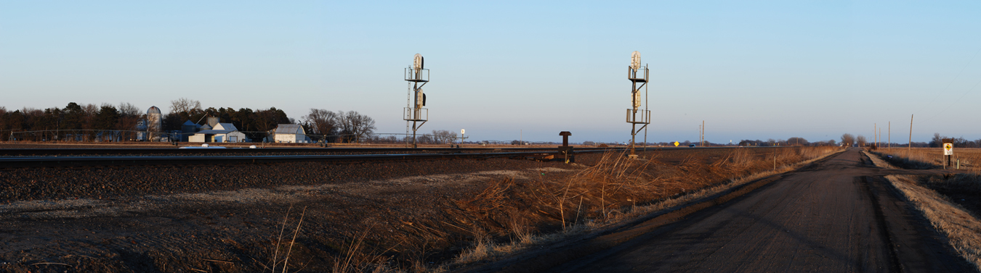
Tracks along side Old Lincoln Highway near Ames, NE, eight miles west of Fremont

Slide 22
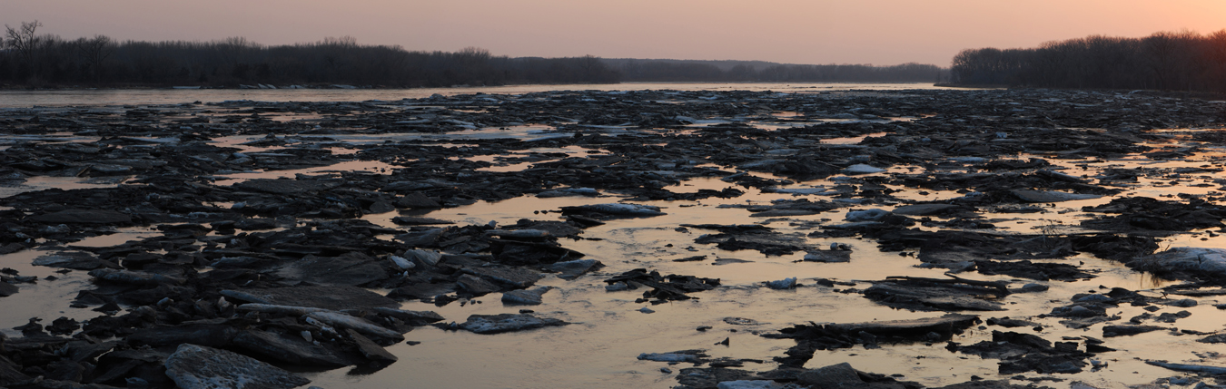
Platte River, North Bend

Slide 23
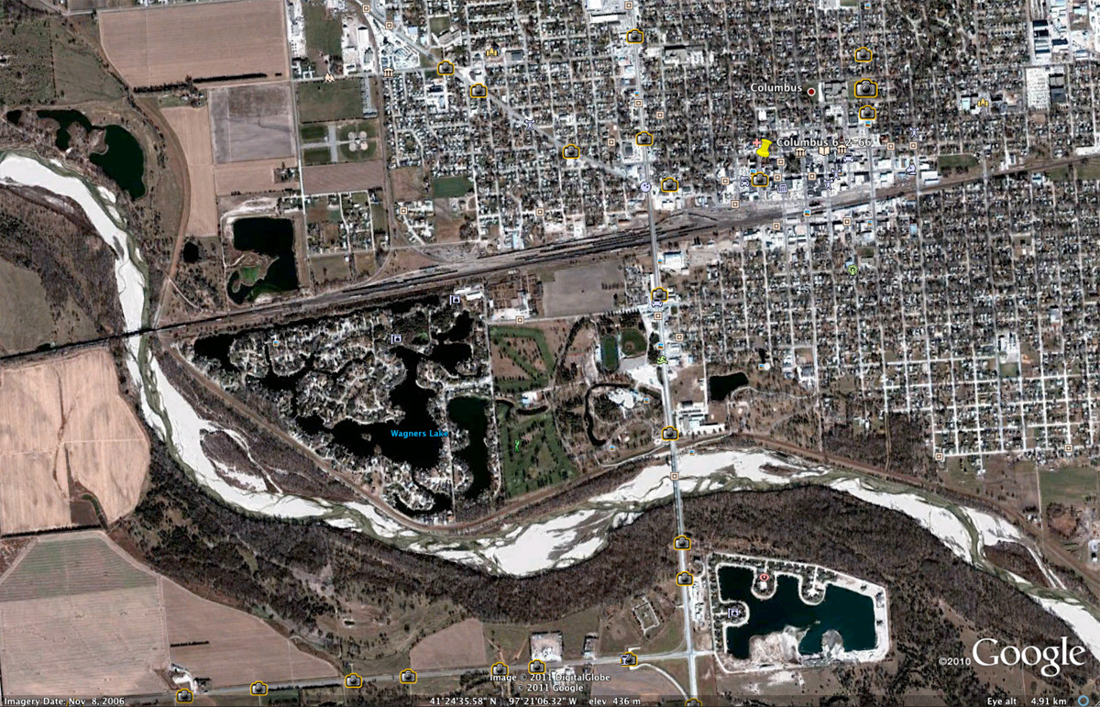
Columbus

Slide 24
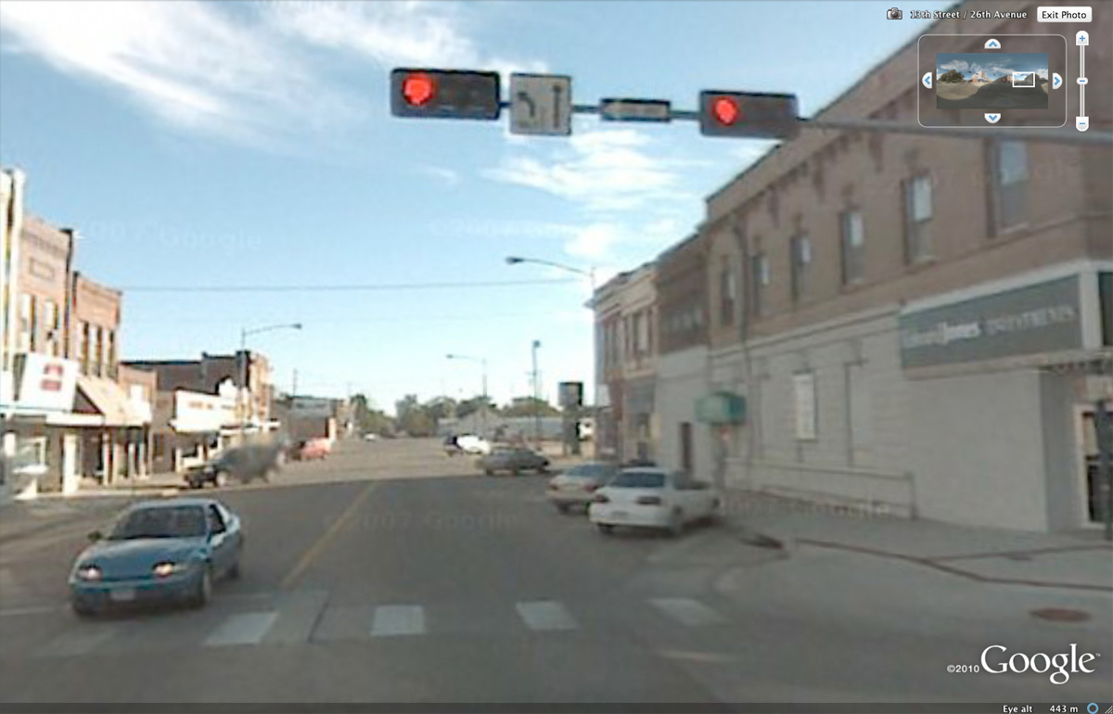
Associated Street View: Columbus

Slide 25
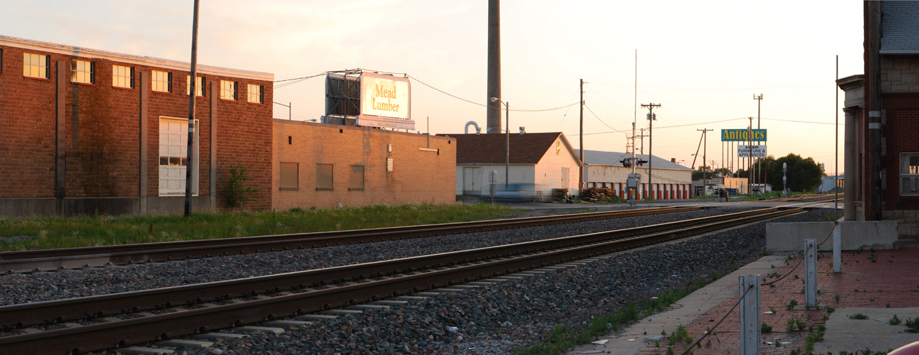
The station at Columbus

Slide 26
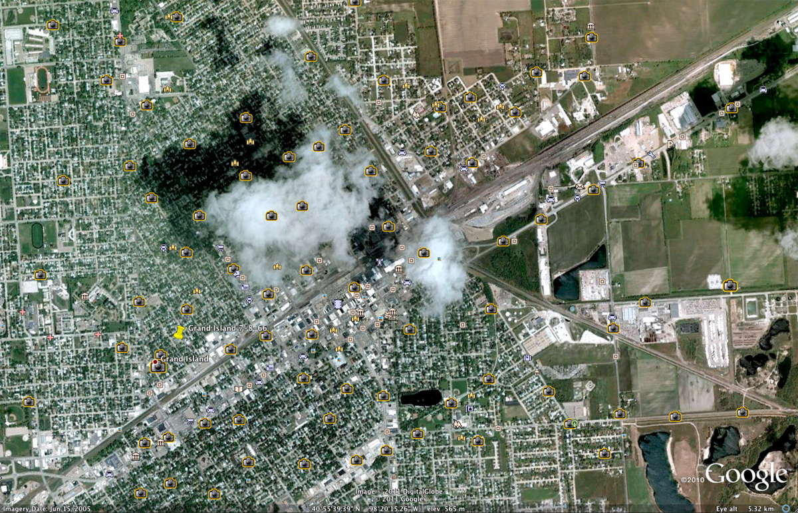
Grand Island

Slide 27
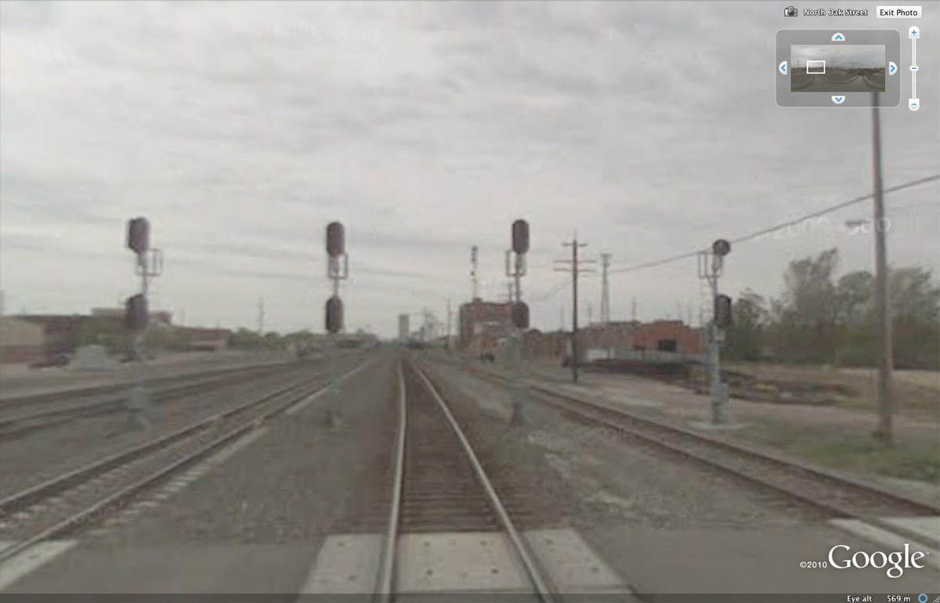
Associated Street View: Grand Island

Slide 28
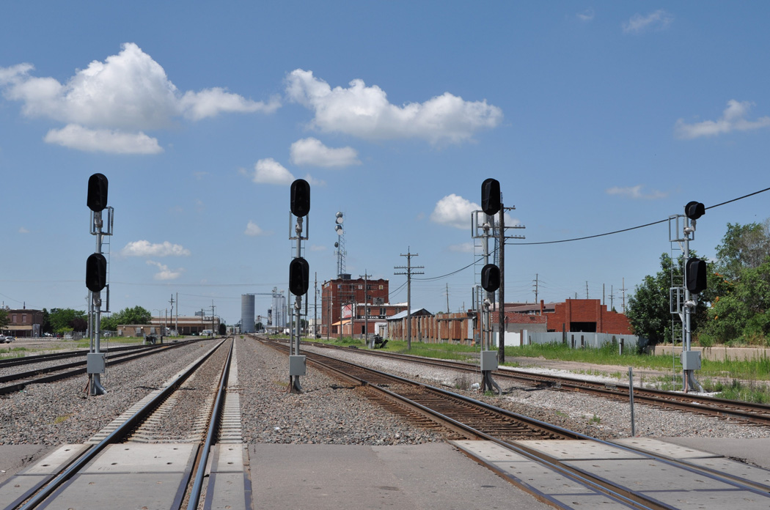
Grand Island

Slide 29
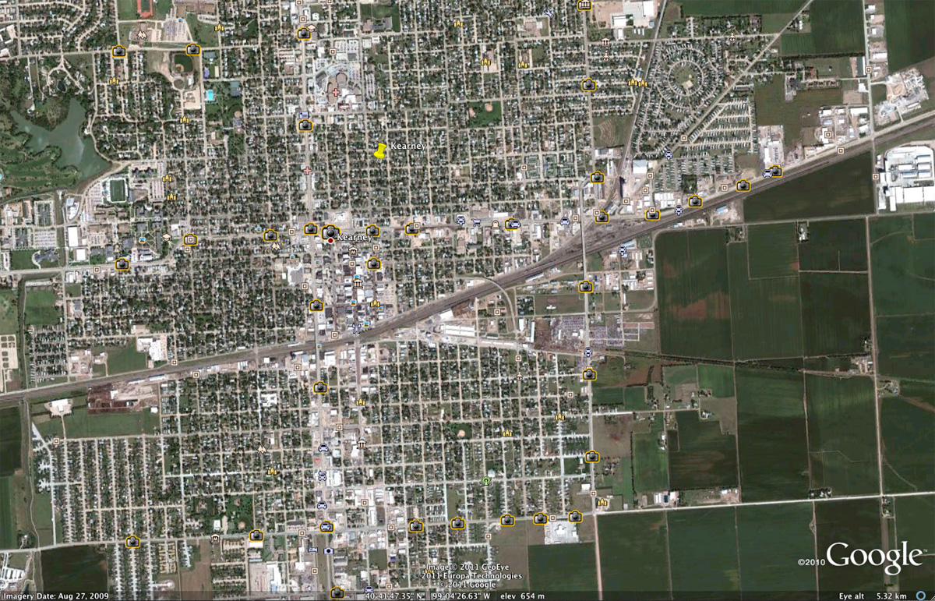
Kearney

Slide 30
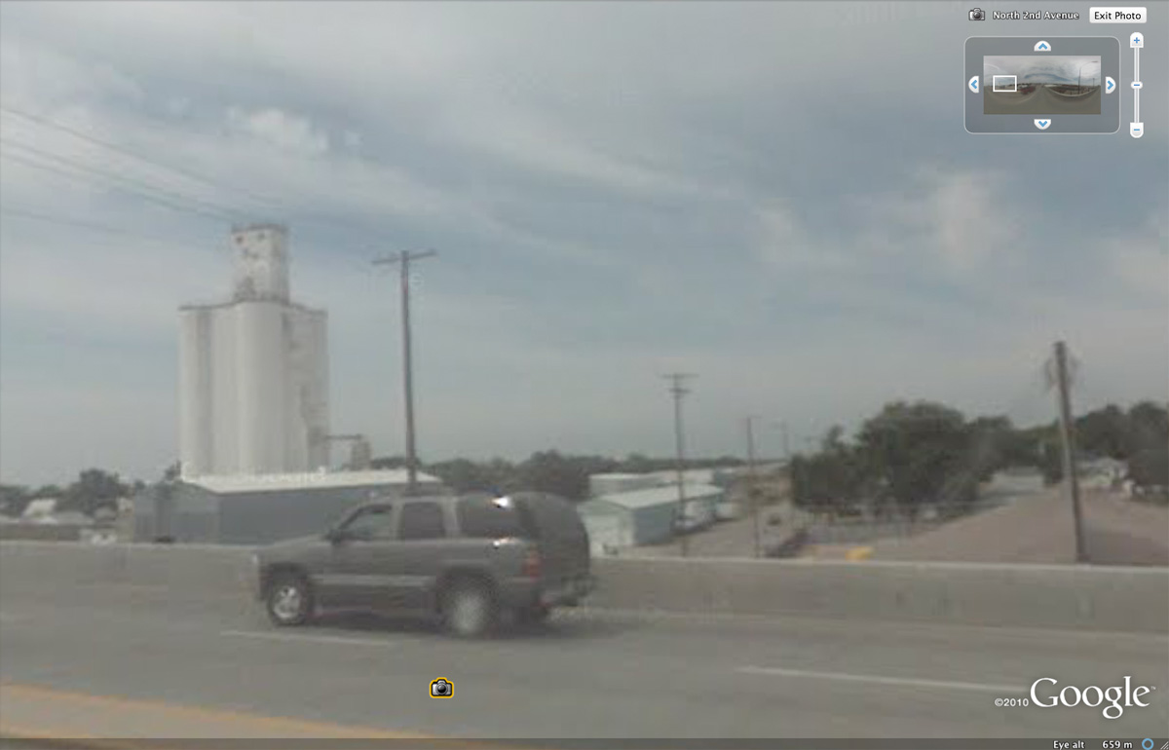
Associated Street View: Kearney

Slide 31
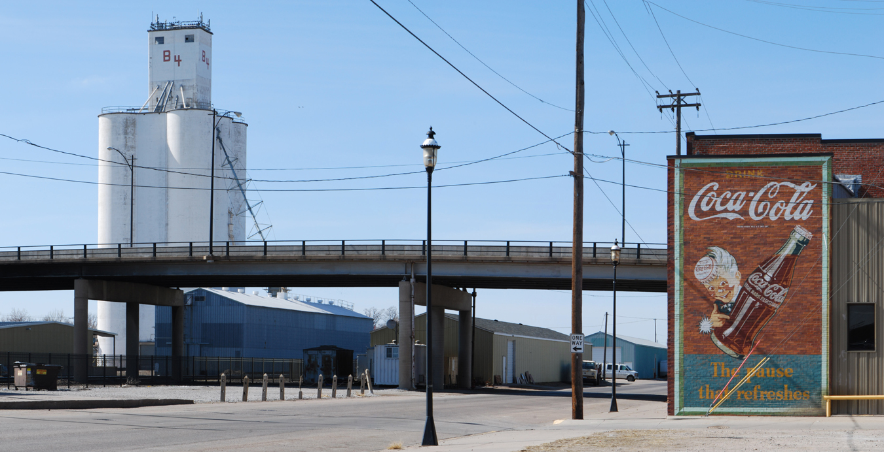
Downtown Kearney

Slide 32
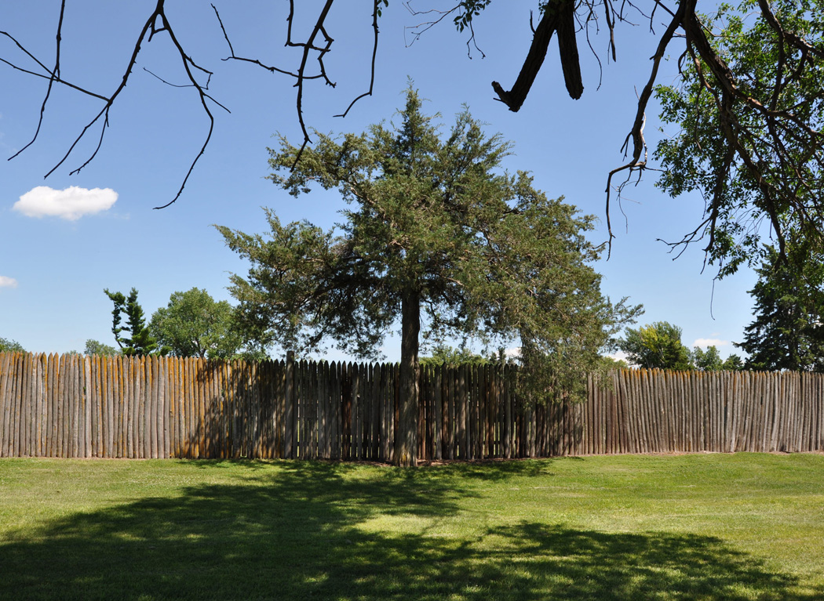
Fort Kearney

Slide 33
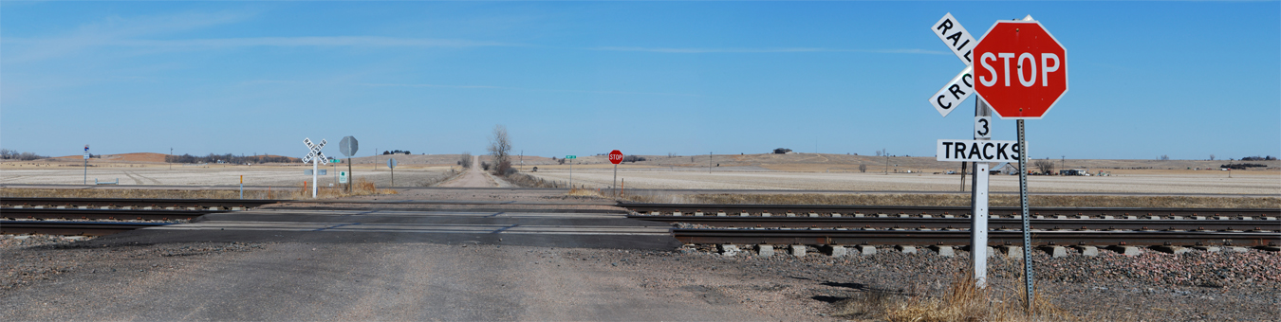
Just west of Elm Creek, Nebraska

Slide 34
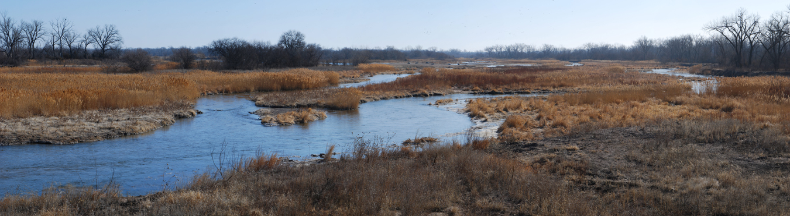
Platte River, south of Overton, Nebraska

Slide 35
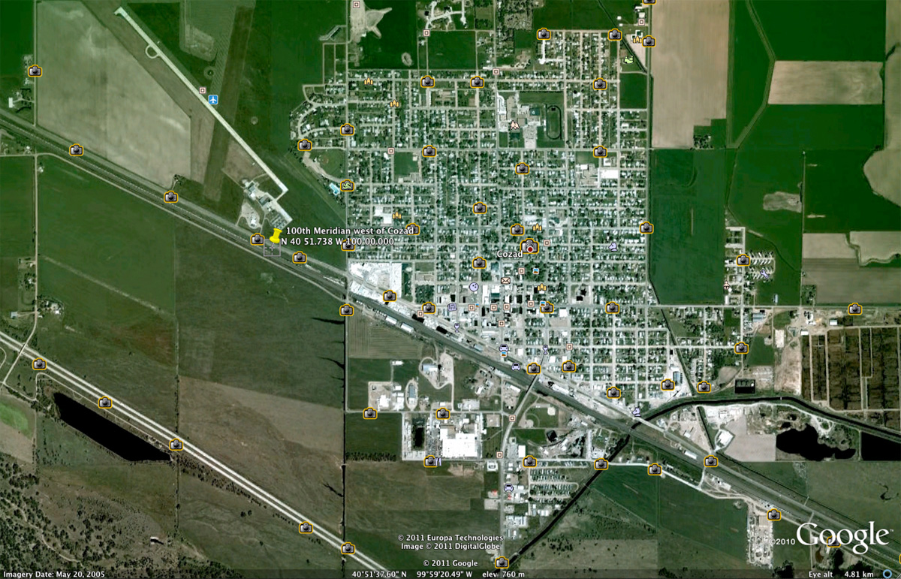
Cozad and the 100th Meridian

Slide 36
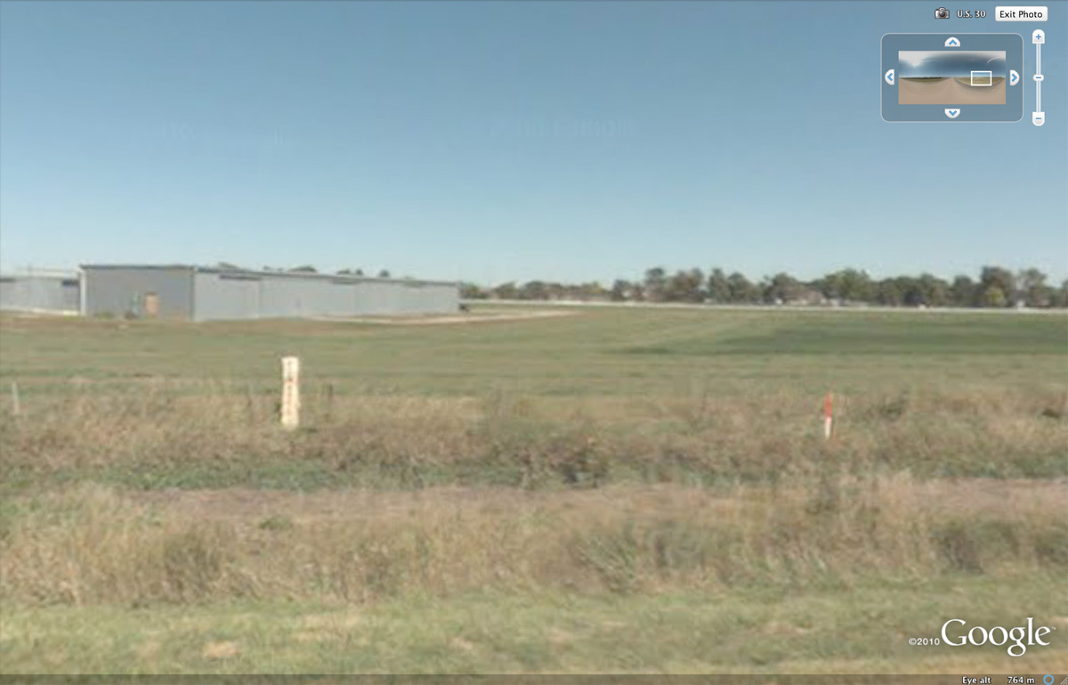
Associated Street View—note marker for 100th Meridian

Slide 37
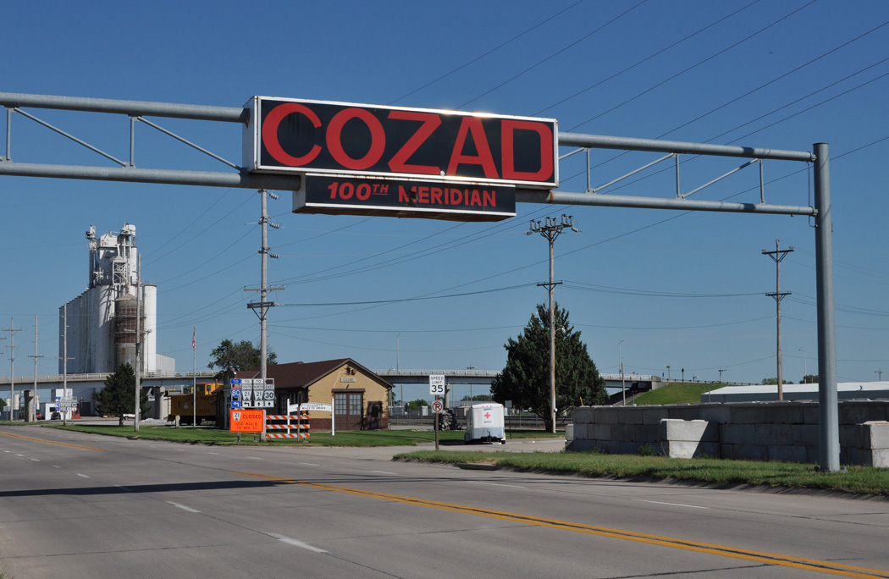
Cozad

Slide 38
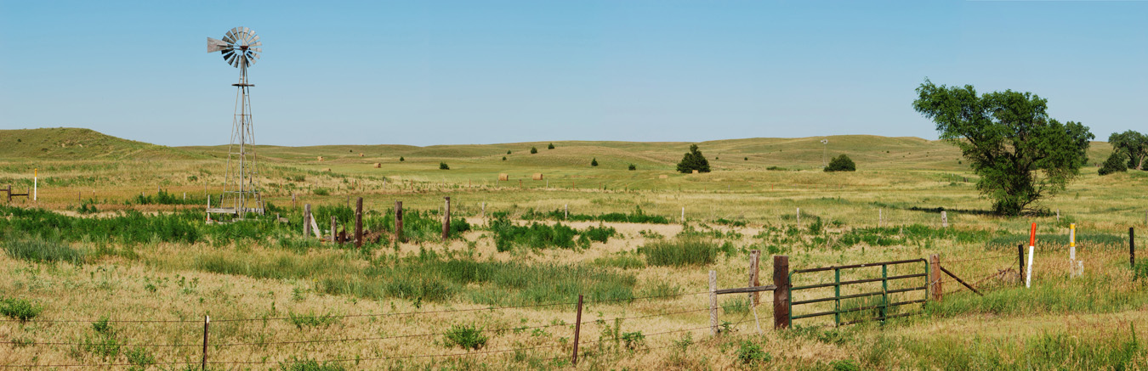
Between Vroman and Brady, Nebraska

Slide 39
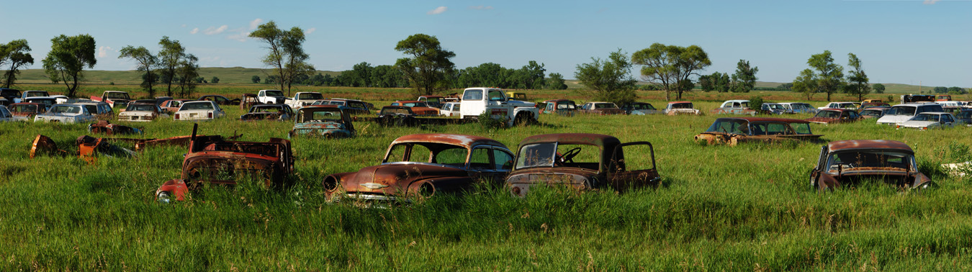
Near Maxwell, Nebraska

Slide 40
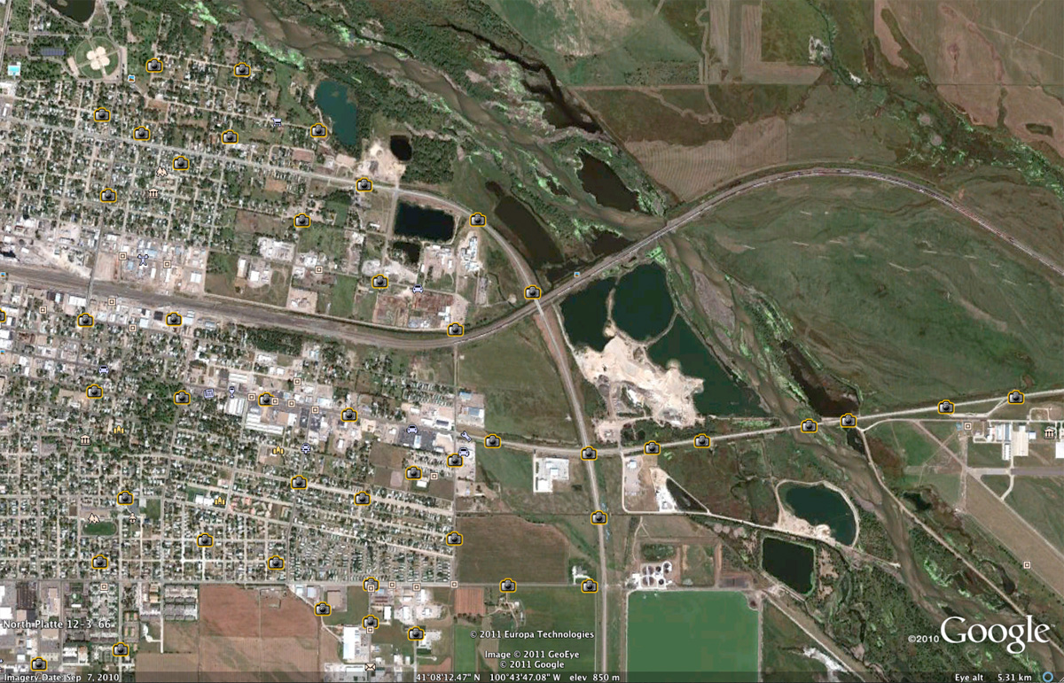
North Platte

Slide 41
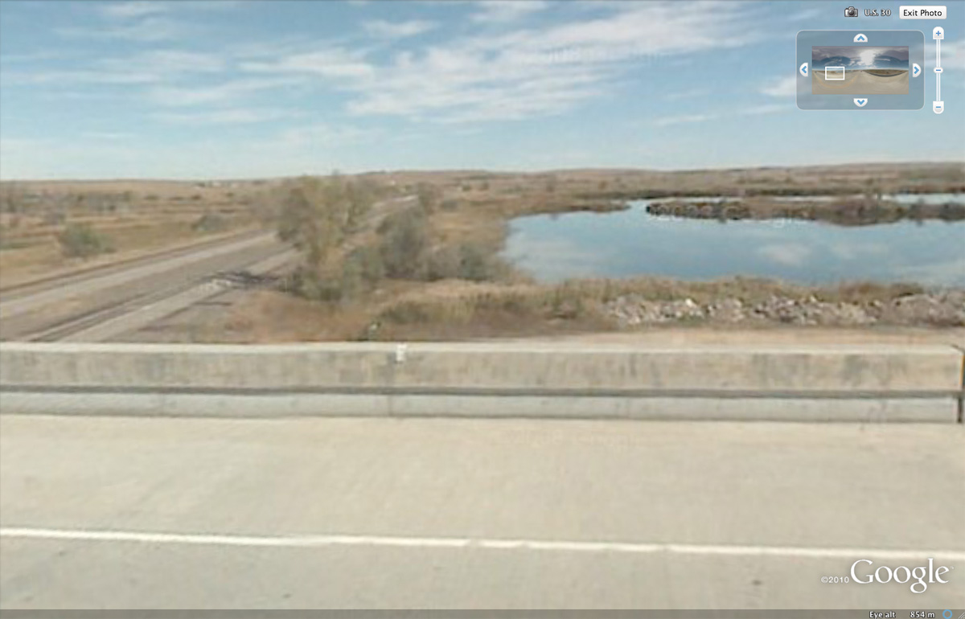
Associated Street View: North Platte

Slide 42
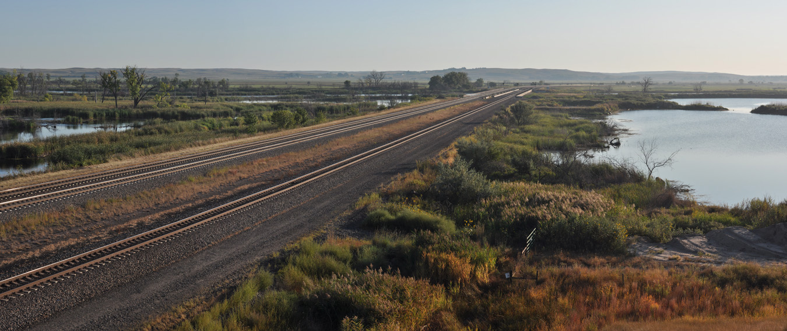
North Platte

Slide 43
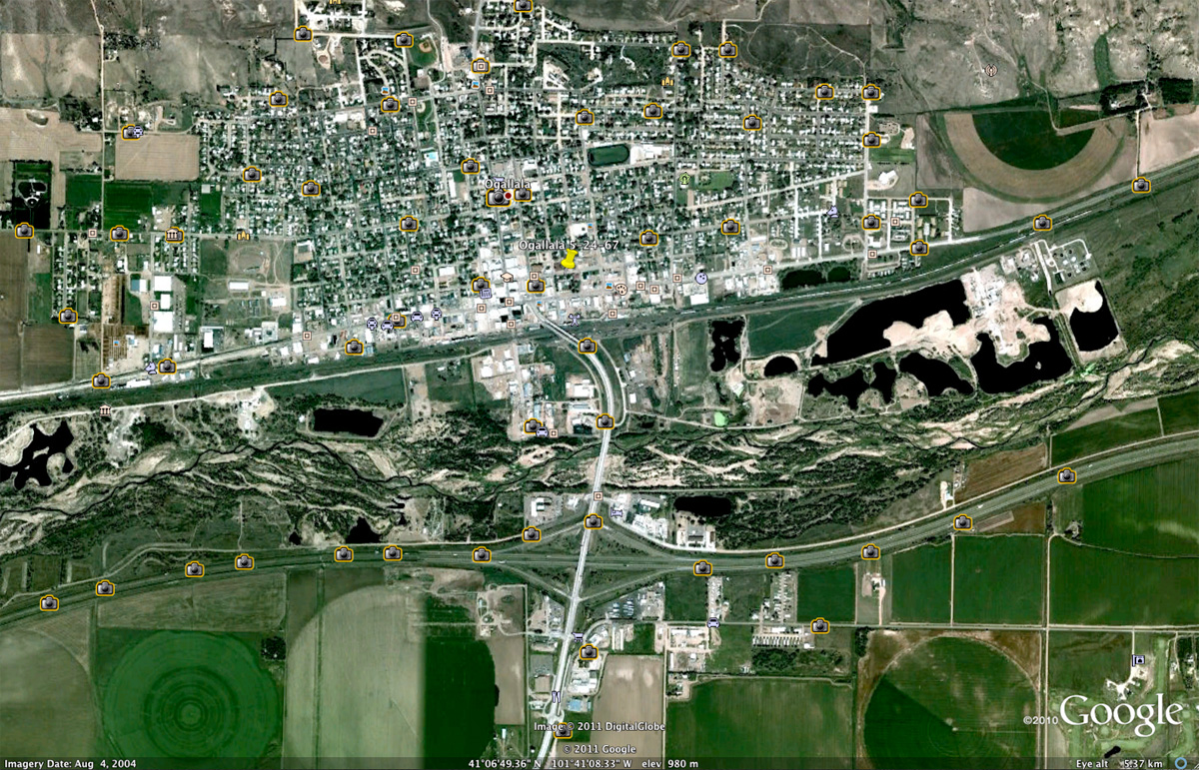
Ogallala

Slide 44
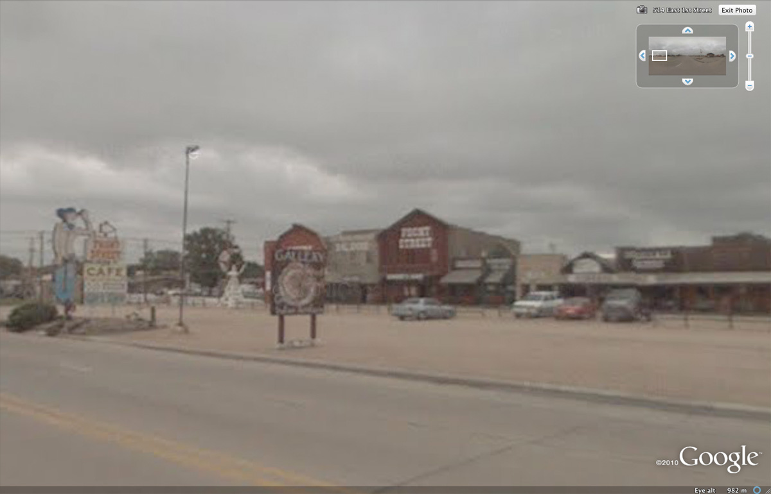
Associated Street View: Ogallala

Slide 45
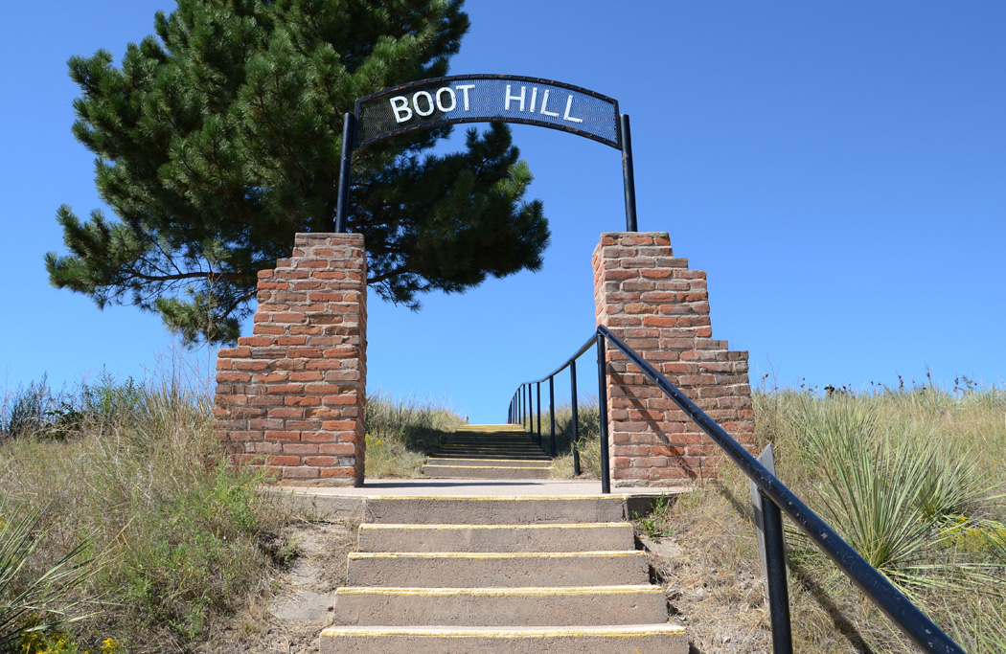
Ogallala

Slide 46
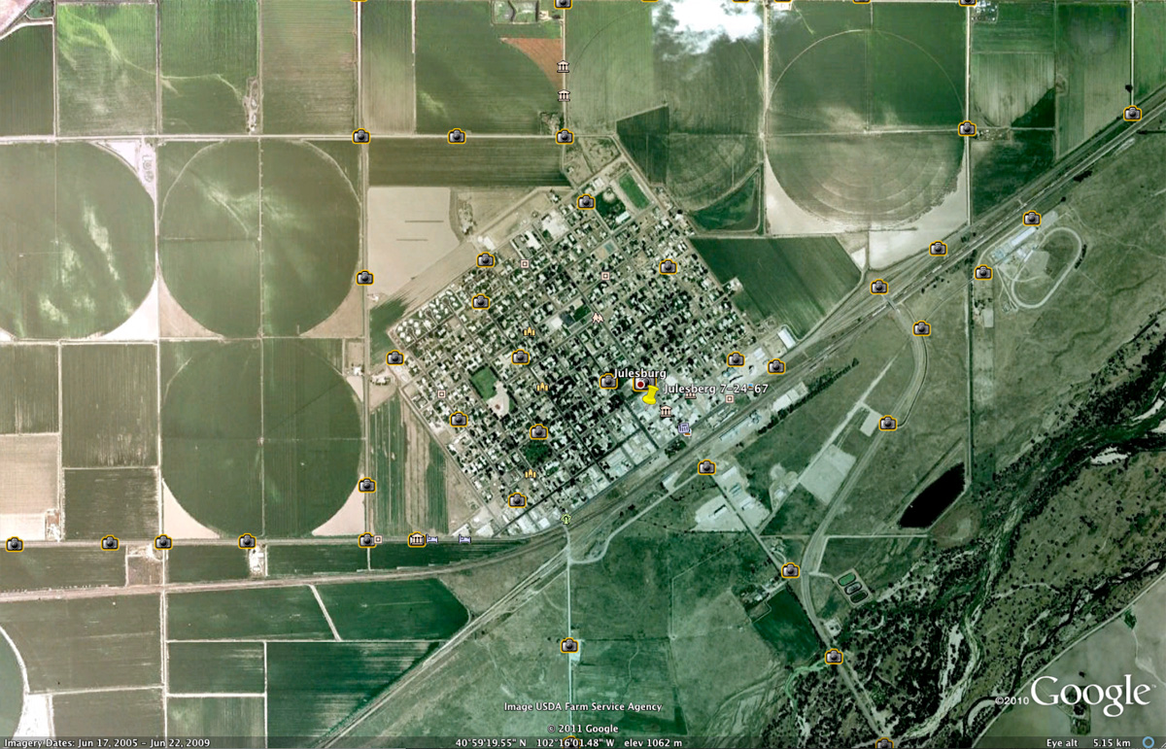
Julesburg

Slide 47
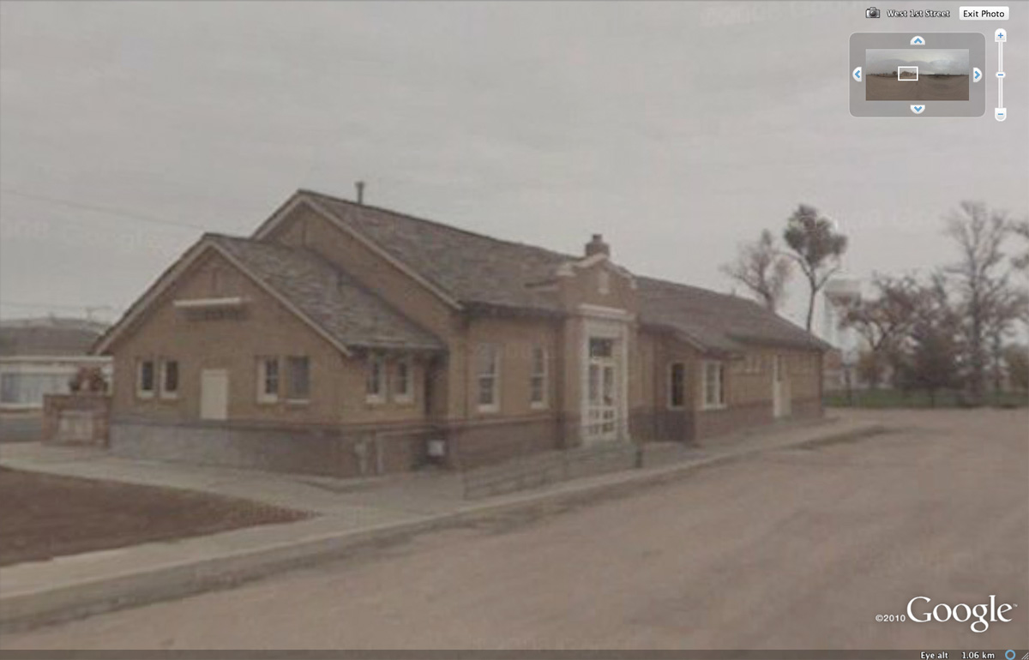
Associated Street View: Julesburg

Slide 48
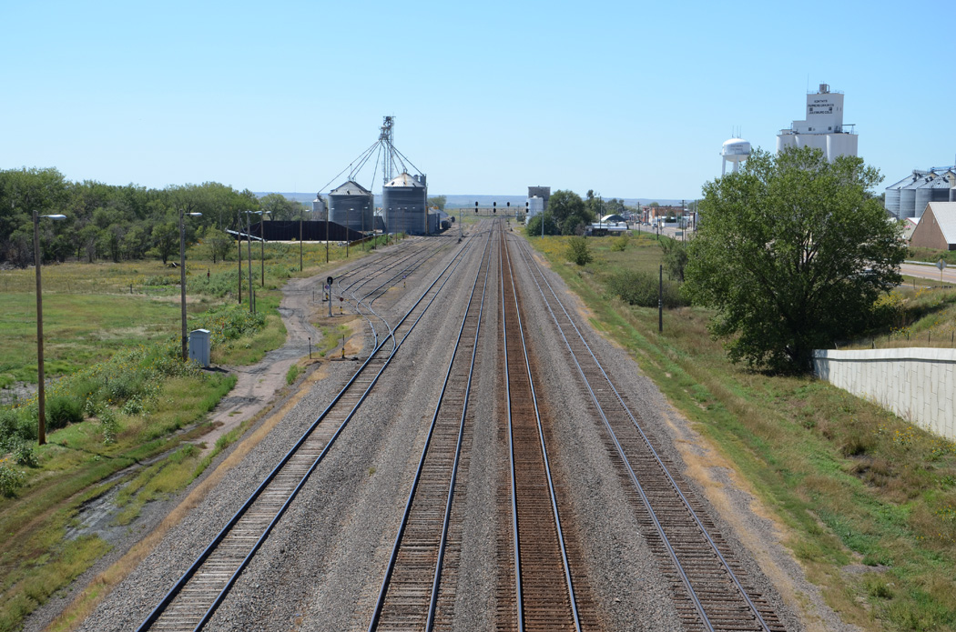
Julesburg, Colorado

Slide 49
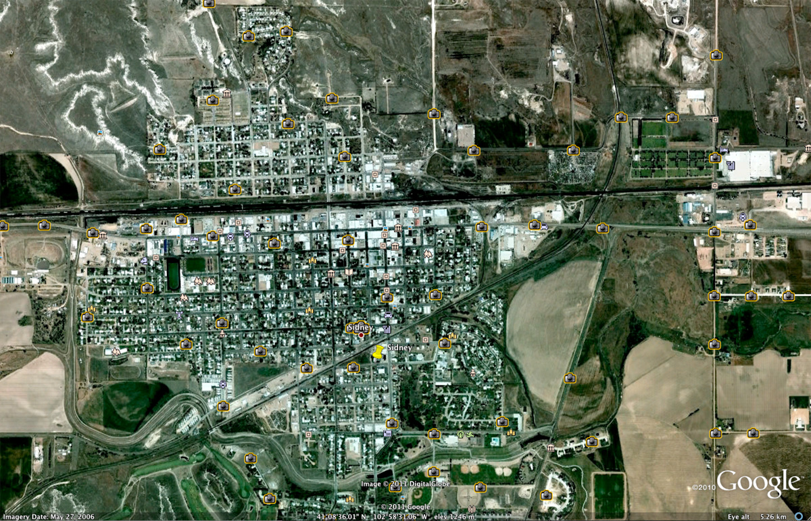
Sidney

Slide 50
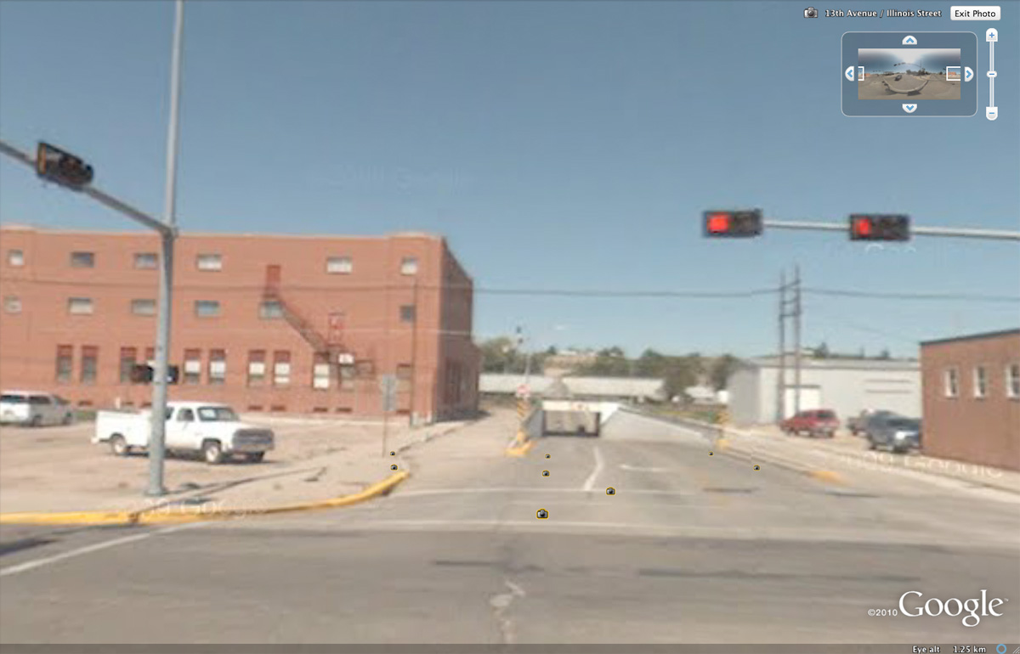
Associated Street View: Sidney

Slide 51
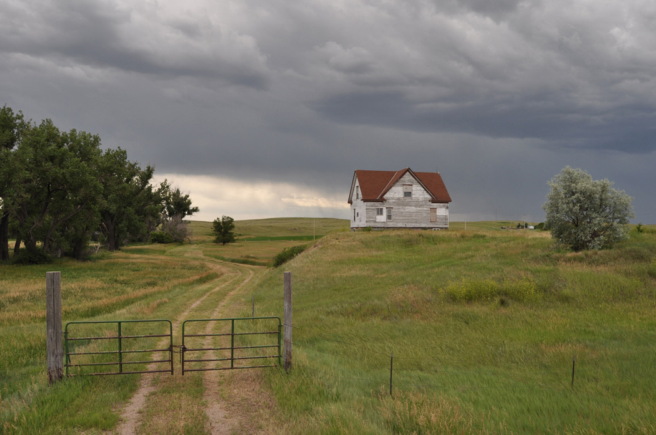
At the western end of the Nebraska panhandle

Slide 52
For the future…
More travel, more photos, more mapping, use of GPS for precise alignment of maps and images; more writing…

Slide 53
Coda—the combination of satellite imagery with historical maps.
For a subsequent trip during the summer of 2011,
I used this combination method for locating where the tracks of the Union Pacific ran through Omaha nearly 150 years ago.
Once historical map is sized and placed correctly, one can use opacity (or click the layer on and off) to see physical relationships during different time periods…

Slide 54
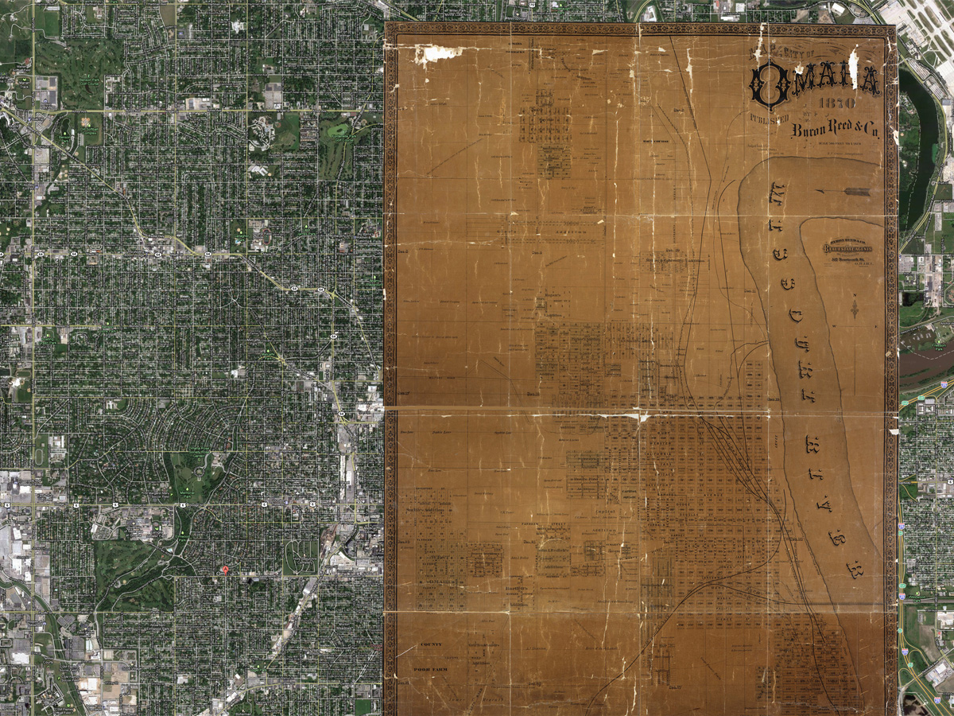

Slide 55


Slide 56


Slide 57
Again, looking a bit closer, one can find specific streets…

Slide 58


Slide 59


Slide 60


Slide 61
My source of historical map of Omaha: http://cprr.org/Museum/Maps/
The link as stated on that webpage:
Omaha, Nebraska. Bryon Reed, 1870
Source for map stated on that web page:
Courtesy Omaha Public Library

Slide 62
FIN
Based on materials presented originally at the
3rd Annual GooglEarth Day conference,
The University of Michigan, Ann Arbor,
School of Natural Resources and Environment.
With input in this material from that conference, particularly from Sandra L. Arlinghaus and Roger Rayle.

