Slide 1
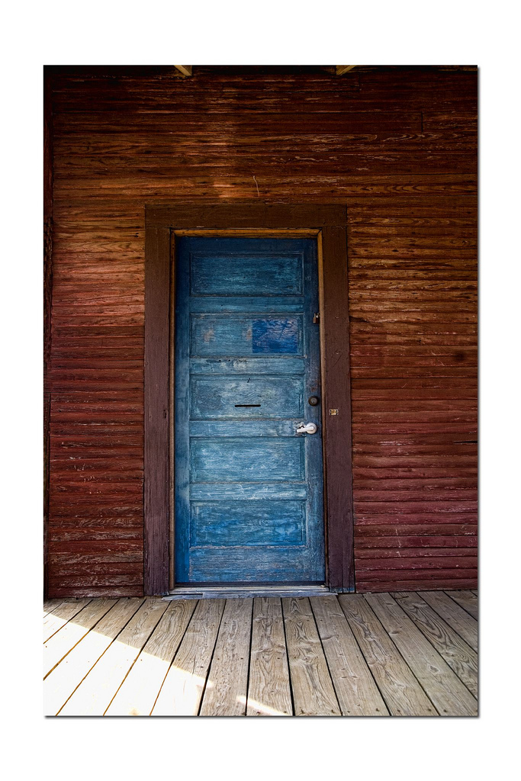
Open Source, Open Doors:
Bringing Your Collection to Your Users with Omeka
Nancy Moussa & Meghan Musolff
University of Michigan Library
ARLIS/NA Conference
April 2013
Notes:
Good afternoon. My name is Meghan Musolff and I’m Special Projects Librarian and Omeka Coordinator at the University of Michigan Library. And along with my colleague, Nancy Moussa, we’re going to discuss how we promote our digital collections through the use of Omeka. I’ll begin by providing background context and describe the problems we were encountering that lead to us to adopt Omeka . Nancy will then discuss how Omeka solved those some of those problems out of the box and how we customized Omeka to solve the rest of the issues. We’ll end our presentation with a brief list of our next steps for the project.

Slide 2
Digital Collections
Notes:
Like most institutions, the University of Michigan Library has a mechanism in place for delivering our digital collections to users. We use a homegrown system (DLXS, http://www.dlxs.org/)

Slide 3
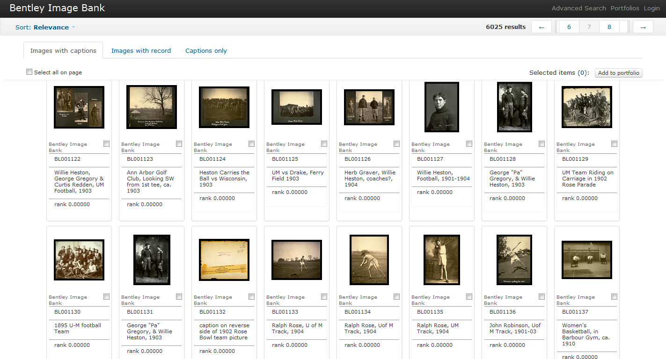
Notes:
Here’s an example screenshot from one of our 250+ digital collections: in this case, the image collection from the Bentley Historical Library. Similar basic concept as most other digital collections: search results are returned with thumbnails

Slide 4
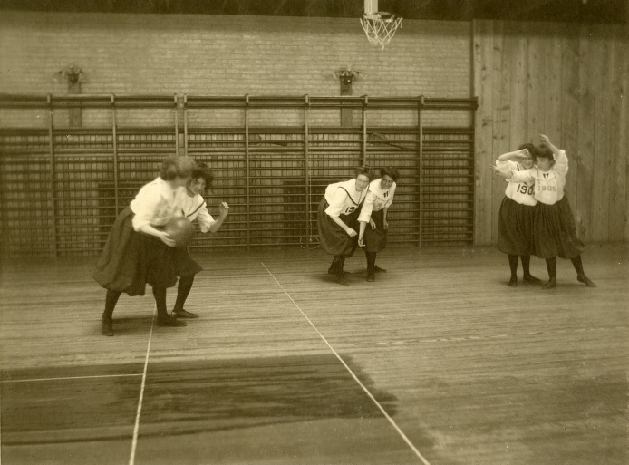
Notes:
…and you click on the thumbnail to see a larger image and more descriptive information. Here we have a lovely photo of a women’s basketball game at Michigan, c.1910.

Slide 5
We want the chance to tell you a story.
Notes:
But while our digital collections repository provided sufficient access to our materials, it wasn’t enough. We wanted to move beyond a mere repository and do more exciting things with our images. We wanted to provide more context to the collection than was displayed through our typical metadata. We wanted the chance to tell a story.

Slide 6

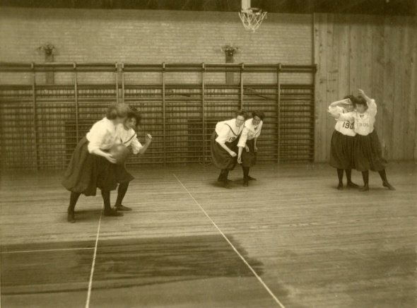
The History of Women's Sports
at the University of Michigan
Notes:
Returning to our basketball image, we wanted the opportunity to tell you how this image fits into the larger history of women’s sports at the University of Michigan.

Slide 7
Physical Exhibits
Notes:
In a similar fashion, we wanted to do more with our physical exhibits.

Slide 8
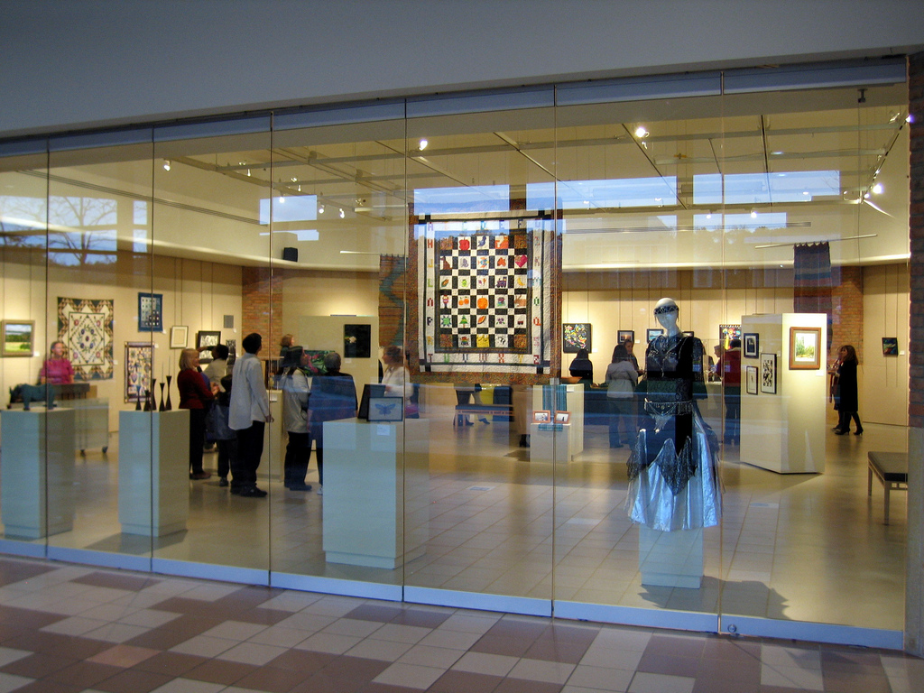
Notes:
At the University of Michigan Library, we have a robust physical exhibit program (led by my colleague Jamie Vander Broek). But we wanted to do more.

Slide 9
We want to extend the life of the physical exhibit.
Notes:
But we wanted to do more. We wanted to extend the life of our physical exhibits. We wanted to bring the content of our physical exhibits to more users. And we want to create a permanent record of the physical exhibit.

Slide 10
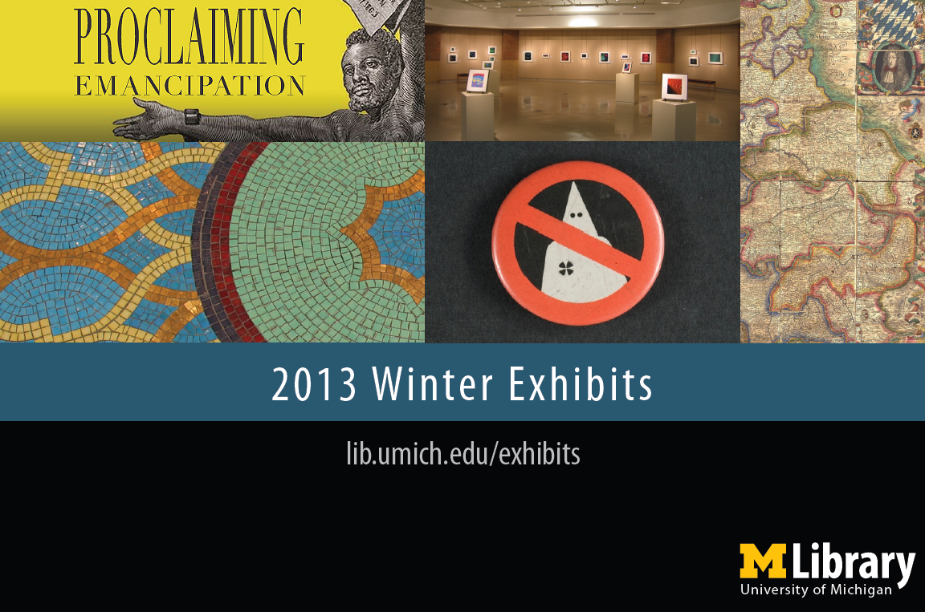
Notes:
So, instead of having exhibits especially organized for the Winter 2013 semester…

Slide 11
FOREVER
Notes:
…we would have them forever. OK, perhaps not forever, but you get the idea.

Slide 12
We want to extend the life of the physical exhibit.
We want the chance
to tell you a story.
Notes:
With these two desires in mind, we began to examine our online exhibit program and investigated how we could better utilize online exhibits to promote our digital collections.

Slide 13
Online Exhibits

Slide 14
Online Exhibits
@ MLibrary
Notes:
There is a long history of online exhibits at the Library. We had been creating online exhibits since the late 1990s and to date we have about 20 legacy or old exhibits.

Slide 15
Previous Online Exhibit Creation Process
Creator
Did everything.
Online
Exhibit
Notes:
The workflow for online exhibit creation in the past went something like this: The exhibit creator did everything. And I mean everything. He/she selected the materials, created digital images or made the digitization request, gathered descriptive metadata, designed the exhibit, found someone to program the exhibit, etc. And once the site went live, the creator was also responsible for maintenance and migration.

Slide 16
Ugh.

Slide 17
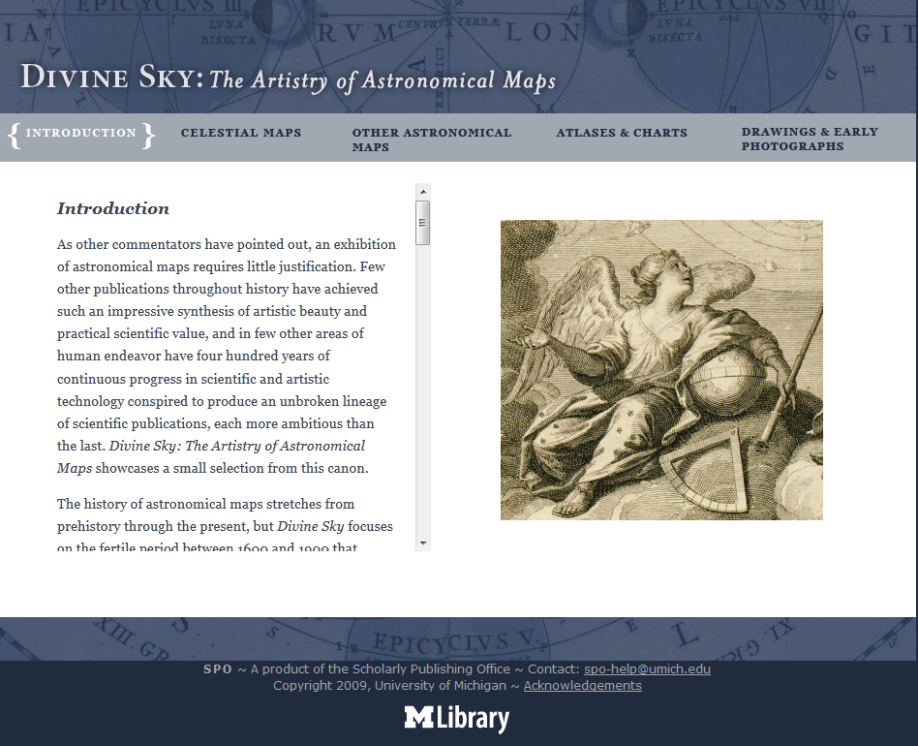
Notes:
This workflow resulted in the creation of some truly beautiful exhibits. Here’s an example created by our former Office of Scholarly Publishing for an exhibit of astronomical maps.

Slide 18
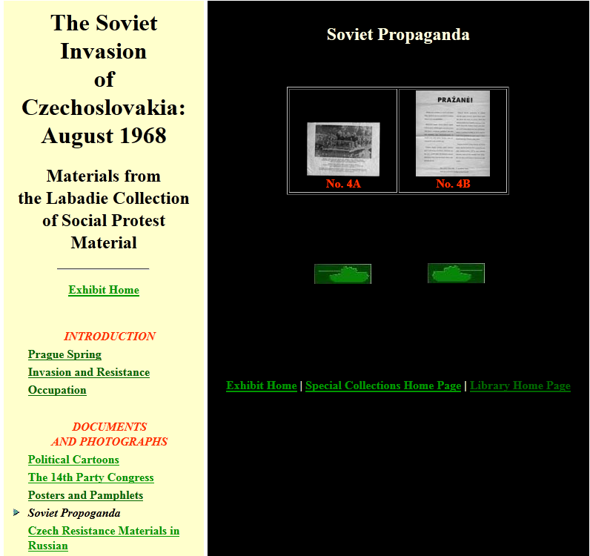
Notes:
But the same workflow resulted in the continued presence of outdated exhibits (both in terms of design and content) remaining “on view” as it were. So, for example we have this online exhibit to mark the anniversary of the Soviet Invasion of Czechoslovakia. Those buttons are tanks and you use them to navigate through the site. Oi.

Slide 19
Problems
Notes:
So, as you can see, there were some problems with the current online exhibit process--both in terms of workflow and design--that needed to be addressed. Because identifying the problems will help us explain our solutions, I’m going to briefly describe each problem we faced with online exhibit creation.

Slide 20
P1: Creator Expertise
Notes:
As we just touched upon, in order to put an online exhibit together, the creator had to do a lot of work and needed a high level of expertise in website design, descriptive metadata, digital collection experience, etc.

Slide 21
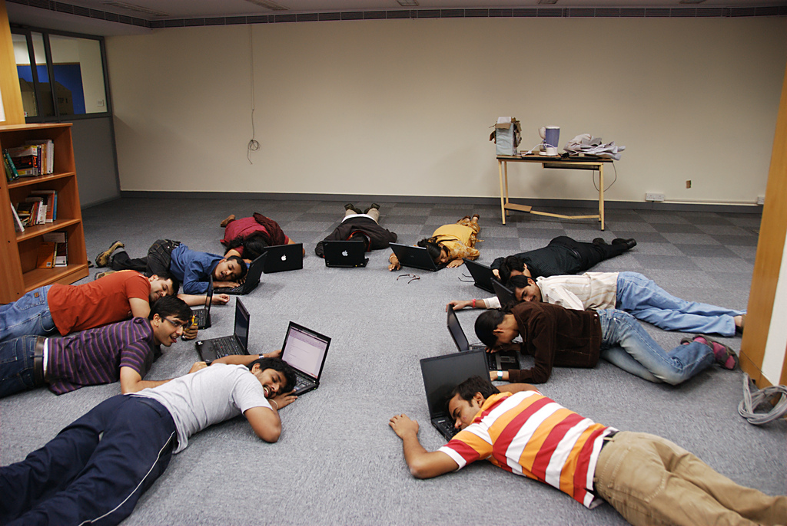
Notes:
This lead to high levels of online exhibit creator fatigue and a reluctance for volunteers to create online exhibits. In identifying a solution, we wanted to make life easier on the creator and remove the burden of having to bring so much expertise to the project.

Slide 22
P2: Site Maintenance
Notes:
The exhibit creator was also responsible for the maintenance and upkeep of the site. This could include updating information/code, recreating the exhibit in a new systems when the library website migrated, etc. In some cases, this lead to the abandonment of some online exhibits.

Slide 23
Notes:
Unfortunately, that’s what happened to our Czechoslovakia website. We wanted to find a way again to lessen the burden of site maintenance from exhibit creators and identify a more holistic solution to online exhibit upkeep.

Slide 24
P3: Lack of Collaboration
Notes:
It’s not like there wasn’t collaboration before on online exhibits--the creator often had to coordinate with the Digital Conversion Unit or Conservation/Preservation Unit, but we wanted to up the ante a bit.

Slide 25

Notes:
We wanted to implement a procedure/workflow that would lead to an increase in collaboration or hand holding across the library--both within and outside the creator’s home unit.

Slide 26
P4: No Branding

Slide 27
Notes:
As you may have noticed from the two previous examples, the previous online exhibits lacked a cohesive design and any University of Michigan Library branding.

Slide 28

Notes:
We wanted to give online exhibits a similar design and look/feel to ensure that visitors to the site knew it contained content from the Michigan Library digital collections. Because the whole point of creating the exhibits was to promote our digital content. A lot of help it was doing if folks couldn’t make the connection between exhibit content and our digital collections.

Slide 29
P5: Improve User Experience
Notes:
Since online exhibits highlight items from our digital collections, we wanted to improve the users experience with the objects through our sites. We wanted users to interact with items as they might in real life.

Slide 30

Notes:
So for example replicating how a user would browse through the various pages of a book. In addition, we wanted to encourage close viewing of items--similar to how users might be able to interact with a physical exhibit.

Slide 31
P6: Not Findable
Notes:
One of the most serious problems with our old online exhibits was that they were virtually unfindable through the library website. All of this effort was being spent on creating exhibits that weren’t being found by our users.

Slide 32
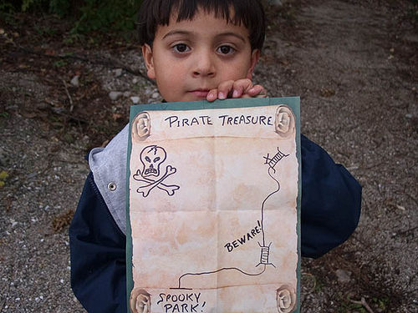
Notes:
Basically, we were trying to display all of these treasures without providing our users with a treasure map. This was a huge problem. We wanted to find a way to better integrate online exhibits into the library website to increase findability of our digital content.

Slide 33
Problems
Solution!
Notes:
In order to begin to address these problems, a committee (in fact, two committees) were convened to review the existing online exhibit workflow and recommend a solution.

Slide 34

Notes:
And in early 2012, Omeka, an open source content management system developed at George Mason University, was selected as the platform for all new online exhibit creation at the UM Library.

Slide 35
Problems
Solution?
Notes:
However, the act of selecting Omeka for online exhibits wasn’t the solution to all of our problems. My colleague Nancy will now walk you through some of our solutions, as well as detail our next steps for the project.

Slide 36
Previous Online Exhibit Creation Process
Creator
Did everything.
Online
Exhibit
Notes:
As a reminder, in the legacy online exhibit process, the exhibit creator was responsible for everything.

Slide 37
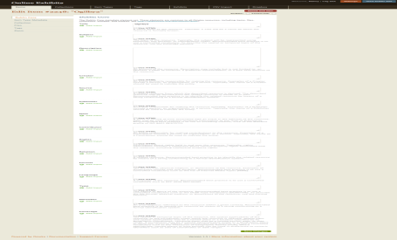
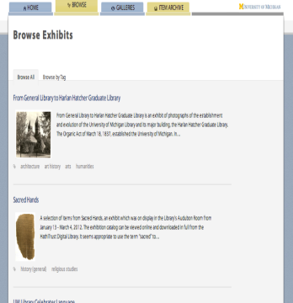
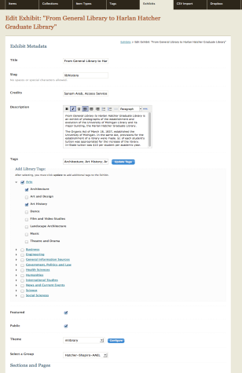
Online Exhibit Process using Omeka
Creator
Collect images and metadata
Create multiple items
Create an exhibit
Display exhibits in browse page
Layouts
Create Pages
Create a section
Notes:
I will talk now about the big picture of using Omeka to create an online exhibit. The process starts with a creator who has a set of images and metadata. Then the creator will use this data to create multiple items. In step 3, the creator will use an Omeka Exhibit Builder plugin to create a new exhibit where the creator creates the exhibit title, description, multiple sections in the exhibit and link each section with multiple pages. Each page will be associated to one of the 12 layouts provided by Omeka. Finally items will be included in the layout.
This whole process is iterative process to create multiple exhibits.

Slide 38
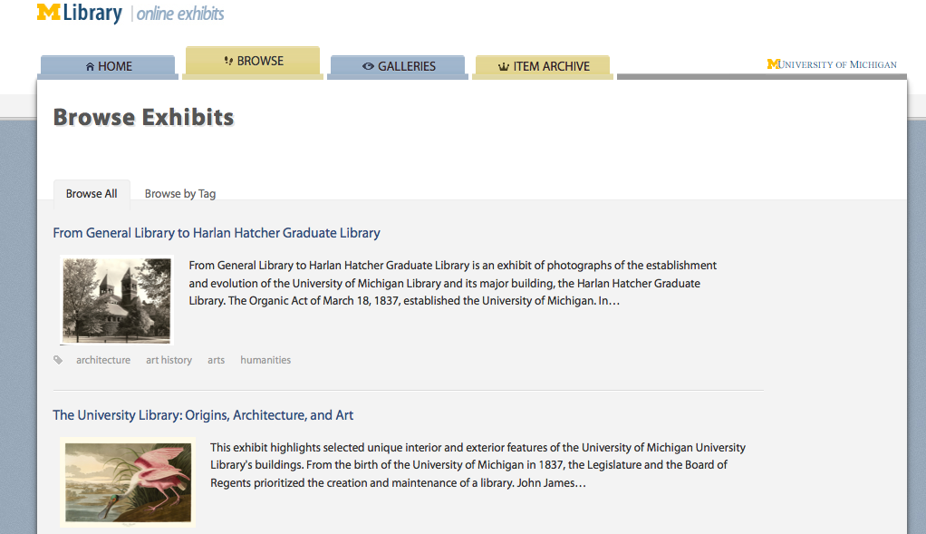
Notes:
The result is a page where you can browse all created exhibits. A closer look at the browse exhibit page, you will see a title for each exhibit, a description, and image as well as tags.

Slide 39
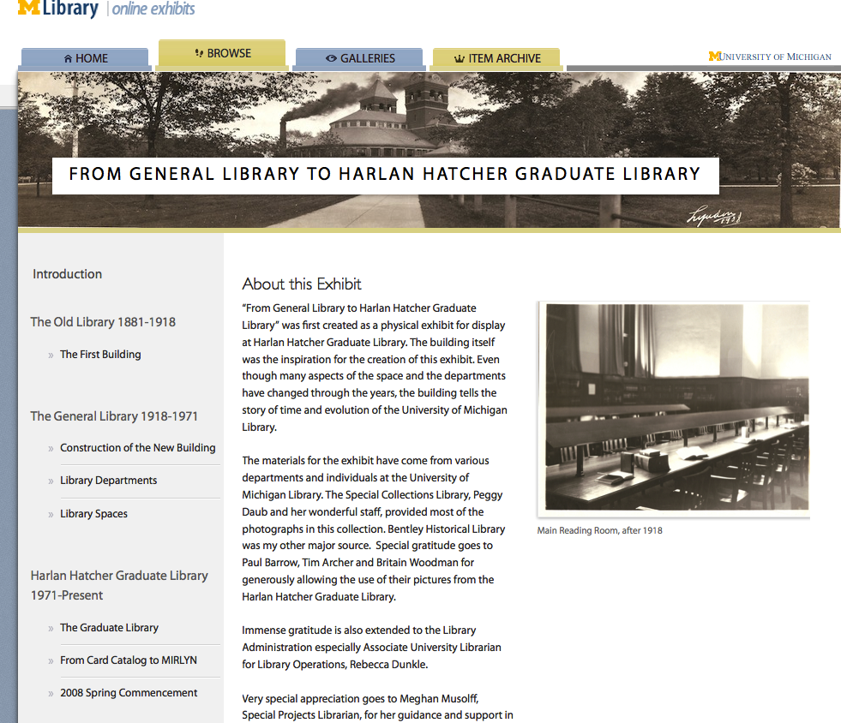
Notes:
Further closer to an individual exhibit, you will see Omeka connect those sections and pages in a hierarchical navigation along with layout pages that present the items created. This is an example of an image item type included in one of the pages in the General library exhibit, as well as a information about the exhibit.
This was a quick general picture about using Omeka to create an online exhibit.

Slide 40
Out-of-Box
Notes:
Out of the box, how did Omeka solve problems mentioned by Meghan?

Slide 41
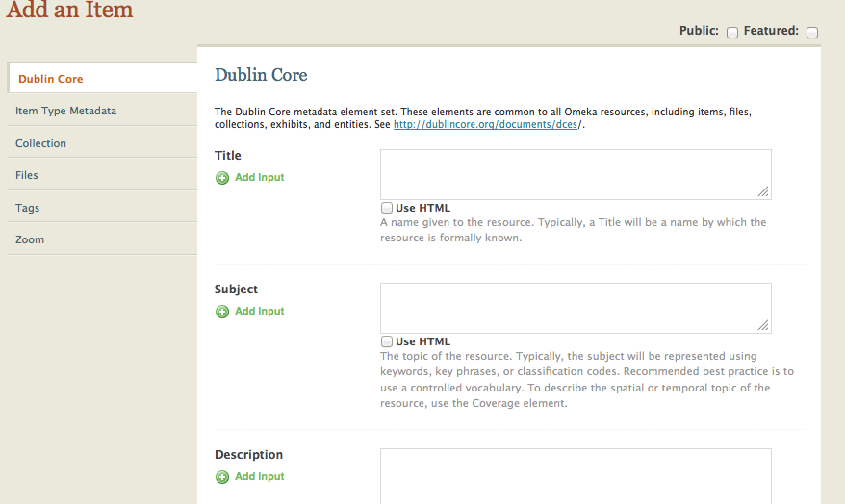
P1: Creator Expertise
Notes:
First problem, Creator expertise, no longer creator need to have all technical expertise or work with others create a site from scratch. E.g, this is how an item page in Omeka looks like, it is a form with meta data fields need to be completed, and linked to other section to decide what items, it can be an image, or sound or video, etc. You can link your item to a collection and you can attached your images, sound video files to your item.

Slide 42
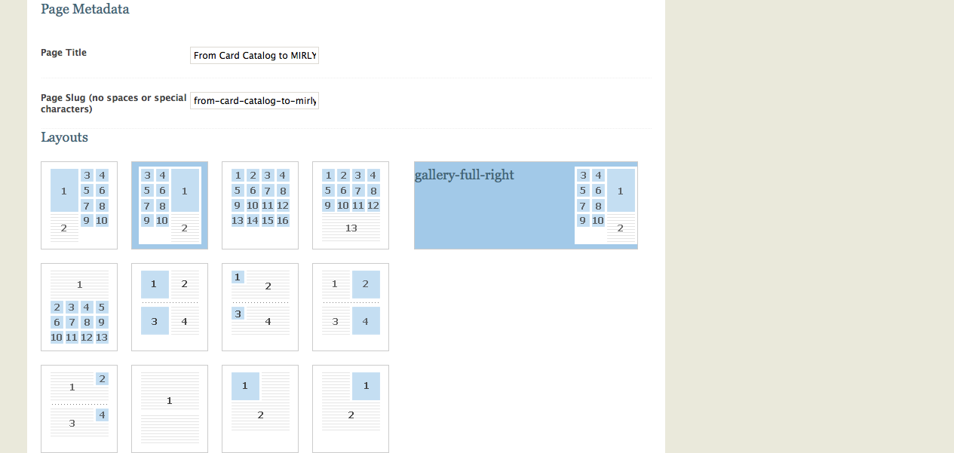
P1: Creator Expertise
Notes:
Creator expertise is solved with Omeka, because it come up with ready made pages or layout – another Omeka terminology which is a form with metadata to fill. Those numbers you see is an the layout of the page and where items will appear.

Slide 43
P1: Creator Expertise
Notes:
The result is a well structure and hyper linked exhibit site with lots of section and pages all created with click and chose.

Slide 44
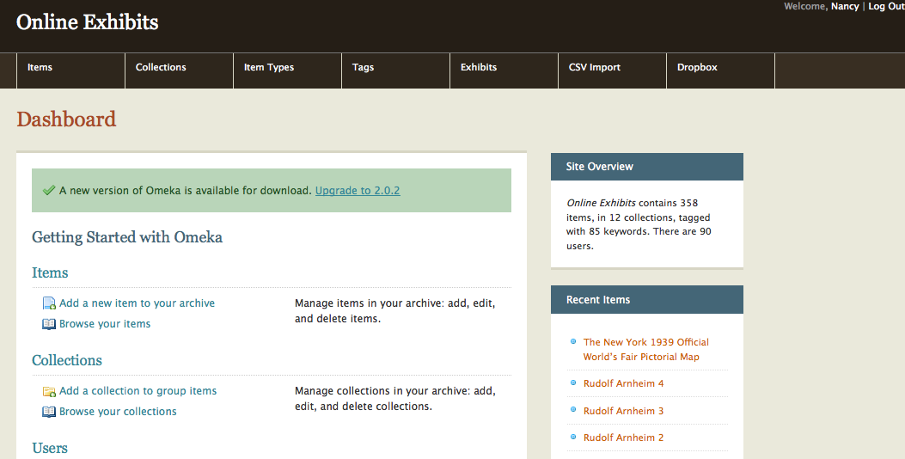
P2: Site Maintenance
Notes:
Because we are using CMS, Out of the box Omeka comes up with admin site that full with html, all what it needs from creator is creativity to organize and use the data.
Omeka also, allow more creativity and customization. It depends on your organization and what you are looking for you can customize and create, themes and plugins to suits ur need.

Slide 45
Customized

Slide 46
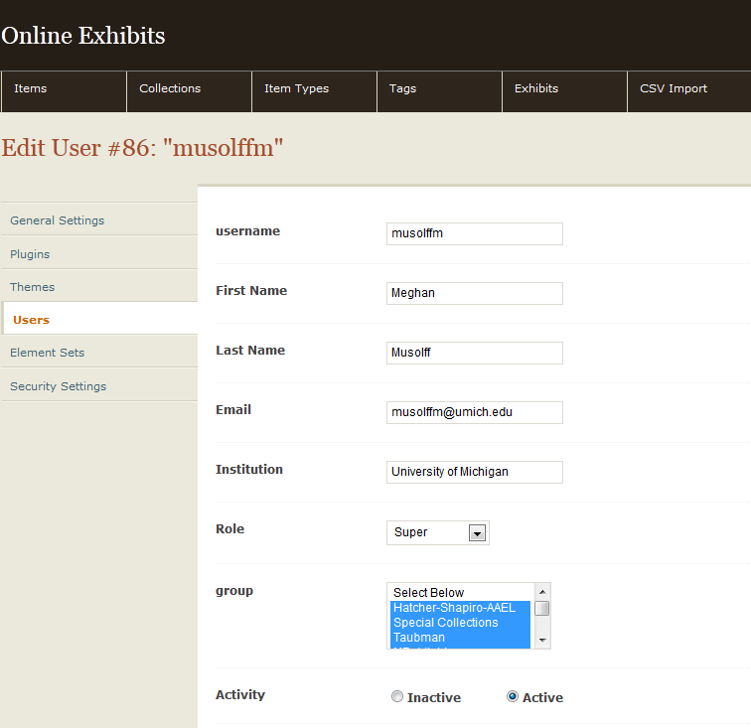
P3: Lack of Collaboration
Notes:
At U-M, among of other feature we developed to customize Omeka to suits our needs, group is a feature helped solved the lack of collaboration. Omeka out of the box does not allow association of creators to groups to build a specific collaboration without giving the admin role.

Slide 47
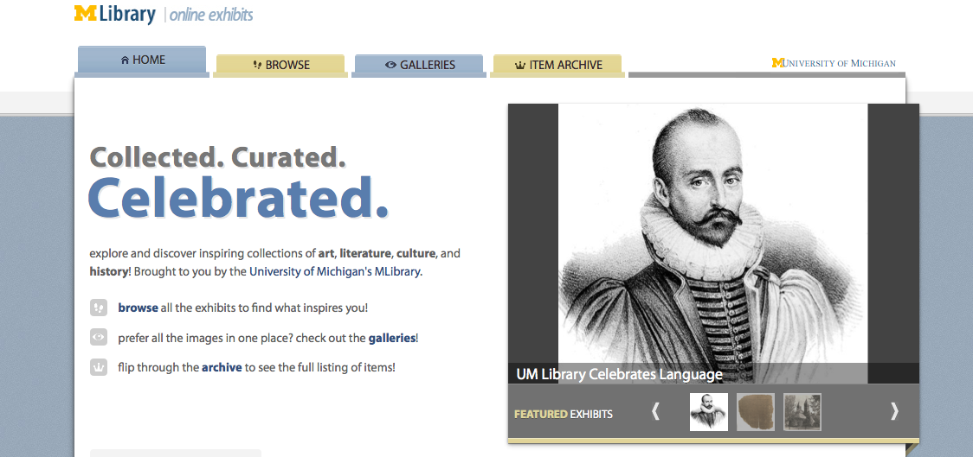
P4: No Branding
Notes:
Our online exhibit needs branding, need to be consistent and cohesive with our Mlibrary website. So we develop our own theme to solve this problem. On the top our Online exhibit developed using Omeka, and on the bottom our Mlibrary site developed using Drupal. Users will feel no distinguish and they feel they are in the same site when move back and forth and we want to keep this consistency issue around our site.

Slide 48
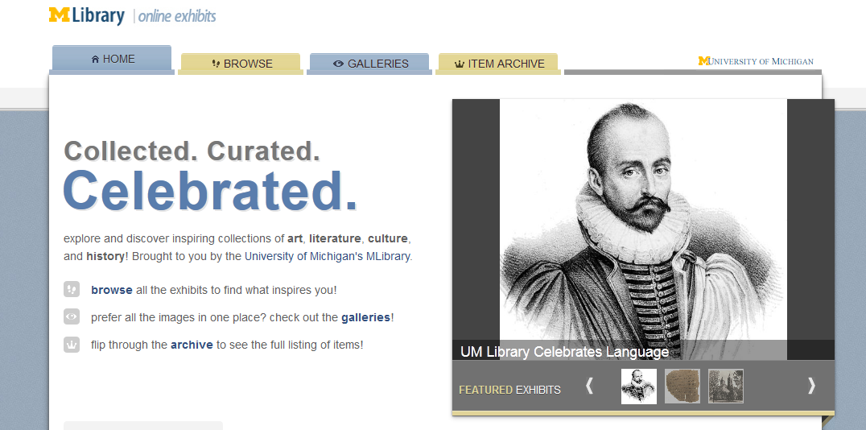
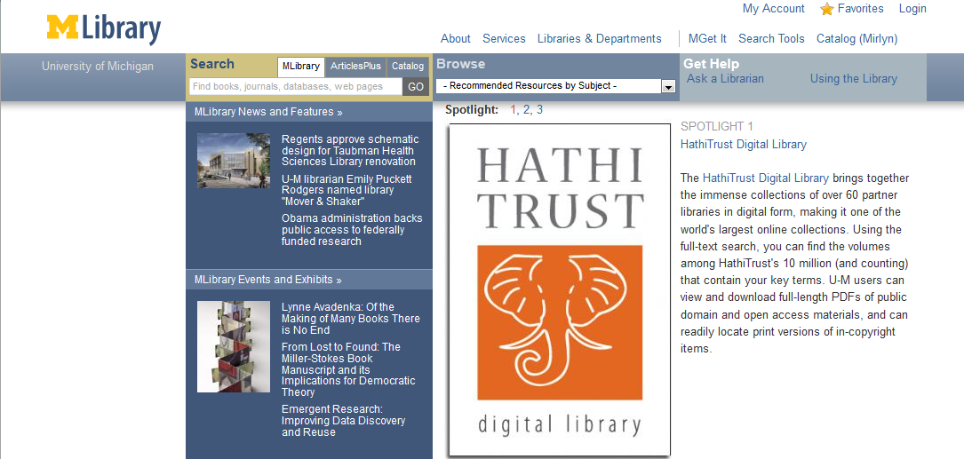
P4: No Branding

Slide 49
P5: Improve User Experience
12 Omeka Layouts
Mlibrary Layout
+
Notes:
Out of the box Omeka come up with 12 layout, we felt we need a new layout that will improve our user experience

Slide 50
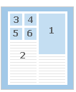
P5: Improve User Experience?
12 12 layouts
Mlibrary

Slide 51
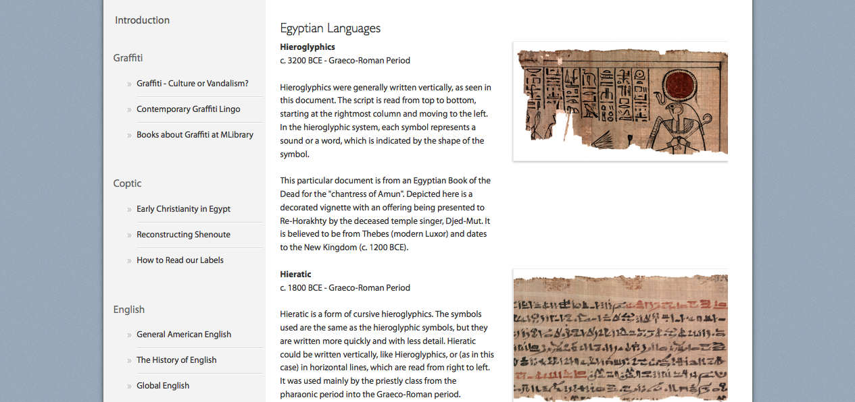
P5: Improve User Experience?
Notes:
E.g out of the box, in all the 12 Omeka layout, the user will click on any image / item it will take him to the item page. Item page display metadata related to the item and the user can get closer view to the item.

Slide 52
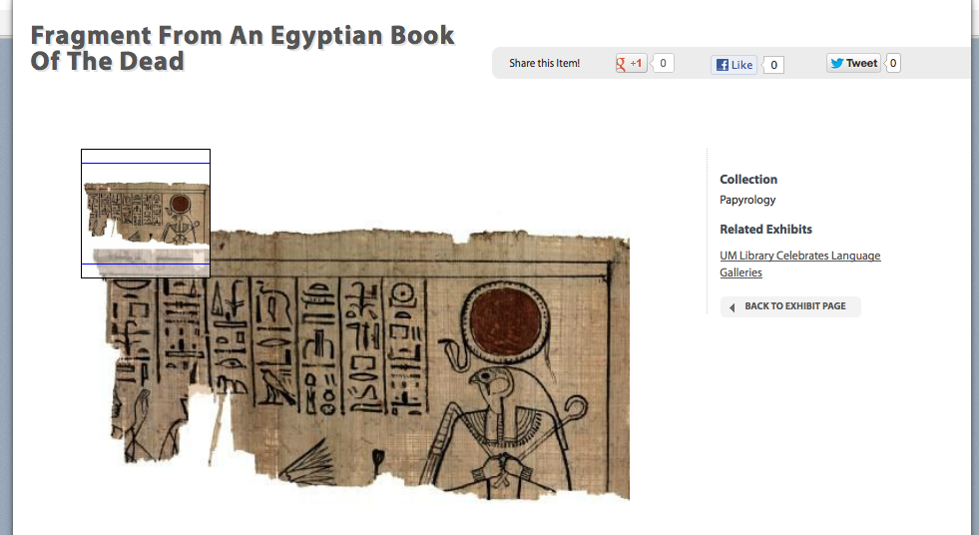
P5: Improve User Experience?
Notes:
If the item include multiple files, the user will click to view each file loosing the context of the exhibit.

Slide 53
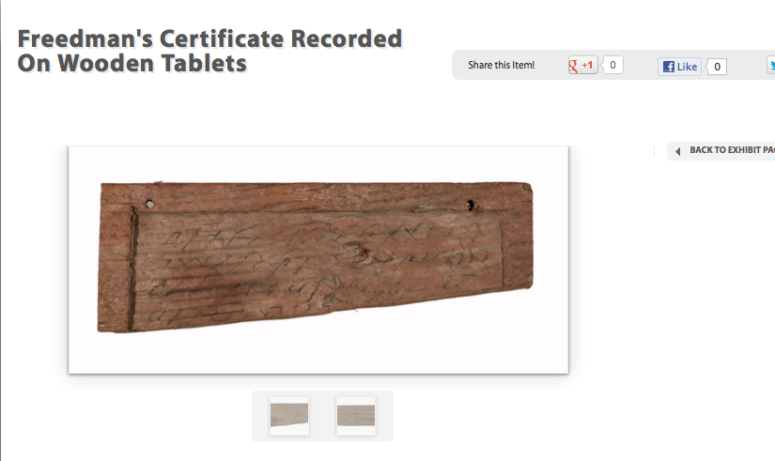

Slide 54
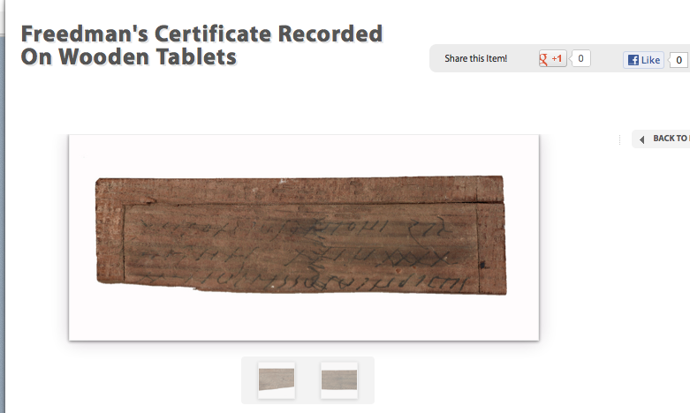

Slide 55
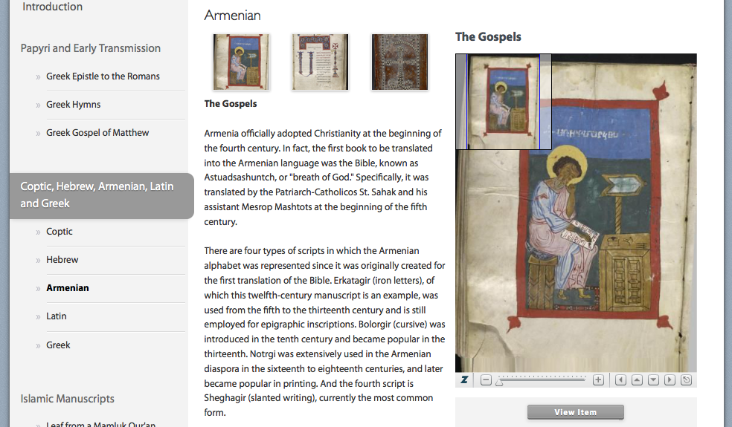
P5: Improve User Experience
Notes:
Our solution instead allow closer look to images using Zooming feature.

Slide 56
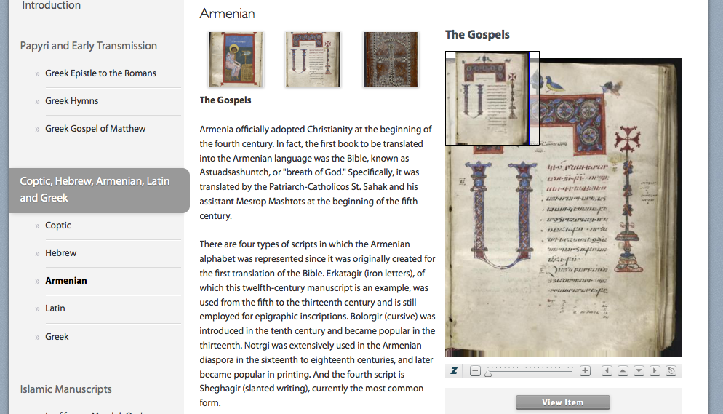
P5: Improve User Experience

Slide 57
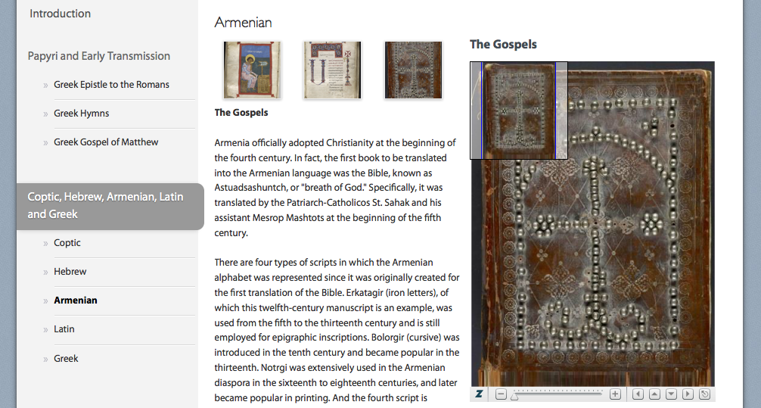
P5: Improve User Experience

Slide 58
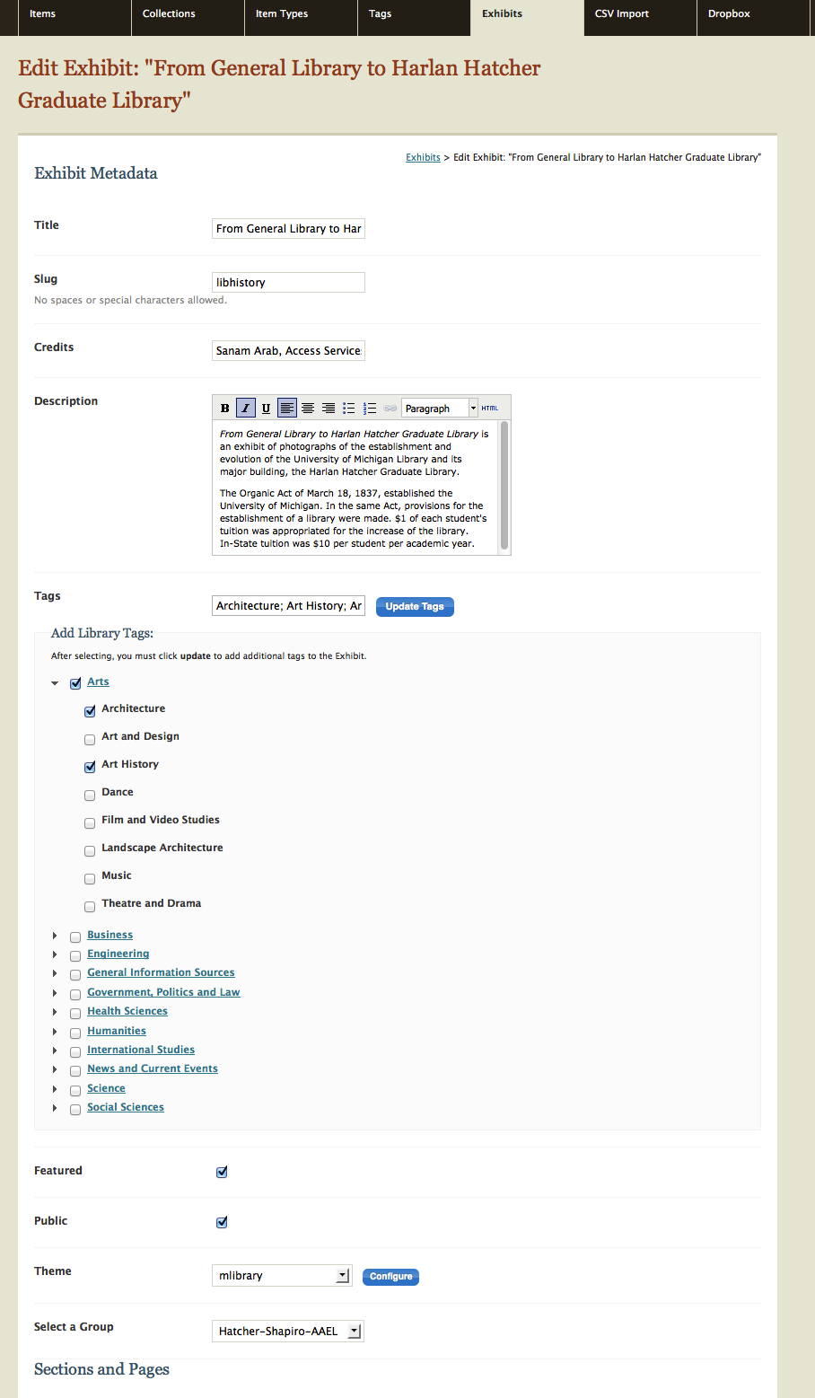
P6: Not Findable
Notes:
Attached Higher level browse control vocabulary to our exhibits solved a serious findable problem for exhibits in the library website that build using Drupal.

Slide 59
Integration between Drupal and Omeka?
Notes:
Two different sites build with two different databases and need to link together. How to make this happen? Tag using HLB was the solution.

Slide 60
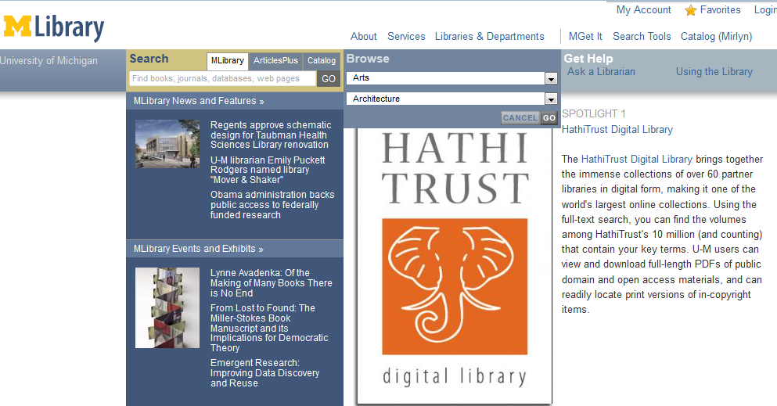
P6: Not Findable
Notes:
E.g you can search using search box, or browse box in Mlibrary website for an exhibit. Result will show at Drupal Mlibrary pages. Click on the link will take us to exhibit page in Omeka.

Slide 61
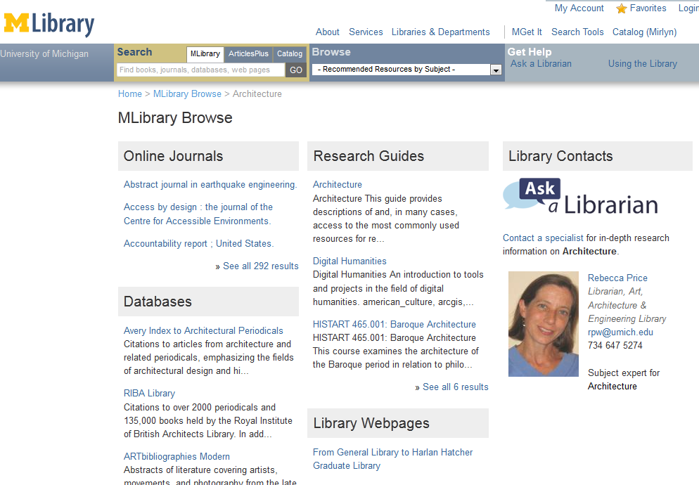
P6: Not Findable

Slide 63
Next Steps
Gather feedback from creators & users
Extend Plugin
  Group feature turn to plugin.
    Edit, add, delete groups.
Install other Omeka Plugins: Timeline, etc.
Migrate to Omeka version 2.0
Pursue collaboration outside MLibrary

Slide 64
          Thank You.
Nancy Moussa (nancymou@umich.edu)
Meghan Musolff (musolffm@umich.edu)
Jamie Vander Broek (jlausch@umich.edu)
http://lib.umich.edu/online-exhibits

Slide 65
Credits
Slide 1: http://www.flickr.com/photos/biggreymare/3787026874/
Slide 6: http://www.flickr.com/photos/dougitdesign/5613967601/
Slide 21: http://www.flickr.com/photos/code_martial/4145914957/
Slide 25: http://www.flickr.com/photos/o_hai/5344181674/
Slide 27: http://www.flickr.com/photos/mlibrary/4484617706/
Slide 30: http://www.flickr.com/photos/paszczak000/4421317209/
Slide 32: http://www.flickr.com/photos/hercules/1978739/
All images CC BY 2.0

