Slide 1
Tools for research collaboration and organization
Marisa Conte
Karen Downing
Merle Rosenzweig

Slide 2
Today’s agenda
Introductions
Part 1: Find!
  Find collaborators with Michigan Experts and Pivot
Part 2: Be found!
  Identity management with ORCID
  Registering research data to increase citability

Slide 3
Discover Collaborators
Michigan Experts
Pivot

Slide 4
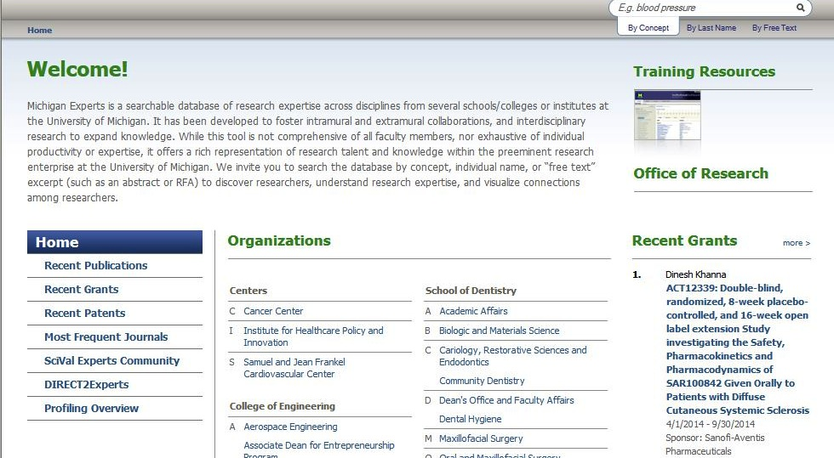
www.experts.umich.edu

Slide 5
Research profiles – by unit
Schools and Colleges
  Dentistry
  Engineering
  Kinesiology
  Medicine
  Nursing
  Pharmacy
  Public Health
Other
  Cancer Center
  Cardiovascular Center
  Institute for Healthcare Policy and Innovation
  Life Sciences Institute
  Michigan Mobility Transformation Center
  Transportation Research Institute
  UM-Dearborn

Slide 6
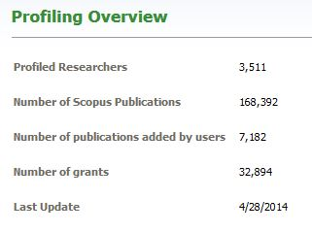
Experts Content

Slide 7
Search Michigan Experts
Browse by College, School, Institute or department
Search by last name (very specific search engine)
Search by concept
Search by freetext

Slide 8
What’s in a research profile?
Scopus publications
  Listed in reverse chronological order; can sort by citation count (Scopus); export as .ris file
Grants (during UM affiliation only)
Fingerprint: primary concepts
Networks
  Institutional, coauthor (profiled and non-profiled)
  Similar experts @ UM
Notes:
Scopus
Citation data (journal articles, conference proceedings)
ePRM
Grant information (NIH, NSF, foundations, sponsored research)
Researchers
Patents

Slide 9
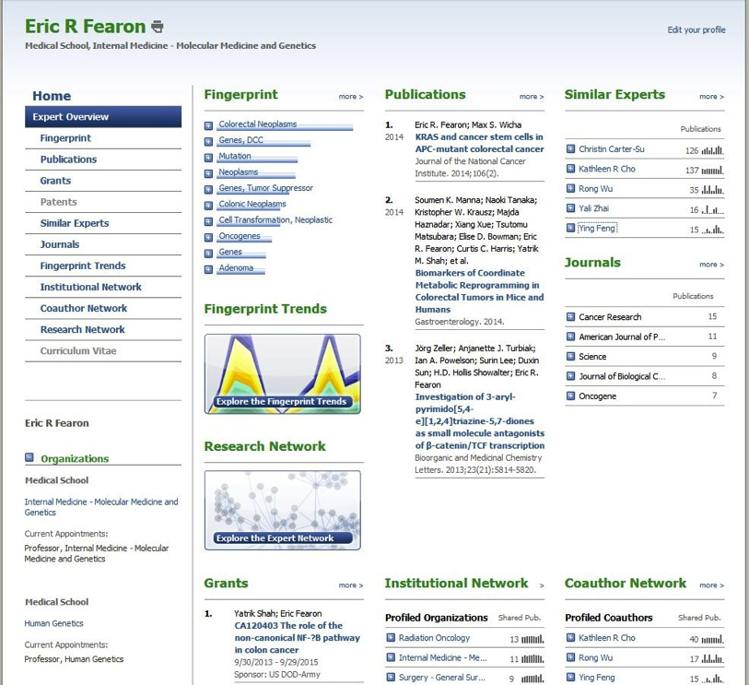
Sample profile
Notes:
Demo profile

Slide 10
Coming soon – new interface
May eliminate browse by department/unit
Enhanced search capabilities
Enhanced network visualizations

Slide 12

Pivot
(formerly COS)
Searchable Researcher Profiles and Funding Datasets

Slide 13
Pivot
“Pivot answers the growing demands on research developers to quickly discover the right funding opportunities and effectively collaborate with their colleagues”

Slide 14
Pivot: Scope
Researcher Expertise
  3,000,000 profiles of scholars across the U.S. and internationally
  Over 10,000 U-M scholar profiles
Funding
  400,000 + funding opportunities from within the U.S. and internationally
  Every type of funder represented (federal, foundation, corporate, societies, professional associations, universities, etc.)

Slide 16
Manage your research identity
Use ORCID to create an accurate profile of your research output

Slide 17

ORCID
Stands for Open Researcher and Contributor ID

Slide 18
About ORCID
Open, non-profit
A registry of unique researcher identifiers
A method of linking research activities and outputs to these identifiers
Distinguishes a researcher from other researchers
Integrates into key research workflows such as:
manuscript
grant submission

Slide 19
Why ORCID?
The focus of the ORCID initiative is solving the name ambiguity problem.
Searching in the MCommunity directory for
j lee retrieves 45 results.
Of the more than 6 million authors in a major journal citations and abstracts database, more than two-thirds of them share a last name and single initial with another author.
A researcher’s name isn’t enough to reliably identify the author of, or contributor to, an article published in a journal or a dataset uploaded to a repository.

Slide 20
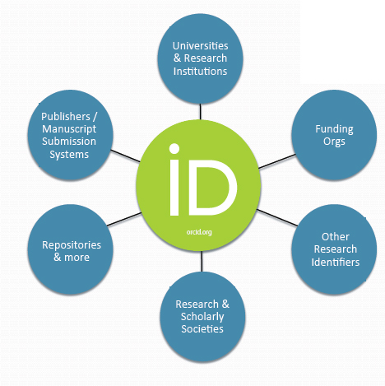

Slide 21
ORCID in practice
ORCID is being adopted worldwide by
publishers
research societies
universities & research institutions
repositories such as Deep Blue
funding agencies
Over 675,000 ORCIDs have been issued since the launch in October, 2012.
ORCID content is in English, Spanish, French, Chinese, Korean, Portuguese, Japanese , and Russian

Slide 22




Slide 23
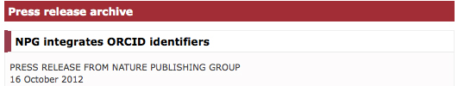
“…nature.com registrants will be able to link ORCID identifiers to their nature.com profile, and authors will be able to link their ORCID identifiers to their manuscript submissions. NPG will also be encouraging authors and registrants to register for an ORCID identifier at www.orcid.org.”

Slide 24
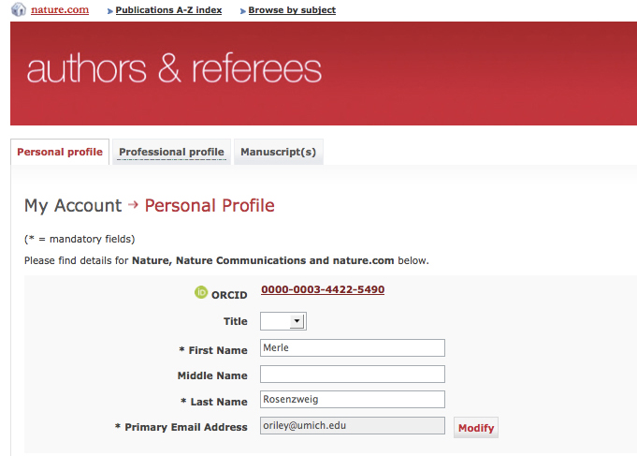

Slide 25
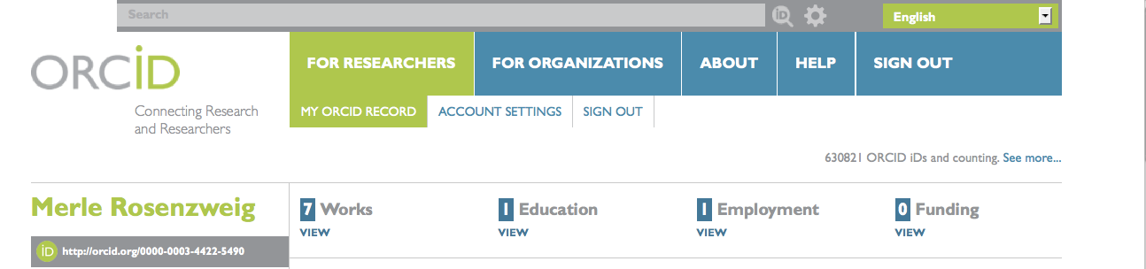

Slide 26


Slide 27
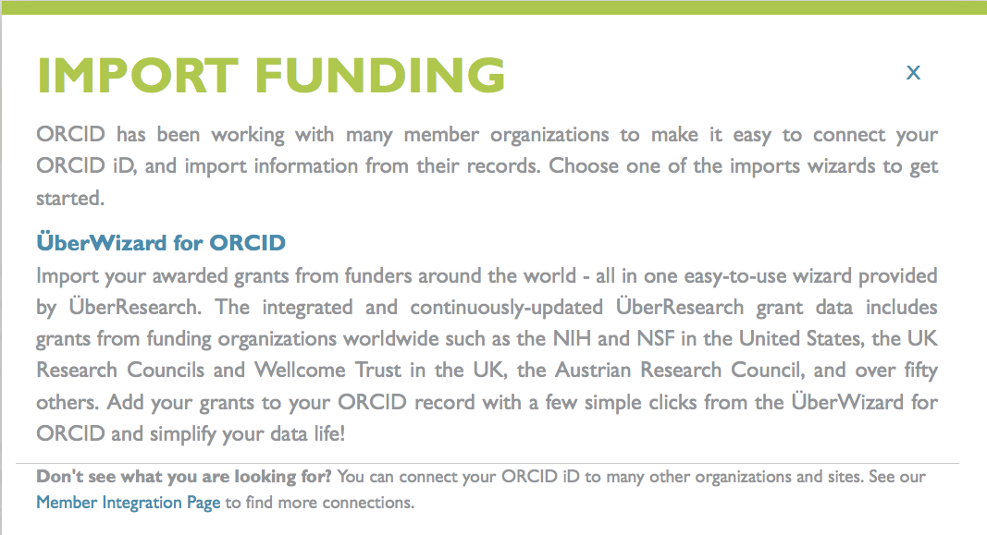

Slide 28
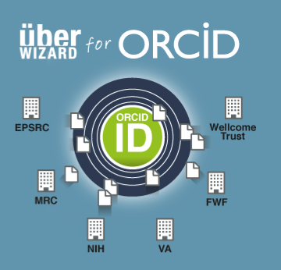

Slide 29
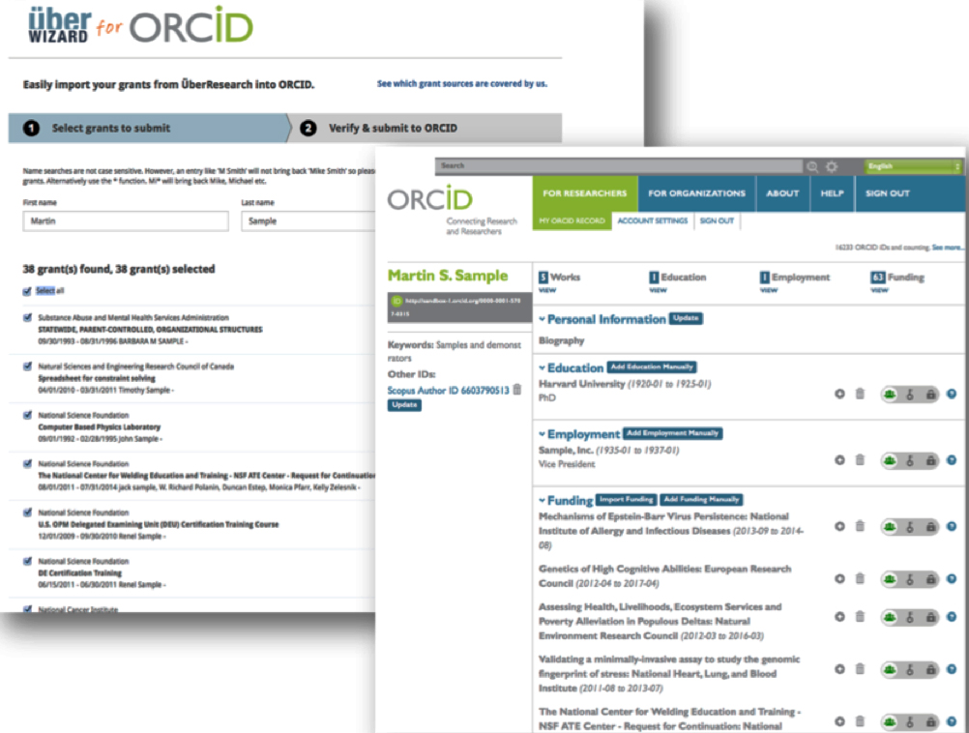

Slide 30

ORCID is making it possible to assign the management of a profile to a delegate.
The delegate will have to have an ORCID.

Slide 31
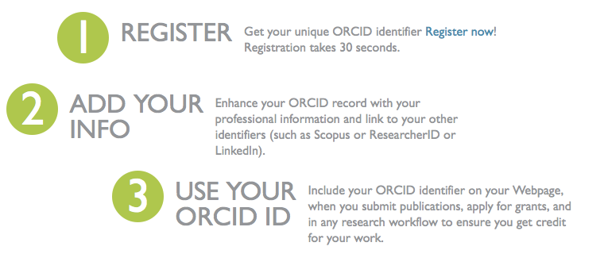
Registering for ORCID is free @ http://orcid.org/

Slide 32
Make your research discoverable
Maximize citability, reuse, collaboration with DataCite

Slide 33
Why is it important to register my research data?
Maximize the impact of your research
  Increase visibility, discoverability, citations
Benefit the greater community
Your funding organization or publisher may require it
  National Science Foundation
  Nature, PLoS One

Slide 34
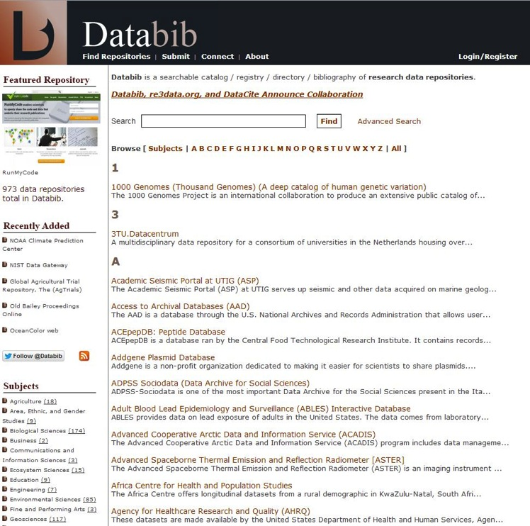


Benefit: reuse data; identify collaborators

Slide 35
What issues do I need to consider?
Are your data reusable? (documentation, format)
Policies or laws governing shareability of sensitive data
  Confidential or restricted-use datasets require different handling
Copyright restrictions

Slide 36
What is DataCite?
International Collaboration
Not-for-profit; driven by research organizations
Offers core services
  Register data; obtain DOI and link to dataset via URL
  Metadata search engine (to find datasets of interest)

Slide 37
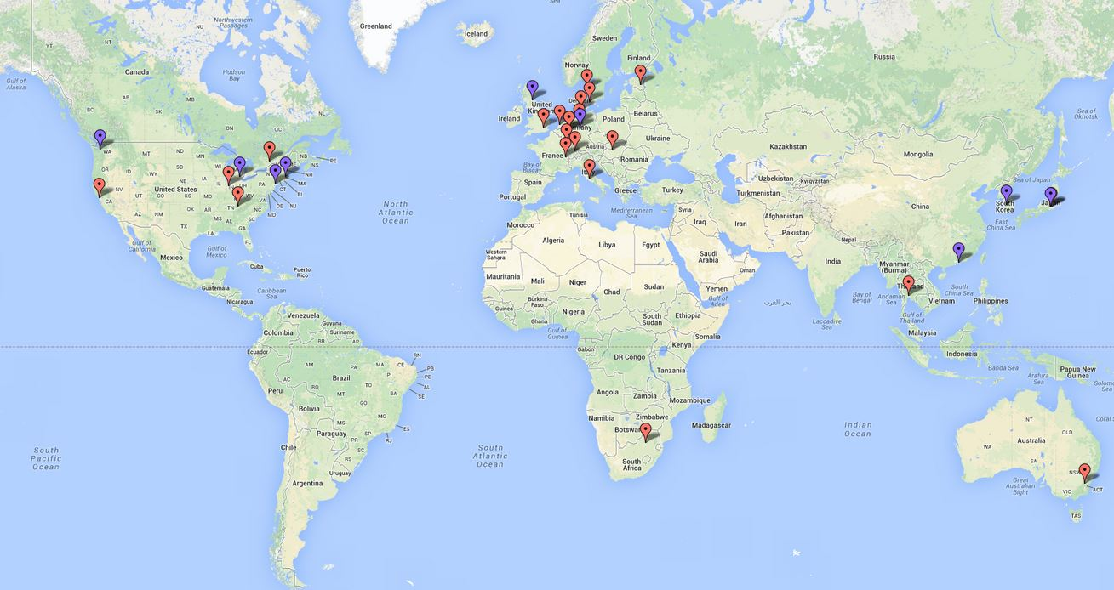
International collaboration

Slide 38
DataCite goals
Establish easier access to research data on the Internet
Increase acceptance of research data as legitimate, citable contributions to the scholarly record
Support data archiving that will permit results to be verified and re-purposed for future study
https://www.datacite.org/whatisdatacite

Slide 39
What DateCite is not
DataCite is NOT a journal
  It is not a resource to publish your data
DataCite is NOT a repository
  It cannot store your dataset
  (neither can the Library)

Slide 40
What does it mean to “register” my data with DataCite?
Registration assigns a Digital Object Identifier (DOI) to your dataset
Dontu, G., Al-Hajj, M., Abdallah, W. M., Clarke, M. F. and Wicha, M. S. (2003), Stem cells in normal breast development and breast cancer. Cell Proliferation, 36: 59–72. doi: 10.1046/j.1365-2184.36.s.1.6.x
The DOI is unique to your dataset; it links to a URL and points to where your dataset is hosted

Slide 41
What kind of data can I register?
Data can be in any format (numerical, textual, audio, video, images)
Data must be hosted online with a valid web address
  Web address must direct to a landing page with information about the dataset and a link to it

Slide 42
How do I register my research data?
Visit http://www.lib.umich.edu/research-data-services/datacite-initiative
Complete the submission form
  Information about you: name, email, department
  Information about your dataset: title, URL, brief description

Slide 43
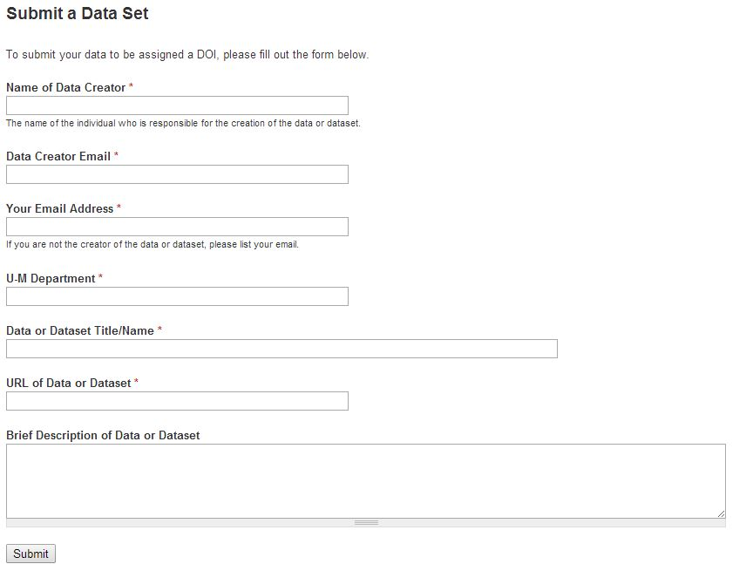

Slide 44
For more information …
Visit http://www.lib.umich.edu/research-data-services/datacite-initiative
Email the Library’s Data Cite Task Force: datacitetaskforce@umich.edu

Slide 45
Questions?
Marisa Conte: meese@umich.edu
  Michigan Experts, DataCite
Karen Downing: kdown@umich.edu
  Grants, funding opportunities, Pivot
Merle Rosenzweig: oriley@umich.edu
  ORCID, NIH compliance

