Slide 1
The Big Squeeze:
State of Book Publishing and Academic Libraries
Mary Beth Barilla, Emerald Group Publishing
Corey Seeman, Univ. of Michigan
Michael Zeoli, YBP
2014 Charleston Conference
Friday November 7, 2014

Slide 2
Presentation Overview
Introductions
Common Ground
From the Libraries - Envisioning the Library of the Future
From the Publishers - New Formats and Models
From the Vendors - What is the Path Forward?
Open discussion

Slide 3



Introductions
Mary Beth Barilla
  Sales Manager (Emerald Group Publishing)
Corey Seeman
  Director, Kresge Library Services
  (U of Michigan)
Michael Zeoli
  VP Strategic eContent Development (YBP)

Slide 4
Finding Common Ground
Can we all agree on some common issues?
  Libraries, publishers and suppliers are all feeling the “big squeeze”
  We all serve the same community of faculty, researchers, and students
  We all still provide services of value to these communities
  We are all part of the same supply chain or eco-system

Slide 5
Envisioning the Library of the Future
Library Perspective
Corey Seeman
  Director, Kresge Library Services (U of Michigan)
  cseeman@umich.edu

Slide 6
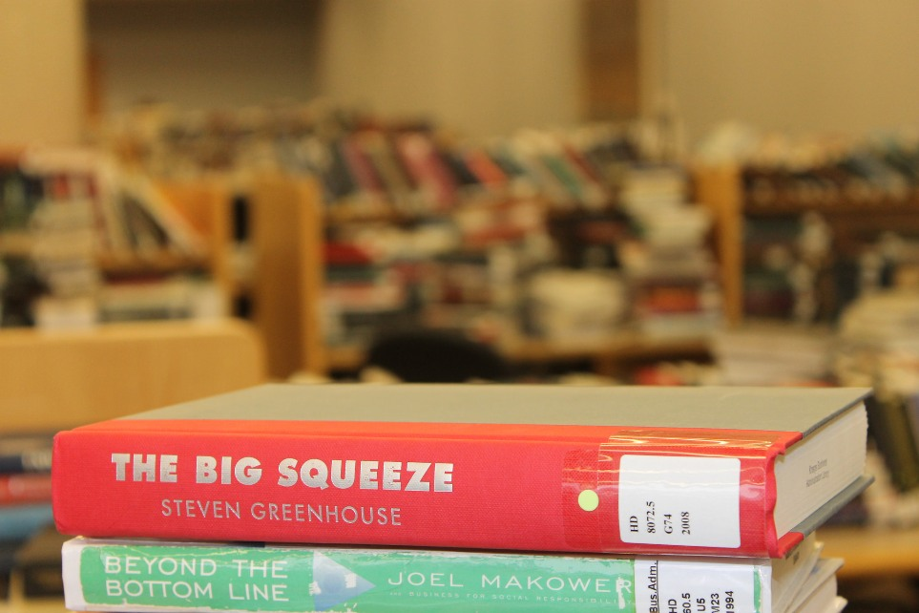
Envisioning the Library of the Future
About the program title…

Slide 7
Envisioning the Library of the Future
The Big Squeeze is about employees being “squeezed dry”
Greenhouse looks at the majority of employees – not all.
We can make the same argument for libraries. Some are prospering, many are being squeezed.
Libraries are a very important element in the Scholarly Communication Supply Chain. When they are squeeze – it has ripple effects through the entire sector.

Slide 8
Envisioning the Library of the Future
ACRL Top Trends in Academic Libraries (June 2014)
  Data
  Device Neutral Digital Services
  Evolving Openness in Higher Ed
  Student Success
  Competency-based Learning
  Altmetrics
  Digital Humanities
See: http://crln.acrl.org/content/75/6/294.full

Slide 9
Envisioning the Library of the Future
While these are great directions, our entire business model is based on our traditional roles and resources.
The perception of our needs for space and student needs are being weighed against each other.
So what does that look like in academic libraries…

Slide 10
Envisioning the Library of the Future

Slide 11
Envisioning the Library of the Future
The library of the future is smaller.
….way, way smaller.
How does this impact what we collect?
How does this impact how we serve our campus?
Do we have the resources to address immediate needs AND be forward thinking about research?

Slide 12
Envisioning the Library of the Future
About the S. S. Kresge
Open hours – 108 to 50 a week.
No student seating
No collection space* (save for 200 volumes)
We lost the physical space – all we have left is the ethereal one!
Full-fledged library to a service unit.

Slide 13
Envisioning the Library of the Future
The ‘born digital’ library vs. the ‘becoming digital’ library.
  Florida Polytechnic University (Lakeland, FL)
  BiblioTech (Bexar County – San Antonio)
  Cushing Academy (Ashburnham, Massachusetts)
Newsworthy for sure
But does it support research?

Slide 14
Envisioning the Library of the Future
The work is a balancing act between budget, space, new work and legacy work.
Libraries have no choice but to be philosophical about collection and service decisions.
Libraries have no choice but to be looking at ROI.
Libraries have no choice but to question resources that are low use.
This MAY hit other parts of the University someday…but its our problem now.

Slide 15
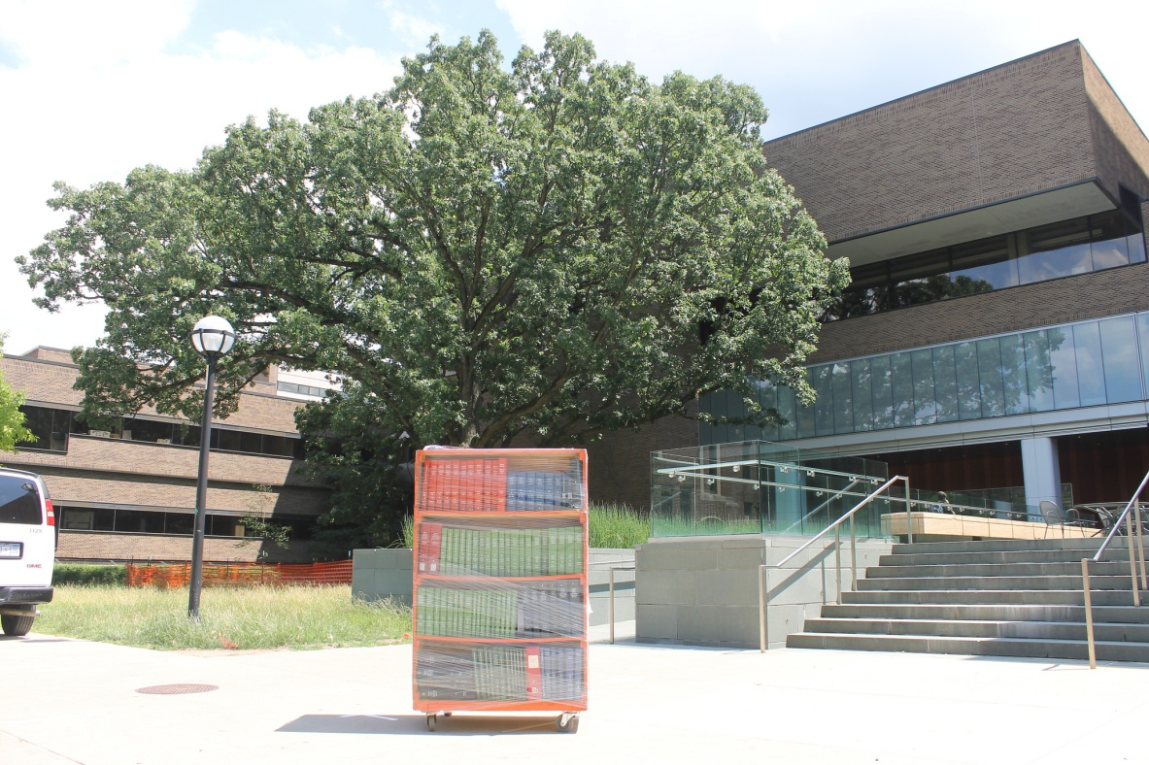
Envisioning the Library of the Future
Content in print is important for research.
It just may not be important now!

Slide 16
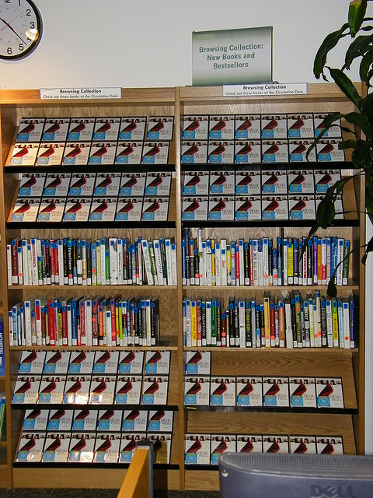
Envisioning the Library of the Future
Losing the ability to be format agnostic.
Old Kresge bought whatever worked
New Kresge cannot!

Slide 17
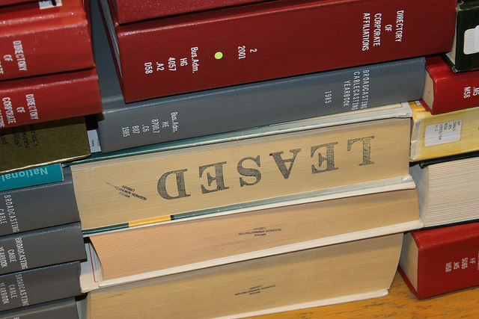
Envisioning the Library of the Future
Growing print divide
Space contractions will prevent libraries from growing in niche areas.
Print still is 2-3% of usage – but 50% of perception

Slide 18
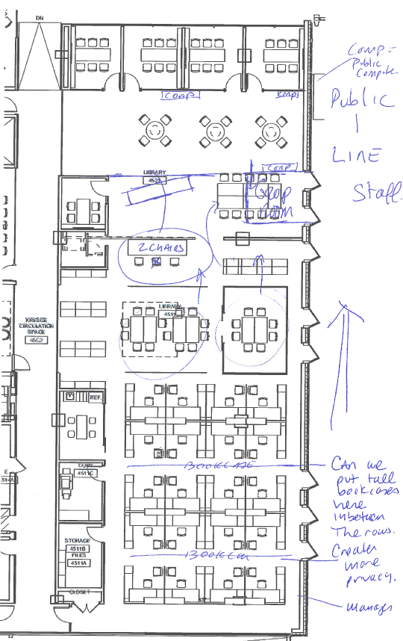
Envisioning the Library of the Future
What the future feel like?
  Libraries as service units
  Collections digital and/or off campus
  Student space managed elsewhere

Slide 19
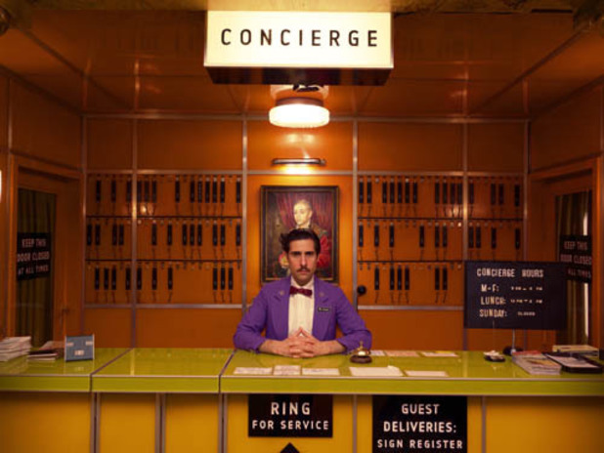
Envisioning the Library of the Future
Mr. Moustafa (about Gustav H.) “To be frank, I think his world had vanished long before he ever entered it - but, I will say: he certainly sustained the illusion with a marvelous grace!”
The Grand Budapest Hotel
Wes Anderson (2014), inspired by the work of Stefan Zweig
Stefan Zweig, Wes Anderson, and a Longing for the Past – The New Yorker, March 14, 2014

Slide 20

Envisioning the Library of the Future
OR…is our problem in libraries this –
We are altruists in a
narcissistic world
Stefan Zweig, Wes Anderson, and a Longing for the Past – The New Yorker, March 14, 2014

Slide 21

New Formats and Models
Publisher Perspective
Mary Beth Barilla
  Sales Manager (Emerald Group Publishing)
  mbarilla@emeraldinsight.com

Slide 22
New Formats and Models
Emerald Books: a Brief History
  An independent, scholarly publisher headquartered in the UK
  Traditionally a journals publisher – known for business and management publishing
  Became a book publisher in 2007
  Currently expanding our business books program

Slide 23
New Formats and Models
“Big Squeeze”: One Publisher’s Perspective
  Print still accounts for ~85% of books program revenue, but sales are shifting to digital
  eBook sales are increasing, but not closing the gap
  Institutional book budgets not growing in most markets
  Authors increasingly concerned about dissemination of their research

Slide 24
New Formats and Models
What do book publishers have to offer?
  Brand/reputation
  Editorial review process
  Editing
  Production and design
  Ensuring discoverability
  Sales and distribution
  Marketing and publicity
  Platform development and support

Slide 25
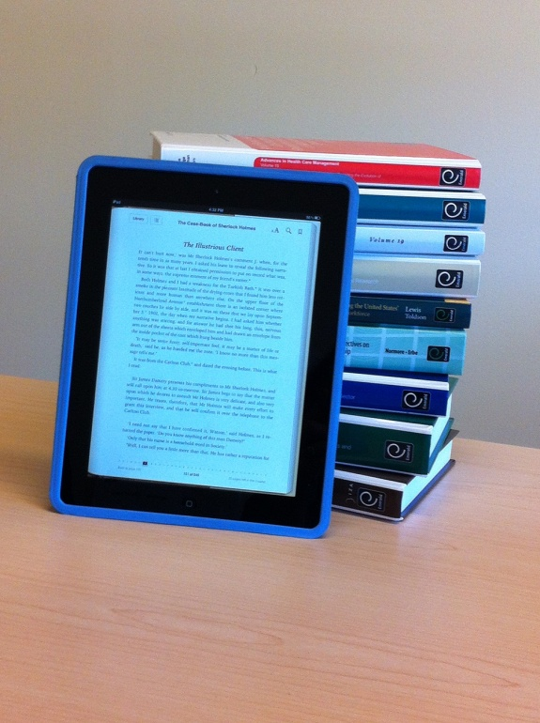
New Formats and Models
Digital Challenges and Opportunities
  New business models
    DDA
    Subscription
    Open Access
  Discoverability
  Usage
  Competing with journals for budget, resources

Slide 26
New Formats and Models
Common concerns and goals
  Enhancing readership
    Access
    Usage
  Sustainability
  Demonstrating value to stakeholders

Slide 27
New Formats and Models
What does the future hold?
  Can publishers and libraries develop a more sustainable business model together?
  What business and purchasing models will endure?
    Publisher platforms vs. aggregator platforms?
    OA monographs?

Slide 28
New Formats and Models
What does the future hold?
  What new products or business models will emerge?
    Is there interest in a print/eBook bundle offer?
    Enhanced eBook content?
  Do authors and end-users still value long-form scholarship (i.e. the “book”)?

Slide 29
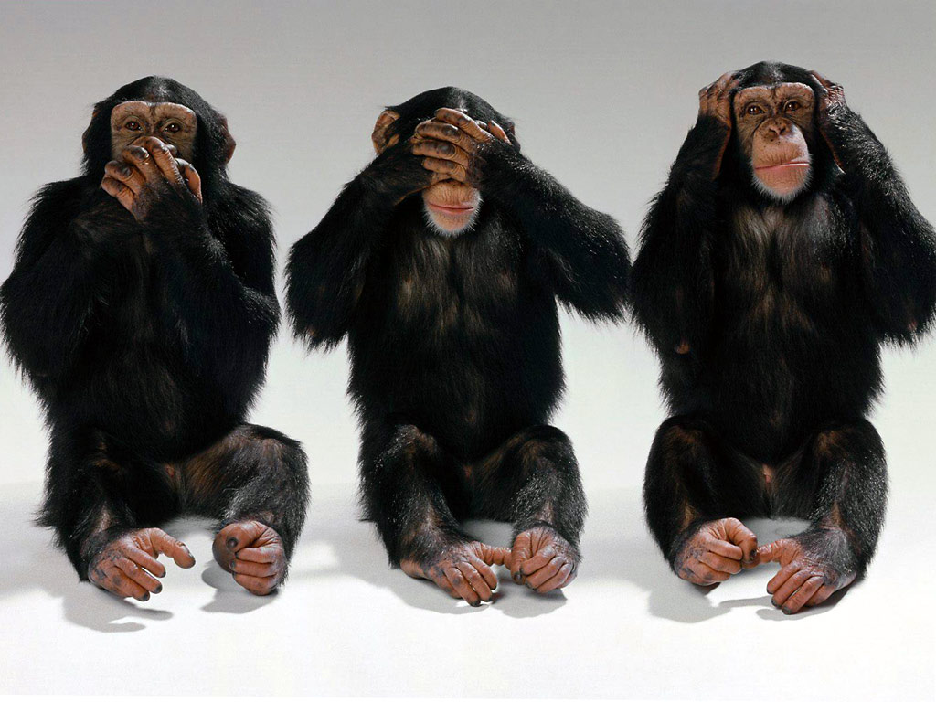
Is There a Path Forward?
The Vendor Perspective
Michael Zeoli
  VP Content Development YBP Library Services
  mzeoli@ybp.com

Slide 30
Where are we going?
“X university is doing a lot of DDA (individual & consortial). The library has also converted Approval Plan book areas to e-slips only (from print books).”
“Y university’s overall budget will be flat this year. The library is now moving all DDA possible eBooks into the DDA repository, and have just changed DDA to allow STLs which decrease DDA expenditures.”
“Z university: eBooks via Approval Plan and Orders are down. DDA purchasing is up;
Library pushing more and more print and ebook notification slips into their DDA pool.”

Slide 31

Is There a Path Forward?
Music sales have been dropping all year, as the record industry navigates a shift from selling downloads to offering music catalogs via streaming services such as Spotify. Album sales are down 14 percent and track sales are down 13 percent, but paid subscriptions jumped 57 percent last year. [Rolling Stone]

Slide 32
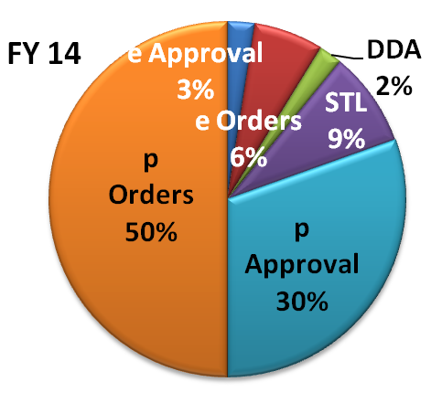
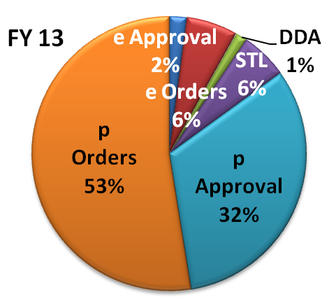
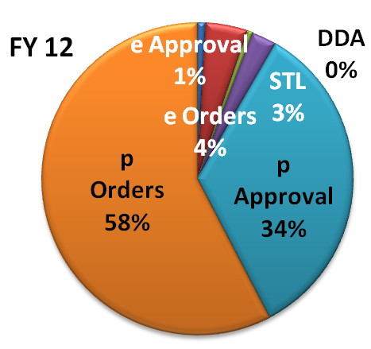
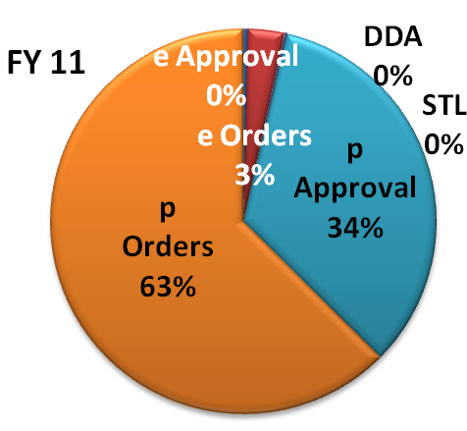
The Fall and the Nuts (units)

Slide 33
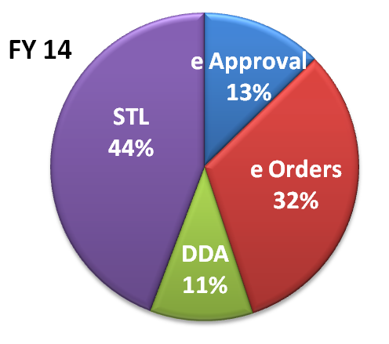
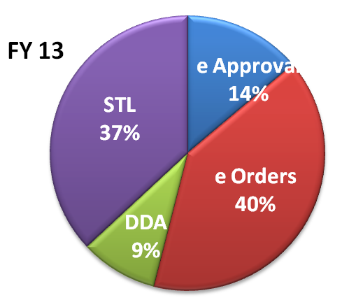
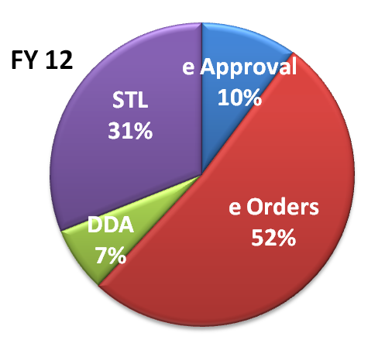
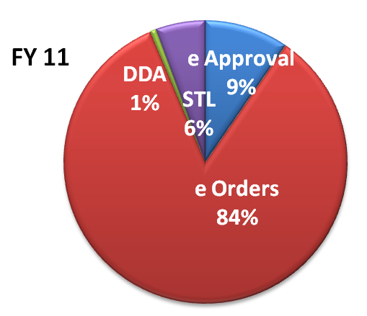
The Digital Nuts (units)

Slide 34
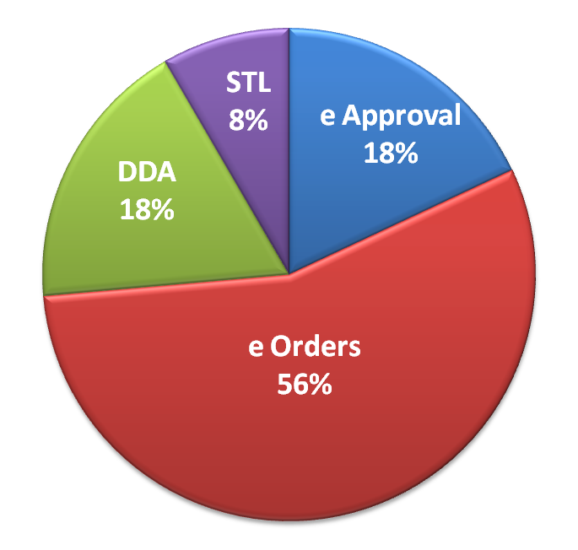
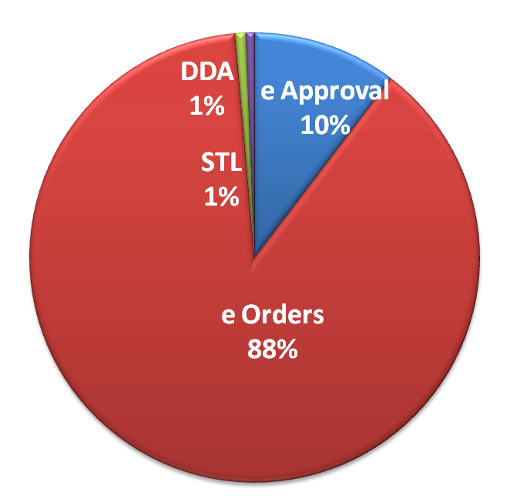
Will these nuts last till Spring? (dollars)
FY 14
FY 13

Slide 35
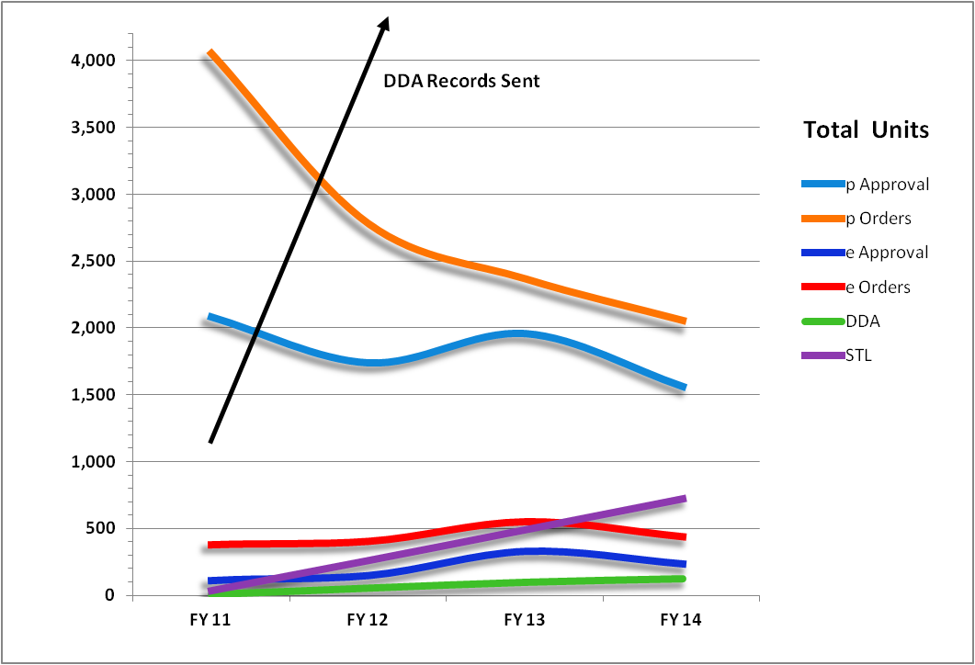
. . . or are the Chestnuts in the fire ?

Slide 36
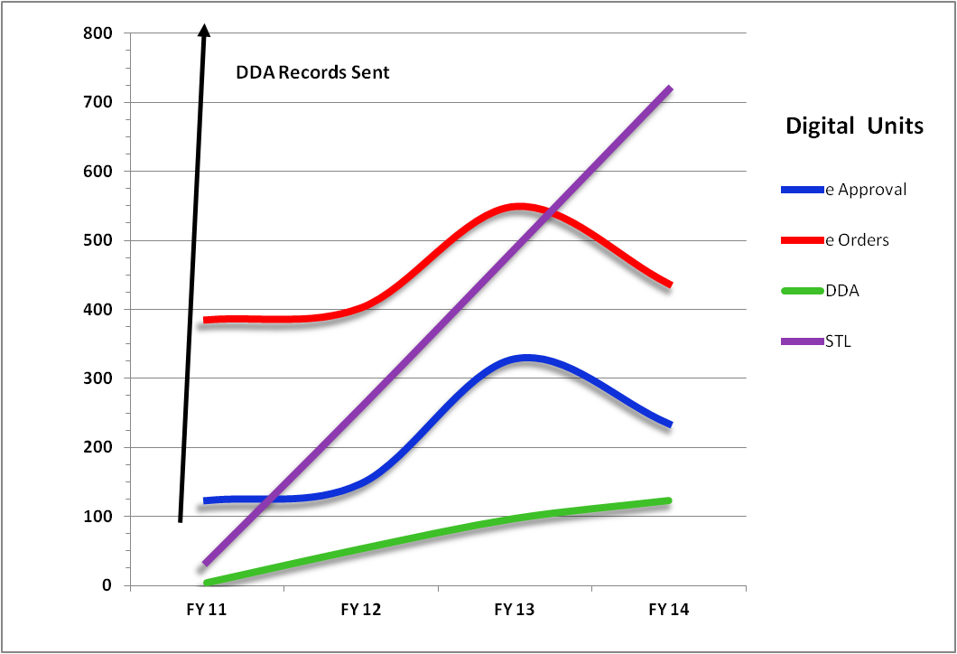
. . . the fire . . .

Slide 37
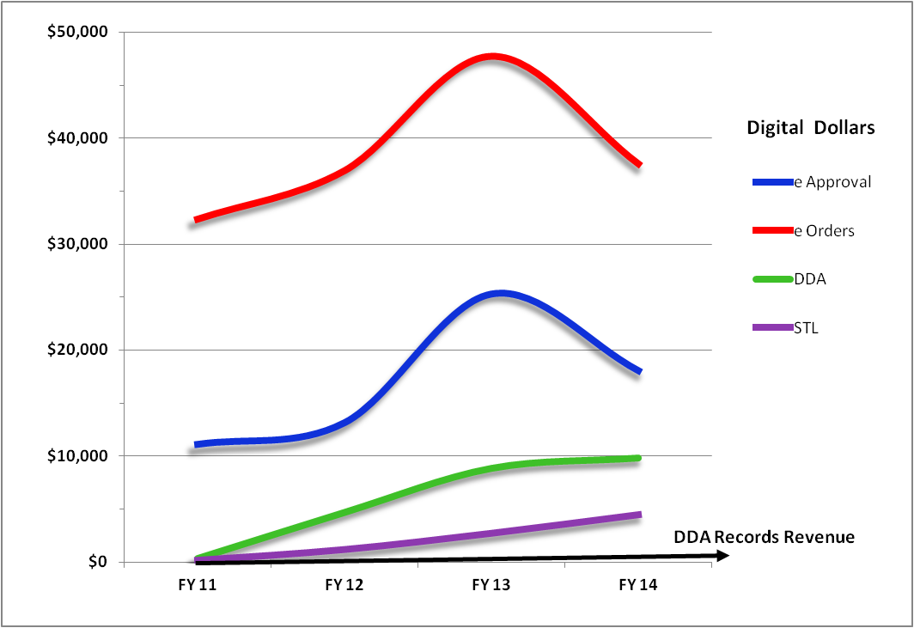
Now where did the nuts get buried?

Slide 38
How much are the nuts worth?
FY | % Digital of Total Sales | DDA Records Sent | Value of DDA Records | % DDA Records Triggered
FY 14 | 21% | 2,898,960 | $313,665,753 | 3%
FY 13 | 17% | 2,095,383 | $209,545,509 | 3%
FY 12 | 10% | 1,038,340 | $100,983,365 | 2%
FY 11 | 6% | 33,119 | $3,174,188 | 3%

Slide 39
. . . and the Squeeze . . .
FY | % eSales = DDA / STL (units) | % DDA / STL = STL (units) | AVG ebook w/o STL | AVG ebook w / STL
FY 14 | 55% | 80% | $108.20 | $65.81
FY 13 | 46% | 80% | $100.00 | $67.38
FY 12 | 38% | 82% | $97.25 | $70.23
FY 11 | 6% | 88% | $95.84 | $91.01

Slide 40
Is There a Path Forward?
Even a blind squirrel finds a nut once in a while . . .

Slide 41
Now What?
Questions
Discussions
Options
Solutions
Any other nominalizations?

Slide 42
Now What?
Mary Beth Barilla
  Sales Manager (Emerald Group Publishing)
  mbarilla@emeraldinsight.com
Corey Seeman
  Director, Kresge Library Services (U of Michigan)
  cseeman@umich.edu
Michael Zeoli
  VP Strategic eContent Development (YBP)
  mzeoli@ybp.com

