Slide 1
Business Resources from the Michigan Electronic Library: Help is Closer than it Appears
Corey Seeman
Kresge Library Services - University of Michigan
cseeman@umich.edu
Saline District Library – February 10, 2015

Slide 2
Program Outline
Key Takeaways
Speaker Introduction
Your Business Researchers and Community
Business Research Basics
Resources in Michigan - at local business libraries
Statewide Resources in Michigan

Slide 3
Program Outline – Key Links
Saline District Library – Business Resources
  http://saline.lib.mi.us/websites-business.html
Kresge Library Guide:
  http://kresgeguides.bus.umich.edu/bizmichigan
Michigan Electronic Library – Business Resources
  http://www.mel.org/index.php?P=MeLGateways&ParentId=832

Slide 4
Key Takeaways
You have more help than you think.
Great resources available from MeL & MeLCat.
Assistance is available from other libraries in Michigan including business libraries at MSU and UofM.
We can help demystifying the nature of business questions.
Understanding what types of information will be needed by entrepreneurs to build a business plan or business model.

Slide 5
Speaker Introduction
Director of the Kresge Library Services (Ross School of Business, University of Michigan, Ann Arbor)
Formerly at the University of Toledo, Chicago Historical Society, Historical Society of Western Pennsylvania and the National Baseball Library of the National Baseball Hall of Fame and Museum
Member of ABLD

Slide 6


Your Business Researchers and Community
Why is Business Important in Michigan?

Slide 7
Your Business Researchers and Community
Current efforts for economic development support in Michigan
  Pure Michigan Business Connect http://www.puremichiganb2b.com/
  Economic Gardening Programs
  Michigan Economic Development Corporation http://www.michiganbusiness.org
  Expansion of Business Resources through the Michigan eLibrary http://mel.org/

Slide 8
Your Business Researchers and Community
Community efforts for economic development support in Michigan
  SCORE - http://www.score.org/
  LibraryBiz Connect - http://tln.lib.mi.us/partnerships/
  ExporTech (U.S. Department of Commerce)
  Livingston County FastTrac

Slide 9
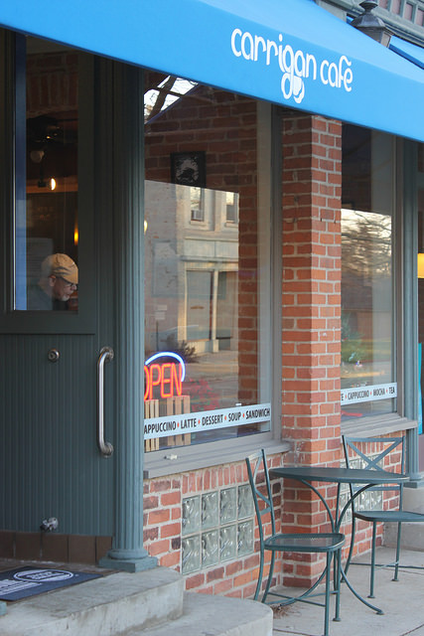
Your Business Researchers and Community
Who is your audience & customer?
  Anyone interested in any business or management concern (including nonprofits)
  Government officials who are evaluating proposals or looking to expand economic development

Slide 10
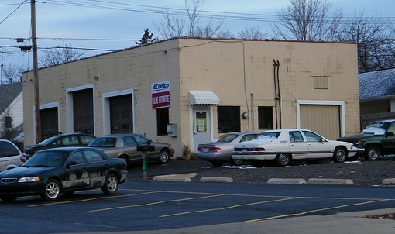
Your Business Researchers and Community
Who is your audience & customer?
  People who want to invest their time and money in their business, not in resources that they might already have access to!

Slide 11
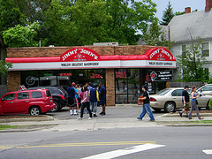
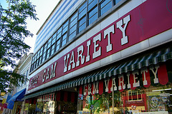
Your Business Researchers and Community
What are people looking for?
  Helping these small business owners learn the landscape of business information
  Provide more detailed support and directions
  Greater ability to help these users because of our focus on business issues

Slide 12
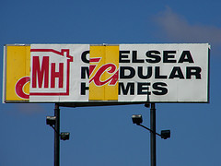
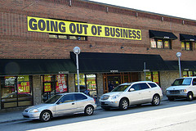
Your Business Researchers and Community
What are people looking for?
  Helping business owners avoid problems that lead to bankruptcy & closings
  Providing resources to ensure their success – which helps everyone in the community

Slide 13
Your Business Researchers and Community
What are people looking for?
Here are sample questions we get at Kresge & Gast Libraries
  Size of a particular geographic market
  Demographics and generational marketing
  Historical company information (stock prices and directory information)
  Industry information
  Company research (market saturation and competitors)

Slide 14
Your Business Researchers and Community
What are people looking for?
  We can provide clarity (what resources do they have access to vs. those that cost).
  We often have a better sense of the value of resources than our users.
  We can provide directed guidance for specific questions.
  We can provide referrals to regional libraries and other centers that can assist.

Slide 15
Business Research Basics
What are the basics of business research?
Business owners are primarily looking for the following areas:
  Companies & organizations
  Industries
  Demographics & statistics
  International business and Import/Export
  Articles and “Best Practices”
Fundamentally – they are looking for answers!

Slide 16
Business Research Basics
Many entrepreneurs will be working on business plans or model canvas generation.
These are essentially resumes for their new venture and can help secure financing and assistance.
A great business plan is no guarantee of success, but it helps the person(s) think through all of the elements of their proposed operation.

Slide 17
Business Research Basics
Business Planning involves thinking about the following elements:
  Company Description
  Market Analysis
  Service or Product Description
  Marketing Description
  Financial Projections
  Supply Chain Projections

Slide 18
Business Research Basics
Company information availability will vary with its size and nature:
  Public Companies have extensive available data (SEC filings and finances) – sometimes there is an issues about a business segmentation
  Private Companies have limited available data – mostly through news & directory resources.
  More famous private companies (Zingermans or Zehnder's) have more articles about them that help tell their story. Most have virtually nothing written up about them.

Slide 19

Business Research Basics
The best path to full-text is through library resources
“I’d Rather hit ‘paydirt’ than a ‘paywall.’
Google is a tremendous tool – but will drive traffic to pay sites.

Slide 20

Business Research Basics
For entrepreneurs – their market might not be clearly defined. Mostly likely it is not. It will take time and patience.
If it is clearly defined – it might not be as entrepreneurial as one thinks.

Slide 21
Business Research Basics
Patience is golden – some research takes time.
Look at articles in the press – they can provide great information that is not available anywhere.
Be open minded with your research. Do not paint yourself in a corner looking for data that might not be available.

Slide 22
Statewide Resources in Michigan
Freely available resources (government and otherwise)
See: http://kresgeguides.bus.umich.edu/bizmichigan
Great material available via the Federal Government:
  U.S. Census
  U.S. Department of Commerce
  U.S. Small Business Administration
  U.S. Bureau of Labor Statistics
Great material also available via the State of Michigan

Slide 23
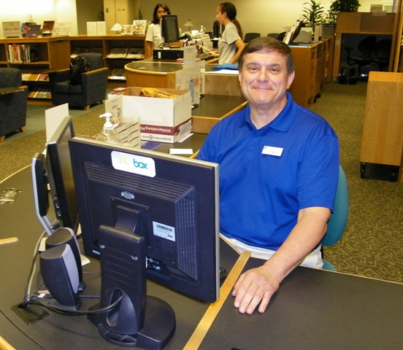
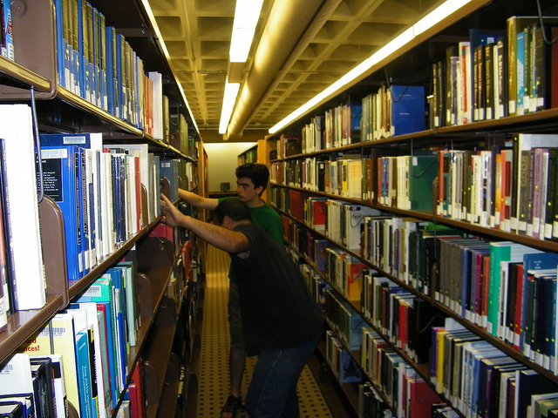
Resources in Michigan – Local Business Libraries
Business Libraries Today
It is about access to information!

Slide 24
Resources in Michigan – Local Business Libraries
Kresge Library Services(University of Michigan)
  Independent Library at University of Michigan - Ross School of Business (3700 FTE)
  Staff of 19 FT people (8 librarians, 11 staff)
  We offer almost 100 electronic resources primarily focused on business
  Reference support available via email and chat only during construction (expected through August 2016)
  Research guides are being built for Michigan residents http://kresgeguides.bus.umich.edu/bizmichigan

Slide 25
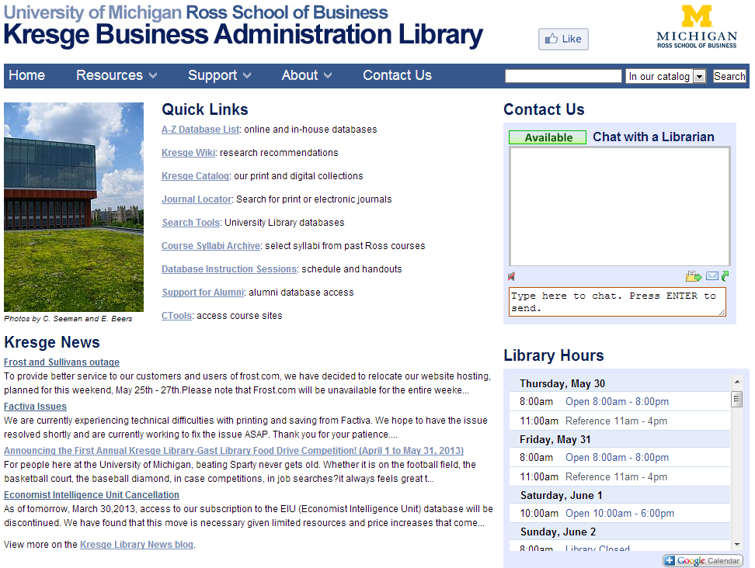
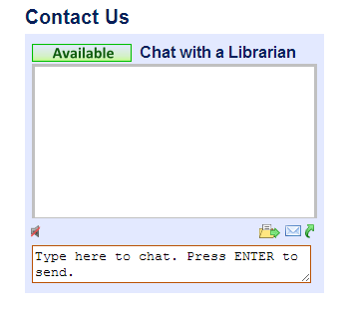
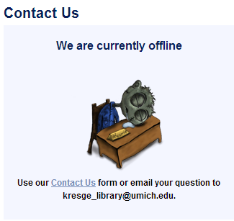
Resources in Michigan – Local Business Libraries
  Kresge IM Chat Service – People all over contact us this way!

Slide 26
Resources in Michigan – Local Business Libraries
Many library options in Michigan
Many larger public libraries have specialized business resources.
Most academic libraries allow walk-in users and have access to numerous business resources.
Suggest to patrons to contact the library first to ensure that you understand community use before making the drive in.
MeL databases are great – patrons can use them already!

Slide 27
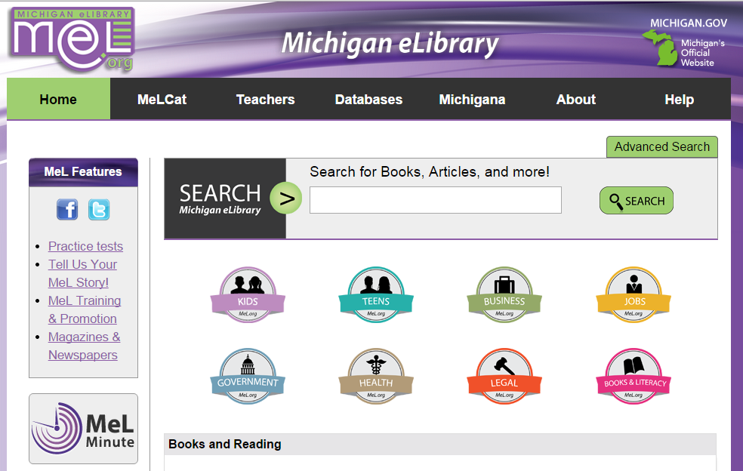
Statewide Resources in Michigan
MeL Databases - http://mel.org/

Slide 28
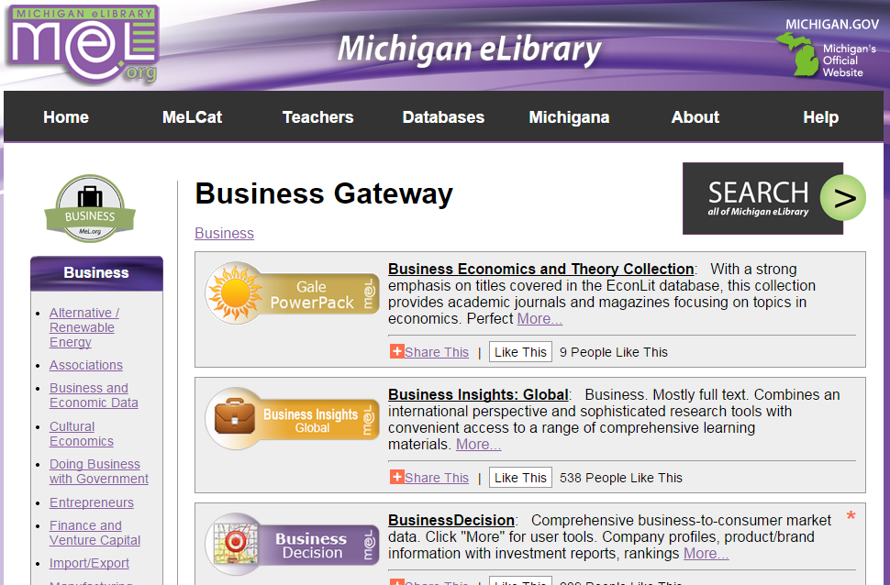
Statewide Resources in Michigan
MeL Databases - tinyurl.com/Melbusiness

Slide 29

Statewide Resources in Michigan
MeL Databases
  Michigan residents may use these from ANY location.
  If you are in Michigan – you go right in.
  If you are outside of Michigan – you will need to authenticate with your library card or Driver’s License.

Slide 30
Statewide Resources in Michigan
MeL Databases
  Business Insights: Global
  BusinessDecision
  DemographicsNow: Business & People
  Gale Directory Libraries
  Gale LegalForms & LegalTrac
  Infotrac Newsstand & General BusinessFile ASAP

Slide 31
Statewide Resources in Michigan
MeL Databases
  Lansing State Journal (Newspaper)
  LearningExpress Library (including Job and Career Accelerator & Workforce Skills for 21st Century Success)
  Pure Michigan Talent Connect
  Small Business Resource Center

Slide 32
Statewide Resources in Michigan
MeL Databases - Business Insights: Global
  One of the best resources available via MeL
  Great source for:
    Company information
    Industry surveys
    Case studies
    Articles on numerous topics related to business
    Market share reporter charts

Slide 33
Statewide Resources in Michigan
MeL Databases - BusinessDecision
  Great source for:
    Comprehensive business-to-consumer market data
    Detailed company profiles
    Product and brand information
    Strong information about the consumer marketplace

Slide 34
Statewide Resources in Michigan
MeL Databases - DemographicsNow: Business & People
  Great source for:
    Consumer and Demographic Information
    Much more user friendly resource for assessing demographic information than the American FactFinder

Slide 35

Statewide Resources in Michigan
  MeL Databases - Gale Directory Libraries
  Gale Directory Library
    Ward’s Business Directory (2012)
    Business Rankings Annual (2013)
  Gale Virtual Reference Library: Business Collection
    Business Plans Handbook
    Various business books on U.S. and global markets.

Slide 36
Statewide Resources in Michigan
MeL Databases - Gale LegalForms & LegalTrac
  Gale LegalForms – Provides copies of legal forms and documents in Word format on business, personal or litigation purposes. Also includes many Michigan documents.
  LegalTrac – Provides access to numerous articles from newspapers, magazines and legal journals.

Slide 37
Statewide Resources in Michigan
MeL Databases - Infotrac Newsstand & General BusinessFile ASAP
Two good article database that can assist with many different topics.
Infotrac Newstand includes full-text newspaper articles (including the New York Times) that has up-to-date content from across the globe.

Slide 38
Statewide Resources in Michigan
MeL Databases - LearningExpress Library
  LearningExpress Library
    Interactive online learning platform of academic and licensing/certification practice tests, elementary level testing for math and reading.
  Job and Career Accelerator
    Easy-to-use online application combining everything you need for a successful job search.
  Workforce Skills for 21st Century Success
    Job search assistance including resume writing and interviewing, as well as computer skills and test prep.

Slide 39
Statewide Resources in Michigan
MeL Databases - Lansing State Journal (Newspaper)
  Available via ProQuest
  Great source for State Information – with full text from November 2002 to the present.

Slide 40
Statewide Resources in Michigan
MeL Databases - Pure Michigan Talent Connect
  Michigan-based service for job openings in the state.

Slide 41
Statewide Resources in Michigan
MeL Databases - Small Business Resource Center
Learn how to start, finance or manage your small business.
Resources include
  Sample business plans
  How to guides
  Articles and best practices

Slide 42
Statewide Resources in Michigan
Getting Help with MeL databases - you can contact Kresge Libraries
Kresge Library (Michigan):
  Kresge_library@umich.edu
  Or cseeman@umich.edu
  Chat at http://www.bus.umich.edu/kresgelibrary/
  http://kresgeguides.bus.umich.edu/bizmichigan

Slide 43
Thank You
Questions?
Corey Seeman
Kresge Library Services
University of Michigan
cseeman@umich.edu

