Slide 1
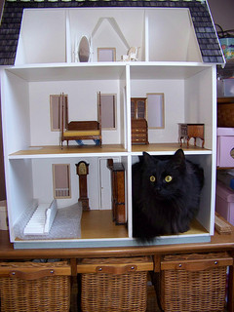
“Where you and I are going to spend the rest of our lives:”
What a future library really looks like.
MIUG 2015
July 17, 2015 – LCC - Lansing, Michigan
Corey Seeman – Kresge Library Services
(University of Michigan)
tinyurl.com/MIUG15CS

Slide 2
Program Overview
Envisioning the Library of the Future
About Kresge and Ross Construction
Change Management
Becoming the Ethereal Library
Providing Value With New Constraints
Closing Thoughts & Questions

Slide 3
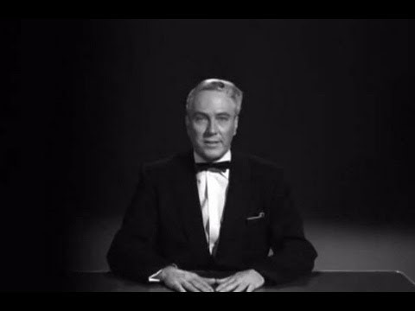
Envisioning the Library of the Future
https://archive.org/details/Plan_9_from_Outer_Space_1959

Slide 4
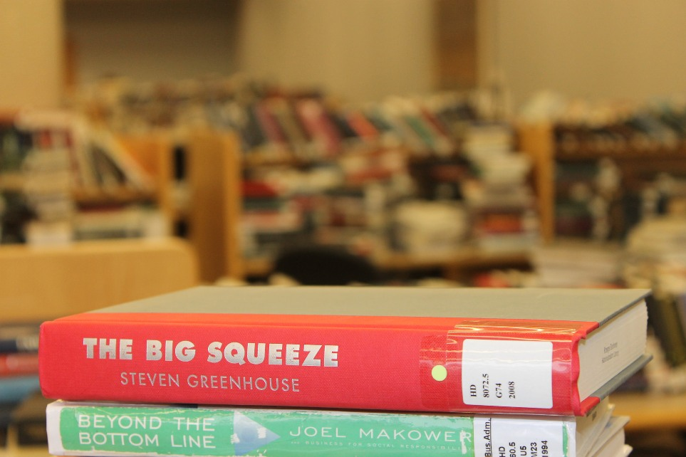
Envisioning the Library of the Future
The Big Squeeze is about employees being “squeezed dry”
Greenhouse looks at the majority of employees – not all.
We can make the same argument for libraries. Some are prospering, many are being squeezed.
Libraries are a very important element in the Scholarly Communication Supply Chain. When they are squeezed – it has ripple effects through the entire sector.

Slide 5
Envisioning the Library of the Future
ACRL Top Trends in Academic Libraries (June 2014)
  Data
  Device Neutral Digital Services
  Evolving Openness in Higher Ed
  Student Success
  Competency-based Learning
  Altmetrics
  Digital Humanities
See: http://crln.acrl.org/content/75/6/294.full

Slide 6
Envisioning the Library of the Future
“Library Space: You might say that library space (and what we’re doing to improve it to meet user expectations better while positioning the library as a place of intentional learning and community engagement) is always a big factor, in any year. In 2015, I think academic librarians will be doing even more experimentation with their spaces in an effort both to attract even more students and demonstrate the beneficial impact of students connecting with the library and librarians. We’re only beginning to explore how new spaces for digital scholarship and creativity fit into the academic library. We’ll be learning more from one another this year about how to get these spaces right.”
- Steven Bell – Top 10 Academic Library Issues for 2015 (Library Journal, February 18, 2015
(http://lj.libraryjournal.com/2015/02/opinion/steven-bell/top-10-academic-library-issues-for-2015-from-the-bell-tower/)

Slide 7
Envisioning the Library of the Future
In Library as Space Program in 2013 (Michigan Library Association) – I shared the notion that the Library had two spaces:
  A physical space
  An ethereal space
They provide distinct functions and benefits to the communities we serve.
Both can be critical for the members of the library’s communities.

Slide 8
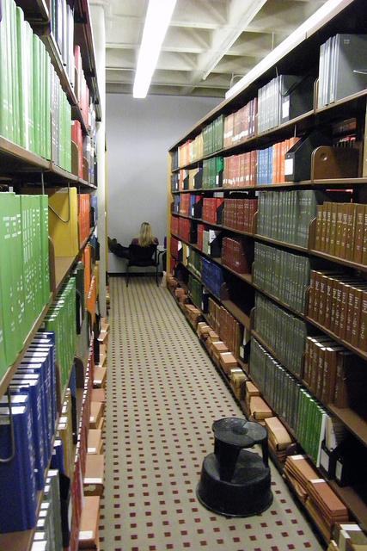
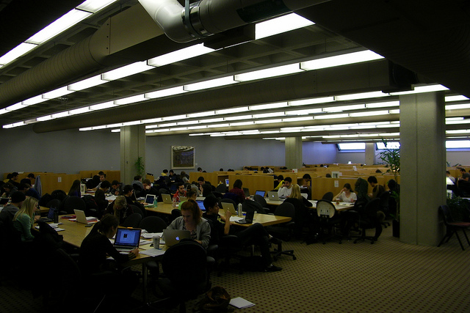
Envisioning the Library of the Future
Physical space is used for:
  Study
  Print Materials
  Interaction Spaces
  Walk-in Access
For many functions - a physical space can be managed just as well by others.
Print collections might be 2% of the usage – but 50% of the perception of the library

Slide 9

Envisioning the Library of the Future
What is the ethereal space?
  With nearly 98% of our usage from electronic resources* – librarians and library staff can operate from almost anywhere
  This is where we connect with our community.
  This is where we provide clarity to a complicated information universe.
  This is where we contribute as a “Value-Add.”
  This is where we SHINE!

Slide 10
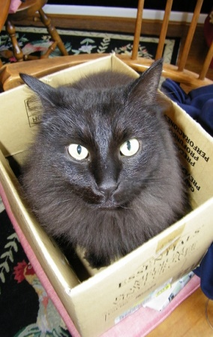
Envisioning the Library of the Future
Would you elect to save your physical or ethereal space?
What if the decision was made for you? (Internal vs. external decisions on space).
Space is a luxury on academic campuses – and with that – we lost ours.
Some engagement, but no open discussion with the community.
With a large construction project, we lost both student and collection space…

Slide 11
Envisioning the Library of the Future
While these are great directions, our entire business model is based on our traditional roles and resources.
The perception of our needs for space and student needs are being weighed against each other.
So what does that look like in academic libraries…

Slide 12
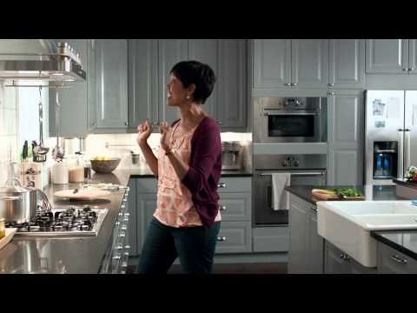
Envisioning the Library of the Future

Slide 13

Envisioning the Library of the Future
The library of the future is smaller….way, way smaller.
How does this impact what we collect?
Can we remain ‘format agnostic?’
Is it about ownership or access to information? (perpetual access via vendor sites).
Shifting from ‘just in time’ vs. ‘just in case’ – the traditional collecting methods of libraries.

Slide 14

Envisioning the Library of the Future
Do we have the resources to address immediate needs AND be forward thinking about research?
What type of tools do we need to support research (catalogs, etc.)?
Should we collaborate into systems vs. running it alone?
How does this impact how we serve our communities?

Slide 15
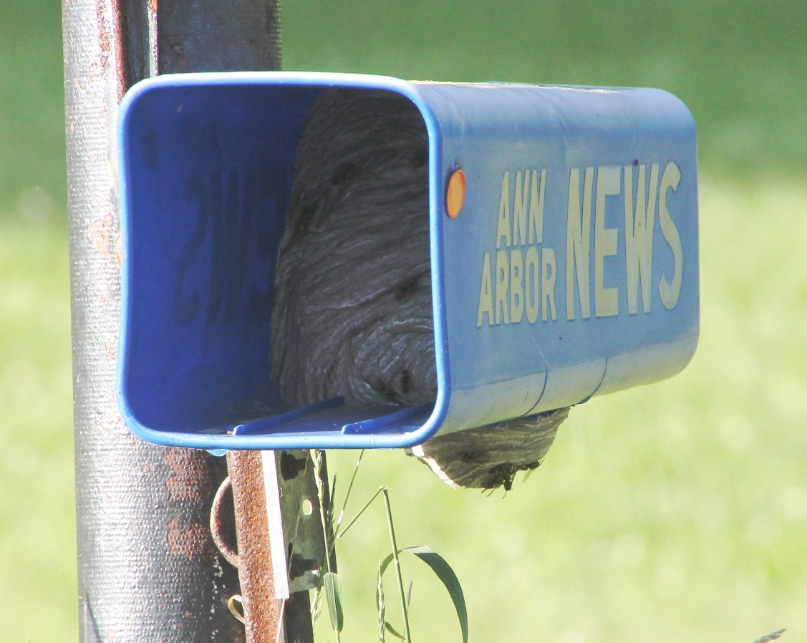
Envisioning the Library of the Future
The future of the library is not alone…
  Industry sectors “Life Cycle Stage” - IBISWorld
    Newspaper Publishing – Decline
    Periodical Publishing – Decline
    Book Stores – Decline
    DVD, Game and Video Rental - Decline

Slide 16
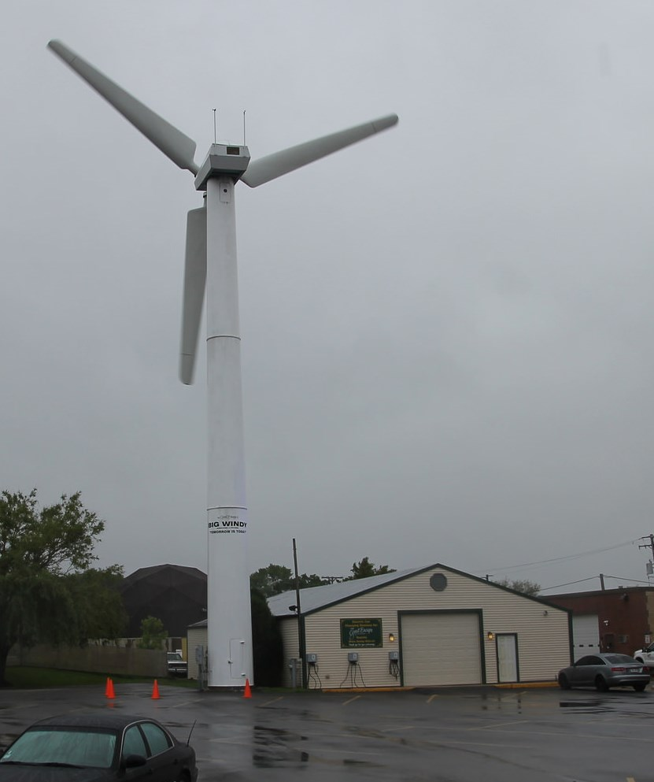
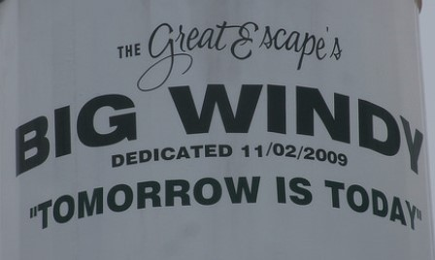
Envisioning the Library of the Future
The future of the library is not…
  Drones
  Self-driving cars
  3D printers (making other 3D printers)
  Slapping “literacy” on any term to take ownership (think flag)
  Completely within our control
The future of the library is what we make of it…

Slide 17
Ross Construction Project
Kresge Business Administration Library
  Built in mid 1980s to serve the research and curricular needs of the Ross School of Business
  We are open 108 hours during the Fall and Winter Terms.
  Seating for nearly 700 students.
  Very visible, located in the center of the Ross Complex (27K square feet).
  We have a collection of over 140,000 volumes in Ann Arbor and Flint (where they are stored at the University of Michigan-Flint)
  Constant state of “Library Erosion”

Slide 18
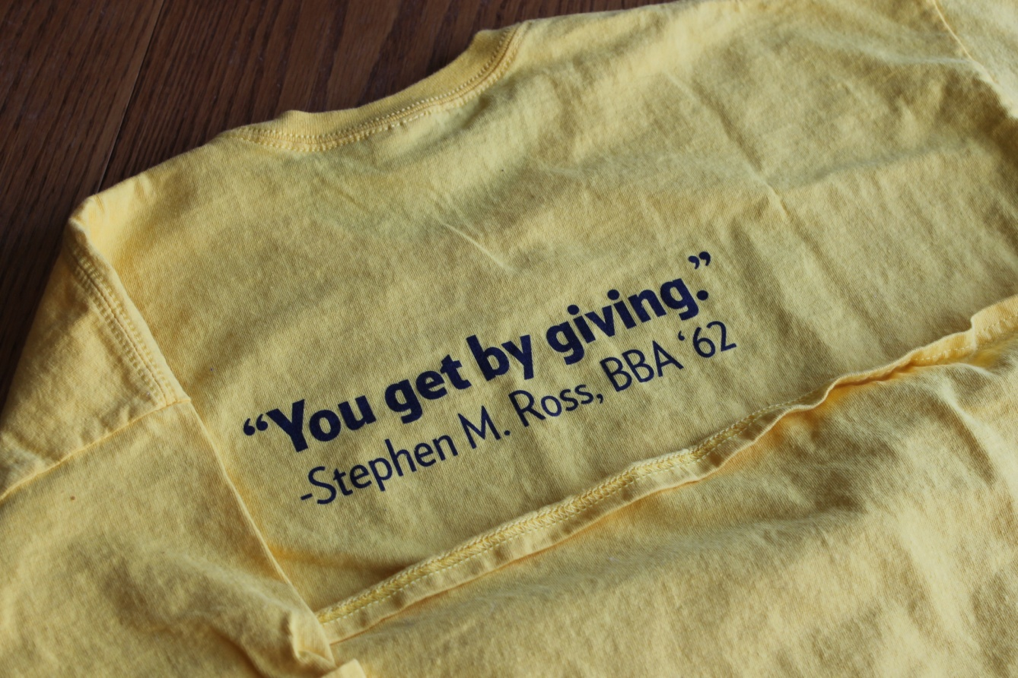

Ross Construction Project
Summer 2013 – Scope of plans shared*
September 2013 – Gift announced
Early 2014 – Plans developed
End of Winter Term – Started vacating the building
June 2014 – Moved to MOtown
July 2014 – Print moved out
Fall 2014 – Rebuilding Kresge Library Services

Slide 19

Ross Construction Project
Fall 2014 – Rebuilding Kresge Library Services
Winter 2015 – Kresge Value Proposition Meetings Started
Summer/Fall 2016 – Expected completion and move in to the new space
January 2017 – Expected opening of the new building to the school

Slide 20

Change Management
For a few years, change has been all around us.
Change.org petitions
  Michigan man has 175K petitions to stop banning Dukes of Hazzard (https://www.change.org/p/viacom-warner-brothers-walmart-ebay-stop-banning-dukes-of-hazard)
A great change may landed someone on the cover of Vanity Fair
  Huge change from when he first jumped into notoriety
  Today – almost unrecognizable
  Accompanied with a photoshoot by Annie Leibovitz…

Slide 21

Change Management
Early movies were mostly fluff (Dear John)
Turned out – he is VERY VERY Funny
He is also a great dramatic actor

Slide 22
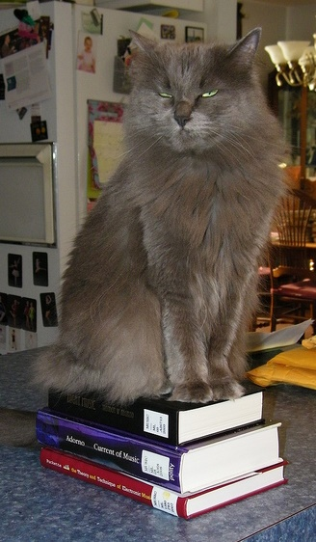
Change Management
NOT a library problem of the 21st century.
Changes over a 30-40 year professional career are huge
Changes in the last 50 years:
  Copy cataloging
  Local online catalogs
  Expanded access (TOC, more subject headings)
  Shared catalogs (MeLCat, etc.)
  Shared systems
  Discovery layers
  Working papers management → digital repositories
  Coffee and food in the library

Slide 23
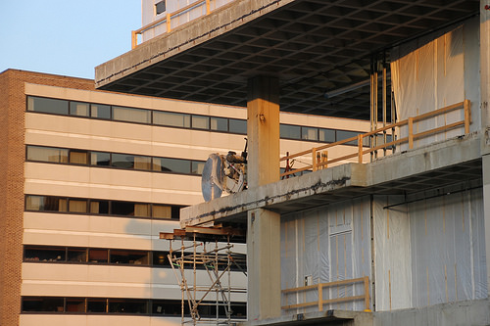
Change Management
Losing Your Physical Space
  You have to come to grips with what this means
  We are not a student destination any longer for study
  We cannot be format agnostic in collecting
  You cannot dwell on the past – you have to…well…

Slide 24

Change Management
Corey’s planning priorities:
  Staff
  Services
  Stuff (and spend)
  Space
Build services based on what you have, not what you had
Make spending choices not on history – but on future needs
We had no choice but to build an Ethereal Library!

Slide 25
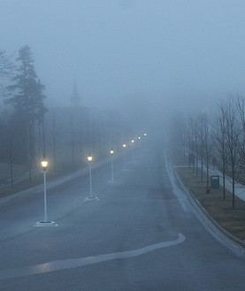
Change Management
Parameters of the Ethereal Library – or the 6P Approach
    Philosophical
    Patient
    Positive
    Proactive
    Perform
    Ms. Pirkola’s Rules

Slide 26

Change Management - Philosophical
This is an opportunity to also be freed from what worked and did not work from the past.
With less space – do not try to recapture everything you did – it will not work.
Don’t be bound by the past – “Forget the Alamo” – Lone Star (John Sayles – 1996)
Systems Lesson - Seeman, C. (2002). Invisible fences: A shocking theory for re-examining work flow. Computers in Libraries, 22(7), 24-30.

Slide 27

Change Management - Patient
Elisabeth Kübler-Ross
  Denial /
  Anger
  Bargaining
  Depression
  Acceptance
Everyone is moving through this at their own pace – Important for this level of change.
Every time someone says “Change is Hard” – it becomes harder…

Slide 28
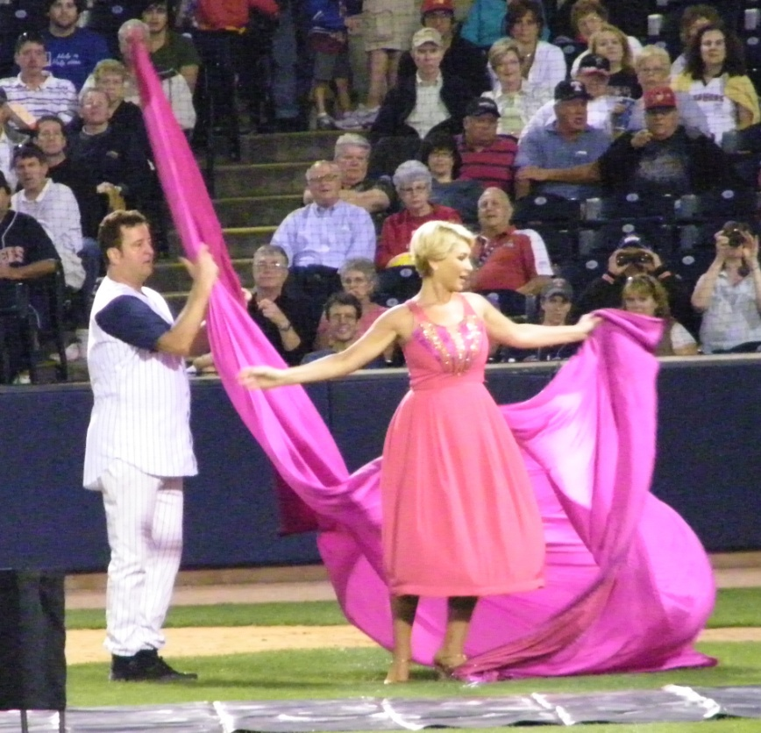
Change Management - Patient
Don’t expect to have everything mapped out on day 1, or day 100 for that matter!
A “born digital” library is much easier to build that a “becoming digital” library.
Quick Change at Toledo Mud Hens – September 2009

Slide 29
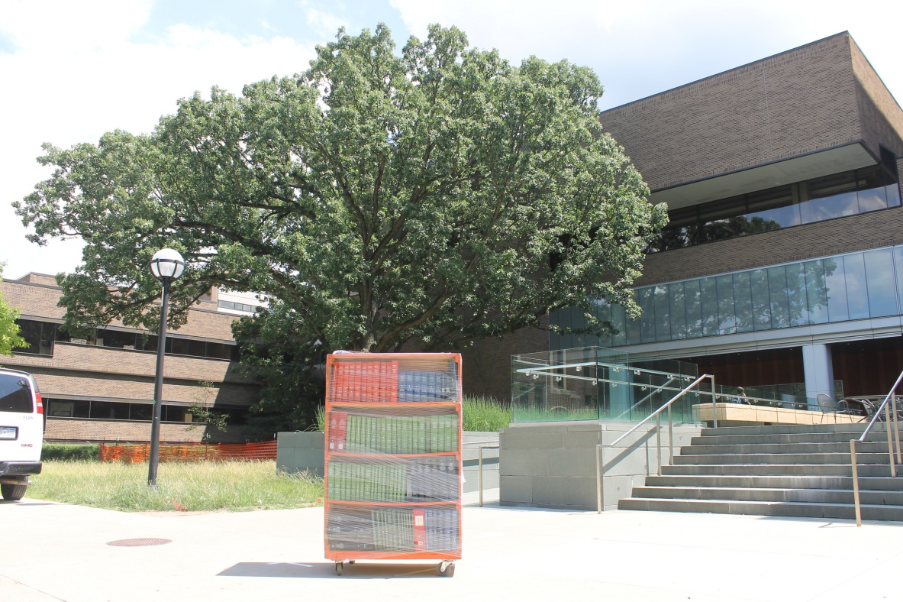
Change Management - Positive
It is very easy to be mired in self-doubt with this type of contraction.
The image of loss cannot be your brand or how you are seen.
Important to not dwell on decisions that do not benefit you in these projects.

Slide 30

Change Management - Positive
There are also some actual positives about not having a public space.
No longer have to worry about evenings and weekends in bad Michigan weather…

Slide 31
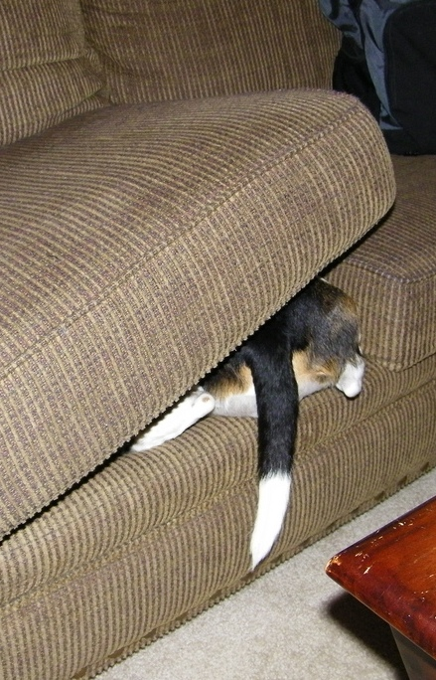
Change Management - Proactive
The biggest issue is that we will be out of sight.
We need to be more proactive about doing outreach and connecting with faculty and students.
We use all virtual reference systems (chat & email) – need to push them more.
Being visible is our biggest need right now.

Slide 32

Change Management - Proactive
I have been a strong proponent of the Reference Desk – even as many libraries are moving away from that.
We experimented with a reference service point at Tozzi Center, but it was not ideal.
We were given the front desk in the Ross Modular Offices – flipped it from Welcome Desk to Reference Desk.
Having visible staff is important – but they need a good place to work from!

Slide 33
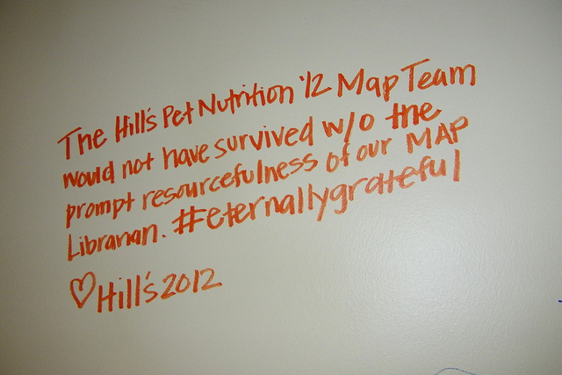

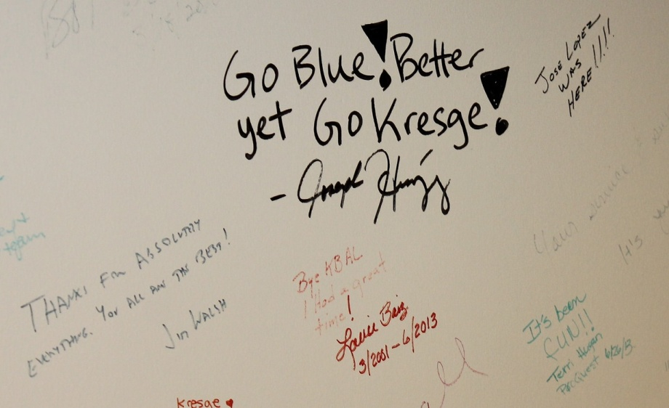
Change Management - Perform
In this change, there was never an issue about Kresge Library as a service point.
That was what kept us going.
That has to be what keeps us going.

Slide 34

Change Management - Perform
Since we have lost our space – it is all about service.
We need to be creative in how we deliver services to our community.
Pay close attention to what they need.
Experiment and change are critical elements.

Slide 35

Change Management - Ms. Pirkola’s Rules
Flexibility!
It has to work in all directions.
We also need to be flexible with staff as they learn to work with these new confines.
New Service points need time to develop.

Slide 36

Change Management - Ms. Pirkola’s Rules
Balance is critical
Empathy for patrons and staff need to be balanced against each other.
  The more we provide for patrons, the more we lean on staff.
  The more we provide for the staff, the less we provide for patrons.

Slide 37
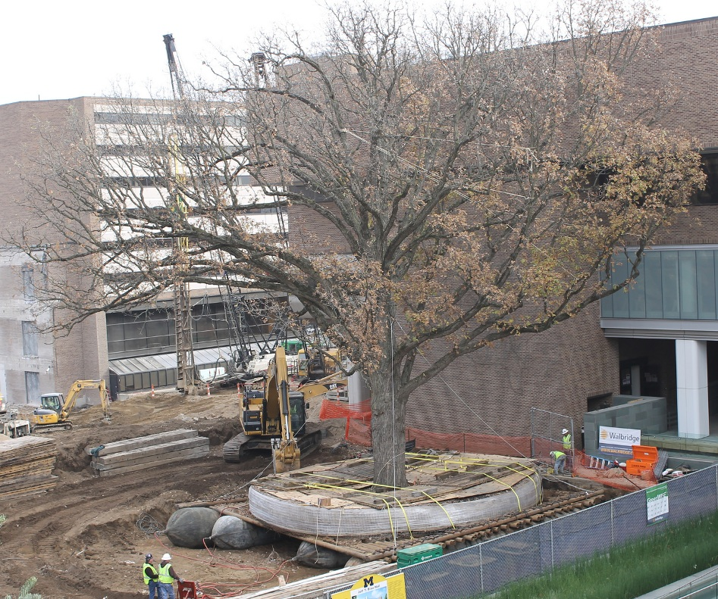
Becoming the Ethereal Library
Managing associated changes to services for the Ross Community

Slide 38
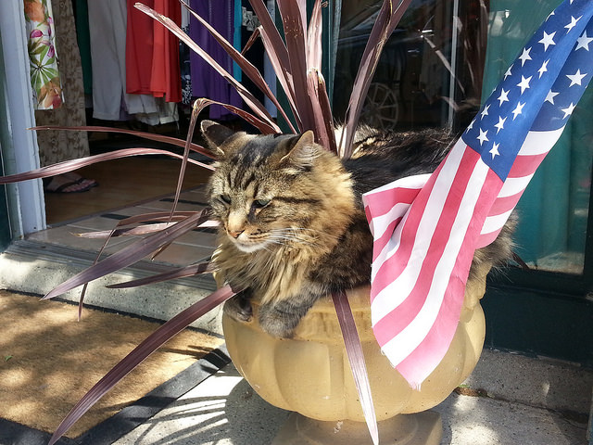
Becoming the Ethereal Library
Assess what you can do with your new space.
Give up traditional services if you cannot manage or run them effectively.
You are playing with house money with these contractions – take risks & be entrepreneurial.
Patriotic Cat Enjoying Freedom – South Haven, Michigan July 4, 2014

Slide 39
Becoming the Ethereal Library – Existing Programs
Embedded Librarian program for MAP and Action-Learning continues at Kresge.
New embedded librarians for entry core class for all BBA Sophomores (500). Librarians are assigned to every section (14) to support their research on a company & response to a social issue. (MERGE)
Faculty Research Service
Continue to support other student research (coursework, clubs, careers, case competitions & curiosity)

Slide 40
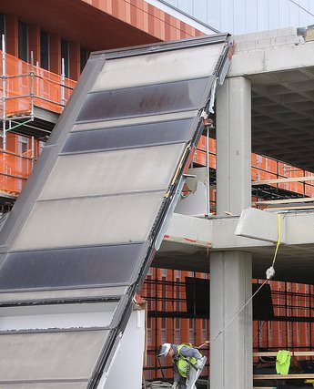
Becoming the Ethereal Library – Existing Programs
Coursepack & Curriculum Support – Moved to Study.net with Kresge Support.
Previously a print solution – but we did not have a large enough distribution point during construction.
Community and Alumni assistance (without walk-in access).
Move remaining print holdings to electronic access.

Slide 41
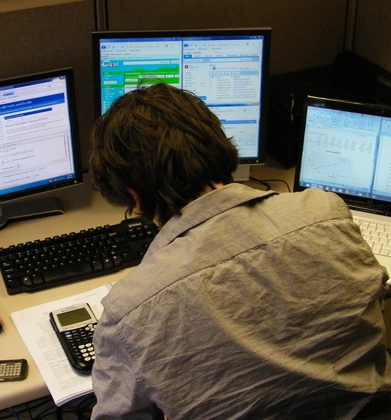
Becoming the Ethereal Library – New Programs
Exam/Assignment Program
  Many faculty do not want to hand back assignments in class.
  Some faculty also do not let students keep completed exams.
  This service ran as a pilot in Winter Term and went go to the Library in the Fall 2014.
  Will Continue with Kresge into the new building.

Slide 42

Becoming the Ethereal Library – New Programs
Modular Office Welcome Desk → became Kresge Reference Desk.
Pickup Location for ILL and Other Deliveries from University Library
Added Global MBA to our course materials operation
Evening/Weekend Remote Reference
Exploring options with Executive Education – The “spaceless dividend”

Slide 43
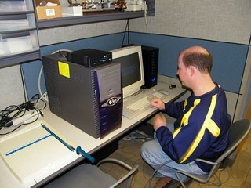
Becoming the Ethereal Library – Tools
We are currently without an integrated system (we have 200 books)
Exploring options currently to use existing tools (journal locator & MIRLYN catalog)
We would like a “business portal” – but need to weigh the return on investment (ROI) of these systems

Slide 44
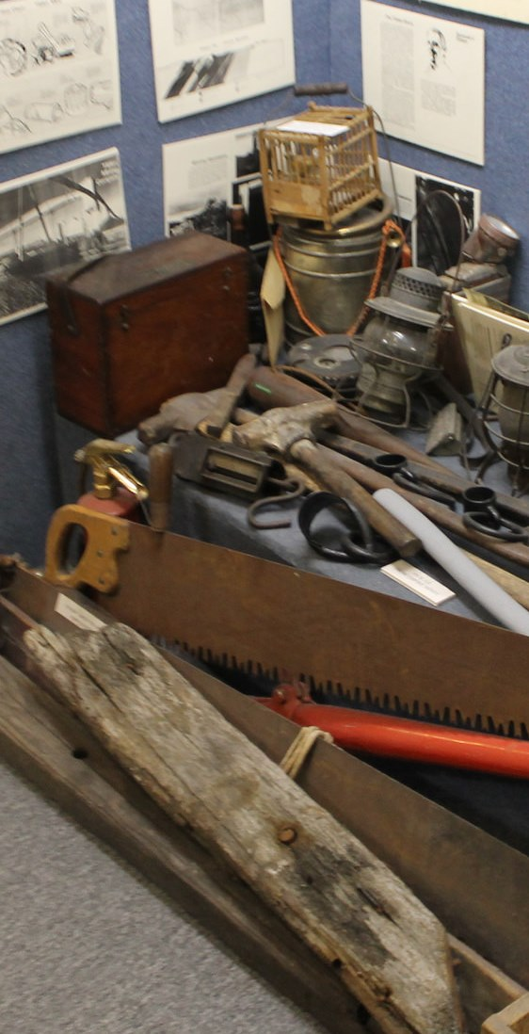
Becoming the Ethereal Library – Tools
Considering the costs – thinking of opting for more content than more containers
Liberating aspects of not “needing” a system
Creative use of existing tools (Libguides for American Business Law Association Bulletin archives: http://kresgeguides.bus.umich.edu/ABLAbulletin
Experimentation & implementation during AY2016 – We hope…

Slide 45
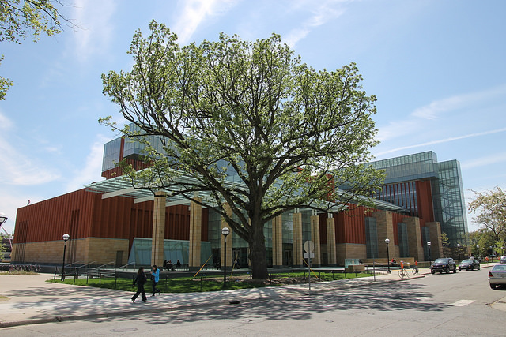
Becoming the Ethereal Library
Most things (even those that moved) eventually bloom again!

Slide 46

Providing Value With New Constraints
Great deal of discussion about the “value” of the academic library.
The need for this discussion could be an indication that we’ve reached a “tipping point.”

Slide 47

Providing Value With New Constraints
There is the appearance of endless information availability from wherever you are – this we know is not truly accurate
If we think about the changes to other industries (automotives, pharmaceuticals, journalism, etc.), few are operating as they’d like.

Slide 48
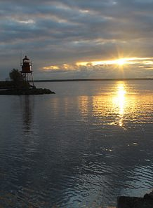
Providing Value With New Constraints
Our “old” value proposition:
  Space for students to study
  Space for physical collections (in all formats)
  Strong historical collection
  Strong electronic collections

Slide 49

Providing Value With New Constraints
Our “new” value proposition must:
  Live within the restrictions of virtually no collection space.
  Figure out new collaboration mechanisms to serve our community.
  Move away from the model where we provided student study space.
  Focus on what we can do vs. what we have done.

Slide 50
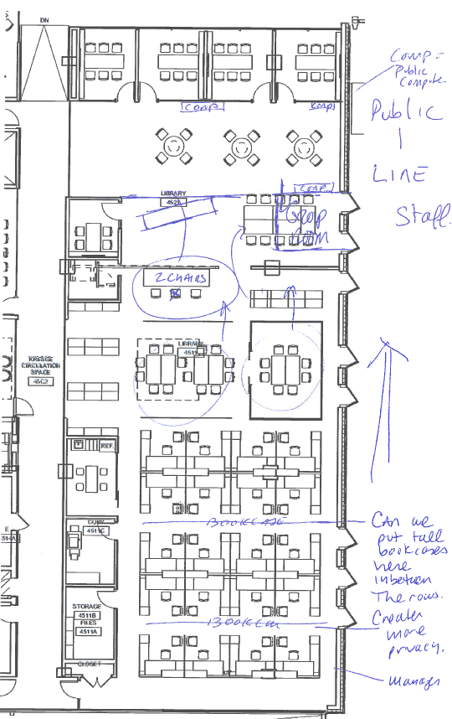
Providing Value With New Constraints
This is the time to think about what our value is and how to continue with the new constraints.
Brain-storming about creating service points – real and virtual.
Failure is an option – it allows us to be entrepreneurial and try things out.
Allows us to change the vision for the new staff space.
Build as you go!

Slide 51
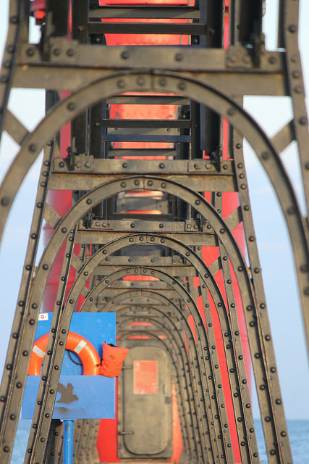
Providing Value With New Constraints
Our “new” value proposition remains:
  Using the resources at our disposal, we will support the curricular and research needs of the Ross Community.
  We will acquire resources only where we have the means to store or manage them.
  Seek out new opportunities to provide services for the school & campus.
  Embrace our new reality.

Slide 52
Providing Value With New Constraints
“Kresge Value Proposition” Meetings
Winter 2015 – with Faculty, Students and Staff
Will continue moving forward
New ideas to come from these meetings:
  New subject and journal alerting services
  Need to bring back course reserves to Kresge
  Managing communication with Ross communities (faculty, staff, students, alumni)
  Grow the exam and assignment program
  Explore opportunities with Exec Education & other departments

Slide 53
Providing Value With New Constraints
MBA Student Exit Survey Comments:
  1 year of no Kresge....lowered rating
  I'd still love an actual library where I can study on the Ross campus.
  Latest editions of most read books should be kept.
  Kresge was closed this year, so I didn’t even really consider them a resource for this year.
  Well, it would have been nice to actually have a library for my second year.
  My satisfaction with the library was lower this year just because there was no easily accessible space. I'm sure it will be fabulous once it is finished!
  They did what they could, but the library doesn't exist right now. It was inconvenient.

Slide 54

Closing Thoughts & Questions
Big Win on Staffing
What does the future hold?
Where is the Long Tail?
What’s in a Name?
Are we the Canary in the coal Mine?

Slide 55
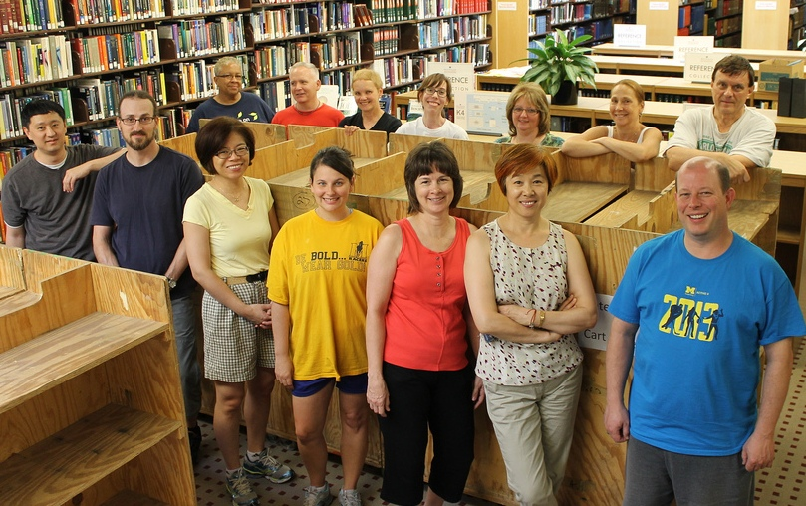
Closing Thoughts & Questions - Big Win on Staffing
The premise with this reduction has been space and space alone.
We have been able to move forward with redeployed staff
No full-time staff losses related to this move.
Temporary Staff counts way down (no need for full evening staff).
New article - “No One Gets Left Behind:” Managing Library Human Resources During Dramatic Shifts in Academic Libraries in Advances in Library Administration and Organization (Volume 33, 2015)

Slide 56

Closing Thoughts & Questions – Library Futures
Fewer certainties for academic libraries now and especially 20 years in the future.
I believe that most libraries will continue to lose space until it is mostly gone.
We need to be nimble, flexible and resilient to meet the needs of the school – this secures the future of the library.
We need to be focused on the end-user of the library resources.

Slide 57
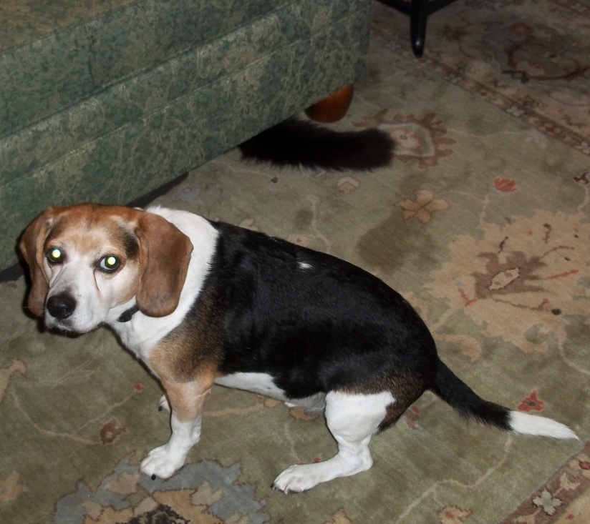
Closing Thoughts & Questions - Where is the Long Tail?
Print collections are built on needs both now and down the road.
Many items are used in 10 or 20 years – but will libraries have space to see that materialize?
Long-term ROI appears to contract in an electronic-only Information environment.

Slide 58
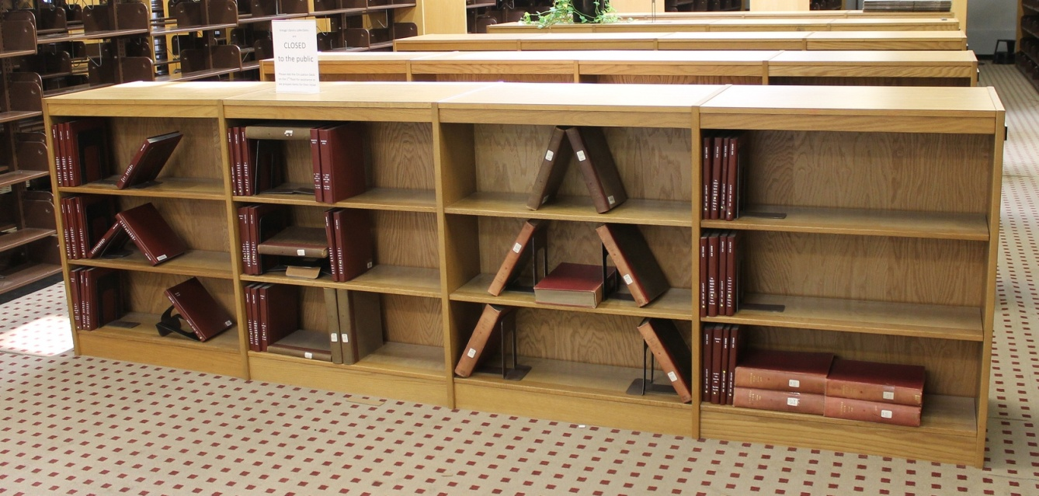
Closing Thoughts & Questions - What’s in a Name?
Changing our name to Kresge Library Services
We are no longer a “destination” or a library in the traditional sense.
The print holdings were 2% of our use, but 50% of our perception.
Even though “Kresge” will belong to the building – “Kresge Library” has great brand recognition at Ross.

Slide 59

Closing Thoughts & Questions - The Canary in the Coal Mine
Are departmental/branch libraries the “canary in the coal mine?”
Is the canary just sleeping?
Our space contraction appears to be the future of libraries everywhere – we just had it happen all at once.
We were saved by service!
Should we just be happy with what we have left…like a squirrel with a churro.

Slide 60
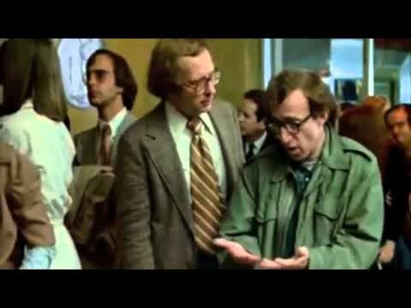
Closing Thoughts & Questions – It’s Not THIS Simple

Slide 61

Thank You
Corey Seeman
cseeman@umich.edu

