Slide 1
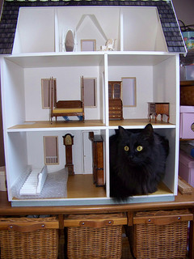
“Where you and I are going to spend the rest of our lives:”
What a future library really looks like.
Re-Think It: Libraries for a New Age
Grand Valley State University – August 2015
Corey Seeman – Kresge Library Services
(University of Michigan)

Slide 2
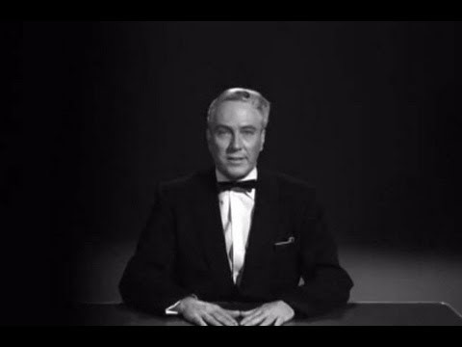
Envisioning the Library of the Future
Greetings, my friend. We are all interested in the future, for that is where you and I are going to spend the rest of our lives. And remember my friend, future events such as these will affect you in the future. You are interested in the unknown, the mysterious, the unexplainable. That is why you are here. And now, for the first time, we are bringing to you the full story of what happened on that fateful day. We are giving you all the evidence, based only on the secret testimonies of the miserable souls who survived this terrifying ordeal. The incidents, the places, my friend we cannot keep this a secret any longer. Let us punish the guilty, let us reward the innocent. My friend, can your heart stand the shocking facts about grave robbers from outer space?
https://archive.org/details/Plan_9_from_Outer_Space_1959
Plan 9 from Outer Space
Edward D. Wood, Jr. (1959)

Slide 3
Envisioning the Library of the Future
ACRL Top Trends in Academic Libraries (June 2014)
  Data
  Device Neutral Digital Services
  Evolving Openness in Higher Ed
  Student Success
  Competency-based Learning
  Altmetrics
  Digital Humanities
See: http://crln.acrl.org/content/75/6/294.full

Slide 4
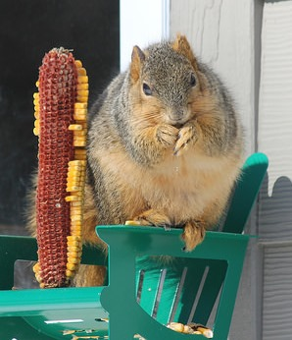
Envisioning the Library of the Future
Great deal of discussion about the “value” of the academic library.
Value of Academic Libraries Report (2010) http://www.acrl.ala.org/value/
The need for this discussion could be an indication that we’ve reached a “tipping point.”

Slide 5
Envisioning the Library of the Future
“Library Space: You might say that library space (and what we’re doing to improve it to meet user expectations better while positioning the library as a place of intentional learning and community engagement) is always a big factor, in any year. In 2015, I think academic librarians will be doing even more experimentation with their spaces in an effort both to attract even more students and demonstrate the beneficial impact of students connecting with the library and librarians. We’re only beginning to explore how new spaces for digital scholarship and creativity fit into the academic library. We’ll be learning more from one another this year about how to get these spaces right.”
- Steven Bell – Top 10 Academic Library Issues for 2015 (Library Journal, February 18, 2015
(http://lj.libraryjournal.com/2015/02/opinion/steven-bell/top-10-academic-library-issues-for-2015-from-the-bell-tower/)

Slide 6
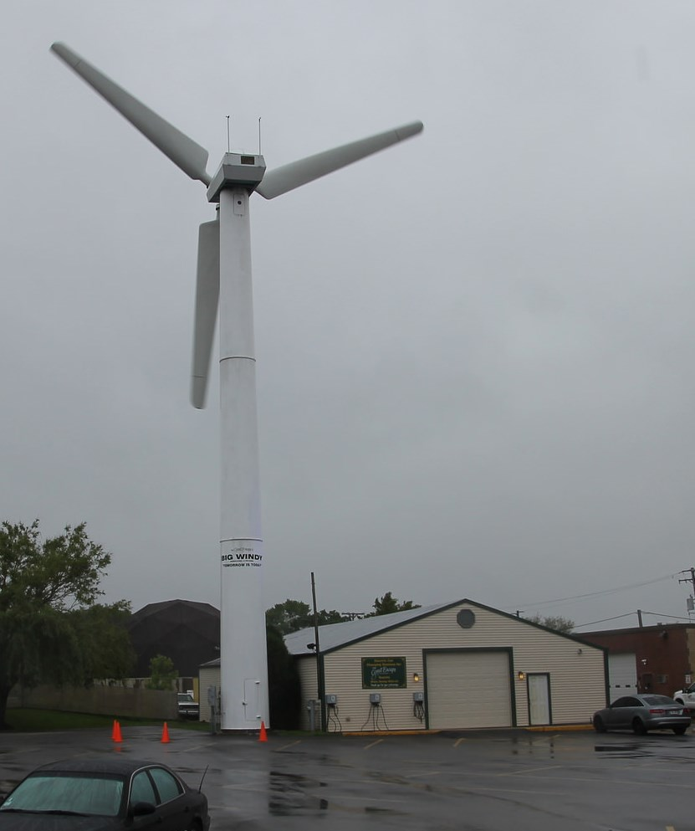
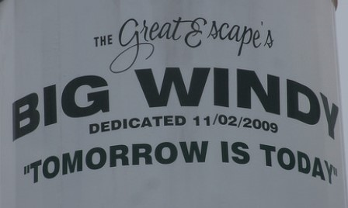
Envisioning the Library of the Future
The future of the library is not:
  Drones
  Self-driving cars
  3D printers (making other 3D printers)
  Slapping “literacy” on any term to take ownership (think flag)
  Completely within our control
The future of the library will be measured in small steps.
The future of the library is what we make of it

Slide 7
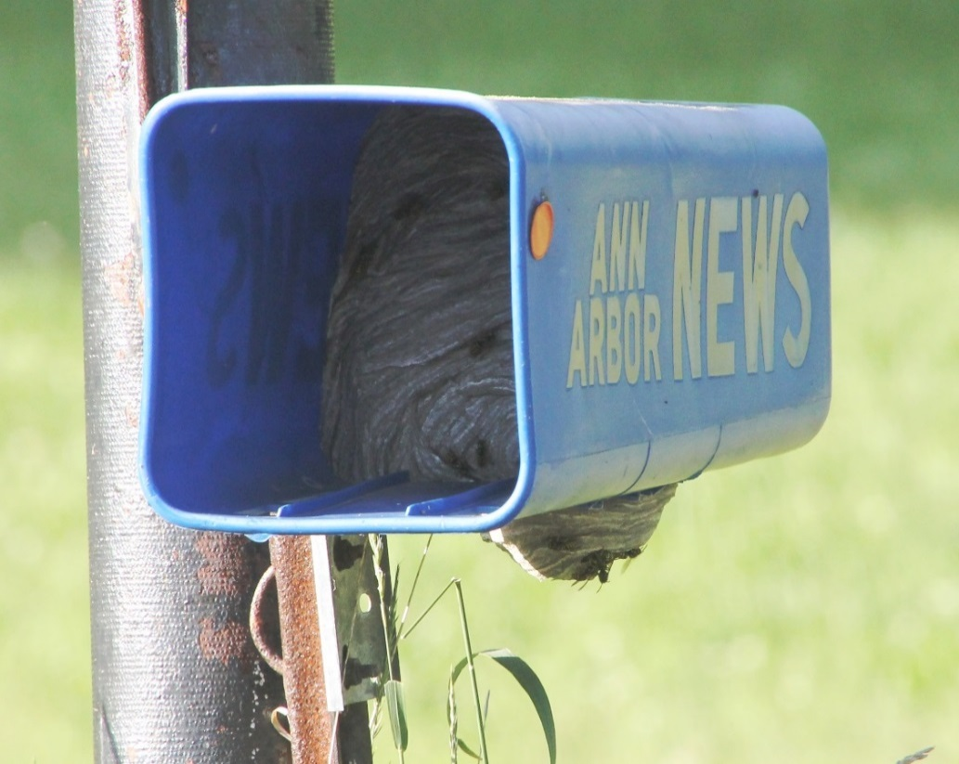
Envisioning the Library of the Future
The future of the library is not dire, nor are we alone
Industry sectors “Life Cycle Stage” - IBISWorld
    Newspaper Publishing – Decline
    Periodical Publishing – Decline
    Book Stores – Decline
    DVD, Game and Video Rental - Decline

Slide 8
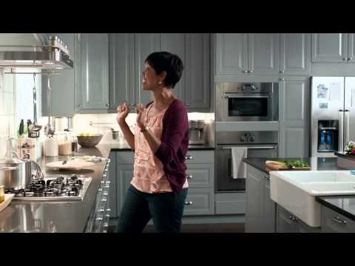
Envisioning the Library of the Future
The future is not altogether good nor bad
The perception of our needs for space and student needs are being weighed against each other.
Ikea “Dream Kitchen” ad

Slide 9
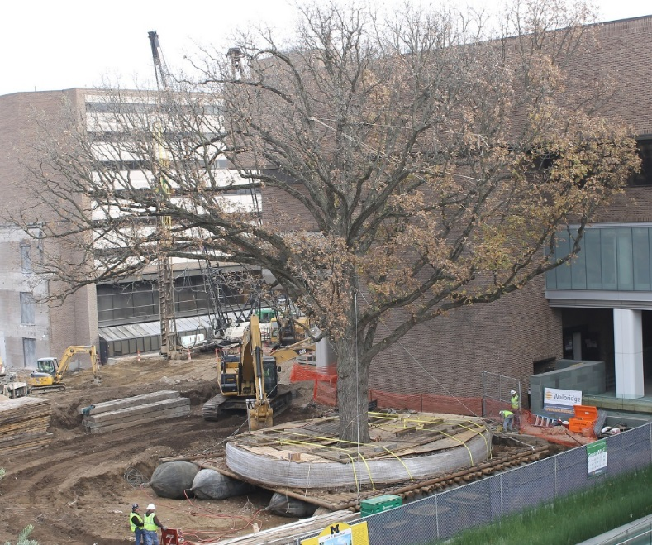
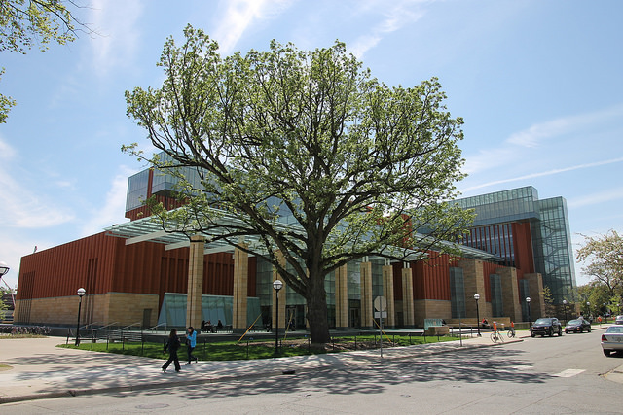
Envisioning the Library of the Future
This will require librarians to balance what libraries have been with what they will become.
Current libraries have feet in both ‘worlds’
We are in a definite transition period that will continue for the next 20+ years.

Slide 10
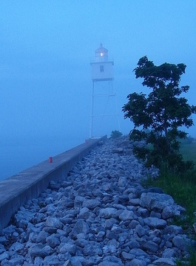
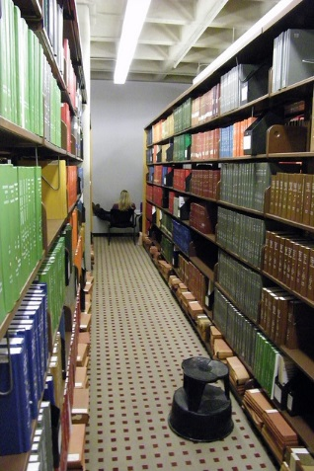
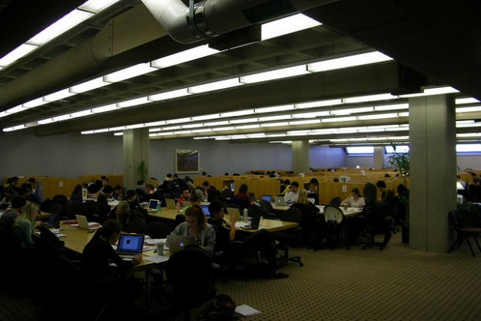
Envisioning the Library of the Future
A Physical Space
  Study
  Print Materials
  Interaction Spaces
  Walk-in Access
  Some of this can be done by others.
An Ethereal Space
    This is where we connect with our community.
    This is where we provide clarity to a complicated information universe.
    This is where we contribute as a “Value-Add.”
  This is where we do ‘library’ work.
  This cannot be done by others

Slide 11
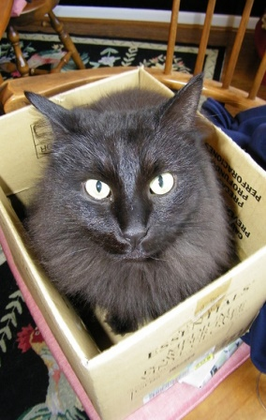
Envisioning the Library of the Future
Our libraries today operate in both spaces.
If forced to choose, do we elect to save your physical or ethereal space?
Will we exercise self-determination for our future?
What are the internal (library) vs external (organization) demands that will have an impact on our space allocation?
The more ambitious the school – the greater the demand for space.

Slide 12

Envisioning the Library of the Future
The library of the future is smaller….way, way smaller. Space is a luxury on academic campuses.
Is it about ownership or access to information? (perpetual access via vendor sites).
Shifting from ‘just in time’ vs. ‘just in case’ – the traditional collecting methods of libraries.

Slide 13
Ross Construction Project
Kresge Business Administration Library
  Built in mid 1980s to serve the research and curricular needs of the Ross School of Business
  We are open 108 hours during the Fall and Winter Terms.
  Seating for nearly 700 students.
  Very visible, located in the center of the Ross Complex (27K square feet).
  We have a collection of over 140,000 volumes in Ann Arbor and Flint (where they are stored at the University of Michigan-Flint)
  Constant state of “Library Erosion”

Slide 14
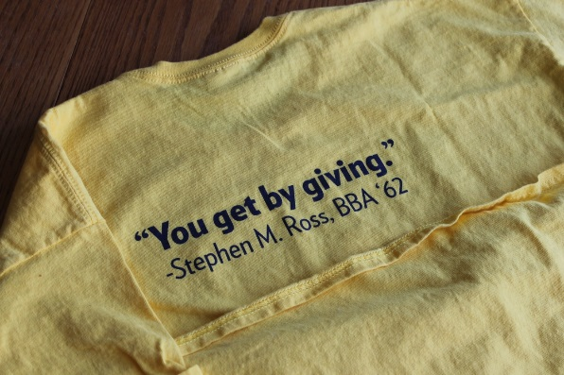

Ross Construction Project
Summer 2013 – Scope of plans shared*
September 2013 – Gift announced
Early 2014 – Plans developed
End of Winter Term – Started vacating the building
June 2014 – Moved to MOtown
July 2014 – Print moved out
Fall 2014 – Rebuilding Kresge Library Services

Slide 15

Ross Construction Project
Fall 2014 – Rebuilding Kresge Library Services
Winter 2015 – Kresge Value Proposition Meetings Started
Summer/Fall 2016 – Expected completion and move in to the new space
January 2017 – Expected opening of the new building to the school

Slide 16
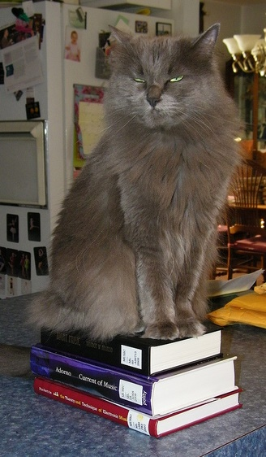
Change Management
NOT a library problem of the 21st century.
Changes over a 30-40 year professional career are huge
Changes in the last 50 years:
  Copy cataloging
  Local online catalogs
  Expanded access (TOC, more subject headings)
  Shared catalogs (MeLCat, etc.)
  Shared systems
  Discovery layers
  Working papers management → digital repositories
  Coffee and food in the library

Slide 17
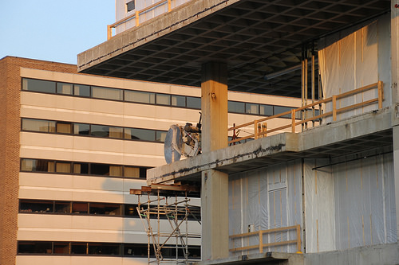
Change Management
Losing Your Physical Space
  You have to come to grips with what this means
  We are not a student destination any longer for study
  We cannot be format agnostic in collecting
  You cannot dwell on the past

Slide 18

Change Management
Corey’s planning priorities:
  Staff
  Services
  Stuff (and spend)
  Space
Build services based on what you have, not what you had
Make spending choices not on history – but on future needs
We had no choice but to build an Ethereal Library!

Slide 19
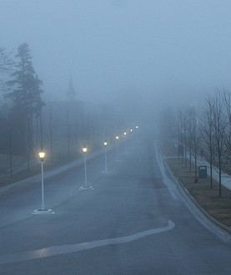
Change Management
Parameters of the Ethereal Library – or the 6P Approach
    Philosophical
    Patient
    Positive
    Proactive
    Perform
    Ms. Pirkola’s Rules
See: tinyurl.com/Ethereal2015

Slide 20
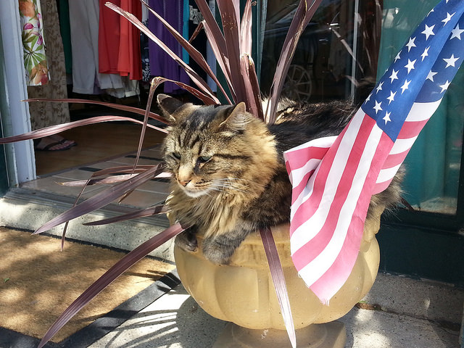
Becoming the Ethereal Library
Three basic tenets:
  Assess what you can do with your new space.
  Give up traditional services if you cannot manage or run them effectively.
  Take risks & be entrepreneurial - You are playing with house money.
Patriotic Cat Enjoying Freedom – South Haven, Michigan July 4, 2014

Slide 21
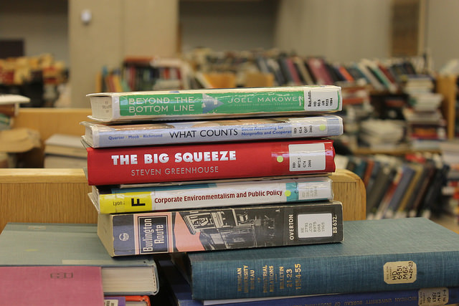

Becoming the Ethereal Library – Programs Lost
No longer collecting print (have 200 volumes)
Unique titles to main library
No longer a “student destination” – some silver linings.

Slide 22
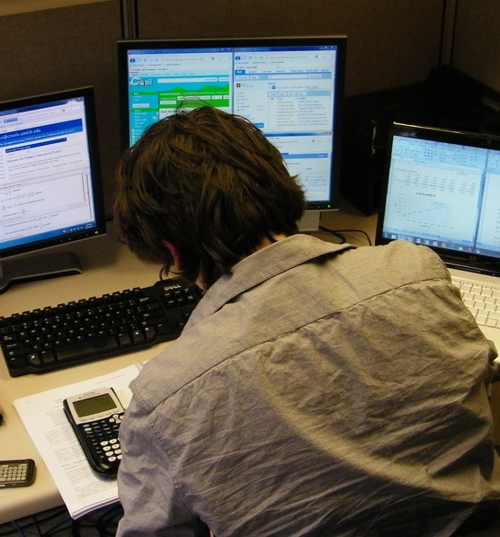
Becoming the Ethereal Library – Programs Gained
Exam/Assignment Program
  Many faculty do not want to hand back assignments in class.
  Some faculty also do not let students keep completed exams.
  This service ran as a pilot in Winter Term and went go to the Library in the Fall 2014.
  Will Continue with Kresge into the new building.

Slide 23
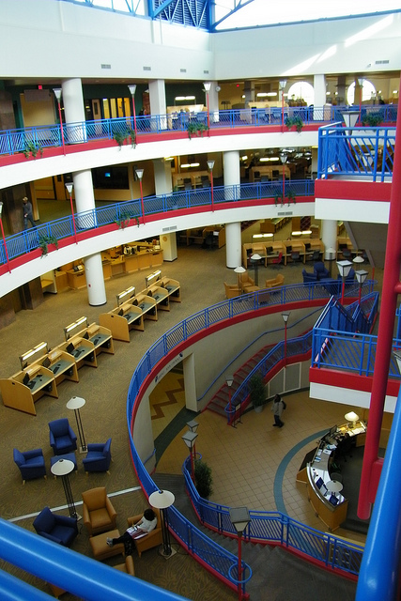
Providing Value With New Constraints
Our “old” value proposition:
  Space for students to study
  Space for physical collections (in all formats)
  Strong historical collection
  Strong electronic collections
Park Library
Central Michigan University

Slide 24
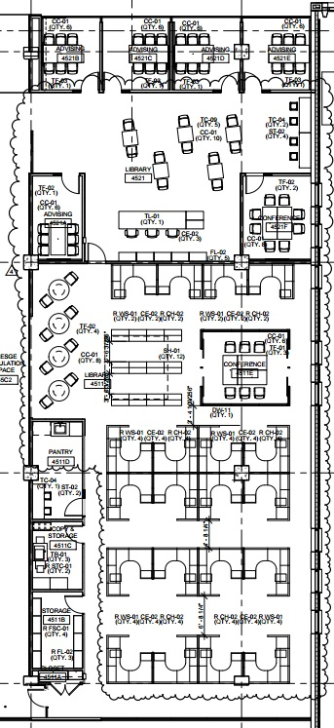
Providing Value With New
Constraints
Our “new” value proposition must:
  Live within the restrictions of virtually no collection space.
  Figure out new collaboration mechanisms to serve our community.
  Move away from the model where we provided student study space.
  Focus on what we can do vs. what we have done.

Slide 25
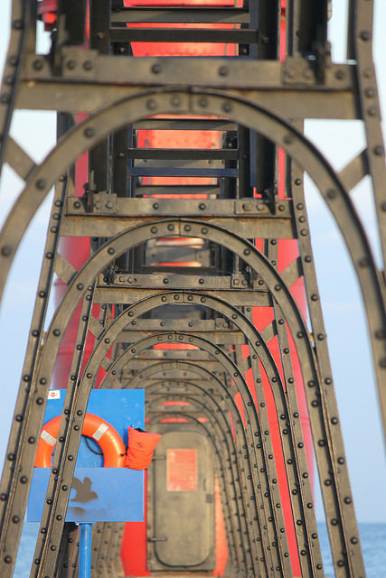
Providing Value With New Constraints
Our “new” value proposition remains:
  Using the resources at our disposal, we will support the curricular and research needs of the Ross Community.
  Seek out new opportunities to provide services for the school & campus.
  Embrace our new reality.

Slide 26
Providing Value With New Constraints
“Kresge Value Proposition” Meetings
Winter 2015 – with Faculty, Students and Staff
Will continue moving forward
New ideas to come from these meetings:
  New subject and journal alerting services
  Need to bring back course reserves to Kresge
  Managing communication with Ross communities (faculty, staff, students, alumni)
  Grow the exam and assignment program
  Explore opportunities with Exec Education & other departments

Slide 27
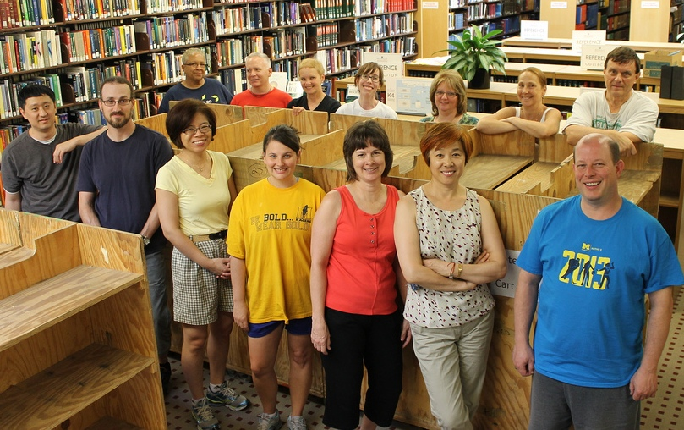
Closing Thoughts & Questions - Big Win on Staffing
The premise with this reduction has been space and space alone.
We have been able to move forward with redeployed staff
No full-time staff losses related to this move.
Temporary Staff counts way down (no need for full evening staff).
New article - “No One Gets Left Behind:” Managing Library Human Resources During Dramatic Shifts in Academic Libraries in Advances in Library Administration and Organization (Volume 33, 2015)

Slide 28

Closing Thoughts & Questions – Library Futures
Fewer certainties for academic libraries now and especially 20 years in the future.
I believe that most libraries will continue to lose space until it is mostly gone.
We need to be nimble, flexible and resilient to meet the needs of the school – this secures the future of the library.
We need to be focused on the end-user of the library resources.

Slide 29
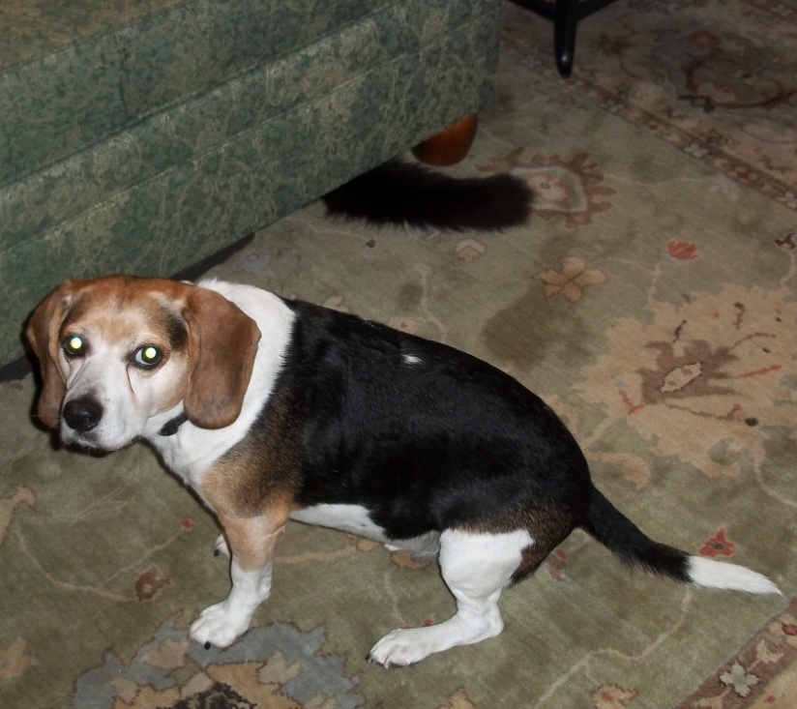
Closing Thoughts & Questions - Where is the Long Tail?
Print collections are built on needs both now and down the road.
Many items are used in 10 or 20 years – but will libraries have space to see that materialize?
Long-term ROI appears to contract in an electronic-only Information environment.

Slide 30
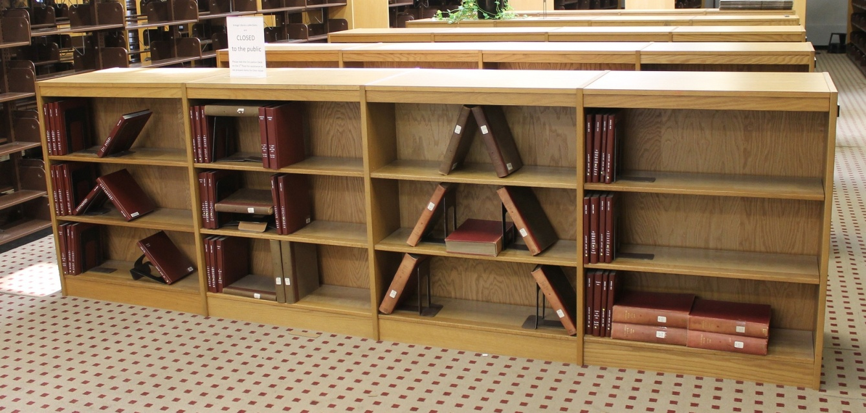
Closing Thoughts & Questions - What’s in a Name?
Changing our name to Kresge Library Services
We are no longer a “destination” or a library in the traditional sense.
The print holdings were 2% of our use, but 50% of our perception.
Even though “Kresge” will belong to the building – “Kresge Library” has great brand recognition at Ross.

Slide 31

Closing Thoughts & Questions - The Canary in the Coal Mine
Are departmental/branch libraries the “canary in the coal mine?”
Is the canary just sleeping?
Our space contraction appears to be the future of libraries everywhere – we just had it happen all at once.
We were saved by service!
Should we just be happy with what we have left…like a squirrel with a churro.

Slide 32
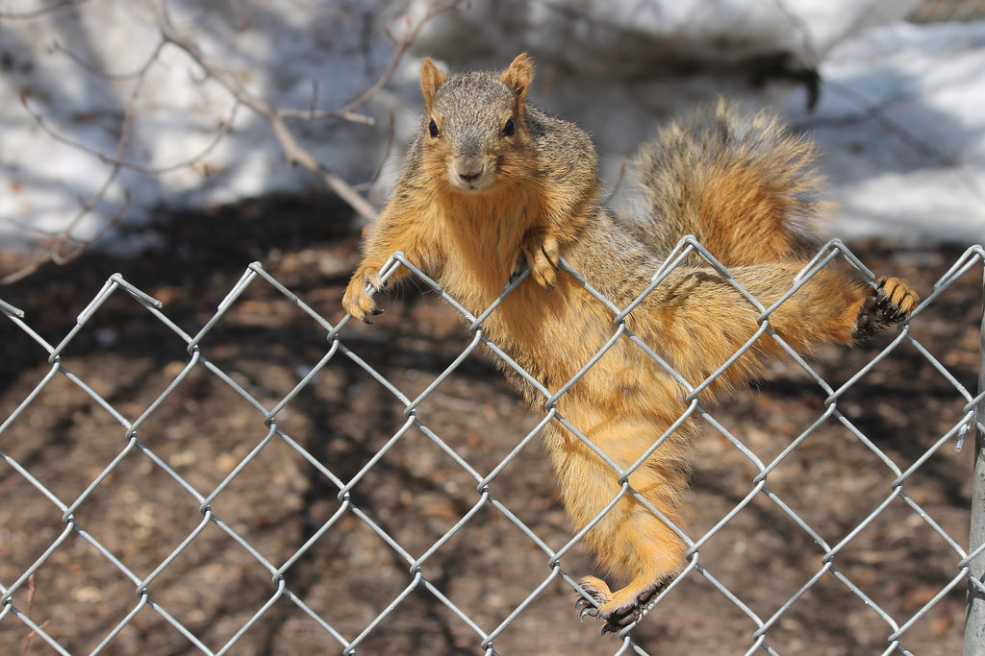
Thank You
Corey Seeman
cseeman@umich.edu

