Slide 1



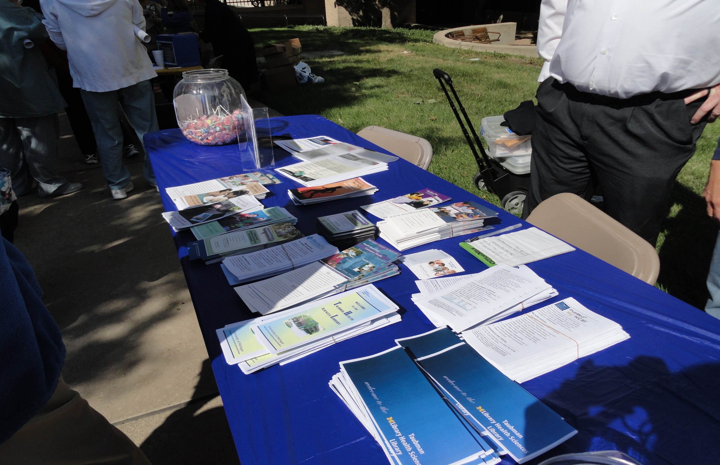
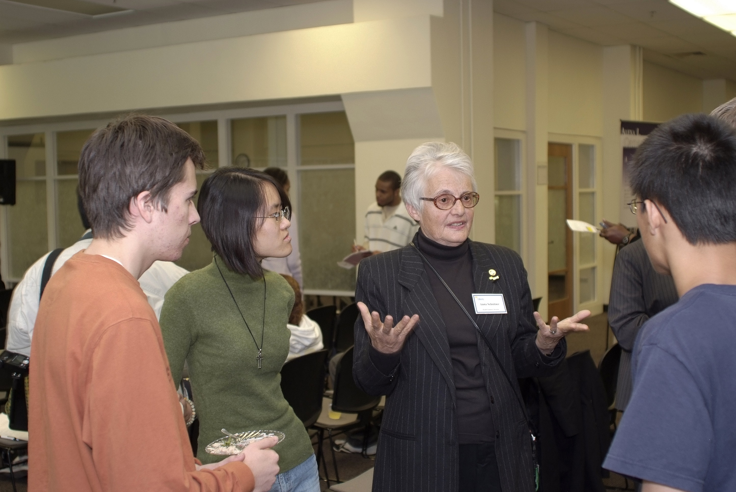
Taubman Health Sciences Library Outreach Programs
By: Jingyi Wang¹ and Anna Ercoli Schnitzer²
1-Jingyi Wang, MPH, School of Public Health, University of Michigan
2-Anna Ercoli Schnitzer, AMLS, Outreach and Disabilities Informationist, Taubman Health Sciences Library, University of Michigan
OVERVIEW
Asian American health and cultural fair
World diabetes day health fair
Through collaboration with the National Library of Medicine (NLM), the University of Michigan Taubman Health Sciences Library is able to reach out to surrounding neighborhoods and communities and provide health information for these populations. By participating in health-related events and programs, library staff members have the opportunity to advocate for resources such as MedlinePlus and PubMed. Targeted populations of the Outreach program include but are not limited to minority groups, people with disabilities, and those of low socioeconomic status. The goal of the program is to provide the public with equal access to and knowledge of health information resources.
The Asian American Health and Cultural Fair allows the library to reach out to the Asian-American community, especially the older population. We have the chance to pass out information flyers on health resources that are available for this particular population and even accommodate to their language needs by having printouts in the specific language. As this Fair is held in association with several student organizations on campus, participation at the event also allows the library to network with these students and educate them about our outreach programs and the broad number of biomedical resources that we are able to offer to the professional field.
The goal of this health fair is to educate the public about diabetes, both type I, II, pre-diabetes, and pregnancy. Staff members at the event interact with attendees and organizers alike and answer their concerns with finding reliable health information resources online. In collaboration with the U-M Comprehensive Diabetes Center, library representatives demonstrate online MedlinePlus as well as PubMed to participants and offer handouts with step-by-step guidance on the navigation process. The library also tries its best to advocate for the event by e-mailing stakeholders and interest groups as well as putting up flyers in the local community.
Give kids a smile!
Give Kids a Smile is an annual event held by the School of Dentistry offering free dental treatment to children between the ages 5-14, especially those without dental insurance. The services provided at the event are free of charge, ranging from a simple dental cleaning procedure to tooth extractions. At this event, the library helps to distribute information on reliable health information resources so that parents can refer to them when needed. In addition, the library aids with the publicity of this event by distributing flyers to hospital buildings and other related sites.
Discussing health resources with community members
Sample of information sheets passed out at health events

