Slide 1
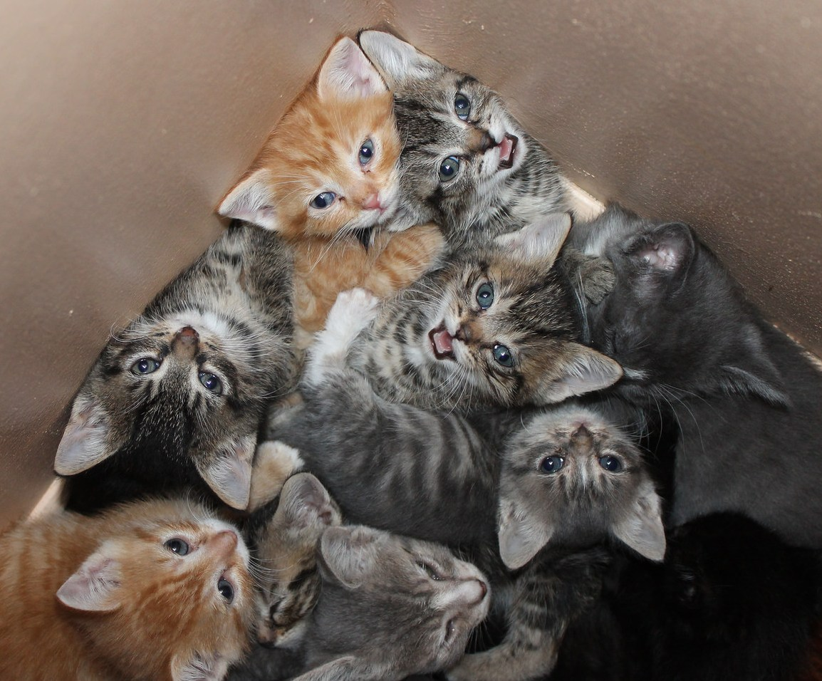
The Ethereal Library: Thinking Creatively
When You Have
No Space To Think
MLA Annual Conference 2015
October 29, 2015 – Novi, Michigan
Corey Seeman – Kresge Library Services
(University of Michigan)

Slide 2
Program Overview
Two Spaces of the Library
About Kresge and Ross Construction
Planning and Rebuilding
Parameters of the Ethereal Library (6P Approach)
The Big Changes
Providing Value With New Constraints
Closing Thoughts & Questions

Slide 3
The Two Spaces of the Library
In Library as Space Program in 2013 (Michigan Library Association) – I shared the notion that the Library had two spaces:
  A physical space
  An ethereal space
They provide distinct functions and benefits to the communities we serve.
Both can be critical for the members of the library’s communities.

Slide 4
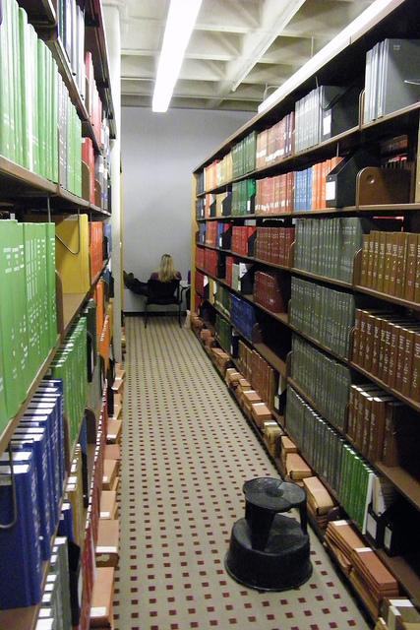
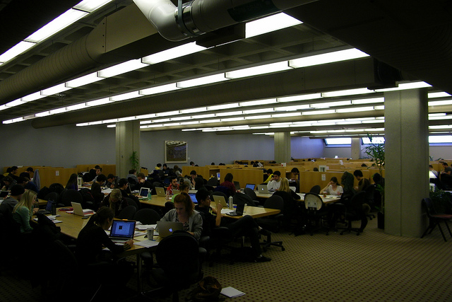
Physical Space
Physical space is used for:
  Study
  Print Materials
  Interaction Spaces
  Walk-in Access
For many functions - a physical space can be managed just as well by others.
Print collections might be 2% of the usage – but 50% of the perception of the library

Slide 5

Ethereal Space
This is where we connect with our community.
This is where we provide clarity to a complicated information universe.
This is where we contribute as a “Value-Add.”
This is where we SHINE!

Slide 6

Ethereal Space
With nearly 98% of our usage from electronic resources* – librarians and library staff can operate from almost anywhere
As Gershwin said well – with ethereal space – “They Can't Take That Away from Me”
* The Business Library Experience

Slide 7
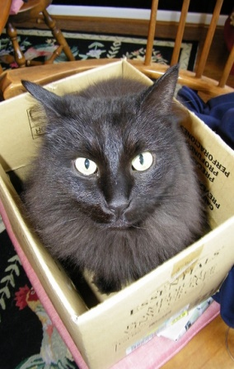
If You Could Have Only One Space?
Would you elect to save your physical or ethereal space?
What if the decision was made for you? (Internal vs. external decisions on space).
Space is a luxury on academic campuses – and with that – we lost ours.
Some engagement, but no open discussion with the community.
With a large construction project, we lost both student and collection space…

Slide 8
Kresge Business Administration Library
Built in mid 1980s to serve the research and curricular needs of the Ross School of Business
We are open 108 hours during the Fall and Winter Terms.
Seating for nearly 700 students.
Very visible, located in the center of the Ross Complex (27K square feet).
We have a collection of over 140,000 volumes in Ann Arbor and Flint (where they are stored at the University of Michigan-Flint)
Constant state of “Library Erosion”

Slide 9
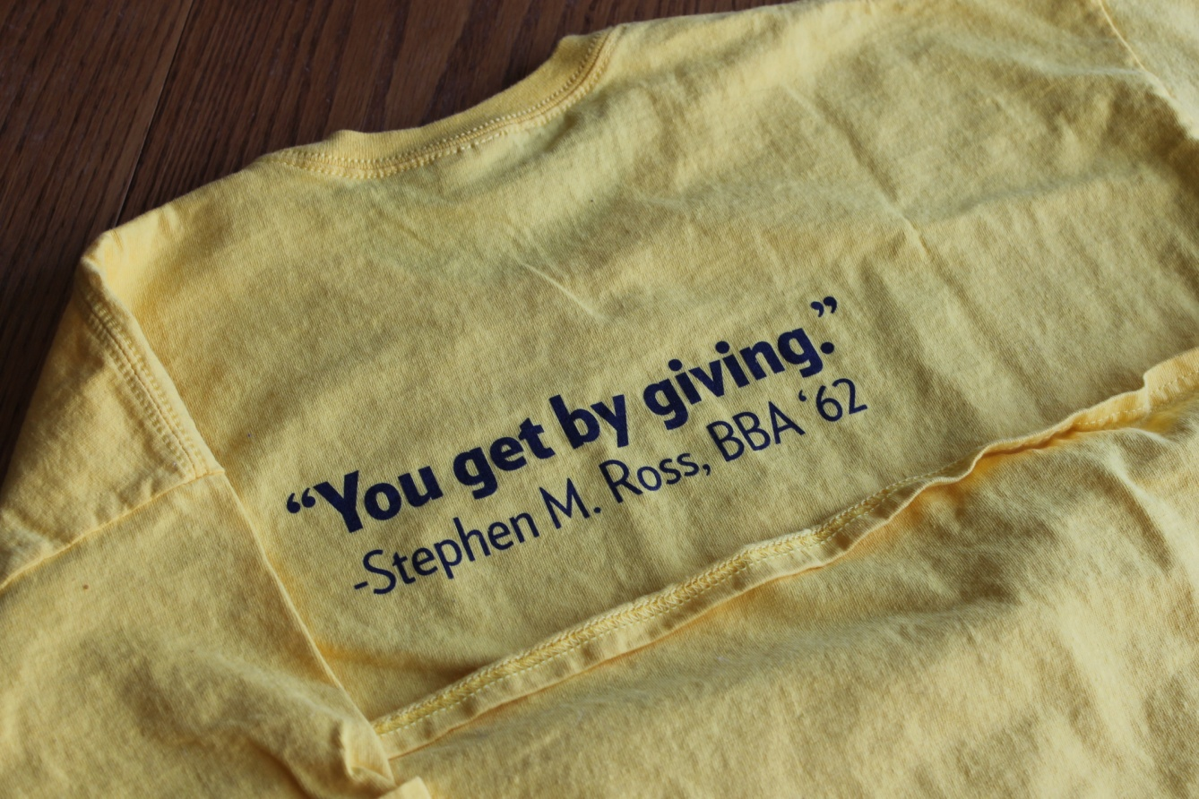

Ross Construction Project
Summer 2013 – Scope of plans shared*
September 2013 – Gift announced
Early 2014 – Plans developed
End of Winter Term – Started vacating the building
June 2014 – Moved to MOtown
July 2014 – Print moved out
Fall 2014 – Rebuilding Kresge Library Services

Slide 10

Ross Construction Project
Fall 2014 – Rebuilding Kresge Library Services
Winter 2015 – Kresge Value Proposition Meetings Started
Summer/Fall 2016 – Expected completion and move in to the new space
January 2017 – Expected opening of the new building to the school

Slide 11

Losing Your Physical Space
You have to come to grips with what this means
We are not a student destination any longer for study
We cannot be format agnostic in collecting
You cannot dwell on the past – you have to…well…

Slide 12

Establishing Priorities
Corey’s planning priorities:
  Staff
  Services
  Stuff (and spend)
  Space
Build services based on what you have, not what you had.
We had no choice but to build an Ethereal Library!

Slide 13
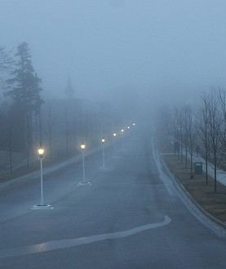
…And Building for the New
Parameters of the Ethereal Library – or the 6P Approach
    Philosophical
    Patient
    Positive
    Proactive
    Perform
    Ms. Pirkola’s Rules

Slide 14

6P Approach: Philosophical
This is an opportunity to also be freed from what worked and did not work from the past.
With less space – do not try to recapture everything you did – it will not work.
Don’t be bound by the past – “Forget the Alamo” – Lone Star (John Sayles – 1996)
Systems Lesson - Seeman, C. (2002). Invisible fences: A shocking theory for re-examining work flow. Computers in Libraries, 22(7), 24-30.

Slide 15
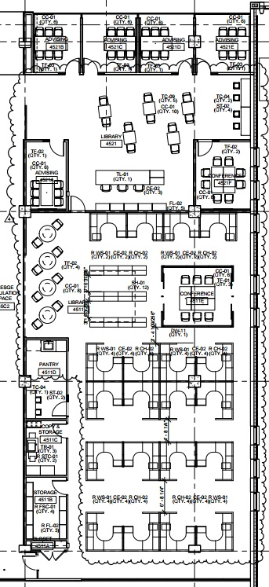
6P Approach: Philosophical
This is the time to think about what our value is and how to continue with the new constraints.
Brain-storming about creating service points – real and virtual.
Failure is an option – it allows us to be entrepreneurial and try things out.
Allows us to change the vision for the new staff space.
Build as you go!

Slide 16

6P Approach: Patient
Elisabeth Kübler-Ross’ Five Stages
  Denial
  Anger
  Bargaining
  Depression
  Acceptance
Everyone is moving through this at their own pace – Important for this level of change.
Every time someone says “Change is Hard” – it becomes harder…

Slide 17
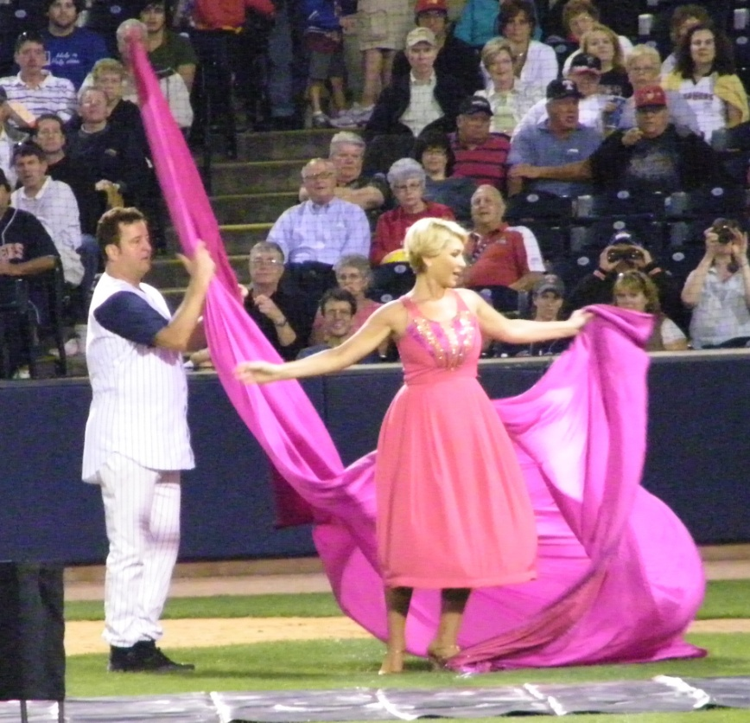
6P Approach: Patient
Don’t expect to have everything mapped out on day 1, or day 100 for that matter!
Things cannot change overnight.
A “born digital” library is much easier to build that a “becoming digital” library.
Quick Change at Toledo Mud Hens – September 2009

Slide 18
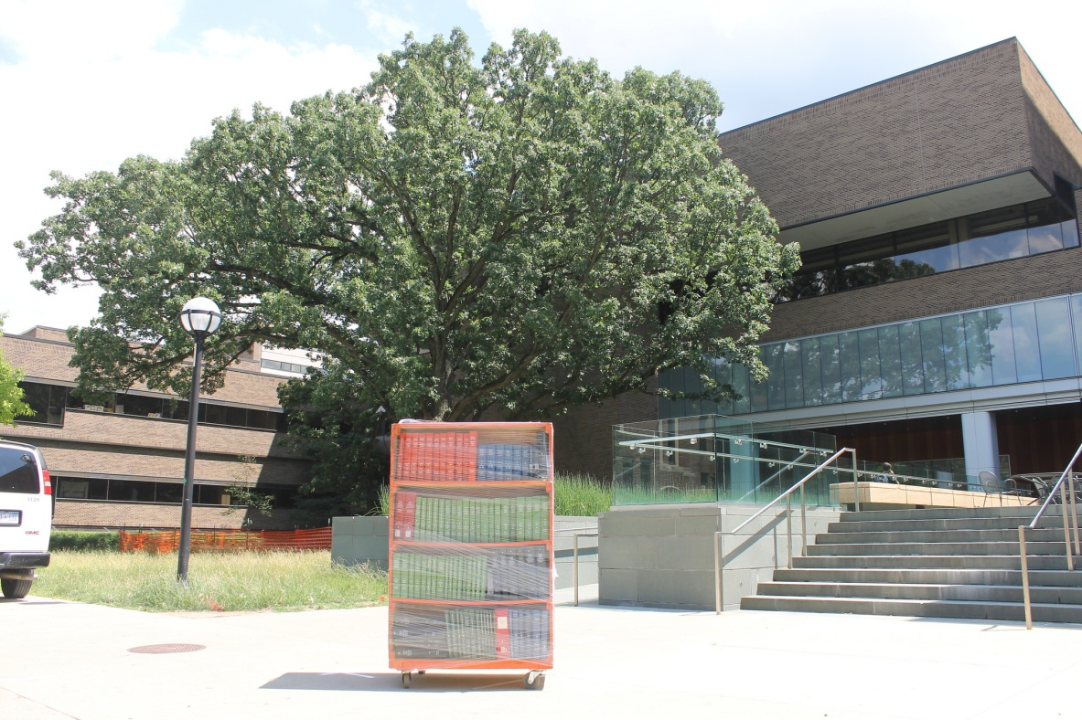
6P Approach: Positive
It is very easy to be mired in self-doubt with this type of contraction.
The image of loss cannot be your brand or how you are seen.
Important to not dwell on decisions that do not benefit you in these projects.

Slide 19

6P Approach: Positive
There are also some actual positives about not having a public space.
No longer have to worry about evenings and weekends in bad Michigan weather…

Slide 20

6P Approach: Positive
Positive approach to a situation is about making the best of it – this takes a while to get to.
How can we continue to meet the needs of the school and the number of communities we serve?
Our work is reflective of us more than our situation.
Despite everything - rather be happy than angry.

Slide 21
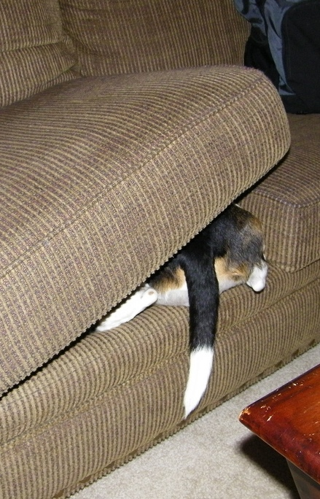
6P Approach: Proactive
The biggest issue is that we will be out of sight.
We need to be more proactive about doing outreach and connecting with faculty and students.
We use all virtual reference systems (chat & email) – need to push them more.
Being visible is our biggest need right now.

Slide 22

6P Approach: Proactive
I have been a strong proponent of the Reference Desk – even as many libraries are moving away from that.
We experimented with a reference service point at Tozzi Center, but it was not ideal.
We were given the front desk in the Ross Modular Offices – flipped it from Welcome Desk to Reference Desk.
Having visible staff is important – but they need a good place to work from!

Slide 23

6P Approach: Proactive
Print Coursepack (TEXTPAK) pickup at “Kresge Library Annex” – Legal Research 102 (short walk).
We are using this time to fundamentally change how we operate.
Working on communication with the Ross Community.

Slide 24
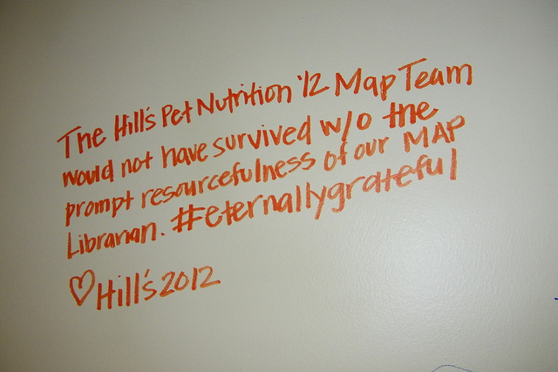

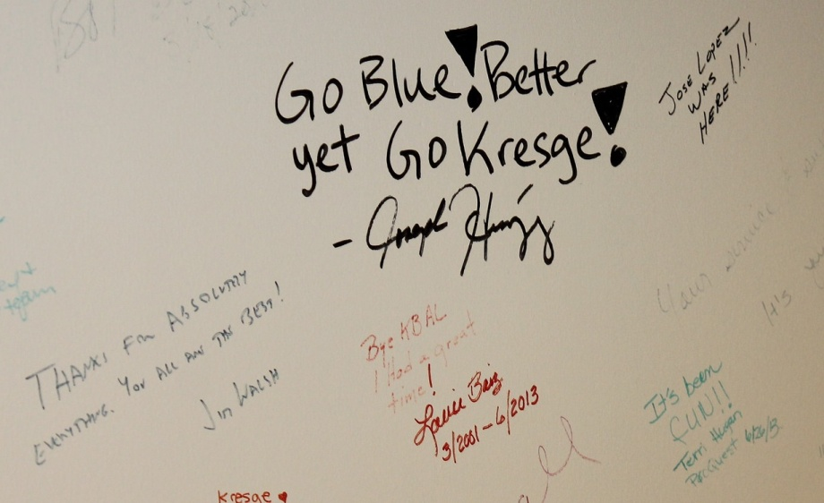
6P Approach: Perform
In this change, there was never an issue about Kresge Library as a service point.
That was what kept us going.
That has to be what keeps us going.

Slide 25
6P Approach: Perform
Kresge Library has been the Service ‘champs’ at Ross.
Great source of internal pride and motivation.
This is the reason why our work (and staff) are separated out from the space.
 | 2010 | 2011 | 2012 | 2013
BBA Kresge | 6.3 | 6.1 | 6.2 | 6.2*
BBA Other Services | 5.68 | 5.68 | 5.66 | 5.77
MBA Kresge | 6.2 | 6.4 | 6.3 | 6.4
MBA Other Services | 5.12 | 5.44 | 5.48 | 5.55

Slide 26

6P Approach: Perform
Since we have lost our space – it is all about service.
We need to be creative in how we deliver services to our community.
Pay close attention to what they need.
Experiment and change are critical elements.

Slide 27

6P Approach: Ms. Pirkola’s Rules
Flexibility!
It has to work in all directions.
We also need to be flexible with staff as they learn to work with these new confines.
New Service points need time to develop.

Slide 28

6P Approach: Ms. Pirkola’s Rules
Balance is critical
Empathy for patrons and staff need to be balanced against each other.
  The more we provide for patrons, the more we lean on staff.
  The more we provide for the staff, the less we provide for patrons.

Slide 29
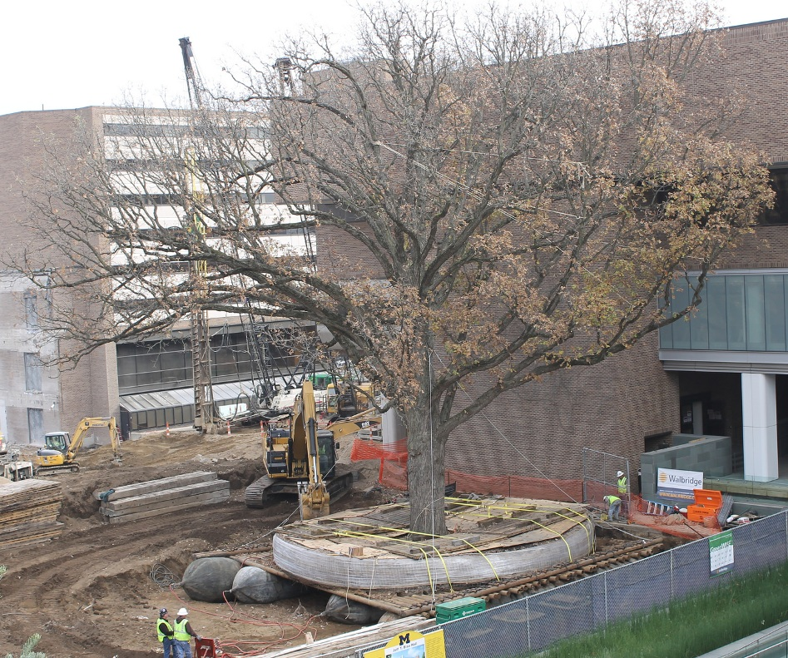
The Big Changes
Managing associated changes to services for the Ross Community

Slide 30

The Big Changes – Existing Programs
Assess what you can do with your new space.
Give up traditional services if you cannot manage or run them effectively.
You are playing with house money with these contractions – take risks & be entrepreneurial.

Slide 31
The Big Changes – Existing Programs
Embedded Librarian program for MAP and Action-Learning continues at Kresge.
New embedded librarians for entry core class for all BBA Sophomores (500). Librarians are assigned to every section (14) to support their research on a company & response to a social issue. (MERGE)
Faculty Research Service
Continue to support other student research (coursework, clubs, careers, case competitions & curiosity)

Slide 32
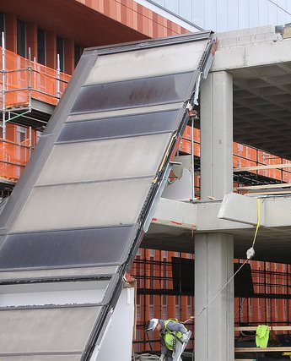
The Big Changes – Existing Programs
Coursepack & Curriculum Support – Moved to Study.net with Kresge Support.
Previously a print solution – but we did not have a large enough distribution point during construction.
Community and Alumni assistance (without walk-in access).
Move remaining print holdings to electronic access.

Slide 33
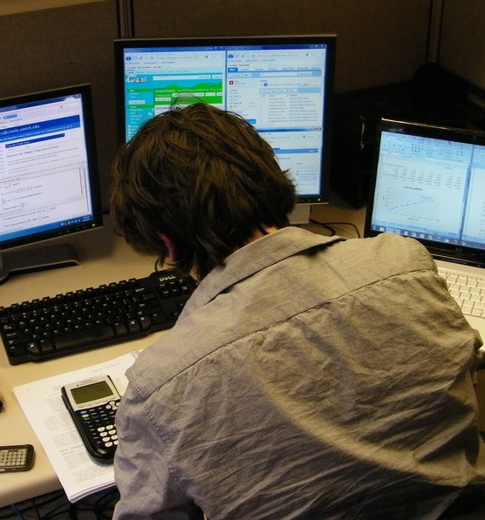
The Big Changes – New Programs
Exam/Assignment Program
  Many faculty do not want to hand back assignments in class.
  Some faculty also do not let students keep completed exams.
  This service ran as a pilot in Winter Term and went go to the Library in the Fall 2014.
  Will Continue with Kresge into the new building.

Slide 34

The Big Changes – New Programs
Modular Office Welcome Desk → became Kresge Reference Desk.
Pickup Location for ILL and Other Deliveries from University Library
Added Global MBA to our course materials operation
Evening/Weekend Remote Reference
Exploring options with Executive Education – The “spaceless dividend”

Slide 35
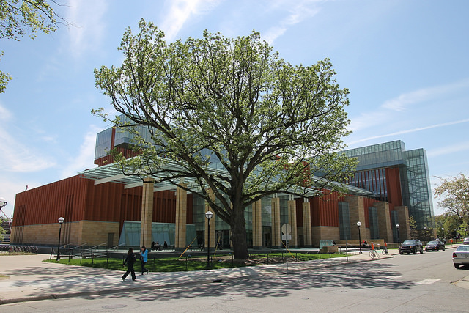
The Big Changes
Most things (even those that moved) eventually bloom again!

Slide 36

Providing Value With New Constraints
Great deal of discussion about the “value” of the academic library.
The need for this discussion could be an indication that we’ve reached a “tipping point.”

Slide 37

Providing Value With New Constraints
There is the appearance of endless information availability from wherever you are – this we know is not truly accurate
If we think about the changes to other industries (automotives, pharmaceuticals, journalism, etc.), few are operating as they’d like.

Slide 38

Providing Value With New Constraints
Our “old” value proposition:
  Space for students to study
  Space for physical collections (in all formats)
  Strong historical collection
  Strong electronic collections

Slide 39

Providing Value With New Constraints
Our “new” value proposition must:
  Live within the restrictions of virtually no collection space.
  Figure out new collaboration mechanisms to serve our community.
  Move away from the model where we provided student study space.
  Focus on what we can do vs. what we have done.

Slide 40

Providing Value With New Constraints
Our “new” value proposition remains:
  Using the resources at our disposal, we will support the curricular and research needs of the Ross Community.
  We will acquire resources only where we have the means to store or manage them.
  Seek out new opportunities to provide services for the school & campus.
  Embrace our new reality.

Slide 41
Providing Value With New Constraints
“Kresge Value Proposition” Meetings
Winter 2015 – with Faculty, Students and Staff
Will continue moving forward
New ideas to come from these meetings:
  New subject and journal alerting services
  Need to bring back course reserves to Kresge
  Managing communication with Ross communities (faculty, staff, students, alumni)
  Grow the exam and assignment program
  Explore opportunities with Exec Education & other departments

Slide 42

Closing Thoughts & Questions
Big Win on Staffing
What does the future hold?
Where is the Long Tail?
What’s in a Name?
Are we the Canary in the coal Mine?

Slide 43
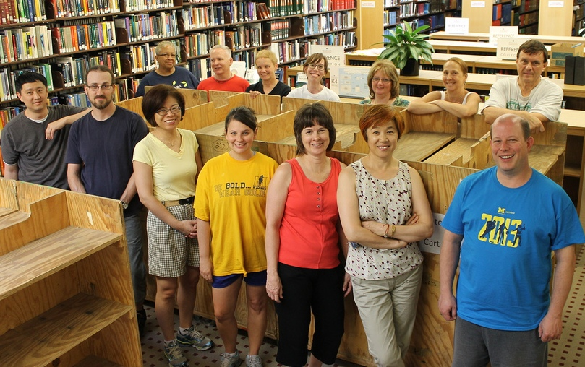
Big Win on Staffing
The premise with this reduction has been space and space alone.
We have been able to move forward with redeployed staff
No full-time staff losses related to this move.
Temporary Staff counts way down (no need for full evening staff).
New article - “No One Gets Left Behind:” Managing Library Human Resources During Dramatic Shifts in Academic Libraries in Advances in Library Administration and Organization (Volume 33, 2015)

Slide 44
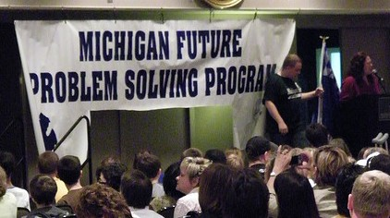
What does the future hold?
Fewer certainties for academic libraries now and especially 20 years in the future.
I believe that most libraries will continue to lose space until it is mostly gone.
We need to be nimble and flexible to meet the needs of the school – this secures the future of the library.
We need to be focused on the end-user of the library resources.

Slide 45
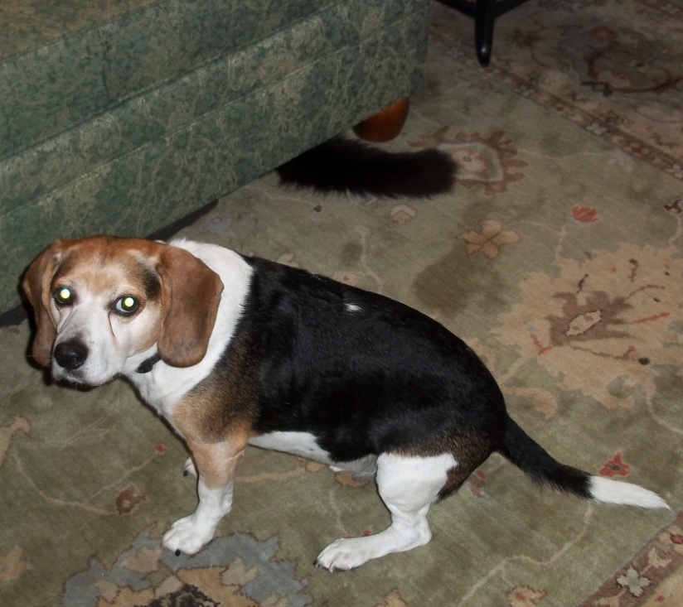
Where is the Long Tail?
Print collections are built on needs both now and down the road.
Many items are used in 10 or 20 years – but will libraries have space to see that materialize?
Long-term ROI appears to contract in an electronic-only Information environment.

Slide 46
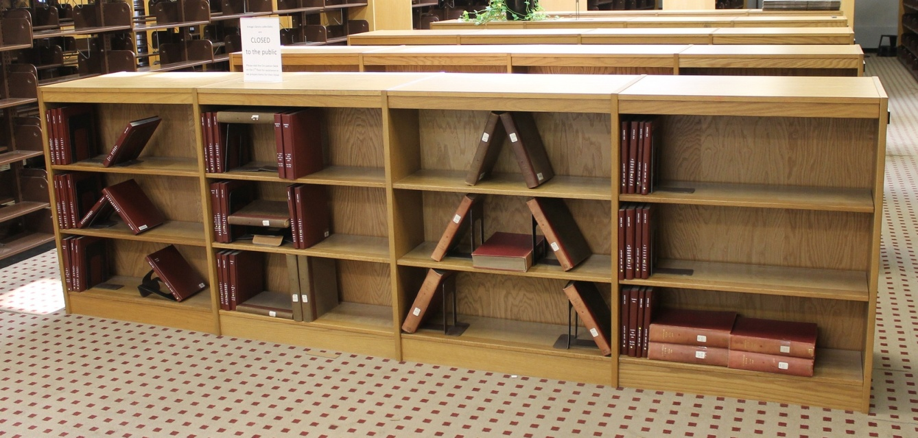
What’s in a Name?
Changing our name to Kresge Library Services
We are no longer a “destination” or a library in the traditional sense.
The print holdings were 2% of our use, but 50% of our perception.
Even though “Kresge” will belong to the building – “Kresge Library” has great brand recognition at Ross.

Slide 47

The Canary in the Coal Mine
Are departmental/branch libraries the “canary in the coal mine?”
Is the canary just sleeping?
Our space contraction appears to be the future of libraries everywhere – we just had it happen all at once.
We were saved by service!
Should we just be happy with what we have left…like a squirrel with a churro.

Slide 48

Thank You
Corey Seeman
cseeman@umich.edu

