Slide 1
Building a Digital Image Collection With flickr: A low (or no) cost approach to sharing your digital assets
Corey Seeman
University of Michigan
tinyurl.com/csflickr2016
Library of Michigan's 2016 Loleta Fyan Small and Rural Libraries Conference
Mackinac Island, Michigan

Slide 2
Presentation Overview
About flickr
Key benefits (7 Fs)
Your Images – Your Rights
Libraries on flickr
Additional resources & Readings

Slide 3
About flickr
flickr.com
Currently a subsidiary of Yahoo!
HOWEVER, it apparently is being shopped for a new owner.
flickr was an independent company founded in 2004 that was purchased by Yahoo! In 2005.
Historically designed for photographers
Community of photographers!

Slide 4
About flickr
Other photo services
Instagram - instagram.com
Imgur - imgur.com
Photobucket - photobucket.com
Shutterfly - www.shutterfly.com
SmugMug - Smugmug.com
Google Photos (Picasa) - photos.google.com
It’s a constantly changing environment!

Slide 5
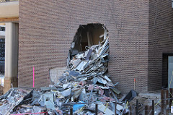
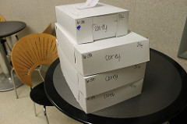
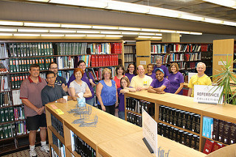
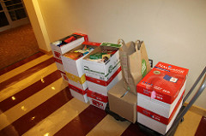
About flickr
You can build collections in all areas:
  Event photos
  Staff photos
  Construction updates

Slide 6
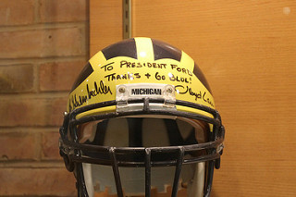
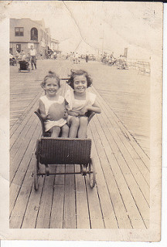
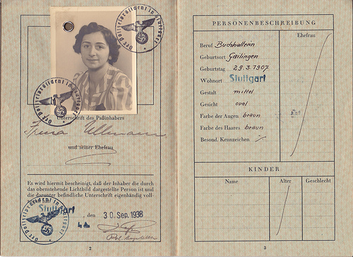
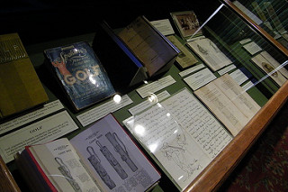
About flickr
  Library Exhibits
  Historical Collections
  Digital Collections

Slide 7
About flickr
Creating digital images is much easier now.
Low-cost flatbed scanners
Services like Legacybox (legacybox.com) to scan photos and movies/VHS tapes
Collaborate with local community organizations and volunteers

Slide 8
About flickr
Getting Started
You need a Yahoo! Account
Sign-up for flickr
Do not need a PRO account
Base account has 1 TB of storage
This may change (actually – it will definitely change!)
Corey’s flickr page: flickr.com/cseeman

Slide 9

Key benefits
Friends (& connections)
Flexibility
Functionality
Forever (& archiving images)
Findability
Figures (& Statistics)
Free!

Slide 10
Key Benefits - Functionality
Easy to load images and videos
Items are arranged as they are loaded.
People find them by tags (descriptive terms), titles, albums and groups.
Images can be public or private.
Internal image editor (Aviary) is really useful!

Slide 11
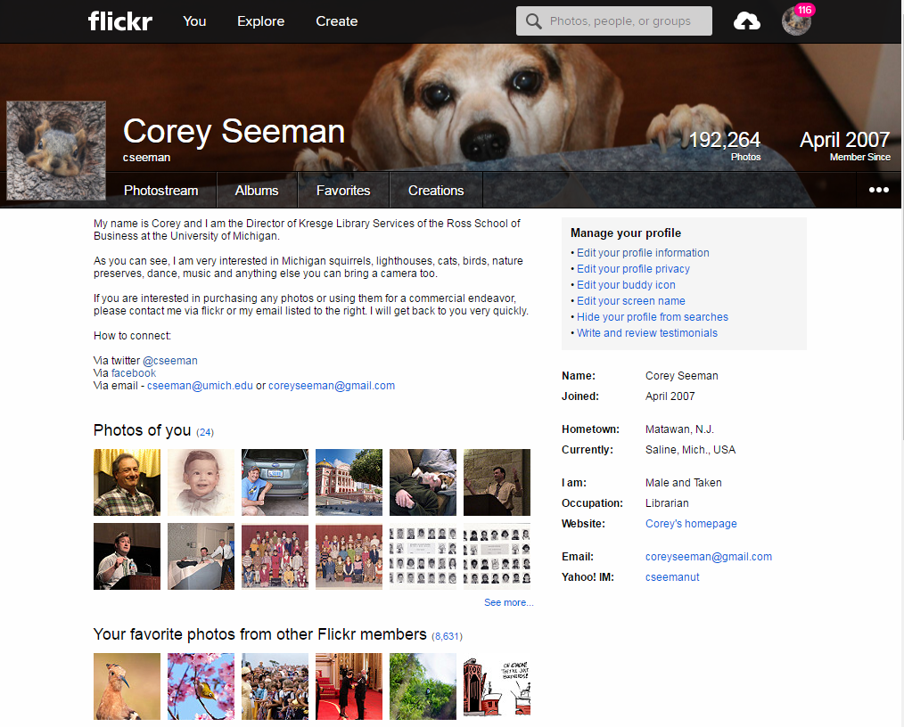
Key Benefits - Functionality
Your Profile page is a good place to add information about your library.
https://www.flickr.com/people/cseeman/

Slide 12
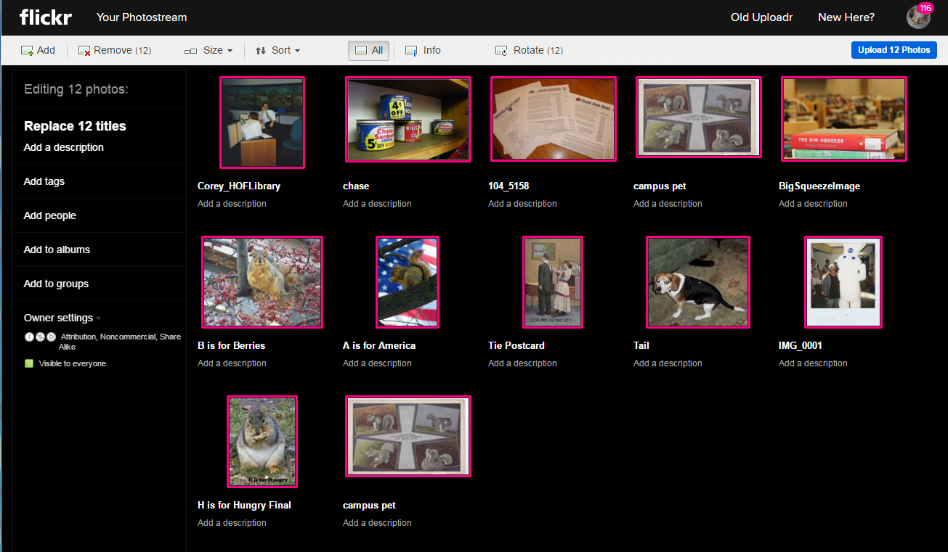
Key Benefits - Functionality
flickr web-based loader
Change descriptors now or later.

Slide 13
Key Benefits – Flexibility
Use Albums and Collections to pull like things together.
This allows you to pull together and segregate collection items from building and event photos.
Creates nice ways to share pictures with members of your community.

Slide 14
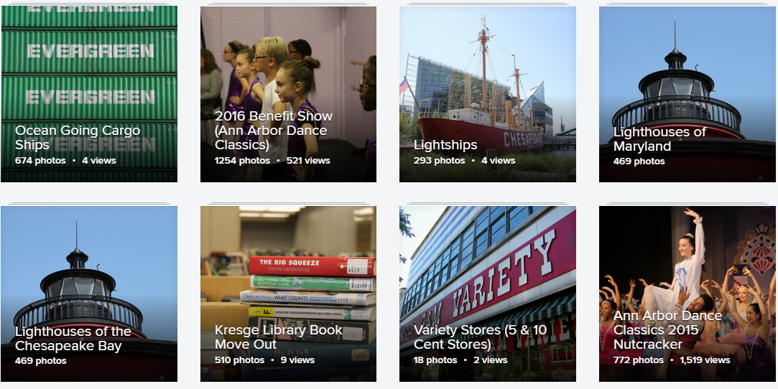
Key Benefits - Flexibility
Albums can be for anything and are only for your account.
https://www.flickr.com/photos/cseeman/albums/

Slide 15
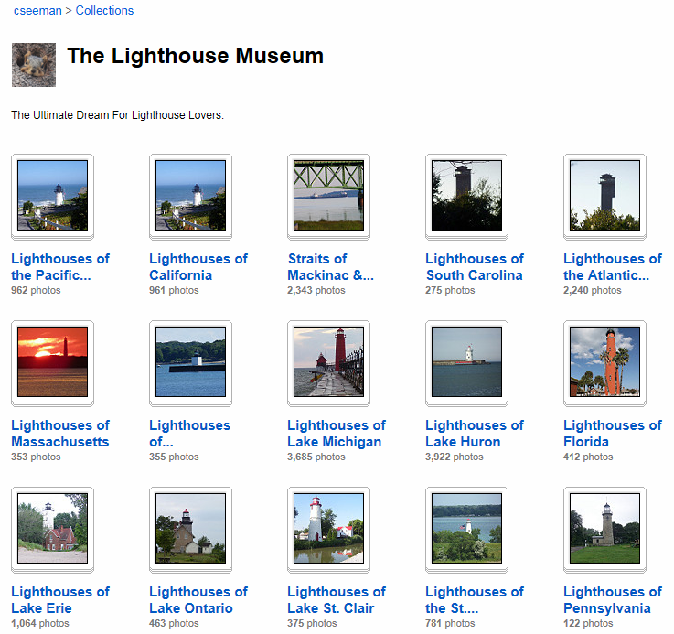
Key Benefits - Flexibility
Collections can bring together similar albums (dance, lighthouses)
https://www.flickr.com/photos/cseeman/collections/

Slide 16
Key Benefits - Findability
Tags are the best ways to have people find your images.
No real clear limit on the number of tags.
Create all sorts of tags to direct people to the items.
You can add tags after the fact.
These become the search-terms in both flickr and search engines.

Slide 17
Key Benefits - Findability
Tags can have external or internal meanings (they all live together).
Sometimes, the tags will not retrieve the image (HINT – you can make the image PRIVATE and then PUBLIC again to re-index – it takes 24 hours).
Images with no tags or only internal use tags will be virtually hidden.

Slide 18
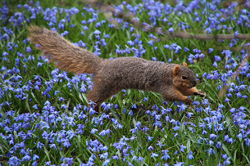
Key Benefits - Findability
Title: Squirrels in Ann Arbor at the University of Michigan (March 31, 2016)
Description: Squirrels out and about on an early spring day in Ann Arbor at the University of Michigan. Made it out after the rains passed through - on Thursday March, 31, 2016.
TAGS: Squirrels "Ann Arbor" Michigan Animal Campus "University of Michigan" UMSquirrels03312016 Spring Eating Peanut March_UMSquirrel Scilla Wildflower

Slide 19
Key Benefits - Findability
Groups are ways to share pictures on a topic with other users.
Michigan Libraries - https://www.flickr.com/groups/michiganlibraries/
Groups on nearly any topic…
Anyone can create a group!

Slide 20
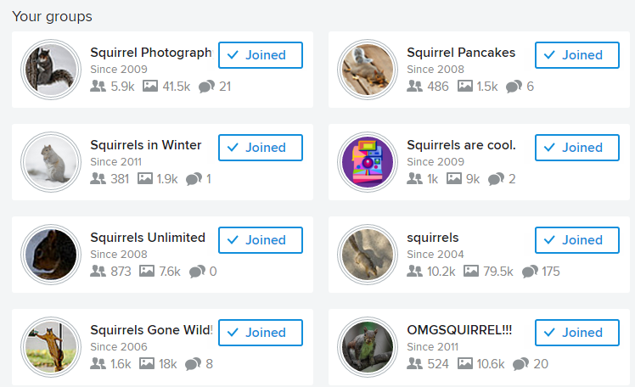
Key Benefits - Findability
Got squirrels???

Slide 21
Key Benefits - Friends
Collaborate with community members and organizations (like historical societies)
Great way to not only share your pictures, but also see those from your contacts.

Slide 22
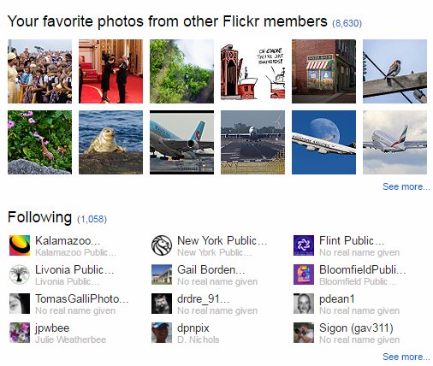
Key Benefits - Friends
Your contacts show on the profile page.

Slide 23
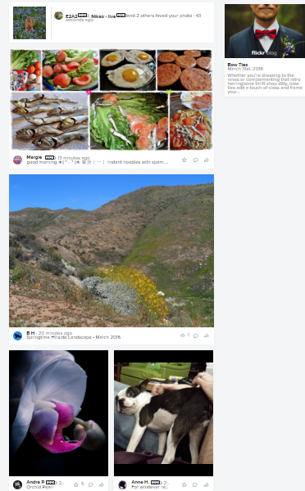
Key Benefits - Friends
Your contacts’ recent pics show on your home page.
You also see your activity (Favorites & Comments)

Slide 24
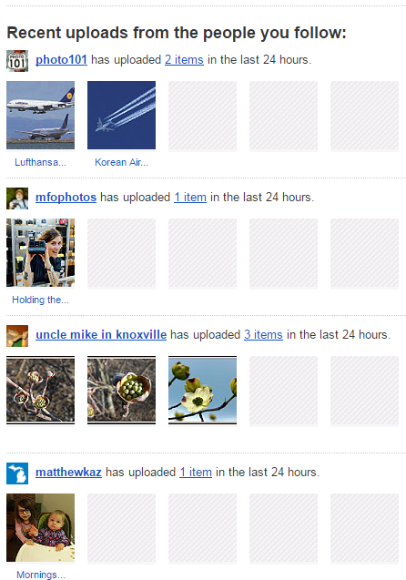
Key Benefits - Friends
You get emails daily showcasing your contact’s new items.
Good for community building

Slide 25
Key Benefits - Friends
Very easy to connect with social networks (facebook, Tumblr, Pinterest, twitter)
Also easy to send embedded text to add into websites.

Slide 26
Key Benefits - Forever
flickr is part of Yahoo!
Not completely secure (no commercial resource is)
Create an off site archive
Since you rename the pictures as you load them to flickr, use folders to keep them together.
Little work as you create the archives – long term benefit.

Slide 27
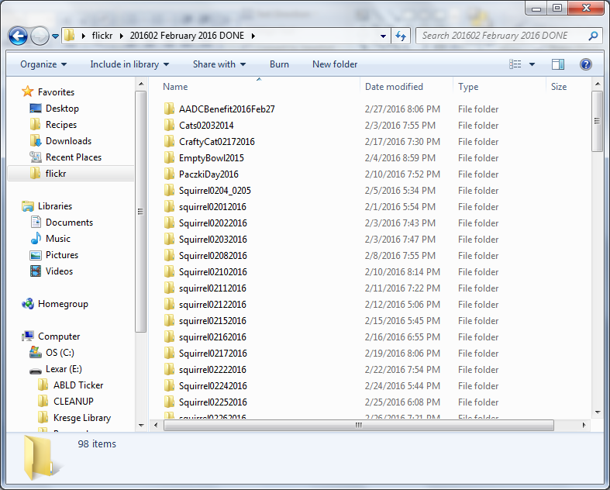
Key Benefits - Forever

Slide 28
Key Benefits – Figures (& Statistics)
flickr provides great statistics to users including:
  Page views
  Image views
  Items marked as favorites
  Comments from other users

Slide 29
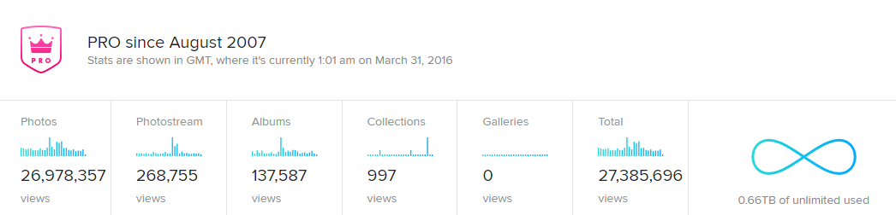
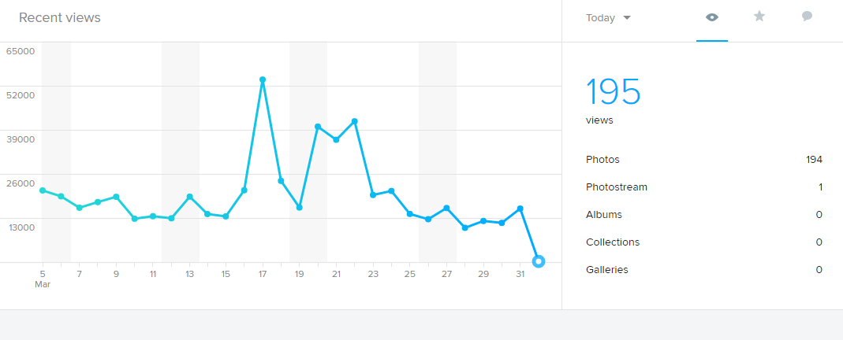
Key Benefits – Figures (& Statistics)
Samples of statistics

Slide 30
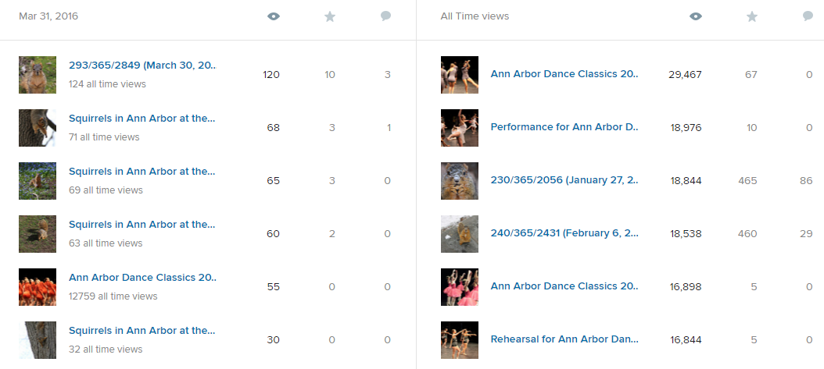
Key Benefits – Figures (& Statistics)
You can see daily and all-time top pic views.

Slide 31
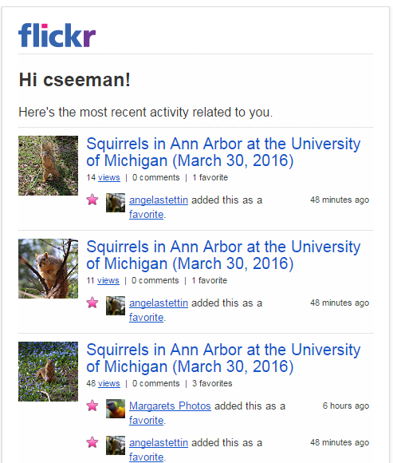
Key Benefits – Figures (& Statistics)
You get regular emails about recent activity.

Slide 32
Key Benefits - Free
Some of these resources are free (for now).
A Library-focused digital image systems are expensive and are not as easy to find or use for your patrons.
PRO accounts are modest in cost ($25 a year).

Slide 33
Your Images – Your Rights
Creative Commons
  https://creativecommons.org/
  https://creativecommons.org/licenses/
Creative Commons Pics on flickr
  https://www.flickr.com/creativecommons/
You can put restrictions on access and downloading if you want.

Slide 34
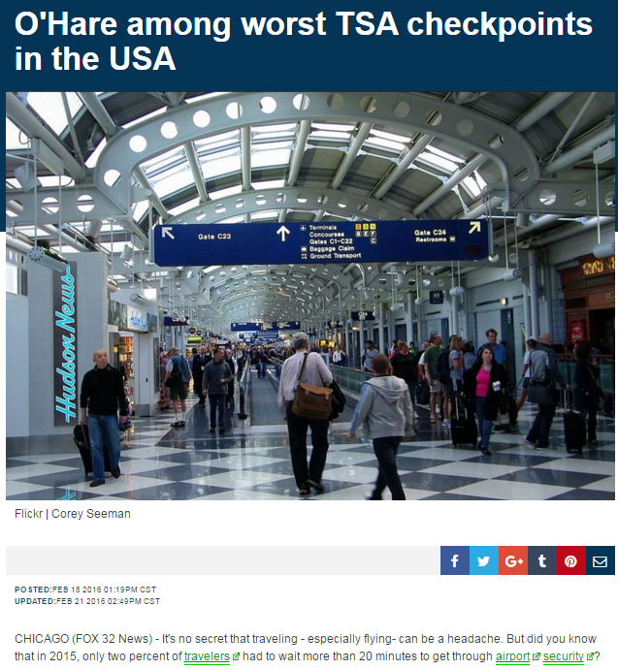
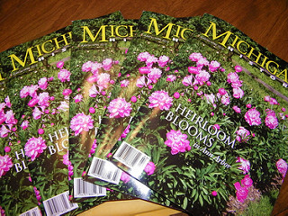
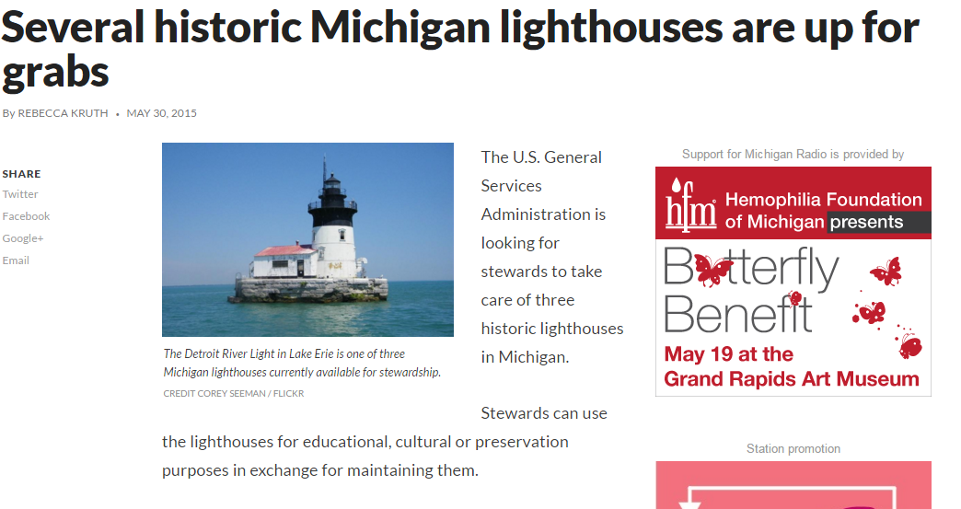
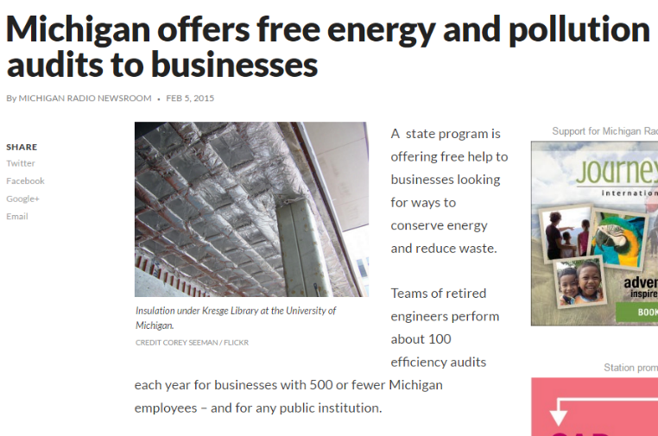
Your Images – Your Rights
If people can find it – they can use it

Slide 35
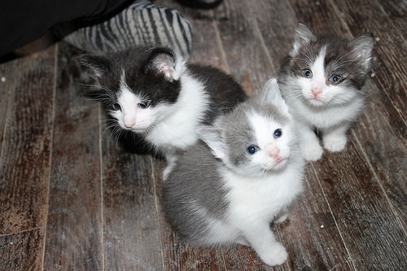
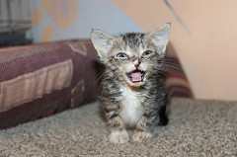
Questions & Thank You
Corey Seeman
University of Michigan
Email: cseeman@umich.edu
Slides: tinyurl.com/csflickr2016
Corey’s flickr page: flickr.com/cseeman
Libraries on flickr & Resources follow this slide!

Slide 36
Libraries on flickr
Libraries are “people” or “members” or “contacts”
Alpena County (MI) Library - https://www.flickr.com/photos/alpenacountylibrary
Ann Arbor (MI) District Library - https://www.flickr.com/photos/37044016@N08/
Canton (MI) Public Library - https://www.flickr.com/photos/cantonpubliclibrary
Dearborn Heights (MI) City Libraries - https://www.flickr.com/photos/33590329@N05/
East Lansing (MI) Public Library - https://www.flickr.com/photos/elpl

Slide 37
Libraries on flickr
Flint (MI) Public Library - https://www.flickr.com/photos/27279835@N04/
Kalamazoo (MI) Public Library - https://www.flickr.com/photos/kalamazoopubliclibrary
Lapeer (MI) District Library - https://www.flickr.com/photos/9867582@N03/
Livonia (MI) Public Library - https://www.flickr.com/photos/7523813@N07

Slide 38
Libraries on flickr
Bloomfield (IN) Public Library - https://www.flickr.com/photos/begcpl
Bloomfield (NJ) Public Library - https://www.flickr.com/photos/106763757@N08
Lester (Two Rivers, WI) Public Library - https://www.flickr.com/photos/lesterpubliclibrary (see: http://www.infotoday.com/mls/nov10/Dawson.shtml)

Slide 39
Libraries on flickr
University of Michigan Library - https://www.flickr.com/photos/mlibrary
Michigan State University Main Library - https://www.flickr.com/photos/msumainlibrary
Library of Congress - https://www.flickr.com/photos/library_of_congress
flickr Commons: https://www.flickr.com/commons
flickr Commons Participating Institutions: https://www.flickr.com/commons/institutions/

Slide 40
Readings and Resources
Anderson, P. F. "31 Flavors - Things to Do With Flickr in Libraries." OCLC WebJunction: the learning place for libraries. March 21, 2012 2012. Web. <https://www.webjunction.org/documents/webjunction/31_Flavors_045_Things_to_Do_With_Flickr_in_Libraries.html>.
Beaudoin, Joan E., and Cécile Bosshard. "Flickr Images: What & Why Museums Share." Proceedings of the American Society for Information Science and Technology 49.1 (2012): 1-7.
Boateng, Frank, and Yan Quan Liu. "Web 2.0 Applications' Usage and Trends in Top US Academic Libraries." Library Hi Tech 32.1 (2014): 120-38.

Slide 41
Readings and Resources
Copeland, Andrea. "Public Library: A Place for the Digital Community Archive." Preservation, Digital Technology & Culture 44.1 (2015): 12-21.
Cunningham, Sally Jo, and Malika Mahoui. "Interacting with and through a Digital Library Collection: Commenting Behavior in Flickr's the Commons". Proceedings of the 13th ACM/IEEE-CS joint conference on Digital libraries. ACM , 2013. 21-24.
Forsyth, Ellen, and Leanne Perry. "Picturing Your Community: Flickr use in Public Libraries." Library Hi Tech News 27.1 (2010): 6-9.

Slide 42
Readings and Resources
Jett, Jacob, Megan Senseney, and Carole L. Palmer. "Flickr Feedback Framework: A Service Model for Leveraging User Interactions". Proceedings of the 13th ACM/IEEE-CS joint conference on Digital libraries. ACM , 2013. 389-390.
Kalfatovic, Martin R., et al. "Smithsonian Team Flickr: A Library, Archives, and Museums Collaboration in Web 2.0 Space." Archival Science 8.4 (2008): 267-77.
Library of Congress. Prints and Photographs Division, et al. "For the Common Good: The Library of Congress Flickr Pilot Project".Library of Congress, Prints and Photographs Division , 2008. (http://www.loc.gov/rr/print/flickr_report_final.pdf)

Slide 43
Readings and Resources
Momeni, Elaheh, et al. "Identification of Useful User Comments in Social Media: A Case Study on Flickr Commons". Proceedings of the 13th ACM/IEEE-CS joint conference on Digital libraries. ACM , 2013. 1-10.
Stephens, Michael. "Flickr." Library Technology Reports 42.4 (2008): 58-62. (https://journals.ala.org/ltr/article/view/4658)
Terras, Melissa. "The Digital Wunderkammer: Flickr as a Platform for Amateur Cultural and Heritage Content." Library Trends 59.4 (2011): 686-706.

