Slide 1

ICPSR's Efforts to Encourage Data Citation
IASSIST Annual Conference
Vancouver, BC
June 1, 2011
Elizabeth Moss, ICPSR
eammoss@umich.edu

Slide 2

About Me
I am a librarian at ICPSR
I search for publications that analyze ICPSR data
(in over 8,000 studies)
One day scripts will take advantage of consistent data citing practices
Making my job obsolete

Slide 3
Overview
ICPSR’s experiment with linking data to published analyses
Finding cited data in the social science literature
How good citing practice affects stakeholders
How ICPSR promotes good practice
What’s next for IASSIST-SIGDC?

Slide 4
1. ICPSR’s Experiment with Linking Data to Literature
Saw the value of clustering the literature with the data for instructors, students, researchers, funders
Led to the creation of the Bibliography of Data-related Literature
Studies link to publications, Bibliography links back to studies and out to full text

Slide 5
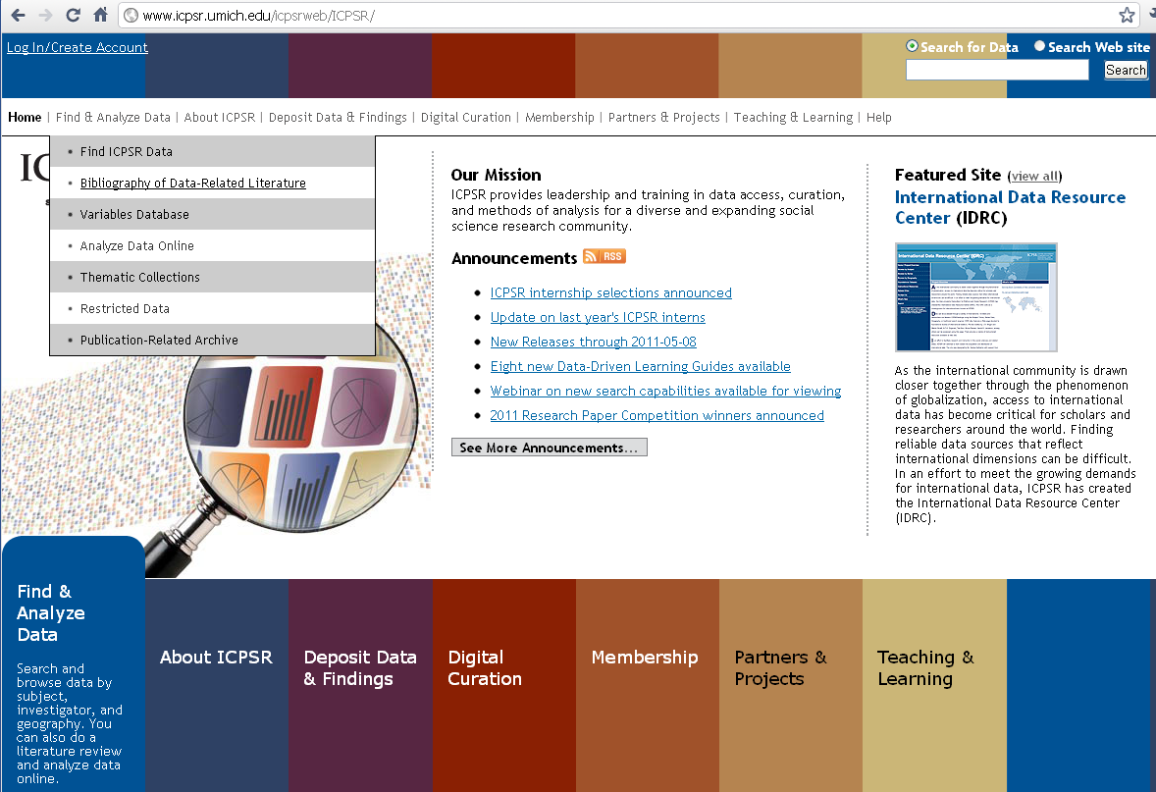

Slide 6
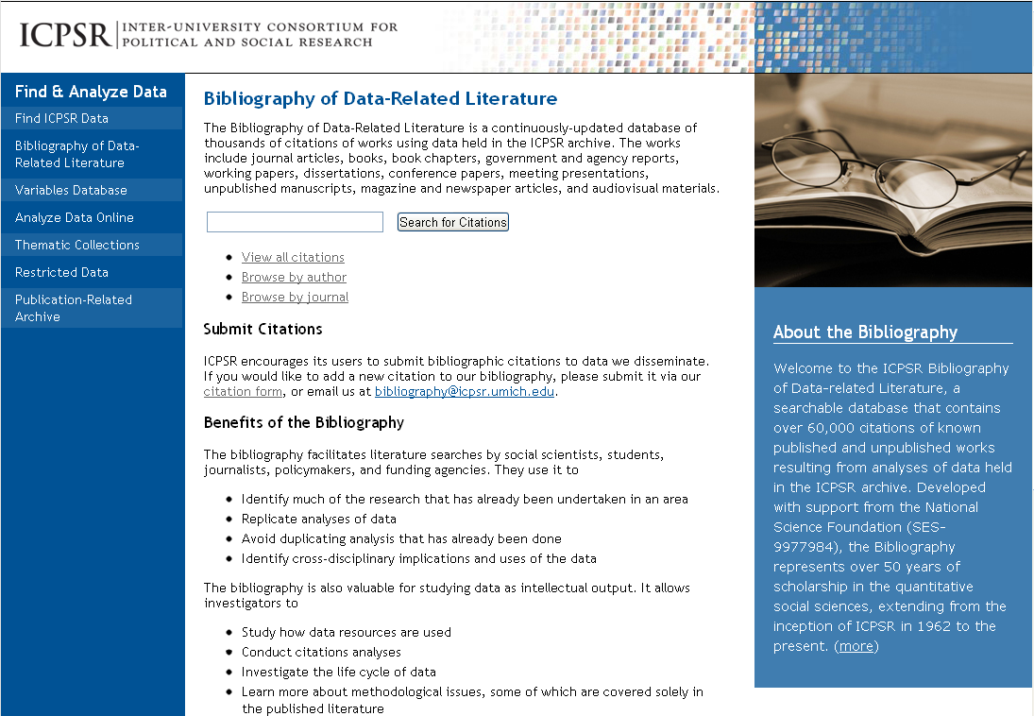

Slide 7
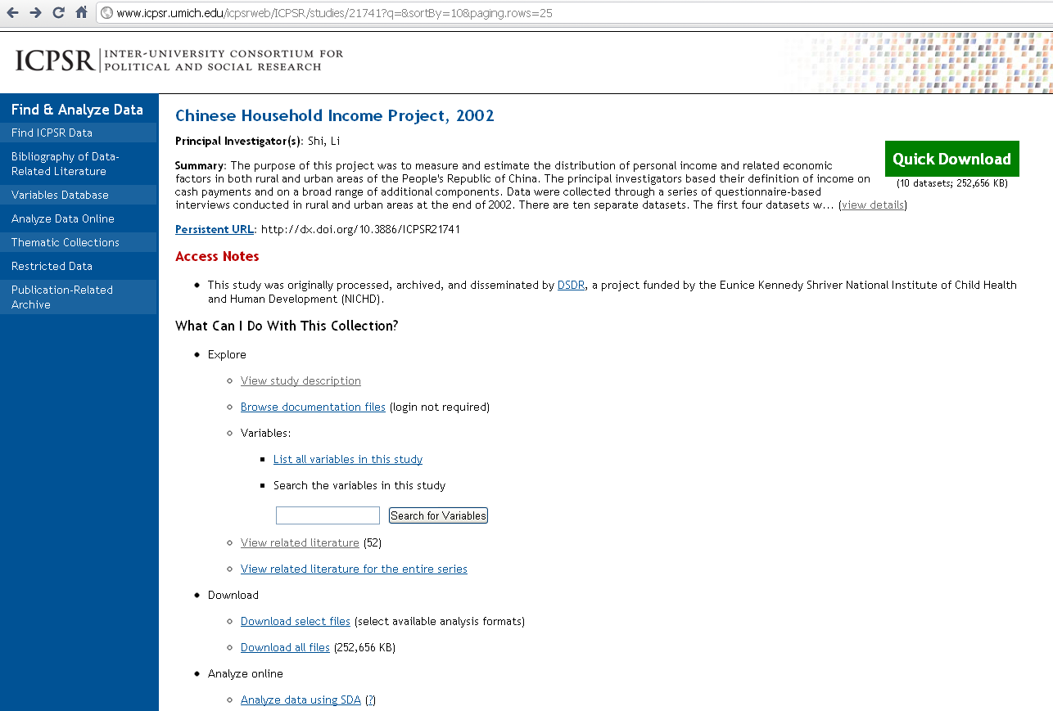

Slide 8
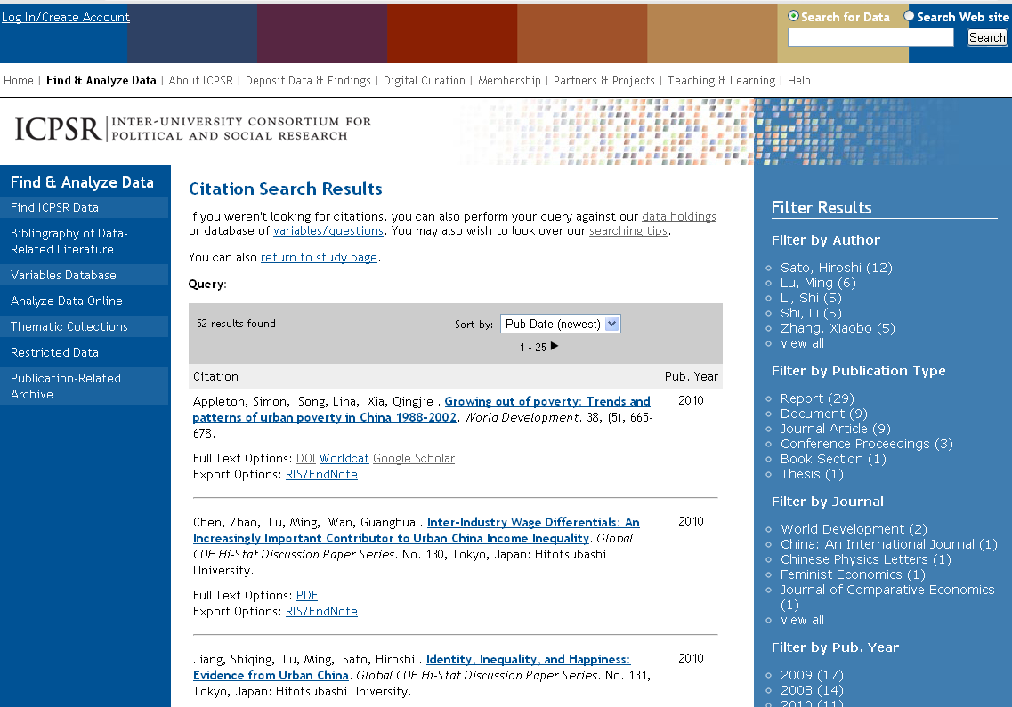

Slide 9
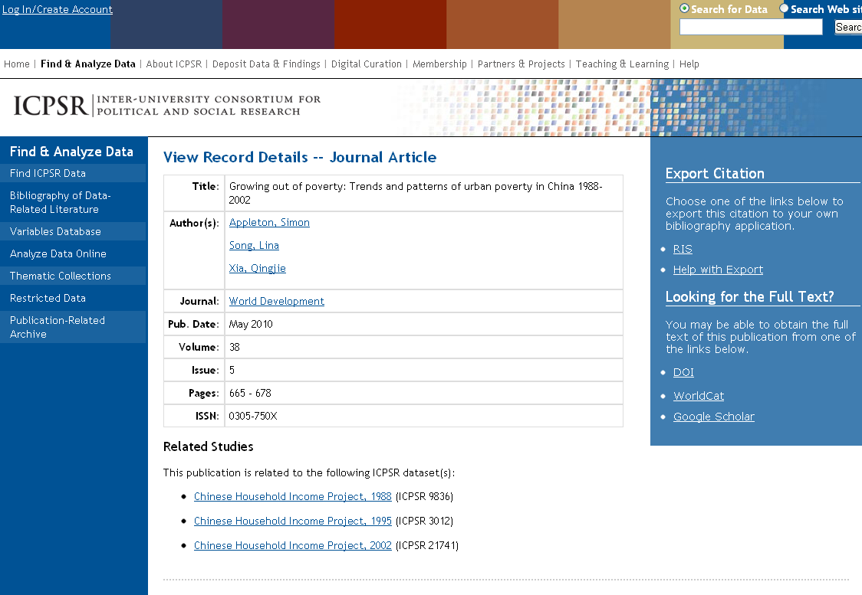

Slide 10
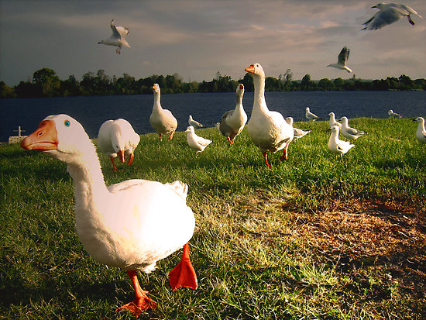
2. Finding Cited Data in the Social Science Research Literature

Slide 11
Abstract?
Acknowledgements?
Charts and Tables?
Appendices? References!
Discussion?
Footnotes?
Sample?
Methods?
Data “Sighting”
(implicit) vs.
Data Citing
(explicit)

Slide 12
Issues with Attribution and Access
Sample described, not named, no author information, no access information, only a publication cited
Data named in text, with some attribution, but no access information
Cited in reference section, but with no permanent, unique identifier

Slide 13
What We Think of as Citable Data
Data are central to the argument
Data are used to generate one table (or 20)
Data are used in comparison to the central data used
Data collection/methodology are described or critiqued

Slide 14
3. How Good Citing Practice Affects Stakeholders
Researchers and data producers – Raises the visibility and legitimacy of their data as intellectual output and may have an impact on tenure and promotion through citation-related metrics
Publishers/publishing platforms – Makes the linkage between publications and underlying data explicit and enhances the rich web of associations linking content creators and their scholarly output

Slide 15
How Good Practice Affects Stakeholders
Data users – Enables authors to cite data used in an article and allows secondary analysts to find data resources of interest and to conduct literature reviews
Librarians and information professionals who help data users – Supports instruction in and assistance with data discovery and reuse

Slide 16
How Good Practice Affects Stakeholders
Funding agencies – Permits funders to measure the impact of their investments
Solutions and standards developers –Facilitates standardization and machine-actionability
All of us – Our research investment is not lost

Slide 17
Data Sharing Increases Research Productivity . . .
The majority of social science data are not archived publicly
Younger researchers are more protective of their research than established ones
When data are archived (formally), 2-3 times more publications are created
Need to ensure all productivity is measured
-- Pienta, Amy M.; Alter, George C.; Lyle, Jared A. (2010) The enduring value of social science research: The use and reuse of primary research data. http://hdl.handle.net/2027.42/78307

Slide 18
4. How ICPSR Promotes Good Practice
Makes it easy for users to cite our data
Aids the cultural shift among data producers, authors, and publishers
Encourages development of technology infrastructure

Slide 19
Provide Citations for Studies
ICPSR has been providing citations to its data since 1990
Based on “Cataloging Machine-Readable Data Files“ by Sue Dodd, American Library Association, 1982

Slide 20
Include Standard Elements and Persistent, Unique Identifier
Content Creator/Principal Investigator
Title
Distributor [ICPSR]
Distribution place and date
ICPSR study number
Version number
Materials designation [Computer file]
DOI

Slide 21
Register DOIs for Studies
DOIs are persistent URLs that ensure resources are always uniquely identified and findable (machine-readable)
Could lead to automatic collection of citations into an index, for rapid creation of study bibliographies and other associated lists
Since 2008 ICPSR has been assigning DOIs to data at the study level

Slide 22
Accommodate Journals’ Interest in Accessing Authors’ Data
Journals more frequently requesting DOIs to ensure that data have been archived before articles are published
Data depositors are coming to ICPSR for DOIs pre-publication, generally depositing into the Publication-Related Archive

Slide 23
Make Citations and DOIs More Prominent
Provides FAQ: Why and How Should I Cite Data
Provides RIS export for data citations into bibliographic citation software
Highlights the data citation and DOI in several places

Slide 24
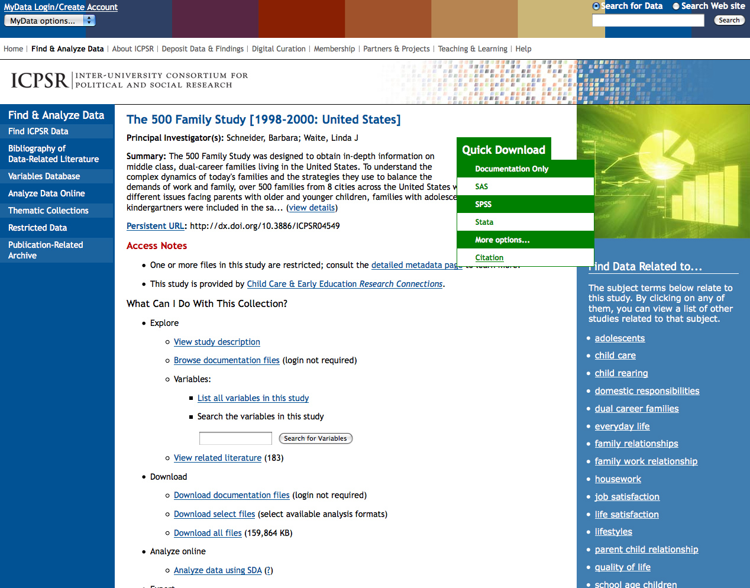

Slide 25
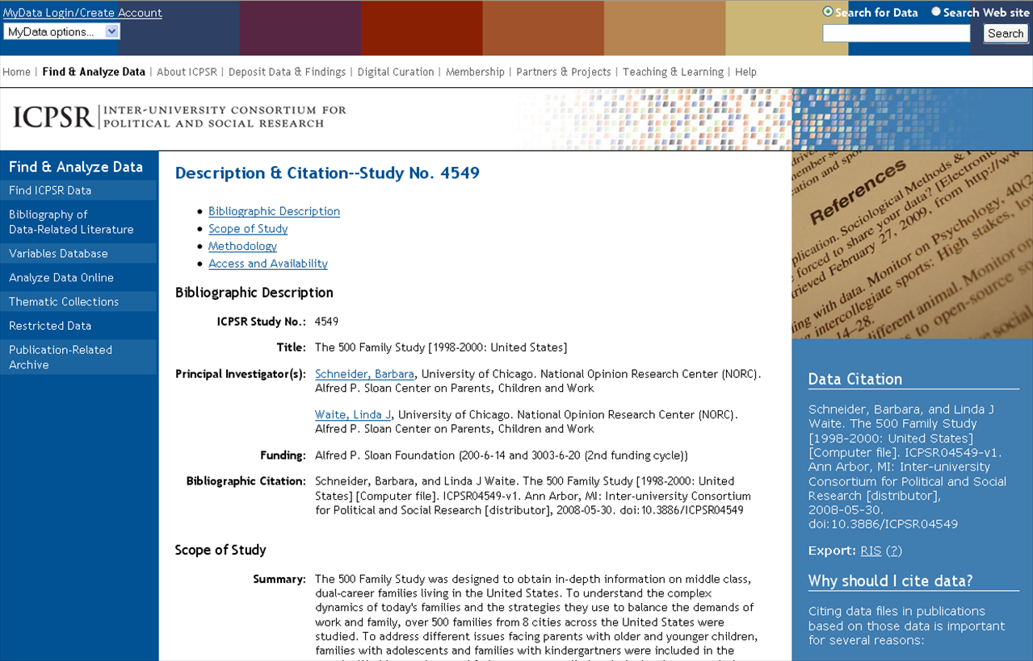

Slide 26
ICPSR Members Promote Data Citing to Students
“How to Cite a Data Set”, University of North Carolina, University Libraries
Anticipate evolving user needs
Fill in the holes left by style guides

Slide 27
Work with Vendors to Promote Data Linking from the Literature
Thomson Reuters to display data linkages in Web of Science
Full and summary records in Web of Science will link to related data when appropriate
ICPSR is providing a periodic data feed of datasets and related publications to TR
TR is integrating data feeds from others including UK Data Archive
The service will be ready in early 2012

Slide 28
Coordinate with Partners to Influence Journals
On behalf of the Data-PASS partners, ICPSR wrote to ASA and APSA urging them to raise the standards for data citations in their journals
Professional associations are in a position to set standards for their members and for journal editors (including copy editors)

Slide 29
Build on Successful Efforts
The letter stressed the importance of citing data the same way that publications are cited and the value of persistent identifiers
Both organizations discussed the letters at recent national meetings
American Sociological Review’s new submission guidelines

Slide 30
Update Citation Software
ICPSR worked with EndNote (part of Thomson Reuters), and “Dataset” is now a Reference Type in EndNote
Metadata fields in this reference type overlap substantially with ICPSR metadata fields
ICPSR is now working with RefWorks to add a new “dataset” Reference Type
Zotero is building a Dataset Type, and could use input from the social sciences

Slide 31
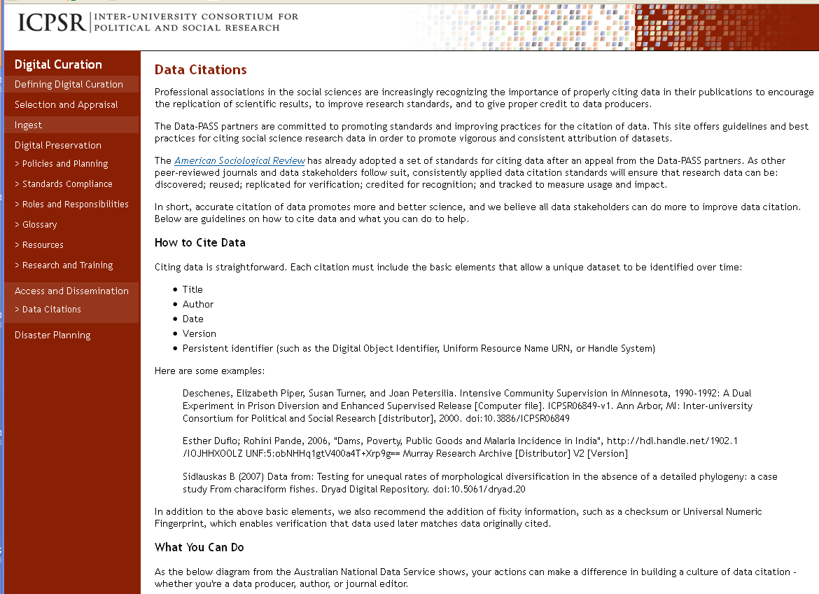

Slide 32
Open to Help with Efforts to Standardize Data Citation
DataCite, and their Metadata Kernel for the Publication of Research Data
IQSS Data Citation Principles Workshop
CODATA Data Citation Standards and Practices (International Council for Science: Committee on Data for Science and Technology)
Notes:
DataCite
DOI registration for research data
ICPSR joined DataCite as an associate member
http://datacite.org/schema/DataCite-MetadataKernel_v2.0.pdf
IQSS
CODATA
http://www.codata.org/taskgroups/TGdatacitation/

Slide 33
5. What’s next for IASSIST-SIGDC?
Represent the interests of the social science community
Identify cross-over with efforts to create standards for the cultural and technological shift

Slide 34
IASSIST Special Interest Group on Data Citation: Stated Goals
Recommend data citation standards and best practices for their use
Work with vendors and projects to ensure that data are cited and linked to publications
Advance the use of persistent identifiers

Slide 35
IASSIST Special Interest Group on Data Citation: Stated Goals
Support data citation-related initiatives and programs
Collaborate and liaison with similar groups in other organizations
Promote awareness and develop pedagogy for data literacy and the data lifecycle as it relates to citation

Slide 36
Today’s Meeting at 5 PM,
Harbour Centre Room 2050
Members include representatives of most of the stakeholder groups
Brainstorm areas of focus and identify gaps
Divide into small action teams

Slide 37
Thank you…
Questions?

