Slide 1

From Shoestrings to Pursestrings: Securing Funding for Small, Open-Access Scholarly Journals
Notes:
Allison will kick us off:
Hi everyone, and welcome to “From Shoestrings to Pursestrings: Securing Funding for Small, Open-Access Scholarly Journals”!

Slide 2
Who’s here?
Michigan Publishing (University of Michigan Library)
Allison Peters, Digital Publishing Coordinator
Rebecca Welzenbach, Director, Strategic Integration and Partnerships
Kelly Witchen, Digital Publishing Coordinator
#LPForum | Thursday, May 19, 2016
Notes:
Allison can do this intro slide to lead into Becky and Kelly discussing the transition:
I’m Allison Peters, digital publishing coordinator at Michigan Publishing, with my colleagues Rebecca Welzenbach, director of strategic integration and partnerships, and Kelly Witchen, digital publishing coordinator, and we’re excited to be here today to talk a bit about our experience working with editors in our Journals Program at Michigan Publishing and to share with you some ideas for how small, open-access journals can seek and secure funding in sustainable, often clever ways.

Slide 3
1
Initiating Transition:
The Grind of Shifting Gears

Slide 4
Where were we...
  Early, early on, our model was: If you make your journal free, we will host for free, and if you charge a subscription, we’ll take a cut
    Our subscription partners, however, have fallen away (or never really took off to begin with)
    Minimal differentiation between internal and external journals
    For external journals: small start-up fee (often waived)
Notes:
Becky does background slide
We don’t really encourage journals to have a subscription-based model.
Focus was more on opening up scholarship, so we took on a wide-range of projects and publications.

Slide 5
...and where are we trying to go together?
  Shifting to a cost recovery model provided the opportunity to establish a precedent of health check-ins with journals
    This is ongoing (annual check-ins)
    Create new documents from scratch
    A budget-balancing act
Notes:
Kelly:
But the good news and, it turns out, the tricky news was that we kept growing, taking on a wider range of projects, and finding new initiatives that we wanted to be part of and offer to our partners. Even though we receive library funding, we began to realize that we were outgrowing our allowance. So we decided we’d need to start charging small fees to maintain the resources and infrastructure that keep our operation running.
In order to break the news of our changing model, we scheduled meetings with editors last summer.
*We soon realized these check-ins would be valuable for various reasons, including giving me a chance to meet some of these people in real life (in a few cases, it was also clear that until we made them have a meeting, the editorial board had not met for many months--or more...).
*It was definitely not something we were excited to have to do, and there was some worry about push back. However, no one seemed shocked. In fact, many people seemed surprised this had not happened earlier.
Here’s what helped make the check-ins effective:
*we gave more than a year of notice;
*we met face to face (or via video) to break the news,
*and we kept the conversation going after those initial meetings in order to answer questions, discuss options, and confirm commitments. (But, this just in, quick and effortless verbal commitments do not signed paperwork make, and we are admittedly still chasing folks down.)
Becky:
*budget estimates, Roles & Responsibilities, fee schedule, publication schedule (should we show what any of these look like?)
-Formalization of all the things we had already been doing (what services are included). Brainstorming sessions about what to charge for and what would be bundled together. Helped us to create a skeleton of the variety of services we actually offer.
Budget balancing: figuring out what budget to anticipate, figuring out what editors should expect to pay (tension between charging back for time vs. flat fee for services; predicting accurately what each journal should expect)
BECKY INSERT SOME SAMPLE DOCUMENTS; ALSO MAKE TEMPLATES AVAILABLE WITH A LINK

Slide 6

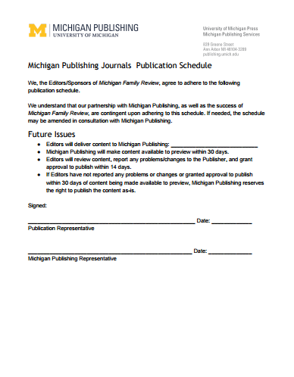
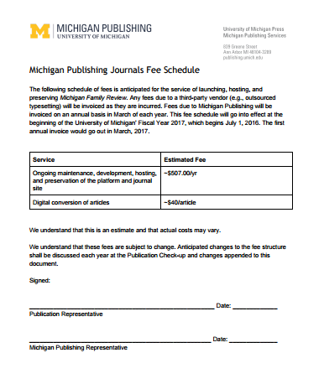
Paperwork!
Notes:
Kelly:
But the good news and, it turns out, the tricky news was that we kept growing, taking on a wider range of projects, and finding new initiatives that we wanted to be part of and offer to our partners. Even though we receive library funding, we began to realize that we were outgrowing our allowance. So we decided we’d need to start charging small fees to maintain the resources and infrastructure that keep our operation running.
In order to break the news of our changing model, we scheduled meetings with editors last summer.
*We soon realized these check-ins would be valuable for various reasons, including giving me a chance to meet some of these people in real life (in a few cases, it was also clear that until we made them have a meeting, the editorial board had not met for many months--or more...).
*It was definitely not something we were excited to have to do, and there was some worry about push back. However, no one seemed shocked. In fact, many people seemed surprised this had not happened earlier.
Here’s what helped make the check-ins effective:
*we gave more than a year of notice;
*we met face to face (or via video) to break the news,
*and we kept the conversation going after those initial meetings in order to answer questions, discuss options, and confirm commitments. (But, this just in, quick and effortless verbal commitments do not signed paperwork make, and we are admittedly still chasing folks down.)
Becky:
*budget estimates, Roles & Responsibilities, fee schedule, publication schedule (should we show what any of these look like?)
-Formalization of all the things we had already been doing (what services are included). Brainstorming sessions about what to charge for and what would be bundled together. Helped us to create a skeleton of the variety of services we actually offer.
Budget balancing: figuring out what budget to anticipate, figuring out what editors should expect to pay (tension between charging back for time vs. flat fee for services; predicting accurately what each journal should expect)
BECKY INSERT SOME SAMPLE DOCUMENTS; ALSO MAKE TEMPLATES AVAILABLE WITH A LINK

Slide 7
Initial Takeaways
    Opportunity to revisit all of our documents and plans
    Chance to truly check in with journals
      You can’t help them succeed if you don’t know where they’re struggling
    Journals have costs of all kinds
      Even if they’re not paying you, thinking about costs and how to cover them will help the journal to thrive in any setting
    Helping editors to understand the complete value of their journal
Notes:
Becky:
Along with providing a much needed refresh for some of our documentation, we were also able to re-re-introduce partners to new initiatives and tools we had implemented. One consistent headache is submission management (journal partners voiced frustrations--we offer solutions through Submittable). Google Scholar alerts. Teaching journal partners how to use Google Analytics and Altmetric in response to journal partners’ want/need for more statistics/analytics (audience, story of impact).
Kelly:
Also, once we had their true attention (since we all know those “important update” emails go unnoticed), we were able to reiterate certain expectations (For example, conversion time. It was always the case that we promised a 30-day turnaround but some of our partners had long ago forgotten that. Sure, it was often the case that we could publish something much more quickly, but it was imperative that we reiterated that this was the exception, not the rule, especially given our increasing workload). More importantly, these conversations gave partners a chance to step back and think about the entire process. Had they been publishing consistently? Did they need a new or different CC license? Did they understand the steps and time involved with the publication process? As we heard yesterday, it is often the case that people simply do not understand the behind-the-scenes work that goes on to publish digital content. One of my favorite stories was a journal editor who emailed me his latest issue and said, “Ok Kelly. Here’s the newest issue for you to copy and paste online.” He literally thought I just had to open the Word file, select all, copy, open up a magical browser tab, paste, and BAM published. No wonder people are confused about less-than-instantaneous turnaround times. (That being said, if someone is working on a browser plug-in that does this, let’s talk later.)
Of course, these check-ins also tuned us into some areas where our publishing partners were struggling:
*Jeff, the editor of the Michigan Journal of Community Service Learning wanted to move away from a subscription-based model in favor of open access but was worried about departmental support, especially with a new head of the department arriving.
* And more generally, some common anxieties popped up:
--Low submission numbers?
--Maintaining a diverse and active editorial board.
--Changeover (MJS new editors yearly).
--Small team sizes/overburdened.
--Tiny budgets. Many journals are getting so many services for free (i.e. work done by volunteers, not just Michigan Publishing), they may never have thought about true production costs before.

Slide 8
2
Providing A
Transition Guidebook

Slide 9
Michigan Publishing’s Guide to Financing Journals
We hosted a journal finances webinar for all of our journal partners in December 2015
  Making a case for a journal and communicating impact
  Managing and tracking finances
  Starting a discussion among editorial teams
    Q&A with the editors of Weave: Journal of Library User Experience, who shared their unique experiences with the editors of our other journals
Notes:
Allison: Naturally, a lot of our publishing partners were worried about where to start with raising money and finding support for their open-access journals, as many of these journals exist thanks to the hard work and dedication of tiny teams of committed scholars who are passionate about a particular subject.
The three of us at Michigan Publishing decided last December to plan and host a webinar about this very topic of how open-access journals can seek and secure funding. We invited the editors of all the journals we publish and through the webinar offered our ideas, shared the successes of publishing partners past, and gave our editors the opportunity to interact with and learn from each other, which was really valuable.
In particular, the editors of one of our journals, Weave: journal of library user experience, were able to secure a lot of money right away, and they were willing to speak openly about their approach, share their ideas, and answer questions from our other partners. Making a case for the importance of the journal, successfully communicating its impact (on the field as well as on its home institution), and closely managing and tracking the journal’s finances were significant points.

Slide 10
Thinking about impact: Remember, reflect, re-imagine...
Why did they initially start the journal?
What gap in scholarship does it fill?
  What would be missing without it?
Who were editors hoping to reach?
What was their primary motivation?
Notes:
Kelly:
*For most of our editors, this work is a labor of love on a shoestring budget with a small team
For journals that don’t have revenue coming from subscriptions/sales (or from author charges), they need to seek support in some other way. We’ve learned that a really important way to gain support from a department, organization, funding agency, etc., is by being able to demonstrate the impact of your publication and tell a good story about it. As librarians and publishers we think a lot about impact and usage already, but our faculty editors are not always as attuned to this (or they’re tied to really specific measures like impact factors). Part of our job is to help them start thinking in new ways about impact. We advised them to consider the following questions: [slide questions]
*They put in all of this labor-intensive and challenging work for important reasons. This was a good time to recall those. One journal editor expressed that his motivation to establish an open access journal on muslim mental health came from a need to channel his personal and cultural experience into “academic activism.”
*This was also a good time to assess how far the journal had come, where it is now, and where they’d like to see it go
*This provided a good set of achievements/goals to share with stakeholders and use as fuel for the funding fire.

Slide 11
Communicating Impact
Google Analytics
Altmetric
Google Scholar Alerts
Any messages from authors, reviewers, readers, etc. about what the journal means to them
Look at the strategic plan of editors’ university, department, etc. to identify what their institution is focusing on right now. How does the journal align?
Notes:
Kelly:
*All of our publications have Google Analytics running behind the scenes. So, that was a good starting point for providing information to editors who wanted to investigate how people are accessing and interacting with their material. We offered to send them overview reports or gave them the option to access the data and dig around for themselves.
*Something like looking at a specific date range could provide interesting insight into how readership has changed or evolved over time. Or if a specific issue has received elevated attention. I know, for us, it’s practice to put a small note in Google Analytics every time we release a new journal issue. That way it’s easy to see if a new release has caused any sort of usage shift.
*Altmetric is a wonderful compliment to Google Analytics and gives a glimpse into the conversations happening about journal content. We have Altmetric up and running for most of our open access content, and it’s an easy way for editors to quickly gauge interest.
*Editors can use all of the above ideas to find ways that their journal aligns with their institution’s mission or goals. For example, one of our library’s goals is to focus on Diversity. It would be very easy to make a case for our entire journals program contributing to this goal, just by printing out the analytics maps of where readers are coming from. That being said….

Slide 12
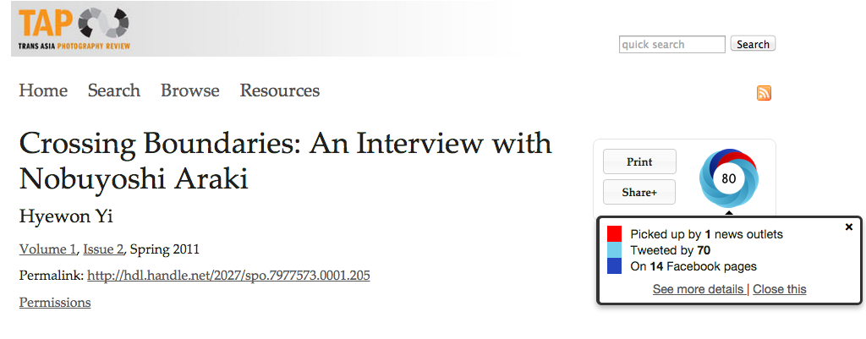
...create a story from the numbers!
Notes:
You need to do more than just throw numbers around.
Saying an Altmetric score is 121 might not mean much to some folks. Dig a little deeper. What type of conversation is taking place on social media? Is it now a noteworthy resource listed on Wikipedia? Or, if your program is using a digital annotation tool like Hypothes.is, there may be conversations happening WITHIN the material itself.
Here’s an example of an article from the Trans Asia Photography Review. This is a journal out of Hampshire college that publishes twice a year with about 10-15 articles per issue and typically well over 100 images per issue...and is basically run by two people, Sandra Matthews, the managing editor (and one of the sweetest ladies around) and her web developer. This particular article has an Altmetric score of 80. Yawn. However, it was mentioned in an article in The Guardian. That bit of information actually means something to people.

Slide 13
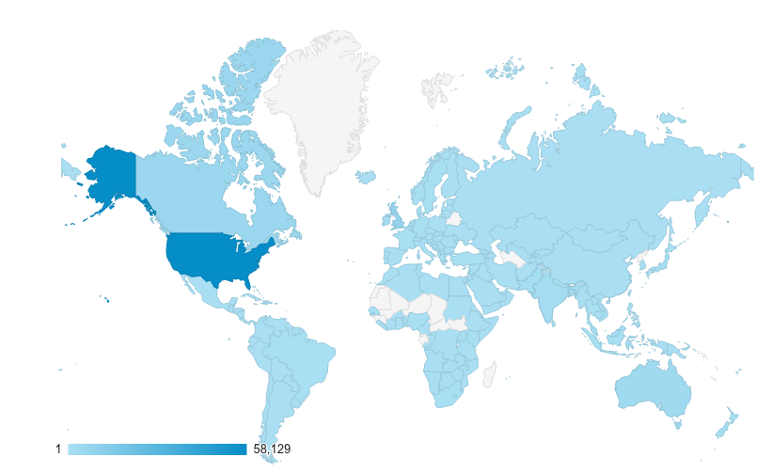
Emphasizing non-academic (and non-US/non-Western) audiences
  available to users at schools of all sizes—if this were a subscription journal, your school might not have access to it (especially if you’re at a small school)
  clinical/practical uses (social workers, therapists)
  Readers around the world
  The public!
Journal of Muslim Mental Health [April 2015-May 2016]
Notes:
Kelly:
*One of the best things about open access, regardless of how big or small your publication is, is that it has a broad reach.
*The Google Analytics maps never have just the United States shaded in. People from all over the world are reading your content because it is freely available to them!
*The bonus of diving into analytics and discovering these stories of impact is that not only does it make a case for the importance of a specific journal and why it should continue, but it will serve as a reminder of the bigger picture of why we all put so much work into putting this work out there. It’s all too easy to get bogged down in the submissions or the editorial board shuffle or the day-to-day production tasks, but recognizing big picture impact will help editors take a much-needed step back and be re-energized. In addition, you can use this as a chance to remind yourself that your publishing program and your publications serve a unique purpose and to be proud of that.
After all, their stories of impact are your stories of impact.

Slide 14
3
Change = Discovery

Slide 15
What alternative funding options and opportunities are available to journal editors?
    Editorial board chips in
    Sponsored themed issues
    Departmental funds from home institution
    Grants
    Team up with a conference or association
    Charging for submissions and/or publication fees
    Donate button
    kickstarter/gofundme (crowdsourcing)
    Advertising
    (Re)negotiating faculty contract to include support for the journal
    Banding together with the institution’s other journals
    Be creative, collaborative
    Bake sale! (jk)
Notes:
Allison:
So, what alternative funding options and opportunities—besides toll-access and author-pays—are available to the editors of open-access journals? Here are some of the ideas our journal editors at Michigan Publishing have come up with:
One option is that members of the editorial board can all chip in
When editorial board members reside at various institutions across the country or around the world, a wider range of options might be available depending on the institution, so pledging an monetary contribution could be in some editors’ interest.
Sharing costs among a larger group of people who are dedicated to the journal and its sustainability means everyone has a tangible stake in it. The effects of this solution, however, could be either positive or negative—some editors might struggle with this. Money can sometimes equal decision-making power, which can cause new conflicts, so that should be considered.
Another option is for editors to find sponsors for special themed issues
One of our student-run journals, Absinthe, publishes a themed issue each year sponsored by a different department on campus. As a journal of literary translation, Absinthe’s content lends itself uniquely well to this model for support.
Seeking departmental funds from the journal’s home institution is another potential avenue
At larger institutions in particular, it’s often possible to secure research funds for an open-access journal. Communicating the journal’s impact is especially important when presenting a journal’s needs to its home institution. As Kelly explained, it’s good to highlight analytics that show an impressive range of geographical readership and outline how audiences are engaging with the journal’s content online.
Departments might also be interested in supporting publications that demonstrate student engagement and learning through a “publishing as pedagogy” program. In academic settings where students are directly involved in the production of a journal (with editorial, marketing, design, web development, or other areas), establishing a formal “publishing as pedagogy” curriculum devoted to the journal’s production could be beneficial to its overall sustainability while also giving students the opportunity to have hands-on experience in publishing.
Another alternative funding option is grants
Depending on where you live, there may be grants available to which you can apply for funding for open-access journals. There’s a great grant in Canada that provides ongoing funding, so the sustainability of the funding is built right in. It’s certainly worth doing to the research relevant to a specific open-access journal to see what money it might be eligible for.
It’s also possible to find funding by teaming the journal up with a conference or association
This is a clever way to collaborate with a group that may already have funds secured. For example, the publication of one of the journals we support, the Bear River Review, is sponsored by the Bear River Writers’ Conference, which is sponsored in part by the University of Michigan Department of English Language & Literature and in part by generous private donors.
Charging for submissions and/or publication fees is definitely an option
This is very simple to control through the submission management tool, Submittable, which a number of our journals at Michigan Publishing use for coordinating editorial and peer review of incoming journal submissions. However, there could be backlash from potential authors if they have to pay to submit their work. For example, the editor of one of our journals, Philosophy and Theory in Biology, tried to start charging a $20 submission fee, and there was an uproar in the philosophy community. That editor then changed it from a required fee to an optional or suggested “tip jar” fee.
Donate button
A donate button is easy to set up through PayPal or Submittable. We encourage all our journal editors to have one--because why not? It involves very little work to put up on a site, and once it’s there, you’re open for donations, so it’s great to have as a possible stream of support--and it’s easy to link to and share on social media for maximum reach.
kickstarter/gofundme (crowdsourcing)
Crowdsourcing campaigns, similar to offering a donate button, might be a “why not?” idea for an open-access journal, especially in the getting-it-up-and-running phase. Kickstarter and Gofundme are two popular crowdsourcing options. However, the chances of reaping the rewards of a crowdsourced campaign might not meet your expectations.
Another option is advertising
Soliciting or accepting curated advertising from related academic or industry groups (including conferences) to go in the journal’s print issues or on its website can be a great way to secure recurring funding if the journal has strong relationships with its advertisers. This kind of curated advertising can actually build a community of support around a journal.
(Re)negotiating faculty contract to include support for the journal
For a dedicated editor whose journal appointment could be funded through a more official structure within their own faculty contract, negotiating (or renegotiating) that contract to include support for the journal is a path to sustainability.
Banding together with other journals at a home institution is another option
Because there’s power in numbers! There might be a better chance of getting institutional support for a journal if its editors are working directly with other journal editors on campus. In fact, simply building a community of journal editors at any institution creates a valuable community for publishing partners across campus.
Ultimately, the challenge of seeking and securing funding can be a chance to be creative in brainstorming and collaborative in articulating the value of open-access journals, passion for a particular subject, and the impact the research can have in the world.
Also, as we heard yesterday, bake sales all the way!

Slide 16
We learned that most journals have no bank account! How can we advise them?
Make use of institutional infrastructure, if possible
Incorporating is an option (though this may not be necessary or make sense; it’s often overkill for a small, open access journal)
Are there stipulations attached to money you’re receiving? What kind of reporting out will need to happen?
Work with the Development Office at your institution to create a channel for a designated gift
Notes:
Becky:
Encourage them to make use of institutional infrastructure if possible
e.g. a sponsored project fund of some kind--this relieves issues with taxes, reporting, etc. They still have to manage their own budget but the larger legal overhead is taken care of by the institution.
If you’re receiving money, you need to make sure you’re telling folks what you’re doing with it--with a grant you may be made to comply, but with other forms of support?

Slide 17
4
Moving Forward

Slide 18
Continuing to chase folks down to determine whether they’re committed to going forward with us
How to waive fees when appropriate?
How to prepare our business office for what’s coming
How to prepare ourselves
Journal Editors’ Tea (panel on campus)
Google Group
Notes:
Kelly:
It’s one thing to discuss all of this and lay out a plan of attack, but it will be another thing to truly get the ball rolling and all the agreements signed. Are we afraid some of our publications might fall off? Yes. Is it time that some of the dwindling publications who have been avoiding us for quite some time ride off into the sunset? Perhaps. But, we hope, by giving them a year of notice and keeping communication lines open, that we can assist everyone through this process. As we said earlier, we have been encouraged so far by the fact that no one has seemed up-in-arms about this new structure and the future. In addition, even if a journal does have to end its relationship with us, I hope we have at least laid the framework for them to truly think about the sustainability and fiscal longevity of their publication...or simply sparked a series of long overdue conversations.
Becky:
Waiving fees: Do we look at impact and popularity? How much will UM affiliation factor in? How many journals will be able to waive?
Preparing the business office: Keeping communication open early on--what exactly do they need so we know what to ask from journal partners.
Preparing ourselves: AHHHHHH! This all means more work and more resources. Where are those coming from? Where does this fall in organization? Will there be new unrealistic expectations from partners? So far, it has felt like we are doing them a great service, will requiring payment shift that attitude? New sets of expectations? New complaints about workflow timelines? What if people are late to pay? What then?
Speak to the timeline--
Allison:
We strive to continue building relationships and a sense of community with our partners:
One way we’re actively doing this is by hosting quarterly “Journal Editors’ Tea” events at the University of Michigan: We see great benefit in bringing together all the journal editors from across our Ann Arbor campus--this is an opportunity for them to learn from each other, fostering a community through leveraging diversity. But will this transition into something else or combine with other events on campus? We aren’t sure yet, and how we can keep the interest up among our editors is one challenge we’ve had in the past that we’ll likely continue have going forward.
Another very simple solution we provided was to create a Google Group for all of our publishing partners. We did this to encourage our journal editors to ask questions and get advice from one another. So far, we’ve only had two editors contribute to the discussion, though, and this has pretty much fallen off since then. We were hoping to give them a venue for connecting and brainstorming together, since we realized many of them face the same challenges, but it can be hard to keep the conversation going. What we’d really love is to host a small conference for our journal editors at Michigan Publishing, where they could speak face-to-face, share their challenges and successes, and learn from each other. It’s a dream!

Slide 19
FINALLY...
Notes:
Bottom line: No one likes to think about money or have money get in the way of scholarship.
In the end, securing a small amount of consistent funding—to defray production and editorial costs, reduce the burden on editors, etc.—has a significant impact on the long-term success of a journal. It’s not just about the money--it’s about the sustainability of the journal, and that means being aware of resources, knowing how to articulate the journal’s story of meaning/impact, and forming the right collaborations to continue getting scholarship out there in the world.
Also, if it gets everyone to think about the value of what an open access journal is accomplishing, it’s worth the time and energy.

Slide 20

Thank you!!

