Slide 1
Sharing Sensitive
Social and Behavioral Science Data
Margaret Levenstein & Jared Lyle
SciDataCon 2016
12 September 2016
Notes:
This presentation discusses how ICPSR, a social and behavioral science data archive, shares sensitive data. As of February 2016, ICPSR's archival holdings include 1,256 restricted-use data collections; ICPSR staff manage over 2,000 active data use agreements. The presentation will discuss how ICPSR: 1) curates data to limit disclosure, 2) uses secure technologies to reduce risk, and 3) trains and informs users through data use agreements. We will also discuss future opportunities to improve the process of reviewing and sharing sensitive social and behavioral science data. The presentation also outlines future opportunities and challenges with respect to sensitive and disclosive data, including privacy budgets, transactional data, geospatial data, and researcher credentialing.
Some information here was presented at IDCC 2013 with George Alter.

Slide 2
About ICPSR
Founded in 1962 as a consortium of 21 universities to share the National Election Survey
Today: 750+ members around the world
Data dissemination for more than 20 federal and non-government sponsors

Slide 3
About ICPSR
600,000+ visitors per year
9,000+ data collections (1,365 of these have at least one file that is restricted-use)
250,000+ files
Staff of 109

Slide 4
What we do
Acquire and archive social science data
Disseminate data to researchers
Preserve data for future generations
Provide training in quantitative methods

Slide 5
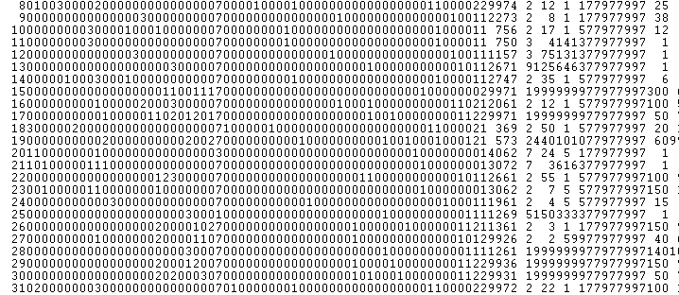
Quantitative data
Notes:
Traditionally, we’ve dealt with quantitative social surveys with properties and structures that made it fairly manageable to assess and treat for confidentiality issues.

Slide 6
Emerging sources, types, and quantities of data
Geo-spatial
Video
Administrative data
Transactions
Clicks
Sensors
Notes:
But more and more traditional data now have disclosure risk, and other types of data are emerging with disclosure risks (e.g., quantity of data, new methodologies), which increases the challenges (and opportunities) to disseminate…

Slide 7
Disclosure: Risk & Harm
What do we promise when we conduct research about people?
  That benefits (usually to society) outweigh risk of harm (usually to individual)
  That we will protect confidentiality
Why is confidentiality so important?
  Because people may reveal information to us that could cause them harm if revealed.
  Examples: criminal activity, antisocial activity, medical conditions...

Slide 8
What are We Afraid of...
  Direct Identifiers
  Inadvertent release of unnecessary information (Name, phone number, SSN…)
  Direct identifiers required for analysis (location, genetic characteristics,…)
Indirect Identifiers
  Characteristics that identify a subject when combined (sex, race, age, education, occupation)

Slide 9
Current Survey Designs Increase the Risks of Disclosing Subjects’ Identities
Geographically referenced data
Longitudinal data
Multi-level data:
  Student, teacher, school, school district
  Patient, clinic, community
  Other people knowing that someone participated

Slide 10
Who are We Afraid of?
Parents trying to find out if their child had an abortion or uses drugs
Spouse seeking hidden income or infidelity in a divorce
Insurance companies seeking to eliminate risky individuals
Other criminals and nuisances
CIA, FBI, KGB, SABOT, SBL, SMERSH, KAOS, etc...
Notes:
Type I disclosure: when an intruder has knowledge that a given person (or organization) is included in a survey and the intruder attempts to find this record.
Type II disclosure occurs when an intruder does not know the identity ahead of time and uses externally available resources (linking databases) to attempt to find survey respondents.

Slide 11
Sharing confidential data
Safe data: Modify the data to reduce the risk of re-identification
Safe places: Physical isolation and secure technologies
Safe people: Training and data use agreements
Notes:
More and more data are coming to us with disclosure risks. The data are harder to evaluate. And they’re much harder to anonymize.
Naturally, the ideal system is for the data producer to reduce or remove disclosure risk upon data collection. But we also understand that many data producers do not identify or understand disclosure issues before submitting to an archive. We see all parties who touch data (producers, archives, and users) responsible for responsible handling of confidential data. Here, we focus on the archive’s role in processing and sharing confidential data.
Our system for archiving and sharing confidential data involves a three-pronged approach: Safe data, Safe places, and Safe people…

Slide 12
Safe Data
Suppressing unique cases
Grouping values (e.g., 13-29=1, 30-49=2)
Top-coding (e.g., >1,000=1,000)
Aggregating geographic areas
Swapping values
Sampling within a larger data collection
Adding “noise”
Replacing real data with synthetic data
Notes:
Safe data involves modifying the actual data to reduce disclosure risk.
All direct identifiers should be removed from files prior to deposit.
All data collections acquired by ICPSR undergo confidentiality review to determine whether the data contain any information that could be used to identify respondents.
There are a number of actions you can take to protect respondent confidentiality: removing, masking, or collapsing variables within public-use versions of the datasets. Or, restricting access to the data.
Removing variables is a good solution for treating direct identifiers.
Blanking masks identifiers by altering original data values to missing data codes. For example, ‘abcd’ to “ “ (all blanks).
Recoding alters original data values to missing data codes. For example, value ‘1234’ is changed to ‘9999’.
Bracketing/collapsing combines the categories of a variable or merges the concepts embodies in two or more variables by creating a new summary variable. For example, age: 13-29=1, 30-49=2.
Top/Bottom coding groups the upper or lower limits to eliminate outliers. For instance, a sample with extreme values for income might top-code or round all income >$100,000.
Perterbing is a more complex statistical technique that involves alteration of the variable by variable suppressing, adding, or removing records, and random noise continuous/pseudo-continuous variables. This technique limits the appeal of the data since it alters the original data values.
Restricting access through requiring users to apply for use, and highly restricted access (e.g., secured enclave-only access).

Slide 13
Further Resources: Safe Data
Statistical Policy Working Paper 22 - Report on Statistical Disclosure Limitation Methodology https://www.hhs.gov/sites/default/files/spwp22.pdf
The American Statistical Association, Committee on Privacy and Confidentiality - Methods for Reducing Disclosure Risks When Sharing Data http://community.amstat.org/cpc/methods/methodse_further_refs
ICPSR's Confidentiality and Privacy web page http://www.icpsr.umich.edu/icpsrweb/content/datamanagement/confidentiality/

Slide 14
Safe Places
Secure Deposit Form
Secure Processing Environment (SDE)
Data protection plans
Virtual data enclave
Physical enclave
Notes:
Safe places involves both the transfer of content to ICPSR and the distribution of the data by the archive.
Your Data Protection Plan should contain the following
components:
1. Make reference to Title of Research Project and Principal Investigators.
2. List and describe all locations where copies of the data will be kept.
3. Describe the computing environment in which the data will be used:
• Computing platform (PC, workstation, mainframe platform)
• Number of computers on which data will be stored or analyzed
• Whether personal computers used in the research project will be attached to a
network or will operate independently (stand-alone)
• Physical environment in which computer is kept (e.g., in room with public
access, in room locked when not in use by research staff)
4. List and describe how data will be stored: (e.g., on PC hard drive, on removable
storage media such as CD, diskettes, or Zip(R) drive.)
5. Describe methods of data storage when data are not being used.6. Describe methods of transmitting the data between research team members (if
applicable).
7. Describe methods of storage of computer

Slide 15
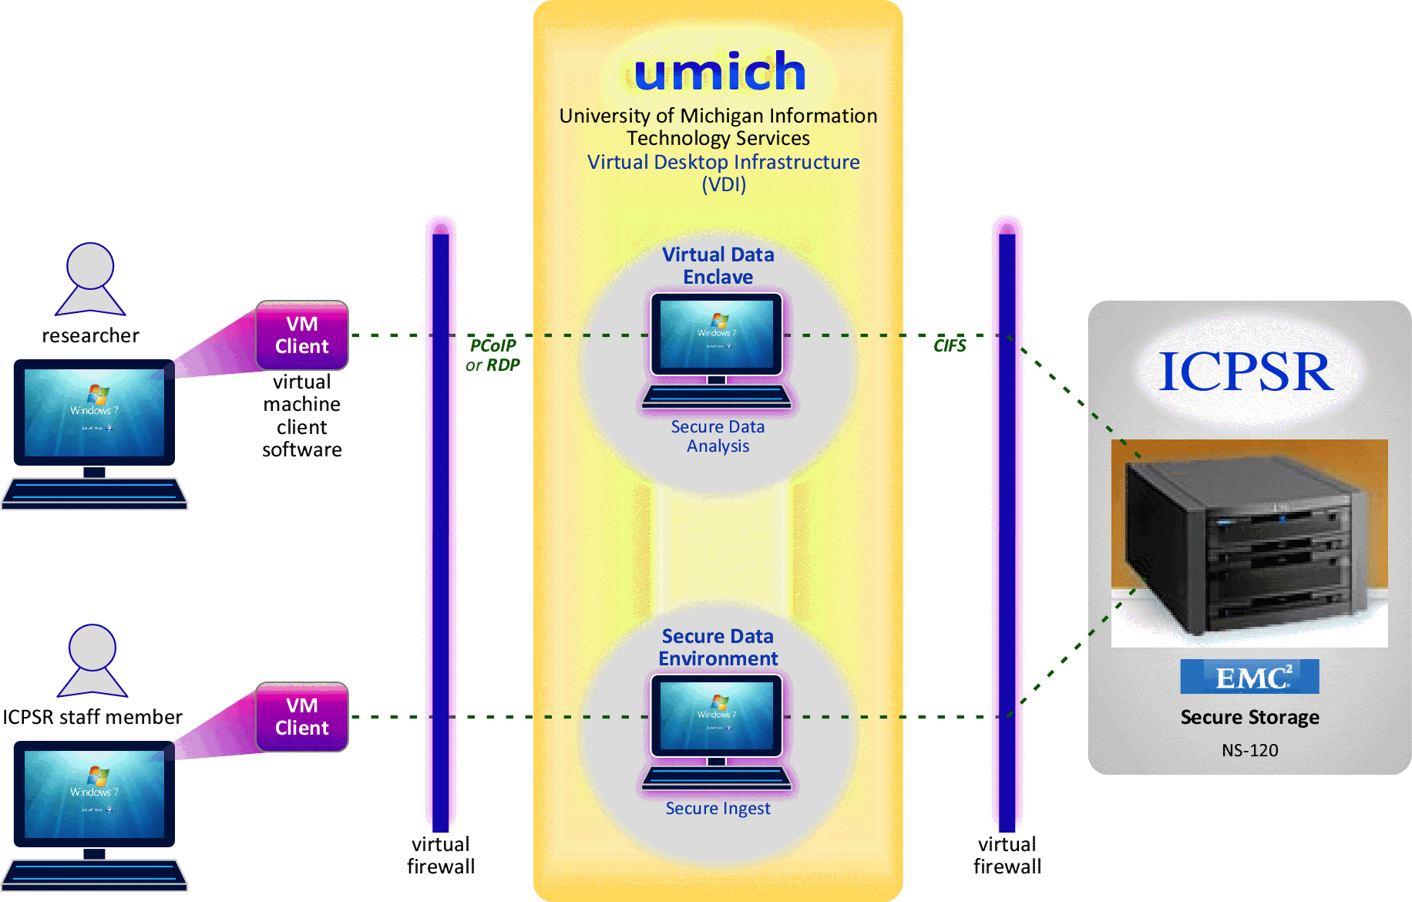

Slide 16
Further Resources: Safe Places
ICPSR “Instructions for Preparing the Data Protection Plan” http://www.icpsr.umich.edu/files/ICPSR/access/restricted/all.pdf
“Introducing ICPSR’s Virtual Data Enclave (SDE)” http://techaticpsr.blogspot.nl/2012/09/introducing-icpsrs-virtual-data-enclave.html
ICPSR Physical Data Enclave http://www.icpsr.umich.edu/icpsrweb/content/ICPSR/access/restricted/enclave.html

Slide 17
Safe People
Staff training
Data use agreements
  Responsible Use Statement
  Research plan
  IRB approval
  Data protection plan
  Behavior rules
  Security pledge
  Institutional signature
Notes:
All staff sign confidentiality pledges. ICPSR offers training to data managers in methods to protect confidentiality. Participants learn how to use a decision tree to assess disclosure risk for each study. The training also includes a new standard for basic disclosure protection, referred to as the five essential steps to limiting risk. At the end of the training, participants are tested on their skills for certification in disclosure risk management

Slide 18
ICPSR Responsible Use Statement
Users of ICPSR data agree to a responsible use statement before downloading data from the Web site. It reads, in part:
Any intentional identification of a RESEARCH SUBJECT (whether an individual or an organization) or unauthorized disclosure of his or her confidential information violates the PROMISE OF CONFIDENTIALITY given to the providers of the information. Therefore, users of data agree:
To use these datasets solely for research or statistical purposes and not for investigation of specific RESEARCH SUBJECTS, except when identification is authorized in writing by ICPSR
To make no use of the identity of any RESEARCH SUBJECT discovered inadvertently, and to advise ICPSR of any such discovery
Agree not to redistribute data or other materials without the written agreement of ICPSR
Source: “Navigating Your IRB to Share Restricted Data” Webinar (http://bit.ly/Vi3RXd)
Notes:
All users must agree to the Responsible Use Statement.

Slide 19
  Restricted Data Use Agreement
Sets requirements of the investigator and institution
Defines ICPSR’s obligations
Requires signatures from investigator and legal representative of researcher’s institution
Incorporates by reference
  Information entered into the access system
  IRB approval or exemption for project
  Data security plan
Source: “Navigating Your IRB to Share Restricted Data” Webinar (http://bit.ly/Vi3RXd)

Slide 20
Data Use Agreement
To avoid inadvertent disclosure of persons, families, households, neighborhoods, schools or health services by using the following
guidelines in the release of statistics derived from the dataset.
  1. In no table should all cases in any row or column be found in a
  single cell.
  2. In no case should the total for a row or column of a cross-tabulation be fewer than ten.
  3. In no case should a quantity figure be based on fewer than ten cases.
  4. In no case should a quantity figure be published if one case
  contributes more than 60 percent of the amount.
  5. In no case should data on an identifiable case, or any of the kinds of data listed in preceding items 1-3, be derivable through subtraction or other calculation from the combination of tables released.

Slide 21
Data Use Agreement
The Recipient Institution will treat allegations, by NAHDAP/ICPSR or other parties, of violations of this agreement as allegations of violations of its policies and procedures on scientific integrity and misconduct. If the allegations are confirmed, the Recipient Institution will treat the violations as it would violations of the explicit terms of its policies on scientific integrity and misconduct.
Notes:
We take confidentiality very seriously…

Slide 22
What are the consequences of violating the terms of use agreement for ICPSR data?
Subjects who participate in surveys and other research instruments distributed by ICPSR expect their responses to remain confidential. The data distributed by ICPSR are for statistical analysis, and they may not be used to identify specific individuals or organizations. Although ICPSR takes steps to assure that subjects cannot be identified, users are also obligated to act responsibly and not to violate the privacy of subjects intentionally or unintentionally.
If ICPSR determines that the terms of use agreement has been violated, one or more of the steps will be taken which may include:
    ICPSR may revoke the existing agreement, demand the return of the data in question, and deny all future access to ICPSR data.
    The violation may be reported to the Research Integrity Officer, Institutional Review Board, or Human Subjects Review Committee of the user’s institution. A range of sanctions are available to institutions including revocation of tenure and termination.
    If the confidentiality of human subjects has been violated, the case may be reported to the Federal Office for Human Research Protections. This may result in an investigation of the user’s institution, which can result in institution-wide sanctions including the suspension of all research grants.
    A court may award the payment of damages to any individual harmed by the breach of the agreement.
Notes:
We take confidentiality very seriously…

Slide 23
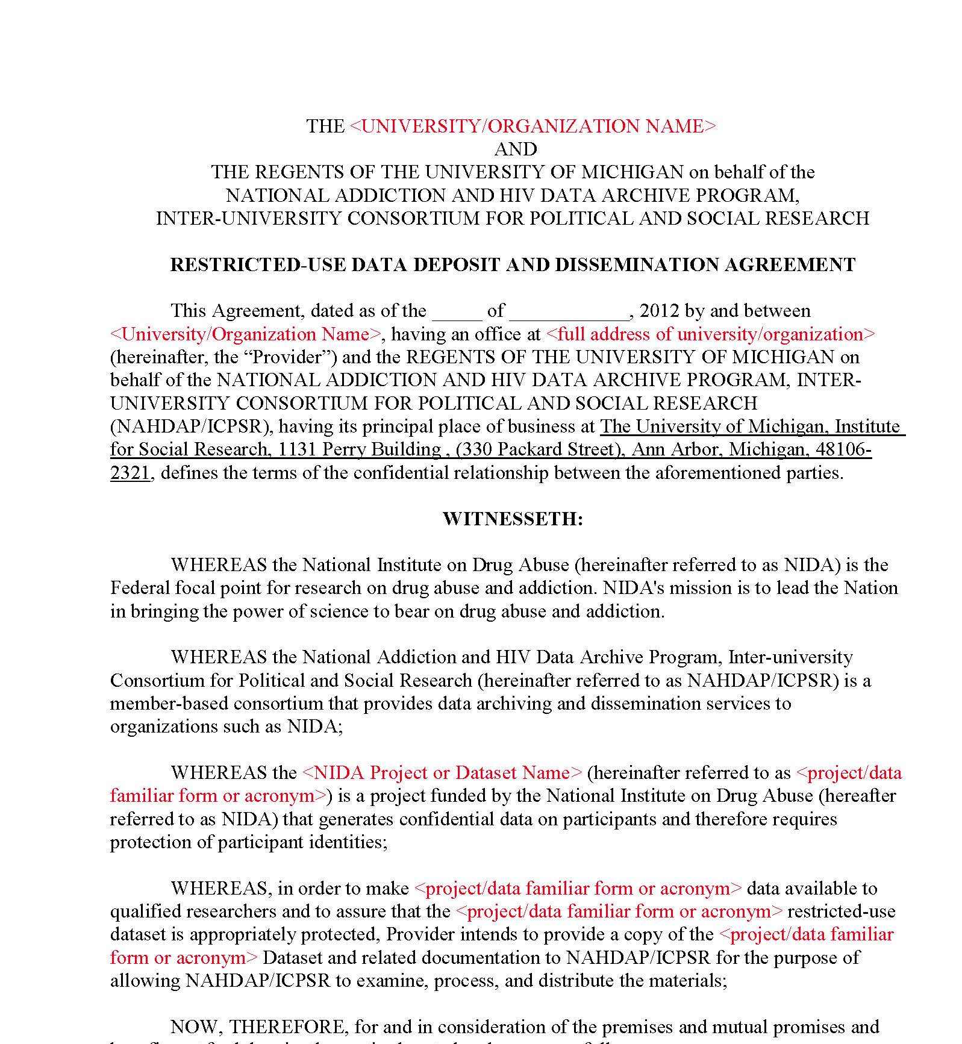
Customizing the RUDDDA
Customize RUDDDA with information supplied by the data provider
  Institution’s legal name and address
  Official name AND familiar reference of project or dataset
  Contact name of legal representative
  Preference for electronic or hard copy
Source: “Navigating Your IRB to Share Restricted Data” Webinar (http://bit.ly/Vi3RXd)

Slide 24
Accessing Restricted-Use Data
Use online data access request system
  Link in Access Notes on study homepage
Must provide:
  Name, department, and title of investigator
  Description of the proposed research
  Approval or exemption from IRB
  Names of research staff accessing data
  CVs and signed confidentiality pledges
  Information on data formats needed and data storage technology
Source: “Navigating Your IRB to Share Restricted Data” Webinar (http://bit.ly/Vi3RXd)

Slide 25
Further Resources: Safe People
Example NAHDAP Restricted Data Use Agreement http://www.icpsr.umich.edu/files/NAHDAP/GenericRDAAgreement.pdf
NAHDAP “Restricted-Use Data Deposit and Dissemination Procedures” http://www.icpsr.umich.edu/files/NAHDAP/NAHDAP-RestrictedDataProcedures.pdf
“Navigating Your IRB to Share Restricted Data” Webinar http://bit.ly/Vi3RXd

Slide 26
Sharing confidential data
Safe data: Modify the data to reduce the risk of re-identification
Safe places: Physical isolation and secure technologies
Safe people: Training and data use agreements

Slide 27
Future Opportunities and Challenges
New types of data
  New research opportunities
  New confidentiality (and proprietary) challenges
New methods for protecting data
  Barriers to data should be low
  Access to confidential data is not “free” from a societal point of view, so it shouldn’t be from the researcher’s point of view either
Interaction of safe data, safe places, safe people
Notes:
Ideas: Proposed researcher credentialing system, the interaction of safe data/safe people/safe places, increased risk associated with data linkages and new types of data (e.g., geospatial), and other approaches such as differential privacy and a privacy budget for managing access to/release of analysis of confidential data). We could also talk about technological improvements, such as two-factor authentication, for the VDE, that we are already doing, but which indicate how technology can increase protection and decrease the barriers to using confidential data. Remote job submission (differential privacy). Researcher credentialing (how do you enforce agreements).

Slide 28
Future Opportunities and Challenges
Interaction of safe data, safe places, safe people
  Tradeoff between information content and confidentiality protection
    Can always – and only – assure 100% confidentiality protection by not allowing access
  Make data safer through transformation, aggregation, suppression, noise infusion
    “Less” safe data can be made safer through safe places and safe people
    Technological change, broadly speaking, can move out the frontier of these tradeoffs
Notes:
Ideas: Proposed researcher credentialing system, the interaction of safe data/safe people/safe places, increased risk associated with data linkages and new types of data (e.g., geospatial), and other approaches such as differential privacy and a privacy budget for managing access to/release of analysis of confidential data). We could also talk about technological improvements, such as two-factor authentication, for the VDE, that we are already doing, but which indicate how technology can increase protection and decrease the barriers to using confidential data. Remote job submission (differential privacy). Researcher credentialing (how do you enforce agreements).

Slide 29
Privacy Budget
Every time you make data, or analysis of data, available, it increases the risk of re-disclosure
Goal is to maximize the social value of data without spending the ‘privacy budget’ that captures the acceptable level of risk

Slide 30
Transactional Data
Commercial (and organizational) transaction data
  Created and collected in course of human activity
  Follow over time, across people and organizations
  Transforming social, behavioral, health sciences
  Contains both personal and organizational content that has private value

Slide 31
How to protect?
One solution: transform data to retain informational content while reducing potential for disclosure
Science article (11 July 2014)
  Examined changes in individual consumption in response to changes in income (classic problem in economics)
  Used transactional data from online app
  Reported individuals’ share of income spent on different types of consumption and share saved
    Not individual transactions, spending, or income

Slide 32
Geospatial Data
Enormous value in linking physical, social and environmental data at very detailed geography
  Increases disclosure risk
Tiered access
  Easier access to data that has been linked, but with the geography itself suppressed
    Example: Income, asthma, air quality but NOT lat/long
  Limited access to detailed geography
    But trusted researchers in safe environments can create new linkages that expand the data that can be more generally available
Principle: greater access comes with responsibilities to the research community

Slide 33
Researcher credentialing
Goal: establish community-recognized system of researcher qualities (training, institutional affiliation, prior experience with restricted data, background checks)
  Reduce cost to researcher of obtaining access
  Reduce cost to data providers of vetting and training researchers

Slide 34
Researcher credentialing
Credentialing allows researchers to establish a reputation for responsible use of confidential data
  Credentialed researchers are offering their reputations as their bond
    The existence of the credential and the reputation gives researchers something that they can lose, and thus makes it possible for them to access data not possible if there were no credible bond

Slide 35
Researcher credentialing
Researcher credentialing can increase data sharing
  Assurance to data providers
  Reduces cost of providing confidentiality protection
Existence of community norms creates a mechanism for data producers to share data.
  Rather than “I can’t share the data,” instead “I’m willing to share data with people with such and such a credential.”
  Data management plans can protect confidentiality by relying on established community norms

Slide 36
Thank you!
maggiel@umich.edu
lyle@umich.edu

