Slide 1
Getting Students Hooked on Research Through the Use of Data
(For Faculty Already Hooked and Those in Another Boat Altogether)
Lynette Hoelter
Presentation at Clark Atlanta University
September 20, 2016

Slide 2

Presentation Outline:
Benefits of using data
Quantitative literacy
Example assignments
  Substantive courses
  Research methods/statistics
Sources of data and more
Image courtesy of jesadaphorn at FreeDigitalPhotos.net
Slides can be found on Google Drive: http://tinyurl.com/CAUDatainTeaching

Slide 3
Which statement best describes your relationship to quantitative data?
  I try to keep my distance from data as much as possible (not very comfortable).
  We have a civil relationship, but you wouldn’t likely catch us hanging out at the coffee shop (somewhat comfortable).
  Data and I are the best of friends (very comfortable).
  I wake up in the morning excited about data and all the cool ways I can manipulate, I mean use, it that day (extremely comfortable).

Slide 4
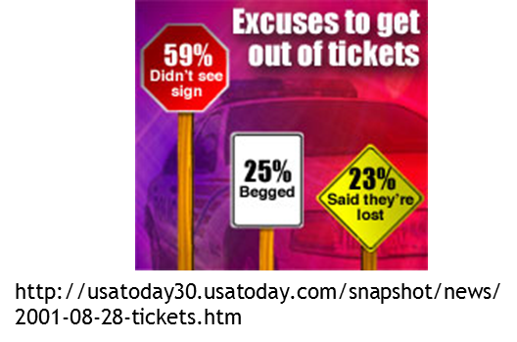
Why Use Data in Teaching?
Boosts students’ quantitative literacies
Engages students with content on a more active level, better recall and understanding of content
Practice thinking critically in a variety of contexts
Creates bridges between substantive courses and “technical” methods/stats courses in disciplines in which they are required
Might attract more quantitatively inclined students to your majors (or at least reduce “math phobia”)
IT’S FUN!!! You can find data about anything

Slide 5
Using Data Gets Students Thinking
Evidence is evidence, right?
Numbers/statistics do not exist apart from people (it is election season…)
  Who counted?
  What exactly did they count?
  Why did they count it?
Quantitative literacy and substantive content go hand in hand
In the words of Mark Twain, “Facts are stubborn, but statistics are more pliable.”

Slide 6
All Students Benefit
General benefits of active learning
Clarity in thinking and writing (e.g., no “fudge words”)
Empirical reasoning becomes a habit of mind
JOB SKILLS – just remind them to include on resume

Slide 7
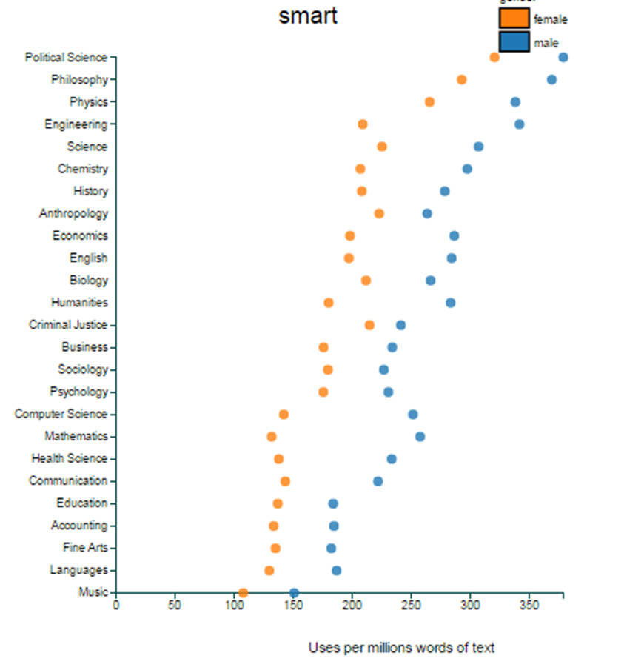
Quantitative Literacy (QR, Numeracy, Stat Lit)
Skills learned and used within a context
Reading and interpreting tables or graphs and to calculating percentages and the like
Working within a scientific model (variables, hypotheses, etc.)
Understanding and critically evaluating numbers presented in everyday lives
Knowing what kinds of data might be useful in answering particular questions
Evaluating and creating arguments based on data
Notes:
“‘Statistical literacy, quantitative literacy, numeracy – under the hood, it is what do we want people to be able to do: Read tables and graphs and understand English statements that have numbers in them. That’s a good start,’ said Milo Schield, a professor of statistics at Augsburg College and a vice president of the National Numeracy Network.
Shield was dismayed to find that, in a survey of his new students, 44 percent could not read a simple 100 percent row table and about a quarter could not accurately interpret a scatter plot of adult heights and weights.”
Chandler, Michael Alison. What is Quantitative Literacy?, Washington Post, Feb. 5, 2009
Critical for a democratic society (Steen 2001)
Informed citizenry – must be able to make sense of information coming from multiple sources.
Use of evidence in making decisions and evaluating arguments.

Slide 8
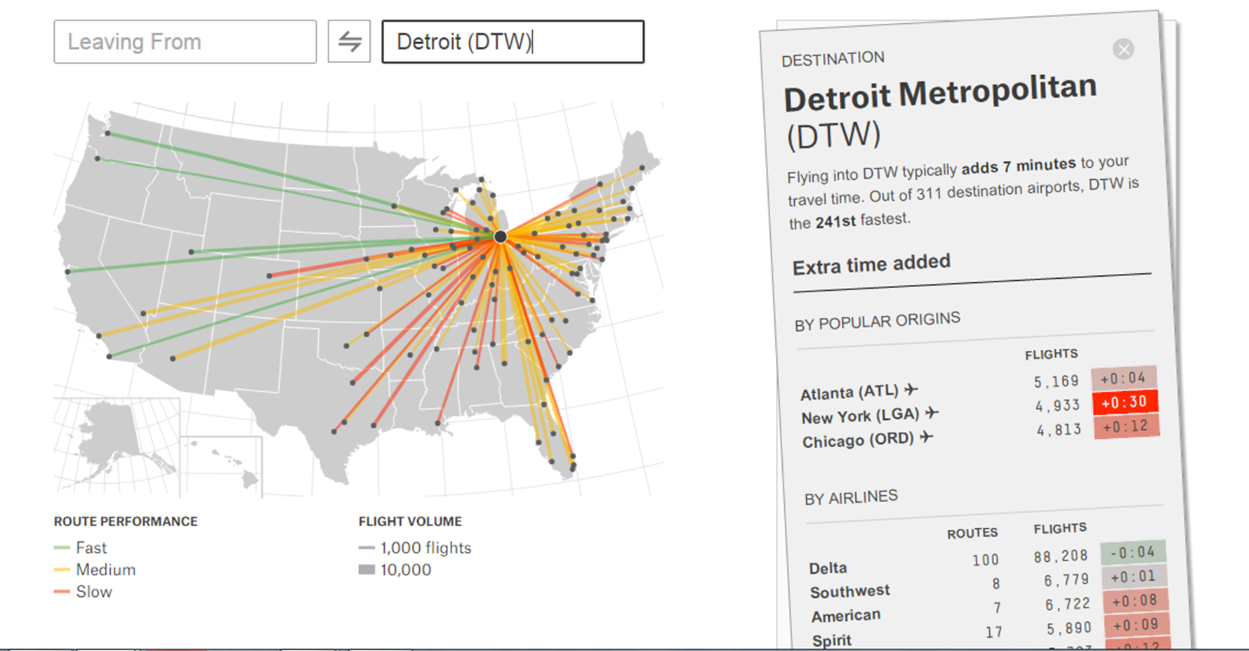
Importance of Quantitative Literacy
Availability of information requires ability to make sense of information coming from multiple sources
Use of evidence is critical in making decisions and evaluating arguments: e.g., risks related to disease or treatment, political behaviors, financial matters, costs/benefits of buying a hybrid
Understanding information is prerequisite for fully participating in a democratic society (Did I mention election season??)
Gets students to begin thinking like researchers
Notes:
Students get information from everywhere from “traditional” sources to blog posts to tweets, etc. Using data within the QL context introduces students to the need to ask questions about the conclusions they hear or read and the data upon which those conclusions are based.
Understanding where data come from and thinking about credibility of the source(s) is critical to using the evidence from those data in making informed decisions.

Slide 9
But… how?!?!?!
I don’t have time, don’t know enough, don’t care enough, have too many students, can’t spare class time, would rather let the people who teach stats teach that stuff, [insert your reason here] to just do that – it’s not easy, you know!
Notes:
Doesn’t have to be a lengthy assignment or in place of other course content – can be used to make points about content. Many sources exist where work is largely already done.

Slide 10
Example Teaching Information
Best Practices
Learning Objectives
Students should be able to:
Articulate why data are better than anecdotes
Explain why association is not causation
Consider definition issues in presentations of data
Identify fallacies in empirical arguments
Recognize typical biases in data and presented results (sampling, question wording, graphs)
Scaffold learning – practice makes perfect
Emphasize process/understanding rather than facts
Incorporate sense of discovery
Group/collaborative work (even think-pair-share)
Some personal interest if possible (comparing home state to another state on Census measures, allowing students to choose variables for at least part of exercise)
Use real-world examples
Notes:
These can dovetail with things already covered in course content. Goals paraphrased from Guidelines for Assessment and Instruction in Statistics Education report (Alliaga et al, 2010).

Slide 11
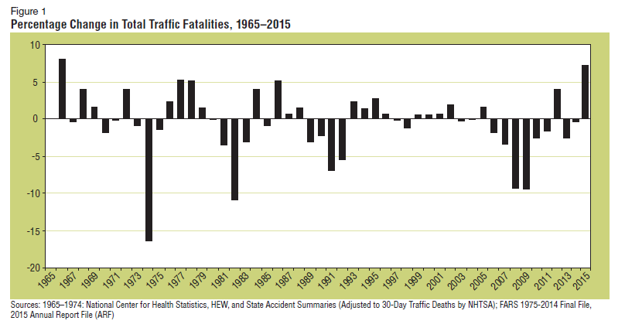
A Few Easy Ideas
Substantive Courses
  Start class with data
  Tie survey data to topic of lecture
  Require evidence-based arguments
Research Methods/Statistics
  Use real data as examples for problems or exams
  Look to documentation from secondary datasets for methods examples
  Replicate published results
Notes:
Example from report about increasing road deaths in US, http://teachingwithdata.blogspot.com/2016/09/road-safety-in-us.html

Slide 12
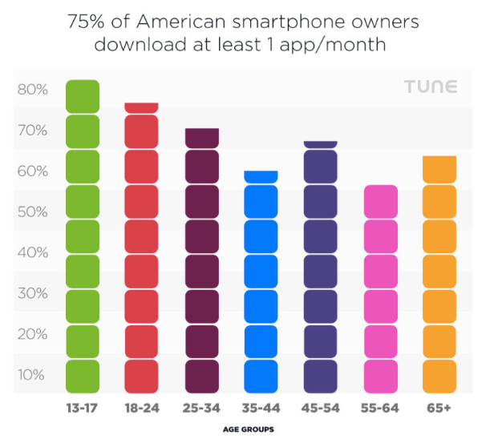
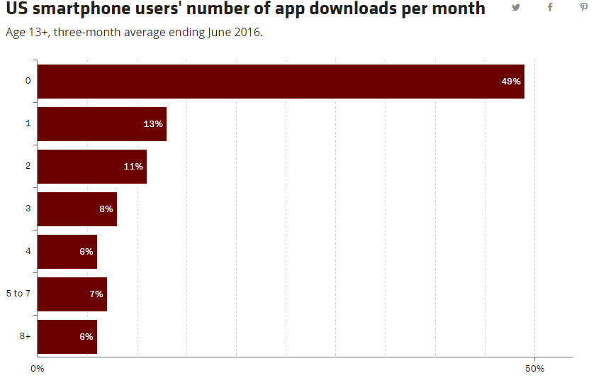
Smartphone App Downloads
Notes:
From: http://www.recode.net/2016/9/16/12933780/average-app-downloads-per-month-comScore and https://www.tune.com/blog/no-the-average-american-does-not-download-0-apps-each-month/
From Recode:
Specifically, some 49 percent of U.S. smartphone users download zero apps in a typical month, according to comScore, reflecting a three-month average period ending this past June.
Of the 51 percent of smartphone owners who do download apps during the course of a month, “the average number downloaded per person is 3.5,” comScore’s report says. “However, the total number of app downloads is highly concentrated at the top, with 13 percent of smartphone owners accounting for more than half of all download activity in a given month.”
Do these concepts sound familiar? That’s because comScore has been banging this drum for a while. Two years ago, a similar study found that almost two-thirds of U.S. smartphone owners downloaded zero apps in a typical month. So this year’s 49 percent suggests an improvement.
What’s the deal? ComScore’s Andrew Lipsman says it’s more a reflection that his company has improved its methodology since then — rather than any drastic changes in the app economy — so it’s not fair to compare the two surveys apples-to-apples.
Meanwhile, others report significantly different data. Tune, a company that works in the mobile-app advertising market, found that 75 percent of U.S. smartphone owners download at least once a month, based on a June 2016 survey.
Tune’s story is based not on survey data but on download data – people with zero downloads are not represented except by extrapolation. Authors also note that many users have multiple devices, etc.

Slide 13
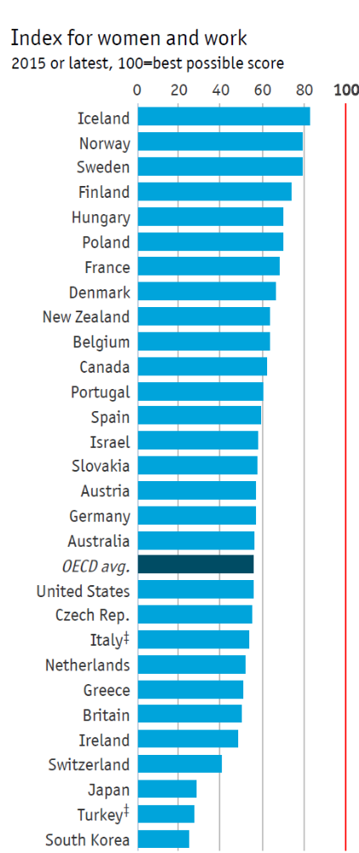
Data as Content
Inequality, work, economics, family, gender, poverty
http://www.economist.com/blogs/graphicdetail/2016/03/daily-chart-0
Have students find their own data on pay differences, job types, etc.
*Female minus male rate Male minus female median wages,
divided by male median wages No data for child-care costs,
median value given Lower or single house **Net earnings

Slide 14
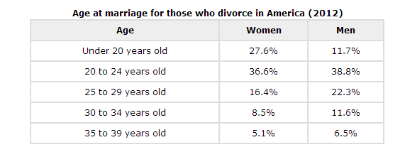

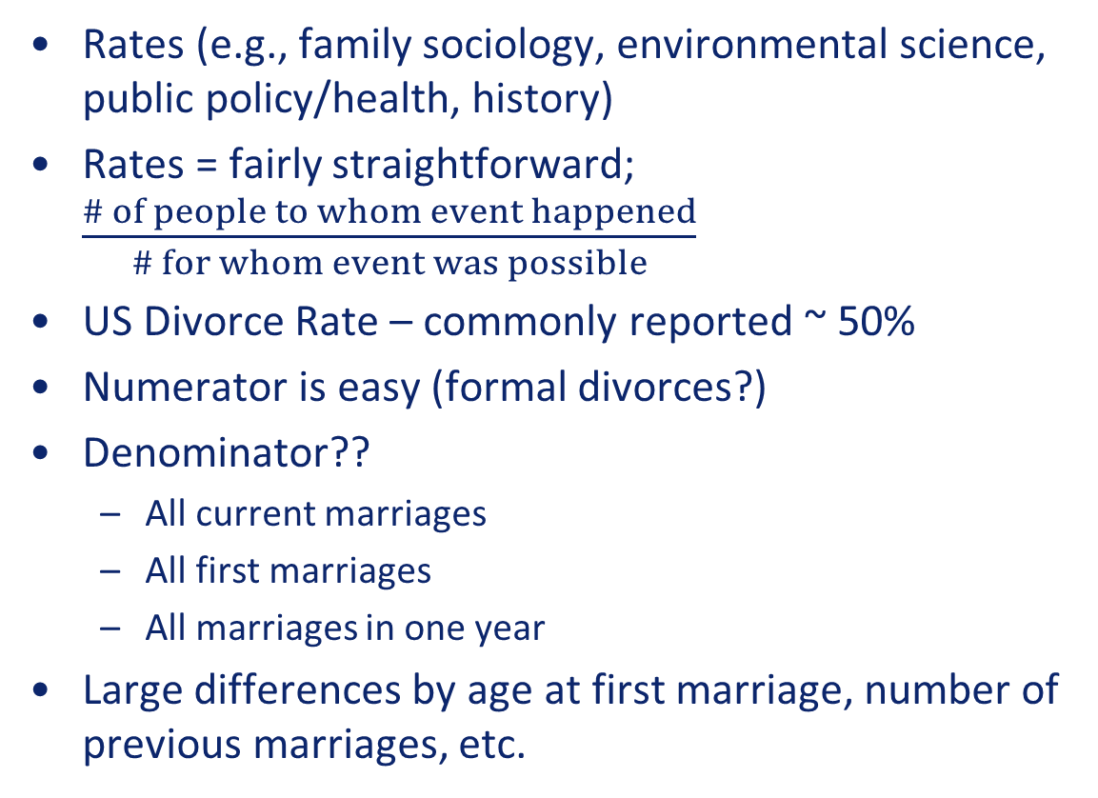
Data as Content
Rates (e.g., family sociology, environmental science, public policy/health, history)
Rates = fairly straightforward; $\frac{\# of people to whom event happened}{\# for whom event was possible}$
US Divorce Rate – commonly reported ~ 50%
Numerator is easy (formal divorces?)
Denominator??
  All current marriages
  All first marriages
  All marriages in one year
Large differences by age at first marriage, number of previous marriages, etc.

Slide 15
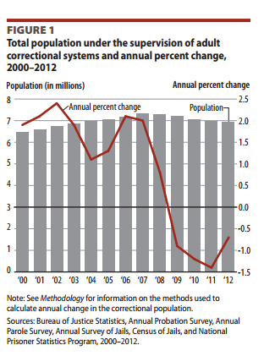
Data as Content
Criminology/Criminal Justice, Public Policy, Deviance
Sources: http://www.bjs.gov/content/pub/pdf/cpus12.pdf and http://www.deathpenaltyinfo.org/node/6495 (next slide)

Slide 16
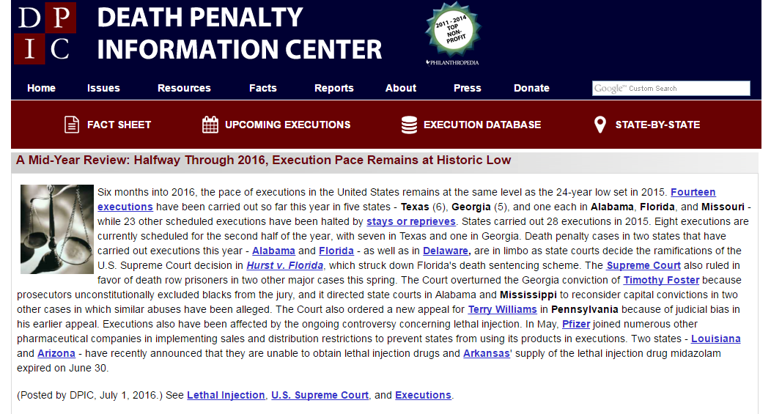

Slide 17
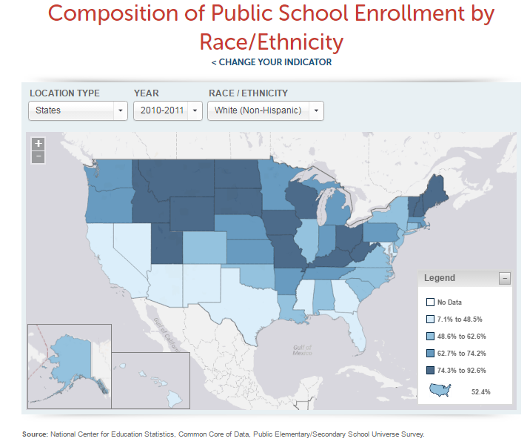
Data as Content
History, Policy, Education or Literature
Compare piece of fiction to statistics to determine “accuracy” of representation
Census data to provide context
Mapping travels of main characters/groups of people
Notes:
Map from: diversitydatakids.org

Slide 18
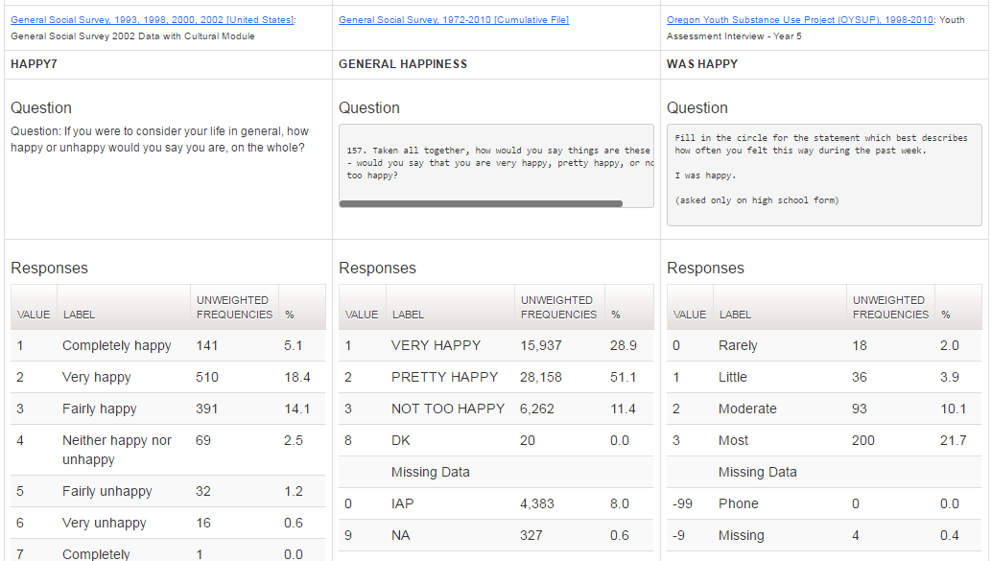
Documentation for “Real Life Methods”
Teaching operationalization, sampling
Creating a student survey
Source: ICPSR Search/Compare Variables
See also: ARDA’s Measurement Wizard, Roper Center’s iPoll…

Slide 19
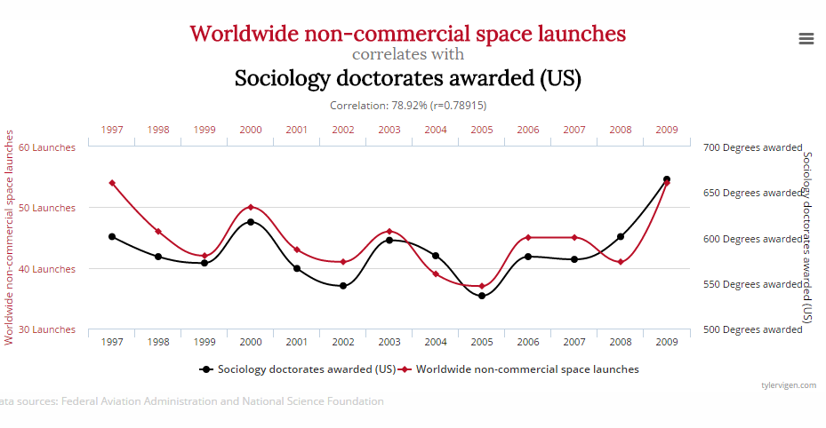
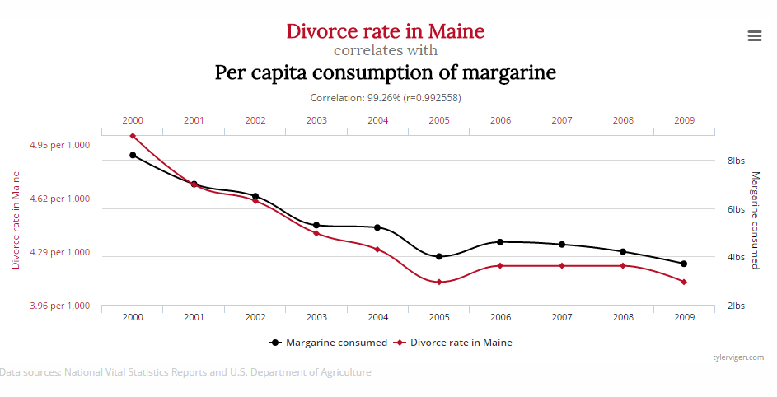
Clarify “Statistics Words” Used in Everyday Language
From: Spurious Correlations
Notes:
Just because one thing comes first does not mean it causes the other – need to identify theory/mechanism by which it might (in addition to relationship and time order).

Slide 20
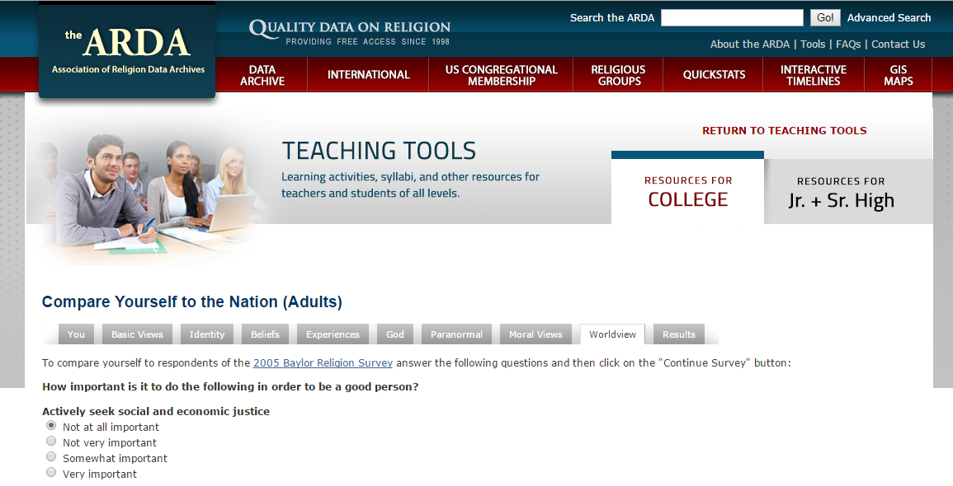
More Surveys in Class
Have students compare themselves to survey respondents
Source: http://www.thearda.com/learningcenter/compareadult/
Attitude surveys as context for arguments in papers or speech/debate
Notes:
Other attitude survey links: General Social Survey – GSS Explorer (NORC), SDA-Berkeley
Roper Center
ICPSR

Slide 21
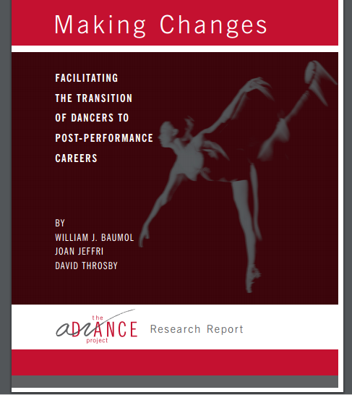
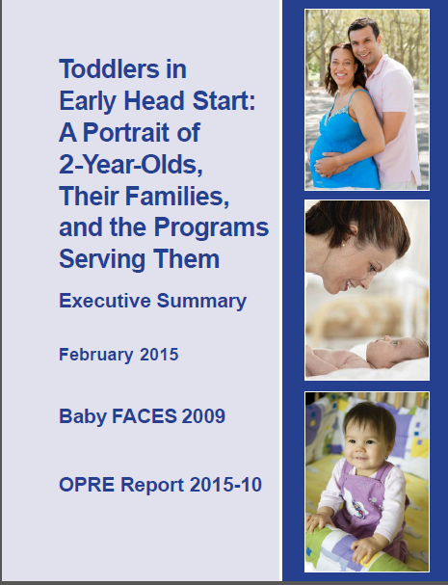
Documentation
Executive summaries – good “first step” before journal articles and/or for replication
Provides example of writing expected in job settings

Slide 22
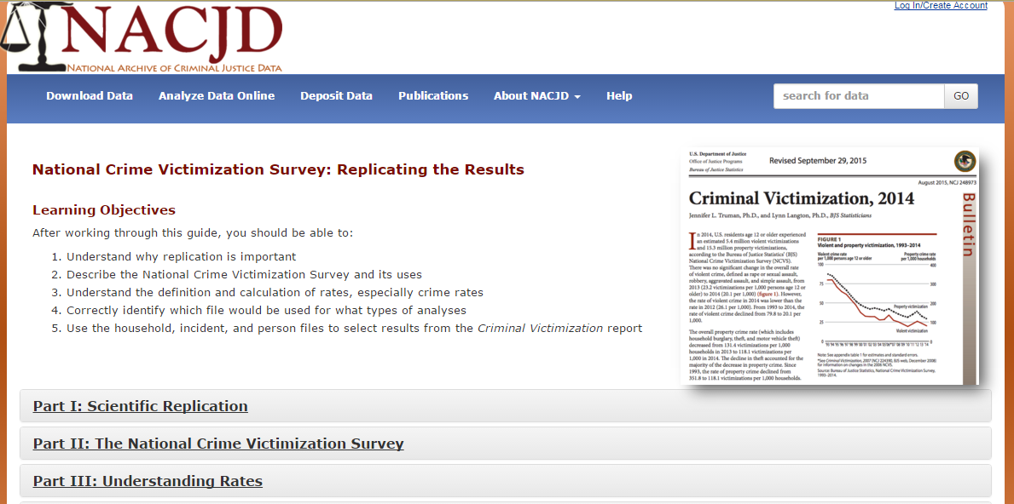
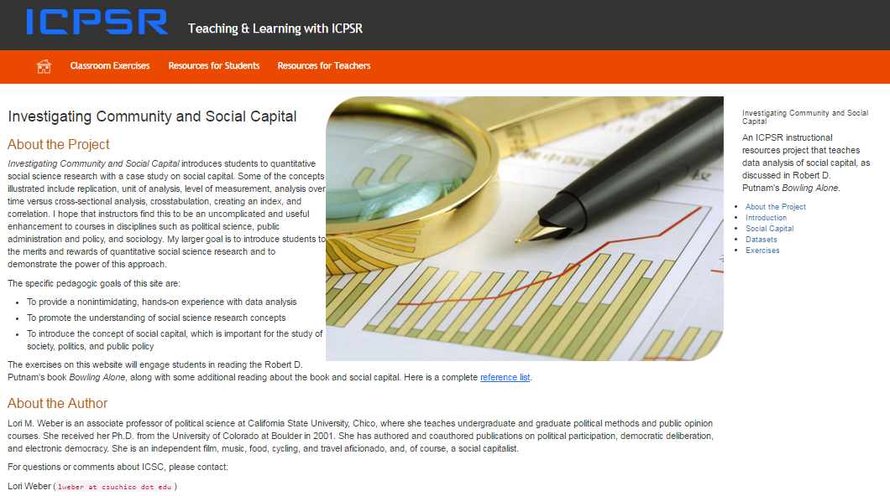
Replicate Published Results
Journal archives or ICPSR replication archive
Learning modules

Slide 23
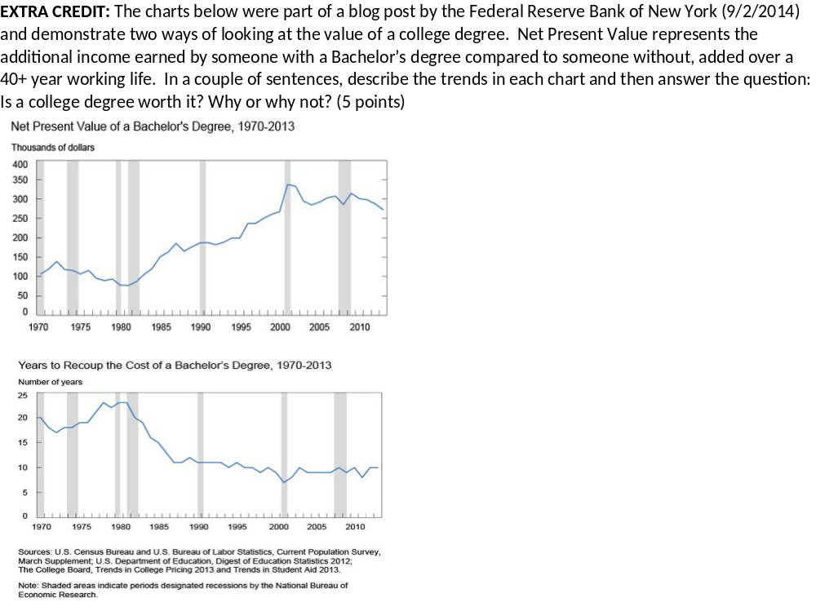
Data on Exam:
Notes:
From Exam 1, SOC250L: Quantitative Applications in Sociology, Eastern Michigan University, Hoelter, Fall 2014.

Slide 24
Students learn to question¹
What is the source of the statement and/or data?
How is the information reported?
Is the sample of adequate size and representative?
¹ Adapted from Healey, Joseph E., 2013. The Essentials of Statistics: A Tool for Social Research (3rd Ed). Belmont, CA: Wadsworth, Cengage Learning.

Slide 25
Websites to Start Your Search
Bureau of Labor Statistics compiled list
Association of Religion Data Archives Learning Center
City-Data.com
Gapminder
Google Public Data
ICPSR: Resources for Instructors
  Data-driven Learning Guides
Pew Research Center: Fact Tank, Reports, Datasets, Interactives
Population Pyramids of the World
Social Explorer: US mapping
Social Science Data Analysis Network
Spurious Correlations
Statistic Brain
Stats.org
Survival Curve
TeachingWithData.org
Understanding Uncertainty
Visualizing Data
Worldometers, USA Live Stats
Public Opinion:
  Gallup Organization
  National Opinion Research Center (GSS Explorer)
  Roper Center (iPoll)
FedStats or Government Centers such as the Census (American FactFinder), NCES, or NCHS
Blogs
  Data360
  Data in the News
  Equality of Opportunity Project
  Floating Sheep
  Graphic Detail (The Economist)
  ABCNews Who’s Counting (Paulos’ column)
  The UpShot (NY Times)
Notes:
Each of these Websites has a number of different kinds of materials and might warrant some investigation. Brief descriptions are as follow:
The Bureau of Labor Statistics has compiled a list of numerous sites with data for analysis and/or interactive tools, including US (national), state-level, and international. Primarily government sites.
Association of Religion Data Archives (ARDA) has a great collection of learning activities that include “compare yourself” surveys, map-based activities, and other exercises based on the religion surveys they archive.
City-data.com – all kinds of data at the city level – crime data, weather patterns, restaurant/food data, cemeteries, and much more
Google Public Data allows for visualizations based on data from many of the sources cited here – can also upload your own
ICPSR’s Data-driven Learning Guides (DDLGs) are self-contained exercises on a variety of topics ranging from attitudes about the environment to family relationships, to political behaviors in China. Resources for Instructors page also includes tool for creating crosstabulation tables for student use, longer modules containing multiple exercises.
Social Science Data Analysis Network (SSDAN) is the umbrella for a number of sites that include mapping activities (CensusScope) and analysis of subsets of variables (DataCounts!) all based on the US Census and American Community Survey. The exercises are created by faculty and are good examples of the kinds of things that are easily used in class.
TeachingWithData.org is a repository of materials (lesson plans, exercises, datasets, etc.) from many sources tagged with metadata to simplify searching and locating appropriate materials. Also includes “Data in the News” feature that pulls from other data blogs
Understanding Uncertainty includes a blog, videos, animations and more, all dealing with probability, chance, and general uncertainty and risk. Interesting blog post on language used to describe “chance” in a variety of situations (e.g., heart surgery)
Pew Research Center reports on surveys they’ve conducted as well as other data presented in popular media. Their site contains exercises, quick facts, datasets, and summary reports. Topic coverage is very broad.
Data-based blogs: Data360, Floating Sheep (maps primarily), Graphic Detail, the UpShot.
Worldometers is a fun site that gives facts related to government, demography, and things related to social environment and culture, broadly defined. It’s a great way to get students thinking about the world around them “by the numbers” and also is a way for them to gain a sense of large numbers. USA Live Stats does the same thing for the U.S. Numbers are updated in real time.
Population Pyramids is a good site for teaching international demography and demographic trends.
Social Explorer uses Census data to create interactive maps and tables. Some features are freely available, others require membership, but UM is a member. (Log in through the library page.)
Gapminder is good for demonstrating global changes over time in things like population size and wealth distribution.
Survival Curve is an interactive exercise that shows the chance of death before one’s next birthday based on a variety of demographic characteristics.
Spurious Correlations is a collection of relationships (strong correlations) discovered as part of a computer science project – computer trolling data.
Who’s Counting is written by John Allen Paulos – doesn’t seem to be currently updated, but still lots of great examples.
Gallup Organization is good for data and reports related to public opinion issues.
Roper Center Public Opinion Archives: Some free content, others member only, but UM is a member. Access through UM library page for iPoll, with search capabilities for 600,000 public opinion survey questions
Government offices – Both NCES and NCHS have “quick stats” or “fast facts” and American Factfinder is good if having students compare their hometown to nation or other characteristics.
Statistic Brain has all kinds of statistics broken into topic areas such as food, geographic, sports, crime, etc.
Stats.org is out of George Mason Univ and their goal is for people to understand the numbers behind the news, so variety of topics, current…
TeachQR.org – the Numeracy Infusion Course for Higher Education; a group at Lehman College has been working on quantitative reasoning instruction through projects funded by NSF and elsewhere. This is a great site for examples across different disciplines. More for professional development than classroom use.
The Science Education Resource Center is aimed primarily at faculty for professional development, but also includes example exercises with extensive data about the context of their use.
UK Data Services has teaching datasets and online analysis using NESSTAR, as well as exercises and other resources for instructors.
European Social Survey site has resources about both substantive topics and methodological issues such as weighting and regression. Great for exploring data comparatively or over time.
The Guardian site includes news about UK but also significant amount of US coverage
Numeracy Infusion Course for Higher Education (NICHE) is based at Lehman College, NY – GREAT resources for QR professional development across the curriculum.

Slide 26
More Sites (but not exhaustive!)
International:
  UK Data Services Teaching with Data
  European Social Survey EduNet
  Statistics Canada
  UK’s The Guardian Data (blog) and visualizations
  Organisation for Economic Co-operation and Development
Professional Development:
  Numeracy Infusion Course for Higher Education
  National Numeracy Network
  Science Education Resource Center (Carleton College)
  TeachQR.org (Lehman College)
  Making Data Meaningful (United Nations Economic Commission for Europe)

Slide 27
In Short:
Get students thinking about numbers and their context as early and often as possible and they will
  Remember content better
  Be more engaged learners
  Understand why stats/methods are important in the social sciences (even if not going to grad school)
  Develop confidence and quantitative literacy
  JOB SKILLS!

Slide 28
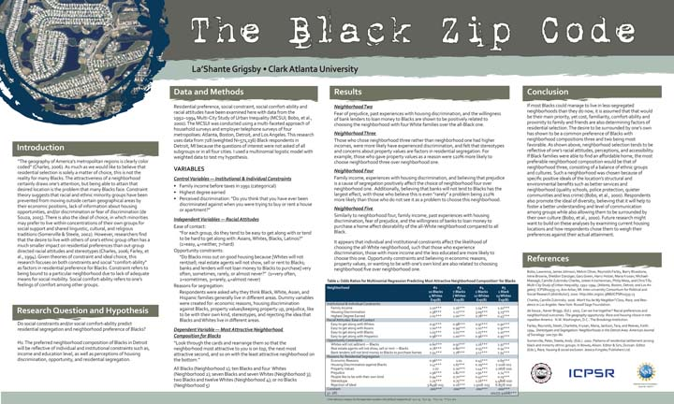
Spotlight on CAU Alum’s Research Experience
La’Shante Grigsby, 2014 ICPSR Summer Intern

Slide 29
Questions? Comments? Suggestions?
Thank You!!!
Lynette Hoelter, PhD
Director of Instructional Resources, ICPSR
lhoelter@umich.edu

