Slide 1
A DDI Primer:
An Overview and Examples of DDI in Action
Barry Radler
Distinguished Researcher (UW-Madison Institute on Aging)
Jared Lyle
Director (DDI Alliance) and Archivist (ICPSR)
Jon Johnson
Senior Database Manager (Centre for Longitudinal Studies, UCL)

Slide 2
Overview
Barriers to sharing data and metadata
DDI: the metadata standard for Social Science
DDI use case with a data archive
  ICPSR archive
DDI use cases in research projects:
  MIDUS portal
  CLOSER portal
DDI Takeaways

Slide 3
Barriers to Sharing Data and Metadata

Slide 4
Barriers to sharing data and metadata
Data are meaningless without metadata
  Data require good documentation for understanding

Slide 5
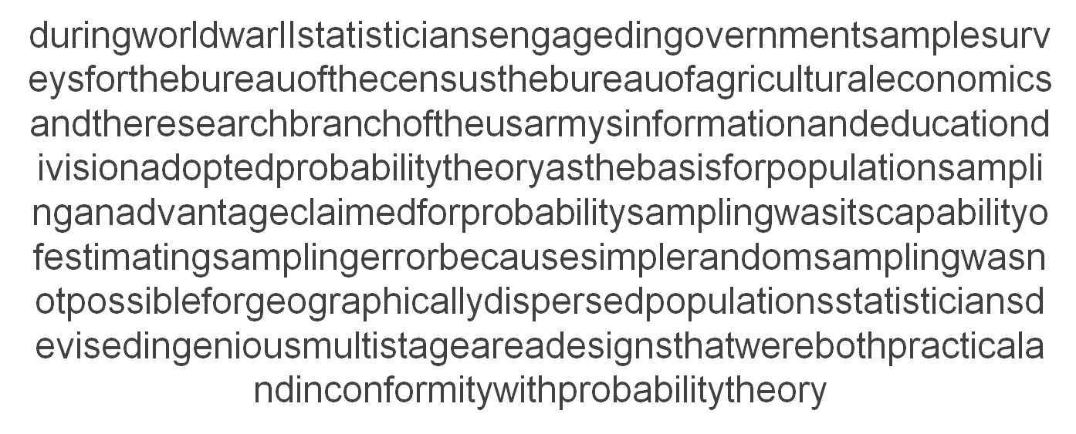
Metadata are like punctuation

Slide 6
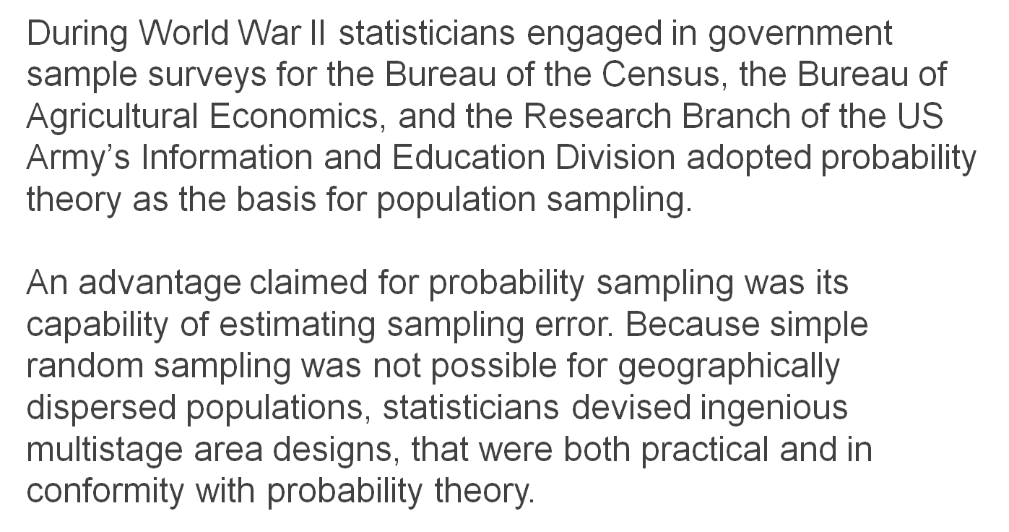
...for your data

Slide 7
Barriers to sharing data and metadata
Different agencies and clients have different systems
Taking over a survey from another agency often requires re-inputting everything
Questionnaire specification quality and format differences
Different clients have different requirements

Slide 8
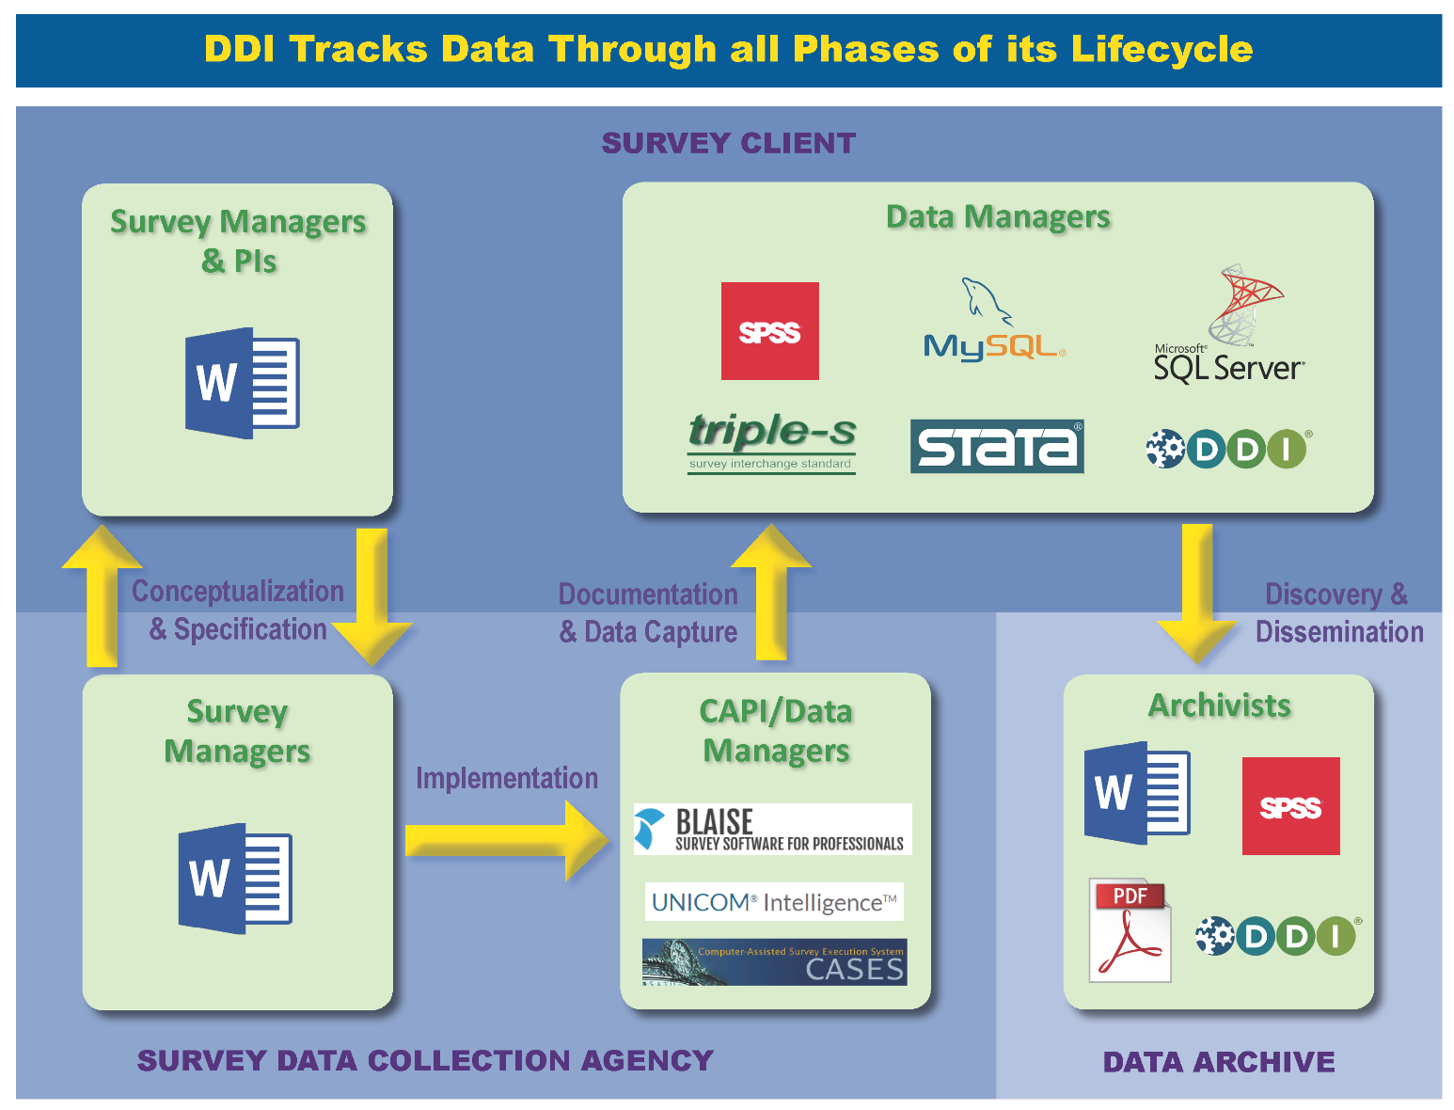

Slide 9
Barriers to sharing data and metadata
Barriers are also internal within organisations
Different disciplines have different attitudes to what is most important
Different departments speak different languages
Communication is always an issue

Slide 10
Talking about the same thing…
Synonyms for Multi-Level Models
hierarchical linear models
hierarchical models
mixed models
nested models
clustering models
generalized estimating equations
Bayesian hierarchical models
random coefficient models
random effects models
random parameter models
split-plot designs
subject specific models
variance component models
variance heterogeneity

Slide 11
DDI:
the Metadata Standard for Social Science
The Data Documentation Initiative is an international standard for
describing social science metadata
in distributed network environments.

Slide 12
DDI Adopters
DDI is being used in over 80 countries around the world. Major projects producing DDI include:
CLOSER - UK longitudinal studies
Consortium of European Social Science Data Archives
German Microcensus Data Archive
International Household Survey Network (IHSN)
Midlife in the U.S. (MIDUS) longitudinal study
Statistics Canada
Statistics Denmark
U.S. Bureau of Labor Statistics
Inter-university Consortium for Political and Social Research (ICPSR)

Slide 13
Why use it?
Advantages:
A Free and Open Standard (XML)
  Introduces a common communication protocol to research processes
Increases transparency across systems and software
Interoperates with other standards such as DataCite and Dublin Core

Slide 14
Benefits of using DDI
Makes research data:
Independently understandable
  To secondary users without data provider responding to individual queries
  Critical information about research data is identified with standard ‘tags’
Machine-actionable
  Reduce manual processes or transcription between steps of systems
  Increase transparency within and between organisations
  Data require metadata for structured reuse throughout the data lifecycle
Discoverable, Dynamic, Interactive!

Slide 15
Before DDI ...
Example:
And now a few questions about you…
At present, how satisfied are you with your LIFE? Would you say A LOT, SOMEWHAT, A LITTLE, or NOT AT ALL
1. A LOT
2. SOMEWHAT
3. A LITTLE
4. NOT AT ALL

Slide 16
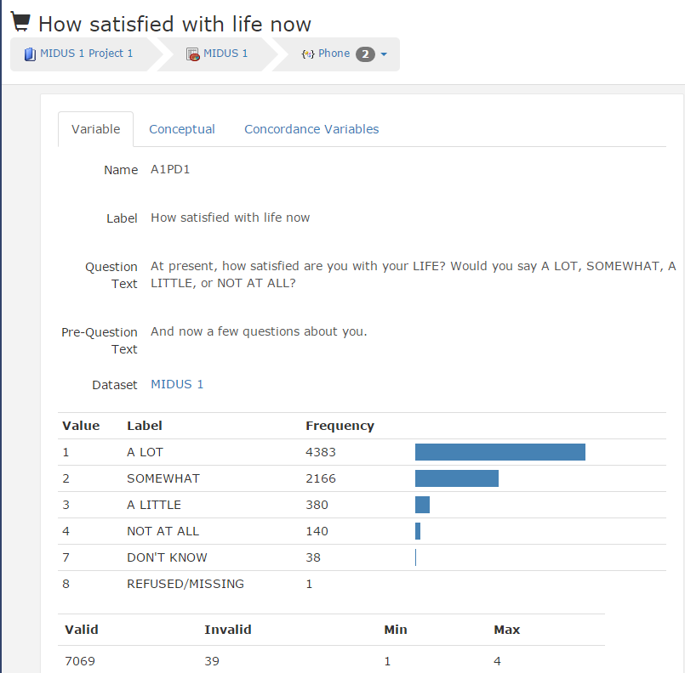
After DDI ...

Slide 17
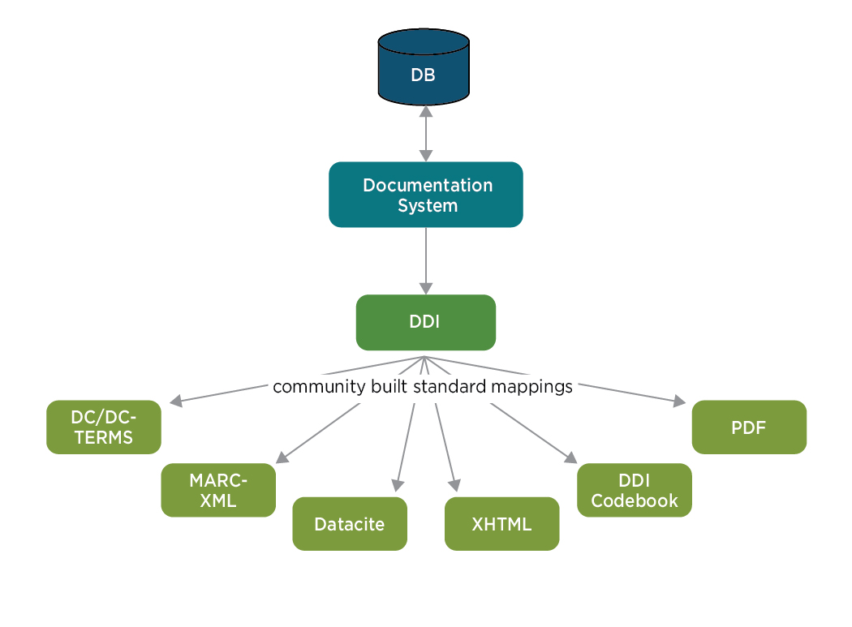
One document, many uses

Slide 18
DDI Use Case with a
Data Archive
  [Several examples originally from Mary Vardigan]

Slide 19

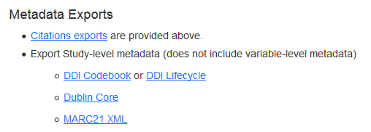
Archives are driven by metadata standards
  They allow all information to be consistently described
  They allow straight-forward search and discovery
  The same information can be re-used in different ways
  There is transportable information for use by different organizations
Notes:
Archive metadata ideally suited to describing:
The study
A catalogue of all the relevant information
The outputs (i.e. datasets, publications)
The relationship to other studies in the same series or research domain
Archive metadata not so well suited to:
Fine grained information describing the processes within a study
Relationships to related data in longitudinal studies
Capturing information during the study itself
Richer metadata is required for conducting studies:
This can be re-used to generate information for Archives
This is more complex to implement – BUT IT IS WORTH IT
For both the Studies and the Archives

Slide 20
Metadata at ICPSR
• ICPSR has over 8000 studies, each with study-level and variable-level metadata
• ICPSR uses the Data Documentation Initiative (DDI-C) metadata standard
• DDI XML drives much of the site functionality

Slide 21

Generating DDI Metadata at ICPSR
Deposit form is core
Data processors and librarians enhance record
DDI Study Description
(XML)
Deposit Form:
Upload data (SPSS) & Documentation
(Word, PDF)
Produced through internal tool that uses SPSS and SDA with question text
Codebook
Questionnaire
DDI Variables Description
(XML)

Slide 22
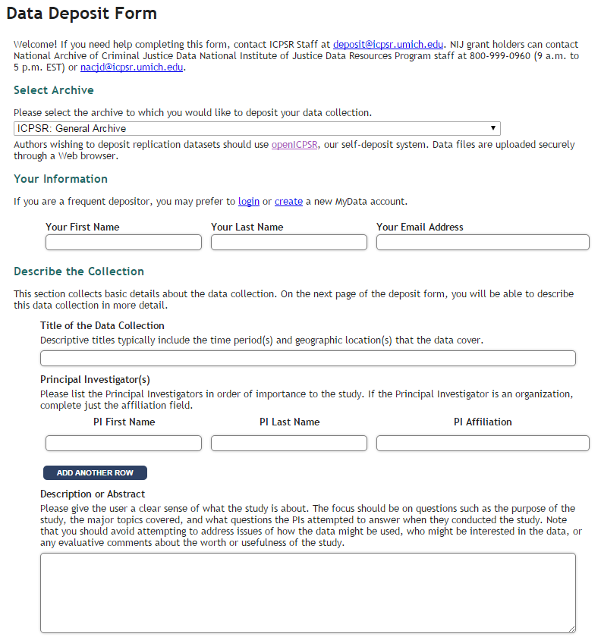
http://www.icpsr.umich.edu/icpsrweb/deposit/

Slide 23
Study-level DDI Elements
Title, Alternate Title
Study Number
Principal Investigator
Funding
Bibliographic Citation
Series Information
Summary
Subject Terms
Geographic Coverage
Time Period
Date of Collection
Unit of Observation
Universe
Data Type
Sampling
Weights
Mode of Collection
Response Rates
Extent of Processing
Restrictions
Version History
Time Method (e.g., longitudinal)
Data Method (e.g., qualitative)

Slide 24
Study-level DDI leveraged
in several ways
Search
Forms basis of Solr Lucene faceted search
Repurposing
Record is reused across ICPSR’s topical archive sites
Interoperating
Records shared with other archives
Study Overview
Becomes PDF overview bundled with each download

Slide 25
Study-level DDI: Search

Slide 26
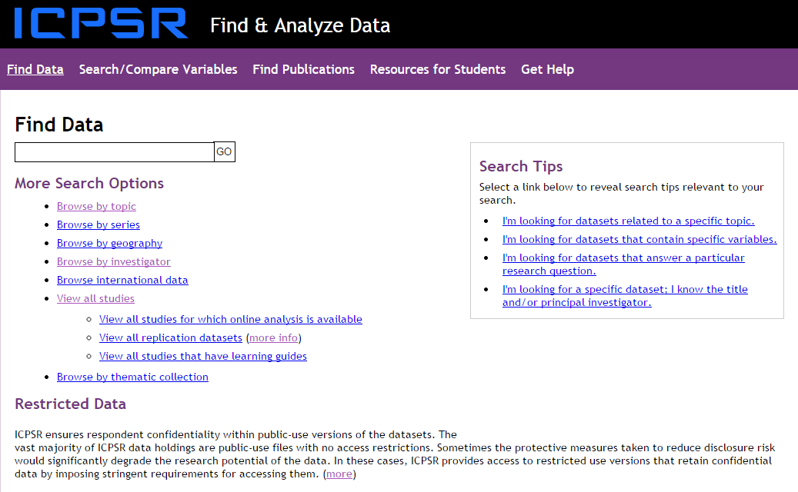
http://www.icpsr.umich.edu/icpsrweb/ICPSR/index.jsp

Slide 27
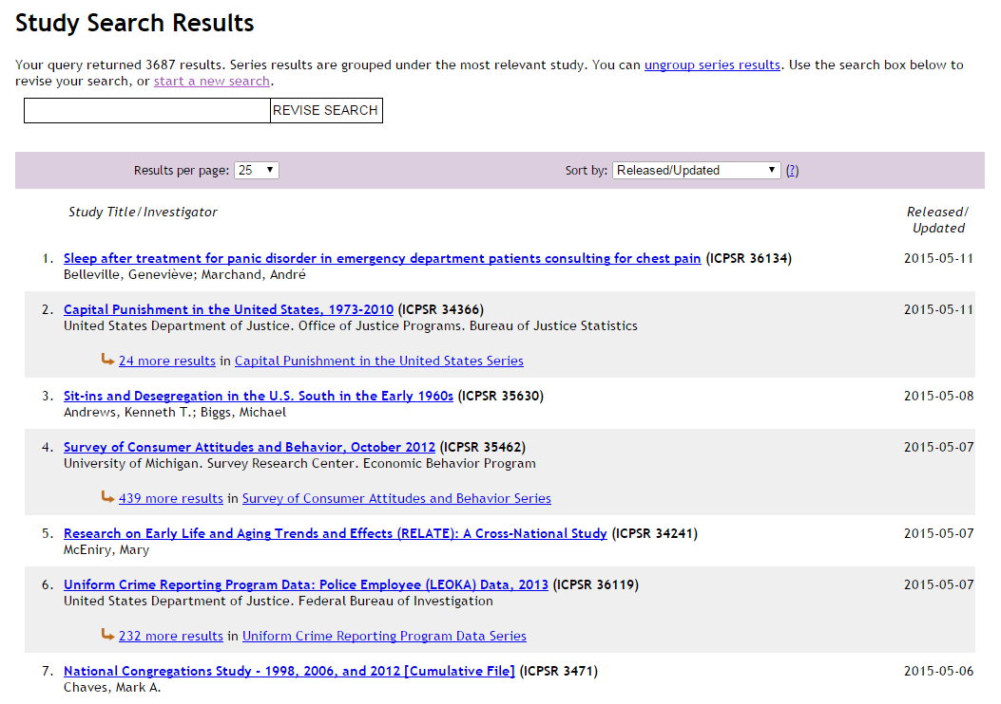
Notes:
http://www.icpsr.umich.edu/icpsrweb/ICPSR/studies?searchSource=find-analyze-home&q=&paging.rows=25&sortBy=5

Slide 28
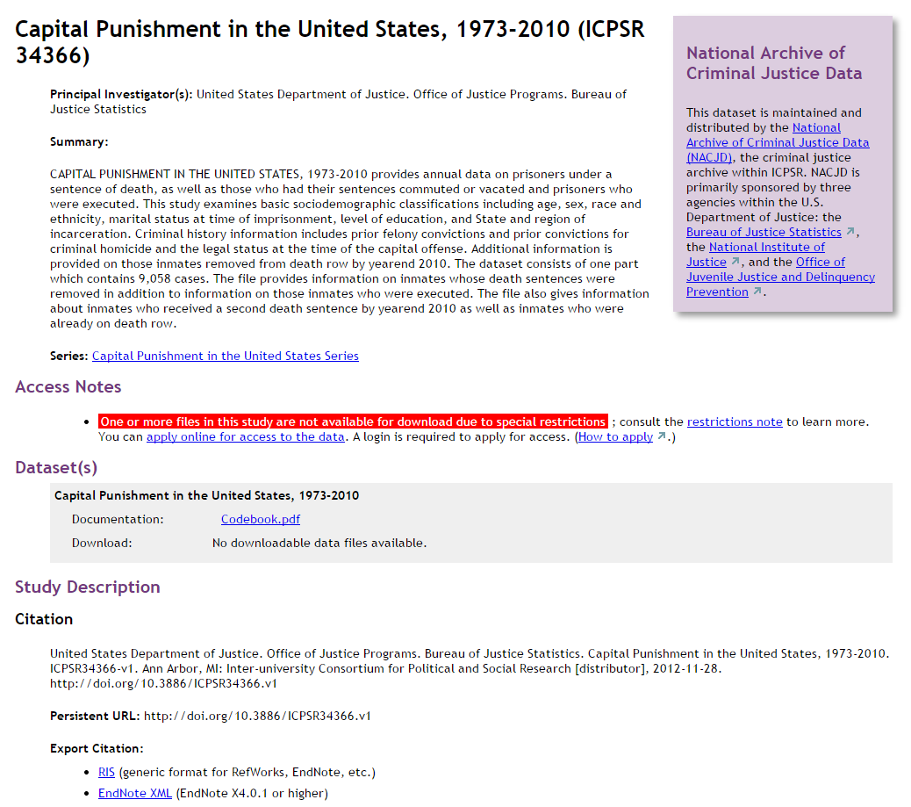
http://www.icpsr.umich.edu/icpsrweb/ICPSR/studies/34366

Slide 29
Study-level DDI: Repurposing

Slide 30
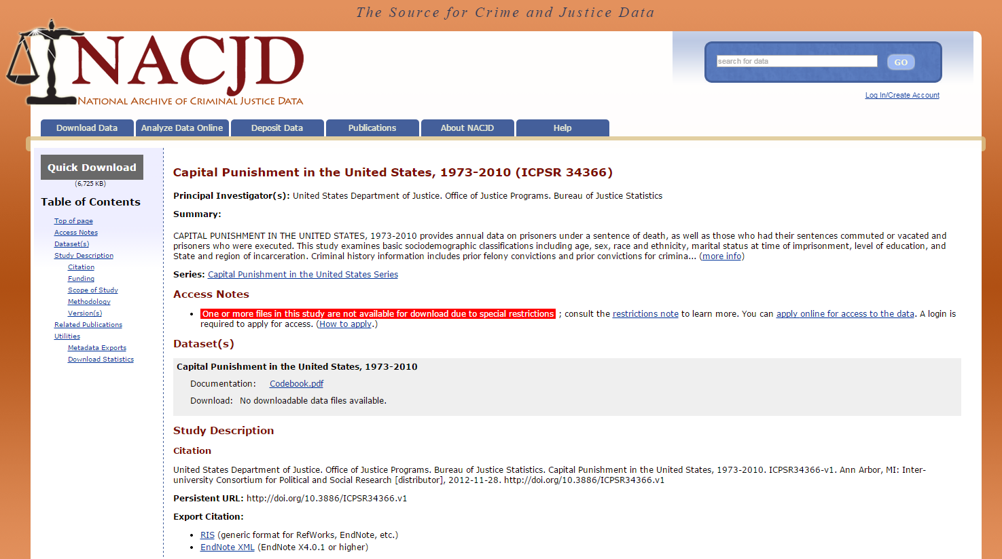
http://doi.org/10.3886/ICPSR34366.v1

Slide 31
Study-level DDI: Interoperating

Slide 32
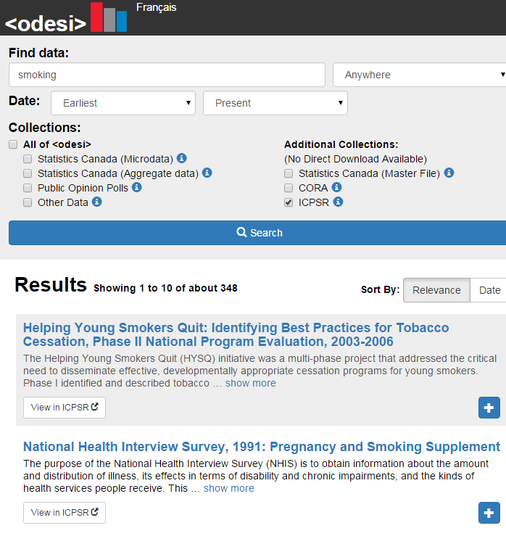
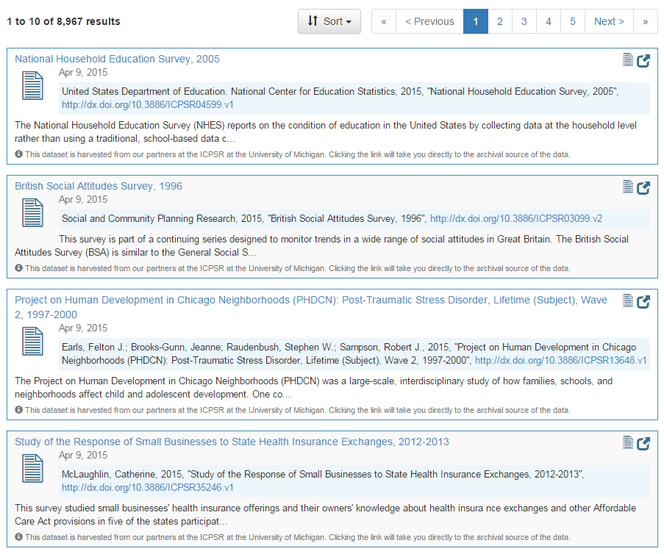
https://dataverse.harvard.edu/dataverse/icpsr

Slide 33
Study-level DDI: Study Overview

Slide 34
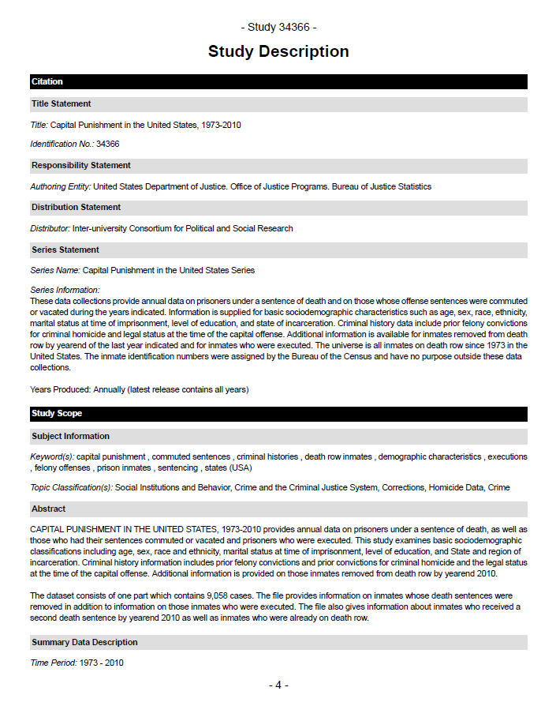
Notes:
Source: http://www.icpsr.umich.edu/icpsrweb/ICPSR/studies/34366

Slide 35
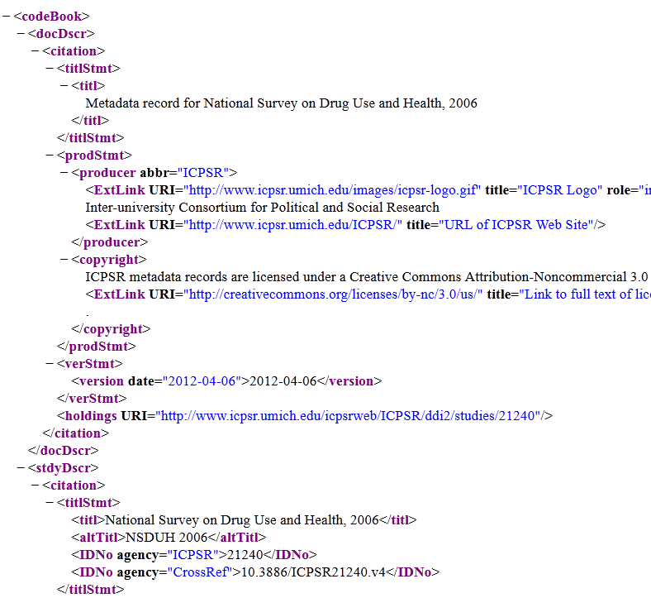
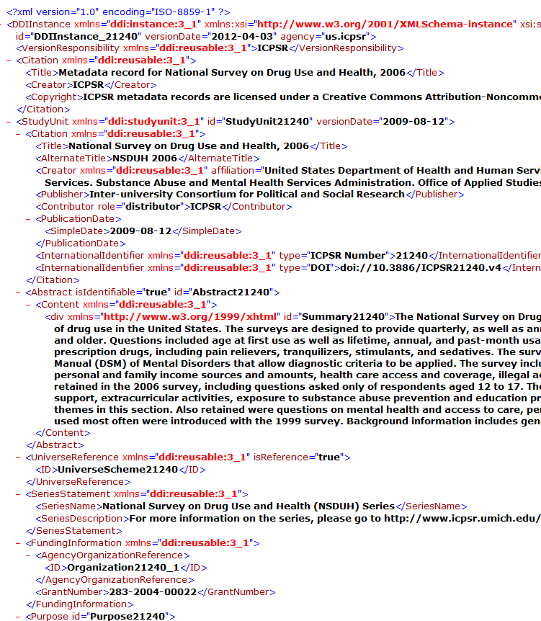
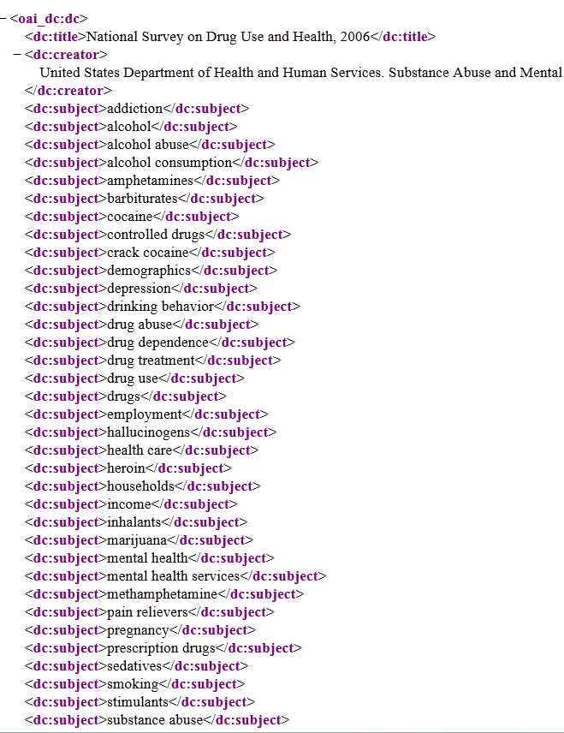
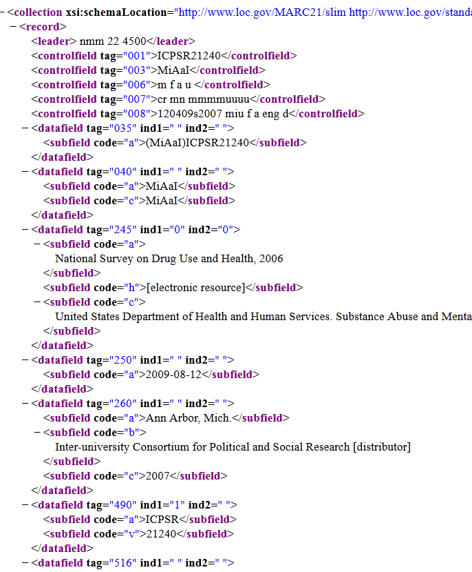
Export Study Description
(DDI, DC, MARC)

Slide 36
Variable-level DDI Elements
Variable group reference
Variable name and ID
Variable label
Descriptive variable text
Question text
Category label and value (responses)
Category statistics (frequencies)
Summary statistics
Notes

Slide 37
Variable-level DDI -
leveraged in several ways
Search
Permits search of variables in a dataset
Search across ICPSR
Serves as foundation for Social Science Variables Database
Codebook with frequencies
Enables generation of PDF documentation

Slide 38
Variable-level DDI: Search

Slide 39
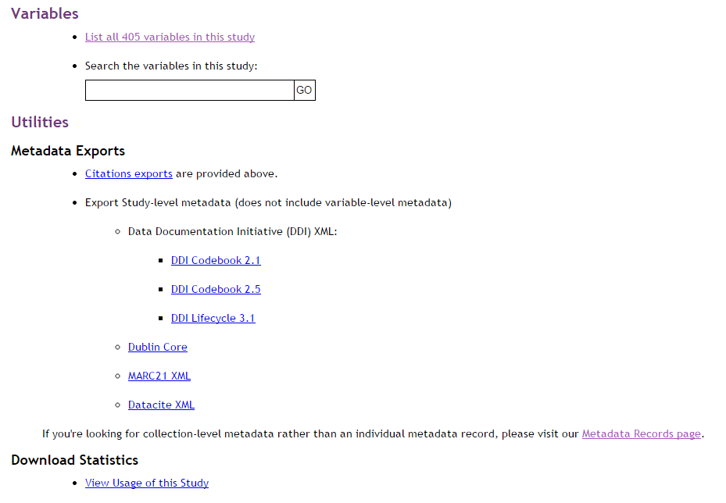
Andrews, Kenneth T., and Michael Biggs. Sit-ins and Desegregation in the U.S. South in the Early 1960s. ICPSR 35630-v1. Ann Arbor, MI: Inter-university Consortium for Political and Social Research [distributor], 2015-05-08. http://doi.org/10.3886/ICPSR35630.v1
Notes:
Source: http://www.icpsr.umich.edu/icpsrweb/ICPSR/studies/34366

Slide 40
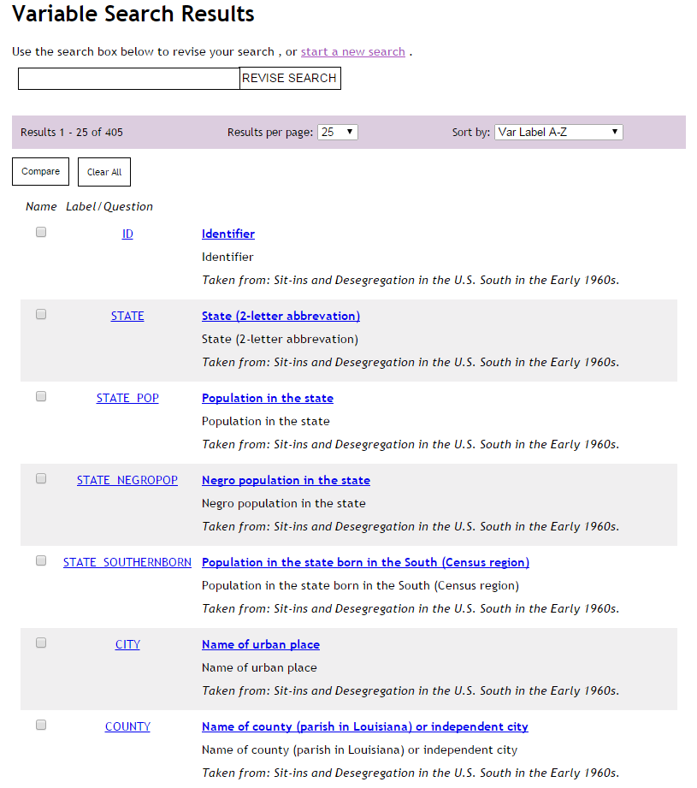
Andrews, Kenneth T., and Michael Biggs. Sit-ins and Desegregation in the U.S. South in the Early 1960s. ICPSR 35630-v1. Ann Arbor, MI: Inter-university Consortium for Political and Social Research [distributor], 2015-05-08. http://doi.org/10.3886/ICPSR35630.v1
Notes:
Source: http://www.icpsr.umich.edu/icpsrweb/ICPSR/studies/34366

Slide 41
Variable-level DDI: Search across ICPSR

Slide 42
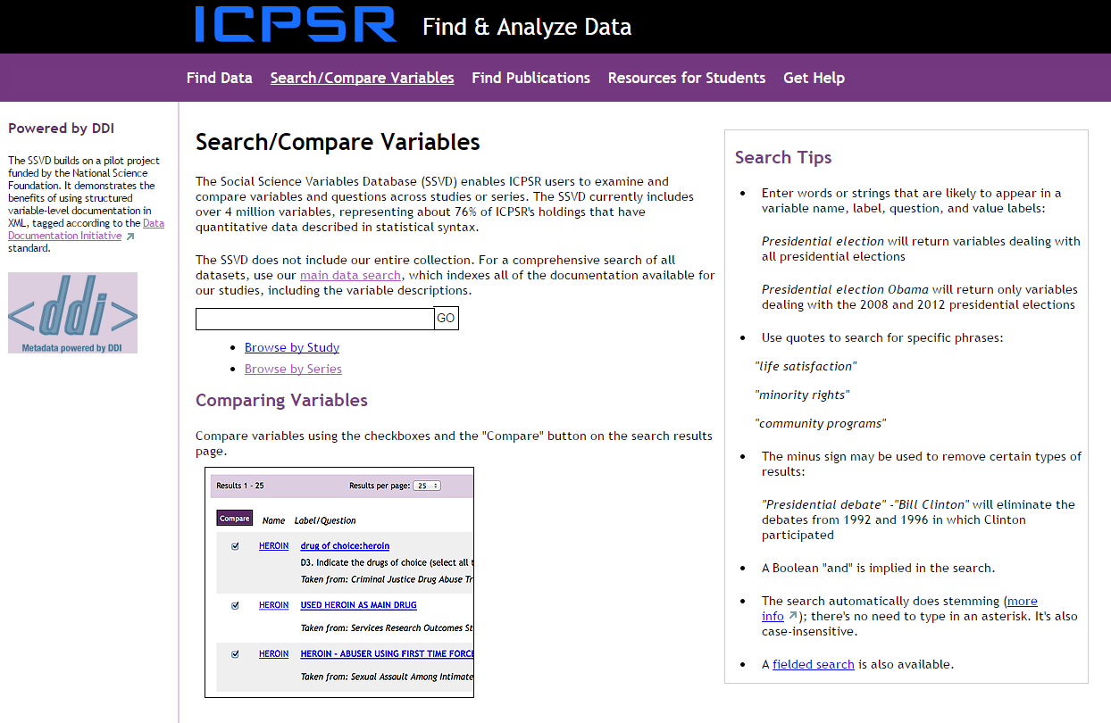
http://www.icpsr.umich.edu/icpsrweb/ICPSR/ssvd/index.jsp

Slide 43
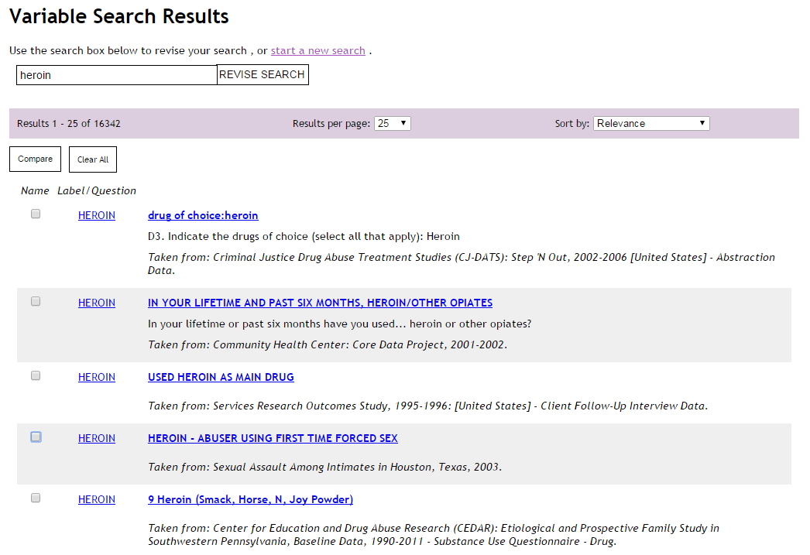

Slide 44
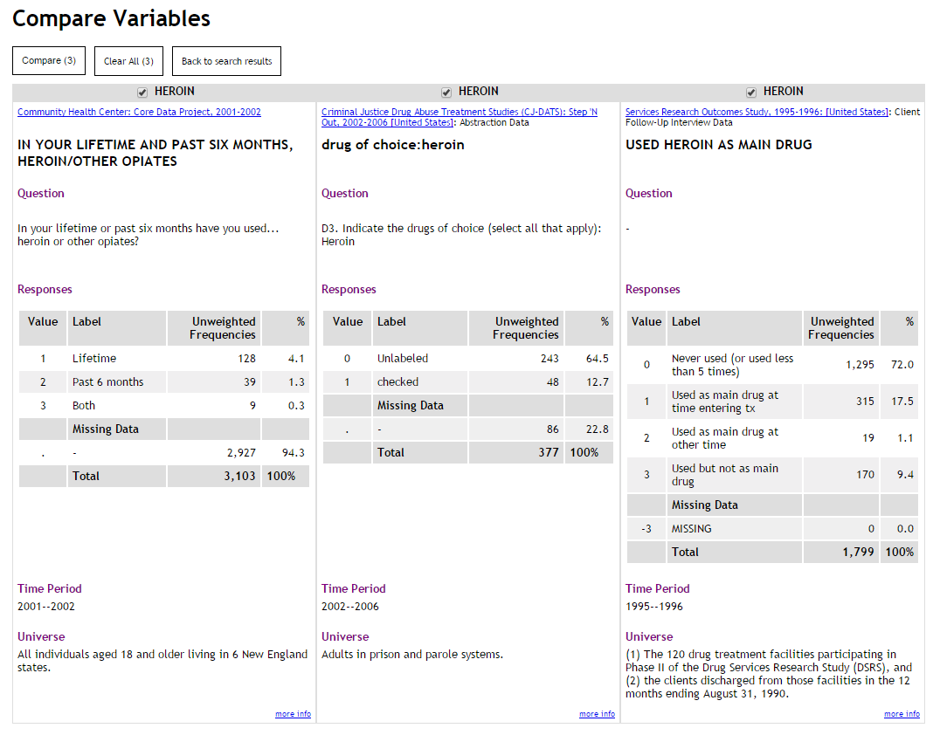

Slide 45
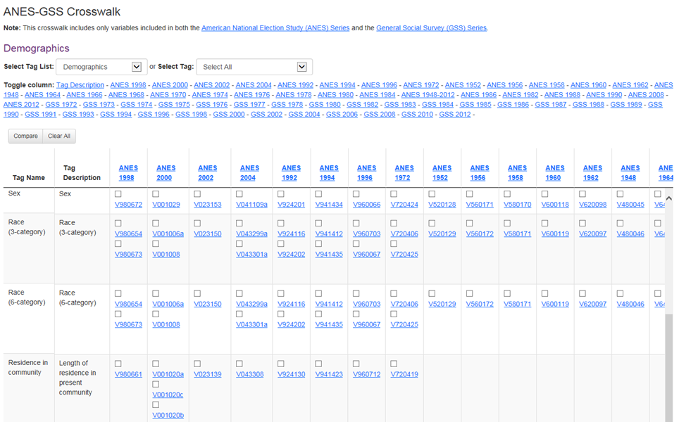
Notes:
This rich metadata, including variable-level metadata, can be used to power tools for finding, comparing, and harmonizing data. This is a crosswalk for data from the American National Election Study (ANES) and the General Social Survey (GSS) (created with NSF 1229957).

Slide 46
Variable-level DDI: Codebook

Slide 47
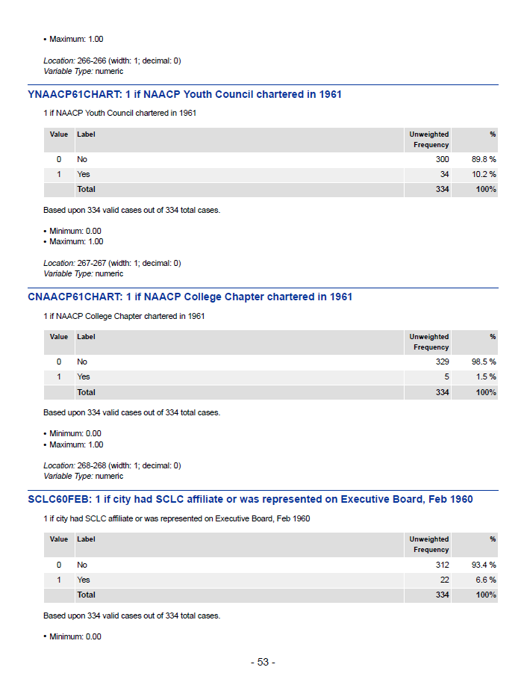
http://doi.org/10.3886/ICPSR35630.v1

Slide 48
Unified Search

Slide 49
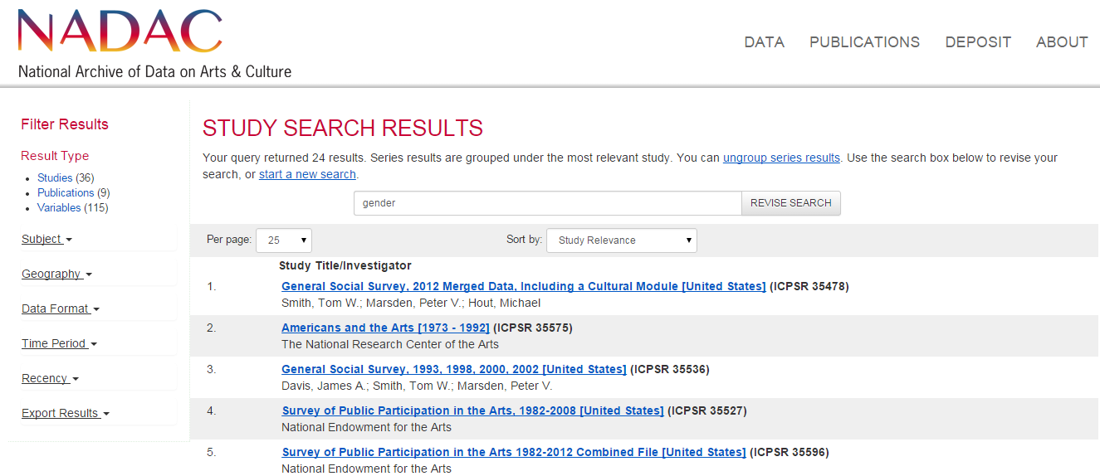
http://www.icpsr.umich.edu/icpsrweb/NADAC/studies?q=gender

Slide 50
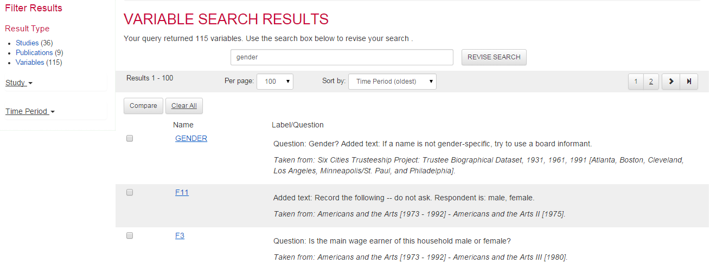
http://www.icpsr.umich.edu/icpsrweb/NADAC/ssvd/variables?q=gender

Slide 51
DDI Use Cases with Research Projects

Slide 52

Use Case: MIDUS
Key strength of MIDUS:
  Multiple longitudinal samples
  Multidisciplinary design
  Products:
    N <13,000
    25,000 variables
    20 datasets
  Wide secondary usage – Open Data philosophy
    Top data download at ICPSR
    68k data downloads; 30k users
    700+ publications

Slide 53
Use Case: MIDUS
Metadata capture is crucial for:
Discovery and search
  Across datasets, waves and disciplines
Harmonization
  Combining waves and related equivalent measures
Data download capabilities
  Merging variables from disparate datasets

Slide 54
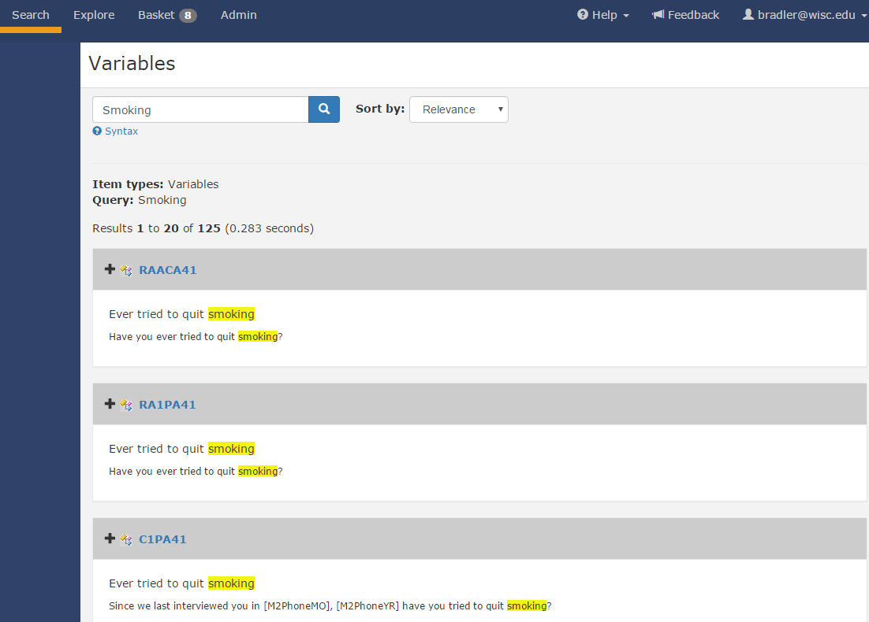
Use Case: MIDUS -
Discovery & Search

Slide 55
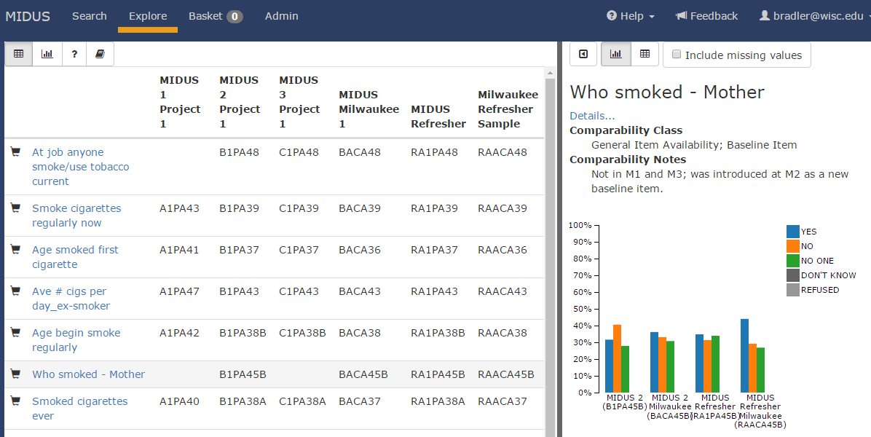
Use Case: MIDUS -
Harmonization

Slide 56
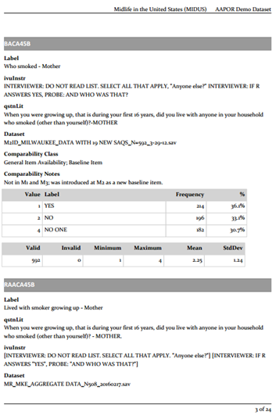
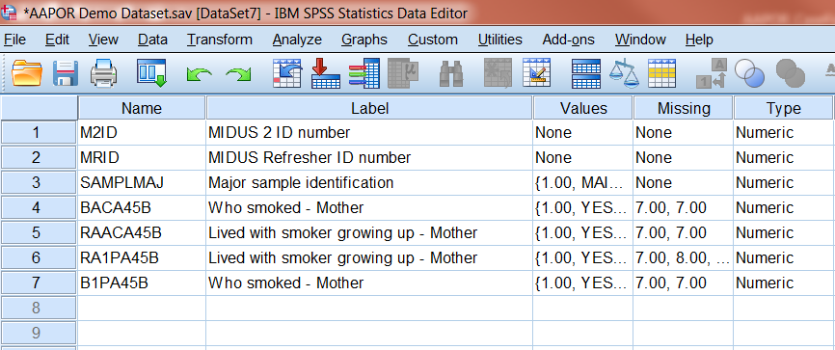
Use Case: MIDUS - Download
Dataset
Codebook

Slide 57

Use Case: CLOSER
Key strengths of CLOSER:
  Multiple longitudinal samples
  Multiple cohorts (1930 – present)
  Biomedical & Social Science
  Products:
    N ~ 150,000 questions
    ~ 250,000 variables
    ~ 300 datasets
  Metadata only platform
  Full Questionnaire flow and contents
  Cross-cohort comparison

Slide 58
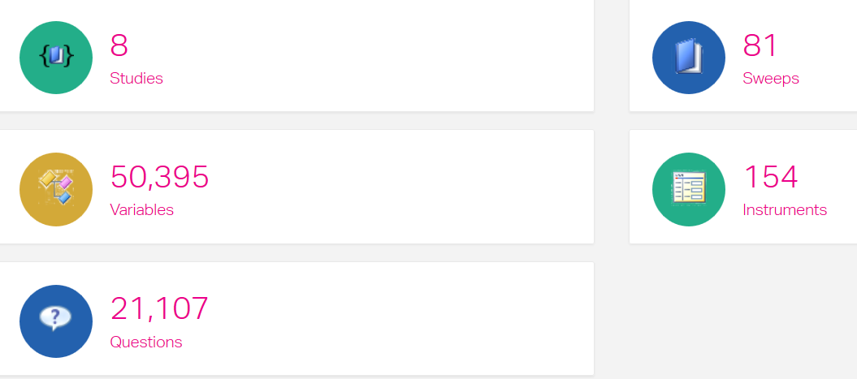
Use Case: CLOSER - Scope

Slide 59
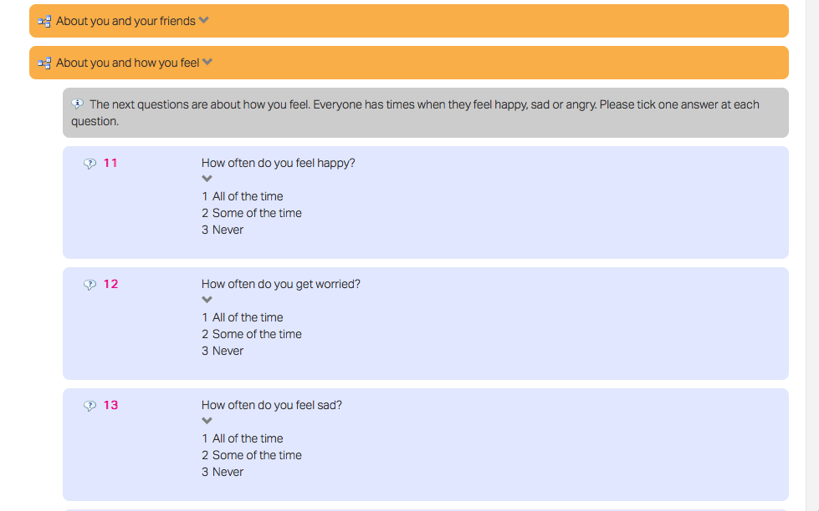
Use Case: CLOSER - Questions

Slide 60
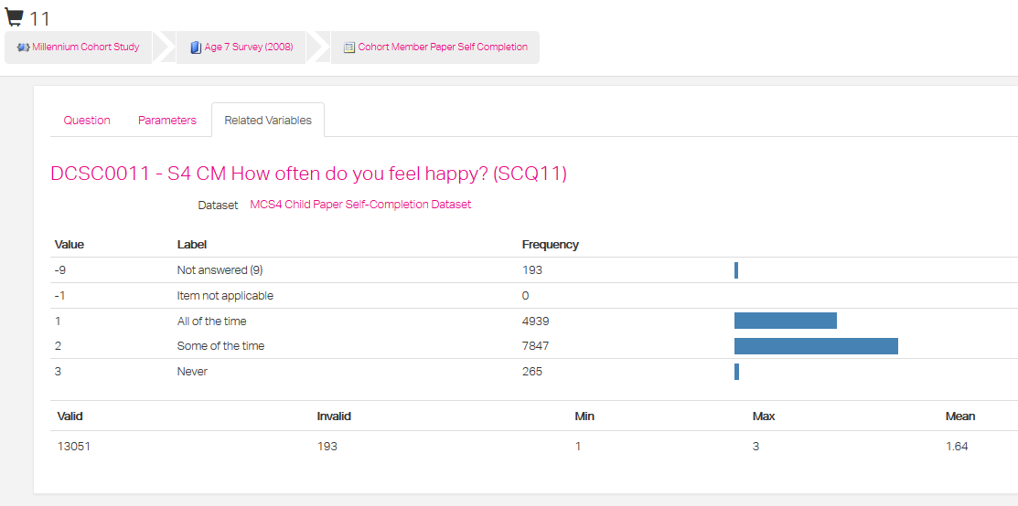
Use Case: CLOSER - Data

Slide 61
DDI Takeaways
Improve data’s reuse factor
Consistently document data using DDI
Reduction in manual processes
Increases accuracy
Reduces costs in time and money
One DDI document → multiple uses
Enabling distributed data collection and research processes
Across different platforms and systems
Between different organizations and researchers
Increased quality of documentation
Raises visibility of needs and gaps
Supports better understanding of data products and data collection processes
New tools easily built to address different problems across the research data lifecycle

Slide 62
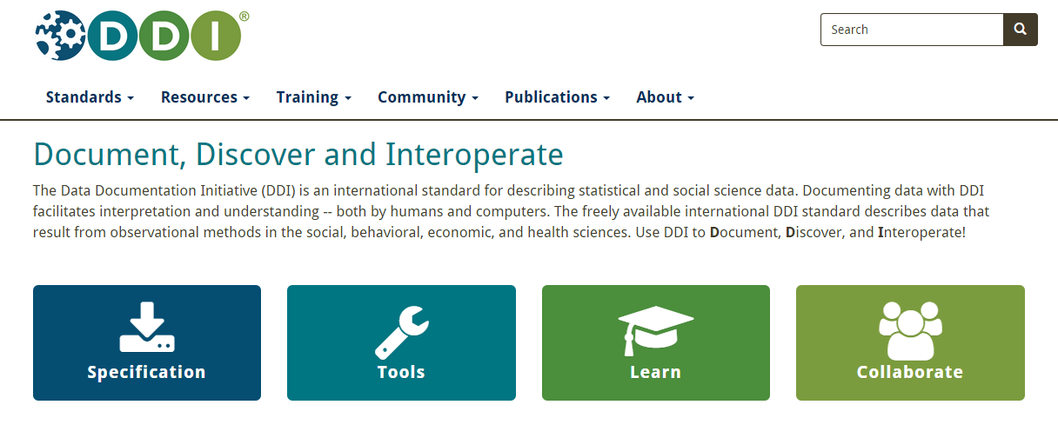
DDI Website
Learn how to get started with DDI: http://ddialliance.org

Slide 63
Thank you!
For more information, questions, ...
Barry Radler (bradler@wisc.edu)
Jared Lyle (lyle@umich.edu)
Jon Johnson (jon.johnson@ucl.ac.uk)

Slide 64
Using Metadata during Studies

Slide 65
Comprehensive Documentation of the Research Process
Notes:
The survey process, especially on large scale longitudinal studies, involves many actors / organizations, reducing information loss between them is critical to increasing quality and reducing costs

Slide 66
What DDI provides…
Capture what was intended
What: what data were captured and why
Capture exactly what was used in the survey implementation
How: the mode, logic employed and under what conditions
Specify what the data output will be
That is, mirrors what was captured and its source
Keep the connection
Between the survey implementation through to the data received -> data management by PIs -> to archiving
Generalised solution
So that is can be actioned efficiently and is self-describing
So that it can be rendered in different forms for different purposes
Notes:
To do something with this, we need ……

Slide 67
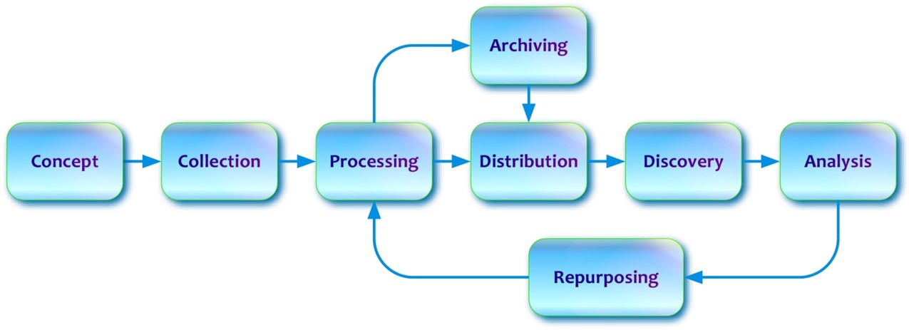
…and a framework to do this
Data Cleaning, Labeling,
And Transformations
Documentation, READMEs,
Descriptions (non-dataset
or variable)
Methodology and
Instrument Design
Instrument Fielding and
Data Collection
Descriptive information for reuse and discovery

