Slide 1
DDI to DATS
ICPSR Metadata on the DataMed Portal
Sanda Ionescu
Jared Lyle
Acknowledgement: Matthew Richardson
North American Data Documentation Initiative Conference (NADDI)
Ithaca, NY
April 6, 2017

Slide 2
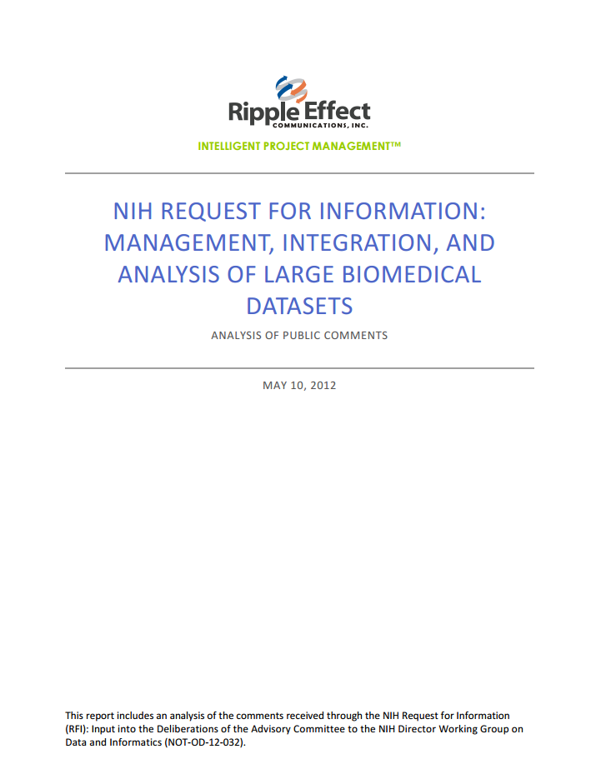
  https://acd.od.nih.gov/DIWG_RFI_FinalReport.pdf
Notes:
bioCADDIE is a direct response to the key recommendations made in this 2012 report requesting the development of a catalog of biomedical data.

Slide 3

Notes:
bioCADDIE is designed to facilitate the discovery of available biomedical datasets that are spread across different databases, repositories, and on the cloud.

Slide 4
Notes:
Note the DDI in the name.

Slide 5
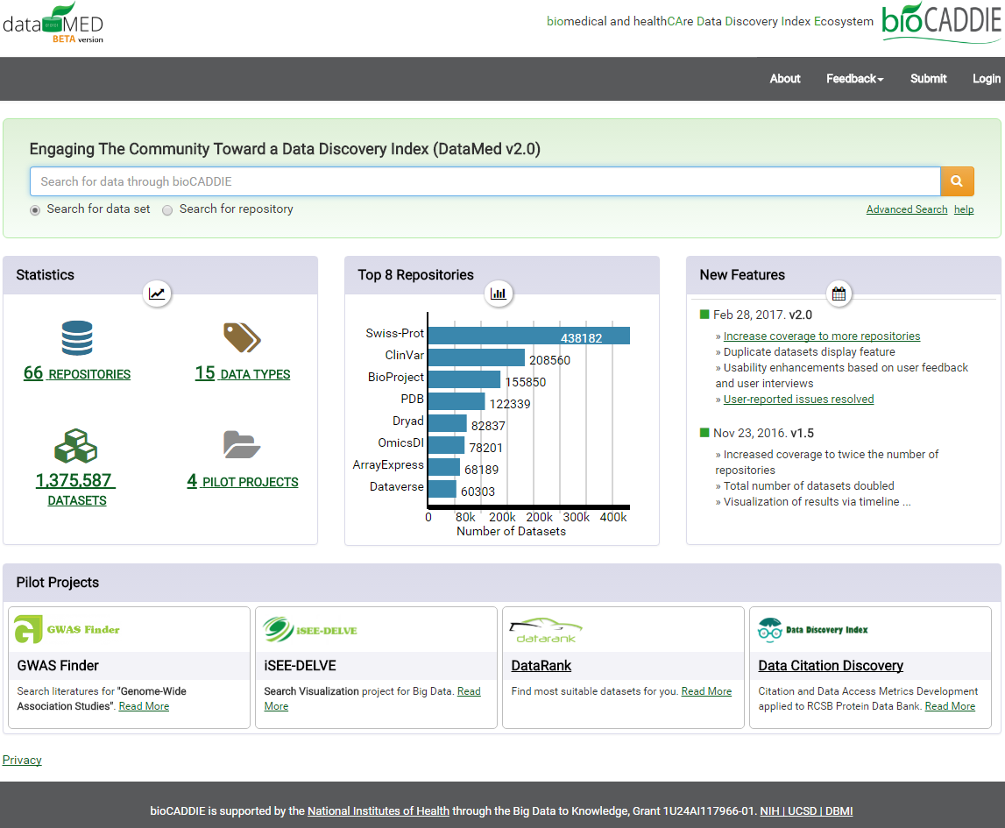
http://datamed.org/
Notes:
A first prototype of DataMed is available at https://datamed.org. It performs searches on a shallow generic index. As of 3 April 2017, it indexes 66 repositories and over 1.3 million data sets, covering 15 data types.
See also: DataMed: Finding useful data across multiple biomedical data repositories L Ohno-Machado1,2*, SA Sansone3*, G Alter4*, I Fore5*, J Grethe1*, H Xu6*, Alejandra Gonzalez-Beltran3 , Philippe Rocca-Serra3 , Ergin Soysal6 , Nansu Zong1 , H Kim1 on behalf of the NIH BD2K bioCADDIE Consortium. http://dx.doi.org/10.1101/094888

Slide 6
DATS – The DAta Tag Suite
  A metadata model developed by the bioCADDIE project to support the data discovery index built into DataMed
    Enables participating repositories’ submission of metadata for ingestion into DataMed
      Repositories’ metadata need to be mapped and converted to DATS for inclusion in DataMed
    Used by DataMed for indexing its metadata and powering its searches.
    Adheres to the FAIR best practices for data management: Findability, Accesibility, Interoperability and Reusability

Slide 7
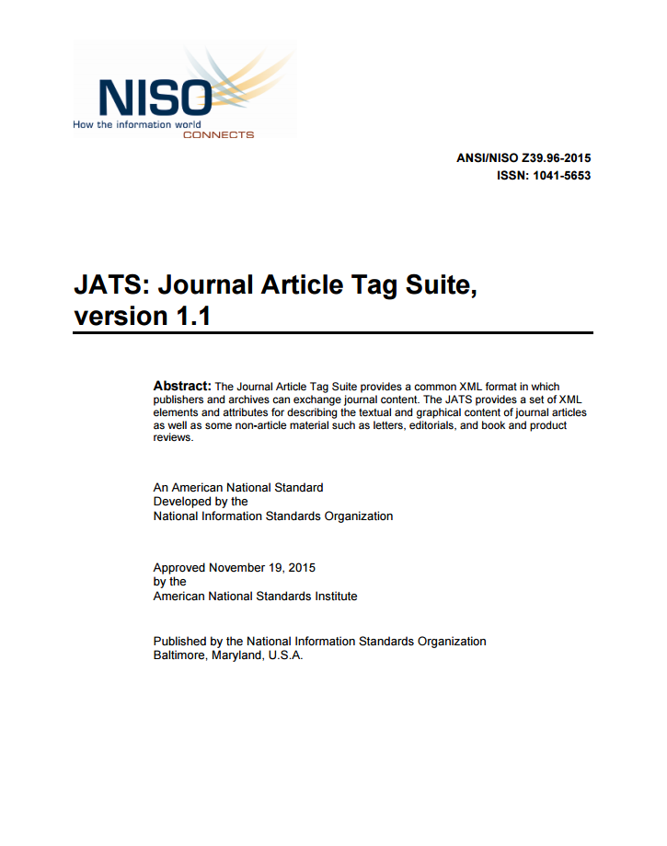
http://www.niso.org/apps/group_public/download.php/15933/z39_96-2015.pdf
Notes:
The DATS model has been specifically named to echo the JATS metadata elements and format (https://jats.nlm.nih.gov) required by PubMed (https://www.ncbi.nlm.nih.gov/pubmed) to index publications. Like JATS, the core DATS elements are generic and applicable to any type of dataset. The extended DATS includes an initial set of elements, some of which are specific for life, environmental and biomedical science domains and can be further extended as needed. Note that the core should by no mean seen as the mandatory set.
From the NISO report: “The purpose of the NISO Journal Article Tag Suite (NISO JATS) standard is to define a suite of XML elements and attributes that describes the content and metadata of journal articles—including research and non-research articles, letters, editorials, book and product reviews—with the intent of providing a common format in which publishers and archives can exchange journal content. The intent of the Tag Suite is to preserve the intellectual content of journals independent of the form in which that content was originally delivered. The Tag Suite enables an archive to capture structural and semantic components of existing material without modeling any particular sequence or textual format.”

Slide 8
DATS – The DAta Tag Suite
DATS Specification v2.2 - NIH BD2K DataMed model, annotated with schema.org (27 March 2017)
Specification and Appendixes available in the bioCADDIE GitHub repository, along with JSON schemata, examples and schema.org annotated JSON-LD serialization
(also citable as DOI: 10.5281/zenodo.438337)
Notes:
See also: DATS: the data tag suite to enable discoverability of datasets Authors Susanna-Assunta Sansone1 *, Alejandra Gonzalez-Beltran1 *, Philippe Rocca-Serra1 *, George Alter², Jeffrey S. Grethe3 , Hua Xu4 , Ian Fore5 , Jared Lyle², Anupama E. Gururaj4 , Xiaoling Chen4 , Hyeon-eui Kim3 , Nansu Zong3 , Yueling Li3 , Ruiling Liu4 , Burak Ozyurt3 , Lucila Ohno-Machado3 , and the bioCADDIE Working Groups Members**. http://dx.doi.org/10.1101/103143
and
https://datascience.nih.gov/sites/all/themes/datascience/conferences/2016/BIO%204%20SusannaAssunta.Sansone.AHM-biocaddie_508.pdf

Slide 9
DATS – The DAta Tag Suite
DATS’ focus – discovery and access
  Includes key metadata descriptors for finding and retrieving data across a variety of repositories
  Not designed to document each stage of the research process
  Centered on dataset-level metadata
  Individual data items are not currently documented in DataMed, but DATS does provide for this option
    Includes a Dimension class that may be mapped to a variable description
Notes:
Give overview of the DATS model with which some of us may be less familiar.
The model is focused on data discovery and access
It includes key elements for …
But it is not designed/intended to document all of the stages of a research project, but rather the final product
It is centered on dataset level metadata
Currently, DataMed does not index individual data items but the standard does provide for this possibility, as it includes a class called Dimension that may be mapped to what we call a variable description

Slide 10
DATS – The DAta Tag Suite
A modular metadata model
  Core DATS elements: generic and applicable to any type of data
    Dataset
      Dataset Distribution
      Data standard
      Data repository
      Dimension
      Data type
      Publication
Notes:
DATS is a modular model and it includes a core set of element that are generic and may be used to document/describe
There is a Dataset superclass that provides information about the distribution of the dataset, the standard(s) used, the repository housing it, the type of data and related publications.
And also the dimension class/element that I mentioned before, that may be used to document individual data items. Not currently used but could be in the future.

Slide 11
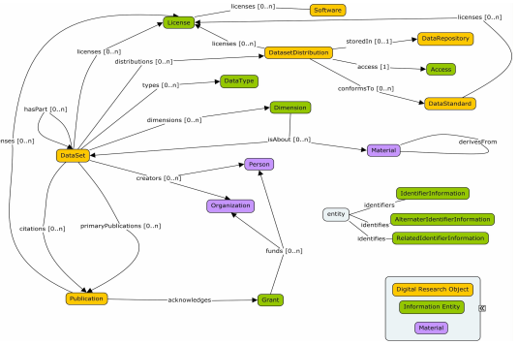
DATS – A Modular Metadata Model
A schematic overview of the DATS core elements, their types and relations
Notes:
And this how the DATS model looks like in a schematic overview – this diagram only presents the core elements their types and the relationships between them

Slide 12
DATS – A Modular Metadata Model
Extended DATS elements: specific for life, environmental, and biomedical science; can be further extended as needed
[DataSet] produced by:
  Study
    Study Group (i.e., population, cohort)
      Material
        Anatomical Part
        Disease
        Biological Entity
        Molecular Entity
          Taxonomic Information
    Activity
      Data acquisition (i.e., collection)
        Instrument / Software
      Treatment
      Data Analysis (includes data processing)
Notes:
In addition to the core elements there is also an extended DATS to support information specific to the life and biomedical sciences
In the example I’m giving here we can see from the name of the classes that they are meant to document biomedical data
A study’s objects may described with their biological characteristics
And some of the processes that take place during a study – like the way the data are collected, the various treatment and experimental protocols, and data manipulation, that includes data processing as well as data analysis

Slide 13
DATS – The DAta Tag Suite
Expressed in machine-readable JSON schemas
  JSON (JavaScript Object Notation) is a lightweight, text-based, language-independent data exchange format.
  DATS JSON schemas:
    One for each main class/object
    Provide information on the model’s structure as well as field-level documentation
  "duration": {
  "description": "The time during which the activity takes place.",
  "type" : "string"
  },
  "location" : {
  "description": "The location where the activity takes place.",
  "$ref" : "annotation_schema.json#"
  },
  "performedBy" : {
  "description": "The person(s) or organization(s) responsible for executing the process.",
  "type" : "array",
  "items" : {
  "anyOf": [
  {"$ref" : "person_schema.json#"},
  {"$ref" : "organization_schema.json#"}
  ]
  }
Notes:
DATS is expressed/serialized in JSON schemas.
JSON is a data exchange format that has become quite popular as it lightweight and text-based and may be understood by both humans and machines.
There is one schema for each main object in the model and it provides information about the structure of the model as well as field level documentation.
JSON is a format that encodes objects in a string. Serialization means to convert an object into that string, and deserialization is its inverse operation. When transmitting data or storing them in a file, the data are required to be byte strings, but complex objects are seldom in this format.

Slide 14
ICPSR Metadata: DDI to DATS field mapping
ICPSR Study-level DDI metadata | DATS DataSet description
<AuthEnty affiliation="University of Michigan. Institute for Social Research. Survey Research Center">Campbell, Angus</AuthEnty> | creators: [{affiliations: [{name: "University of Michigan. Institute for Social Research. Survey Research Center"}], firstName: "Angus", fullName: "Campbell, Angus", lastName: "Campbell"}
<titl>ANES 1952 Time Series Study</titl> | title: "ANES 1952 Time Series Study"
<keyword vocab="thesaurus">candidates</keyword> | keywords: [{value: "candidates", valueIRI: http://www.icpsr.umich.edu/icpsrweb/ICPSR/thesaurus/entry?topic=subject&entry=candidates}
<cleanOps> <list type="bulleted"> <itm>Performed consistency checks.</itm> <itm>Standardized missing values.</itm> | curationStatus: [{value: "Performed consistency checks.", valueIRI: ""}, {value: "Standardized missing values.", valueIRI: ""},
 | distributions: [{"access": [{"authentications": [{"value": "simpleLogin","valueIRI":""}]
 | distributions: [conformsTo: [{description: "Metadata are prepared using Data Documentation Intitiative Codebook 2.5.", "name": "DDI"}],
Notes:
At ICPSR we started out by mapping our DDI metadata fields to DATS elements using mainly the DataSet class.
Most of the mapping was pretty straightforward. and
I’m showing here an example of some corresponding fields.
But we also looked at DATS independently (of DDI) – to make sure we were capturing //could fill all of the mandatory fields in DATS and we also contributing information that was required/recommended by the BioCaddie team, but not included in ICPSR’s DDI.
As an example, here at the bottom we specified how we authenticate, and also the standard that our metadata conforms to.
(IRI – internationalized resource identifier)

Slide 15
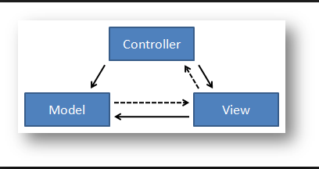
ICPSR Metadata in DATS
Conversion tool: typical Model-View-Controller (MVC) setup.
Java Models built for each of the JSON schemas
Java Controller creates a DataSet object and populates it with metadata content extracted from an Oracle database
Java DataSet object translated to JSON for View (and delivery)
Notes:
To convert our study-level metadata to DATS, we used an MCV setup – this is the technical term I got from our developer
So we built .. And generated code that creates ….content extracted from the Oracle database in which our study metadata are stored.
Finally the Java object is translated to JSON and is ready for delivery.
This is done dynamically so that every time there is a request for our metadata in DATS format, we deliver the most recent version.

Slide 16
ICPSR metadata indexed and searchable on DataMed
http://datamed.org/
Notes:
So we sent over (provided) our metadata to DataMed, where it was indexed and as a result, ICPSR’s collection is now searchable on the portal.
Go to the DataMed site.
ICPSR is listed among the member repositories
Its collection is searchable in its entirety (9,784 studies)
Follow link - And this is how the ICPSR study-level metadata looks when converted to DATS (individual study).
As you can see, it looks different than what we would expect from a DDI-based display, because the information is organized differently but the relevant content is still there.

Slide 17
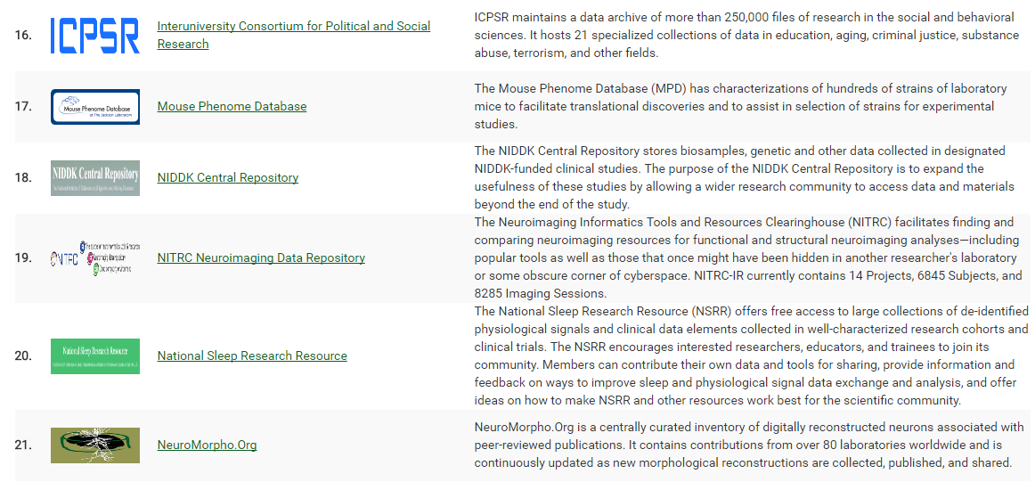
https://datamed.org/repository_list.php

Slide 18
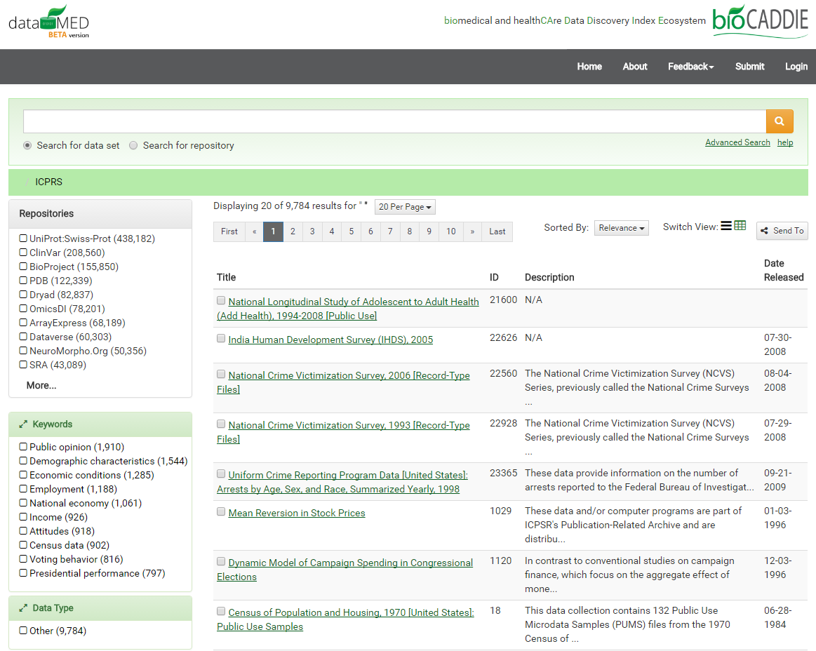
https://datamed.org/search-repository.php?query=%20&searchtype=data&repository=0025

Slide 19
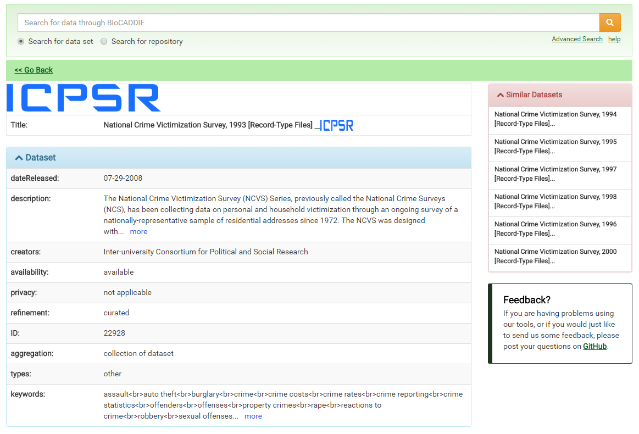
https://datamed.org/display-item.php?repository=0025&id=580ea0365152c648c68d0069&query=

Slide 20
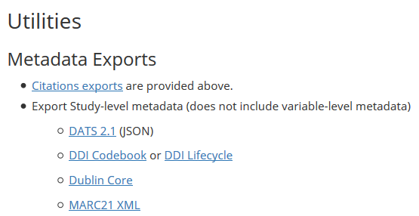
ICPSR also freely distributes its study-level metadata in DATS format on each study page:
All of the formats listed above are available for public download
Notes:
In addition to that, we are also now distributing our study-level metadata in the DATS format on our own website.
On each study page we have several types of metadata formats publicly available for download, and DATS is now one of these formats.

Slide 21
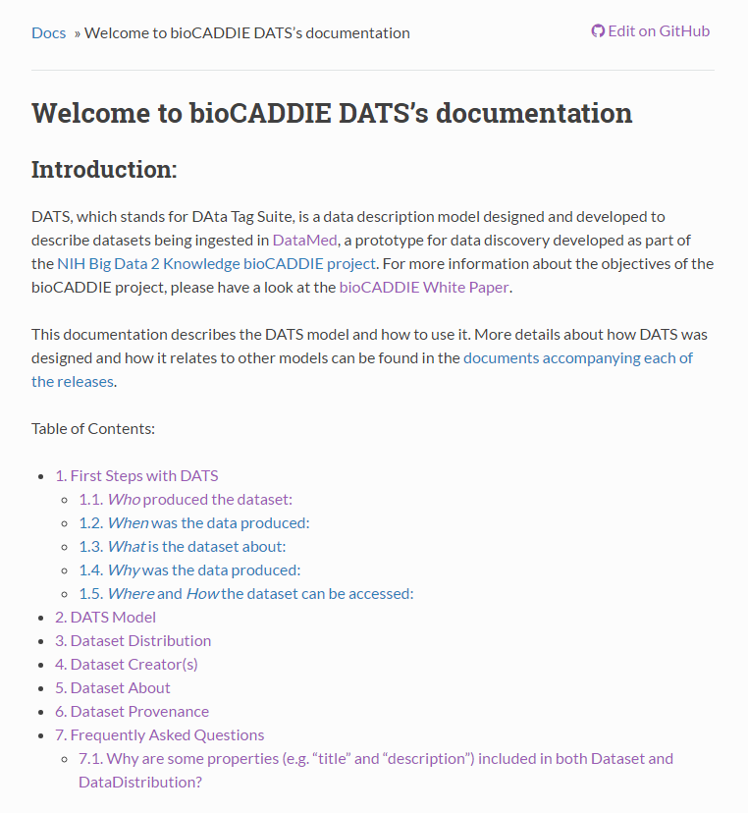
Documentation and Curation Guidelines
http://wg3-metadataspecifications.readthedocs.io/en/latest/

Slide 22
Thanks!
Sanda Ionescu (sandai@umich.edu)
Jared Lyle (lyle@umich.edu)

