Slide 1
Automated Capture and Description of Data Transformations
Jeremy Iverson, Colectica
Dan Smith, Colectica
Pascal Heus, Metadata Technology North America
Ørnulf Risnes, Norwegian Centre for Research Data
Jared Lyle, ICPSR
George Alter, ICPSR (PI)
NSF Data Infrastructure Building Blocks (DIBBs) (ACI-1640575)

Slide 2


http://c2metadata.org/

Slide 3
Why Metadata?
Data are useless without Metadata – “data about data”
Metadata should:
  Include all information about data creation
  Describe transformations to variables
  Be easy to create
Our goal: Automated capture of metadata

Slide 4
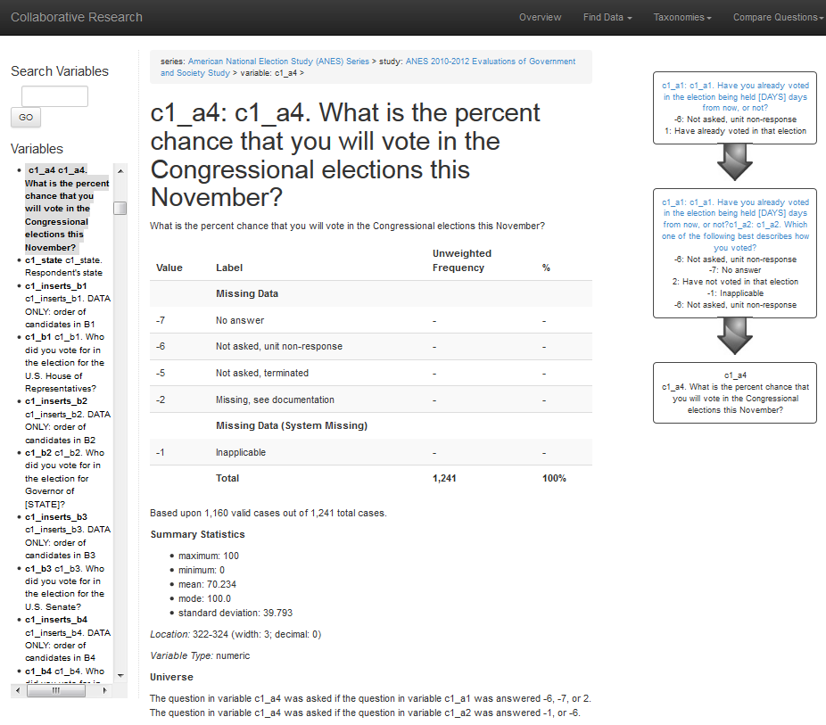
Notes:
Metadata for the American National Election Study: What question was asked? How was the question coded? Who answered this question?

Slide 5
How are research data created?
Most surveys are conducted with computer assisted interview software (CAI)
  CATI – Computer-assisted Telephone Interview
  CAPI – Computer-assisted Personal Interview
  CAWI – Computer Aided Web Interview
There is no paper questionnaire
The CAI program is the questionnaire
  i.e. the program is the metadata

Slide 6
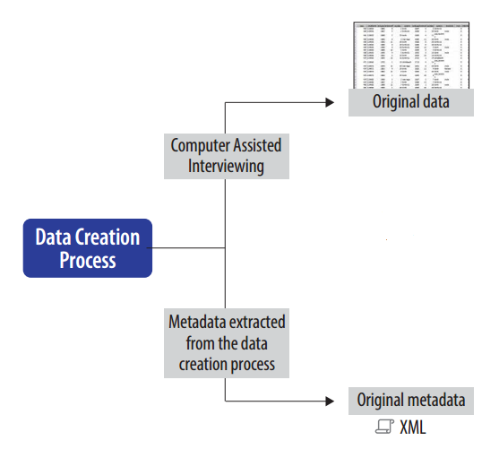
Notes:
We already have tools to convert CAI to machine-readable metadata. These include: MQDS, Colectica

Slide 7
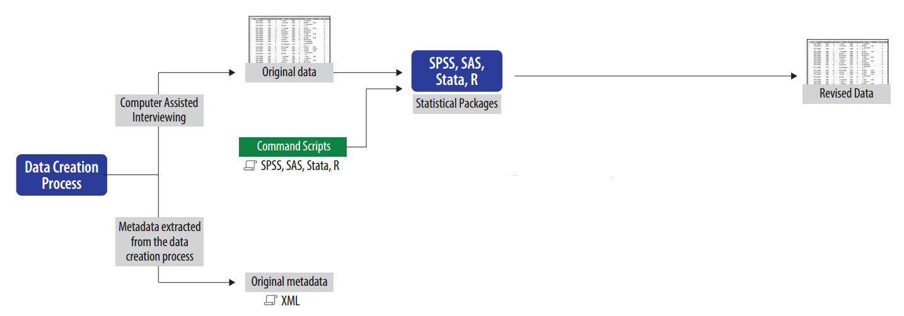
Notes:
But when a project modifies the data, they no longer match the metadata. This means the transformations are then recorded by hand -- if at all.

Slide 8
What’s missing?
Statistics packages have limited metadata
No question text
No interview flow (question order, skip pattern)
No variable provenance
Data transformations are not documented.

Slide 9
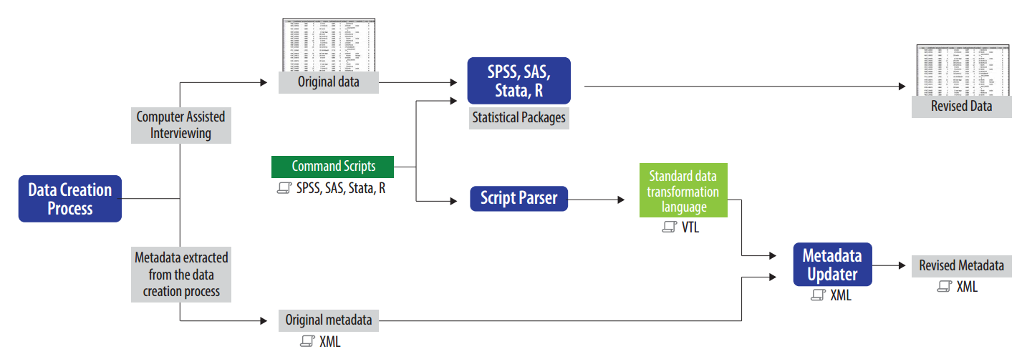
Notes:
We are automating the capture of transformation metadata.

Slide 10
Benefits of automated metadata capture
Metadata will be better
  All the information in the CAI can be included.
  Variable transformations can be described
Automation will lower costs
  Metadata will not be discarded and re-created
All metadata will be standardized and machine readable
  Codebooks with rich information can be rendered at will
If we make it easy and beneficial, researchers will use it.

Slide 11
Some Details

Slide 12
Project High Level Tasks
All
  Collect scripts. Agree on VTL representations.
  Standards for incorporating VTL into DDI and EML
ICPSR
  Test data and scripts
  Testing created DDI metadata
  Testing created EML metadata
  Active DDI codebook with VTL
NSD
  Stata Script Parser
  SAS Script Parser
Colectica
  SPSS Script Parser
  R data transformation package
MTNA
  VTL to DDI Metadata Updater
  VTL to EML Metadata Updater
  DDI comparison and validation tool

Slide 13
Target Data Transformations for Year 1
Unconditional assignment (SPSS: COMPUTE; Stata: gener)
  Arithmetic operations
  List of mathematical functions (exp, ln, log, …)
Conditional assignment (SPSS: IF; Stata: replace ...if)
  Logical expressions
Recode (SPSS: RECODE; Stata: recode)
SPSS | Stata | SAS | R | VTL
COMPUTE | generate replace | [assignment] |  | [assignment] :=
IF | replace … if | IF...THEN/ELSE |  | if … then … else
RECODE | recode | IF...THEN … ELSE … IF … THEN |  | if … then … elseif … then

Slide 14
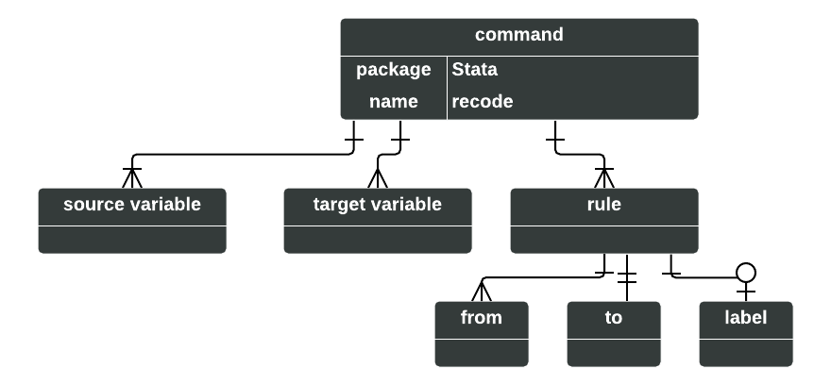
What is recode (in Stata)?
recode -- Recode categorical variables
recode var1 var2 (1 2 = 2) (3/max = 5)
recode a b (1 = 2), prefix("modified_")
recode x y (1 = 2), generate(modified_x modified_y)
recode x y (1 = 2 "Labelfor2") (3 = 5 "Labelfor5")
recode total (0/140=0 F) (141/180=1 D) (181/210=2 C) (211/234=3 B) (235/300=4 A), gen(grade)
recode a (1 . .a 5/6 = 7) (nonmissing = 8) (missing = 9) (* = 2)

Slide 15
What is recode (in SPSS)?
RECODE var1 var2 var3 (-1=7) (-2=8).
RECODE AGE (MISSING=9) (18 THRU HI=1) (0 THRU 18=0) INTO VOTER.

Slide 16
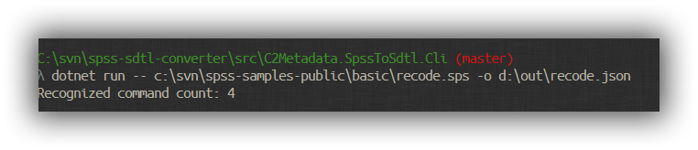
Apps to Detect Transformations

Slide 17
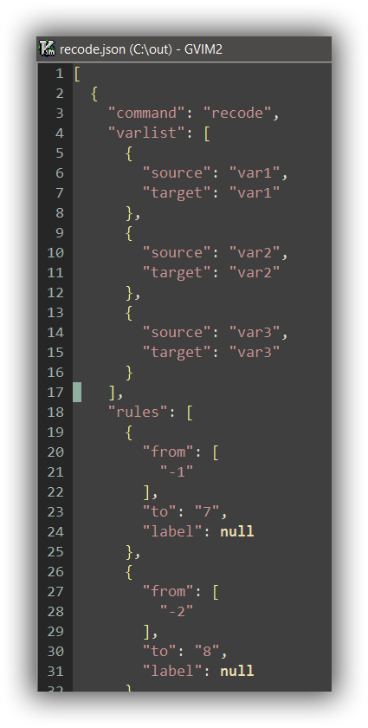
Recode in JSON

Slide 18
JSON-schema for recode description
Published at
https://gitlab.nsd.uib.no/nsd-external/stata2vtl/blob/develop/resources/recode_schema.json
Functional recode parser available at
http://ekstern.nsd.no/metacap/stata2vtl

Slide 19
Continuing Work
Describe more types of transformations
Detect those transformations in SPSS, Stata, SAS
R library for transforming data

Slide 20
Thanks!
http://c2metadata.org/

Slide 21
Following are slides not used in the main presentation...

Slide 22
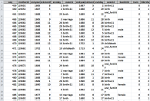
Original
data
Computer Assisted Interviewing
CAI
We already have tools to convert CAI to machine-readable metadata.
CAI to DDI
Convert to DDI:
CollecticaMQDS
others
Original metadata
DDI XML

Slide 23

Original
data
What happens when a project modifies the data.
Statistical Packages
SPSS
SAS
Stata
R
Computer Assisted Interviewing
Command scripts:
Revised
data
SPSSSAS
Stata
R
CAI
The modified data no longer match the metadata.
CAI to DDI
Convert to DDI:
CollecticaMQDS
others
Original metadata
DDI XML

Slide 24

Metadata are re-created after the data are transformed.
Original
data
Statistical Packages
SPSS
SAS
Stata
R
Computer Assisted Interviewing
Command scripts:
Revised
data
SPSSSAS
Stata
R
CAI
Transformations are documented by hand
CAI to DDI
Convert to DDI:
CollecticaMQDS
others
Original metadata
DDI XML

Slide 25
Automating the capture of transformation metadata.
Original
data
Statistical Packages
SPSS
SAS
Stata
R
Computer Assisted Interviewing
Command scripts:
Revised
data
SPSSSAS
Stata
R
CAI
Standard
Data Transformation Language
Revised metadata
Script Parser
SDTL
DDI XML
XML Updater
CAI to DDI
Convert to DDI:
CollecticaMQDS
others
Original metadata
Missing links that we will build.
DDI XML

