Slide 1
History Has Its Eyes on You: Lighthouses and Libraries Weathering Storms of Change
Corey Seeman
University of Michigan
Great Lakes Resource Sharing Conference
Oak Park, Illinois – June 9, 2017
http://tinyurl.com/SeemanGLRS2017
Twitter @cseeman / Email cseeman@umich.edu

Slide 2
Program Outline
Introduction
Lighthouses Then and Now
Lighthouses as “Public Good”
Libraries as “Public Good”
Connections for Librarians
Future Challenges for Resource Sharing
Envisioning the Library of the Future
South Haven (MI) Light

Slide 3
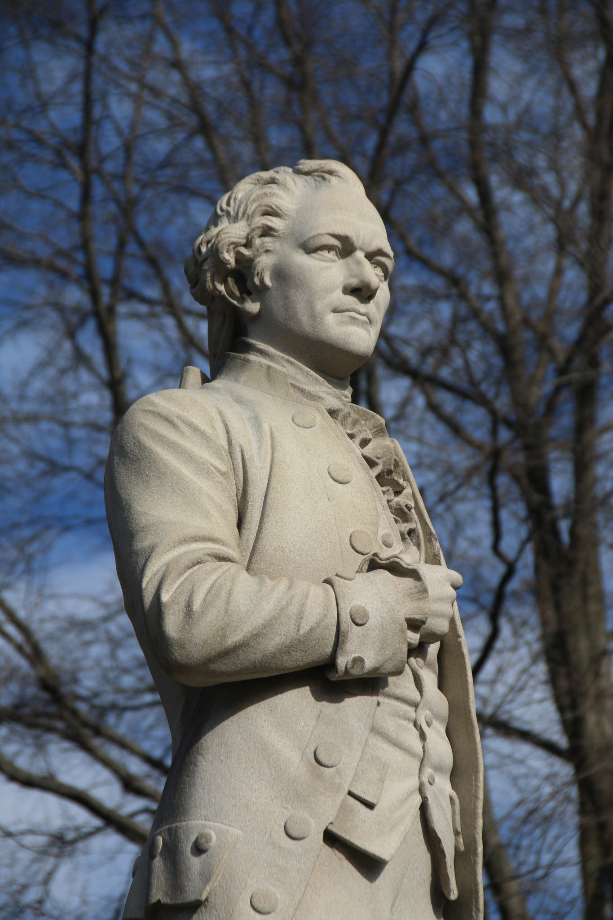
About the title….
Comes from Lin-Manuel Miranda’s Brilliant Musical, Hamilton.
Song titles can be used in practically any context (3rd time I have used it in my presentations).
George Washington sings to Hamilton:
  I was younger than you are now
  When I was given my first command
  I led my men straight into a massacre
  I witnessed their deaths firsthand
  I made every mistake
  And felt the shame rise in me
  And even now I lie awake
  Knowing history has its eyes on me
Alexander Hamilton Statue – Central Park, NYC (2017)

Slide 4
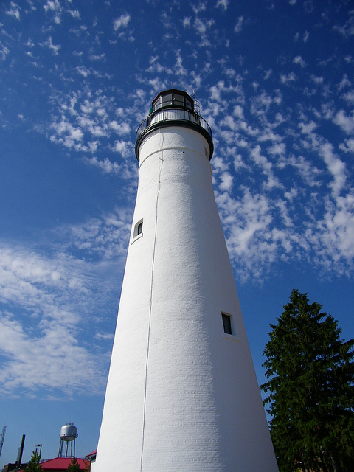
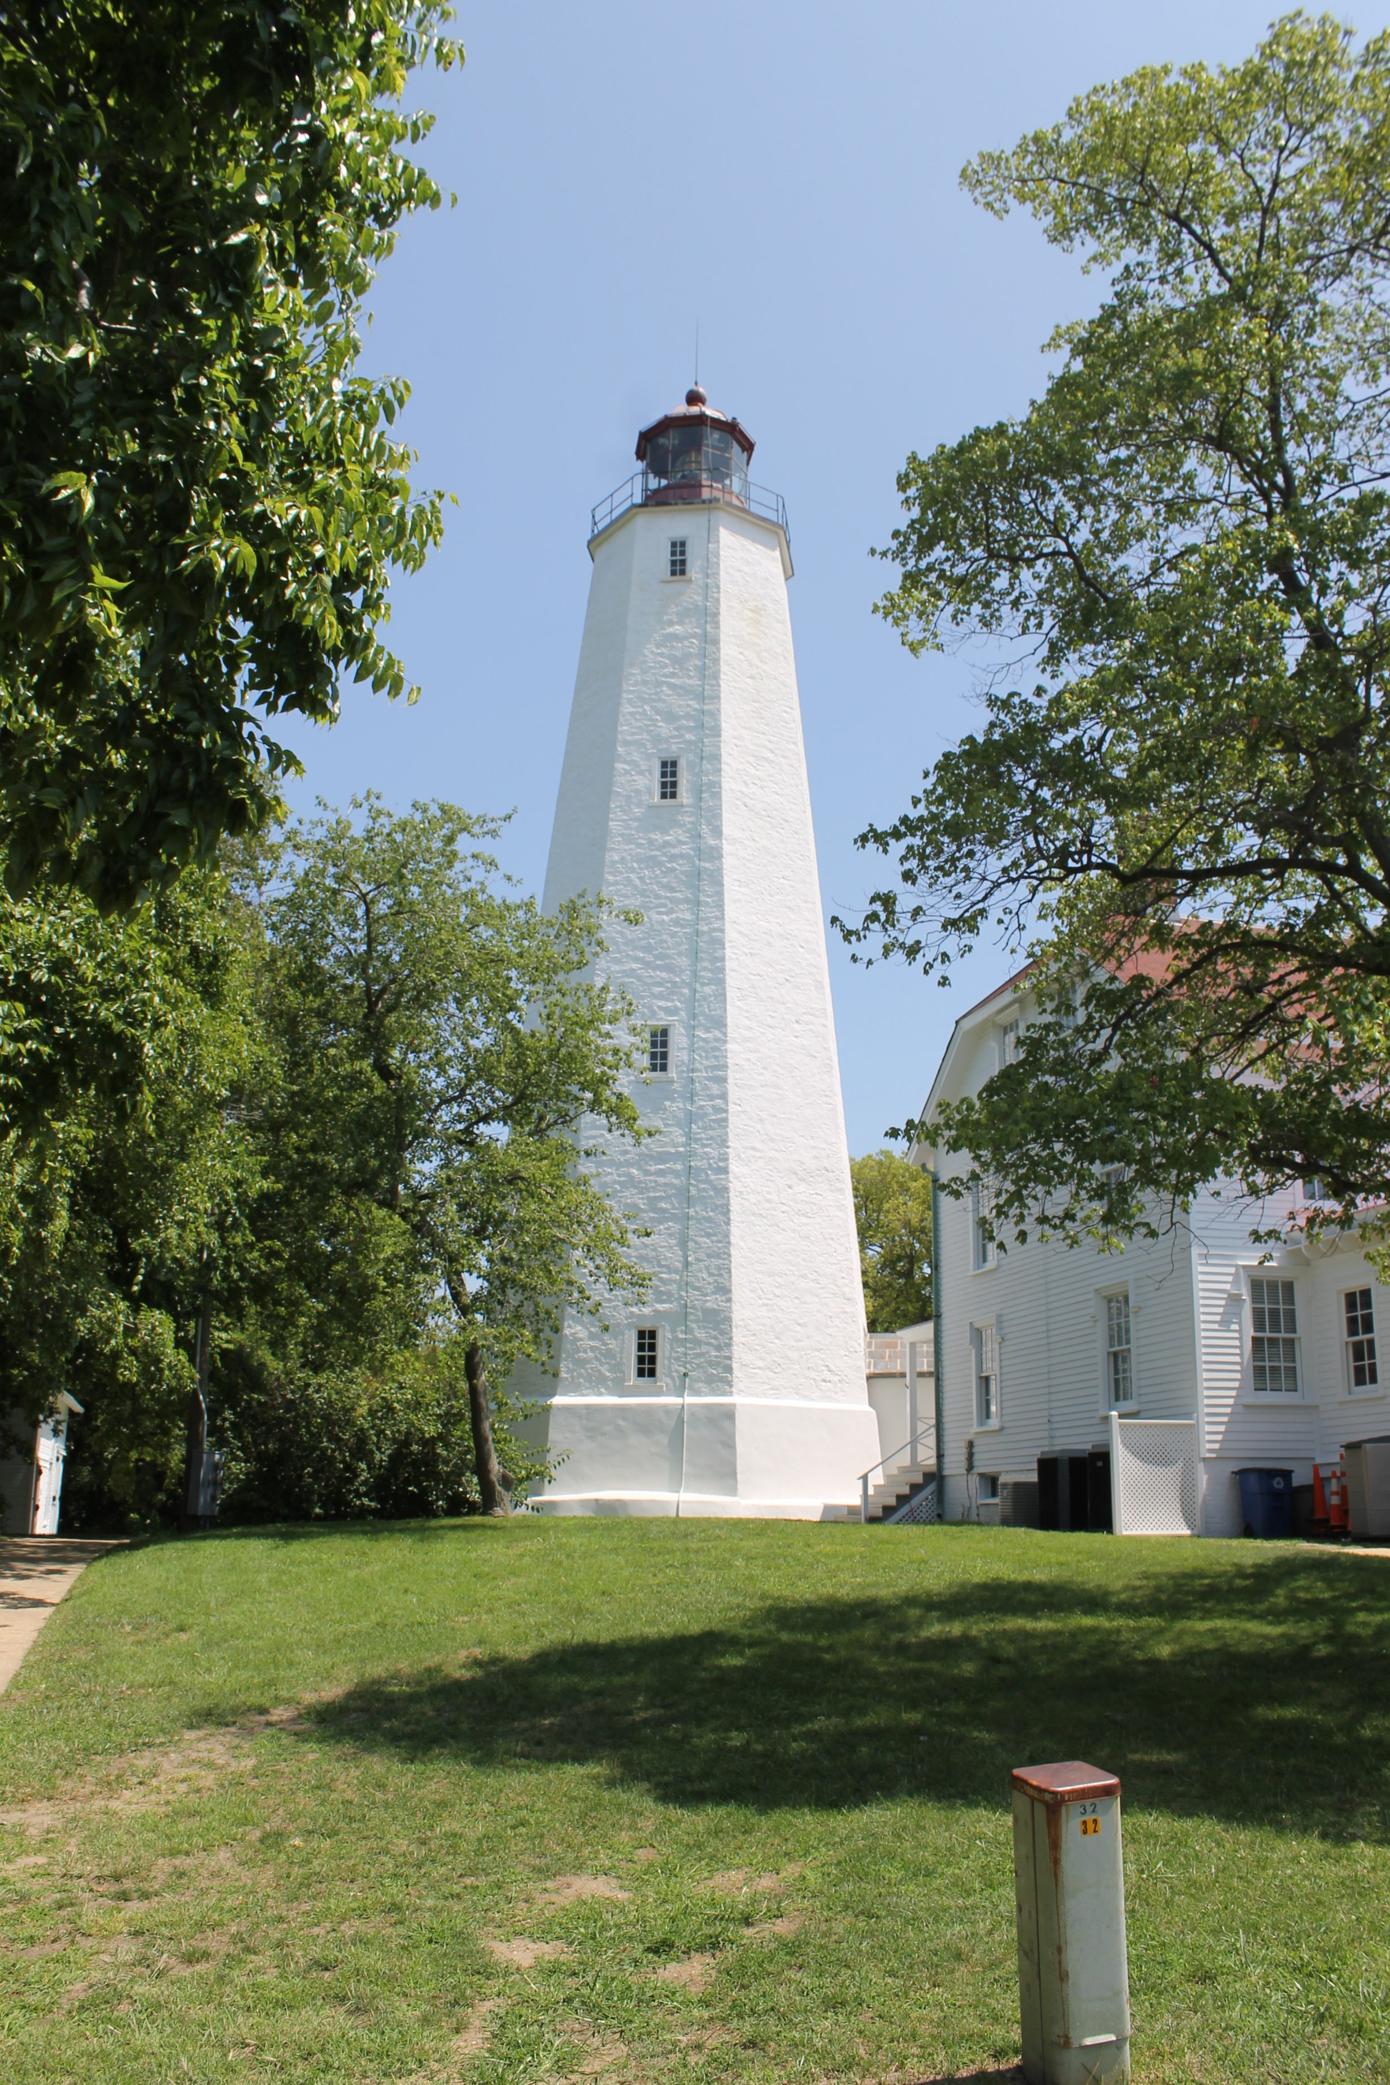
Lighthouses Then and Now
Boston Light – first lighthouse in the United States (first lit in 1716)
Sandy Hook NJ is the oldest working light (1764)
Fort Gratiot – Oldest in the Midwest (1829)
Sandy Hook (NJ) Lighthouse
Fort Gratiot Lighthouse (Port Huron, MI

Slide 5
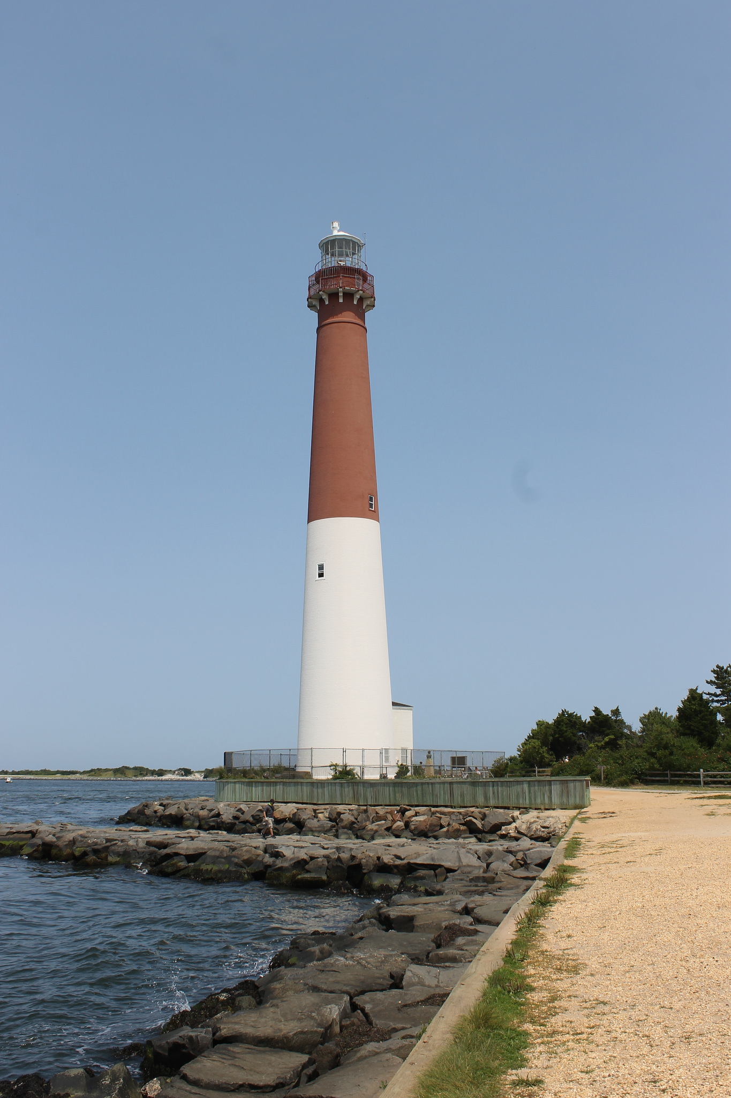
Lighthouses Then and Now
Long, long before Boston, Sandy Hook and Fort Gratiot, there was a lighthouse in Alexandria (Pharos of Alexandria), Egypt that was one of the Seven Wonders of the Western World.
It is estimated that it stood 103-118 meters tall – or 2x taller than Old Barney (NJ) – our 4th tallest light.
Also in Alexandria was possibly the most famous library of all times.
Barnegat Lighthouse (Long Beach Island, NJ)

Slide 6
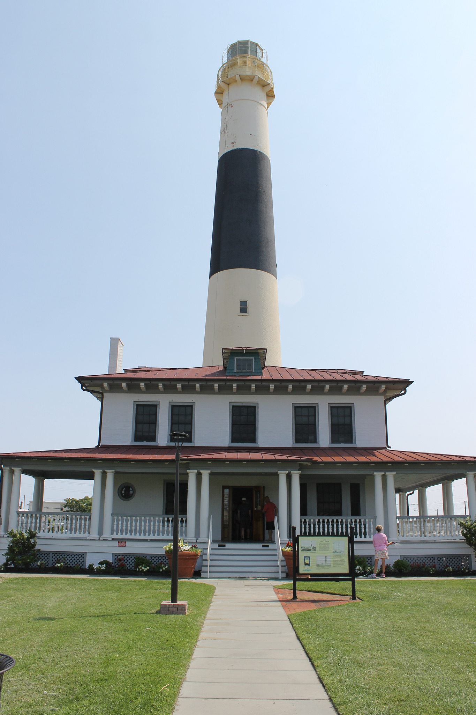
Lighthouses Then and Now
Location of lighthouses along the ocean shores and great lakes were strategic.
Lights were naturally placed in harbors (often range lights) and along the shore.
Lights are typically 20 miles apart because light could be seen around 10 miles.
Each light had their own signature pattern for the lamp as well as a unique pattern for daytime identification.
Absecon Lighthouse (Atlantic City, NJ)

Slide 7
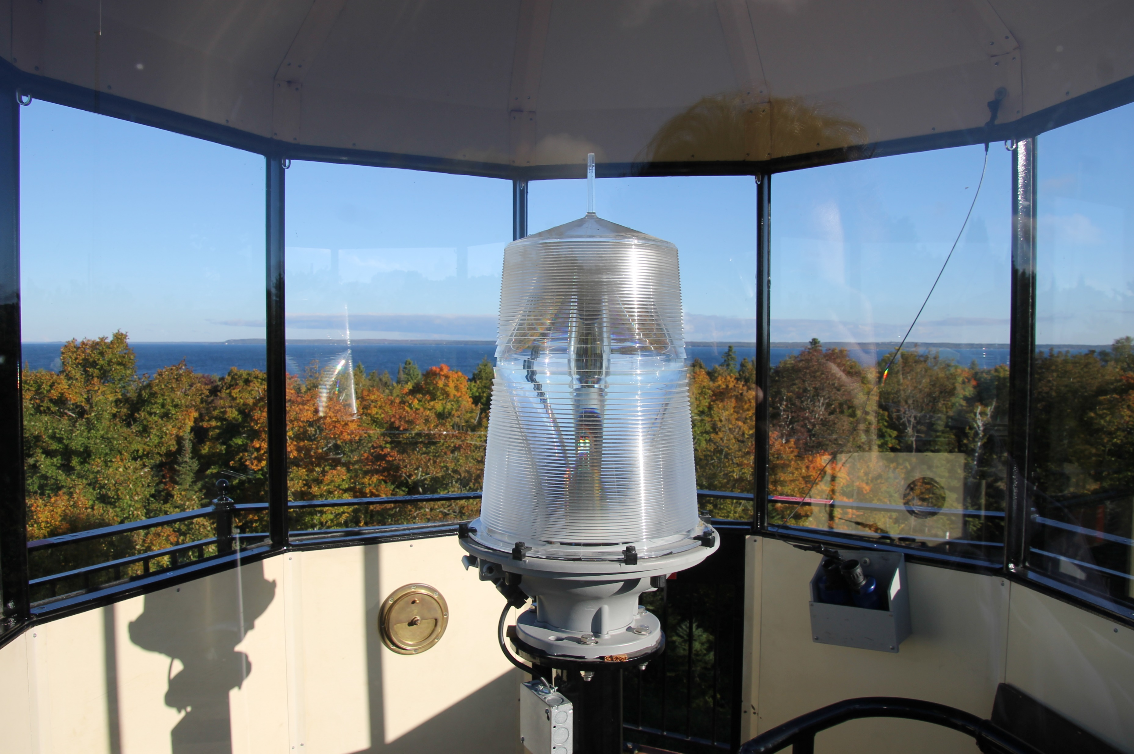
Lighthouses Then and Now
Lighthouse automation changed everything. Electrical lights were introduced in the 19th Century.
Automation of lights started as early as the 1920s, but took place in greater fashion after World War II.
McGulpin Point Lighthouse (Mackinaw City, MI)

Slide 8
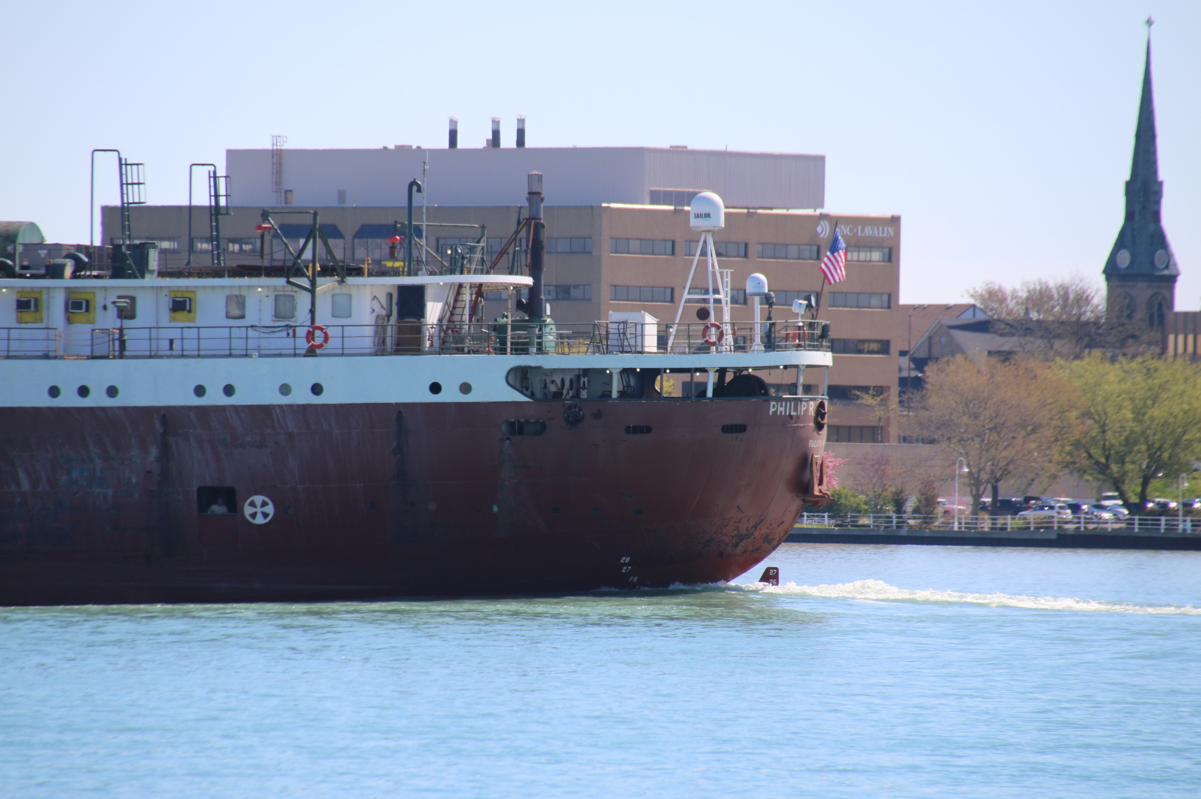
Lighthouses Then and Now
Ship radar and navigation tools have become more sophisticated.
Even smaller vessels are likely to have GPS tools to help them find safe harbor.
Freighter Philip C. Clarke passing Port Huron (MI) on the St Clair River

Slide 9
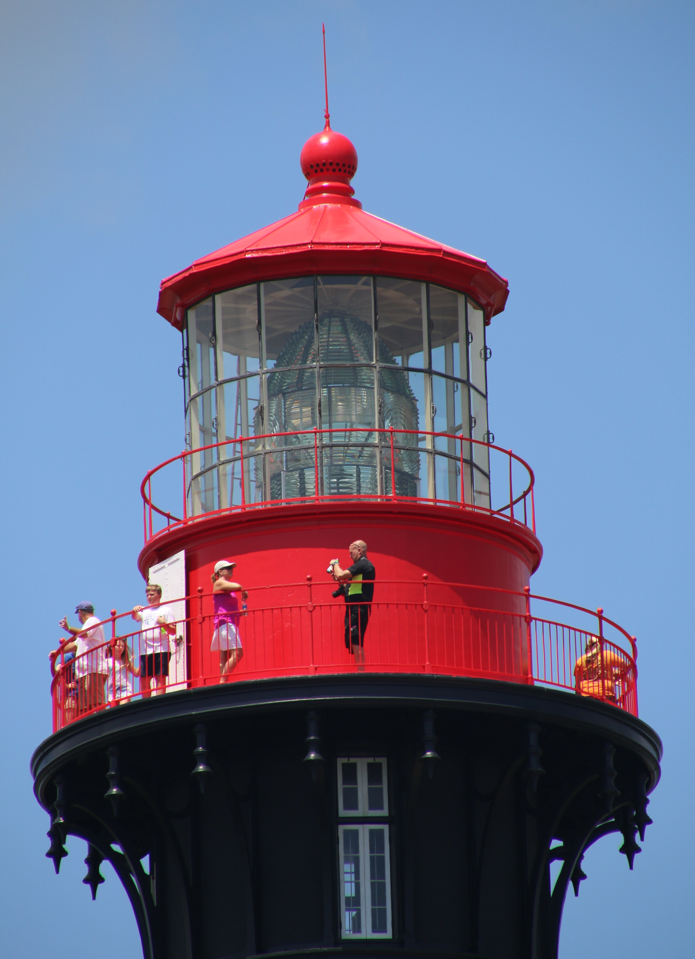
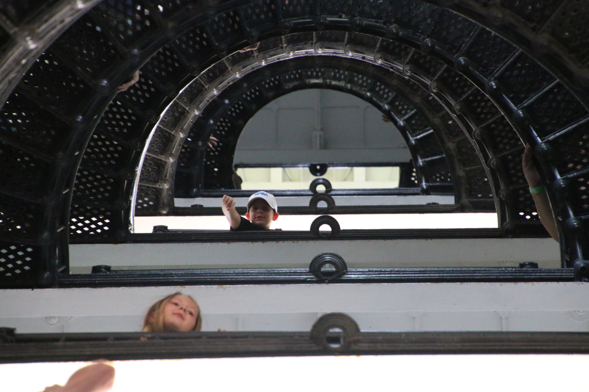
Lighthouses Then and Now
Changing roles and function of lighthouses.
Now, primarily historic sites and tourist attractions.
Some through State Parks and National Park Service.
Buildings are not well suited for repurposing.
Transition from life saving to educational and cultural roles.
St. Augustine (FL) Lighthouse

Slide 10
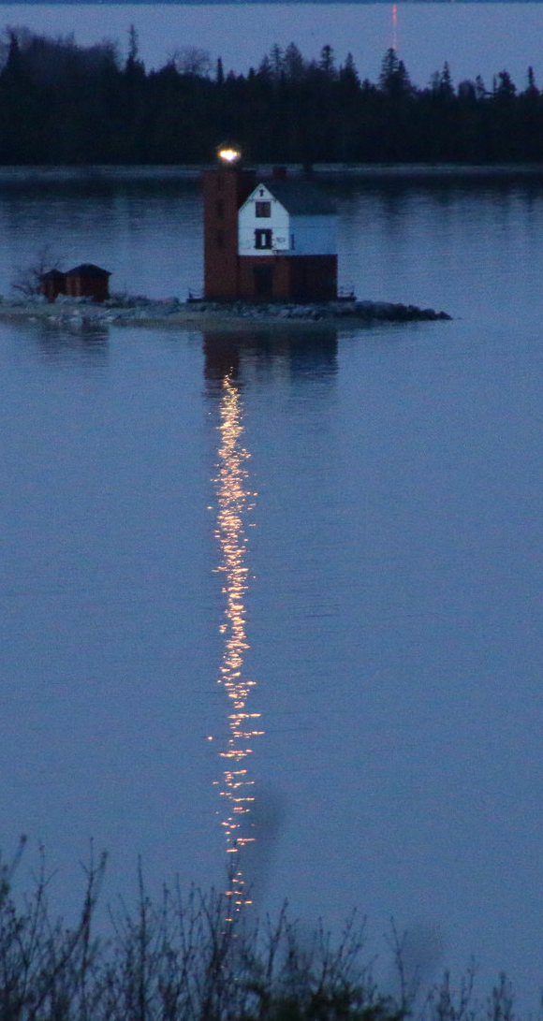
Lighthouses Then and Now
While their functions and value have changed, the lights are still lit at night.
There is a value in providing these aids to navigation.
There may be small vessels that do not have advanced radar that larger ships have.
To argue that we do not need lighthouses is to argue that all books are online. Not there yet.
Round Island Lighthouse (Mackinac Island, MI)

Slide 11
Lighthouses as a “Public Good”
What is a “Public Good”?
Traditional economists saw lighthouses as a “public good”
John Stuart Mill in Principles of Political Economy (1848) stated:
  “it is a proper office of government to build and maintain lighthouses, establish buoys, etc. for the security of navigation: for since it is impossible that the ships at sea which are benefited by a lighthouse, should be made to pay a toll on the occasion of its use, no one would build lighthouses for motives of personal interest…” (from Coase, 1974)

Slide 12
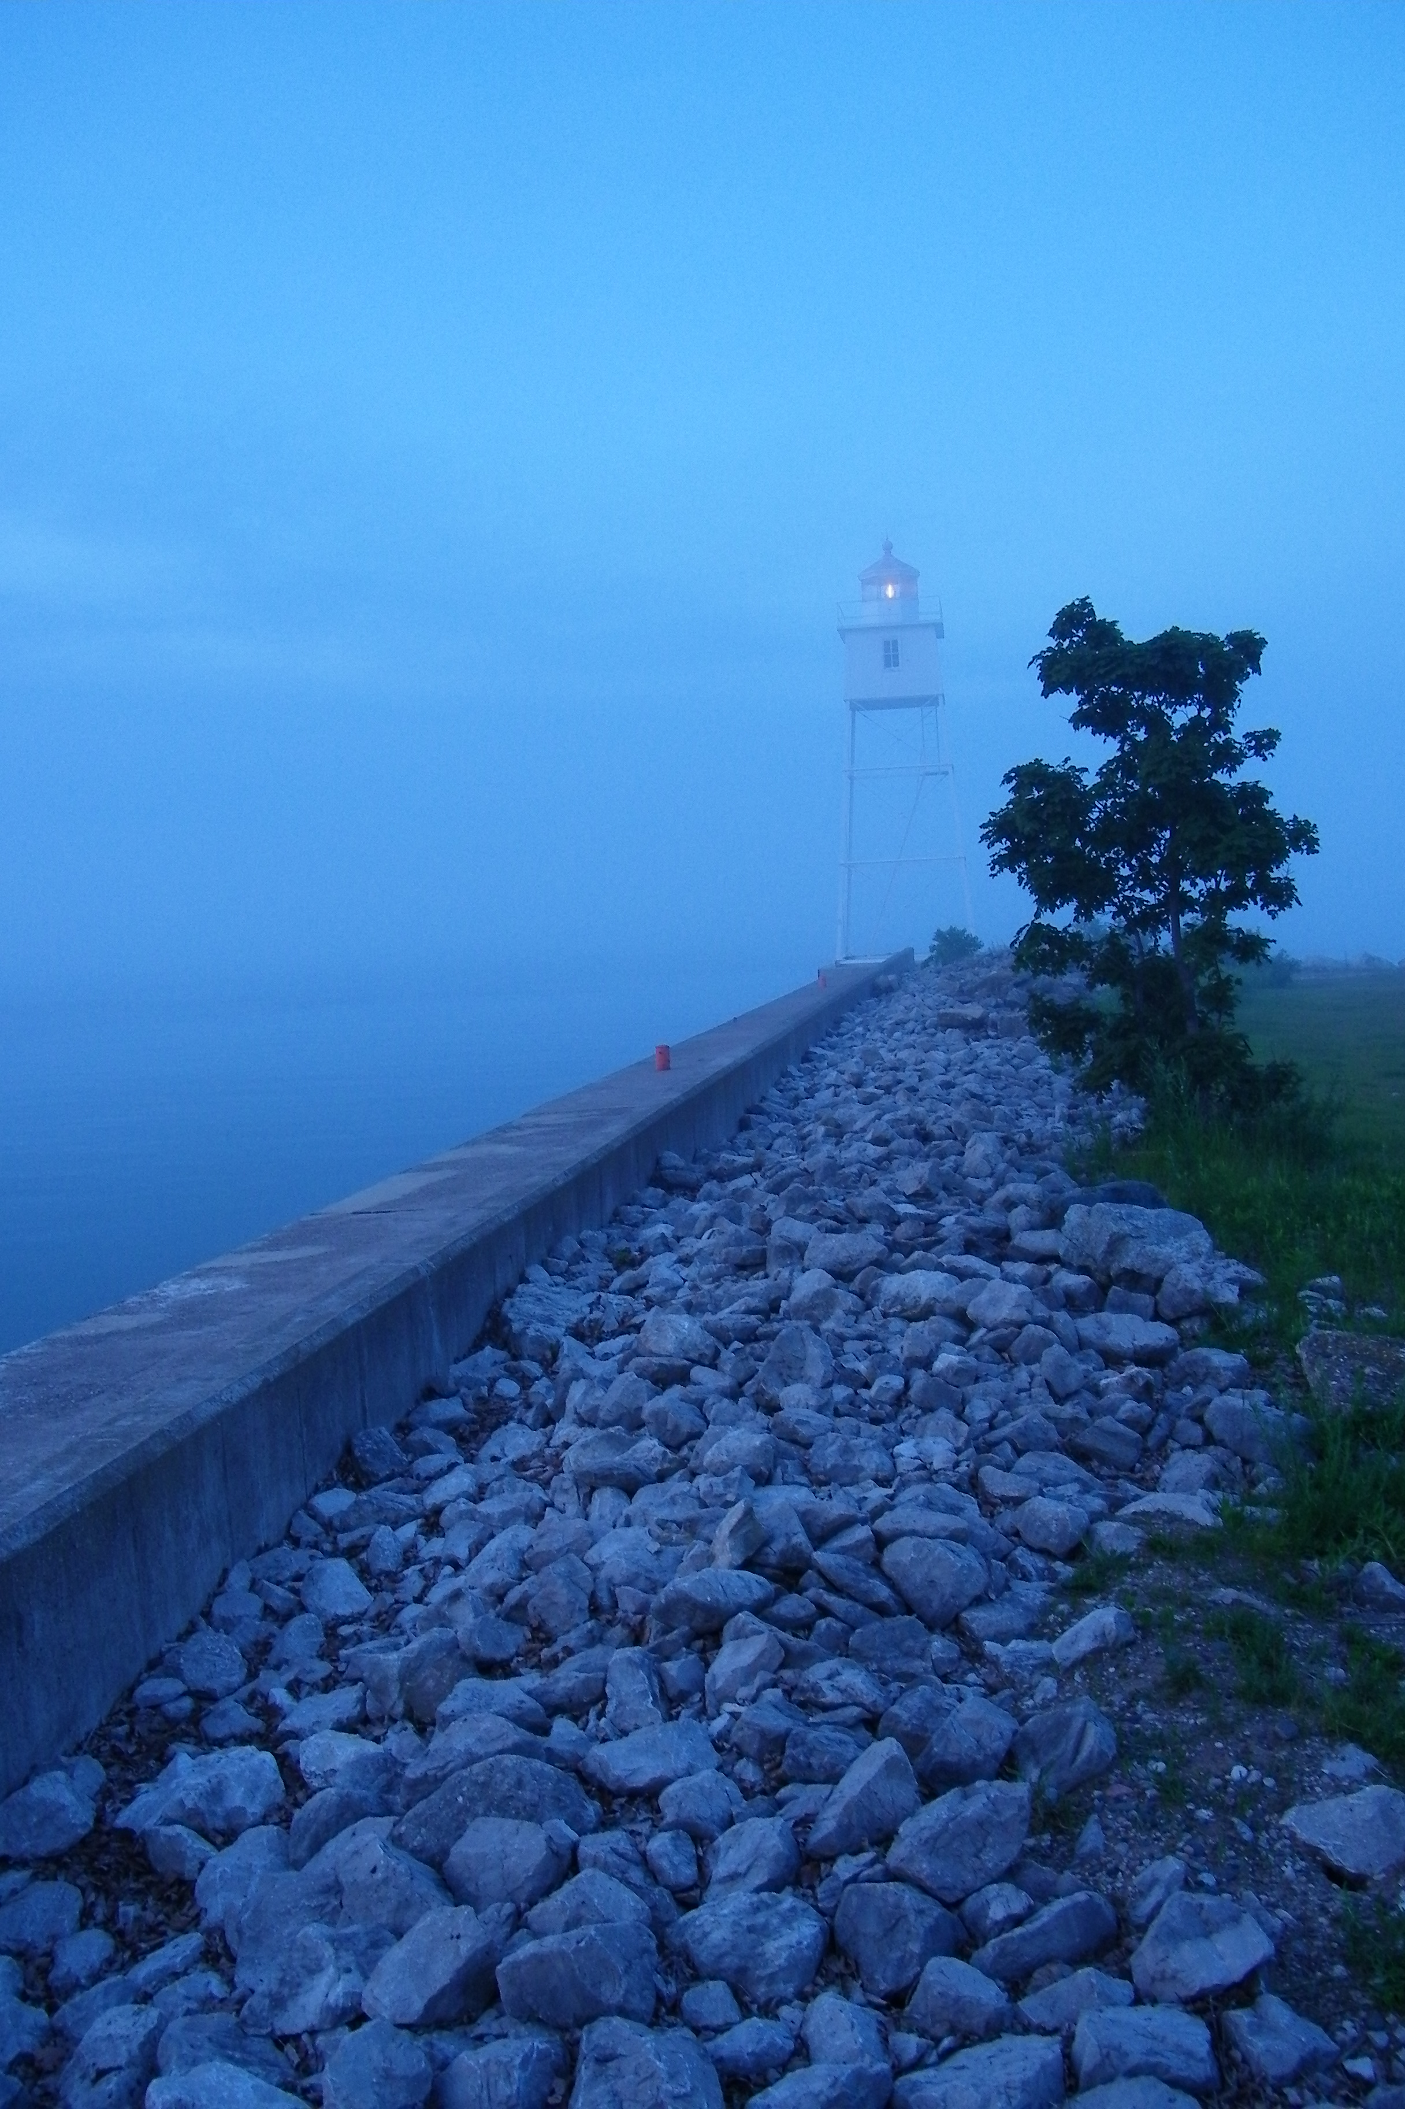
Lighthouses as a “Public Good”
Paul Samuelson in his Economics: An Introductory Analysis (6th Ed, 1964) stated:
  “Take our earlier case of a lighthouse to warn against rocks. Its beam helps everyone in sight. A businessman could not built it for a profit, since he cannot claim a price for each user. This certainly is the kind of activity that governments would naturally undertake.” (from Coase, 1974)
Other examples from economists including Henry Sidgwick, & A. C. Pigou are shared as well.
Grand Marais (MI) Light

Slide 13
Lighthouses as a “Public Good”
In his challenge to the notion of the lighthouse as a “public good”, Coase looked at the British Lighthouse System in the 19th Century.
Coase connected that the lighthouses in the UK were managed by Trinity House, a private corporation charged by royal charter over 500 years ago (https://www.trinityhouse.co.uk/about-us/trinity-house-faq)
So if the British lighthouses are managed by a private corporation, are their management a “public good?”
Coase, Ronald H. "The Lighthouse in Economics." The Journal of Law and Economics 17.2 (1974): 357-76.

Slide 14
Lighthouses as a “Public Good”
Barnett, William, and Walter Block. "Coase and Van Zandt on Lighthouses." Public Finance Review 35.6 (2007): 710.
Block, Walter, and William Barnett. "Coase and Bertrand on Lighthouses." Public Choice 140.1/2 (2009): 1.
Conway, Hannah Caroline. "Illuminating Science: The Lighthouse as Public Good and the Role of the Scientific Expert in Nineteenth-Century British Lighthouse Reform." ProQuest Dissertations Publishing, 2015.
Elodie Bertrand. "The Coasean Analysis of Lighthouse Financing: Myths and Realities." Cambridge Journal of Economics 30.3 (2006; 2005): 389.
Krause, Martin. "Buoys and Beacons in Economics." Journal of Private Enterprise 30.1 (2015): 45.
Laurent Carnis. "The Political Economy of Lighthouses: Some further Considerations." Journal des Économistes et des Études Humaines 20.2 (2014): 143.
Lindberg, Erik. "From Private to Public Provision of Public Goods: English Lighthouses between the Seventeenth and Nineteenth Centuries." Journal of Policy History 25.04 (2013): 538-56.
Van Zandt, David E. "The Lessons of the Lighthouse:" Government" Or" Private" Provision of Goods." The Journal of Legal Studies 22.1 (1993): 47-72.

Slide 15
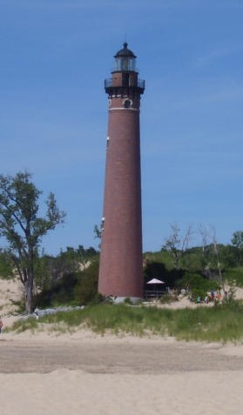
Lighthouses as a “Public Good”
However, the tradition in the United States is for publicly funded and managed aids to navigation.
1789-1910 - United States Lighthouse Establishment & United States Lighthouse Board - Department of the Treasury (9th law passed by Congress)
1910-1939 - Bureau of Lighthouses - Department of Commerce
1939 - Joined the United States Coast Guard - Department of the Treasury (etc.)
  http://www.terrypepper.com/lights/lists/chronology.htm
Little Sable Point Lighthouse (Mears, MI)

Slide 16
Lighthouses as a “Public Good”
There is no question that maintaining buoys, towers, lights, lighthouses, daymarks and shapes is an expensive and labor-intensive undertaking. But the unalterable fact is that these physical aids are essential to the safety of navigation on our waterways. Funding this infrastructure is always going to be a challenge. It is my opinion that the Coast Guard is the best organization to provide national-international continuity, and they should receive sufficient funding to provide for the continued maintenance of these critical navigation items.
  Captain Lynn Korwatch (executive director of the Marine Exchange of the San Francisco Bay Region) hearing before the Subcommittee on Coast Guard and Maritime Transportation of the House Committee on Transportation and Infrastructure, February 4, 2014. (Finding Your Way: the Future of Federal Aids to Navigation, p. 26)

Slide 17
Lighthouses as a “Public Good”
Core element in this discussion is “nonexcludability”
“In its purest form, non-excludability means that once a good has been created, it is impossible to prevent other people from gaining access to it (or more realistically, is extremely costly to do so).”
  Blakeley, N., Lewis, G., & Mills, D. (2005). The Economics of Knowledge: What makes ideas special for economic growth? New Zealand Treasury.
Excludability is when you can prevent consumers from getting access to a good or service who have not paid for it.

Slide 18
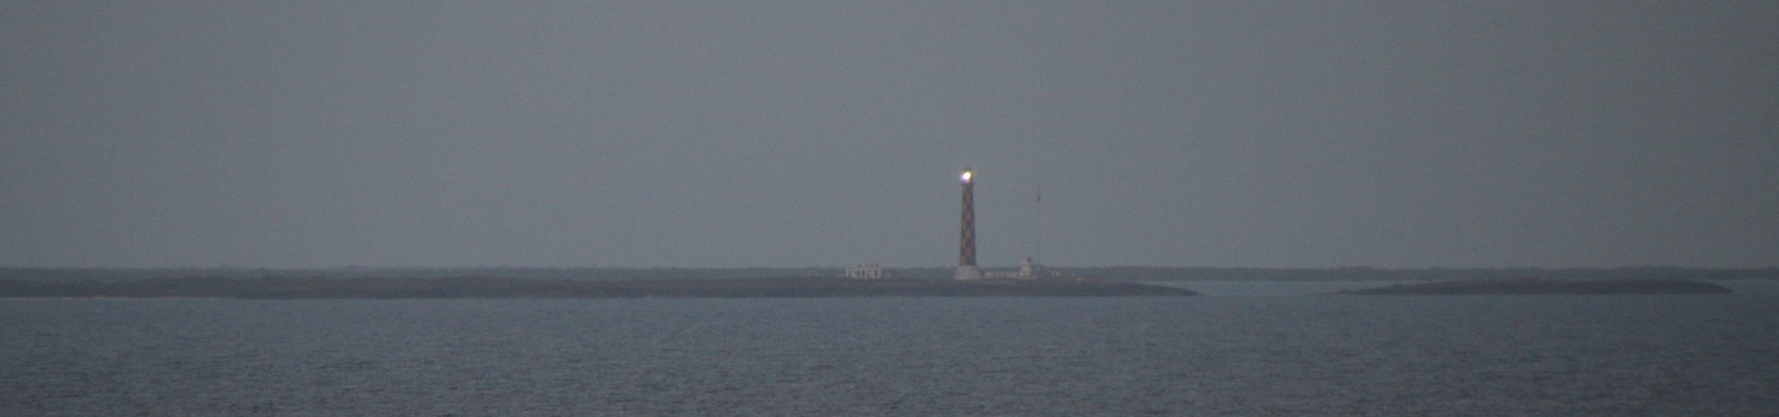
Lighthouses as a “Public Good”
If we think about the true nature of a “Public Good” – it is about providing a service for people who extend beyond who will pay taxes or fees.
Faro Paredón (Ciego de Avila Province, Cuba) – not near a port and serves as a beacon for all ships traveling north of Cuba. First lit in 1859.

Slide 19
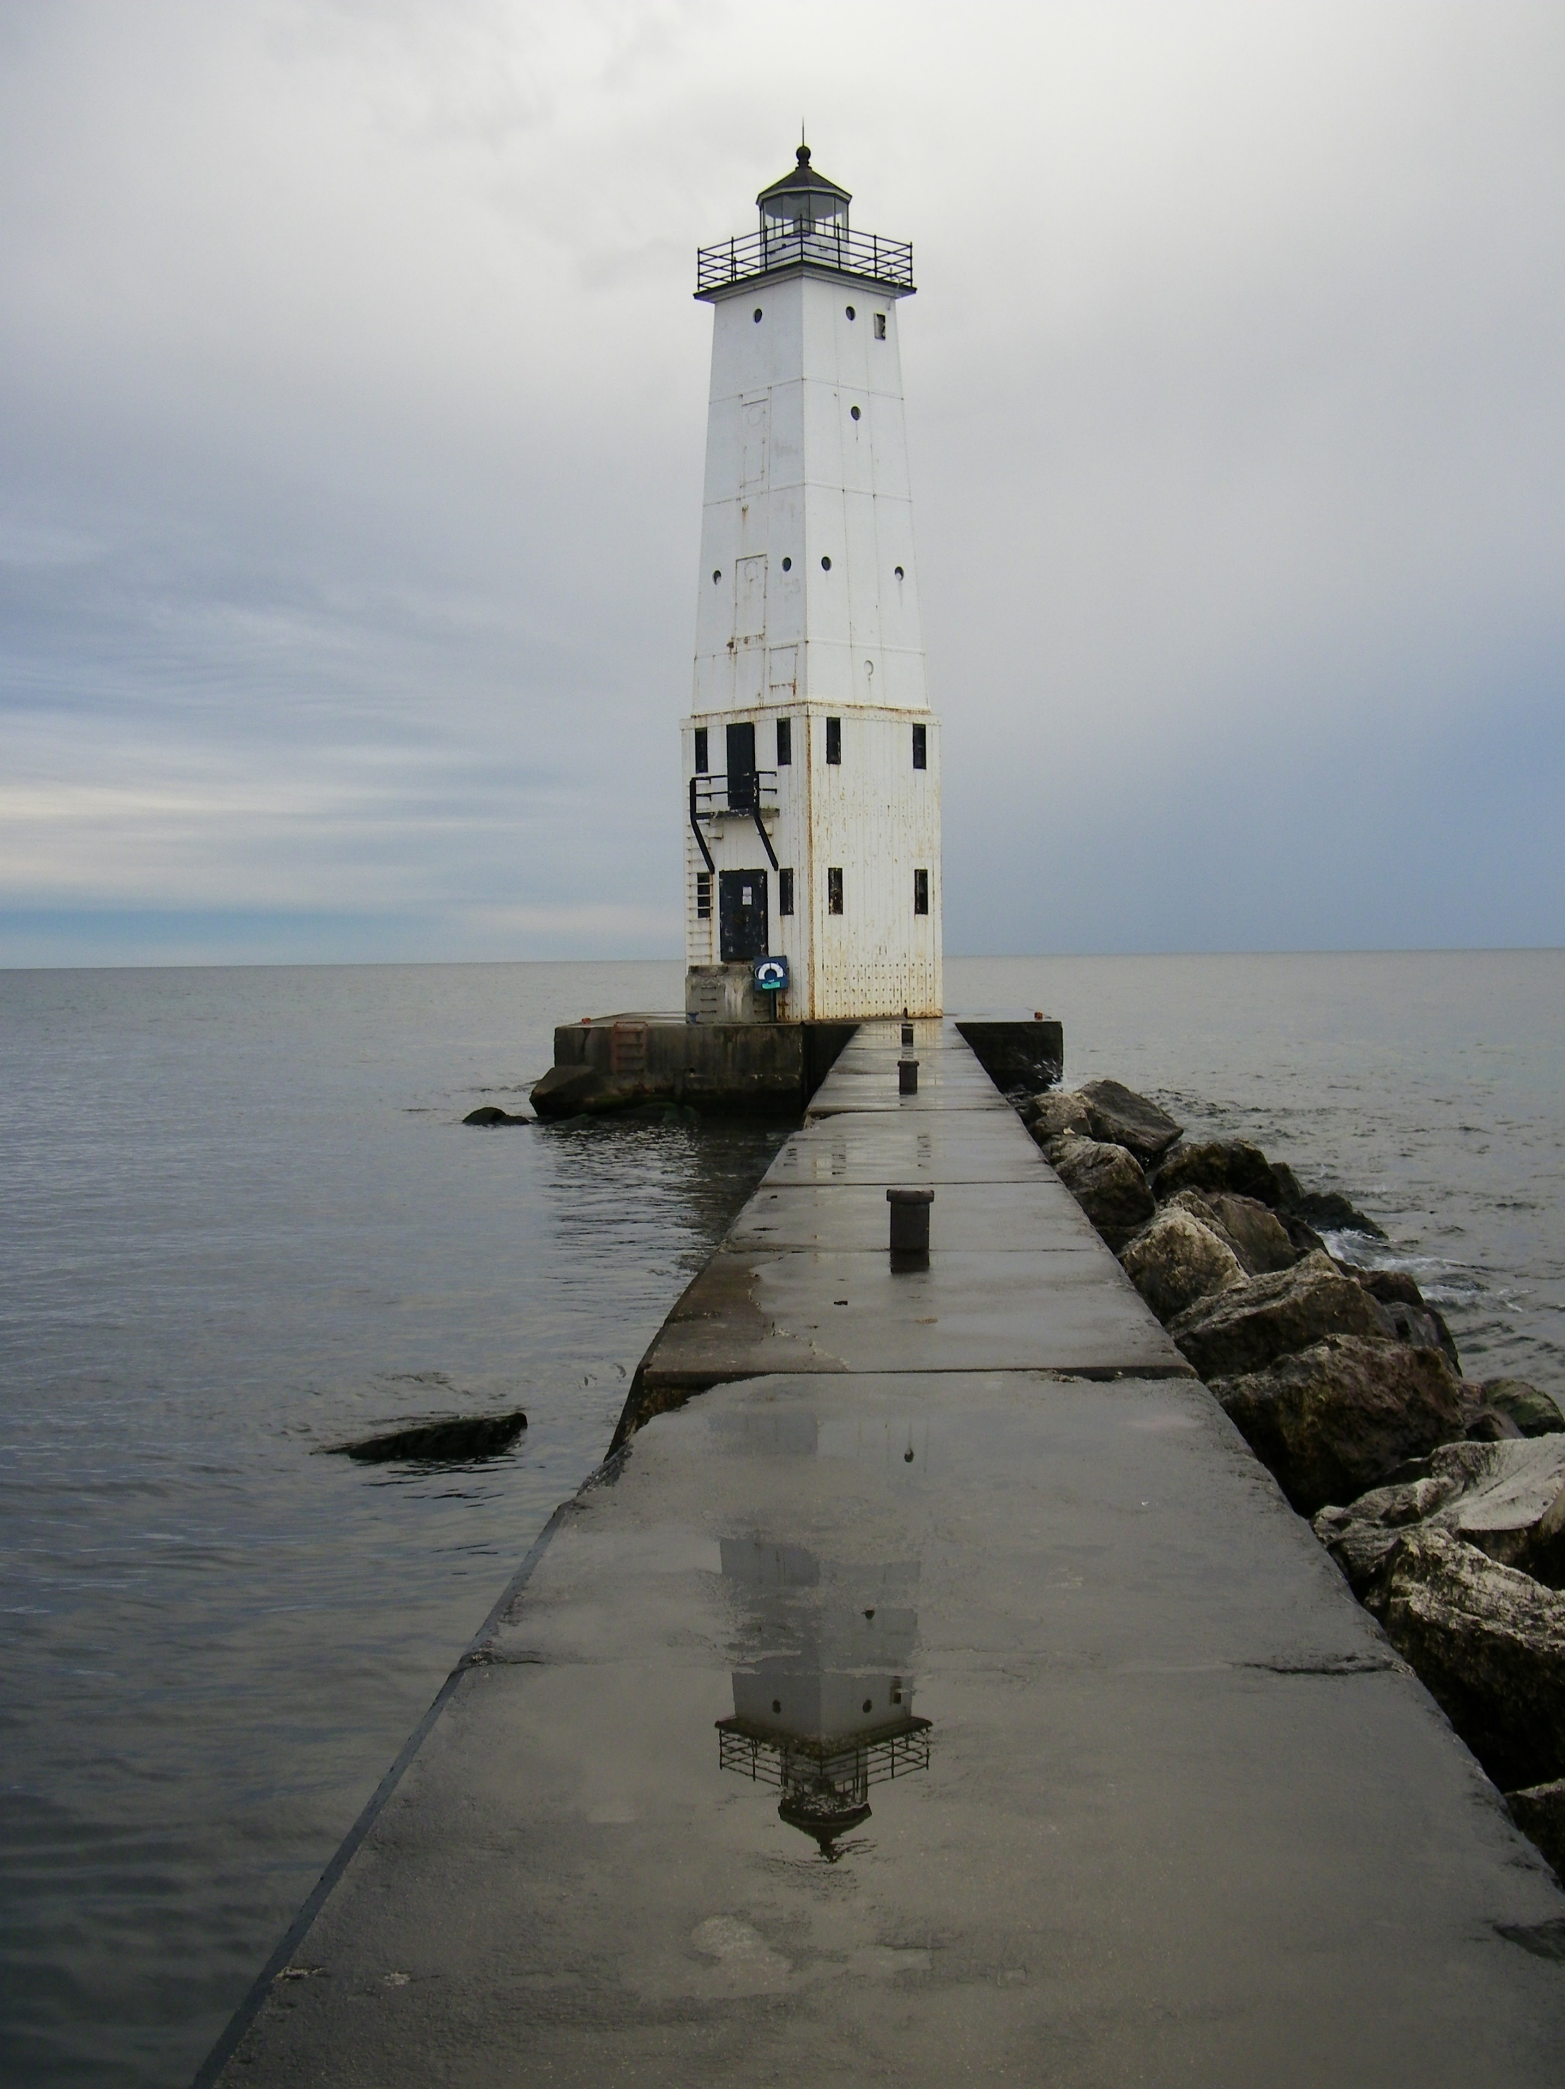
Lighthouses as a “Public Good”
Despite the general recognition that lighthouses are an important aspect of a community, they are not funded without restraint.
The fact that we cannot have maritime travel without them, does not mean that they are impervious to change.
Constant reflection is needed to chart the course forward.
Frankfort (MI) Light

Slide 20

Libraries as a “Public Good”
How many times have we heard that libraries are the “heart of the institution”?
We are not revenue driven – in fact, we are revenue-adverse.
We look at community outreach at Universities – a large percentage of work for the public good comes from libraries and archives.
Our goals are to provide services for patrons who are with us now as well as those who will come years from now.
Squirrel at the University of Michigan, Ann Arbor

Slide 21
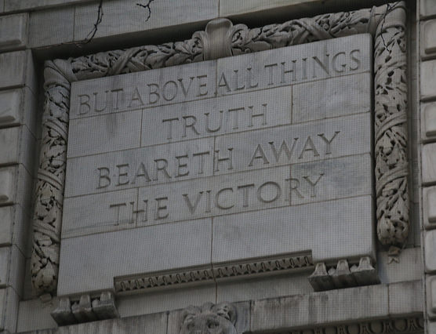
Libraries as a “Public Good”
“Critical Librarianship” – a social justice mission for libraries.
Universities need libraries as a means of acquiring information for the diverse research activities on campus.
While this is hits at the core of an academic campus, does that ensure a library’s longevity?
New York Public Library - Schwarzman Building (Fifth Avenue). Quote from 1 Esdras (Book of Ezra)

Slide 22

Libraries as a “Public Good”
ACRL Publication 2010
Oakleaf, M. J. (2010). The Value of Academic Libraries: A comprehensive research review and report Association of College and Research Libraries
Does this reflect a “tipping point”?

Slide 23
Connections for Librarians
So where are the connections between Lighthouses and Libraries, especially during dramatic change? Plenty!
Perception is Reality
Free Rider Problem
Different Dynamics of Building Use
Imagery is Important
Embracing the Change

Slide 24
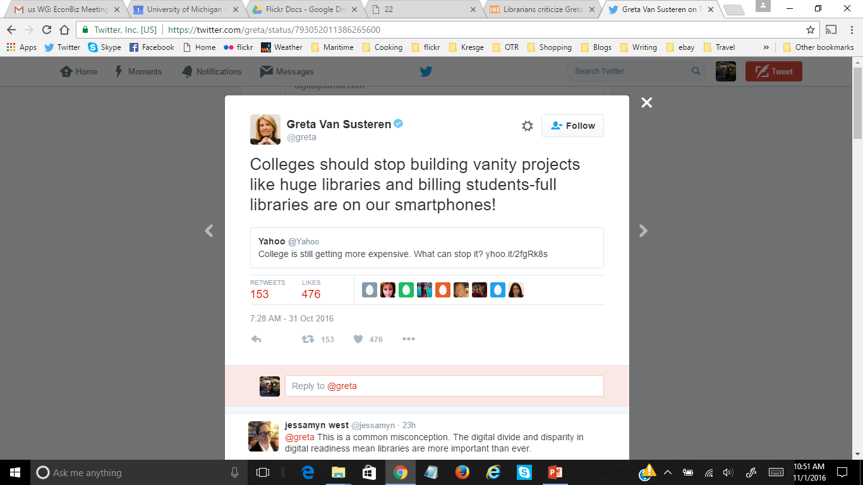
Connections for Librarians
Perception is Reality
Administrators are looking at space and wondering if it is being used the best it can be?
Librarians criticize Greta Van Susteren plenty after 'vanity projects' comments
http://ihenow.com/2ejbBbP

Slide 25

Connections for Librarians
Perception is Reality
Travel + Leisure Photo Contest – June 4th

Slide 26

Connections for Librarians
Free Rider Problem
Plagues both lighthouses and libraries.
Both are very large centralized expenses that many members of the community fail to understand the overall value.
While librarians serve the whole campus, academics primarily are focused on one specific area.
Do people care about a lighthouse on Isle Royal (MI) or ancient Greek History if they are not your destination or field?
Squirrel at the University of Michigan, Ann Arbor

Slide 27
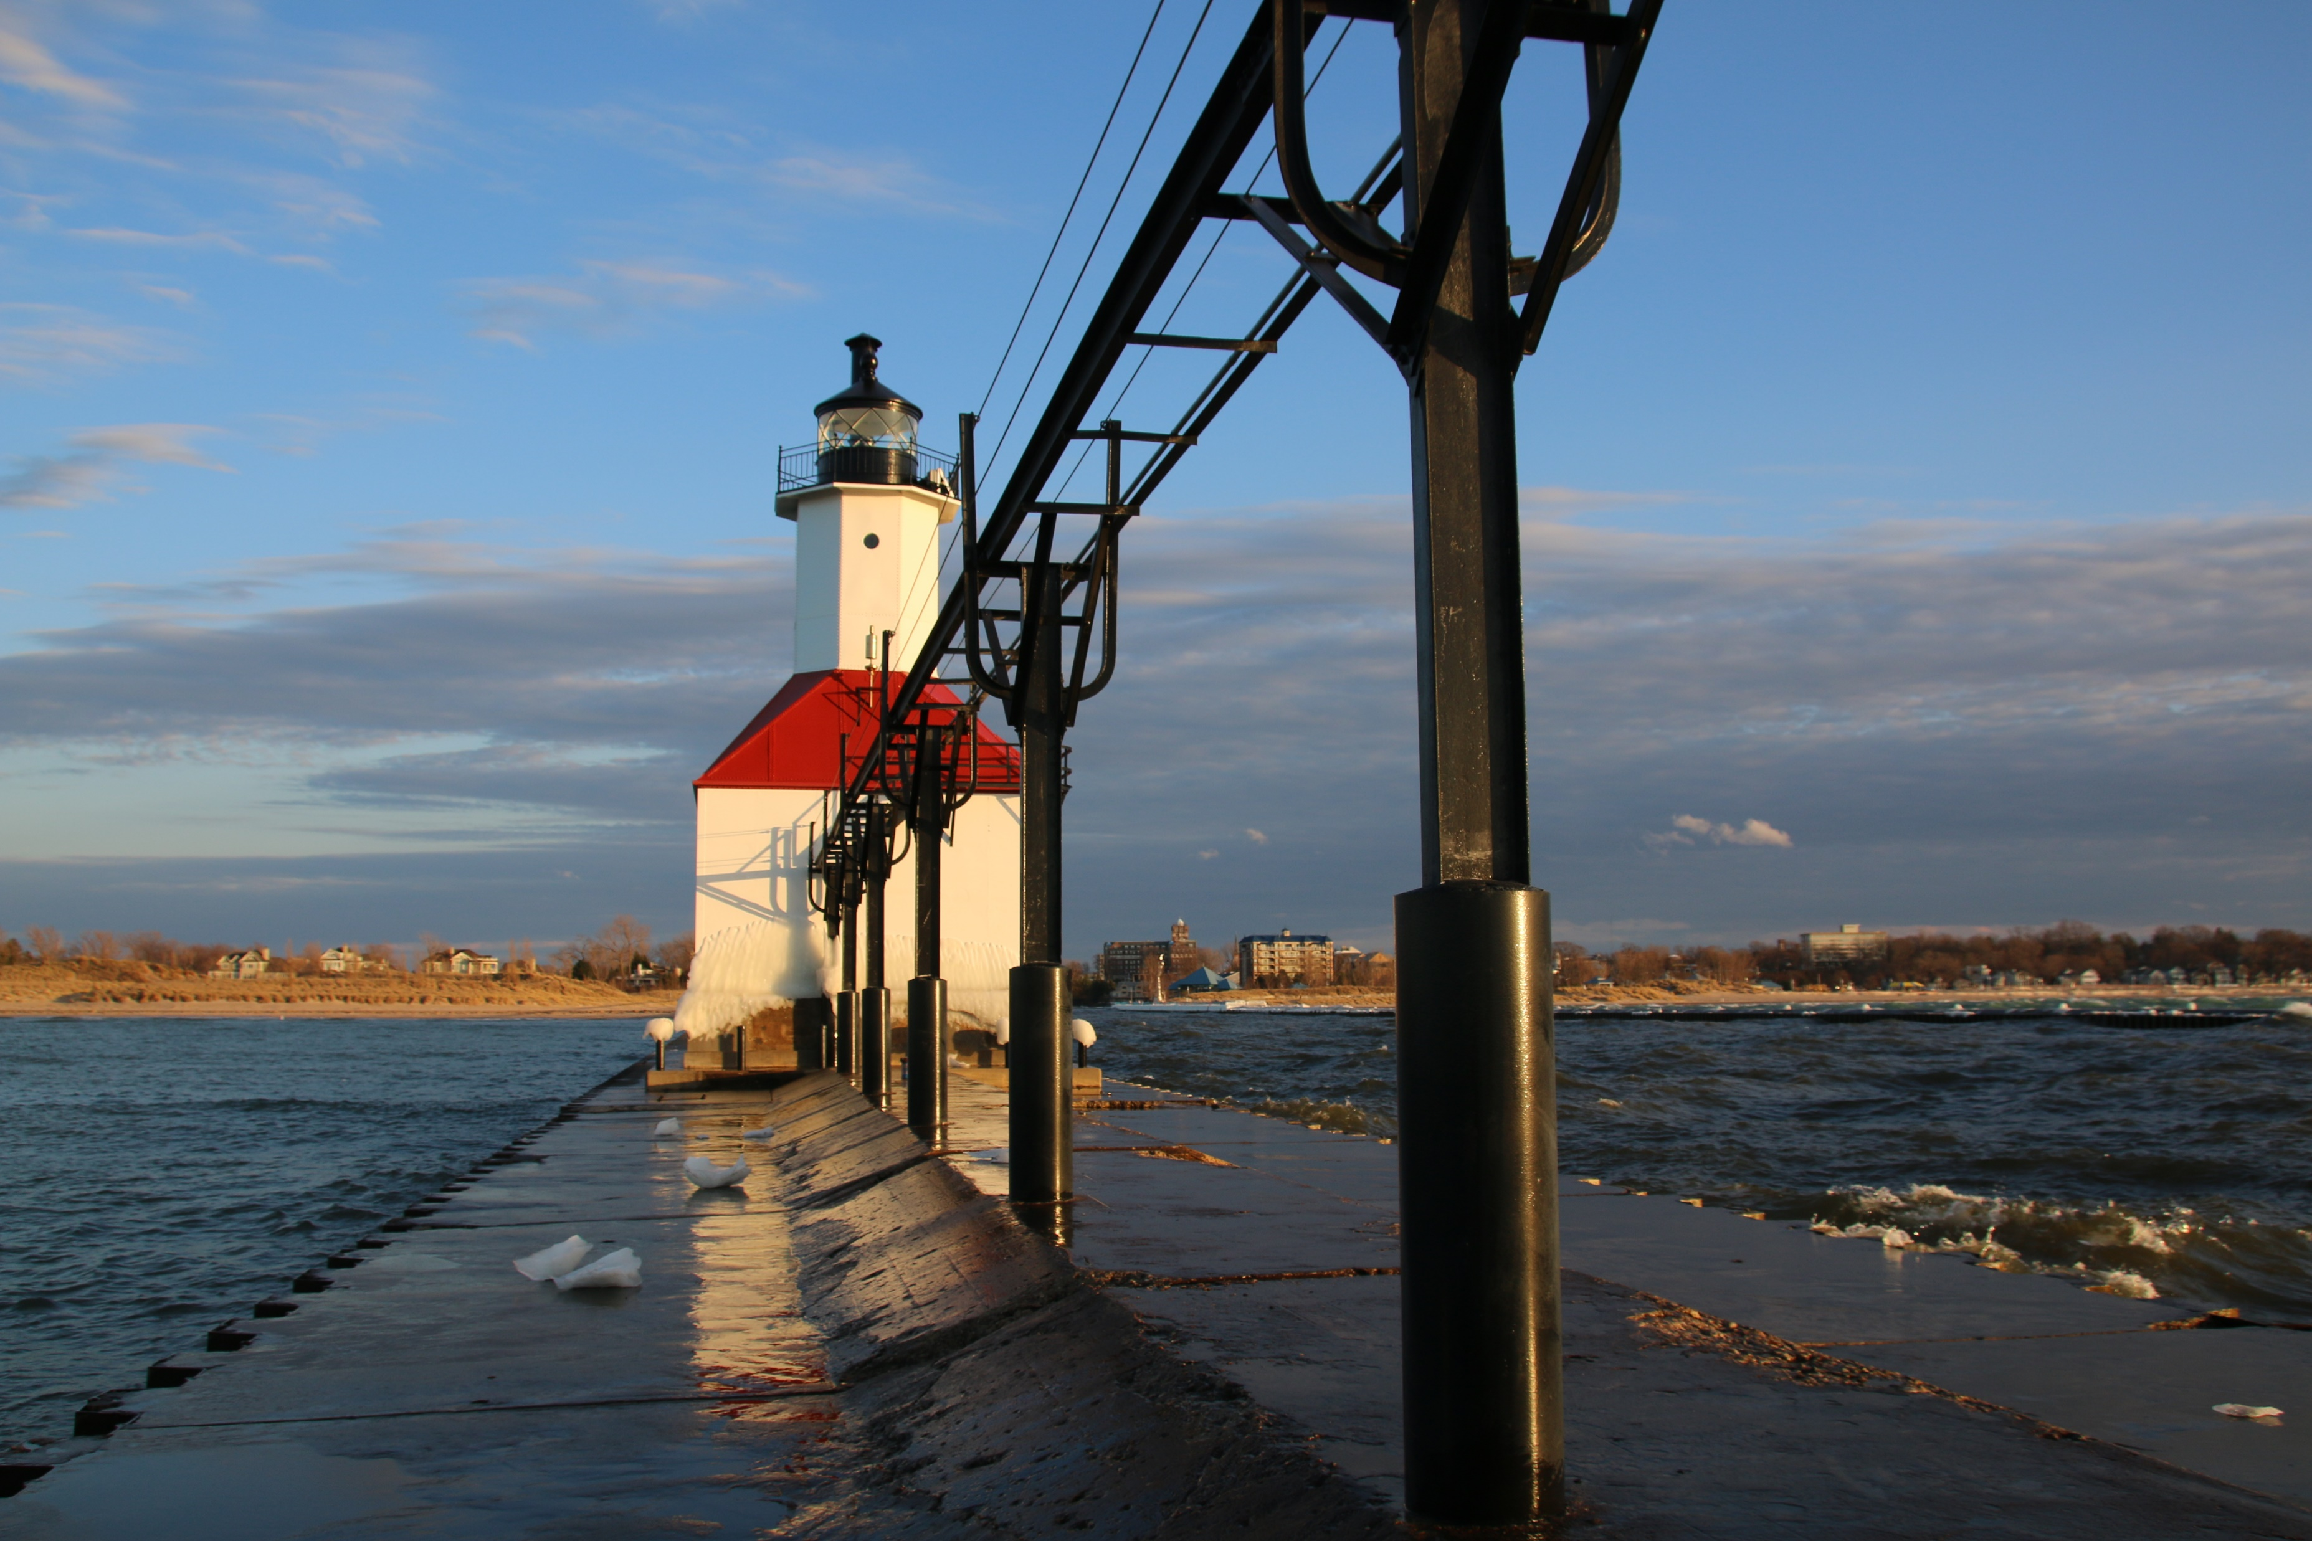
Connections for Librarians
Different Dynamics of Building Use
Lighthouses
  Beautiful
  Historic
  Historically significant as architecture
  No real other purpose except as a home
St. Joseph (MI) Pier Light

Slide 28
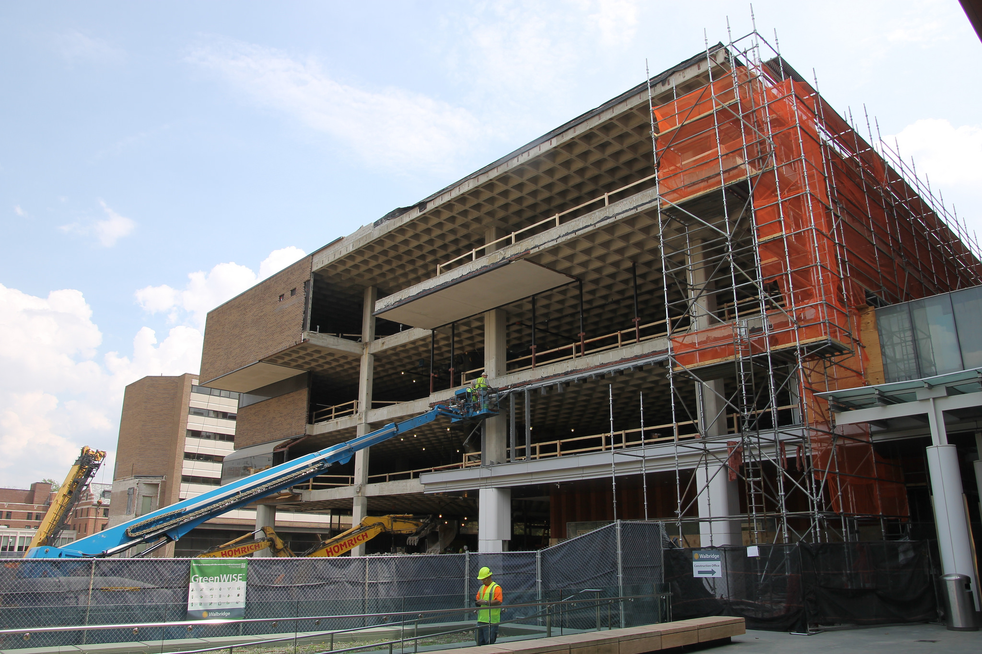
Connections for Librarians
Different Dynamics of Building Use
Libraries
  Large
  Easily repurposed
  Perception of better use of space by administrators (many reports to this end)
  Easily flipped into large student space
  Easily flipped into staff or lab space
  Easily flipped into anything….
Kresge Business Administration Library (University of Michigan) During Renovation

Slide 29
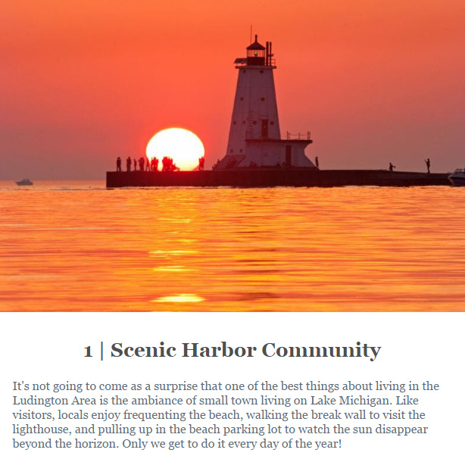
Connections for Librarians
Imagery is Important
Lighthouses lead you to safety & safe harbor.
Symbols of harbor communities (Ludington, Michigan – image from an email about the top 10 reasons for locating to Ludington)
Lighthouses can help when you are lost – provided you see them.

Slide 30
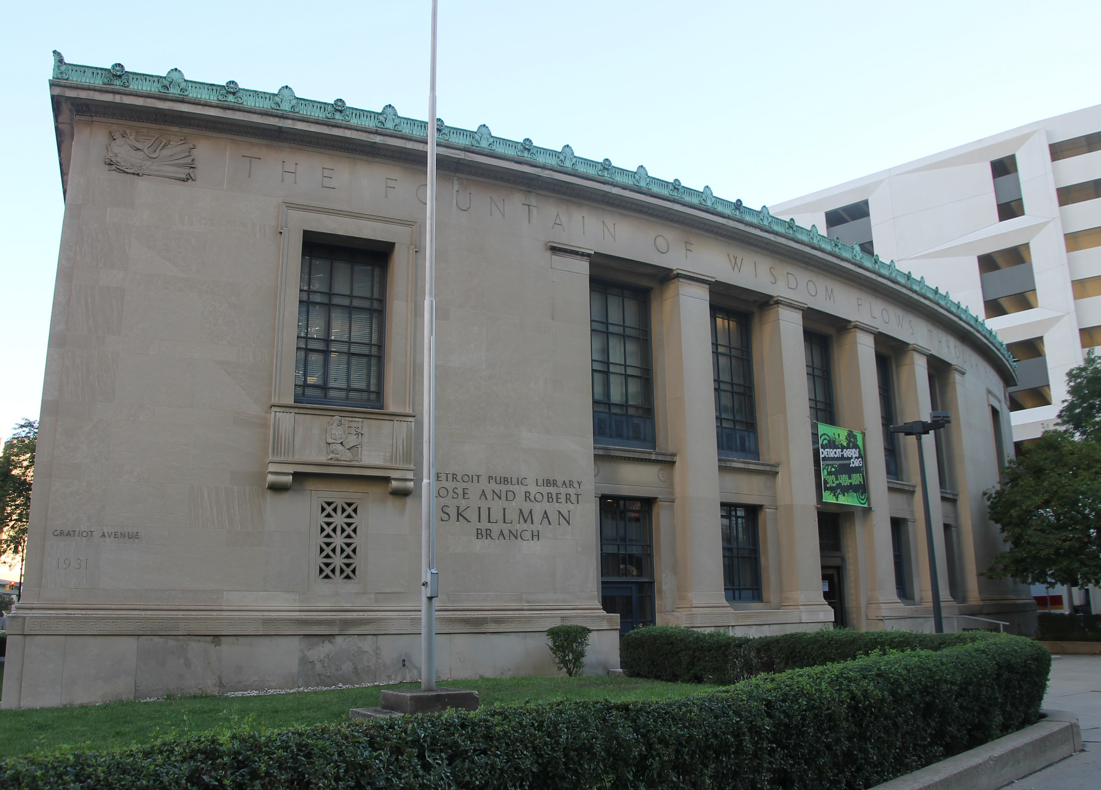
Connections for Librarians
Imagery is Important
Libraries have books.
Libraries are your connection for information.
“The fountain of wisdom flows through books” inscribed in this library.
Libraries can help when you are lost – provided you connect with them.
Skillman Branch, Detroit Public Library

Slide 31
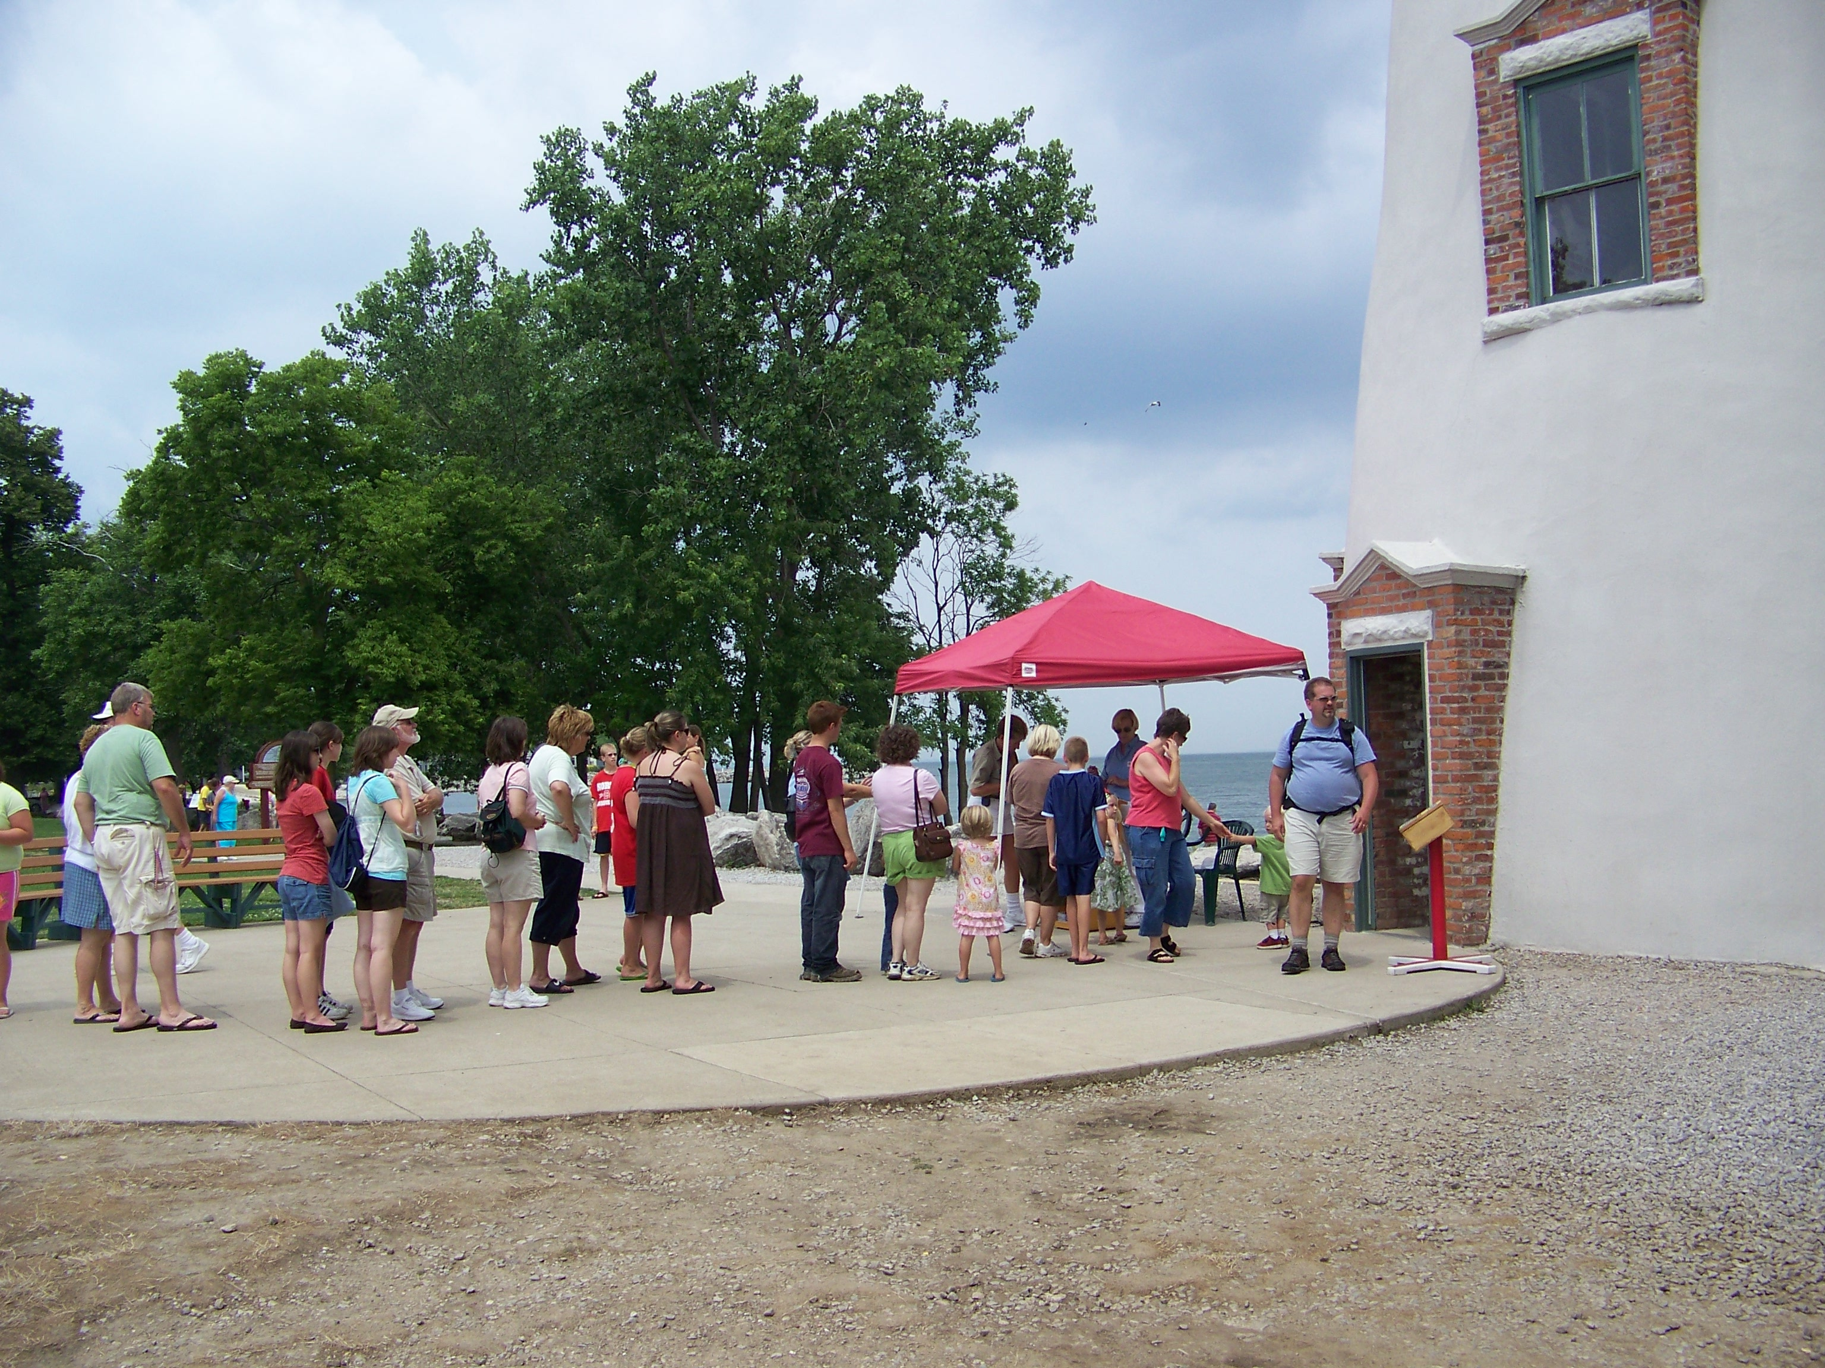
Connections for Librarians
Embrace the change
Automation started changing lighthouse staffing needs after World War I.
Automation accelerated after World War II.
Changing technology enabled lighthouses to operate lighthouses with occasional visits.
Lighthouses have transitioned to historical sites and museums.
Marblehead (OH) Lighthouse

Slide 32
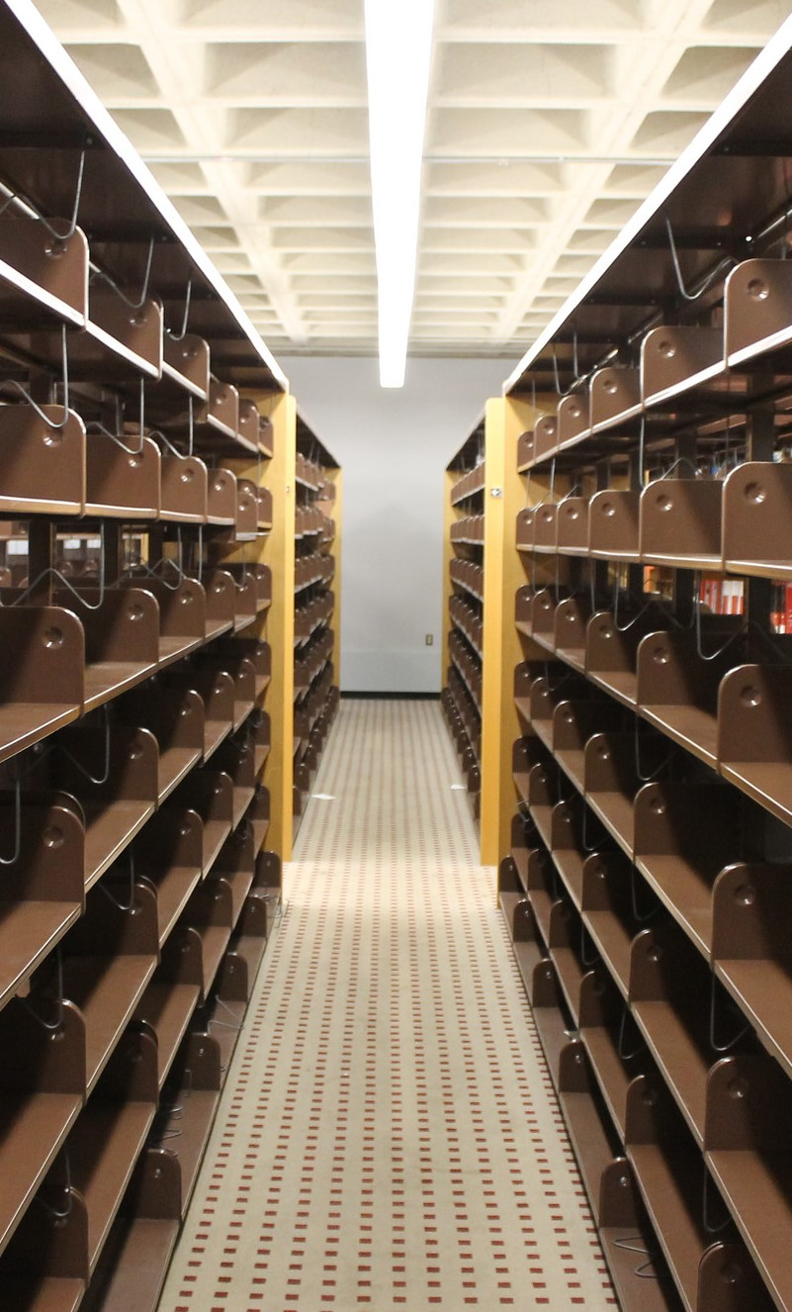
Connections for Librarians
Embrace the change
Whether we want it or not, things are changing for libraries and on our campuses and communities.
Education is also changing for higher education in general (Purdue recent purchase of Kaplan University).
Space demands on campuses that will see us with less real estate.
New libraries are student spaces, not for print materials.
Moving back to closed stacks environment (after being open stacks for years).
Empty Shelves at Kresge Library After the Books Left

Slide 33
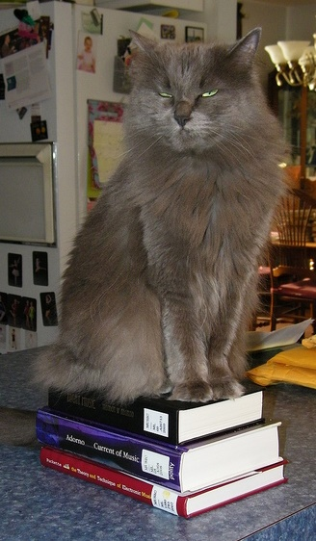
Connections for Librarians
Embrace the change
NOT a library problem of the 21st century.
Changes in the last 50 years:
  Copy cataloging
  Local online catalogs & shared systems
  Expanded access (TOC, more subject headings)
  Shared catalogs (MeLCat, etc.)
  Discovery layers
  Working papers management → digital repositories
  Coffee and food in the library
How many staff are checking in serials?
Wanda Hates eBooks

Slide 34
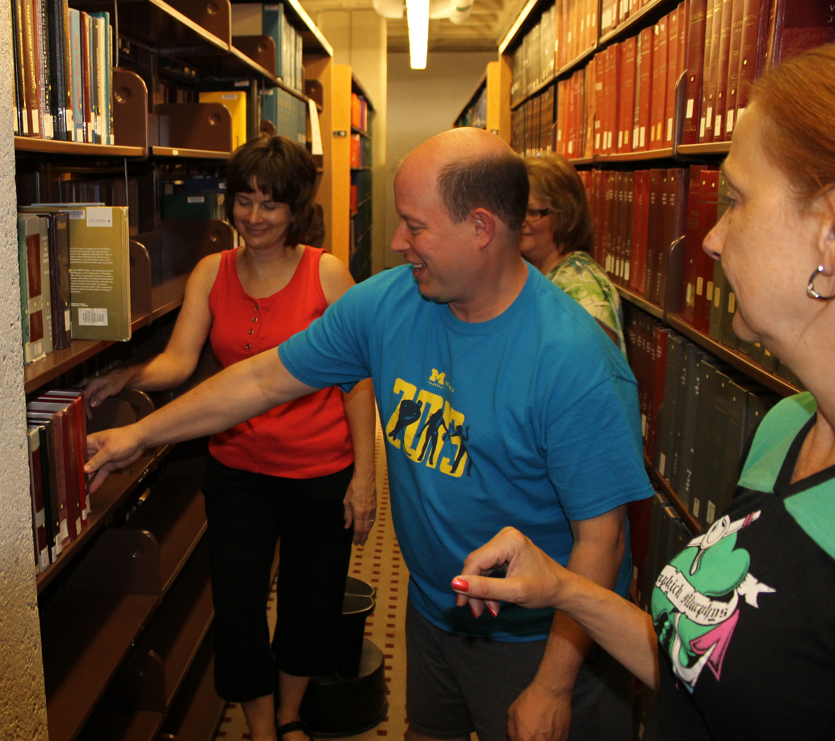
Connections for Librarians
Embrace the change
The Library’s challenge is to stay relevant and service oriented, even without all the resources and tools once at our disposal.
Unlike lighthouses, we don’t want libraries to be relegated to museums.
Who lives, who dies, who tells your story
Kresge staff finishing a large collection merging project in 2013

Slide 35
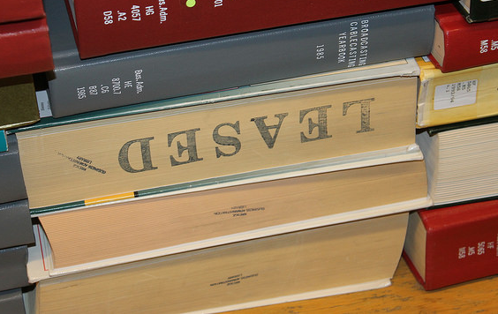
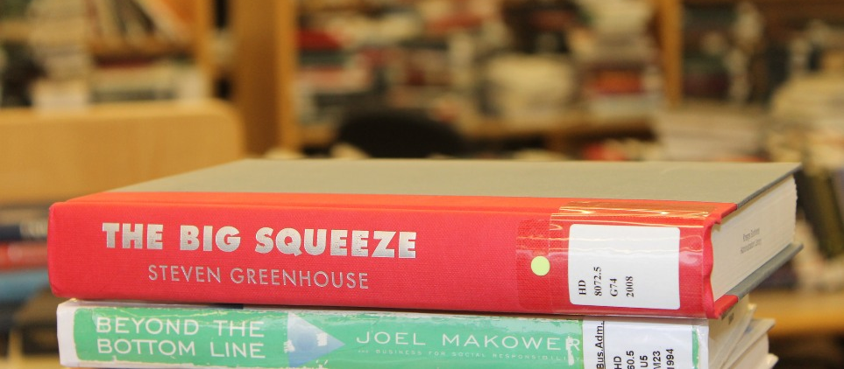
Future Challenges for Resource Sharing
Challenge for libraries are great both now and in the near future.
There is almost always a higher priority for space than the retention of print resources.
Administrator question - If something has not been scanned yet – is it valuable?
Our community does not care where it comes from…

Slide 36
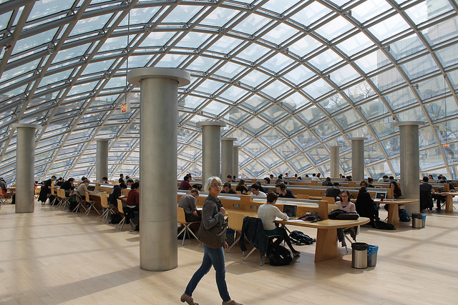
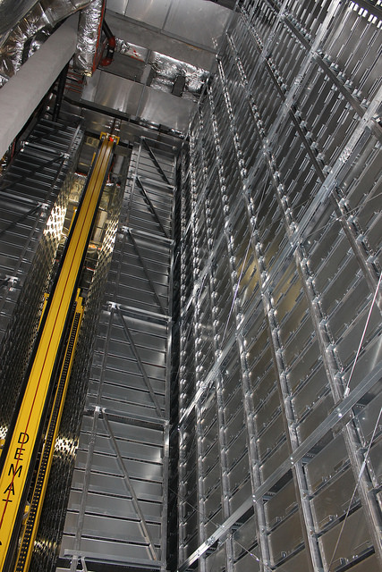
Future Challenges for Resource Sharing
Just as a lighthouse cannot protect the shore where they are not located, can libraries support research where they do not have collections?
Mansueto Library at Univ. of Chicago is a dream that we all have. Our desire to hold on to the past while embracing the future. It is a dream that many if not most cannot afford.
University of Chicago’s Mansueto Library

Slide 37
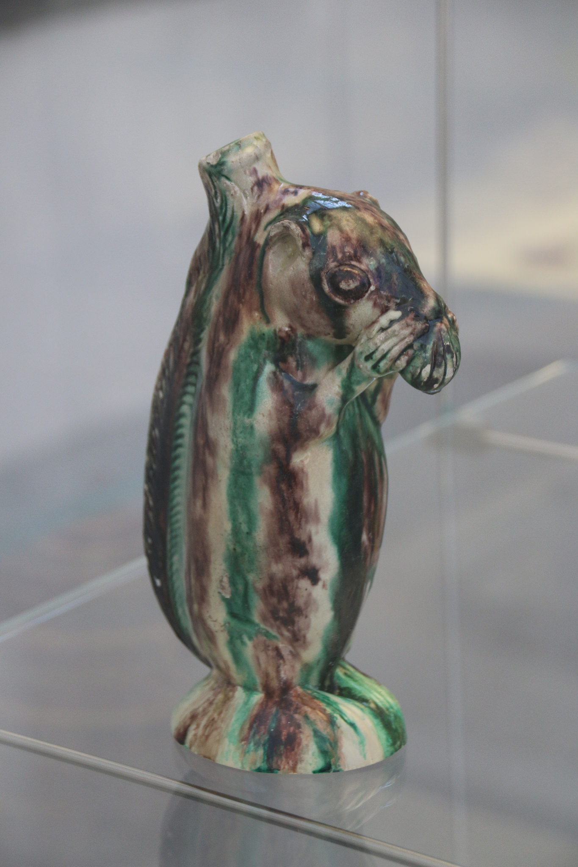

Future Challenges for Resource Sharing
Original vs. digital copy
Do we have the rights to share?
Squirrels at the Met (NYC)
Bottle from Salem, NC - ca. 1790–1805.
Snuffbox from Germany (Schrezheim manufactory), ca. 1761-1770. In Gallery 538 – closed the day I went.
Two decorative squirrels in the collection of the Metropolitan Museum of Art, New York City

Slide 38
Future Challenges for Resource Sharing
This is my vision of collection building in libraries – we need to find the balance between these needs.
Future Use
This is where Libraries have traditionally bought for (and many still do)
Community Needs
Community Aspirations & Desires
This is where our campuses really want us to be working. This might be where the turnaways come from.
Current Use

Slide 39
Future Challenges for Resource Sharing
Library challenge is that we have multiple stakeholders and they have different needs – especially for business.
Faculty needs – scholarly journals, articles, books , datasets
Student needs – articles, company & industry information, market reports
Community – Mostly similar to student needs
Student
Community
Faculty

Slide 40
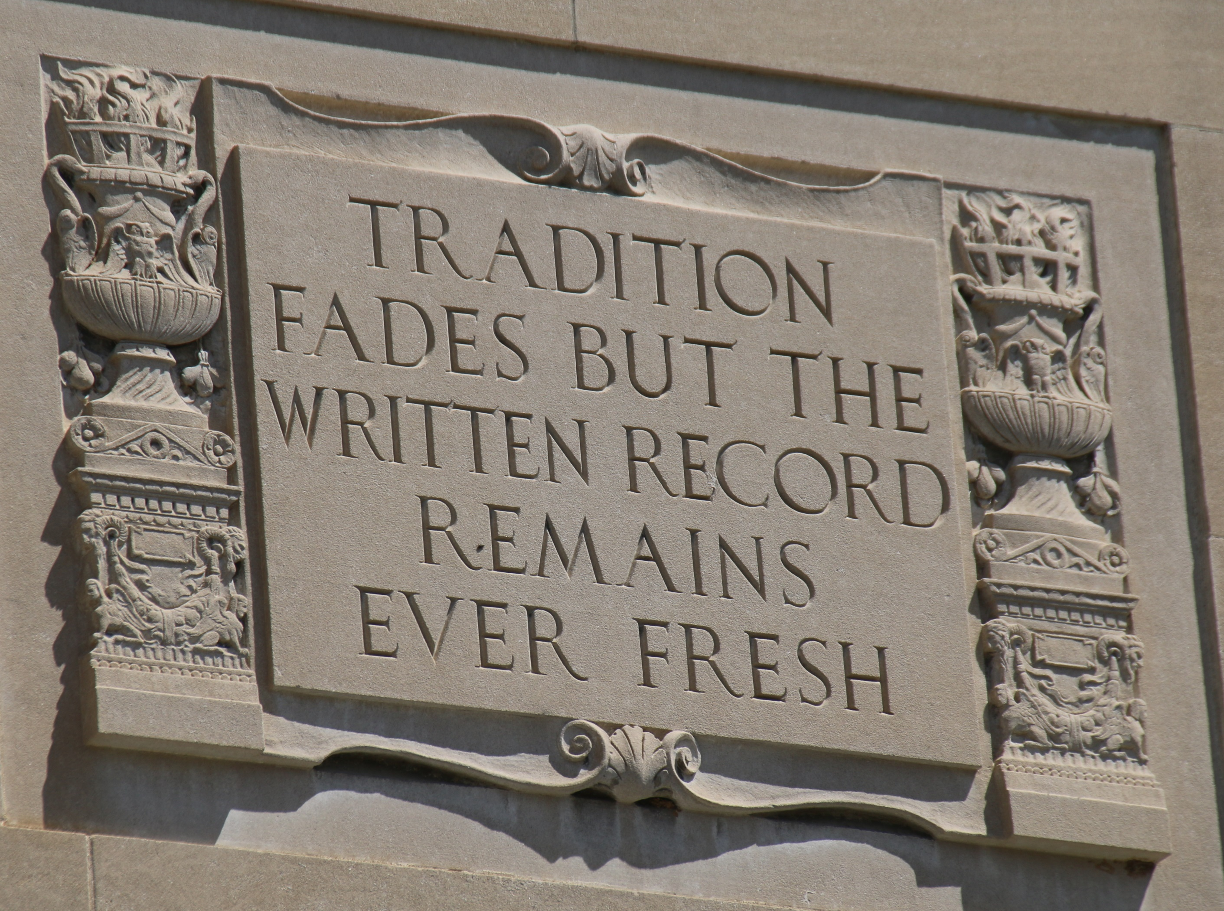
Future Challenges for Resource Sharing
Many of our resource sharing models are based on items on the shelves.
We are increasingly constrained by resources that we cannot put in a mailing envelope.
Other challenges include:
  Rare books
  Electronic only resources
  Licensing restrictions
William L. Clements Library – University of Michigan, Ann Arbor

Slide 41
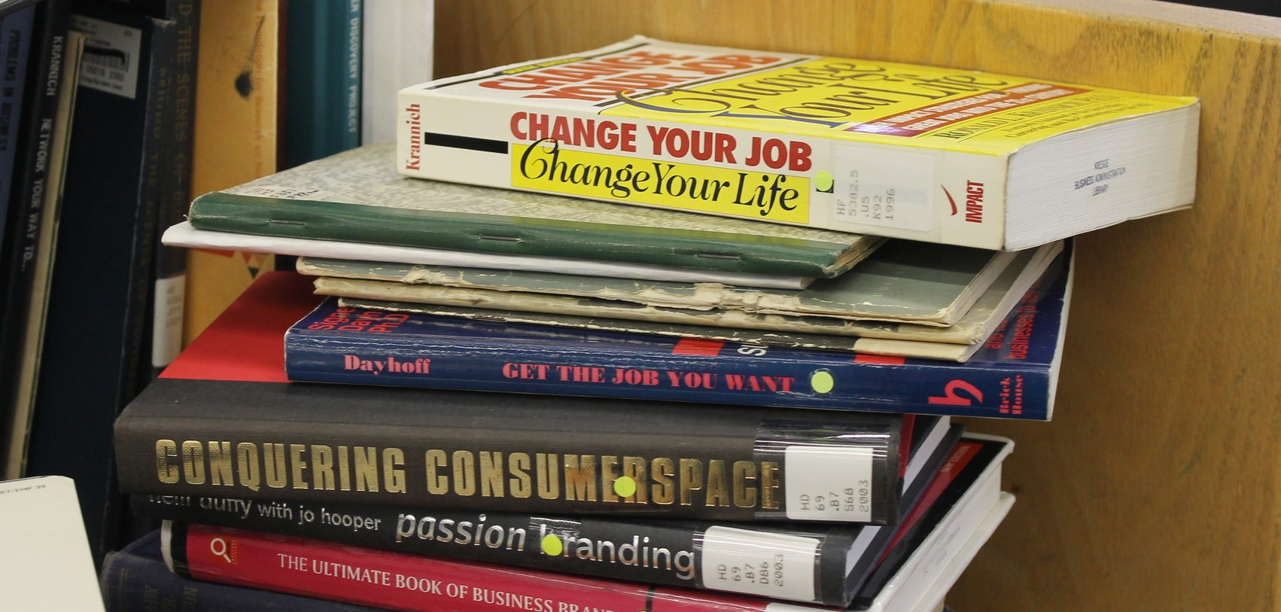
Future Challenges for Resource Sharing
Building collections for use over a ‘10 year window’ is not our future.
Our governing bodies will not be keen on buying items that sit on a shelf just-in-case when the academy is shifting to just-in-time.
We invest heavily in discovery platforms to get people to use these resources – the ultimate “low class problem.”

Slide 42
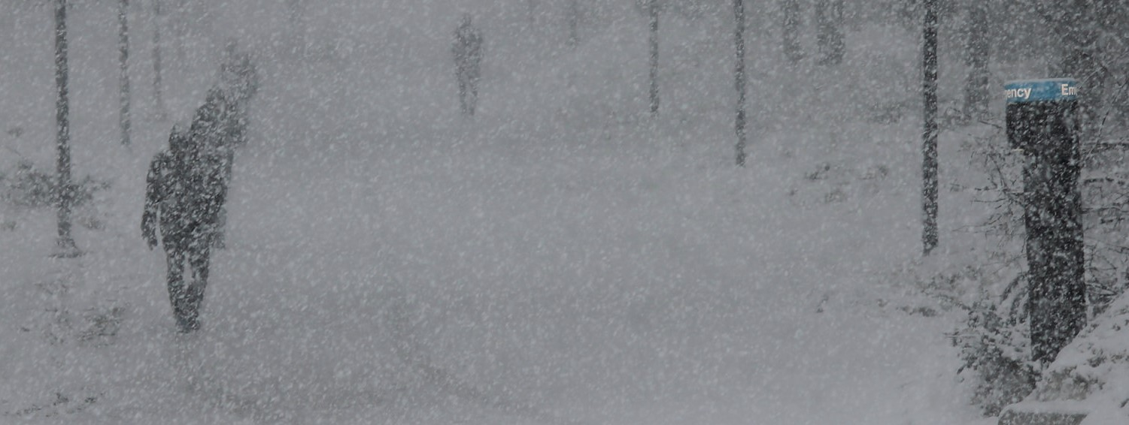
Envisioning the Library of the Future
History has its eyes on us!
Just as a lighthouse keeper could not turn his or her back on a storm, we cannot turn our backs on our community’s needs.
Our services must reflect our community’s unique needs
Winter storm near the Ross School of Business at the University of Michigan, Ann Arbor

Slide 43
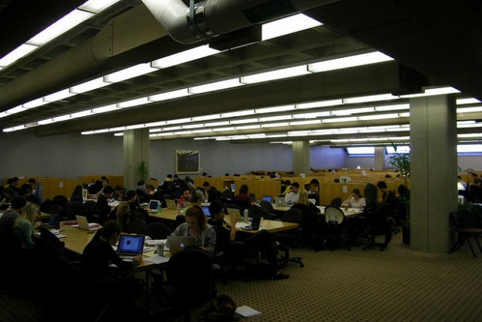
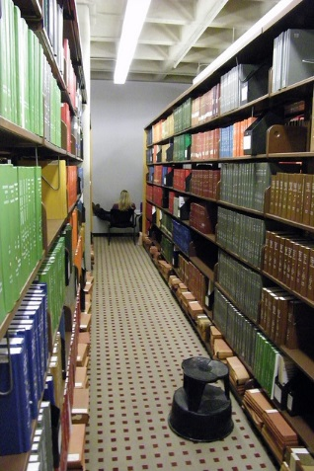
Envisioning the Library of the Future
A Physical Space
  Study
  Print Materials
  Interaction Spaces
  Walk-in Access
  Some of these services may be easily done by others
An Ethereal Space
    This is where we connect with our community.
    This is where we provide clarity to a complicated information universe.
    This is where we contribute as a “Value-Add.”
  This is where we do ‘library’ work.
  This work cannot be done as well by others.
  This work is not-space dependent.
The OLD Kresge Library

Slide 44

Envisioning the Library of the Future
At Kresge, the “Ethereal Library’s” value proposition is:
  Live within the restrictions of virtually no collection space.
  Figure out new collaboration mechanisms to serve our community.
  Focus on what we can do vs. what we have done.
  Forget the dead, take care of the living!
Squirrel at the University of Michigan, Ann Arbor

Slide 45
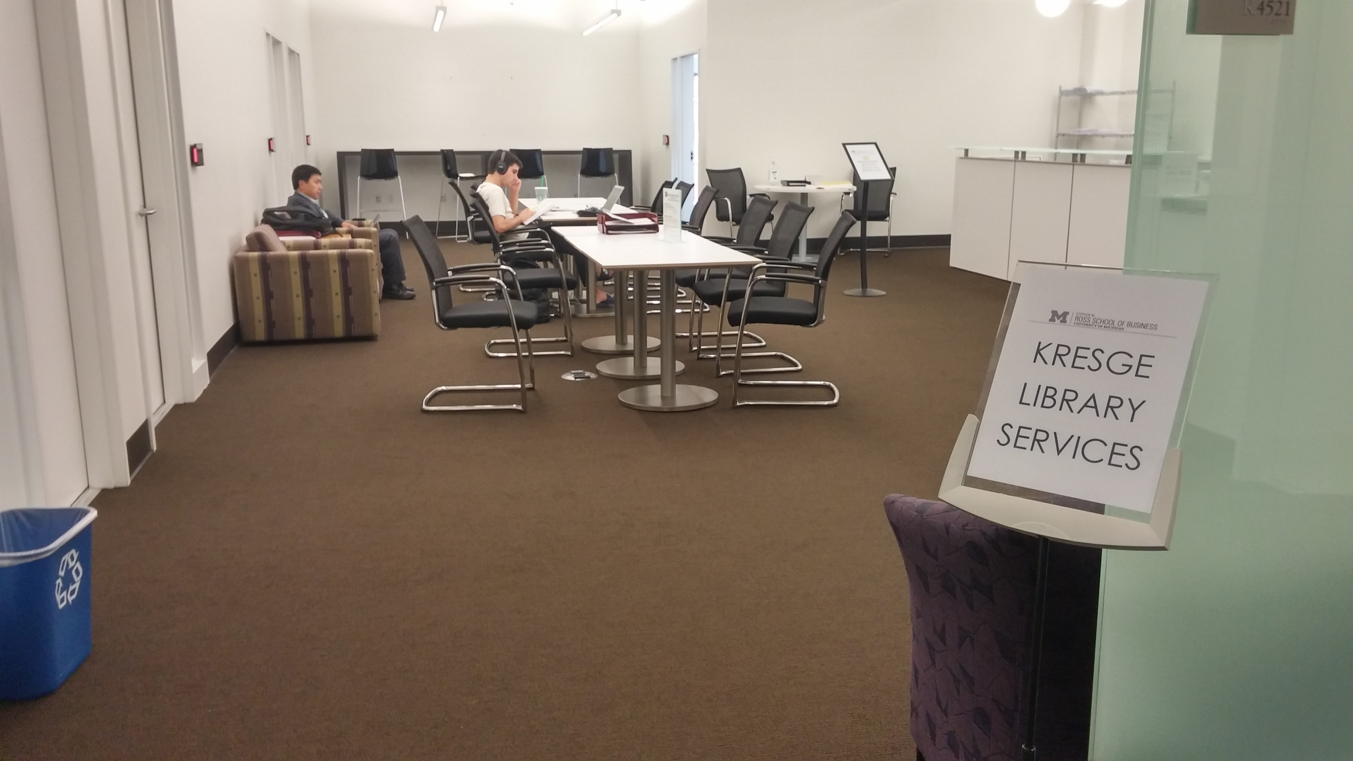
Envisioning the Library of the Future
“A completely re-thought Kresge Library Services, transitions from a collection of physical reference materials to a full suite of information resources and research services, guided by expert staff.” – Ross Dividend, Fall 2016 (Ross Alumni Magazine)
The library did not close, but become virtually unrecognizable.
You do not always choose your path, but how you respond.
The NEW Kresge Library Services at the University of Michigan

Slide 46

Envisioning the Library of the Future
When changes take place all at once, it forces you to take the leap.
Our library of the future is different and we have made mistakes…
From the title song -
  I made every mistake
  And felt the shame rise in me
  And even now I lie awake
  Knowing history has its eyes on me
…but come on in, the water’s fine!
Enjoying Deep Creek State Park (Western Maryland)

Slide 47

Questions & Thank You
Corey Seeman
cseeman@umich.edu
@cseeman
Slides: tinyurl.com/SeemanGLRS2017
Corey’s Web Home: www-personal.umich.edu/~cseeman/

