Slide 1
Collaboration beyond the classroom:
Connecting with students through Career Services
Danguole Kviklys, Joel Scheuher, Sally Ziph
University of Michigan, Ross School of Business, Kresge Library Services

Slide 2
Traditional Career Workshops

Slide 3

UM Ross School of Business
Kresge Library Services
UM Ross School of Business: 3,300 students
  Degrees include: MBA, BBA, MM, PhD, ExecMBA, Business Minor, Dual Degree
Kresge Library Services
  Eight reference librarians
  Electronic library only
  100+ databases

Slide 4
Kresge Library Career Resources
Offer 50 minute Kresge Library Career Resources sessions 6-8x month
  Geared toward off-campus job search
Career Resources at Kresge Library libguide
  Databases include: Vault Campus, CareerBeam, Going Global/USA City Career Guides
Follow-up appointments as needed

Slide 5
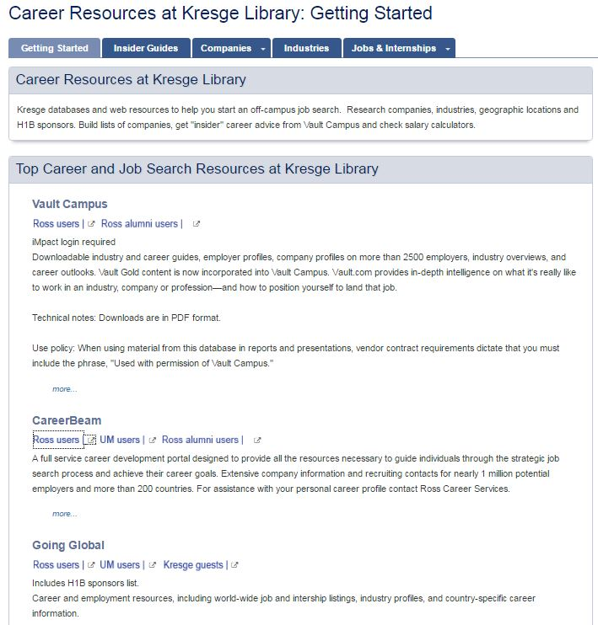

Slide 6
Challenges to traditional career workshops

Slide 7
Challenges with Career Workshops
Scheduling
  Students have many demands on their time
  We scheduled several sessions each month at different days/times, hoping they would come
Marketing
  Library messages got lost in the email flood
  Library messages were assumed to talk about library things – not career stuff
Student Focus
  We didn't know the students’ interest until they attended a workshop
Notes:
Scheduling: Classes, Group Projects, Clubs, Interviews, Case Competitions, and in some cases, Jobs, relationships, and personal lives.

Slide 8
Workshop Challenges
Geographic Focus
US
International
Company Type
Public Companies
Private Companies
Target Companies
Known companies to target
Lists of possible options

Slide 9
Workshop Challenges
Stage of job search
Actively interviewing
Just getting started
Student Mix
Undergraduates
Graduates
Job Focus
Full-time jobs / careers
Internships

Slide 10
Workshop Challenges
Student Ability
Consumer Products, Consulting, Manufacturing, Real Estate, Retail, Wealth Mgmt., and many more
Multiple Industries
Accounting, Business Administration, Management, Supply Chain Management
Expert searchers
Multiple Programs
Never visited our website

Slide 11

Results?
Low (and sometimes no) attendance
Macro-level presentations
Workshops that were neither strategic nor effective

Slide 12
Job Action Group (JAG) Teams

Slide 13

Collaboration Opportunity
Request from Ross Career Services for librarians to work with facilitators
Job Action Groups (JAGs)
  “Our consultants are looking for a brief review of services/databases available through Kresge (similar to Career Action Days intro) but then more individualized searches depending on the functions/roles of the members of the Job Action Groups who are actively recruiting with a list of target companies. “
Includes weekly check-ins until students get jobs
Marketed through Career Services

Slide 14

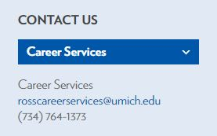
UM Ross Career Services
The Ross Career Services office includes five full-time career consultants, and six recruiting and outreach staff
Schedule recruiting season company visits
Resume and cover letter support
Networking opportunities

Slide 15
Library Director on JAG Groups
“These groups are being formed by Career Services to be a more proactive and collaborative way to connect to students who do not have jobs yet. These are either students who started with the on-campus search—or are in the off-campus search because they are looking for opportunities that do not interview here. This is brand new from Career Services, so it will be new for all of us.”

Slide 16

Librarian’s Role in JAG Groups
Help students create lists of companies to target
Individualized off-campus search strategies for specific Job Action Group functions/roles
Follow-up appointments
Specialized pages created for Career Resources libguide
  MSCM group
  MACC group
  MBA2 group
  Tech + Entrepreneurship group

Slide 17
JAG Guide Example

Slide 18
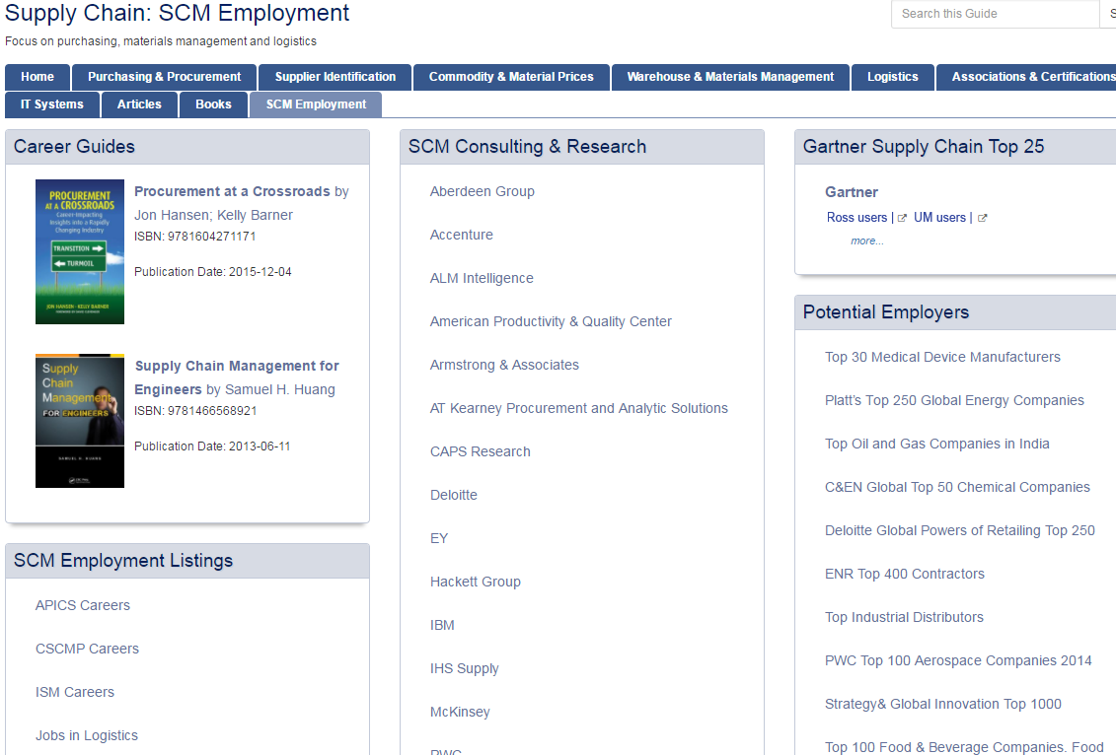
Supply Chain Employment JAG Guide
Encourage students to reach out into the world and explore employment possibilities in a wide range of business sectors
Expand career options beyond Amazon, Boeing or the top consultancies
http://kresgeguides.bus.umich.edu/c.php?g=204290&p=4449545

Slide 19
Supply Chain Employment JAG Guide
Objective: Identifying career and job opportunities
Use rankings to investigate employment opportunities with the world’s leading companies in a wide range of sectors. Identify:
  Companies with highly ranked supply chain operations
  Large industrial or retail companies who frequently have complex supply chains
  Growth industries and companies who offer new opportunities
  Best companies to work for
Provide basic job tools

Slide 20
Next Steps and Outcomes

Slide 21
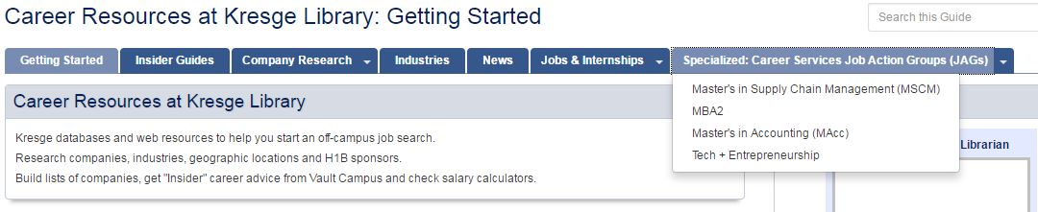
Next Steps
Create additional JAG guides
  Include similar info found in MSCM guide
    Vault Guides
    Salary surveys
    Top companies

Slide 22
Next Steps
Exploit other collaboration opportunities
  Interaction with other staff departments was traditionally difficult (silos)
  Renovations forced us into temporary quarters with other departments
    Learned about their needs
  Our newly renovated space put us close to even more departments
  This interaction inspires ideas and opportunities

Slide 23
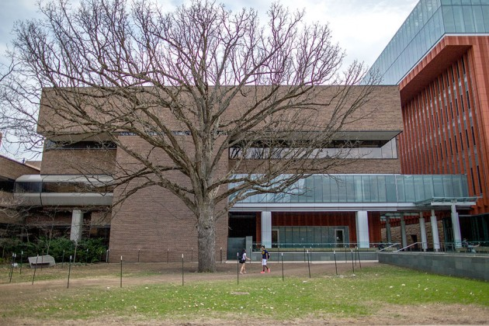
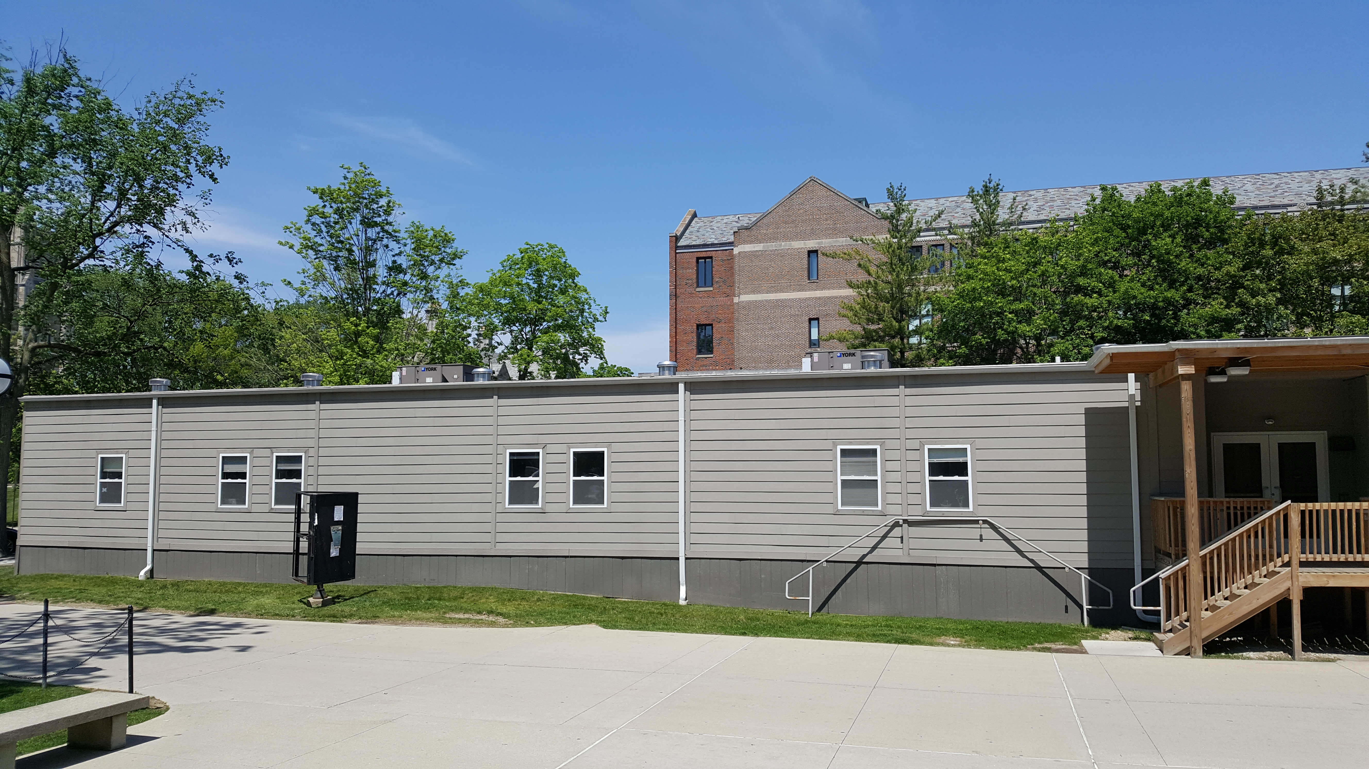



Slide 24
Next Steps
Approach groups with collaboration potential
  Marketing and Communications
    Leverage MarCom expertise to advertise other library services
    Create consistent branding with Ross School
  Human Resources
    Assist search committees with background information on candidates for top positions
  Development
    Identify potential donors and their stories
  Undergraduate Programs, IT, Faculty Support

Slide 25
Outcomes
Scheduling
  Ross Career Services manages the meetings
  Librarian attends a session at key points
Marketing
  Social media and email communications are sent through school channels, not our own
    Students get fewer communications
    Library gets greater exposure to a wider audience
  JAG team communications are sent by Ross Career Services
Student Focus
  Presentations are strategic and highly relevant

Slide 26

Outcomes
Visibility of online library raised
  Virtual services highlighted now that library has no physical collection
Streamline services
  Discontinue the traditional workshops in favor of Job Action Group support (Fall term)
Get to know students
  Watch them get jobs!

Slide 27

Takeaways
Be opportunistic
  Seek collaboration with groups that are win-win
  Exploit the expertise of others
  Don’t be afraid to ask for something in return
Show initiative
  Approach other groups politely (in person if possible)
  Listen to their issues
  Offer solutions that help

Slide 28
Collaboration beyond the classroom:
Connecting with students through Career Services
Danguole Kviklys, Joel Scheuher, Sally Ziph
University of Michigan, Ross School of Business, Kresge Library Services

