Slide 1
RDMI – Examples in Practice
Tom Murphy
CTO and Director of Computing
ICPSR – University of Michigan

Slide 2
Research Data Management Implementation
What are ICPSR’s greatest Data Management Challenges?
ICPSR’s support for scientific data management and the research data lifecycle
Primary drivers for RDM – Meeting the Needs

Slide 3
What are ICPSR’s greatest Data Management Challenges?
Size of Data
Volume of Data
Type of Data
Metadata
Curation
Discoverability
Online Analysis
Sustainability
Common Data Elements
Cross Discipline Use
Dissemination
Reuse
Cross Archive Integration
Researcher Tools
Expanding Public Input
Data Visualization

Slide 4
ICPSR’s support for scientific data management and the research data lifecycle
Data Ingestion
Dynamic Metadata Harvesting
Data Curation
Metadata Editors / Archive
Long Term Sustainability and Dark Archives
Data Discovery Tools
Data Set Workspace Management
Collaborative & Iterative Data/Study Publishing

Slide 5
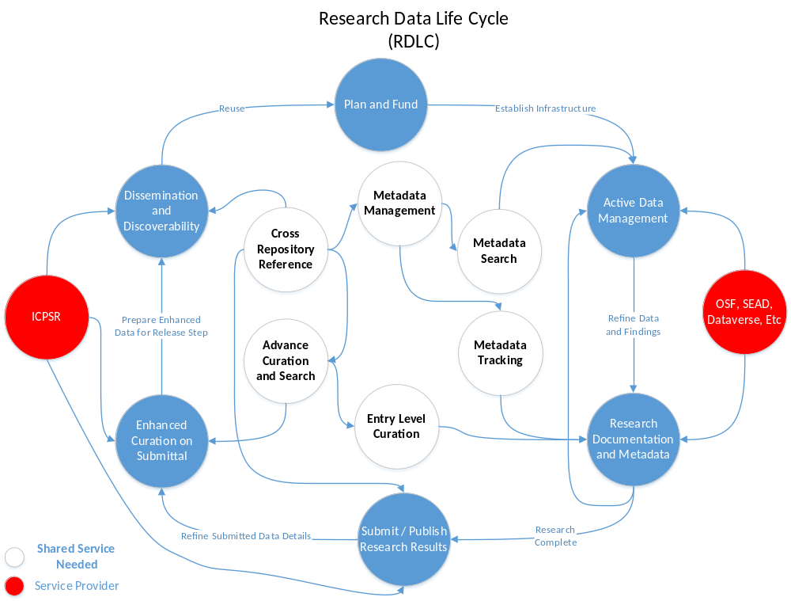

Slide 6
Primary drivers for RDM – Meeting the needs
Researchers
  Allow the researchers a place to gather their artifacts and prepare for publication submittal. PIs, depositors, data stewards, etc
Publishers
  A consistent paradigm for managing data submissions
Archives / Repositories
  Ingesting all types of data and disciplines
  Allow integration of cross research data sets as appropriate
Data Enhancement for Reuse
  Curation of data at all levels via tools
Technology
  Open Source based product and open architecture for easier adaptation

Slide 7
Primary drivers for RDM – Guiding Principles
Comprehensive Digital Asset Management Platform.
Open Archival Information Systems (OAIS model) compliant.
Multi-tenancy. ICPSR needs to support multiple archives and agencies.
Secure. Privacy and Security are primary concerns for social research data.
Service Oriented and Modular.
Scalable; Ability to handle large datasets and peak activity spikes.
Open Source technologies with good community engagement;
Enable standards based metadata harvesting and data exports.
Cohesive technology choices.
Flexible UI components that can be re-used and enables faster development.

Slide 8
Thank You

