Slide 1
Critical business collections: Examining key issues using a social justice lens
Heather Howard, Purdue University Libraries
Katharine Macy, IUPUI
Corey Seeman, University of Michigan
Alyson Vaalar, Texas A&M
Charleston Conference 2017
http://tinyurl.com/CHS17CritBiz

Slide 2
Program Outline
Business Librarianship Basics
What is Critical Librarianship
Open Access & Evaluation of Collection Resources
Database Licenses & Practical Business Activities
Making Business Resources Available for Walk-in Users
Questions

Slide 3
Business Librarianship Basics
What is Critical Librarianship
Heather Howard, Purdue University Libraries (hahoward@purdue.edu)

Slide 4
Business Librarianship Basics
Who are our patrons?
  Students
  Faculty
  Entrepreneurs
  Business Owners
  Business Incubators
  Startup Accelerators
What are our collections?
  Books and eBooks
  Business Journals
  Business Databases
    Market Research
    Demographics
    Company Research
    Articles/News
  Datasets

Slide 5
What is Critical Librarianship
Examining ways in which libraries and librarians consciously and unconsciously support systems of oppression [1]
Critical librarianship includes:
  development of critical thinking, information literacy, and lifelong learning skills in students
  engagement with:
    Diversity
    Information ethics
    Access to information
    Commodification of information
    Labor
    Academic freedom
    Human rights
    Engaged citizenry
    Neoliberalism [2]
[1] Mark Hudson, “Progressive Librarians Guild Midwinter Meeting,” ALAConnect, January 21, 2012. Accessed October 18, 2017. http://connect.ala.org/node/166009.
[2] Kenny Garcia, “Keeping Up With… Critical Librarianship,” American Library Association, June 19, 2015. Accessed October 18, 2017. http://www.ala.org/acrl/publications/keeping_up_with/critlib.

Slide 6
Open Access & Evaluation of Collection Resources
Katharine Macy, IUPUI (macyk@iupui.edu)

Slide 7
Why you should discuss open access (OA)
Democratization of information
Widens the reach of their research!
Information creation
Librarians can provide advice when choosing journals for publication and navigating author agreements.
Challenges faced when discussing OA
  Measuring Impact
  Business school rankings
  Tenure process

Slide 8
Evaluation of Collection Resources
For accessibility…
  Mouse dependent software does not work for screen readers necessary for visually impaired.
  Is audio available?
  What tools exist to help with learning disabilities?
Use adaptive software to mitigate
Examples of software: JAWS 17, Read & Write Gold, Kurzweil 3000
Advocate for accessibility with vendors!

Slide 9
Evaluation of Collection Resources
Market research and survey data
We must understand our available content to help our students navigate the pitfalls
Issues that may be present:
Binary representations of gender
Evaluation of methods for potential bias
Other issues?

Slide 10
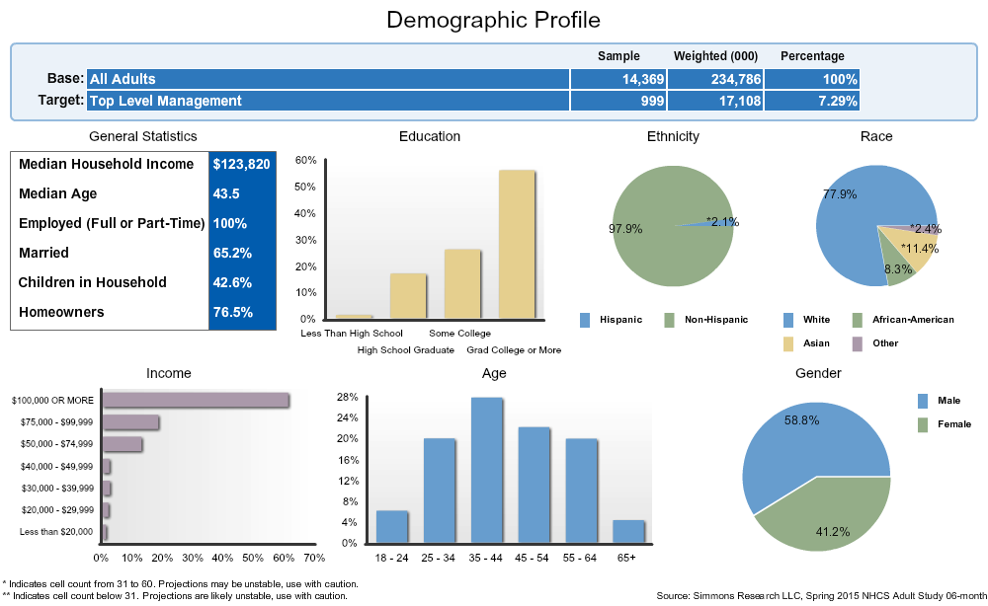
Navigating pitfalls – A Case Study
Persona creation for a marketing project deliverable.
Pitfall
Using research to support stereotypes.
Current national demographic trends may point to those currently in positions of power.

Slide 11
Database Licenses & Practical Business Activities
Alyson Vaalar, Texas A&M (asvaaler@library.tamu.edu)

Slide 12

Database Licenses & Experiential Learning
Alyson Vaaler – Texas A&M University

Slide 13
Experiential Learning
Consulting Projects
Case Competitions
Internships
Incubators
Entrepreneurship Classes

Slide 14

Example PMBA Project – Consulting Capstone
Develop portfolio management program
Result in $10MM-25MM cash flow gains
Sign NDA

Slide 15
Examples: Commercial Use Language
No form of commercial use…permitted. [Authorized Users may not] publish, re-distribute or make available to third parties any Intelligence which any of them extract from the Service, whether by itself or as part of any work or other material
Authorized Users may...[use] the information comprised in the Services as part of a live project conducted as a requirement as part of the course PROVIDED THAT as a maximum, ONLY the lesser of 2.5% of any single report forming part of the Services, and 25% of a section within any single report, (such percentages to exclude indexes and contents pages) is included in a dissertation or thesis by way of a direct extract.
Customer may use, access, copy, store, display and create derivative works of…the Data for its internal business purposes and may use minor portions of the Data, as part of reports, or separately, given to clients of Customer, whether in electronic or other present or future media

Slide 16
So what?
Confidence in recommending sources to patrons, especially for staff
Awareness of educational activities that licenses support and knowing the questions to ask vendors
Implications for other disciplines (medicine, engineering, etc.)

Slide 17
Things to Think On
Teach the process not the tools
Teach awareness/education [3]
Acceptable use policies
Specific license language
[3] Aagaard, Posie and Natasha Z. Arguello, “Practical Approaches to Compliance for Entrepreneurial Uses of Databases in Libraries.” Reference Services Review 43, no. 3 (2015): 419-438.

Slide 18
Making Business Resources Available for Walk-in Users
Corey Seeman, University of Michigan (cseeman@umich.edu)

Slide 19
Making Business Resources Available for Walk-in Users
Libraries have long-standing policies and practices of welcoming diverse members of the community to use their resources.
While circulation might be limited to current members of the community, most are are free to browse and use onsite. Even might be the case with private universities.
As we transition to electronic resources, the dynamics of walk-in use has been a problem that has been front and center on the minds of librarians, especially for business.

Slide 20
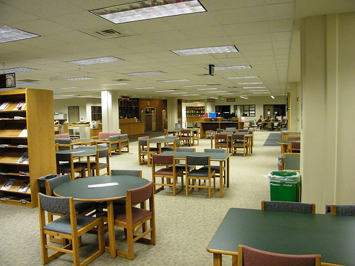
Making Business Resources Available for Walk-in Users
Role of the Land-Grant Universities and making resources available broadly.
University extension services do a great job of disseminating information.
Libraries at those schools have a strong ethic when it comes to making these available.
Gast Business Library, Michigan State University (2011)

Slide 21
Making Business Resources Available for Walk-in Users
Academic libraries pay pennies on the dollar for resources that are expensive for commercial clients.
Making these resources available to as broad an audience is very important to the cultural mission of a library.
Supporting a connection with the community that the rest of the school may or may not support.

Slide 22
Making Business Resources Available for Walk-in Users
Who are walk-in users?
  Local community members
  Students at other schools
  Independent scholars
  Visiting scholars
  Interested individuals
  & people engaged in business
There is a perception that business men and women are using these resources to by-pass the need to purchase them.
Here is where Perception might not equal reality…

Slide 23
Making Business Resources Available for Walk-in Users
Ross Community | 18563 | 90.48%
Other Michigan | 826 | 4.03%
Ross Alumni | 784 | 3.82%
Non UofM | 343 | 1.67%
Total | 20516 | 100%
Library transactions (mostly reference) over the past five years by affiliation – Kresge Library Services (July 2012-October 2017)

Slide 24
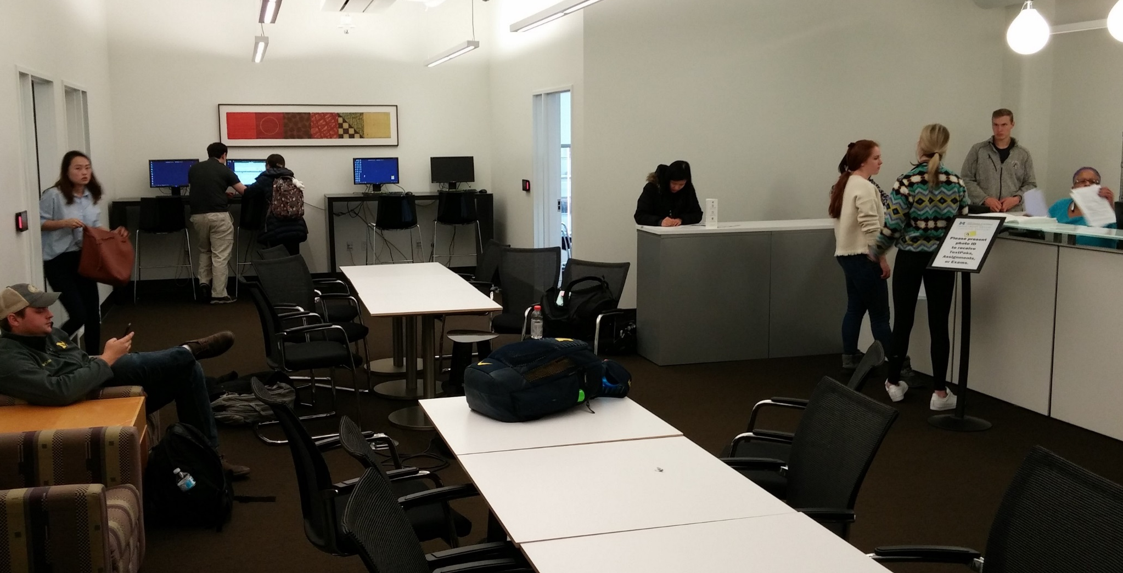
Making Business Resources Available for Walk-in Users
Librarians need to find balance – between the needs of the current students and the needs of the community.
Can libraries afford to walk away from a resource that does not allow walk-in use?
While we have terminals, we do not offer walk-in printing (does not work with computing environment).

Slide 25
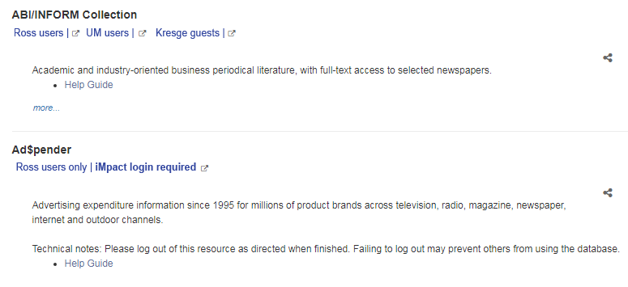
Making Business Resources Available for Walk-in Users
Ideally, we would make all resources available to walk-in users
HOWEVER with specialized resources (very valuable to our students), publishers may not allow this use.
They may be new to library environment.
Resources who have “walked-out” of the library market – Factiva for alumni and Pharma eTrack. They need to balance the risk and reward.

Slide 26
Questions & Thank You
Heather Howard, Purdue University Libraries (hahoward@purdue.edu)
Katharine Macy, IUPUI (macyk@iupui.edu)
Corey Seeman, University of Michigan (cseeman@umich.edu)
Alyson Vaalar, Texas A&M (asvaaler@library.tamu.edu)

