Slide 1
What's Past Is Possible: Opportunities and Perspectives for Library Alumni Resources
Jo-Anne Hogan
Director of Product Management - ProQuest
Corey Seeman
Director, Kresge Library Services - University of Michigan
Charleston Conference 2017
http://tinyurl.com/CHS17CSAlumni

Slide 2
Program Outline
Introduction
The Vendor-Publisher Perspective
The Library-Alumni Perspective
Survey Results (October 2017)
Questions & Thank You

Slide 3
Introduction
Jo-Anne Hogan is Director of Product Management at ProQuest. She has been with ProQuest for 15 years managing various product lines, most recently aggregated business products such as ABI/INFORM.
Jo-Anne works closely with ProQuest’s sales & marketing, content licensing, and legal teams, and is familiar with the opportunities and challenges related to offering alumni products.
Contact Information:
  Jo-Anne.Hogan@proquest.com

Slide 4
Introduction
Corey Seeman is the Director, Kresge Library Services (Ross School of Business, University of Michigan – Ann Arbor)
He has been director since October 2006.
Kresge Library has provided a suite of resources for alumni since the mid-2000s. Our resources have grown and contracted over time.
Contact information:
  cseeman@umich.edu
  @cseeman (twitter)

Slide 5
The Vendor-Publisher Perspective: ProQuest
For Jo-Anne Hogan's slides, please write
  Jo-Anne.Hogan@proquest.com

Slide 6
The Library-Alumni Perspective
Kresge Library Services – Ross School of Business
Resources Offered to Alumni
Acquiring Resources for Alumni
Services Offered to Alumni
Coordination with Development and Alumni Affairs

Slide 7
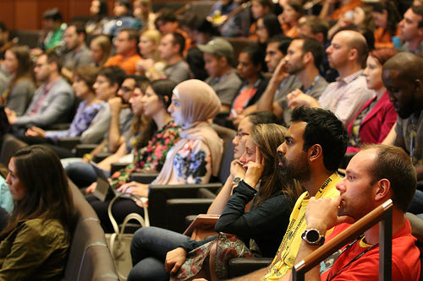
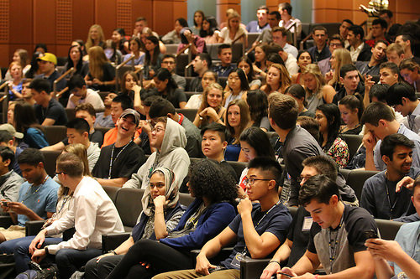
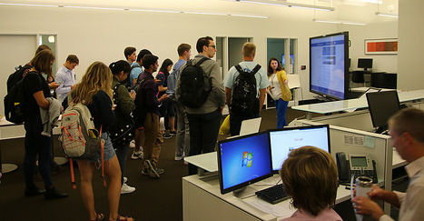
The Library-Alumni Perspective

Slide 8
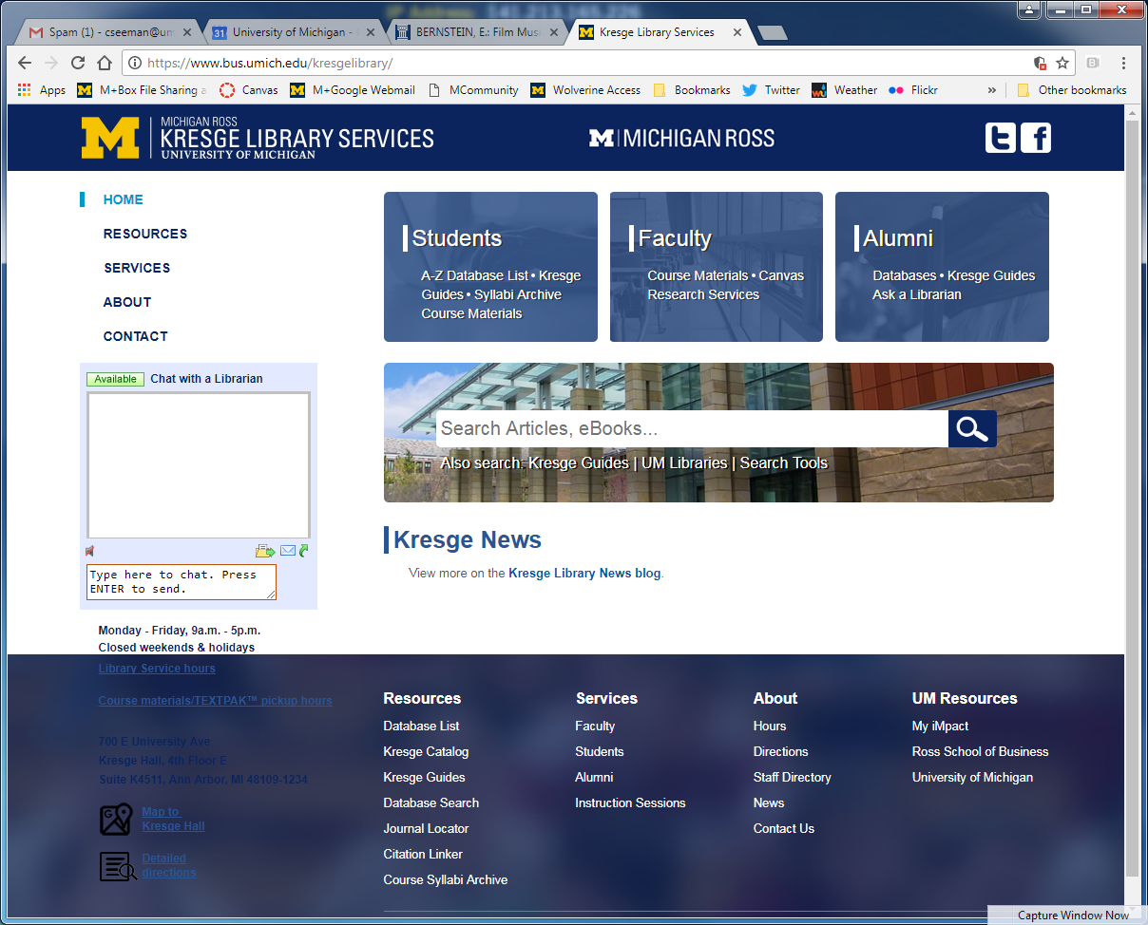
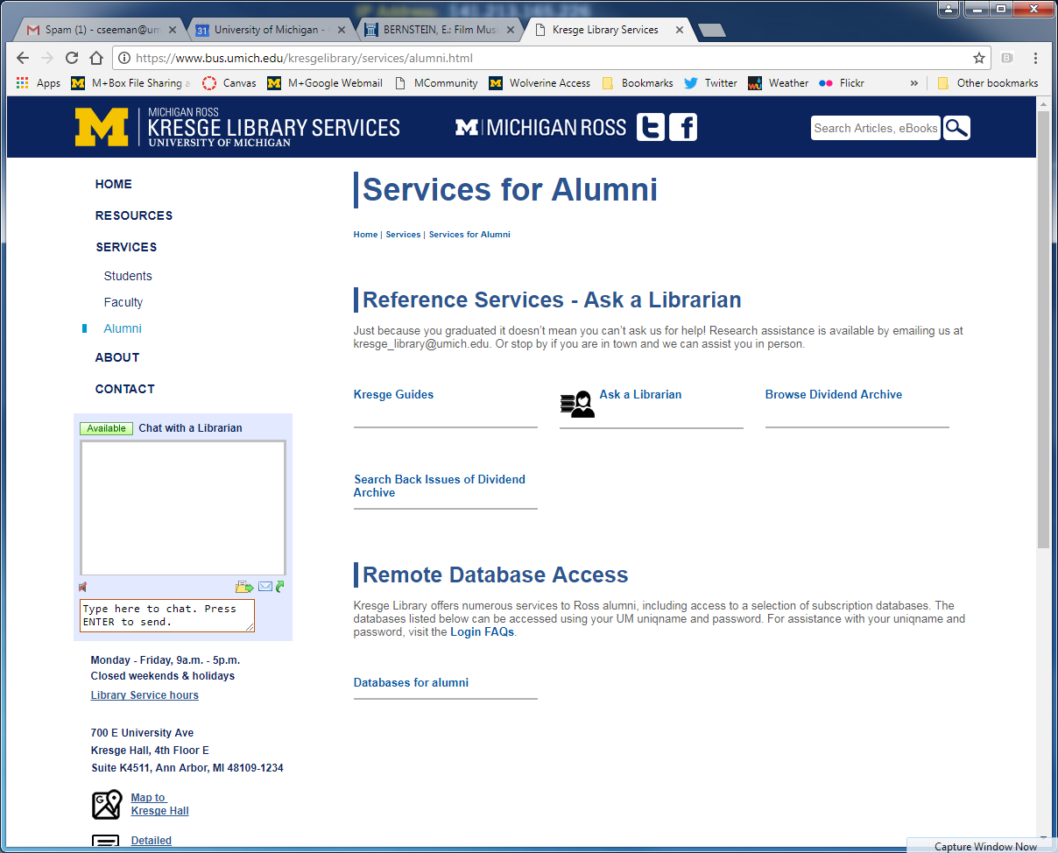
The Library-Alumni Perspective

Slide 9
The Library-Alumni Perspective
Resources Offered to Alumni
  Found here: https://www.bus.umich.edu/kresgelibrary/services/alumni.html
  Initial focus is career resource & tools.
  Been expanded over the years
  Resources are electronically available to alumni no matter where they are (walk-in use, when available, is open to anyone)
  RossIT maintains a web-portal for Ross alumni – so they can authenticate from wherever they are
  Intended for personal use – but kinda hard (OK IMPOSSIBLE) to police

Slide 10
The Library-Alumni Perspective
Resources Offered to Alumni
  University of Michigan Alumni Association offers a suite of resources available with membership (ProQuest & Project MUSE) - http://alumni.umich.edu/educational-enrichment/online-publications-resources/

Slide 11
The Library-Alumni Perspective
Resources Offered to Alumni
Career Resources
  Vault Campus
  CareerBeam
Company & Industry
  D&B Hoovers
  Mergent Online/Intellect/Archives
  BMI
News
  Business Source Alumni Edition
  Business Insights: Global
See links for updated list
We also have a few discount programs (MarketResearch.com)

Slide 12
The Library-Alumni Perspective
Acquiring Resources for Alumni
  Direct purchase
  Negotiated Access (as extension of campus resource)
Kresge Library Direct Purchases < 1% of our current resource budget for alumni
THAT BEING SAID – it is still difficult to justify when you are cutting budgets
We have attempted to provide balance as best we can – even holding onto resources we may not love because they have alumni access

Slide 13
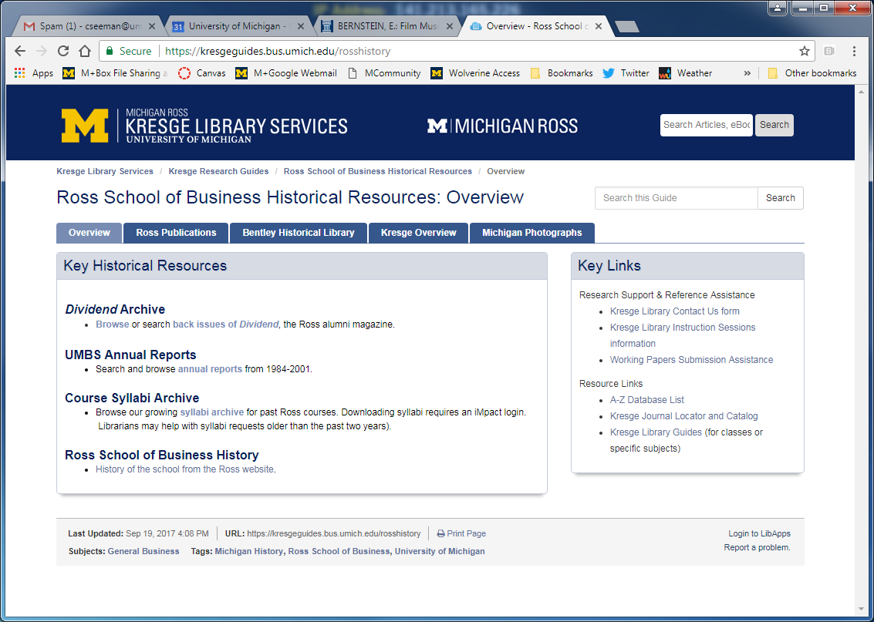
The Library-Alumni Perspective
Acquiring Resources for Alumni
Some resources maybe not cost much or anything, and be useful for alumni
https://kresgeguides.bus.umich.edu/rosshistory

Slide 14
The Library-Alumni Perspective
Services Offered to Alumni
  Reference Services (phone, email, chat) – we use those resources that they have access to
  Finding resources that they may also have access to (Michigan has a suite of business resources for all residents)
  Syllabi Archives – We can assist alumni (who no longer have access) to find syllabus. Useful for graduate school or certification.

Slide 15
The Library-Alumni Perspective

Slide 16
The Library-Alumni Perspective
Coordination with Development and Alumni Affairs
Alumni Advantage (Ross School of Business)
https://michiganross.umich.edu/our-community/alumni
Suite of resources and benefits that are provided to all Ross graduates (started around four years ago)
We rolled Kresge databases right into the service.
The developer of that concept is now the school’s Dean….

Slide 17
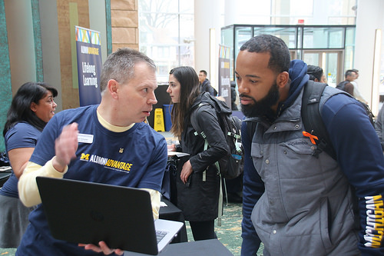
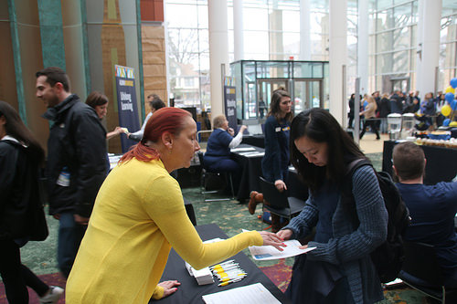
The Library-Alumni Perspective
Coordination with Development and Alumni Affairs
Alumni Orientation (Ross – March 31, 2017)

Slide 18
Survey Results (October 2017)
We surveyed business librarians in October 2017 on the practices, resources and services when working with alumni.
Focus was on business librarians around the world.
October 6-27, 2017
69
  60 geographically identified:
    Europe: 17
    Latin America and the Caribbean: 3
    United States & Canada: 40

Slide 19
Survey Results (October 2017)
Q1 - Do you offer any library electronic resources for your alumni?
# | Answer | % | Count
1 | Yes | 62.32% | 43
2 | No | 36.23% | 25
3 | Don't Know or N/A | 1.45% | 1
 | Total | 100% | 69

Slide 20
Survey Results (October 2017)
Q2 - Do you have a page on your library website specifically for alumni?
# | Answer | % | Count
1 | Yes | 49.28% | 34
2 | No | 50.72% | 35
3 | Don't Know or N/A | 0.00% | 0
 | Total | 100% | 69

Slide 21
Survey Results (October 2017)
Q5 - How do you obtain alumni resources? (check all that apply)
# | Answer | % | Count
1 | Pay separate subscription rates for alumni populations | 18.27% | 19
2 | Added onto current packages at no extra cost | 21.15% | 22
3 | Added onto current packages at an incremental cost | 11.54% | 12
4 | Identify freely available resources (such as Open Access resources or Export.gov) | 24.04% | 25
5 | We do not offer any resources | 16.35% | 17
6 | Other | 8.65% | 9

Slide 22
Survey Results (October 2017)
Perception of Value
Q13 - As a librarian, how do you rate the value of alumni access to library resources? (1 being the lowest value - 9 being the highest value) – 5.09 Mean
Q14 - How would you perceive the value to alumni for access to these resources? (1 being the lowest value - 9 being the highest value) – 6.03 Mean

Slide 23
Survey Results (October 2017)
Q9 - Do you offer reference services for your alumni?
# | Answer | % | Count
1 | Yes | 88.71% | 55
2 | No | 11.29% | 7
3 | Don't Know or N/A | 0.00% | 0
 | Total | 100% | 62

Slide 24
Survey Results (October 2017)
Q15 - Please share any comments you have about alumni access to library resources and library services (selected comments):
Allowing alumni would enormously increase our potential user numbers and would lead to massive price increases for databases because our database costs are based on user population.
If the typical career path for graduates is in smaller businesses or even entrepreneurial activities, it would be valuable to have an agreement with a vendor that enabled limited access to some our of our resources for 2-3 years afer graduation, because the small businesses would be very unlikely to subscribe to these resources.
Alumni access has been made easier for us by UK wide negiations by JISC (Joint Information Systems Committee).

Slide 25
Survey Results (October 2017)
Alumni ask for access all the time. We can't even facilitate access to the resources that routinely license to alumni at no additional cost such a Project Muse or JSTOR because University IT is not motivated to implement authentication. University Alumni Office doesn't see it as a priority either.
Value of access to electronic resources is tricky. If we had alumni-specific collections, they wouldn't receive the same content they had in school, so their perception of the value might be high at first, but very low once they realize what they have. Business students especially would be in for a rude awakening, as they expect access to market research reports and other privileged information.
I work at a state university that consistently has budget problems. The only thing I ever do with collections is try to [keep] the few business databases we have from being cancelled. I can't even imagine an environment at this university where we would be able to talk about alumni resources. That being said, it is common for our alumni to work with students in the business college, and I'm always happy to alumni use what we have available to them in-person in the library.

Slide 26
Questions & Thank You
Jo-Anne Hogan
Jo-Anne.Hogan@proquest.com
Corey Seeman
cseeman@umich.edu
Slides & Survey Results:
tinyurl.com/CHS17CSAlumni

