Slide 1
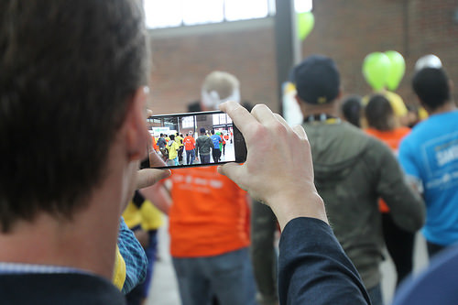
Save the Time of the Reader: Using S. R. Ranganathan's Fourth Law to Build the Business Library of the Future
Corey Seeman
University of Michigan
3rd Global Conference on Emerging Trends for Business Librarianship
November 21-22, 2017
Indian Institute of Management - Ahmedabad, India
http://tinyurl.com/ETBL17Seeman
twitter @cseeman
email cseeman@umich.edu

Slide 2

Program Outline
Change Management & the “Modern Library”
Dr. Ranganathan's Fourth Law
Challenge of Supporting Business Education and Entrepreneurial Research
A Public-Service Approach to the Fourth Law
Building the Library of the Future & Closing Thoughts
Questions

Slide 3
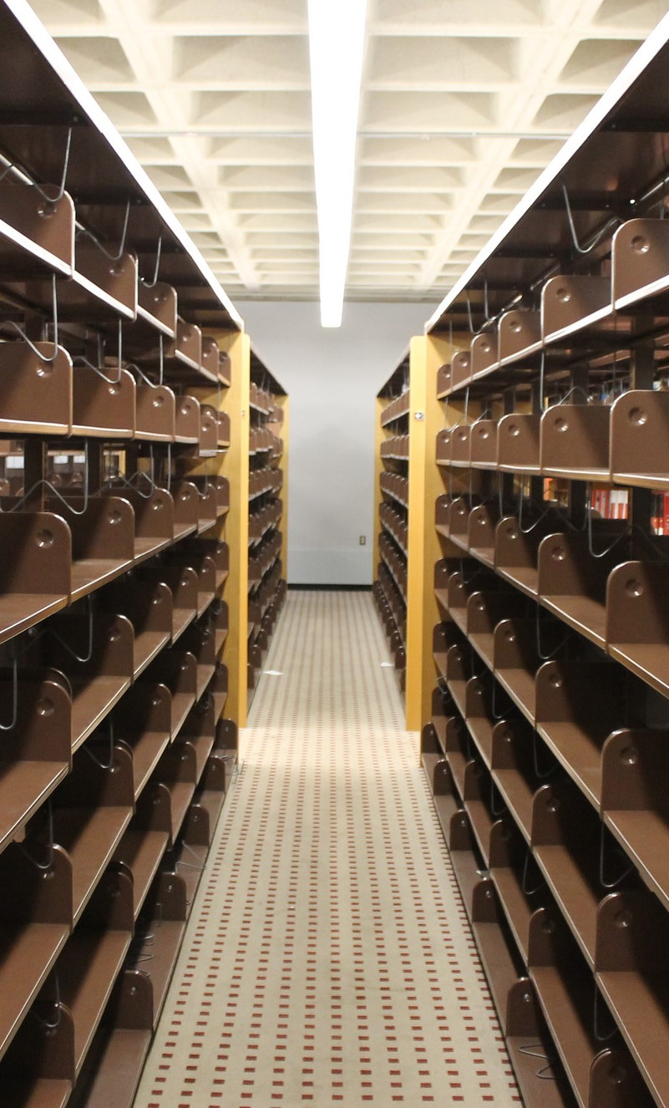
Change Management & the “Modern Library”
Let’s think about our current library…
And take away your print volumes
Now, take away your book stacks
Finally, let’s move student space out of a library
What do you have left?
Empty Shelves at Kresge Library After the Books Left

Slide 4
Change Management & the “Modern Library”
"Business has always been subject to uncertainties and change. It is affected by the elements, by wars, by mass movements, by changes in the wants and desires of consumers and by government regulation. Above all, competition tends continually to modify the business structure. New methods, new products and new processes introduce new elements that undermine the supremacy of one industry or firm or even a whole system of doing business. And the trend toward increasing regulation of business by governmental bodies here and abroad must not be ignored. In short, one generalization that truly applies to all business is: Change is continuous and inevitable."

Slide 5

Change Management & the “Modern Library”
Quote is from: Coman, Edwin T. Sources of Business Information. New York: Prentice-Hall, 1949.
It is very easy to think about change only in our world
However, we have been subjected to change for years and years…
…and will be subjected to change for years into the future

Slide 6
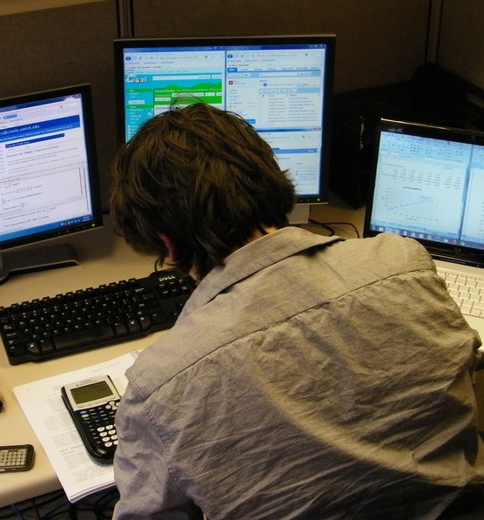
Change Management & the “Modern Library”
Librarians are fantastic about envisioning change when they are leading the way
We have done a good job of embracing the new electronic environment in a hybrid fashion with traditional print volumes and physical media
These incremental changes can add up when pieced together…

Slide 7
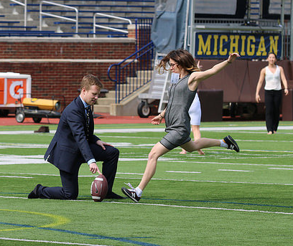
Change Management & the “Modern Library”
HOWEVER, we are likely still behind where our patrons are and where they likely WISH we are
Because we collect for the ‘long term,’ we are likely far more conservative than we should be
We may be challenged in taking on projects and roles that may not be our ideal situation
This may lead us to strange combinations as well - like business students playing American football

Slide 8
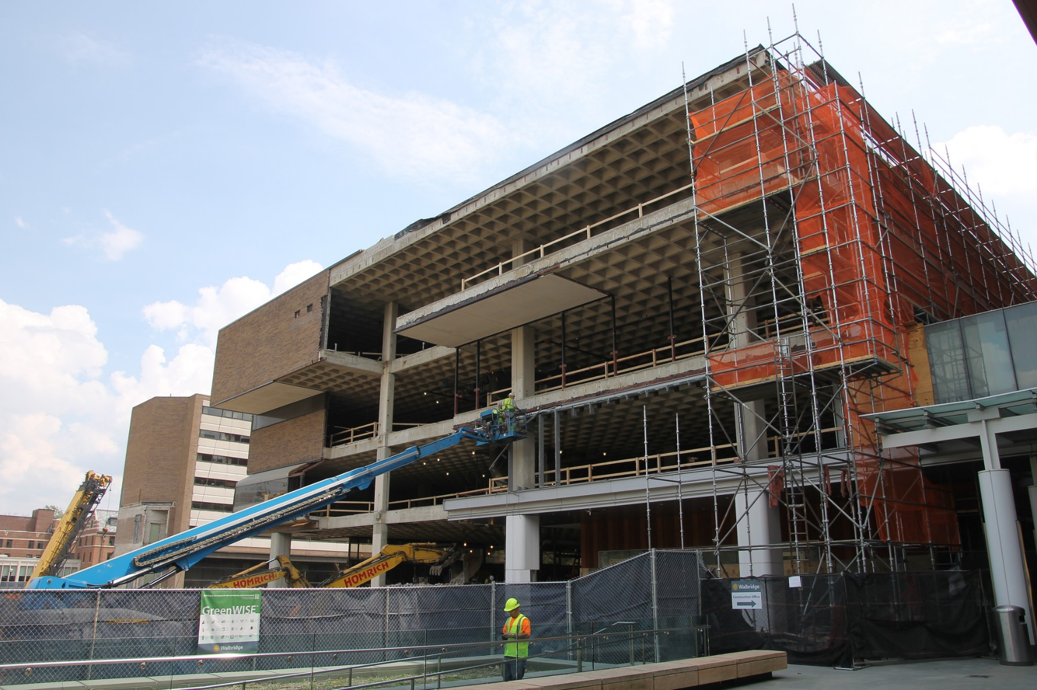
Change Management & the “Modern Library”
Change in libraries will more likely be a change that is thrust upon us
Are we ready to manage through real change?
Are we ready to give up services and resources our space will no longer accommodate?
Are we ready to embrace the change being asked – or demanded of us?

Slide 9

Change Management & the “Modern Library”
For many of our patrons, libraries are nothing more than waiting rooms where they can be productive
They want a place to…
  charge electronics
  study or do work
  relax
  sit
  collaborate
They are typically very malleable
Waiting for a flight at Hartsfield-Jackson Atlanta International Airport – November 6, 2017

Slide 10
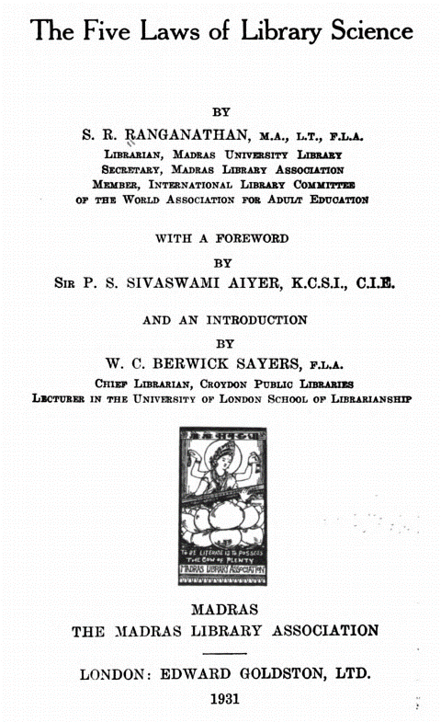
Dr. Ranganathan's Fourth Law
Dr. Ranganathan’s Five Laws (1931)
  First Law: Books are for use
  Second Law: Every reader his / her book
  Third Law: Every book its reader
  Fourth Law: Save the time of the reader
  Fifth Law: The library is a growing organism

Slide 11
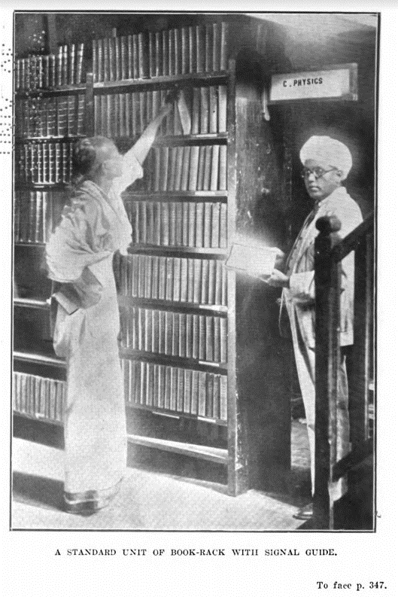
Dr. Ranganathan's Fourth Law
Fourth Law: Save the time of the reader
This can be considered a technical services law as it focuses on cataloging and acquisitions
Reference is included here but may be less critical than organization of books
You save time by helping readers find what they are looking for

Slide 12
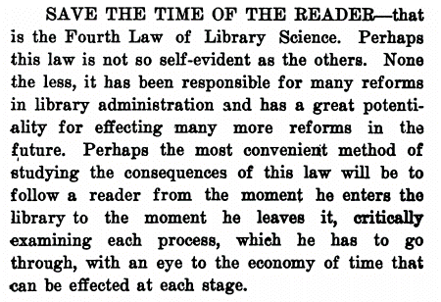
Dr. Ranganathan's Fourth Law
The world of libraries in 1931 were dominated by closed stacks systems where card catalogs were all that could be used to locate items
The open vs. closed stacks dilemma is coming back as we have so many volumes offsite
Dr. Ranganathan focused on the way that books are organized as the focus of this law
Ranganathan, S. R. 1892-1972. The Five Laws of Library Science. Madras: The Madras Library Association, 1931. p337

Slide 13
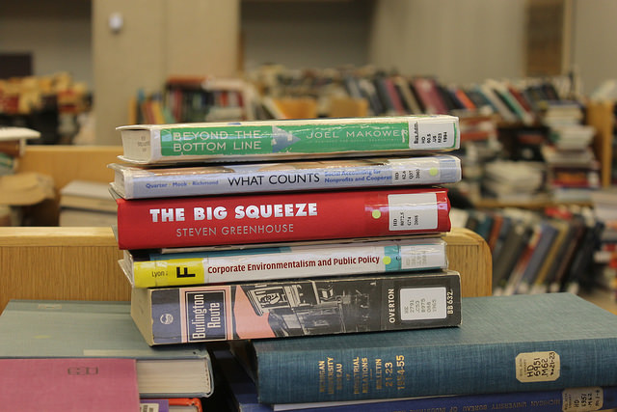
Dr. Ranganathan's Fourth Law
If collections are well documented and described, items may more easily be found (or discovered) and used
It is not only the way that it is interpreted – but also laid out in his 1931 book
Reference services would be available as needed

Slide 14
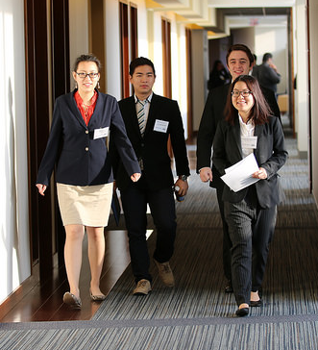
Challenge of Supporting Business Education and Entrepreneurial Research
The conundrum of business librarianship in the 21st Century
Business education is dominated by case studies, which provide discrete lessons and use data to illustrate points
Cases have learning objectives and popular ones may reflect upon events that have taken place years and year ago

Slide 15
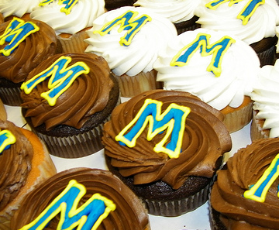
Challenge of Supporting Business Education and Entrepreneurial Research
Entrepreneurs, on the other hand, are exploring new ways and new markets – many of which have not been fully explored or even understood
Entrepreneurial thinking is not adding a fee on an existing service
Or coming up with a simple idea for a new store – like a cupcake shop (a few years ago – very popular in the states)

Slide 16
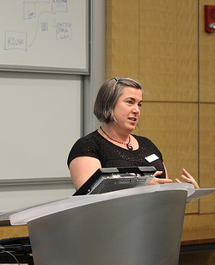
Challenge of Supporting Business Education and Entrepreneurial Research
Library instruction works well when the type of information needed matches the structure or organization of the data
Library instruction works well (like cases) when the problems can be simulated with example issues (Karate Kid)
Library instruction has shortcomings when the information needs go beyond what can be shown in a structured format
Library instruction has shortcomings also when the needs go beyond the walls of the library
Entrepreneurship should be somewhere new…if there is a report – then it is not as unique as you think it is

Slide 17
Challenge of Supporting Business Education and Entrepreneurial Research
This is my vision of collection building in libraries – we need to find the balance between these needs
Future Use
This is where Libraries have traditionally bought for (and many still do)
Community Needs
Community Aspirations & Desires
This is where our campuses really want us to be working. This might be where the turnaways come from
Current Use

Slide 18
Challenge of Supporting Business Education and Entrepreneurial Research
Library challenge is that we have multiple stakeholders and they have different needs – especially for business
Faculty needs – scholarly journals, articles, books , datasets
Student needs – articles, company & industry information, market reports
Community – Mostly similar to student needs
Student
Community
Faculty

Slide 19
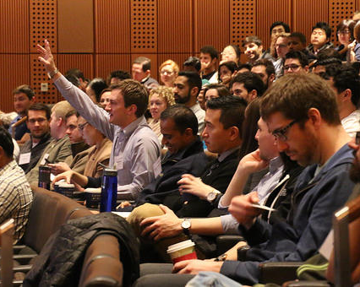
Challenge of Supporting Business Education and Entrepreneurial Research
Michigan Ross approach
The educational opportunities we provide need to mirror the world of business
We need to teach students how to manage through Ambiguity and Complexity
Students need to understand VUCA (Volatility, Uncertainty, Complexity & Ambiguity)
We do this through experiential learning programs
This is a great opportunity for the Kresge Library

Slide 20
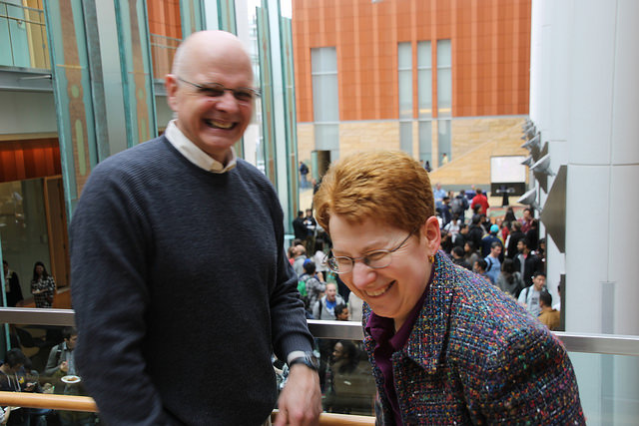
Challenge of Supporting Business Education and Entrepreneurial Research
Kresge Library has long supported action-learning at Ross – our signature learning program
MAP (Multidisciplinary Action Projects) brings together 4-6 students to work as a team to solve a real-world problem
Each team works with 2 faculty members, peer coach, communications coach and a Librarian
The Kresge Embedded Librarian program fits the core mission of the school and has a librarian working with all student teams
We have changed our staffing to ensure we had sufficient librarians to support these programs

Slide 21
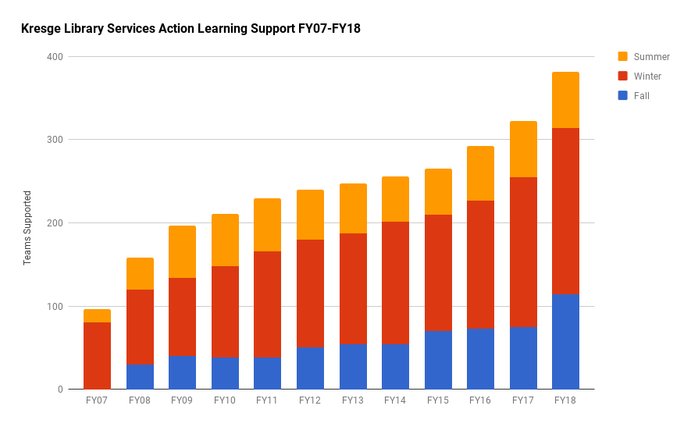
Challenge of Supporting Business Education and Entrepreneurial Research

Slide 22

A Public-Service Approach to the Fourth Law
Fourth Law: Save the time of the reader
There are MANY different ways to save the time of the reader:
  Help them find resources they need
  Help them track down articles they cannot locate
  Help them understand the value of particular resources
  Provide reference services to ensure students can spend more time doing the analysis
  Understand that their information needs may not be in traditional library resources

Slide 23
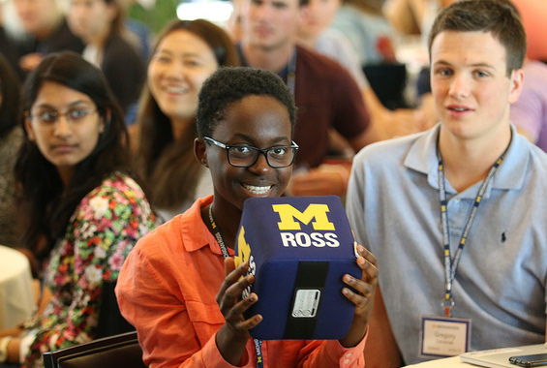
A Public-Service Approach to the Fourth Law
Fourth Law: Save the time of the reader
The biggest challenge in supporting business research is that the nature of the questions may not match the organization of the information
Our students and researchers need assistance to craft and explore business resources to provide them with tools to answer their questions
This is the ‘value-add’ of the librarian

Slide 24

A Public-Service Approach to the Fourth Law
“Everyone you will ever meet knows something you don't.” ― Bill Nye (University of Massachusetts Lowell 2014 graduation)
Everyone can do something that you can’t do….
https://www.youtube.com/watch?v=wzwX-qu5fRA

Slide 25
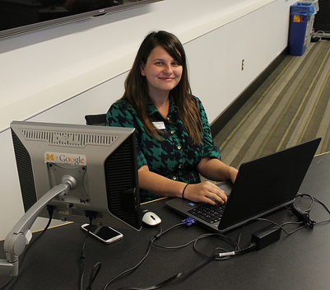
A Public-Service Approach to the Fourth Law
Librarians are very good at finding resources
We are good at moving beyond the limits of metadata searching (as in a catalog or A&I database) and narrowing down results in full-text searching
Lets focus on that and stop running away from helping our patrons

Slide 26
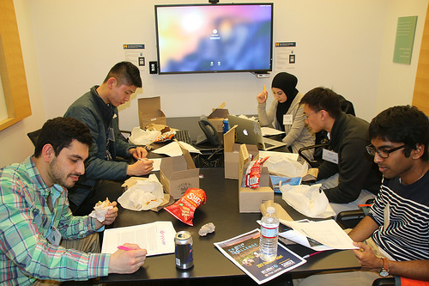
A Public-Service Approach to the Fourth Law
Build relationships with our patrons
When supporting MAP teams at Michigan Ross, each team works with an assigned librarian
One of the BEST ways we save the time of the reader is through that arrangement
When working with a dedicated librarian, students do not have to repeat what they are looking for
They also do not need to worry about getting the same material repeatedly
Relationships > Transactions

Slide 27
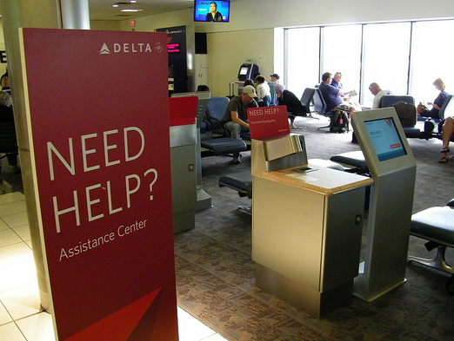
A Public-Service Approach to the Fourth Law
The electronic library environment has created great strides in creative self-sufficient users
We have been pushing self-service in the profession
This is desired by our users when they have known-item searches (particular book, article or report)
But what happens when they have an unknown-item search?
This service to our researchers IS the future of the library
Hartsfield-Jackson Atlanta International Airport July 11, 2012

Slide 28

A Public-Service Approach to the Fourth Law
Topic like Logistics & Supply Chain
These are complicated for people in the field – let alone students and entrepreneurs
In order to save the time of the reader, we
  Aspire to understand the problem
  Seek out information that helps solve the issue
  Connect with the user and share resources that may help
  Reconnect if the resources were not useful
  Lead, not point
Boeing Dreamlifter (modified 747) at Charleston, South Carolina USA – November 10, 2017

Slide 29
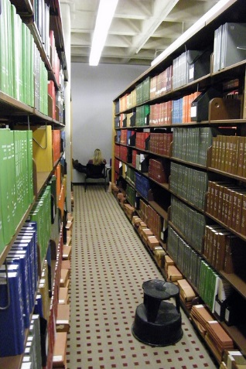
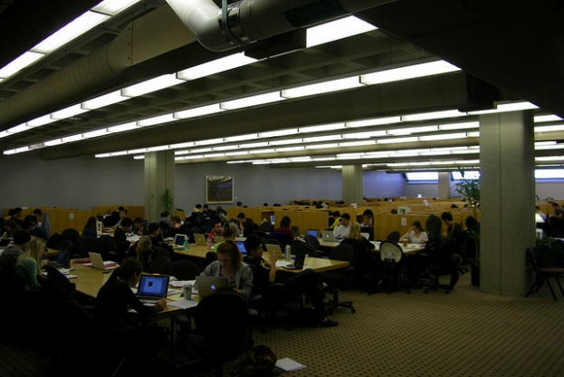
Building the Library of the Future & Closing Thoughts
A Physical Space
  Study
  Print Materials
  Interaction Spaces
  Walk-in Access
  Some of these services may be easily done by others
An Ethereal Space
    This is where we connect with our community
    This is where we provide clarity to a complicated information universe
    This is where we contribute as a “Value-Add”
  This is where we do ‘library’ work
  This work cannot be done as well by others
  This work is not-space dependent
The OLD Kresge Library

Slide 30

Building the Library of the Future & Closing Thoughts
At Kresge, the “Ethereal Library’s” value proposition is:
  Live within the restrictions of virtually no collection space
  Figure out new collaboration mechanisms to serve our community
  Focus on what we can do vs. what we have done
  Forget the dead, take care of the living!
Squirrel at the University of Michigan, Ann Arbor

Slide 31
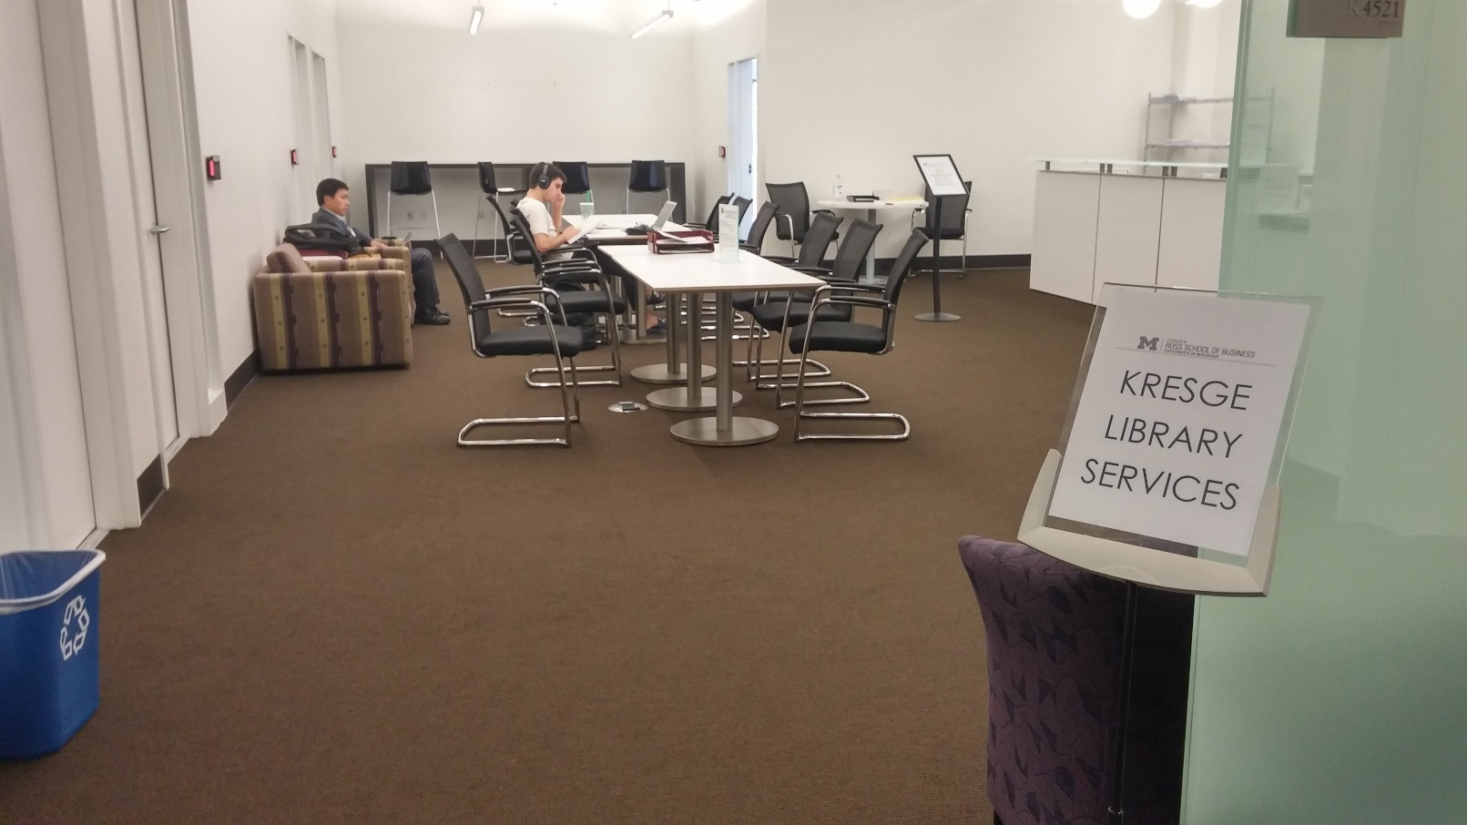
Building the Library of the Future & Closing Thoughts
“A completely re-thought Kresge Library Services, transitions from a collection of physical reference materials to a full suite of information resources and research services, guided by expert staff.” – Ross Dividend, Fall 2016 (Ross Alumni Magazine)
The library did not close, but become virtually unrecognizable
You do not always choose your path, but how you respond
The NEW Kresge Library Services at the University of Michigan

Slide 32

Questions & Thank You
Corey Seeman
cseeman@umich.edu
@cseeman
Slides: tinyurl.com/ETBL17Seeman
Corey’s Web Home: www-personal.umich.edu/~cseeman/

Slide 33
Bibliography & Readings
Bhatt, RK. "Relevance of Ranganathan's Laws of Library Science in Library Marketing." (2011)
Carr, Patrick L. "Reimagining the Library as a Technology: An Analysis of Ranganathan’s Five Laws of Library Science within the Social Construction of Technology Framework." The Library Quarterly 84.2 (2014): 152-64.
Coman, Edwin T. Sources of Business Information. New York: Prentice-Hall, 1949.
McMenemy, David. "Ranganathan's Relevance in the 21st Century." Library Review 56.2 (2007): 97-101.
Rimland, Emily. "Ranganathan's Relevant Rules." Reference & User Services Quarterly 46.4 (2007): 24-6.
Walter, Scott. "Ranganathan Redux: The “Five Laws” and the Future of College & Research Libraries." College & Research Libraries 73.3 (2012): 213-5.

