Slide 1



Notes:
Abstract: To achieve the goal of improving the health of women and children, low-smoke stove technology needs to be widely adopted. Specifically, BLUElab aims to expand low-smoke stove usage from one partner community to over 20. The adoption of our stove technology will be deemed successful in a given community when 50% of its population has a low-smoke stove and there is one trained stove builder per 50 households.

Slide 2
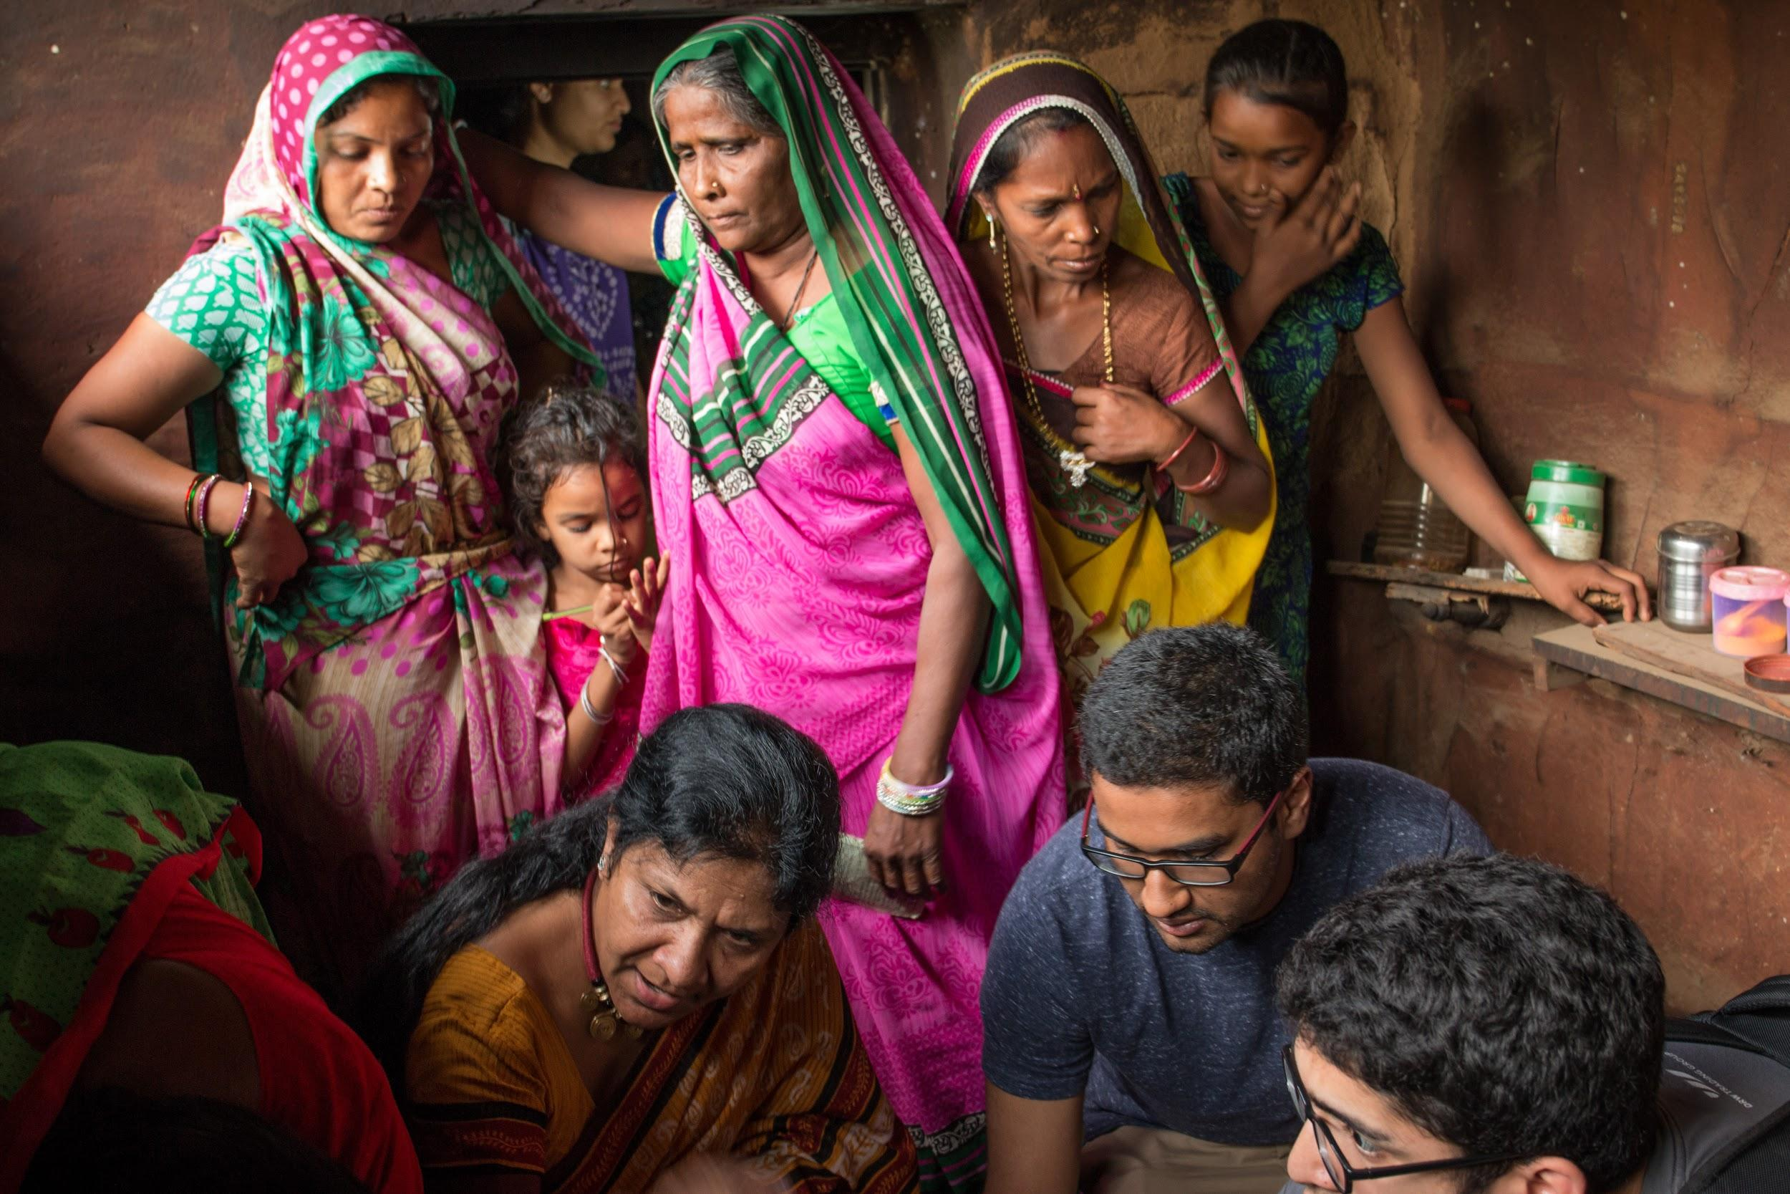
Objective
Low-smoke stove technology expansion
Notes:
Objectives-
expand low smoke-stove from the 2 communities into 20 new communities
Expansion Plan Description: The main focus behind this plan is for Sumitraben, our partner stove builder, to develop independence in building the stove and then eventually teaching others how to build it.
The foundation is going to be the main drive behind the expansion while we provide mostly technical support
There are two main documents to help with expansion:
Build Kit- to make sure consistent building
ToT Trainer Module- to teach others in communities to be stove builders

Slide 3
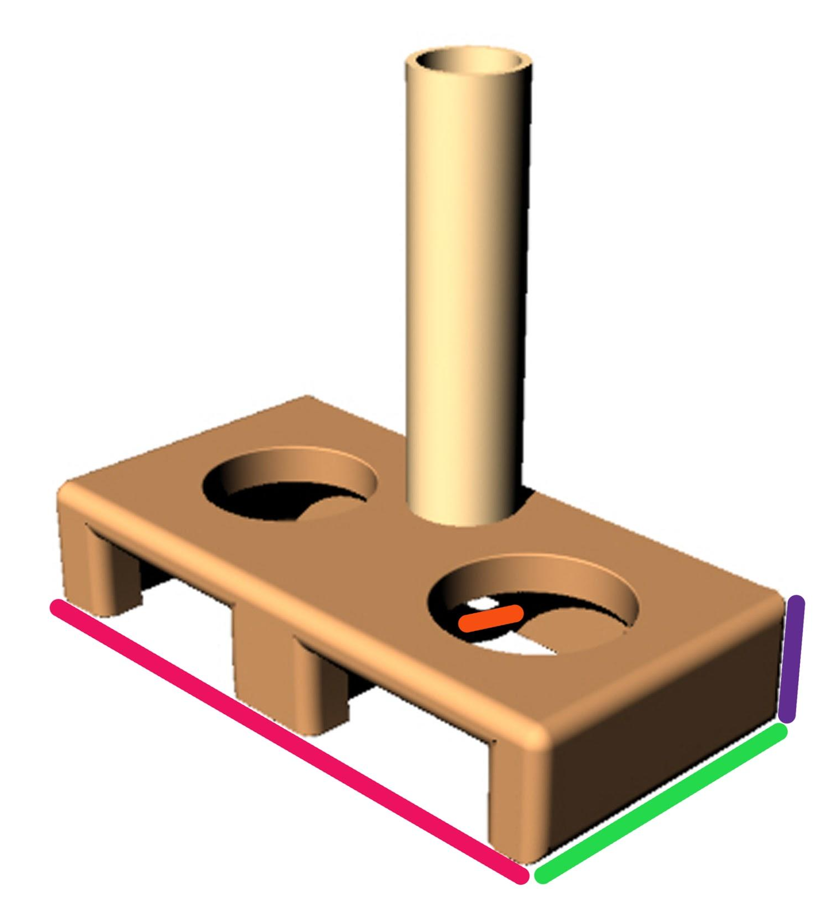
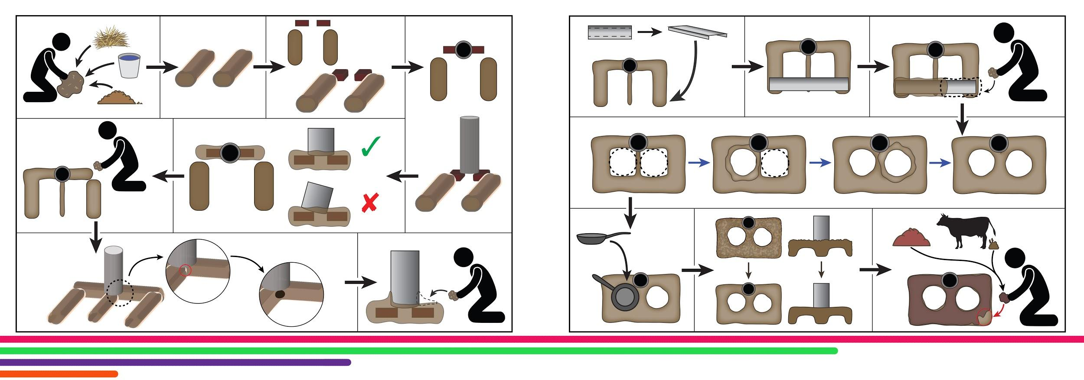
Methods
Notes:
There are two main documents to help with expansion:
Build Kit- to make sure consistent building
ToT Trainer Module- include additional information necessary to the long-term success of a stove-builder in building and maintaining stoves, help our master builder learn how to communicate the design and her methods effectively

Slide 4
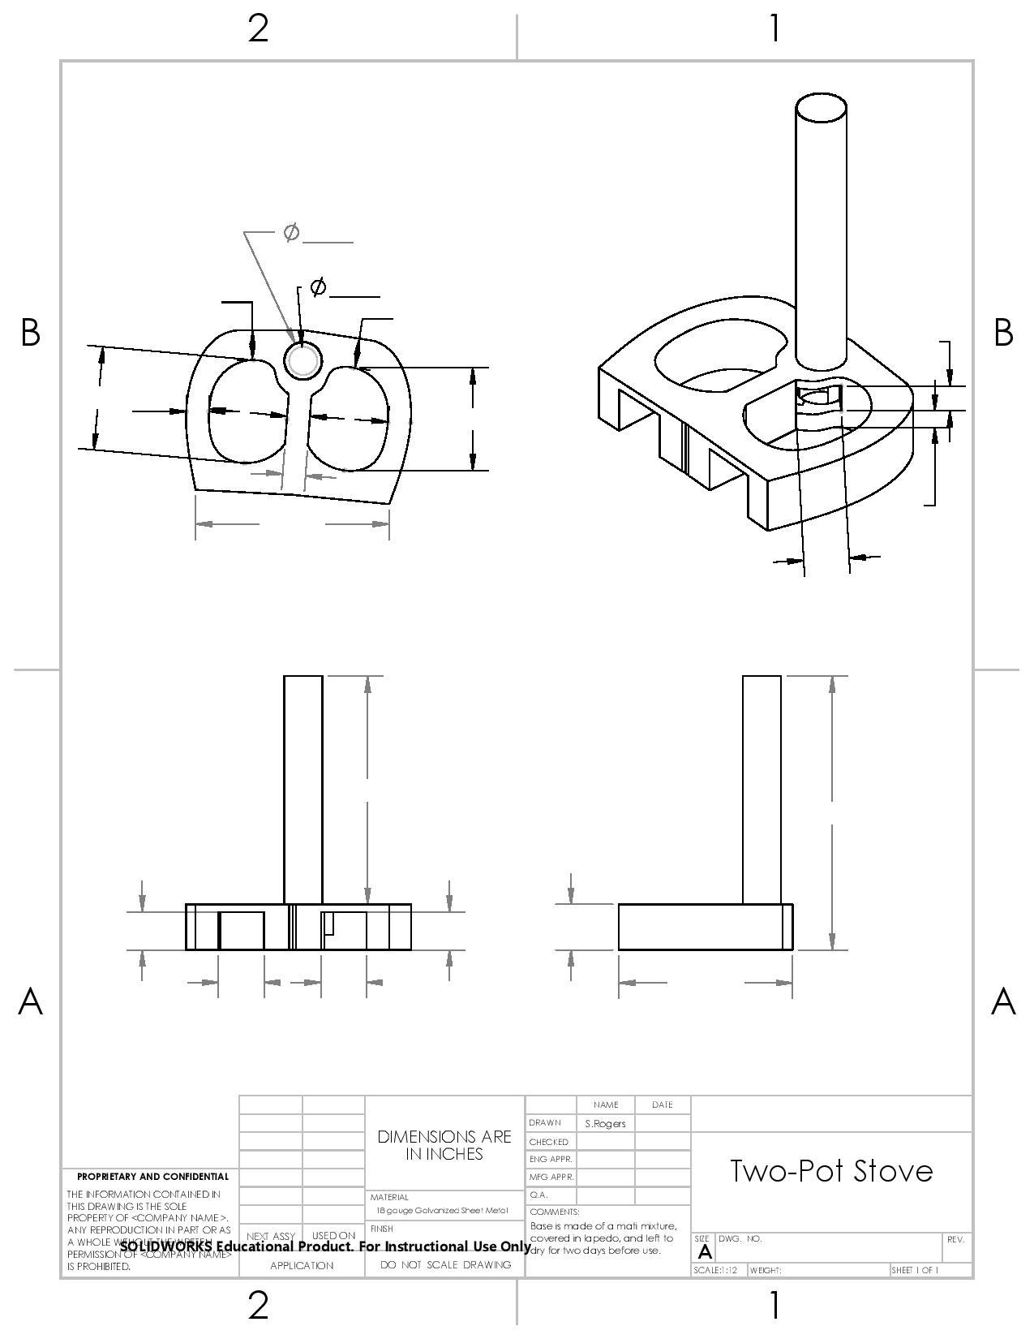
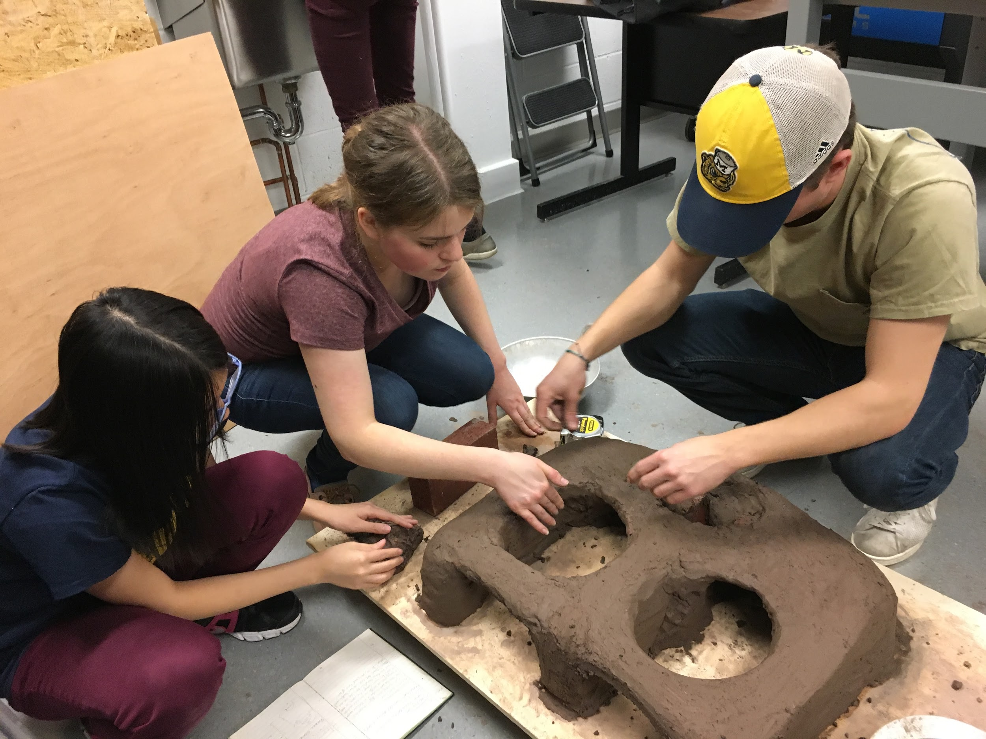
Challenges
Notes:
Challenges- During stove design development and future challenges
During stove design
Finding an appropriate metal that would not breakdown under extreme temperatures
Determining the most applicable chimney that can vent smoke away from the users faces efficiently and is durable
Figure out the material composition of the soil used to build the stove
In the future removing the metal bridge from the stove
The adaptation of the technology into 20 new communities
Consistency of design
New women becoming stove builders
Entering new communities and creating demand for these smokeless stoves
Finding out the dynamics of the community in terms of social networks and how resources are shared
Building and establishing trust among the community members
Properly identifying which communities to work with based on their needs

Slide 5
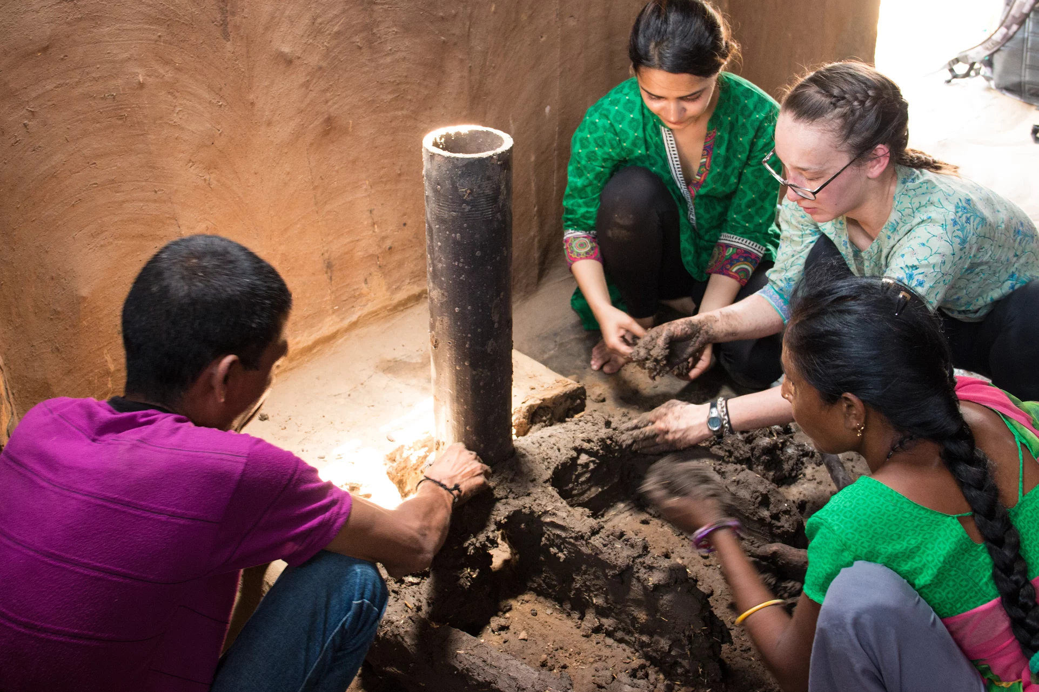
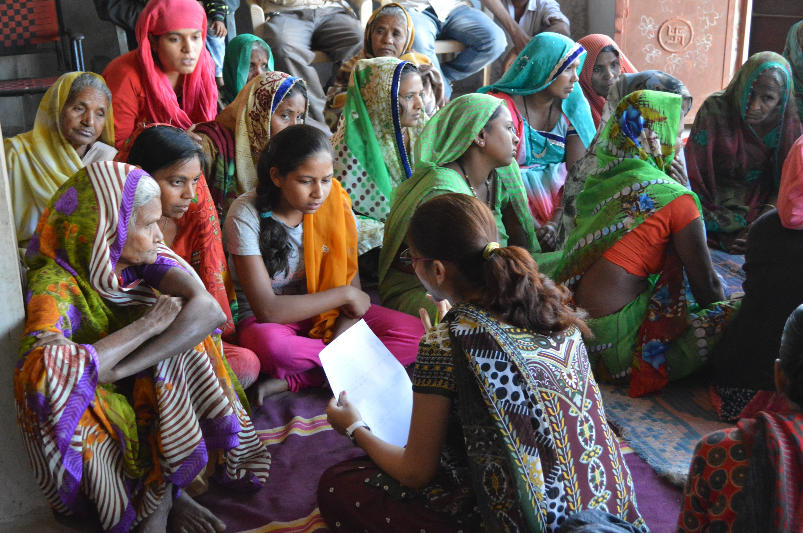
Impact
Notes:
Enhances Global Scholarship:
Our team learns how to most effectively implement our co-designed technology for a community that has much different needs than us. We enhance our global perspective by learning about the Indian people and their culture, which allows us to make our design and implementation process cohesive and accommodating to the community.
We accommodate the community member’s needs by directly immersing our members in the rural communities through our service trips. This allows us to gain valuable insight first hand regarding the day-to-day difficulties the members face.
We advocate for diversity and inclusion:
We let the women in the communities speak up and have their voices heard by seeking their opinions and concerns regarding our designs. These women are empowered by having their voices heard, which is quite uncommon in these rural, patriarchal communities.
We advocate diversity as our goal is to gather the voices of all types of community members such as children, women, the elderly, and males to engage the community fully throughout our design process. This ensures various opinions are gathered and the entire community is incorporated into our needs assessment and design process.

Slide 6
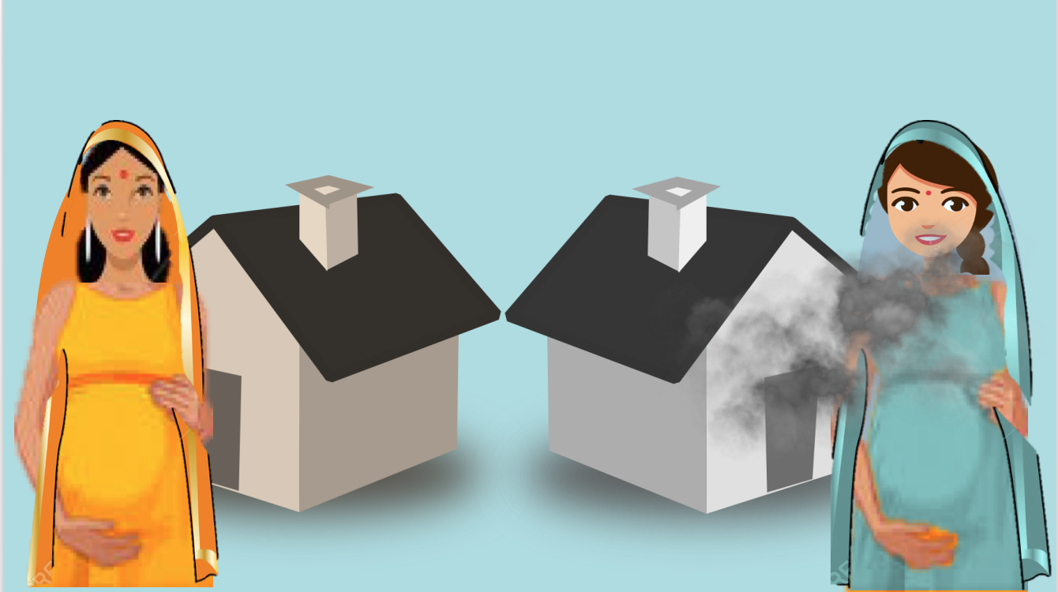
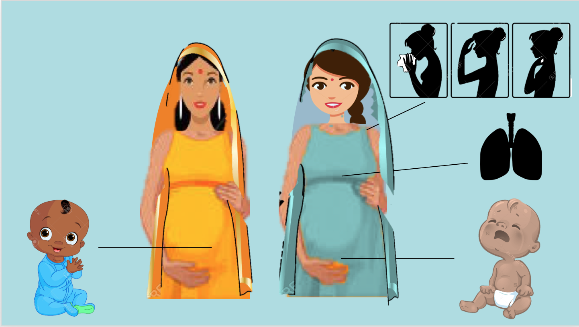
Health
Smoke Inhalation Presentation
Notes:
Our project has high significance as numerous people in India are negatively impacted my household air pollution (HAP): 800,000,000 people are affected and 1,000,000 people die annually according to the World Health Organization. 58% of Indian households rely on biomass as their primary cooking fuel which contributes greatly to HAP.
Our stoves reduce carbon dioxide and monoxide inhalation by 50%

Slide 7

What We have Learned
Trust
Technology
Communication
Notes:
How to develop trusting relationships with different communities
How to expand the technology efficiently
Overcoming language barriers
Potential ideas on how to further reduce the cost of the stove for the families
Census data for the surrounding communities
Constraints on the overall system

Slide 8
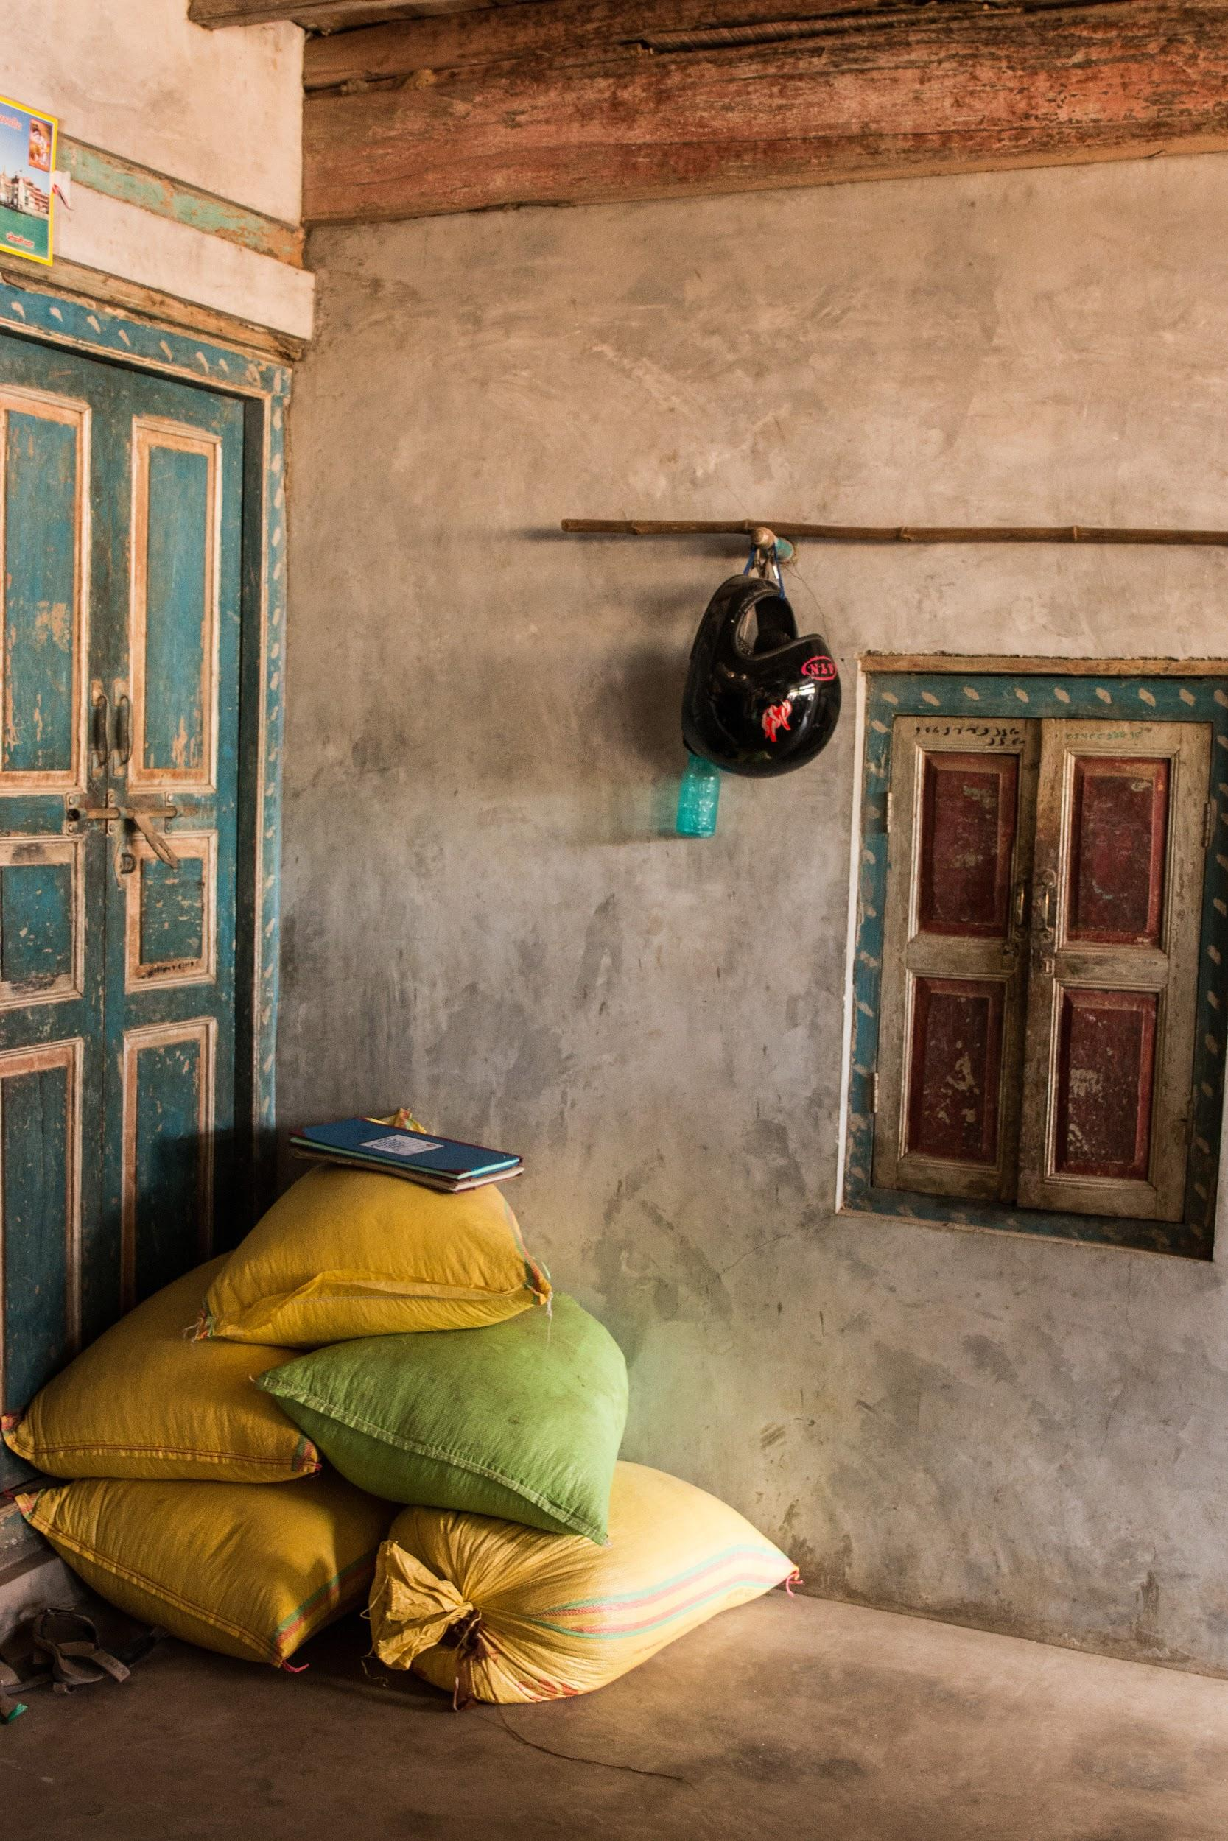
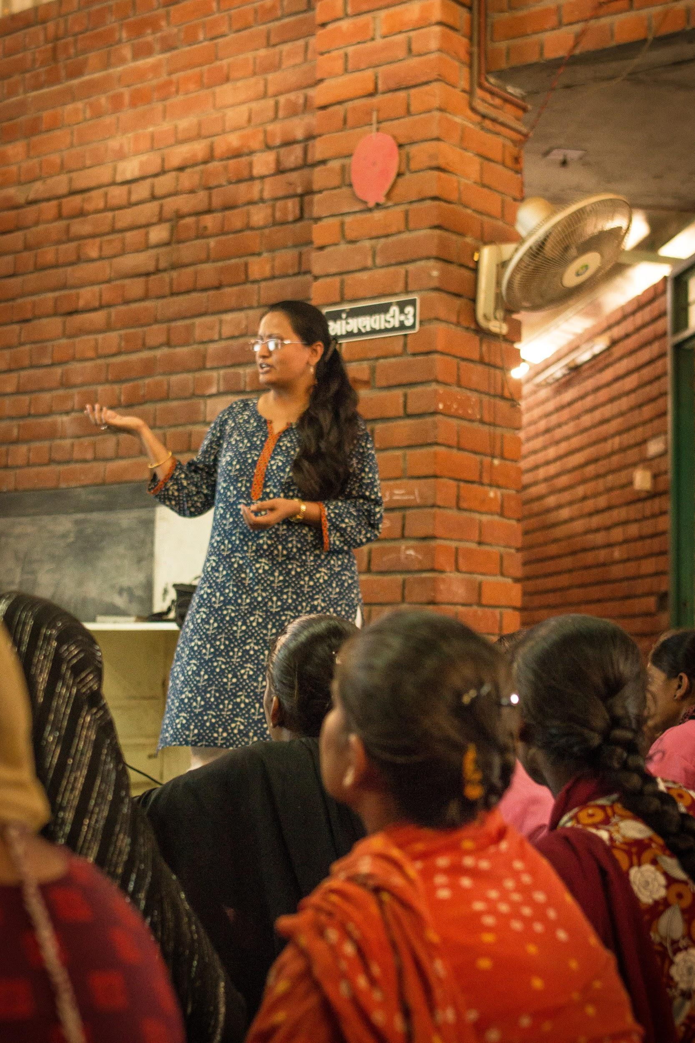
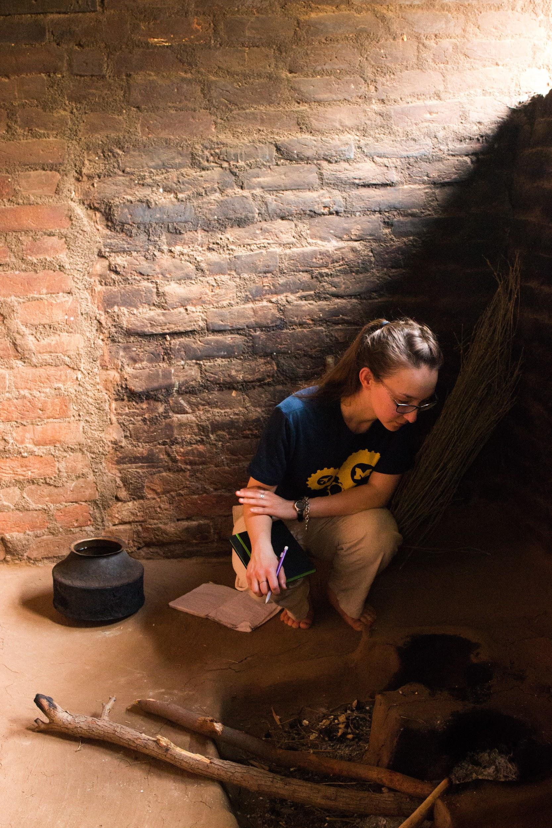
Library Partnership
Notes:
Partnering with the U-M Library has given us access to experts who will guide us as we research information relevant to proper stove implementation, including community engagement
Specifically, our education-based sub-team would be able to utilize the plethora of knowledge that the library offers to create educational modules that are accurate but also relevant and relatable to our audiences
This wealth of knowledge will allow us to produce a positive impact on the community we work with.

Slide 9
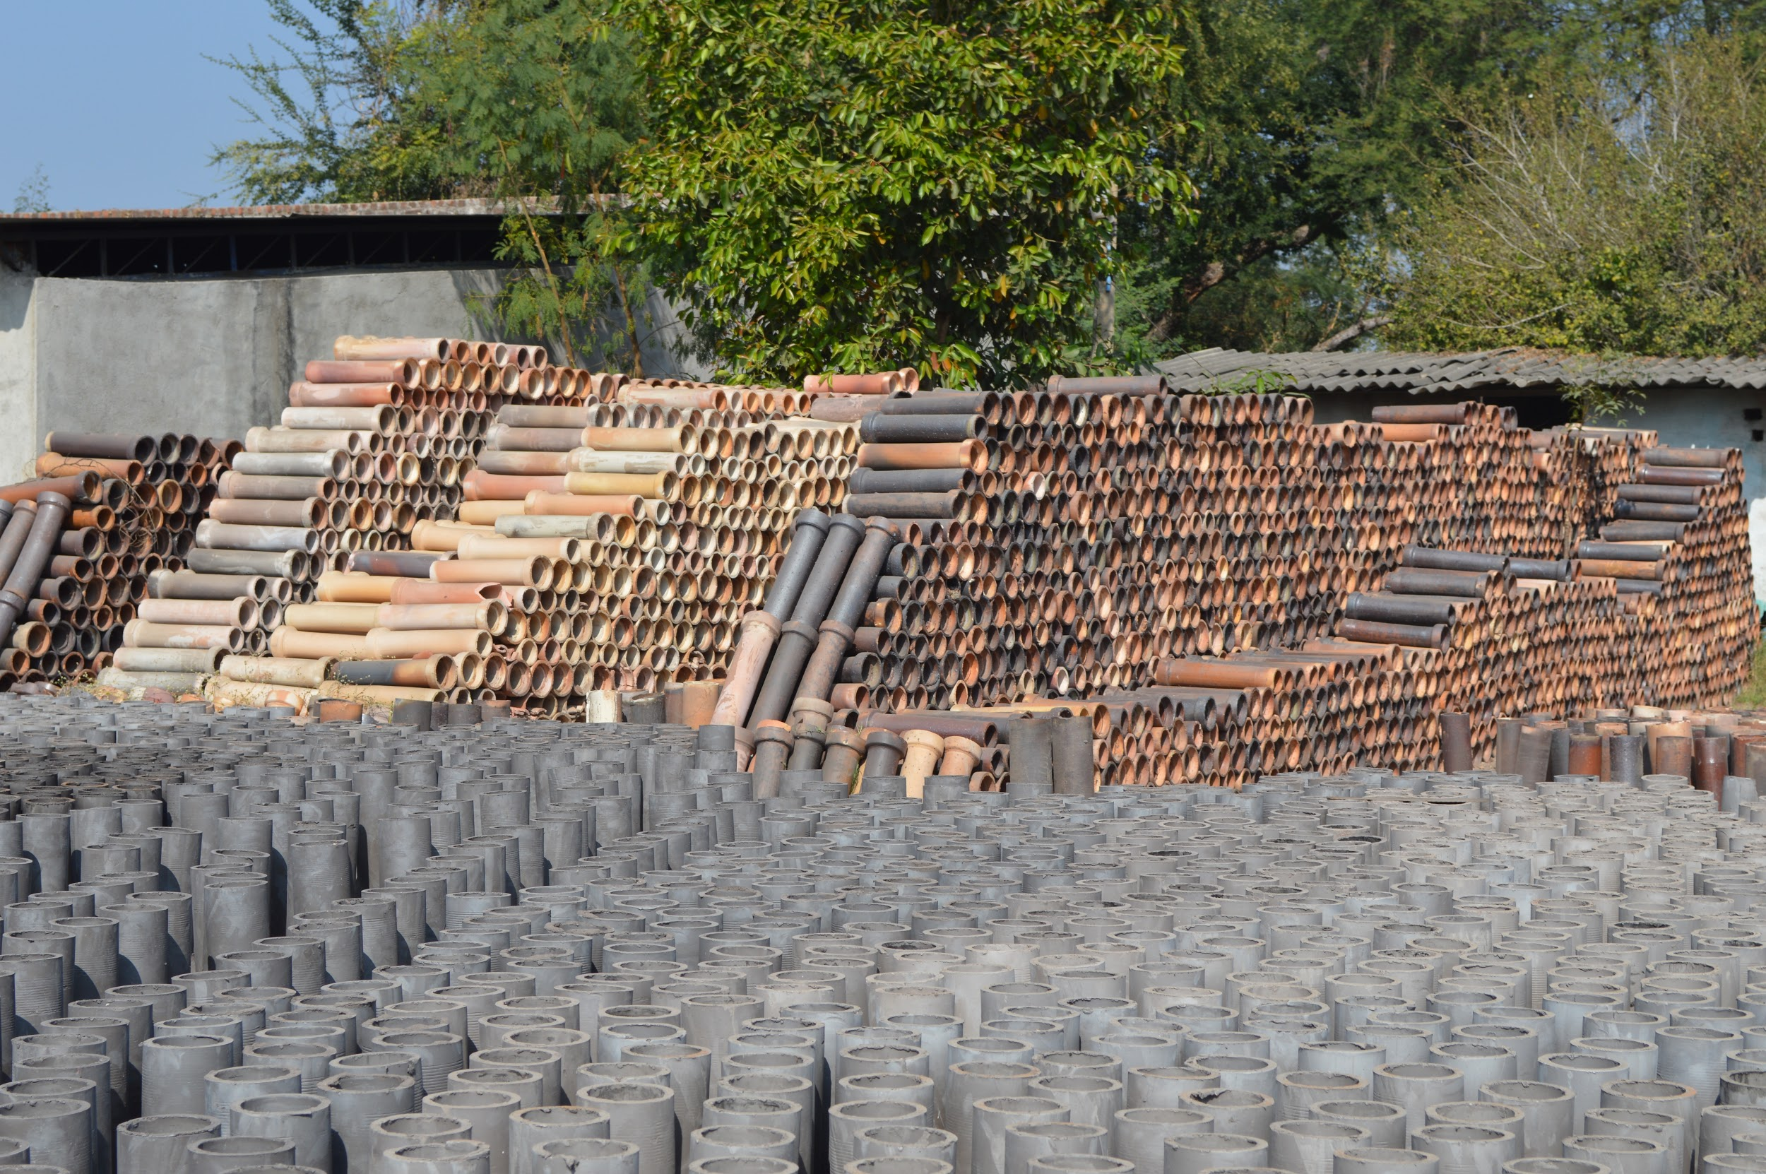
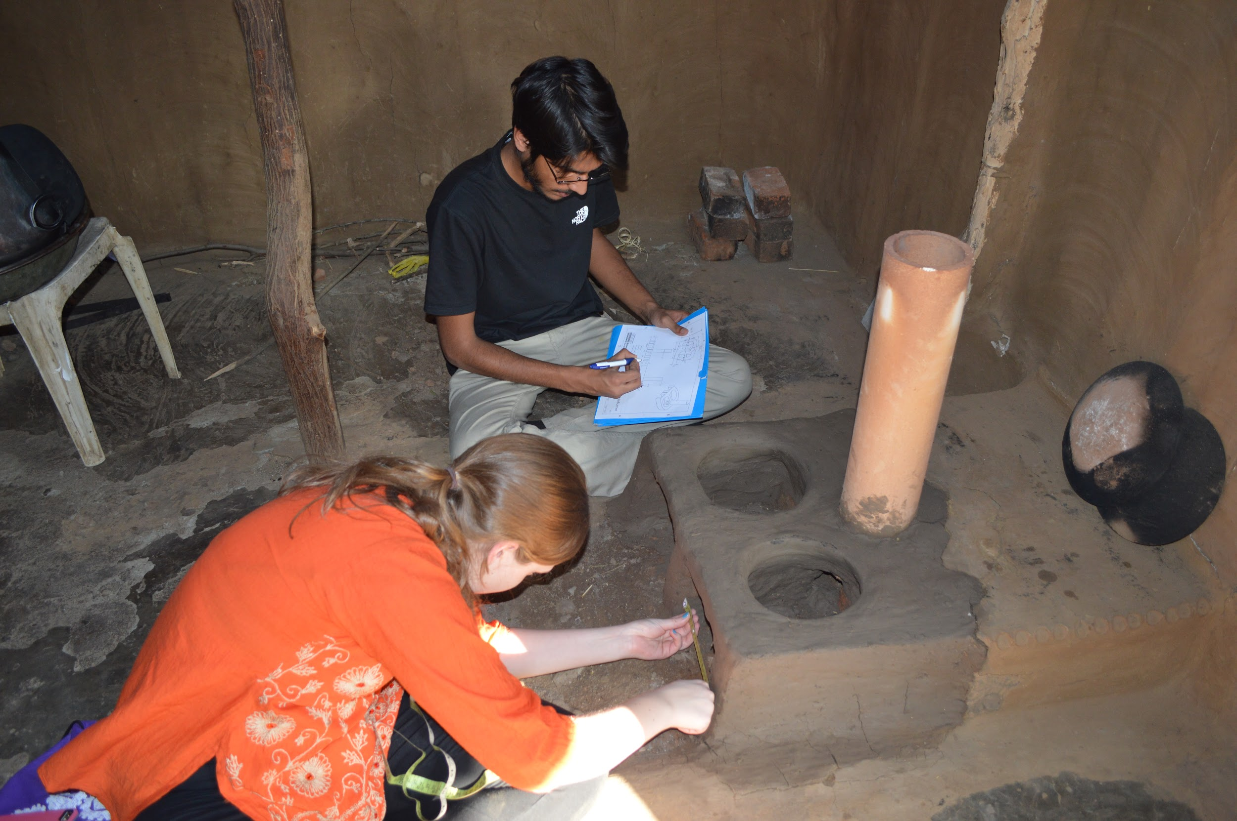
Further Work
Notes:
Collecting user feedback
Monitoring stove functionality and implementation plan progress
Trouble-shooting on need basis
Communicate with community leaders

Slide 10





Acknowledgments

Slide 11
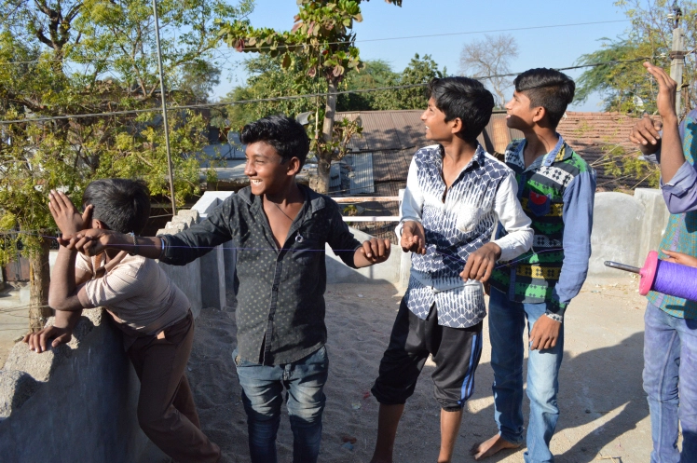
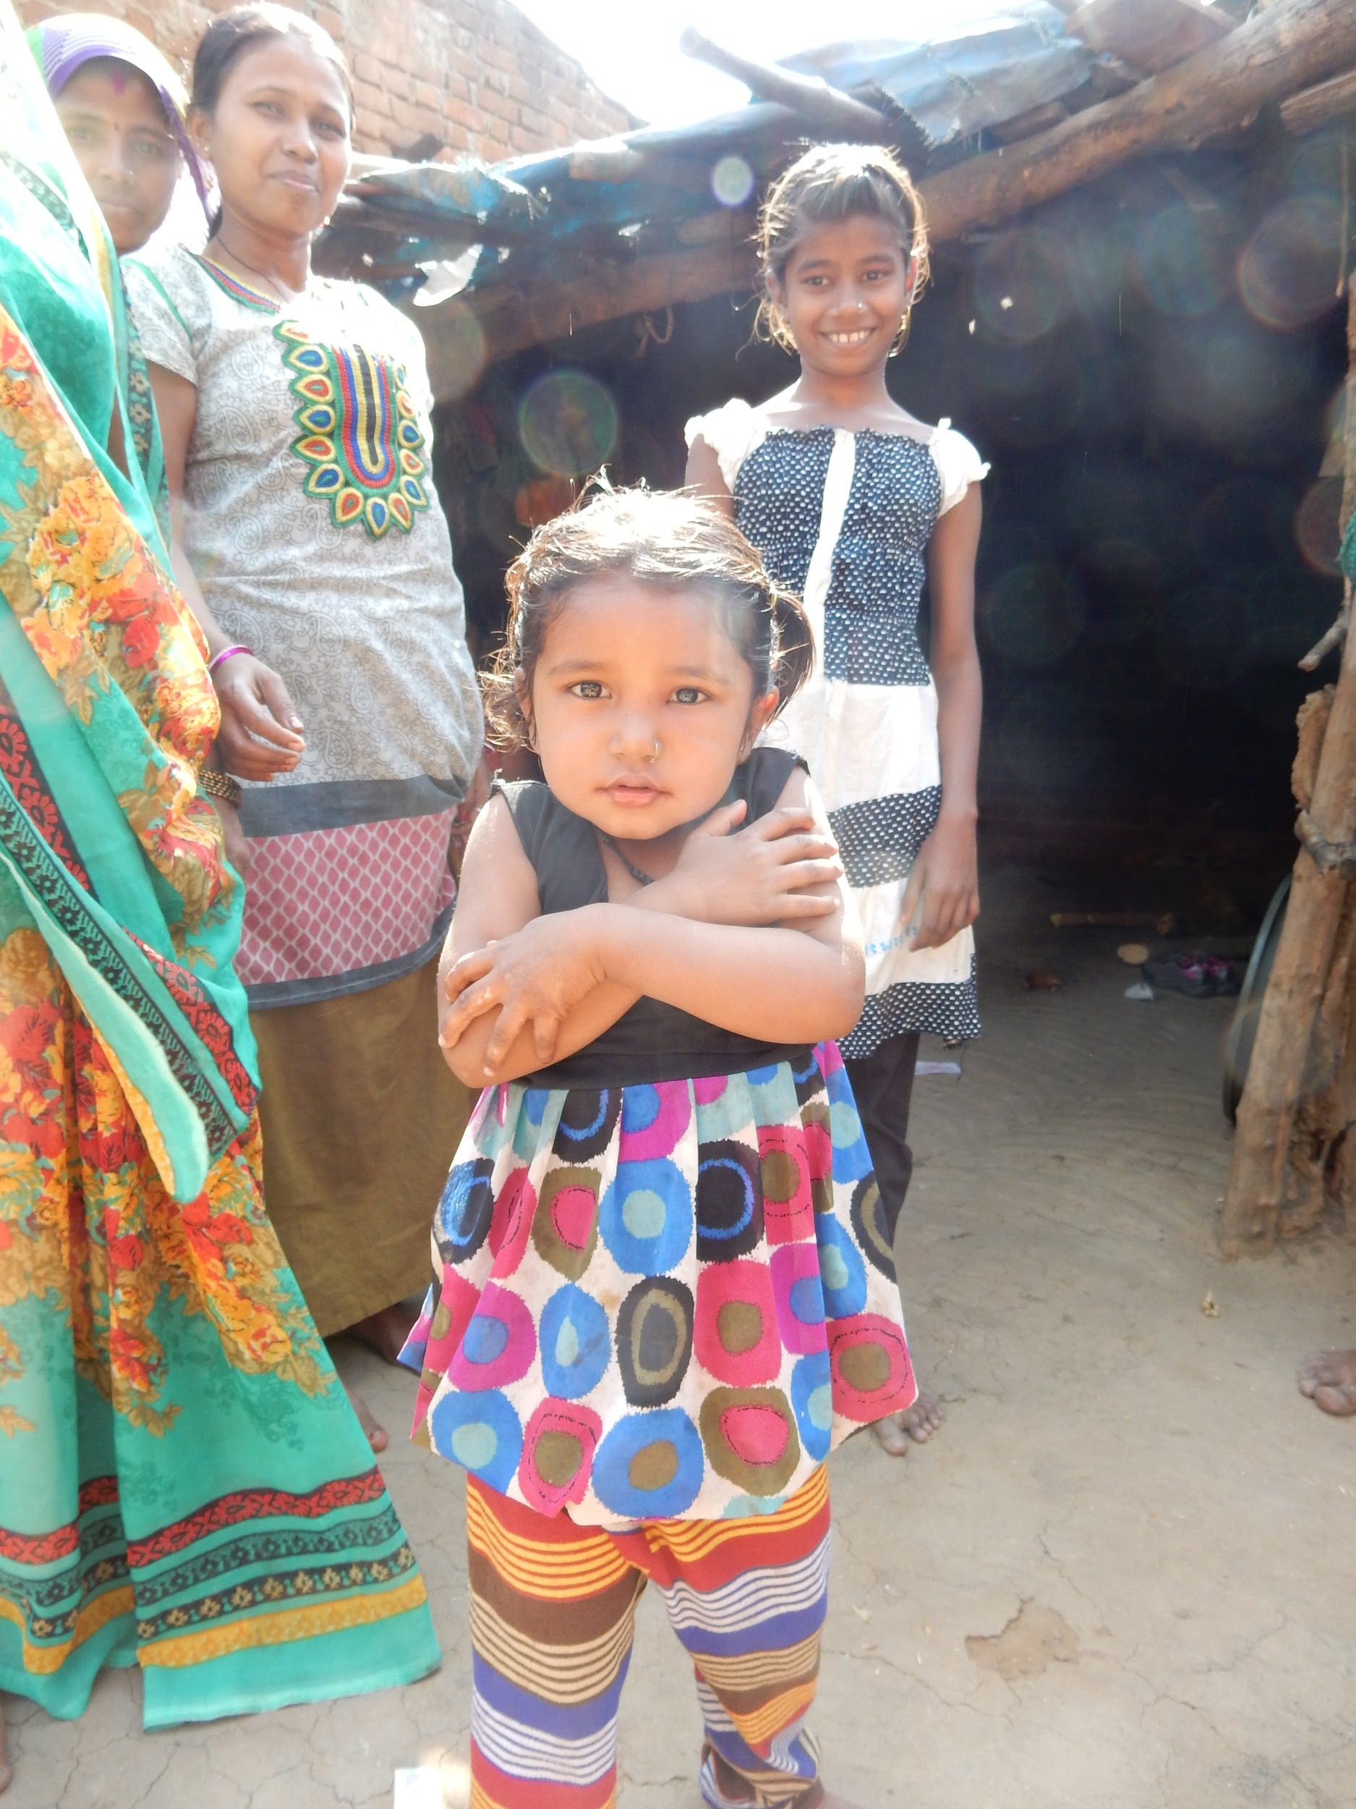
Questions?
Thank you!

