Slide 1
Understanding the Development of Multicultural Identities
Shima Sadaghiyani
Maria Tout
Fatima Al-Rasool

Slide 2
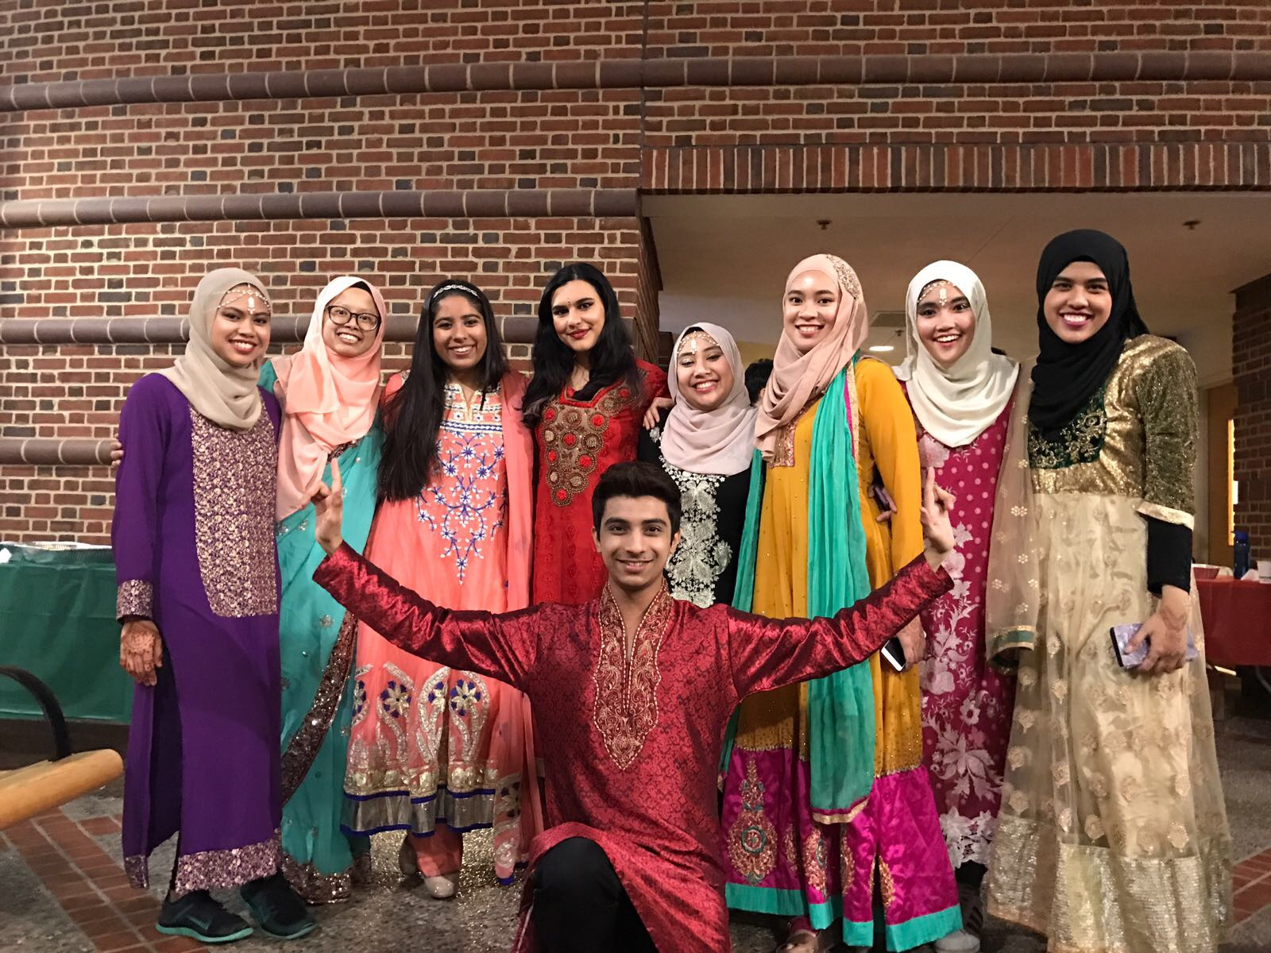
Objectives: Purpose
To gain a better understanding the concept of multiculturalism
How people view multicultural identity
How those identities are formed & how they evolve over time
Notes:
Purpose: How people view their own, as well as others’, multicultural identity & how those identities are formed & how they evolve over time
Caption for photo: Colors. Of different people, colorful outfits, diverse background. But aren't these differences that make us as a human being unique?

Slide 3
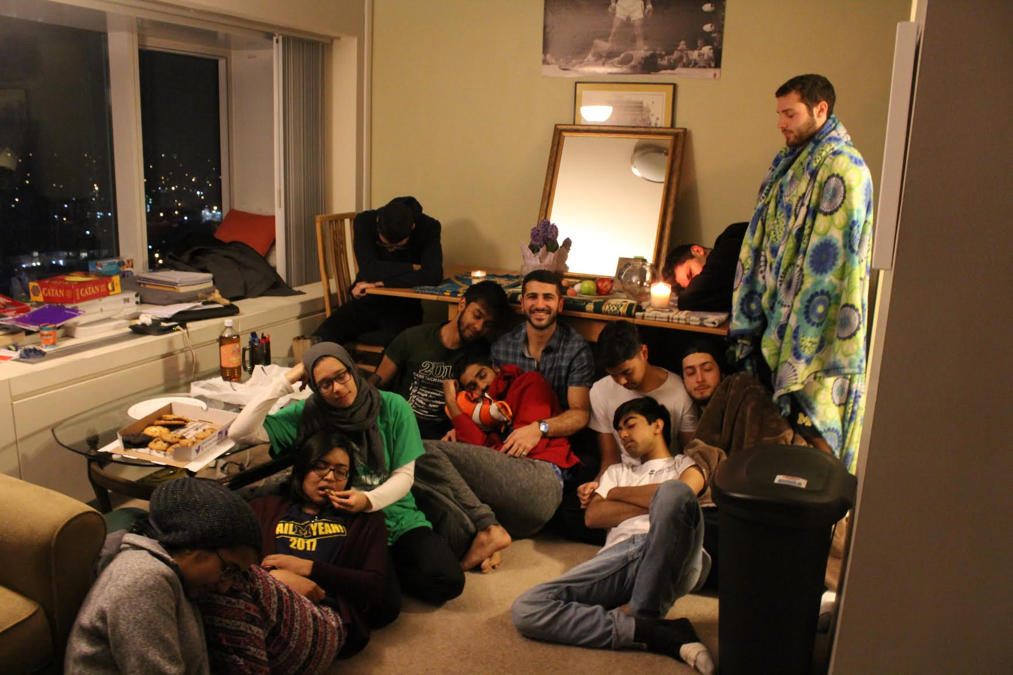
Here I am celebrating Norooz, the persian new year, with many of my non Persian friends. As you can see they are all asleep because it was 6:30 in the morning.

Slide 4
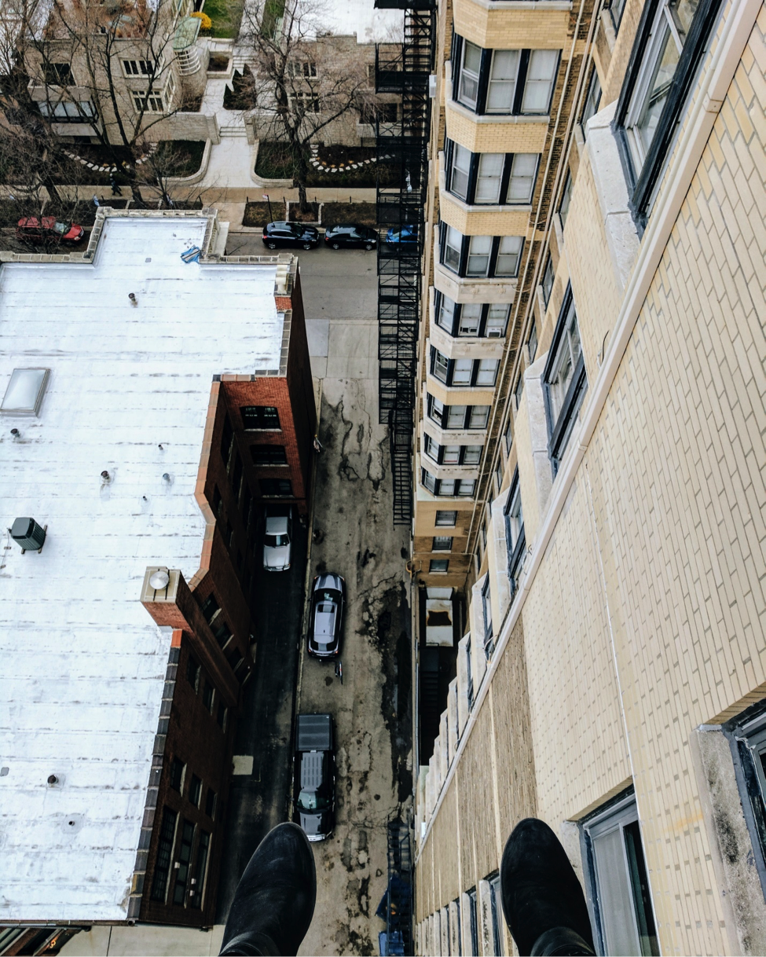
Not part of your world.

Slide 5
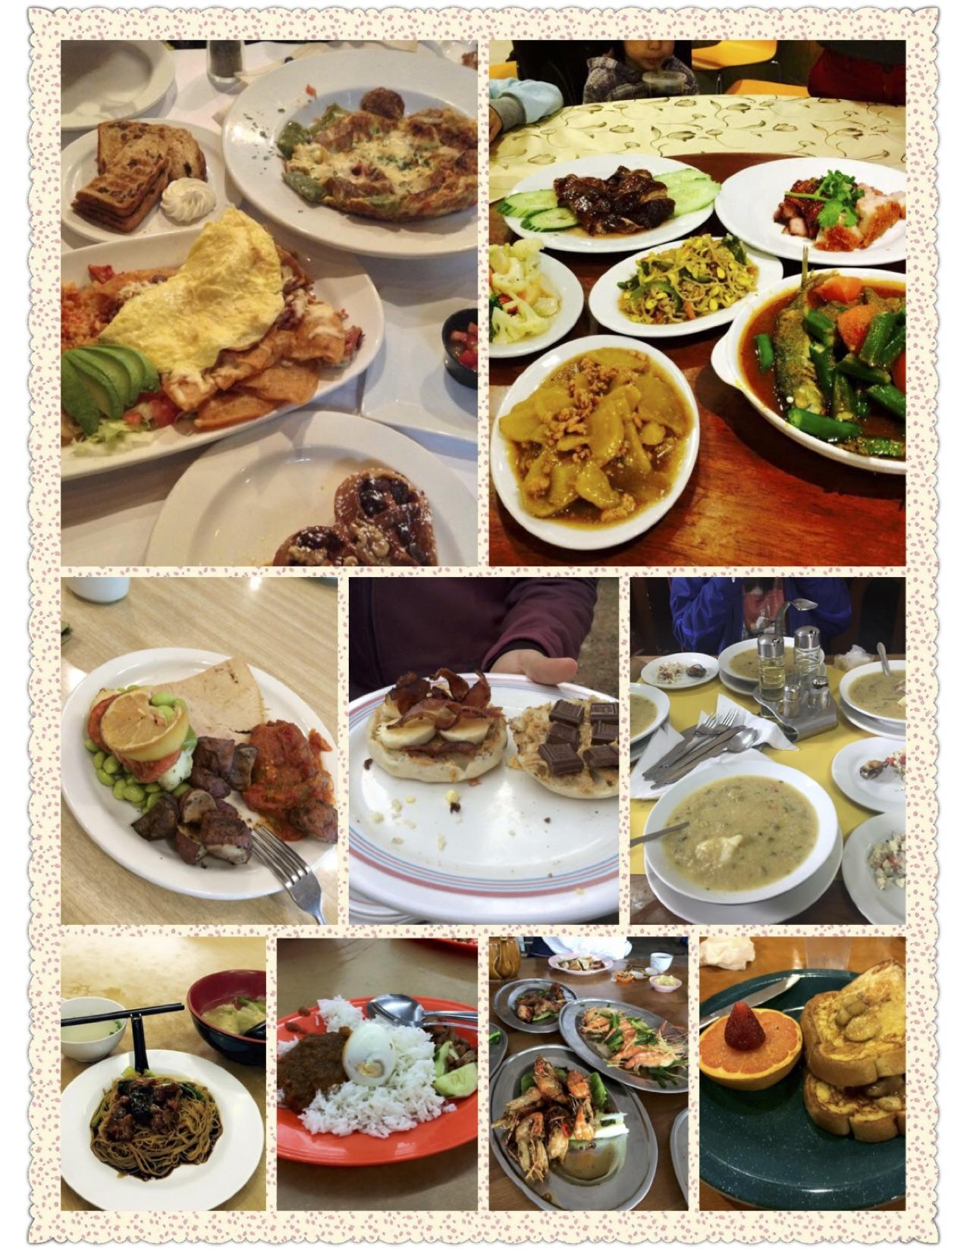
Food connect us with people of different culture around the world. This is my food journey that is tied closely to all the significant moments during the past few years.

Slide 6
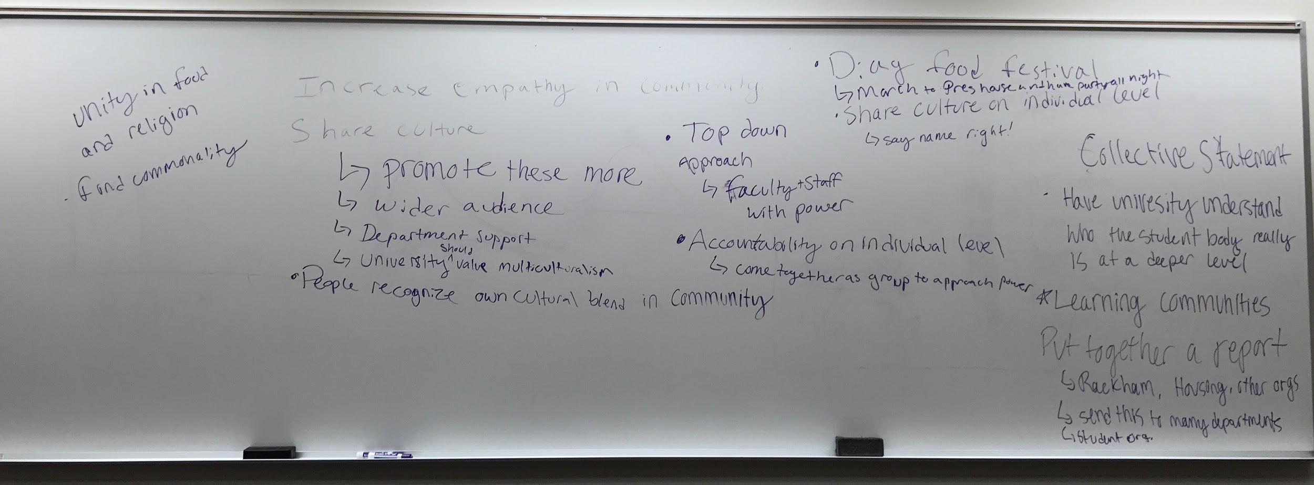
Objectives: Hopeful Accomplishments
catalysts for positive change
Drawing attention
Grassroots, bottom up approach
Notes:
Accomplish: participants becoming catalysts for positive change
Ideas of: increasing empathy within community, sharing culture, university should value multiculturalism
Hoped to be inclusive in the sense that, through photovoice, we wanted to give people with multicultural identities a chance to speak about their experiences and drive the research instead of merely conducting a study that dominated their individual voices

Slide 7
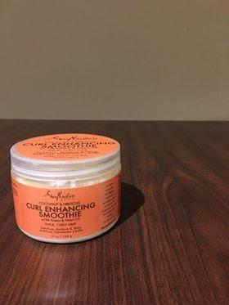
Challenges
Letting discussion come organically during focus group in a way that is beneficial and not forceful.
Forming groups in a way that had an equal mix of representation from different multicultural identities.
Thinking about moving forward.
Magic
Notes:
Letting discussion come organically during focus group in a way that is beneficial and not forceful.
Benefit: this is a very bottum-up survey method
Contrasts sharply with research that typically imposes certain ideas on participants (top-down)
Forming groups in a way that had an equal mix of representation from different multicultural identities.
Not one voice dominating the group and dialogue.
Thinking about moving forward.
Action plan → what can we do to be effective?

Slide 8
Real Life Impact
Educational Impact
  Photos will be publicly displayed
  Public will be able to glean into multiculturalism
Unique Methodology
  Photovoice puts power into the hands of the people
  Requires an action plan at the end for immediate action

Slide 9
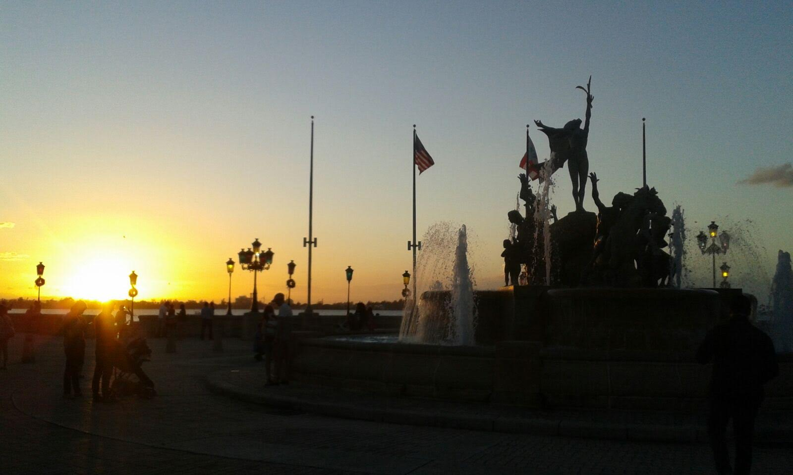
What I Learned
Mixed group allowed us to broaden our horizons
  Learning about different cultures
  Hearing different experiences that we might not have had ourselves
  How much we all have in common
Learned through Photovoice project
  Bottom → up research
  Facilitating focus group
  Designing a project
People connect over food
¡Que Bonita Bandera! "What a Beautiful Flag!"

Slide 10
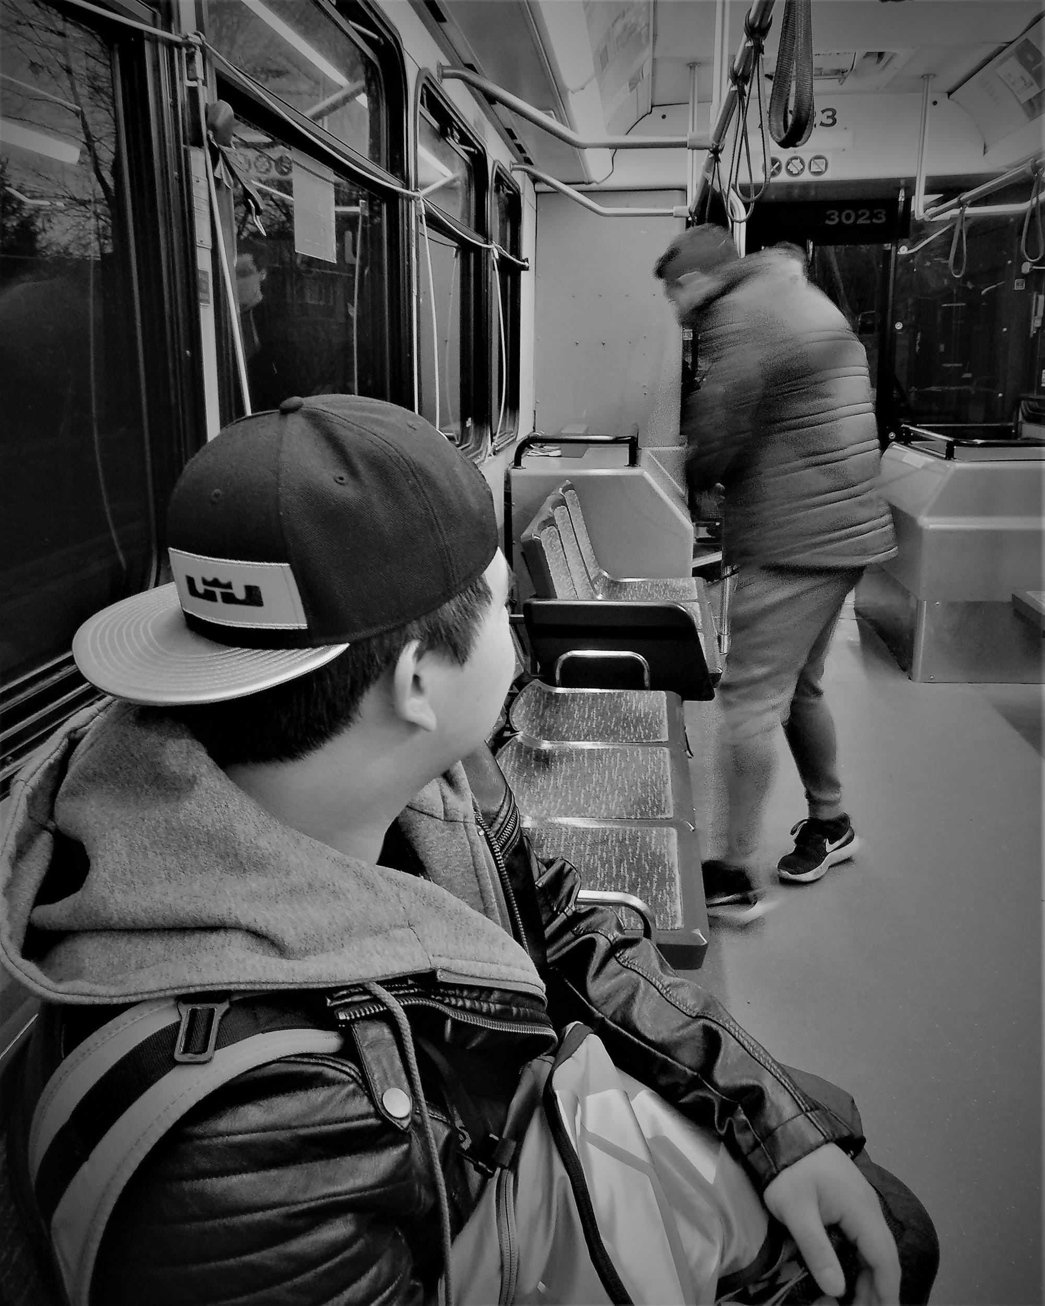
Library Partnership
Will display work in Shapiro Undergraduate Library
helped us connect and provided a space
valued our topic of diversity
studying
abroad
Notes:
Shapiro: Spring Term and Fall Term
Libraries: helped us connect with the public and provided a space where we could display photos showing our participants’ multicultural experiences
The very fact that these libraries valued our topic of diversity was instrumental in the implementation of our project

Slide 11
Further Work
We developed an action plan with our participants
Sharing cultures to a wider audience rather than in-groups
Address faculty and staff to implement a diversity curriculum
Mandatory sessions to be educated on different cultures and beliefs for all attending students
International Culture Festival
  Cultural groups on campus present their culture through music, food, rituals, performances for a couple of days on the diag
  Open to public to attend, educating people on various cultures
  Brings people together through commonalities and food

Slide 12
Acknowledgements
Our participants
University of Michigan Library
Andrea Belgrade
Undergraduate Research Opportunity Program (UROP)
Fiona Lee and Mari Kira
Rebecca Price

