Slide 1
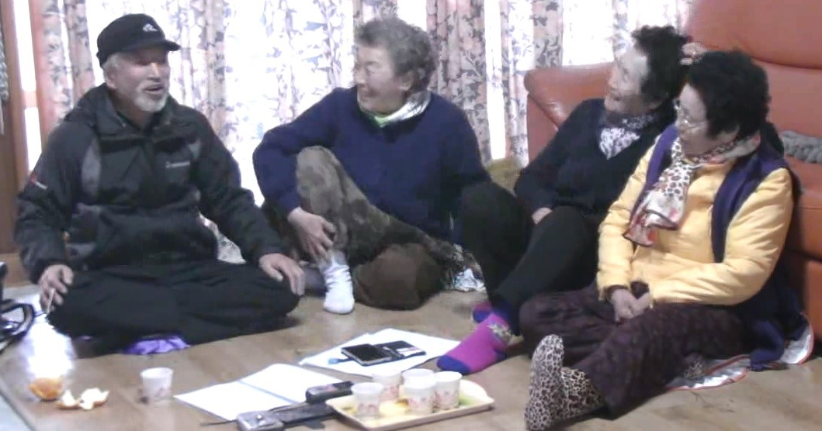
Oral history and language revitalization
Jejueo talking dictionary
Moira Saltzman, University of Michigan
moiras@umich.edu

Slide 2
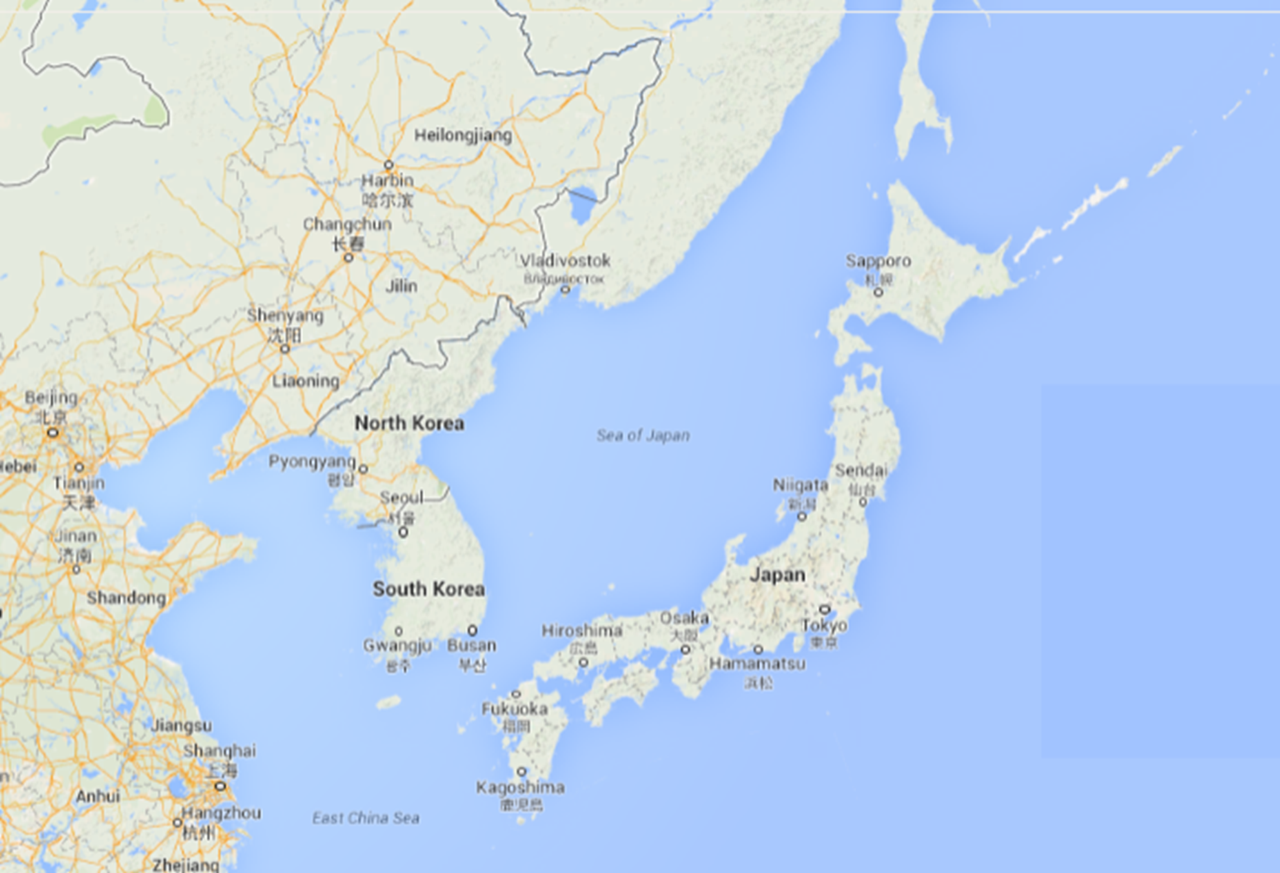

Slide 4
Background
5,000-10,000 native speakers of Jejueo
  Native speakers over age 75
  No monolingual speakers
Islands of Jeju Province, South Korea
  Population 600,000
  12 million tourists in 2014
Tsuruhashi neighborhood of Osaka, Japan
  Small diasporic enclave
  Not transmitted to 2nd generation

Slide 5
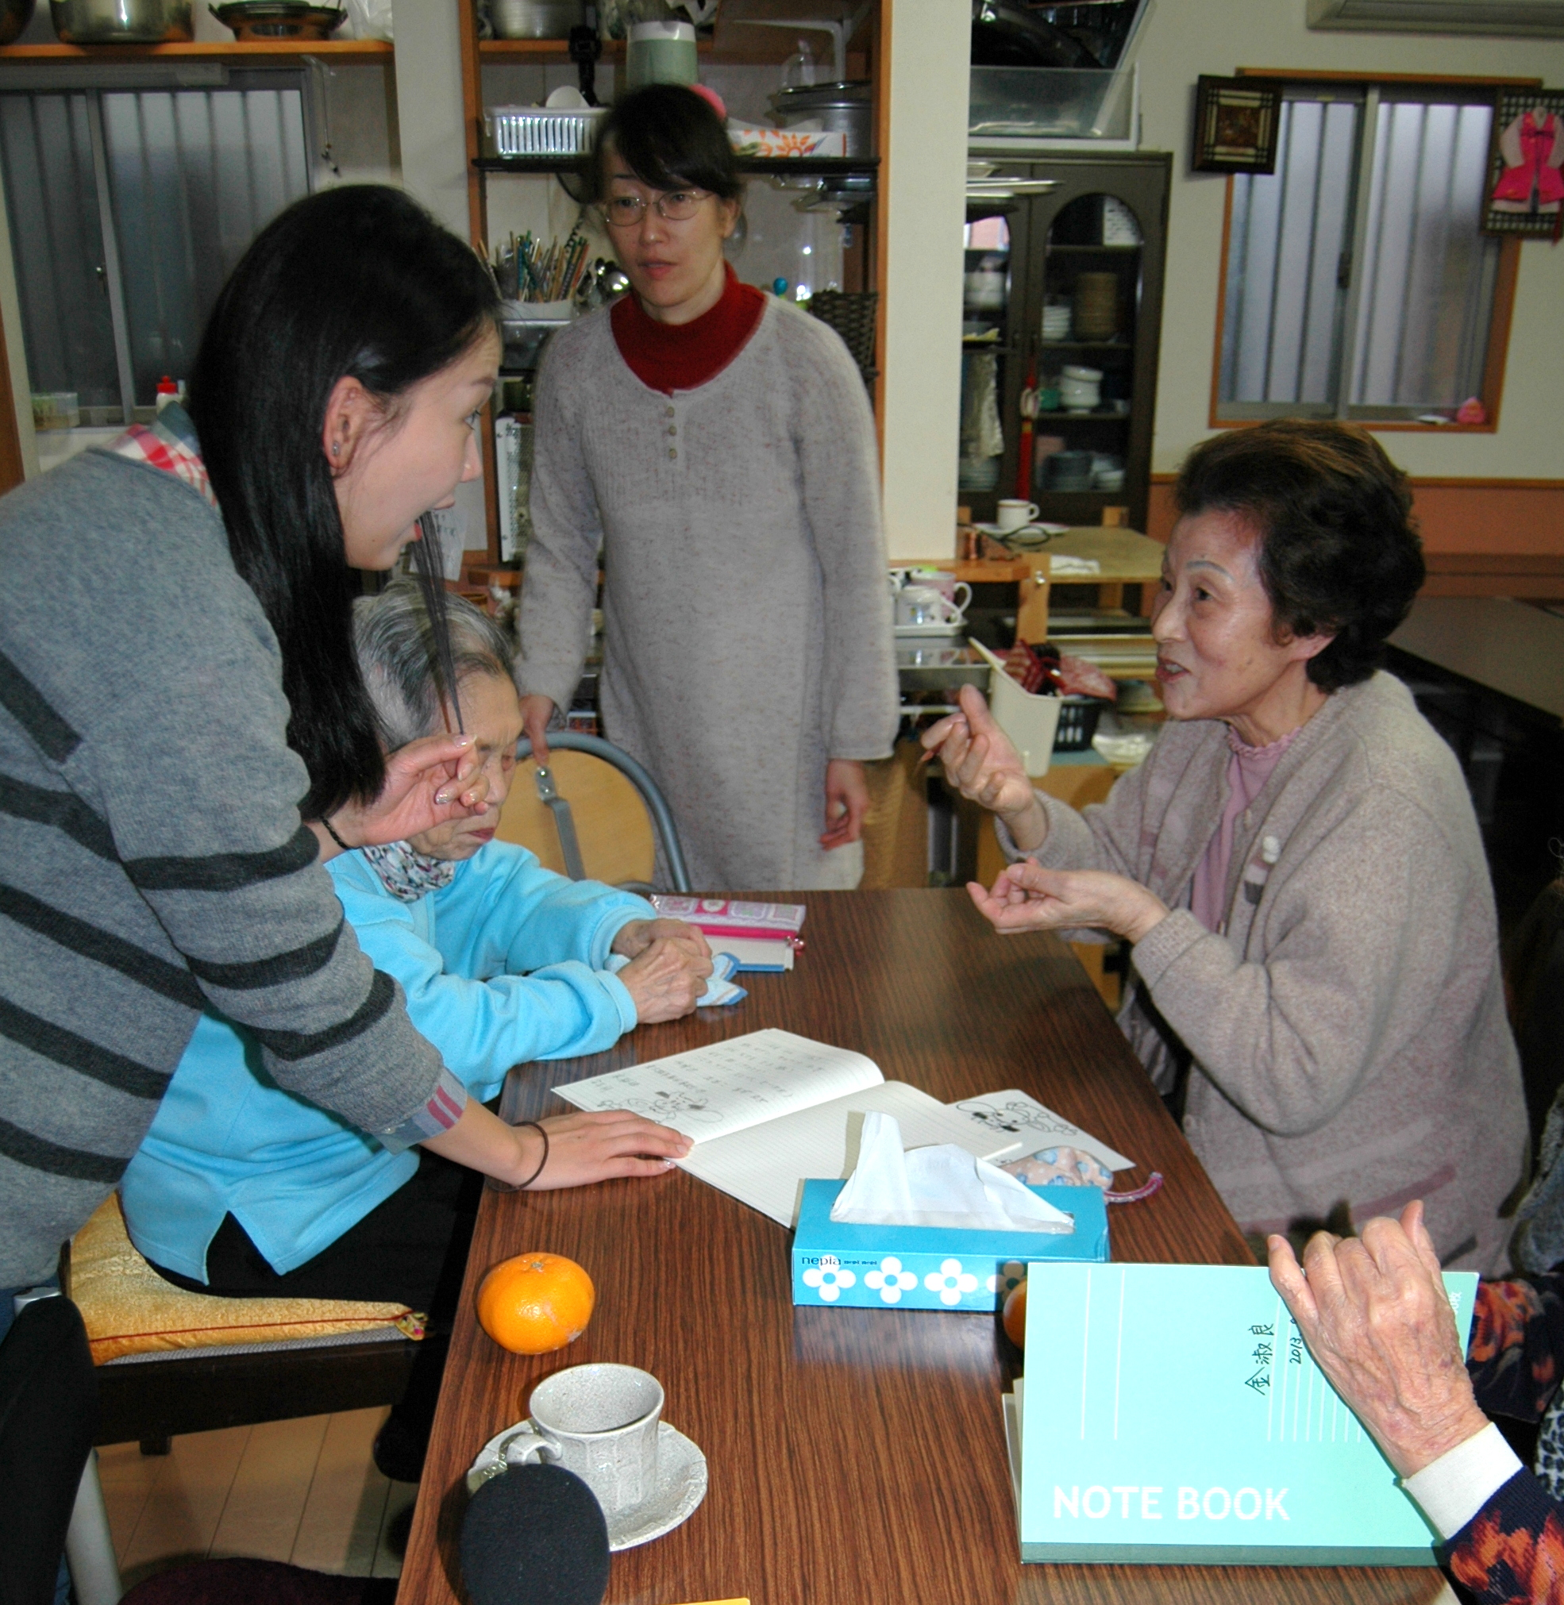
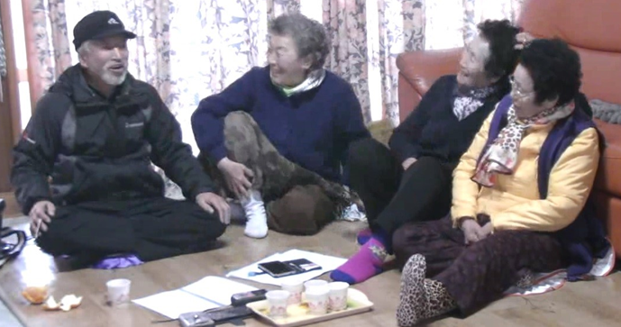
Jeju, Korea and Tsuruhashi, Osaka

Slide 6
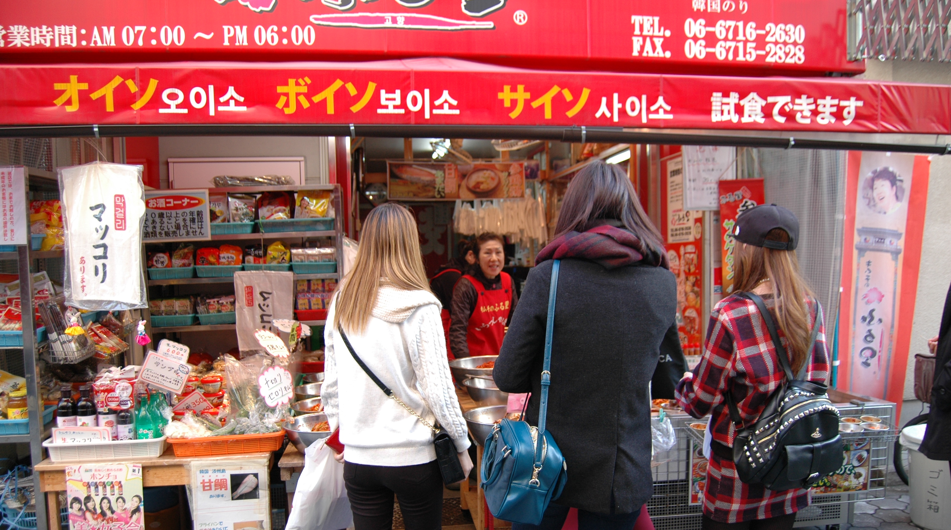
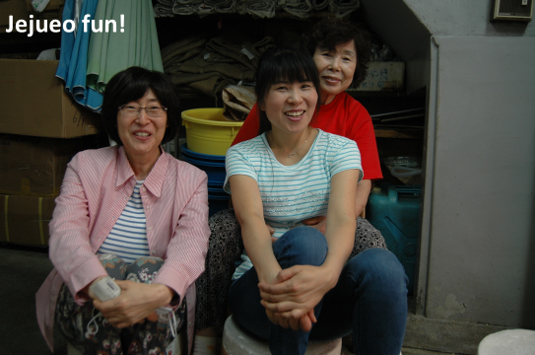
Korea Town, Tsuruhashi
No current numbers or sociolinguistic
studies on speakers in Osaka

Slide 7
What is a language? What is a dialect?
“A language is a dialect with an army and navy.”
                -Max Weinreich
Political:
Dominance, unification, diversification
  Hindi vs. Urdu
Linguistic:
Degree of mutual intelligibility
Can people from different areas understand one another?
  Polish vs. Russian

Slide 8
Language or dialect
Jejueo is considered an unintelligible dialect of Korean
  6 dialects of Korean, divided loosely along province lines
  Jeju is only mutually unintelligible dialect of Korean
    8-12% mutual intelligibility
    20-25% of lexicon shared
    Semantic differences
  Jejueo closely related to Korean
    Debate over language family hierarchy
  Naming Jejueo a separate language defies unification of the nation
    Language and culture are centralized in Seoul
    Standardization key after independence from Japan

Slide 9
Why does it matter?
Language more likely to be protected
Languages have prestige value
  Jeju disempowered by mainland governing bodies since 476
Why revitalization?
  Empowerment of community
  Scientific knowledge of linguistic diversity of human language
    Tip of the iceberg for Jejueo
    Korean historical linguistics
  Preservation of historic, anthropological, cultural, ecolinguistic knowledge going back millennia
    Jejueo kinship terminology
    Jeju rituals
Revitalizing the language is healing. It connects you with ancestors. It reconnects you with the community and creates a common identity everyone is proud of. It’s a very healing thing to be able to say something in your language.
                Colleen Fitzgerald

Slide 10
Jeju heritage: wind, rocks, women??
Matriarchal
  Women economic heads of family
  Myths revolve around grandmother goddesses
Agricultural and fishing economy
  Haenyeo female divers in prominent economic role
  Strong respect for environment
Strong shamanic tradition
  Robust regional mythology
  Oral history of Jeju
Cuisine
Architecture

Slide 11
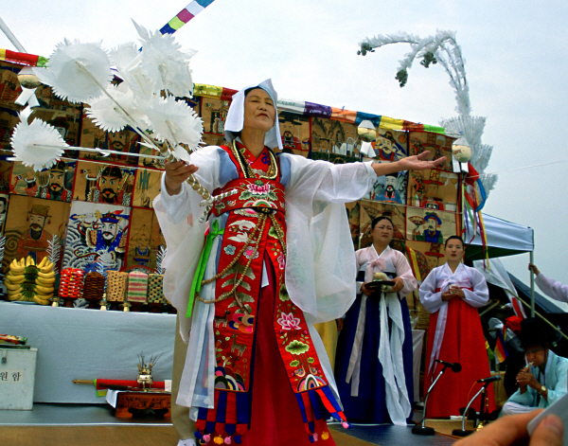
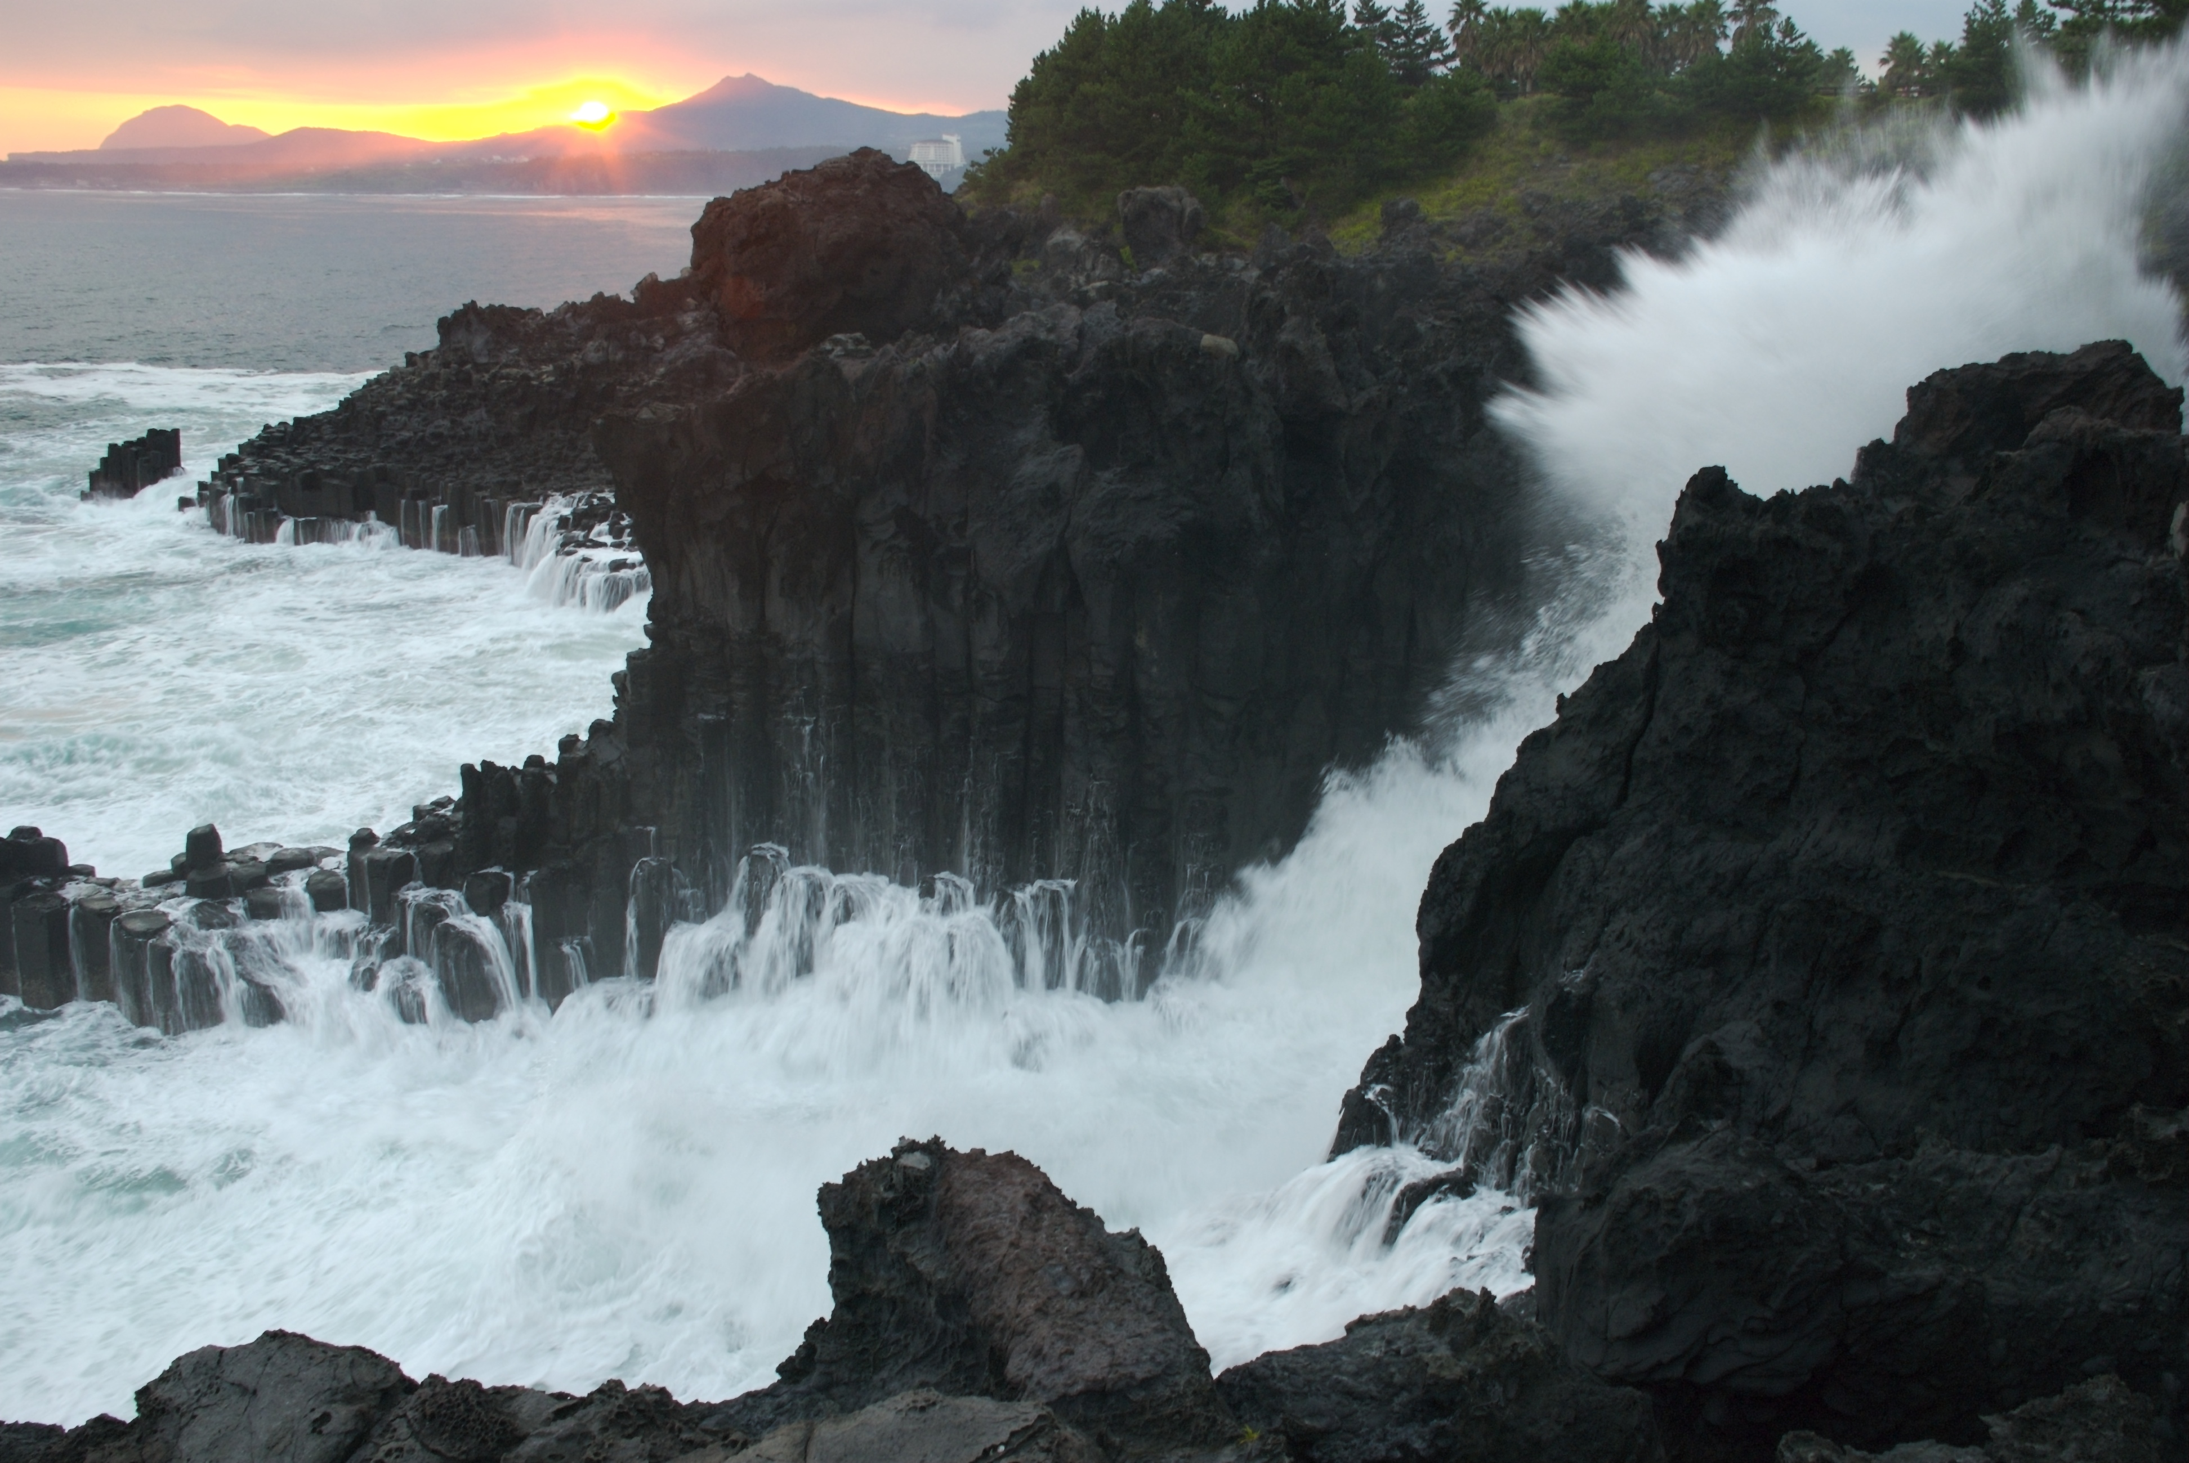
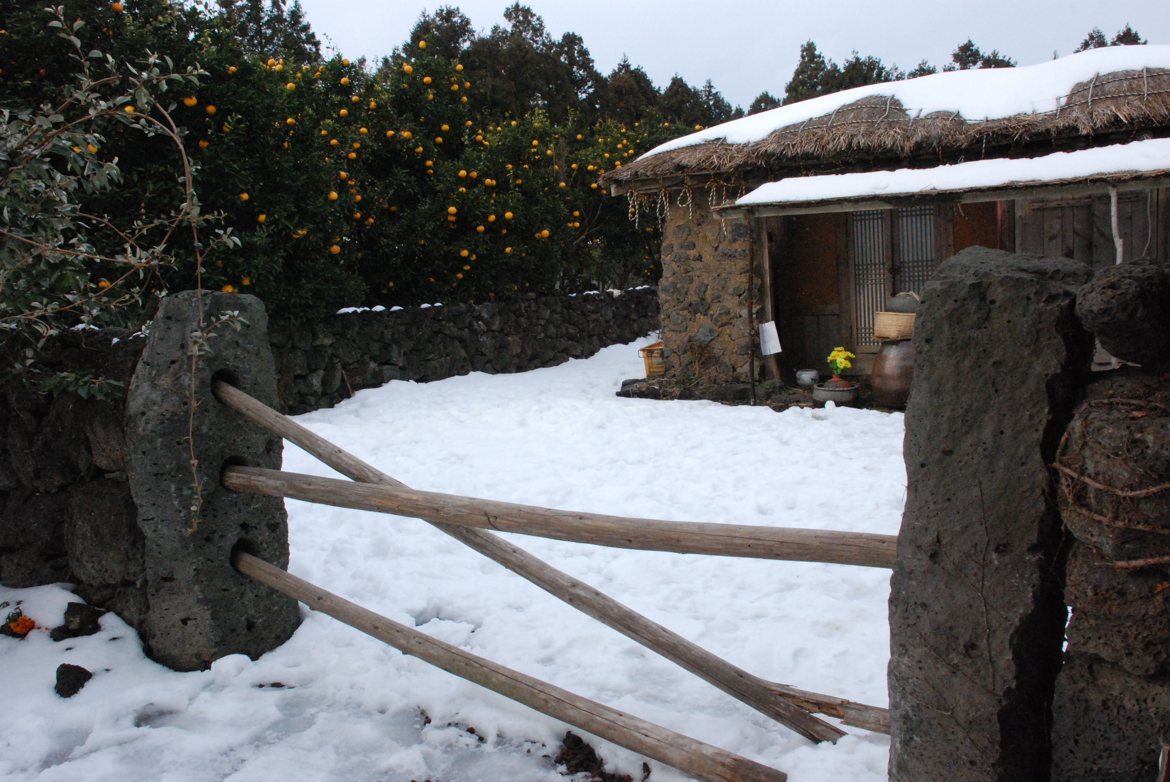
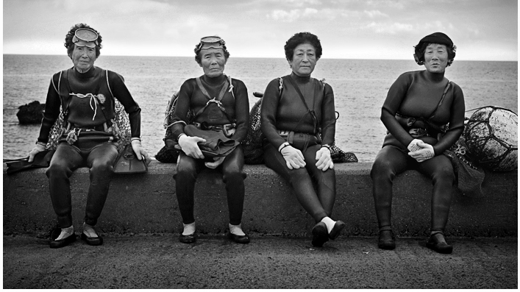

Slide 12
Jejueo sketch
SOV, agglutinative/fusional language like Modern Standard Korean
Preserves many features of Middle Korean
  Lexical (words)
  Phonological (sounds)
  Syntactic (sentence structure)
Large inventory of loan words from Japanese, Mongolian and Manchurian
  e.g mikkang ‘orange’, mol ‘horse’, dere ‘to there’ (particle)
4 discourse registers marked by verbal endings (MSK 6)
Smaller inventory of honorific lexical items
Unique inventory of ideophones

Slide 13

Jejueo sample
MSK halmʌni -oa sonjʌ -ka pas -esʌ milkam-ɯl ta -go is͈ -ta grandmother-COM grandchild-NOM field-LOC orange-ACC pick-PROG EXIST-DECL.PRS
Jejueo sontɕi halmaŋ -i mik͈aŋ tʰa.m -sʌra grandchild grandmother-NOM orange pick.PROG-DECL.PRS
‘The grandmother and grandchild are picking oranges [in the field].’

Slide 14
Status of Jejueo
Classified as a critically endangered language by UNESCO (2010)
Historical factors of language shift
  4.3 massacre
    Approximately 30% of Jejueo speakers killed
    Immigration to Osaka- approximately 25,000
  Korean war
    100,000 migrants from mainland
    Made up over 50% of population of Jeju
  ‘New Village Movement’ 1971
    Park (1961-1979) banned indigenous practices, e.g. shamanic rituals
  Education

Slide 15
Domains of Use
5,000-10,000 fluent speakers out of Jeju population of 600,000
Fluent speakers above 75 years
Modern Standard Korean (MSK) used in governmental, educational, media, communicating with outsiders
Jejueo used in the home, marketplace, native shamanic rituals, intimate settings between speech community members

Slide 16
Language attitudes
Qualitative study of Jejueo language attitudes, Kim 2013
Jejueo represents absence of boundaries between speakers
  Can cause offence to interlocutor who judges intimate register inappropriate
  Perceived as showing a relaxed mood
    “When we calm down, dialect comes out naturally.”
Linked to emotionality
  Preferred variety for expressing feelings or emotional involvement
    Emotional messages will be better understood if expressed in Jejueo than MSK
    Mimetic words and ideophones absent from MSK

Slide 17
Low prestige value
Jejueo predates urbanization/modernization of Jeju
  Unwritten language
  Used in indigenous religious practices
    Shamanism banned by government in 1971 and rejected by mainstream Korean society
  Language shift result of painful events of mid 20th century
    4.3 massacre, Korean War
    Up to 95% of villages on Jeju burned during these years
    4.3 massacre taboo until 1998 (4.3 uprising linked with communist sympathy)

Slide 18
Language attitudes cont.
MSK is ‘respectful’
    Although Jejueo has distinct honorific registers, words are shorter and seen as lacking in the morphological formality of MSK
Speech level | Modern Standard Korean | Jejueo
IV | ha-syeoss-seub-ni-kka? | hae-su-gwang?
III | ha-syeoss-eo-yo? | hae-su-gae?
II | haess-eo-yo? | haen-ma-ssim?
I | haess-eo? | haen?

Slide 19
Current revitalization efforts
‘Symbolic’ support of Jejueo revitalization
  Jejueo speech contests (1 day/ year), cultural events
Top-down
  Jejueo scholars develop Jejueo programs
  generate some support from local government, which installs programs in public institutions, media
  No basis in studies on sociolinguistic factors
Discrete projects
  No existing research or community-oriented projects work in tandem
Inconsistent programming
  Educational, community and media-based programs occur at most 2 hours a week; for children 1 day a month
  Immersion programs necessary to achieve fluency (O’Grady)

Slide 20
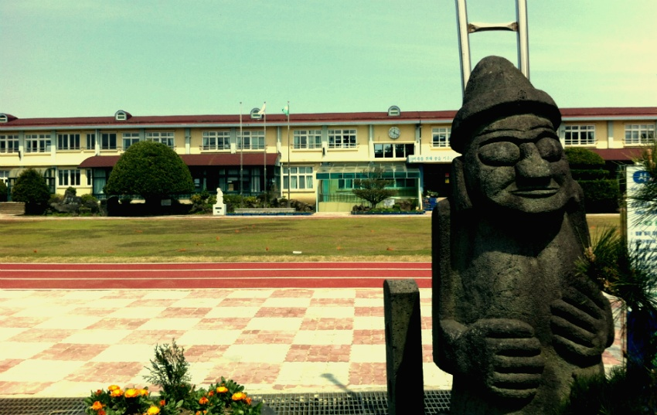
UNESCO 2015
March 10, 2015 JOE ordered elementary school teachers to teach Jeju language curriculum
  UNESCO 2010 classification of Jejueo as ‘critically endangered’ not met with action

Slide 21
Jejueo revitalization reform
Prior ideological clarification
  What activists are trying to preserve
  Why this is desirable
Image planning/ prestige planning
  Influence attitudes
    Jeju identity linked to language
    Bring Jejueo into world context- what other speech communities have done
    Media presence
Macro-meso-micro framework
  Bottom-up interest combined with top down support
  Join branches of interested parties:
    Jejueo Preservation Society, JNU, outside linguists, Global Inner Peace activists, teachers, community members
Immersion classes
Tools for language learning and linguistic documentation

Slide 22
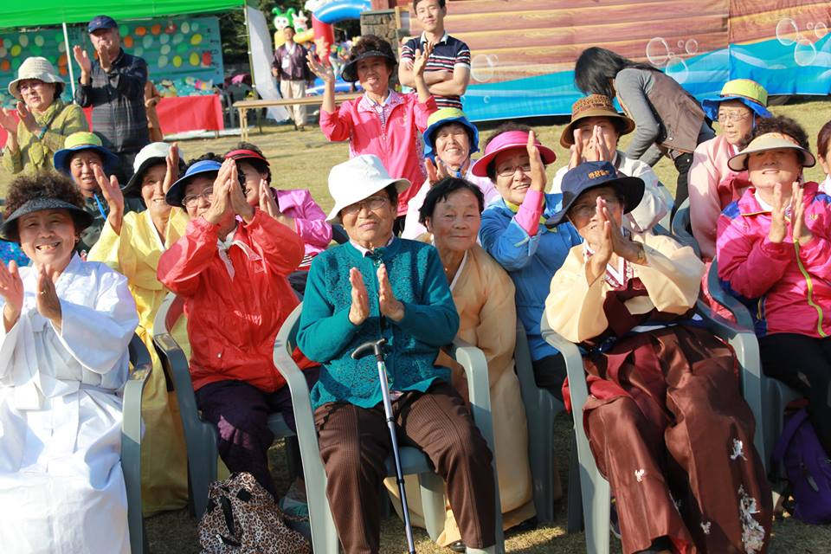
Tall order:
Make a device that benefits science,
The community,
And serves as a long-lasting record of a language

Slide 23
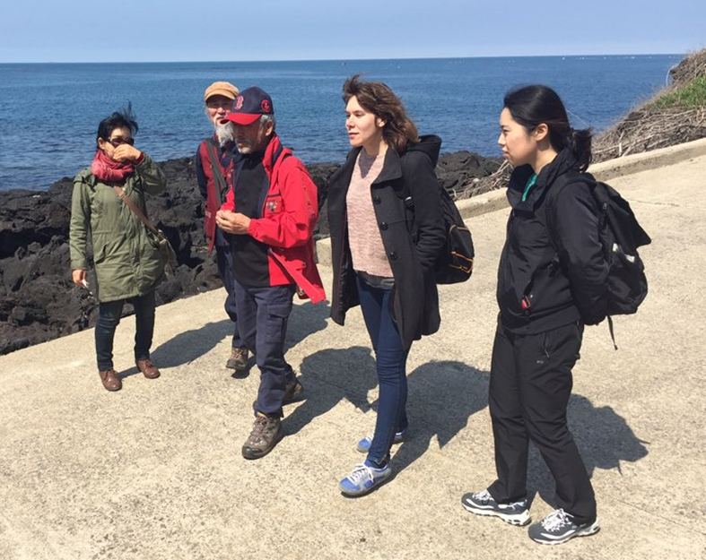
Talking dictionary of Jejueo
Free online multimedia database
Multimodal
  language-learning modules, games, audio dictionary, browsable photos, printable transcripts of videos, 200 hours of videos of natural speech with multi-tiered interlinear glossing
Linguistic training of community language activists to continue documentation of Jejueo, community elders are consultants

Slide 24
Contents of dictionary
Jejueo, Korean, Japanese, English
  Audio files of lexemes with definitions
  Photographs of native items
  Video files of natural language use in cultural context
  Searchable lexemes, morphemes, topics for language acquisition
  Cultural information: shamanistic rituals, preparation of cuisine, etc.
  Previously unpublished annotated videos from Jeju scholars (Rositano, Kim, Yang, Kang)
  Accessible on Jeju municipal website (jejueo.com)
  Android application
September 2016

Slide 25
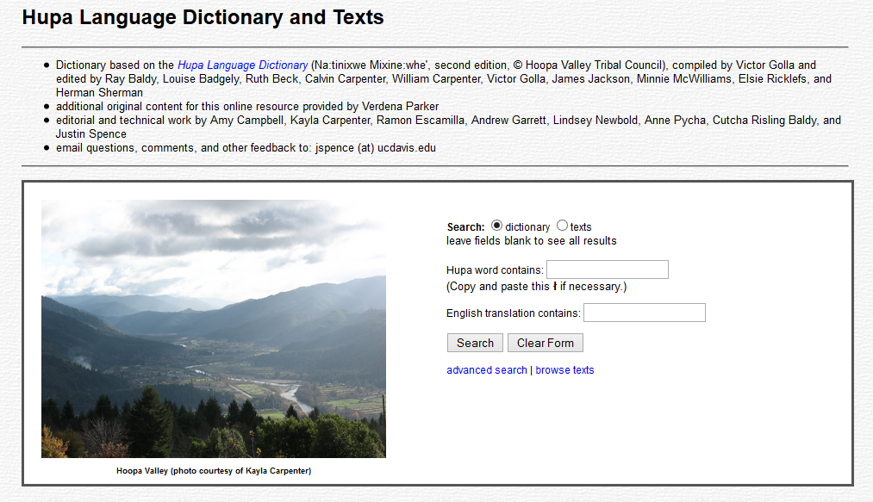
Sample

Slide 26
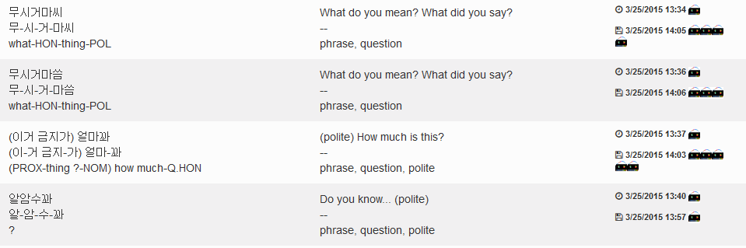
Jejueo lexemes: sample
Lingsync, a collaborative online tool for linguistic documentation and annotation

Slide 27
Jejueo lexemes: sample
Lingsync, a collaborative online tool for linguistic documentation and annotation
word
definition
morphemes
gloss
tags

Slide 28
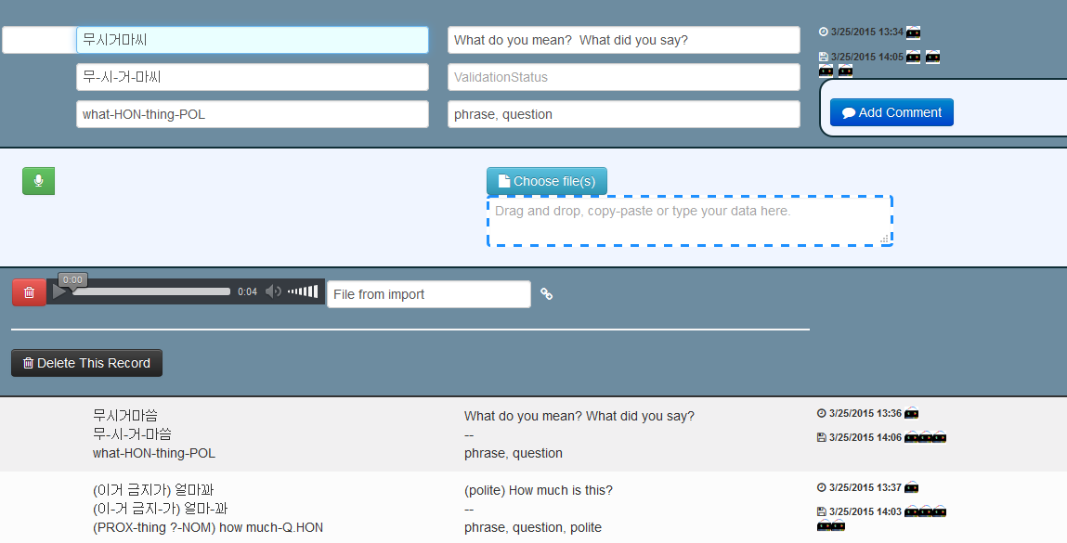

Slide 29
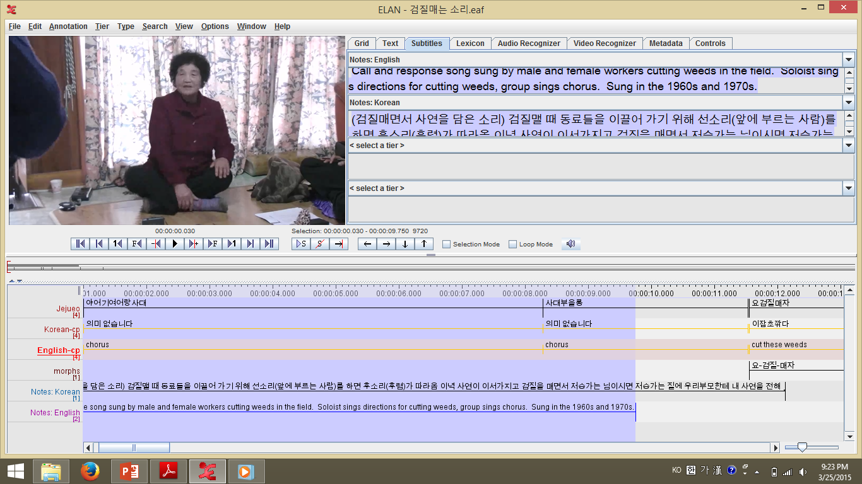

Slide 30
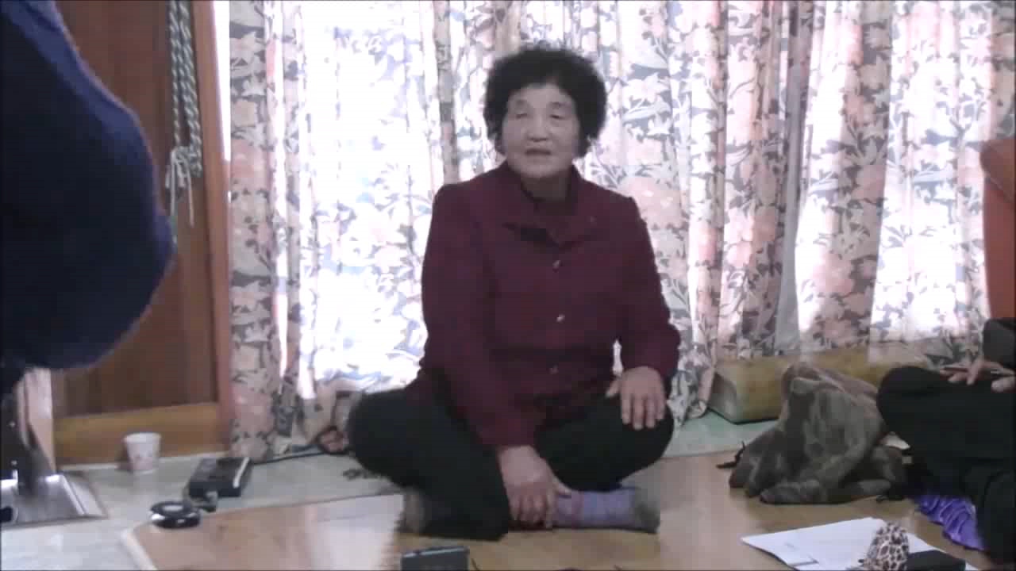
Video: 검질매는 소리
Weed-Cutting Song 잡초깎는 소리

Slide 31
Conclusions
Jejueo must be transmitted to younger generations before the last generation of fluent speakers disappears.
Immersion classes
Status planning based on sociolinguistic research
Corpus planning
  standardization of orthography
  School curriculum
Documentation and revitalization tools
  Jejueo Talking Dictionary

Slide 32
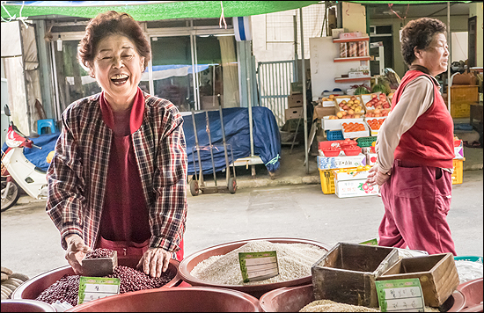
고맙수다! Thank you!
Jejueo market phrases pamphlet available at umich.academia.edu/moirasaltzman

Slide 33
References
Kang, Jeong-Heui. 2005. Studies in morphological changes of the Jeju dialect. Seoul: Youkrak.
Kim, Soon-Ja. 2011. A Geolinguistic Study on the Jeju Dialect. Jeju: Jeju National University Ph.D. dissertation.
Kim, Soung-U. 2013. Language attitudes on Jeju Island - an analysis of attitudes towards language choice from an ethnographic perspective. London: SOAS MA dissertation.
Lee, Ki-Moon & Samuel R. Ramsey. 2011. A History of the Korean Language. Cambridge: Cambridge University Press.
O’Grady, William. In preparation. Documenting Language-hood.
Saltzman, Moira. 2014. Language contact and morphological change in Jejueo. Detroit: Wayne State University MA dissertation.
Song, Jae-Jung. 2012. South Korea: Language policy and planning in the making. London: Routledge.
Yang, Chang-Yong. In preparation. Language attitudes on Jeju Island.

Slide 34

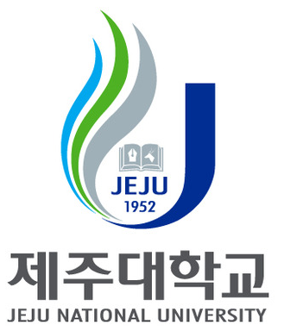




Thank you!

