Slide 1

Library Mini-Grant
Parisa Soraya, Master’s in Health Informatics (MHI) ‘17

Slide 2

HALF OF ALL AMERICANS
LIVE WITH A CHRONIC ILLNESS
1

Slide 3
WHAT IS CHRONIC ILLNESS?
Lasting 3 months or more, typically life-long
Generally can not be prevented by vaccines or cured by medication

Slide 4
WHAT IS CHRONIC ILLNESS?
Obstructive Lung Disease
Colitis
Celiac Disease
Eating Disorders
Heart Failure
Chronic Pain
Dysautonomia
Asthma
Irritable Bowel Disease
Arthritis
Stress
Depression
Leukemia
Type 1 and Type 2 Diabetes

Slide 5
CHRONIC ILLNESS IS OFTEN AN INVISIBLE ILLNESS

Slide 6






2
DEPRESSION ASSOCIATED WITH CHRONIC ILLNESS:
Amplifies Symptoms
Obesity, Smoking, Sedentary Lifestyle
Decreases
Medication Adherence
2. J. Katon W. Epidemiology and treatment of depression in patients with chronic medical illness. Dialogues in Clinical Neuroscience. 2011;13(1):7-23.

Slide 7


4
HEALTH OUTCOMES
INCREASED
PEER SUPPORT
Notes:
They reviewed seventeen studies with 4,715 participants (3 cluster RCTs, 14 RCTs. Showed an improvement in pooled HbA_{1c} level with an SMD of 0.121 (95% CI, 0.026–0.217; P = .01; I² = 60.66%) in the peer support intervention group compared with the control group; this difference translated to an improvement in HbA_{1c} level of 0.24% (95% CI, 0.05%–0.43%).
Peer support interventions showed an HbA_{1c} improvement of 0.48% (95% CI, 0.25%–0.70%; P <.001; I² = 17.12%) in the subset of studies with predominantly Hispanic participants and 0.53% (95% CI, 0.32%–0.73%; P <.001; I² = 9.24%) in the subset of studies with predominantly minority participants; both were clinically relevant. In sensitivity analysis excluding cluster RCTs, the overall effect size changed little.
CONCLUSIONS Peer support interventions for diabetes overall achieved a statistically significant but minor improvement in HbA_{1c} levels. These interventions may, however, be particularly effective in improving glycemic control for people from minority groups, especially those of Hispanic ethnicity.

Slide 8
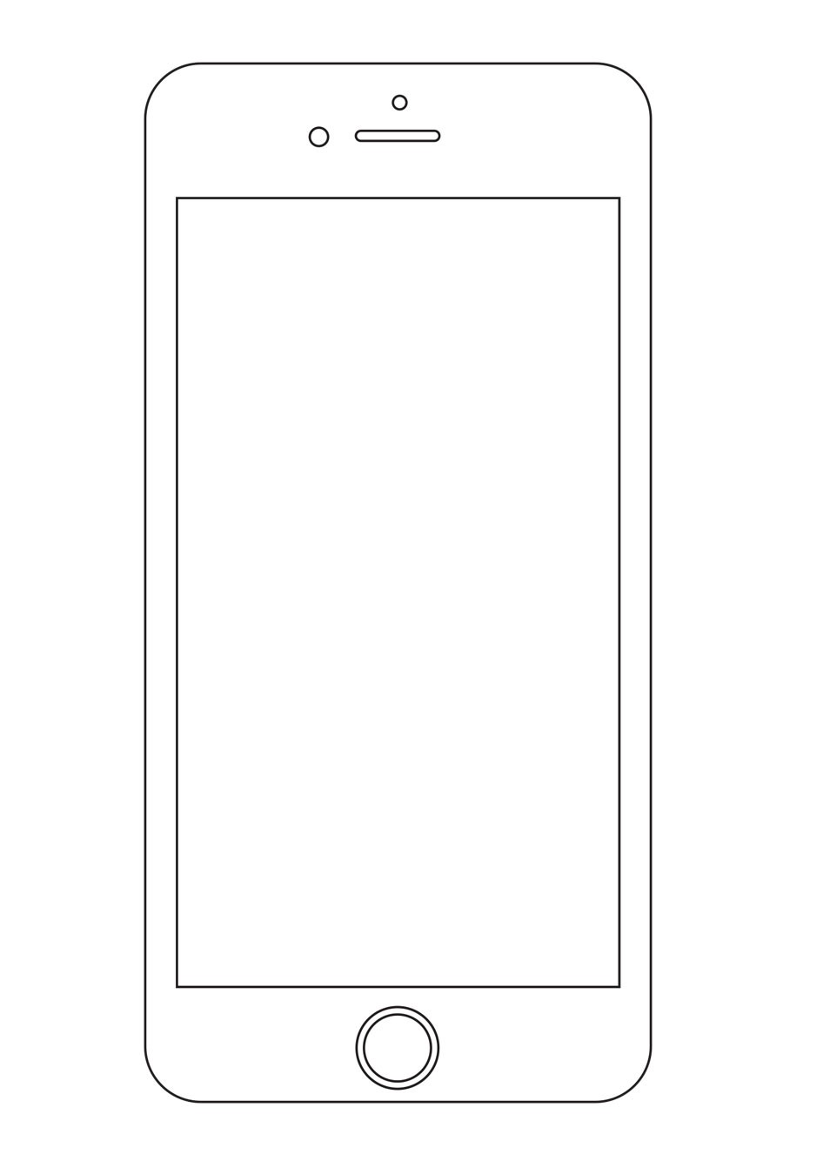
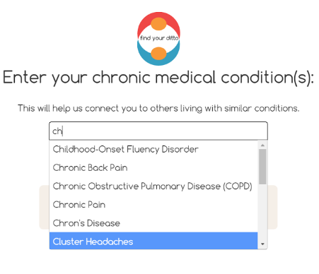
THE FIND YOUR DITTO SOLUTION
> Match people who share chronic conditions for in-person, peer support
> Adjunct resource to mobilize peer-peer support wherever and whenever needed

Slide 9
MARKET VALIDATION & TRACTION
Low-tech pilot, University of Michigan (February – March 2016)
> 100 + Students
> 40+ Chronic Illnesses
> 90% Match Rate

Slide 10
MARKET VALIDATION & TRACTION
Low-tech pilot, University of Michigan (February – March 2016)
> 8/10 Average Experience
> 98% Would Use FYD Again
> 84% Will Continue Meeting

Slide 11
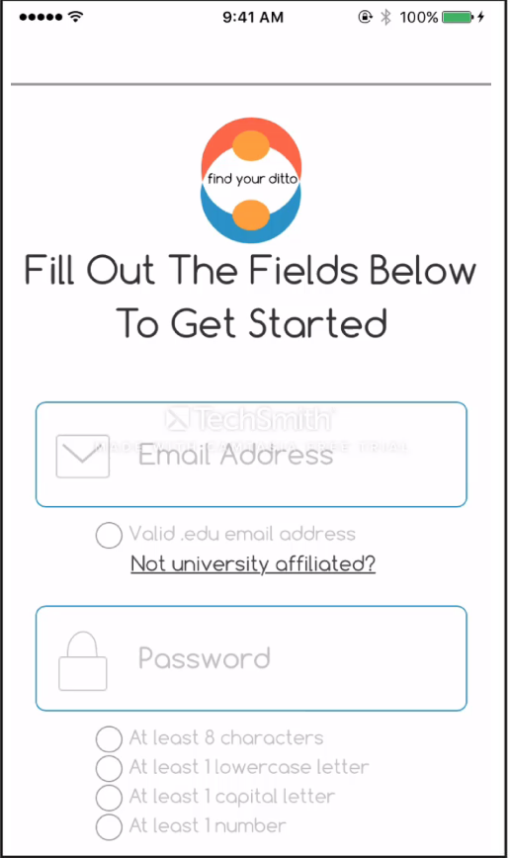
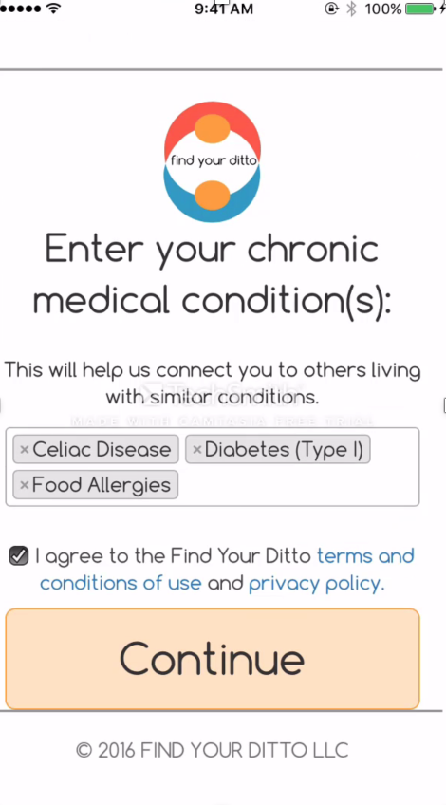
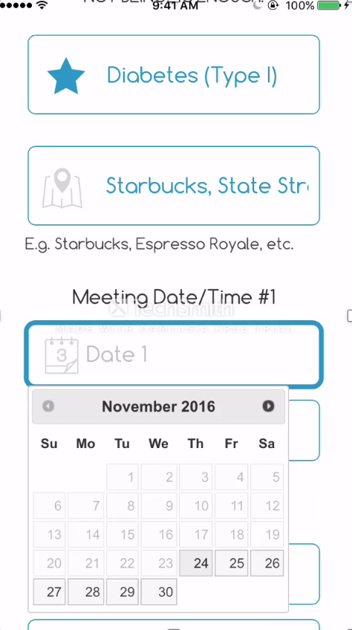
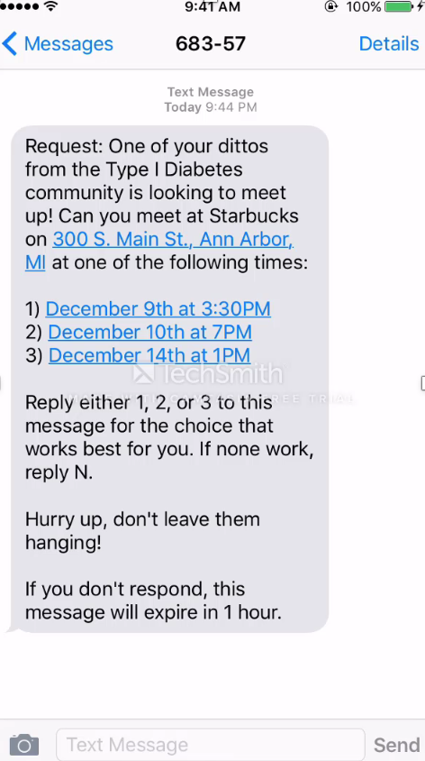
On-demand, geolocalized meetup
Web and Mobile Based
Notes:
Take out

Slide 12
SOCIAL IMPACT
Psychological Mediation Framework
Informed by:
Social Capital Theory
RESOURCE KNOWLEDGE
CONTINUED CONNECTION
MEASURED EFFECT
AWARENESS
SOCIAL CONNECTION

Slide 13
SOCIAL IMPACT
SHORT | MEDIUM | LONG
On-demand Support
Peer Support System Foundation
Established Support Community
Knowledge of Community Health Resources
Increased usage of Community Health Resources
Improved health outcomes
Emergent issues redirected to local professional expertise
Improved psychosocial functioning

Slide 14
LIBRARY PARTNERSHIP
Patricia Anderson, Emerging Technologies Informationist, Taubman Health Sciences Library
> Developed credible resource list for patients
> How to reach patients who can’t meet in-person
> Introduction to UM Council for Disability Concerns
> Deep understanding of chronic illness support landscape

Slide 15
FUTURE PRODUCT MILESTONES
Emergency Panic button
Temporally assessed platform impact on emotional health
Profile Buildout Functionality
User ability to collect ‘dittos’
Expanded chat functionality
Calendar for illness-specific events
Community Forums featuring geo-specific content
Video/Phone connection for those unable to meet in person
(i.e. individuals with disabilities)

Slide 16
FUTURE STEPS
PARTNERSHIP
Physician Partnership for Peer-Review Studies
Emergency Department:
gun shot victim youth in Detroit
Endocrinology Department:
Diabetes patients
UNIVERSITIES
Setting up launches at Big 10 Universities

Slide 17
“it’s not just me”
Notes:
KEEP

Slide 18
Creating a world where no person living with chronic illness ever has to feel alone.
www.findyourditto.com
info@findyourditto.com

Slide 19









ACKNOWLEDGEMENTS

