Slide 1
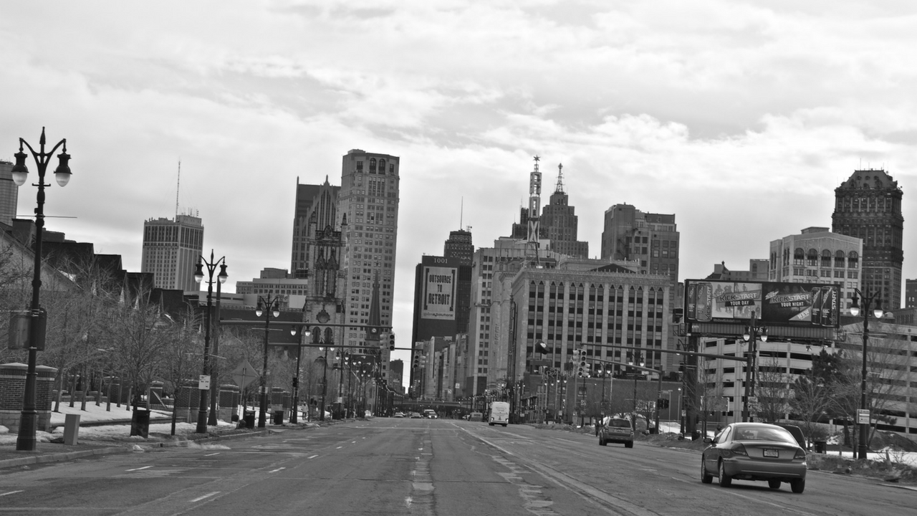
Is transportation a determinant of health?
Stories from residents of Detroit
Tarlie Townsend, Kenny Fennell, and Benjamin Morse

Slide 2
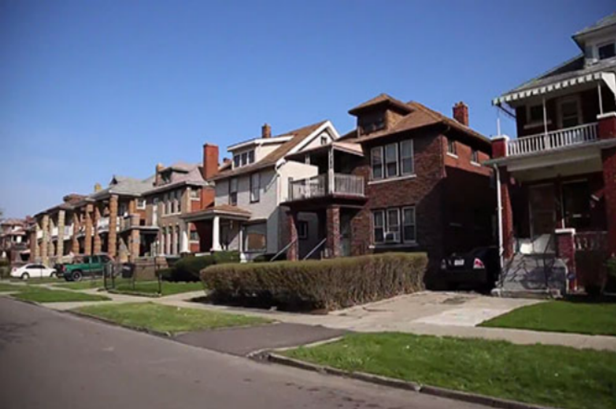
“The reason that I would leave two hours early is because the last bus was supposed to be at 8:30, but that 8:30 bus never showed up. Never. So if I missed that 8:30 bus, I’d be done! …
“You know, but then you have to consider your policies at work. I’m at work two and a half hours early. Company policy is you can’t sleep at work. …
“And so that meant I got far less sleep, and so yes it does affect your health. You know, just the unsettling nervousness and things like that—nothing major, but emotionally it’s draining. And so I’ve got a life, too. I gotta take care of my grandkids, and I have things that I have to do.”
- Paula, 51

Slide 3
Social Determinants of Health:
Access to health care is just one piece of the health disparities puzzle
Neighborhood and Built Environment
Employment
Safe, reliable, affordable, and efficient transportation
Health Care
Health outcomes
Education
Social and Community Context

Slide 4
Public Health?
Urban Planning
Economics
Neighborhood and Built Environment
Employment
Safe, reliable, affordable, and efficient transportation
Health Care
Health outcomes
Education
Social and Community Context

Slide 5
The Mini-Grant
25+ in-depth interviews with residents of Detroit
How do you get where you need to go, and how does this influence your daily life?

Slide 6
Preliminary Findings
Neighborhood and Built Environment
Employment
Safe, reliable, affordable, and efficient transportation
Health Care
Health outcomes
Education
Social and Community Context

Slide 7
“And it happens that people get fired, you know, because, you know, when they didn’t make it to work, you know, on time and stuff.” – Arthur, Security Guard
”I go to school…And I ride four buses. And I leave here at 7:30 in the morning. And...my classes don’t start until 9:30. And it takes me every bit of that time to get there...I want my GED.”
- Francine, Senior Center Resident
“As far as recreational or social, I feel very isolated…I don’t have a car right now, so...I don’t know how to catch the buses around here.”
- Brenda, Senior Center Resident

Slide 8
“Transportation. That’s the root right there.”
- Arthur, 64

