Slide 1
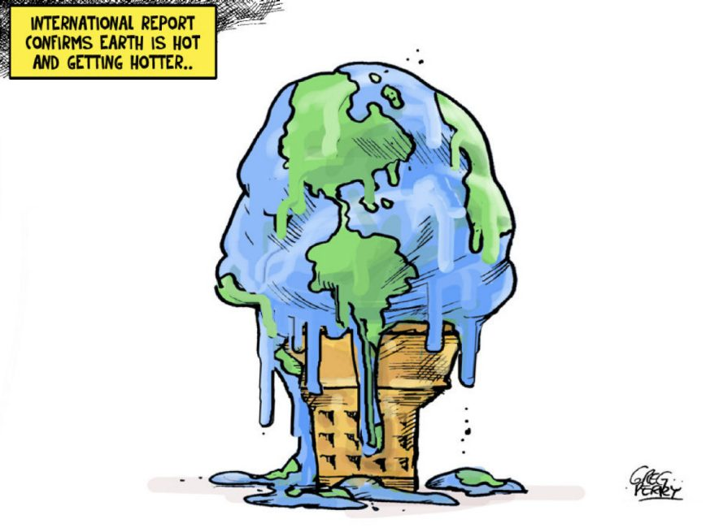

Abaca Games
Logo By Danny Vincenz
Social Impact Video Game Venture

Slide 2

Notes:
Believe it or not there is more about climate

Slide 3
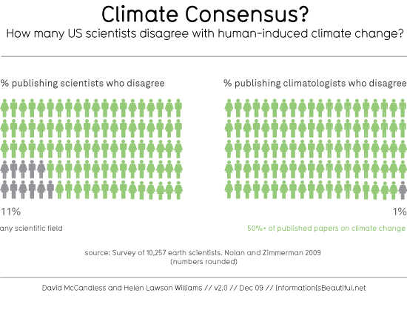

Slide 4
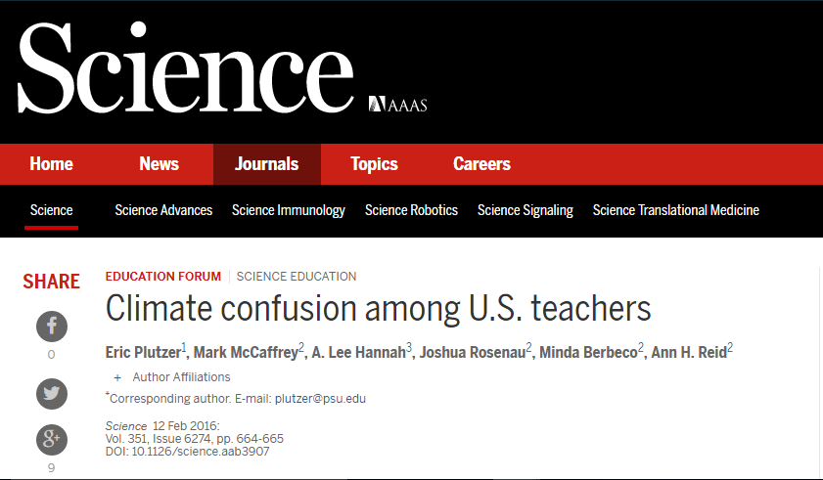

Slide 5
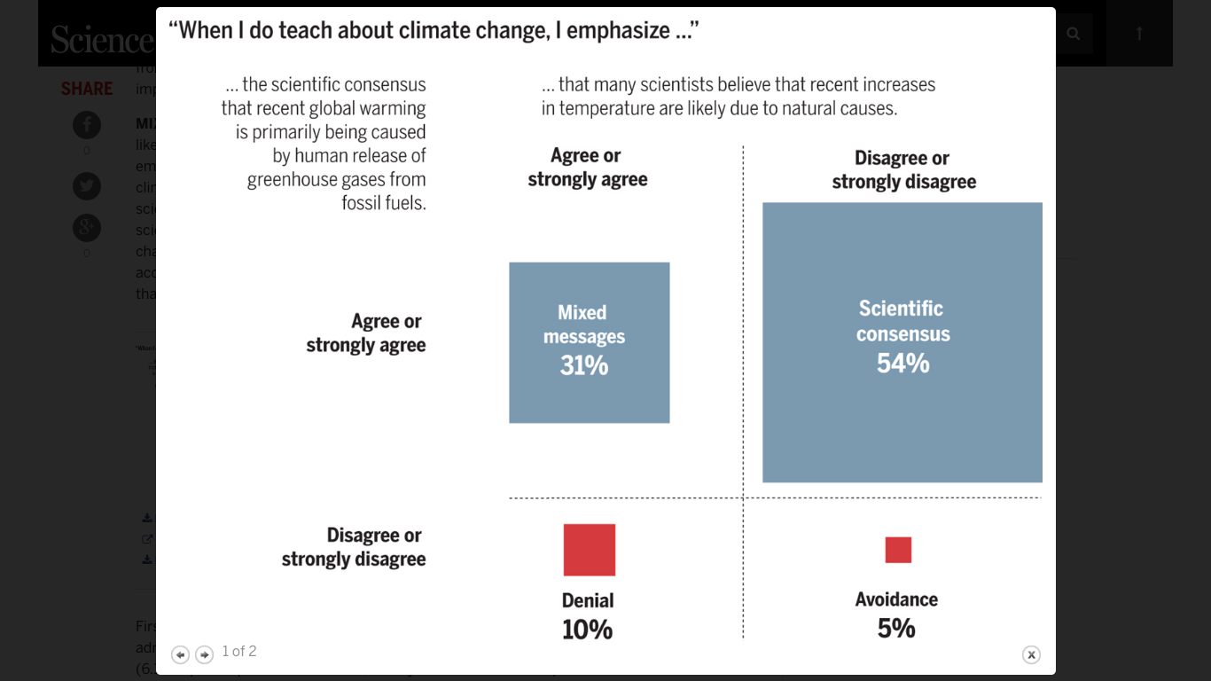
Notes:
Teachers don’t have the right curriculum to teacher climate change concepts

Slide 6
“Climate change is difficult to communicate by its very nature.”
However,
“Education and Communication are among the most powerful tools the nation has to bring hidden hazards to public attention, understanding, and action”
- United States National Research Council
Notes:
As of November 2015 Michigan adopted new science standards which include the following content on climate change which students will be tested by the state-wide standardized test.
Analyze geoscience data and the results from global climate models to make an evidence-based forecast of the current rate of global or regional climate change and associated future impacts to Earth systems.

Slide 7

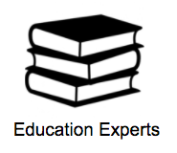
Conducted 30+ interviews

Slide 8
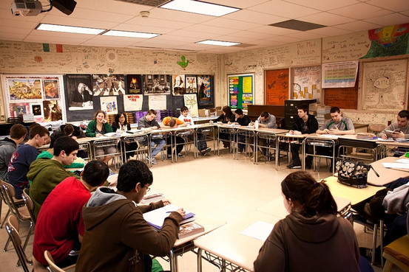
Key takeaways
High school students are the most important group for addressing climate change
Notes:
They
Middle school sttudents ahave not reached the stage where they think critically about climate change. 10 years ago they tdropped the eS class There is no class in highschool focused on earth science.
a. A game could really help teachers and environment if it is able to teach the students about climate change.
b. Only privileged students have the luxury to care about climate change. Disadvantaged groups generally have bigger problems to worry about.
c. Key audience is a high school student who care but not know what to do. His mind is still malleable.
d. High school students believe that climate change is a debate.
e. Teachers are willing to assign climate change videogame as an extra credit or homework.

Slide 9
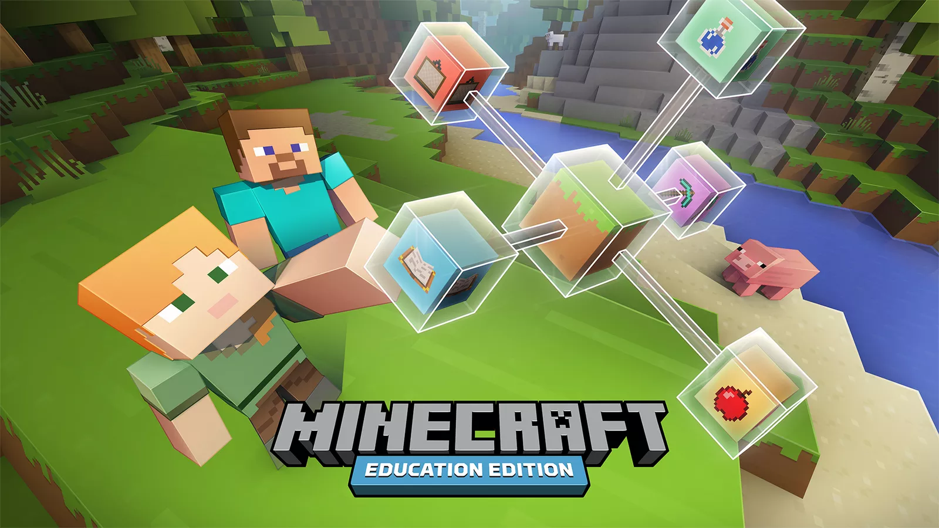
Key takeaways
New Required Curriculum
Teachers will assign a climate change video game as extra credit or homework
“ ESS3.D Global Climate Change: ...human impacts are greater than they have ever been… ”
Notes:
Next generation science standards flip the way science is taught on its head. Instead of focusing on memorizing scientific facts it teachers students how to solve problems using the scientific method

Slide 10
How might we engage high school students to do something feasible about climate change.
Problem Statement

Slide 11
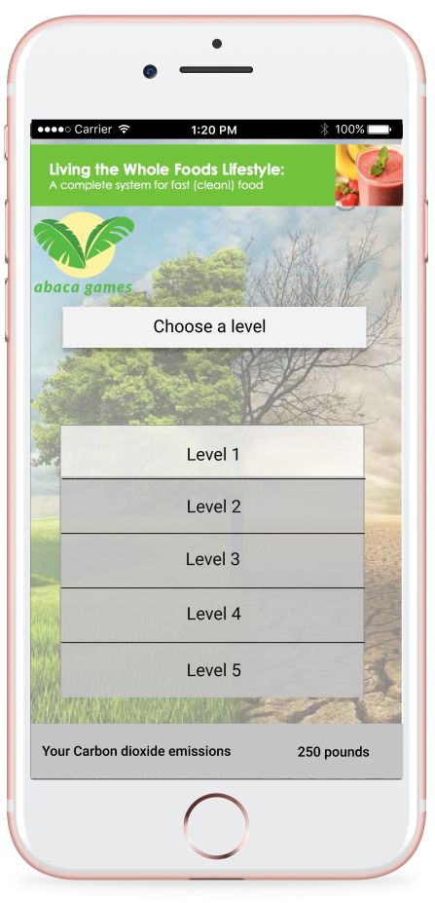

Free role-playing mobile game that engages high school students to take actions to fight climate change in a virtual environment
Notes:
Role Playing Game that makes high schoolers take action to curb climate change in the virtual environment.

Slide 12
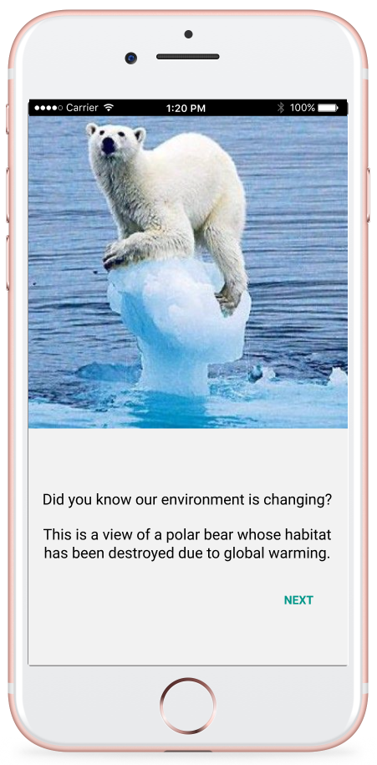
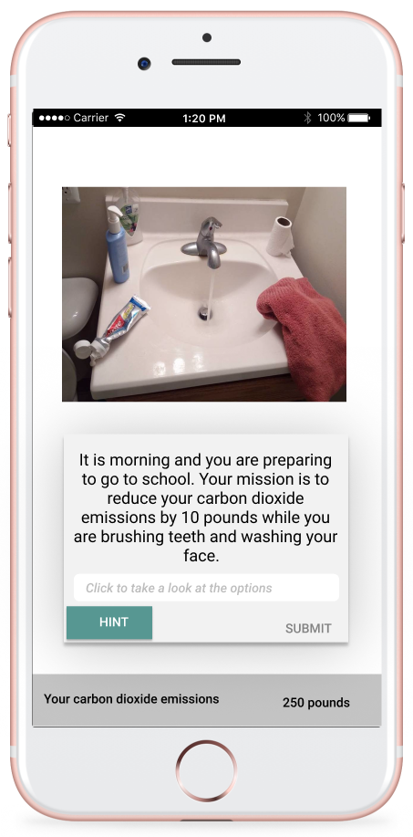
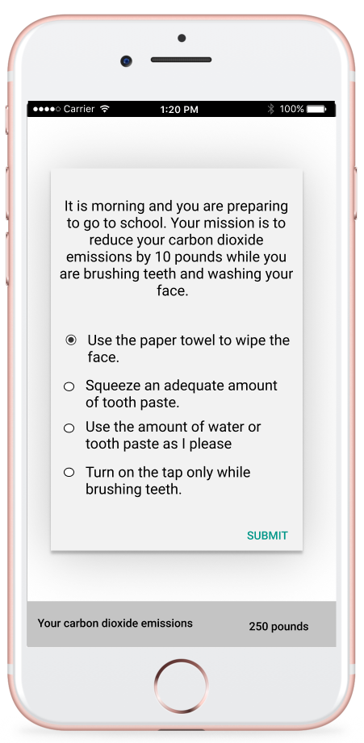
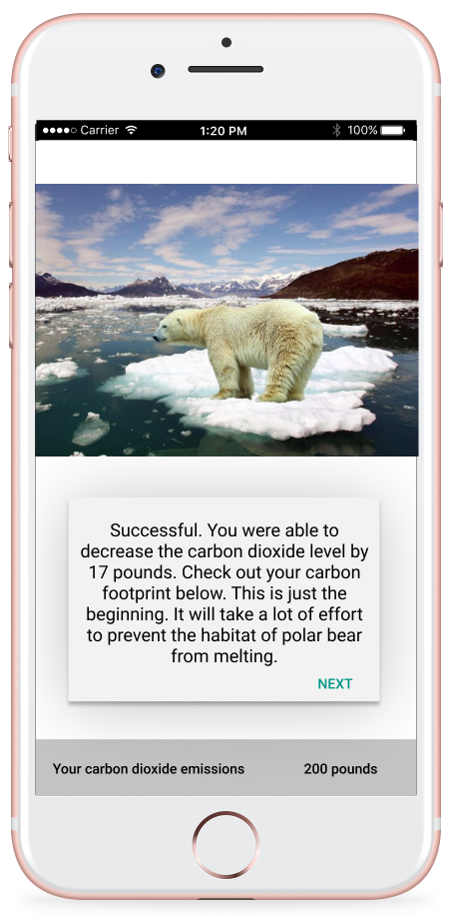
Notes:
Evaluation: different options can lead to the different points they have.

Slide 13









GAME PROGRESS
Original art by Danny Vincenz

Slide 14



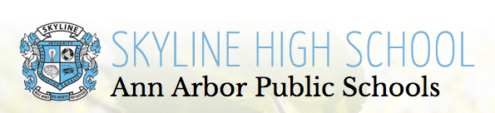

Business model
Partnership
Advertisement & In-game Purchases
Part of money will be donated to combat climate change
UM online climate action course
Third Millennium
Alliance
High school teachers
Notes:
Our game will gain revenue through advertising. All the money will go to curbing the problem of cc.
A green alternative to your internet games like fruit ninja and candy crush
“Act on Climate: Steps to Individual, Community and Political Actions”
UM massive open online climate action course Coursera courses is taken by high school students. This course is being developed in School of Natural Resources and Environment

Slide 15
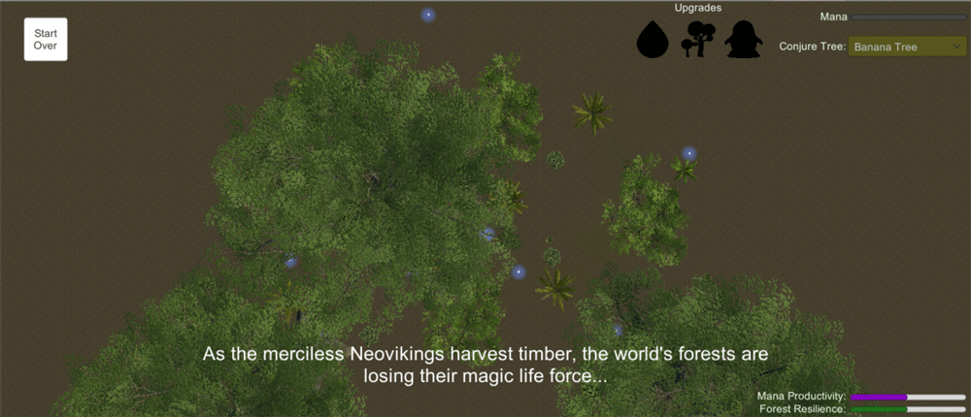
Last Forest of the Jama-Coaque

Slide 16
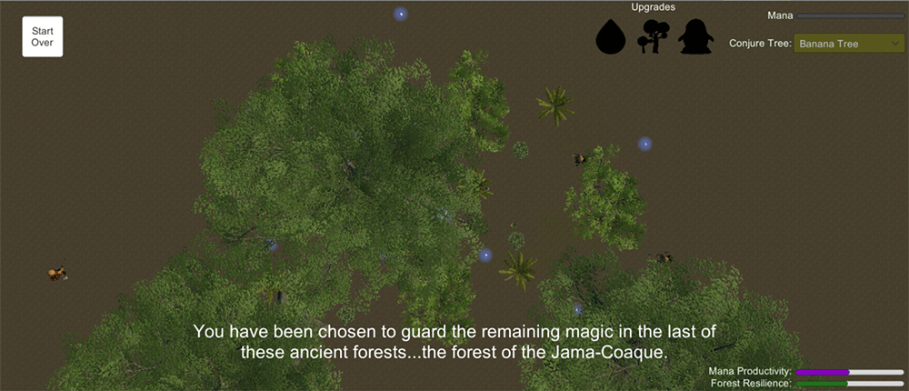
Last Forest of the Jama-Coaque

Slide 17
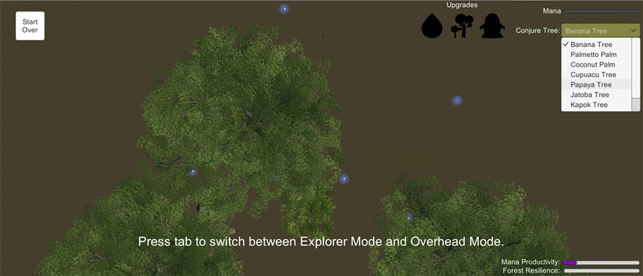
Last Forest of the Jama-Coaque

Slide 18
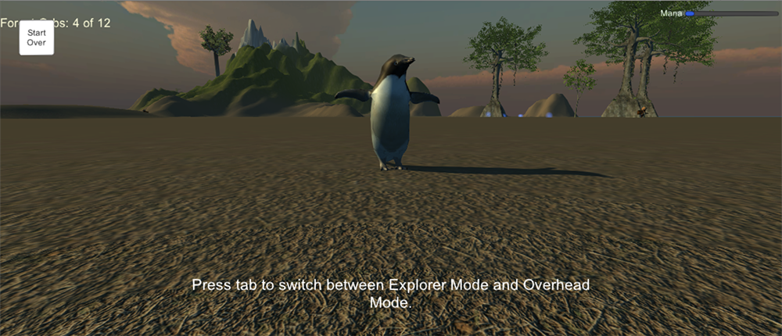
Last Forest of the Jama-Coaque

Slide 19
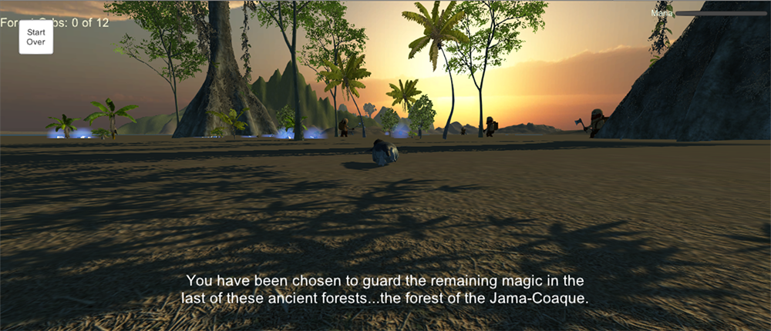
Last Forest of the Jama-Coaque

Slide 20
Jungle King Defense

Slide 21
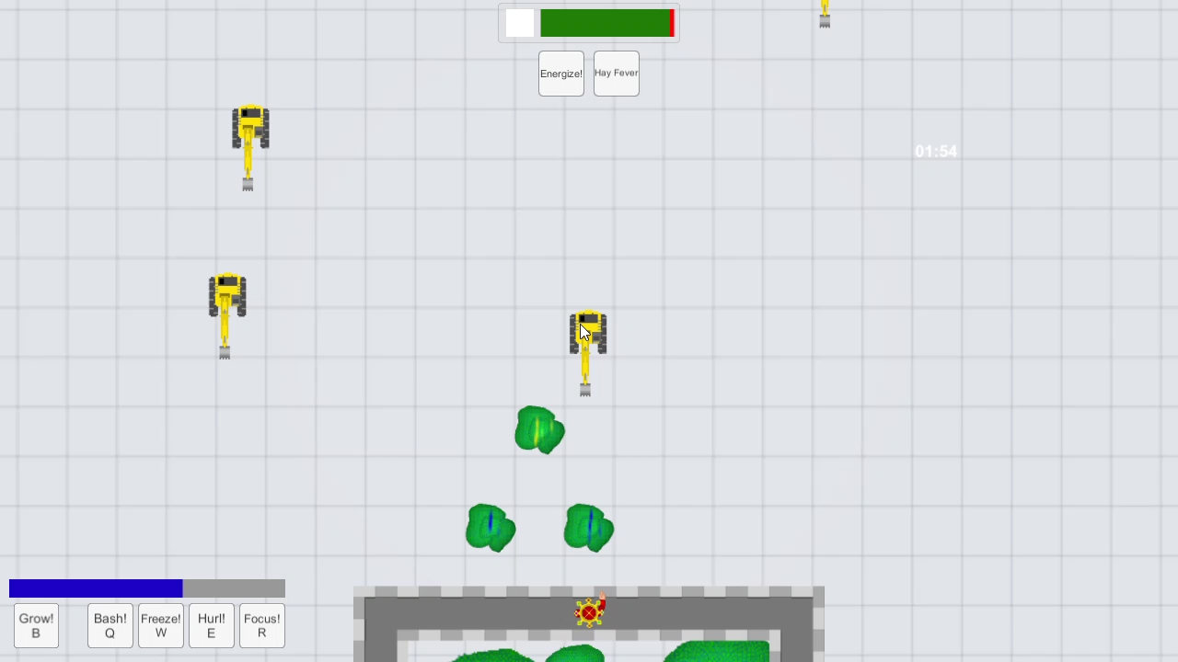

Slide 22
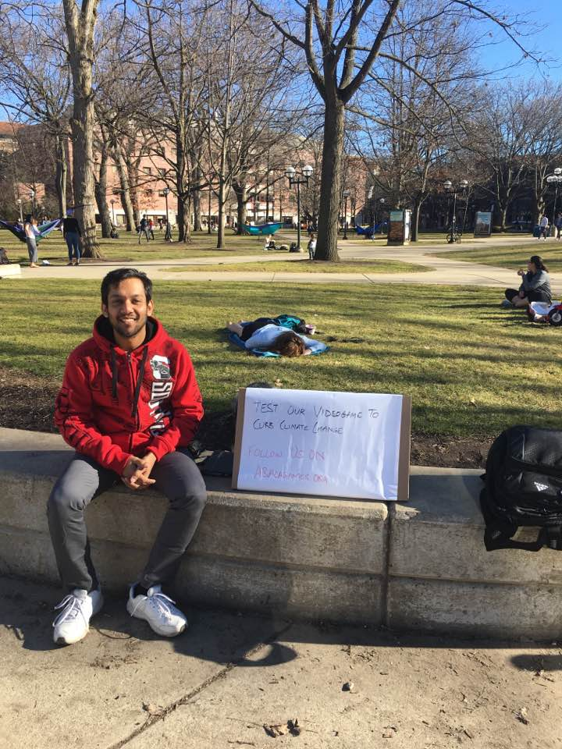

Pilot: Minimum Viable Product
High School Classroom
On Campus
Notes:
We created a prototype and tested it with students on the University of Michigan central campus and with high school students at Star International Academy.

Slide 23
Feedback
“ I think the game is a really good idea because it is informing people about climate change and how they can reduce their carbon dioxide emissions.”
“I really like how this game is trying to inform people about global warming in an interactive way so people could get engaged.”
“It’s great to not only educate people that climate change is a problem, but actions they can take to fix it.”
Notes:
We got very positive feedback for our concept and the game.
Some of the feedbacks were:
game is a really good idea as it is informing people about climate change.
It’s an interactive way to get people engaged in the issue of climate change.
it’s great to not only educates people that climate change is a problem, but actions they can take to fix it.

Slide 24
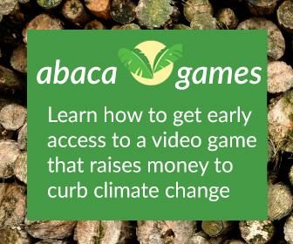
Pilot: Fake Door
Posted on Google Display Network:
300,000 impressions
1,400 clicks click rate higher than the average
105 early access sign-ups
Ad by Justin Smith. Recent Stamps Graduate
Notes:
We also put an adword for our game on google display network which was highly successful.
It garnered 300,000 impressions with 1400 clicks. The click rate was higher than the average of .35%.
We also got 105 people to sign up for early access.

Slide 25
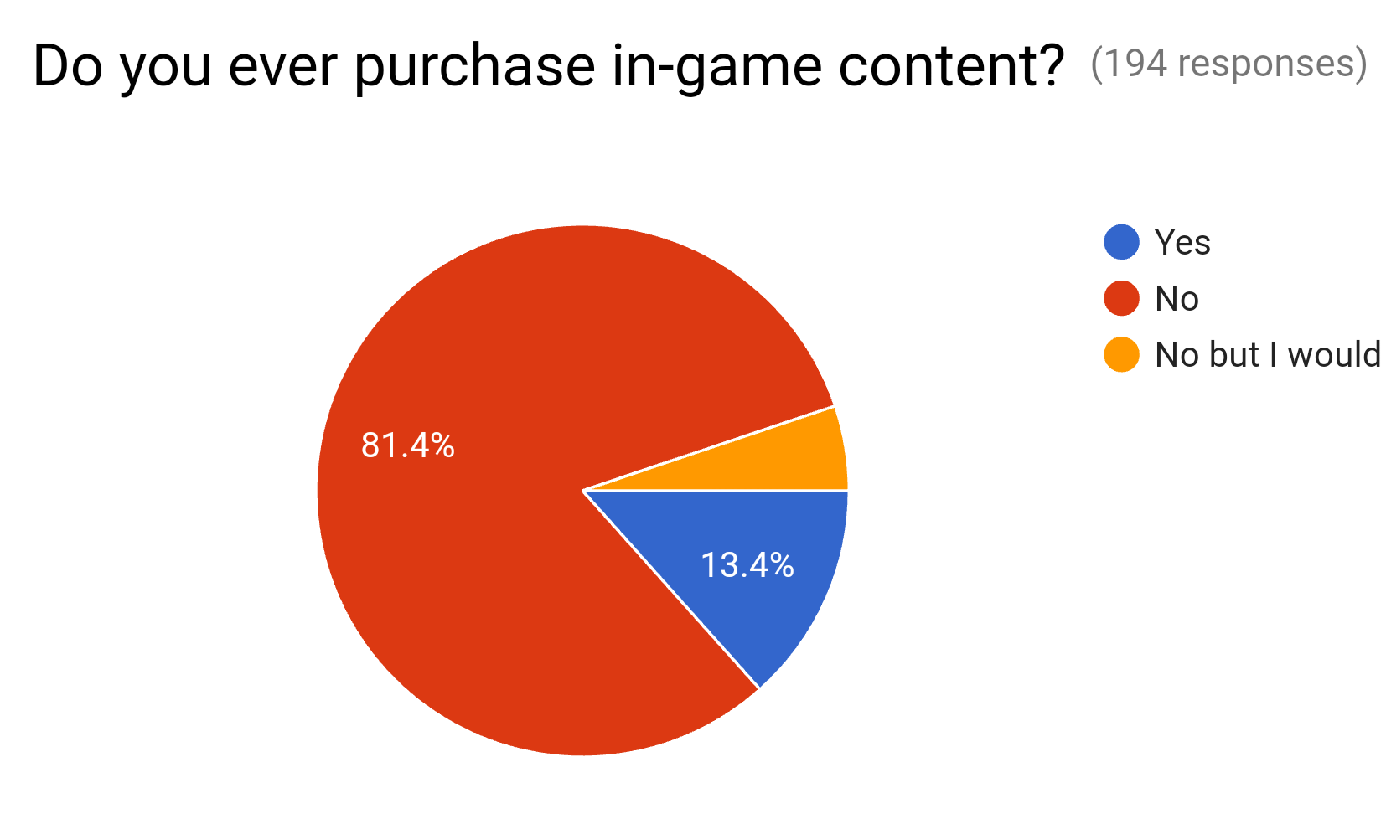
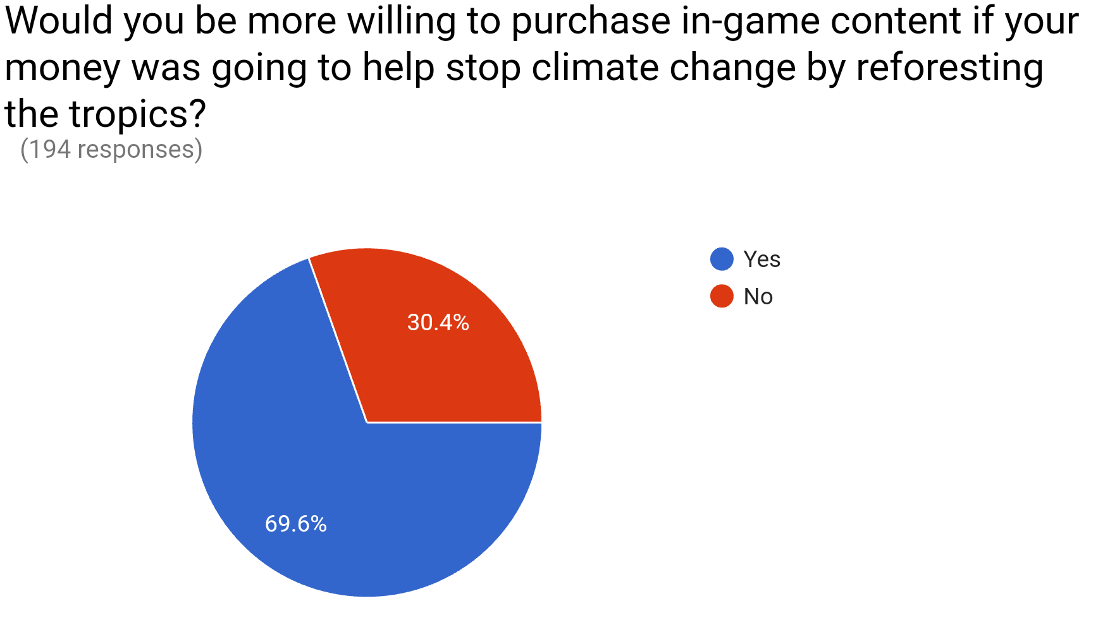
Increased willingness to make in-game purchases
Notes:
From the 194 respondents we got from our survey, we found that the willingness to spend in in-game purchases increased by 56% if the users knew that the revenue from the game went to an environmental charity.

Slide 26
What’s next?
Testing with higher fidelity prototype
Partnership with green companies
Continue early access sign ups
Release beta version in 2018
Notes:
These are some of our next steps.
We will continue to test the game with high schoolers using hi-fi prototypes. Try to find green company partners for in-game advertisements. Continue to get early access signups. Additionally we plan to release the beta version of the game in the beginning of 2018.

Slide 27

Sign up for Early Access at abacagames.org

Slide 28
Team
Jatin Gupta
Chris Karounos
Chia-ju Lee
Climate Change Specialist
Game Developer
UX Designer
Game Developer
Education Specialist
High School Teacher
Notes:
As far as the team is concerned, we have the team to design the game and implement it. Between the 3 of us, We have a climate change specialist, education specialist, UX designer, high school teacher and game developer.

Slide 29
Thank you Justin Schell for amazing mentorship!!! And University of Michigan Library Mini-Grant for support!
Also Justine Smith, Michael Ellis, Danny Vincenz for their art
http://danielvincenz.itch.io/
http://daniel-vincenz.squarespace.com/
Notes:
Even though we have the team to develop the game, we still need your support. So, let’s get together to make climate change a household issue and change the next generation into climate activist.

