Slide 1
Chicanos of La Raza
Minorities and Involvement in Third Party Politics
Isabel McMullen

Slide 2
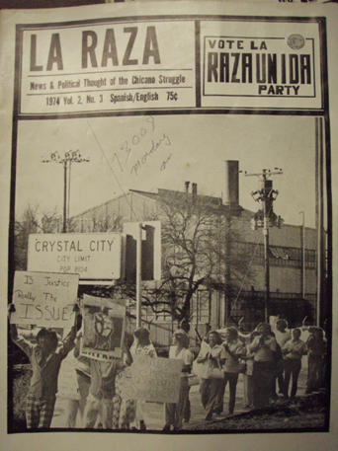
Raza Unida Party 1970-1978

Slide 3
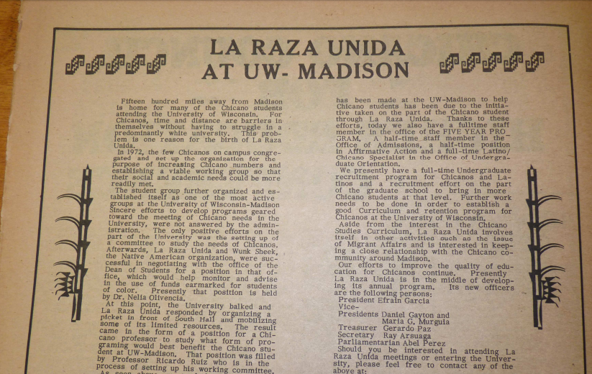
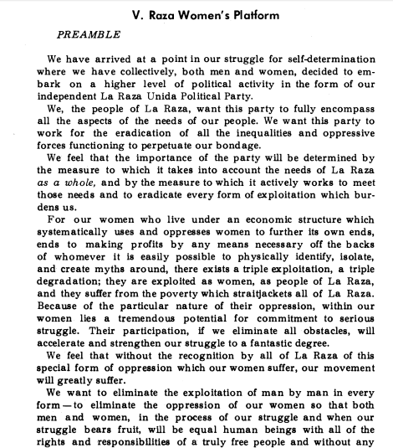
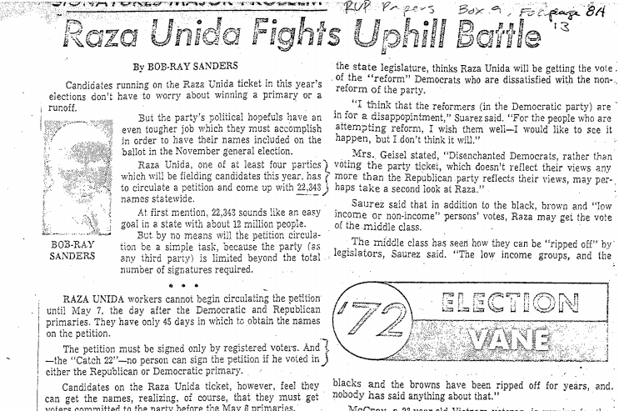

Slide 4
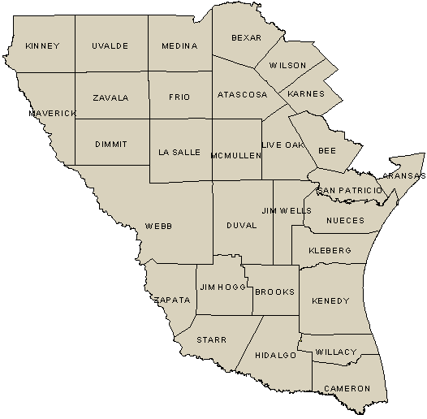
South Texas: Counties of Zavala, La Salle, Dimmit, Duval, Jim Hogg, Willacy

Slide 5
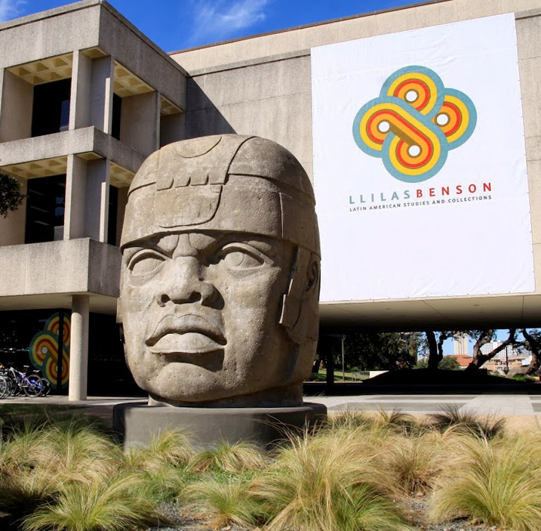
Benson Library at the University of Texas in Austin.

Slide 6
Raza Unida Party
Roundtable
-Maria Elena Martinez, Chair, Texas RUP
-Linda del Toro, Travis County RUP Chair
-Dr. Emilio Zamora, RUP Organizer
-Ernesto Calderon, RUP organizer in Waco
-Ruby Calderon, RUP organizer in Waco
-Teresa Perez Wisely, RUP and Union organizer
-Martha P. Cotera, Mujeres Pro-Raza Unida organizer and RUP candidate for State Board of Education
-Juan E. Cotera, Raza Unida Party, organizer on urban issues and housing/grants support and Director Urban Renewal Agency in Crystal City, Texas.
-Dr. Angela Valenzuela, project research mentor and support

Slide 7
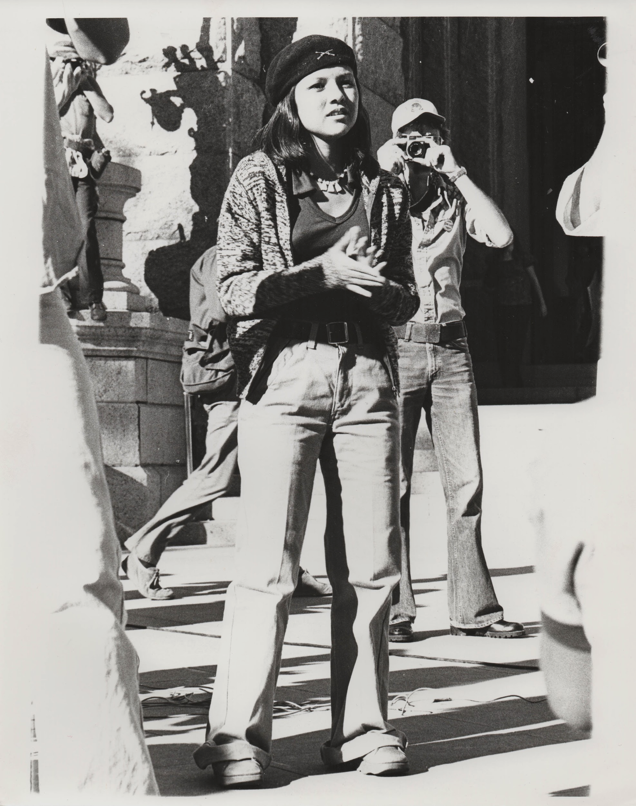
Impact of the party, Impact of my work

Slide 8
Thank You to Michigan Library Engagement Program!

Slide 9
Questions?

