Slide 1
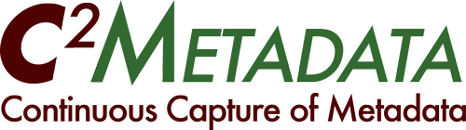
George Alter, ICPSR (PI)
NSF Data Infrastructure Building Blocks (DIBBs) (ACI-1640575)
Pascal Heus, Metadata Technology North America
Jeremy Iverson, Colectica
Jared Lyle, ICPSR
Ørnulf Risnes, Norwegian Centre for Research Data
Dan Smith, Colectica
Notes:
Title: C2Metadata project. Alternative title: Automated Capture and Description of Data Transformations
Abstract: Accurate and complete metadata is essential for data sharing and for interoperability across different data types. However, the process of describing and documenting scientific data has remained a tedious, manual process even when data collection is fully automated. Researchers are often reluctant to share data even with close colleagues, because creating documentation takes so much time.
This presentation will describe a project to greatly reduce the cost and increase the completeness of metadata by creating tools to capture data transformations from general purpose statistical analysis packages. Researchers in many fields use the main statistics packages (SPSS®, SAS®, Stata®, R) for data management as well as analysis, but these packages lack tools for documenting variable transformations in the manner of a workflow system or even a database. At best the operations performed by the statistical package are described in a script, which more often than not is unavailable to future data users.
Our project is developing new tools that will work with common statistical packages to automate the capture of metadata at the granularity of individual data transformations. Software-independent data transformation descriptions will be added to metadata in two internationally accepted standards, the Data Documentation Initiative (DDI) and Ecological Markup Language (EML). These tools will create efficiencies and reduce the costs of data collection, preparation, and re-use. Our project targets research communities with strong metadata standards and heavy reliance on statistical analysis software (social and behavioral sciences and earth observation sciences), but it is generalizable to other domains, such as biomedical research.
EDDI URL: http://www.eddi-conferences.eu/ocs/index.php/eddi/eddi17/paper/view/316

Slide 2

http://c2metadata.org/
Partners:
Notes:
Our web site: http://c2metadata.org/
Partners include the American National Election Studies, Colectica, ICPSR, MTNA, NORC, the Norwegian Centre for Research Data, and the University of Michigan. The C²Metadata project is supported by the Data Infrastructure Building Blocks (DIBBs) program of the United States National Science Foundation through grant NSF ACI-1640575.

Slide 3
The Problem

Slide 4
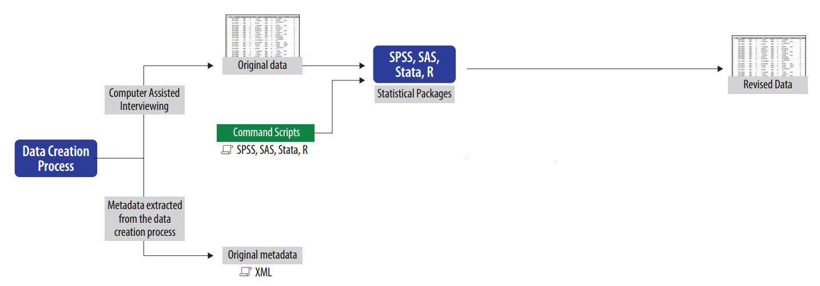

Notes:
Most data are born digital (the program is the metadata). Metadata can often be extracted directly from the data creation process. (We already have tools to convert CAI to machine-readable metadata. These include: MQDS, Colectica.)
But when a project modifies the data, they no longer match the metadata. This means the transformations are then recorded manually and incompletely -- if at all.

Slide 5
What’s missing?
Statistics packages have limited metadata
No question text
No interview flow (question order, skip pattern)
No variable provenance
Data transformations are not documented.

Slide 6
The Solution

Slide 7
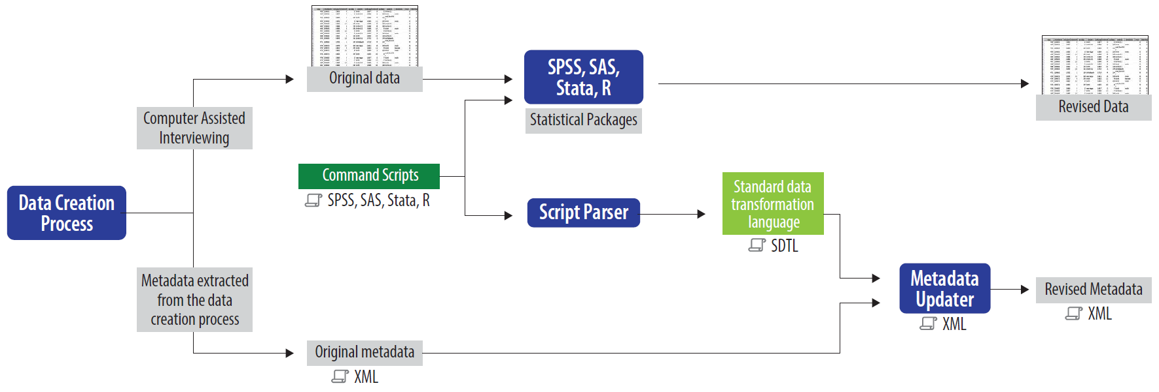
Notes:
We are automating the capture of transformation metadata. We will build missing links with the script parser and XML updater.

Slide 8
Why Metadata?
Data are useless without metadata
Metadata should:
  Include all information about data creation
  Describe transformations to variables
  Be easy to create
Our goal: Automated capture of metadata

Slide 9
Benefits of automated metadata capture
Metadata will be better
  All the original information can be included.
  Variable transformations can be described
Automation will lower costs
  Metadata will not be discarded and re-created
All metadata will be standardized and machine readable
  Codebooks with rich information can be rendered at will
If we make it easy and beneficial, researchers will use it.

Slide 10
Some Details

Slide 11
Project High Level Tasks
All
  Collect scripts. Agree on VTL representations.
  Standards for incorporating VTL into DDI and EML
ICPSR
  Test data and scripts
  Testing created DDI metadata
  Testing created EML metadata
  Active DDI codebook with VTL
NSD
  Stata Script Parser
  SAS Script Parser
Colectica
  SPSS Script Parser
  R data transformation package
MTNA
  VTL to DDI Metadata Updater
  VTL to EML Metadata Updater
  DDI comparison and validation tool

Slide 12
Target Data Transformations for Year 1
Unconditional assignment (SPSS: COMPUTE; Stata: gener)
  Arithmetic operations
  List of mathematical functions (exp, ln, log, …)
Conditional assignment (SPSS: IF; Stata: replace ...if)
  Logical expressions
Recode (SPSS: RECODE; Stata: recode)
SPSS | Stata | SAS | R | VTL
COMPUTE | generate replace | [assignment] |  | [assignment] :=
IF | replace … if | IF...THEN/ELSE |  | if … then … else
RECODE | recode | IF...THEN … ELSE … IF … THEN |  | if … then … elseif … then

Slide 13
One command in detail: RECODE

Slide 14
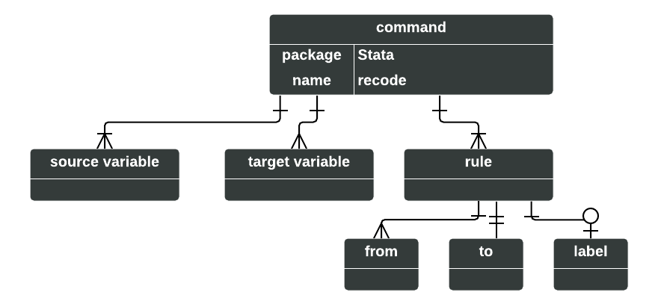
What is recode (in Stata)?
recode -- Recode categorical variables
recode var1 var2 (1 2 = 2) (3/max = 5)
recode a b (1 = 2), prefix("modified_")
recode x y (1 = 2), generate(modified_x modified_y)
recode x y (1 = 2 "Labelfor2") (3 = 5 "Labelfor5")
recode total (0/140=0 F) (141/180=1 D) (181/210=2 C) (211/234=3 B) (235/300=4 A), gen(grade)
recode a (1 . .a 5/6 = 7) (nonmissing = 8) (missing = 9) (* = 2)

Slide 15
What is recode (in SPSS)?
RECODE var1 var2 var3 (-1=7) (-2=8).
RECODE AGE (MISSING=9) (18 THRU HI=1) (0 THRU 18=0) INTO VOTER.

Slide 16
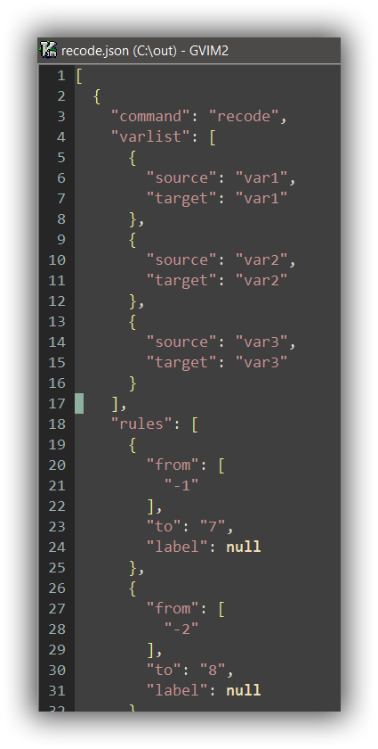
Recode in JSON

Slide 17
SDTL Development
Still in active development
http://c2metadata.gitlab.io/sdtl-docs/
Using COGS, an open source production framework to generate JSON schema, XML schema, and rich documentation

Slide 18
Apps to Detect Transforms

Slide 19
Stata Parser Tool: Online
Functional recode parser available at
http://ekstern.nsd.no/metacap/stata2vtl

Slide 20
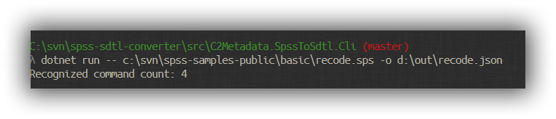
SPSS: Command line

Slide 21
SDTL Reader
Desktop application for Windows, macOS, and Linux
Open SPSS syntax files (*.sps)
Open SDTL JSON files

Slide 22
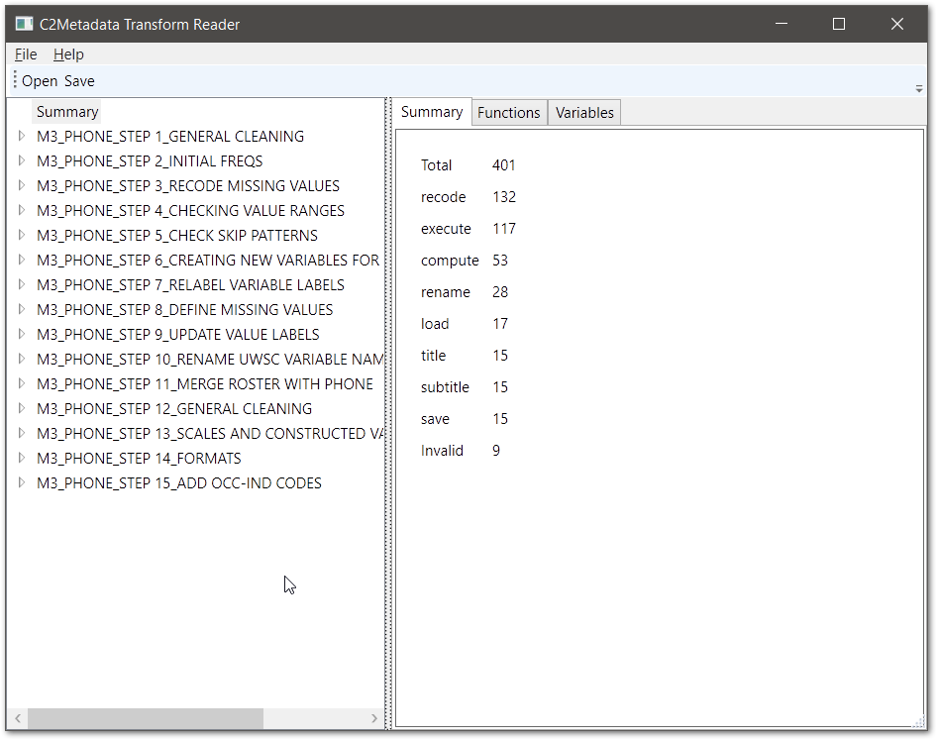

Slide 23
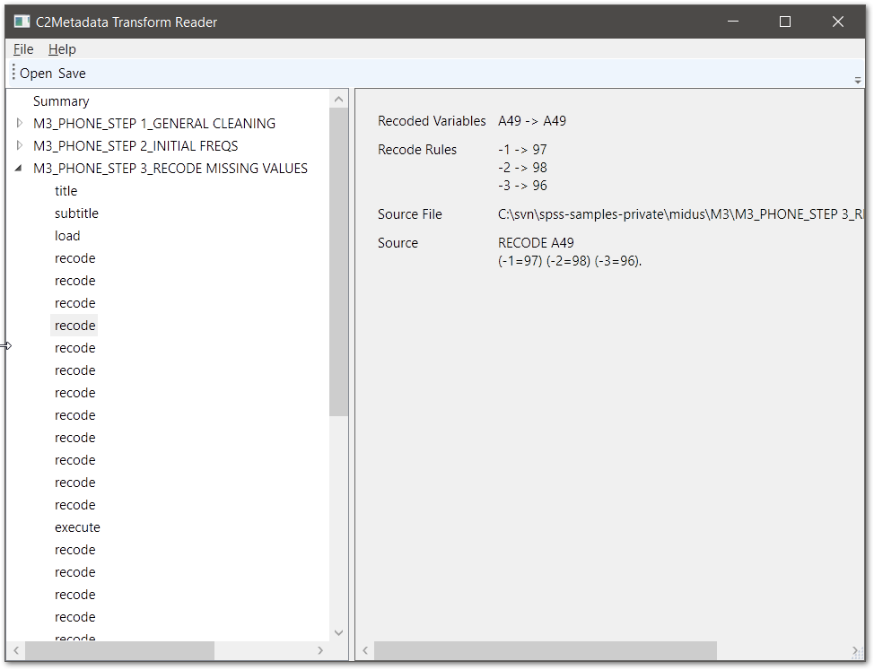

Slide 24
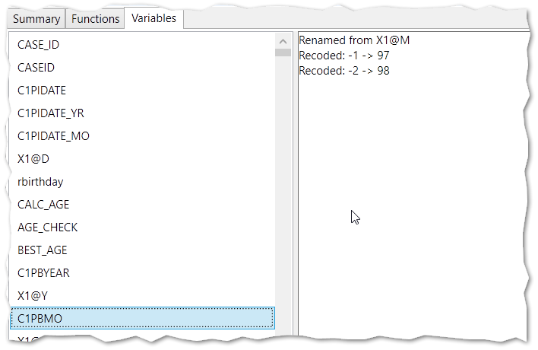

Slide 25
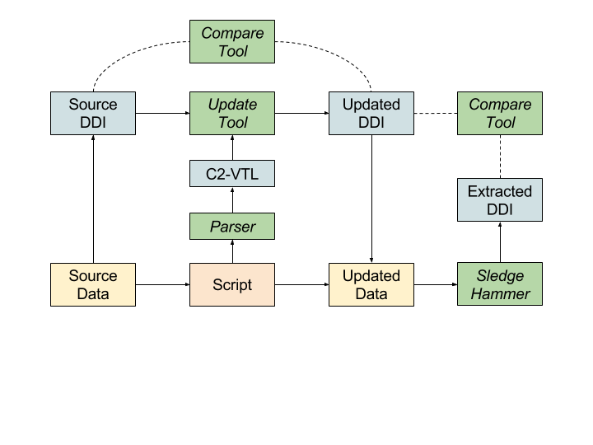
DDI Metadata Updater
Notes:
This illustrates the process of:
(1) using a script parser to generate C2-VTL
(2) Read the C2-VTL to create a DDI file matching the updates data file (using input DDI from source file)
(3) Use the comparison tool to analyze / document the differences
(4) For validation purposes, use the tool to compare the generate DDI with actual DDI produce from the new data file (e.g. with our SledgeHammer utility)

Slide 26
Future

Slide 27
Continuing Work
Describe more types of transformations
Detect those transformations in SPSS, Stata, SAS
R library for transforming data

Slide 28
Follow Along
Project website at c2metadata.org
Source code managed at gitlab.com/c2metadata
Public Proof-of-Concept app in March

Slide 29
Thanks!
http://c2metadata.org/

Slide 30
Following are slides not used in the main presentation...

Slide 31
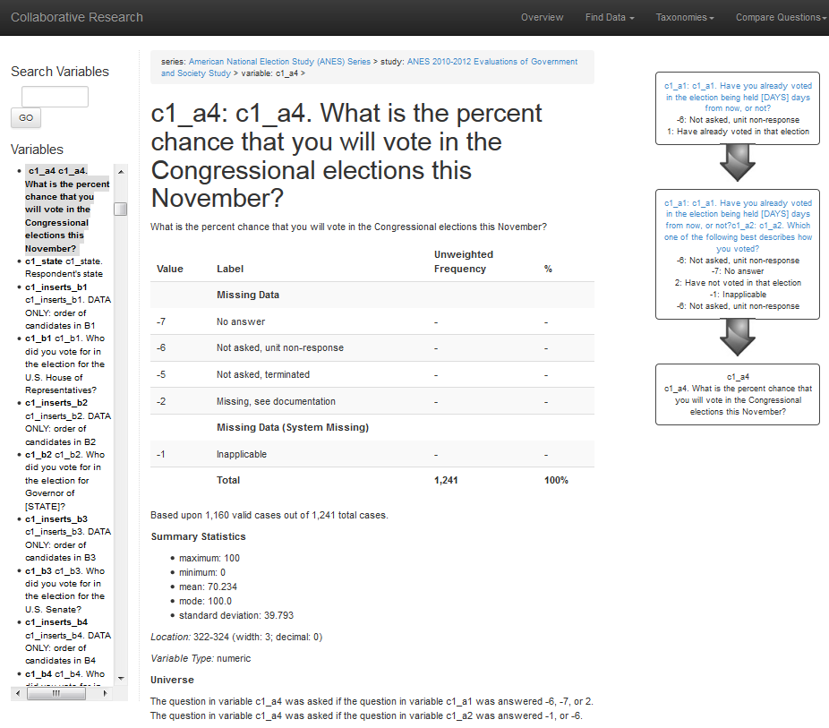
Notes:
Metadata for the American National Election Study: What question was asked? How was the question coded? Who answered this question?

Slide 32
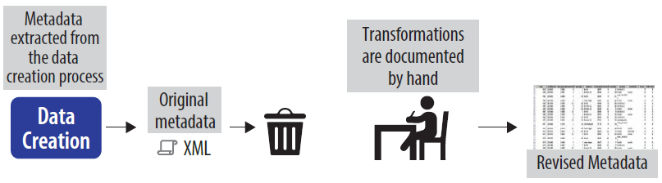

Slide 33
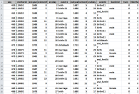
Original
data
Computer Assisted Interviewing
CAI
We already have tools to convert CAI to machine-readable metadata.
CAI to DDI
Convert to DDI:
CollecticaMQDS
others
Original metadata
DDI XML

Slide 34
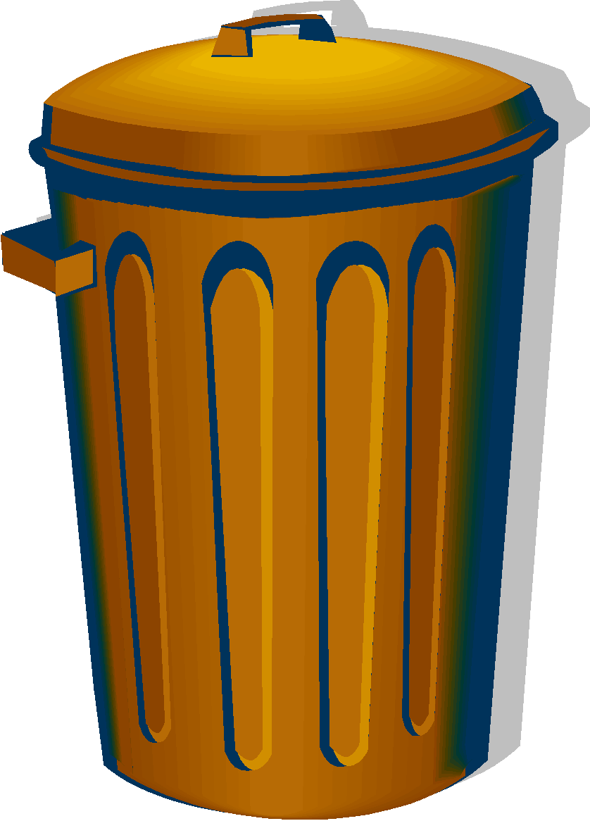
Original
data
What happens when a project modifies the data.
Statistical Packages
SPSS
SAS
Stata
R
Computer Assisted Interviewing
Command scripts:
Revised
data
SPSSSAS
Stata
R
CAI
The modified data no longer match the metadata.
CAI to DDI
Convert to DDI:
CollecticaMQDS
others
Original metadata
DDI XML

Slide 35

Metadata are re-created after the data are transformed.
Original
data
Statistical Packages
SPSS
SAS
Stata
R
Computer Assisted Interviewing
Command scripts:
Revised
data
SPSSSAS
Stata
R
CAI
Transformations are documented by hand
CAI to DDI
Convert to DDI:
CollecticaMQDS
others
Original metadata
DDI XML

Slide 36
Automating the capture of transformation metadata.
Original
data
Statistical Packages
SPSS
SAS
Stata
R
Computer Assisted Interviewing
Command scripts:
Revised
data
SPSSSAS
Stata
R
CAI
Standard
Data Transformation Language
Revised metadata
Script Parser
SDTL
DDI XML
XML Updater
CAI to DDI
Convert to DDI:
CollecticaMQDS
others
Original metadata
Missing links that we will build.
DDI XML

