Slide 1
Drinking Water at the Epicenter of Cholera in Haiti
“Healing Water” : a documentary film project as mutual aid
Vicky Koski-Karell
she/her, they/them
MD/PhD Anthropology, G2
Recognizing that we are gathering on the indigenous lands of the
Wyandot, Potawatomi, Odawa, Ojibwe, and others.

Slide 2
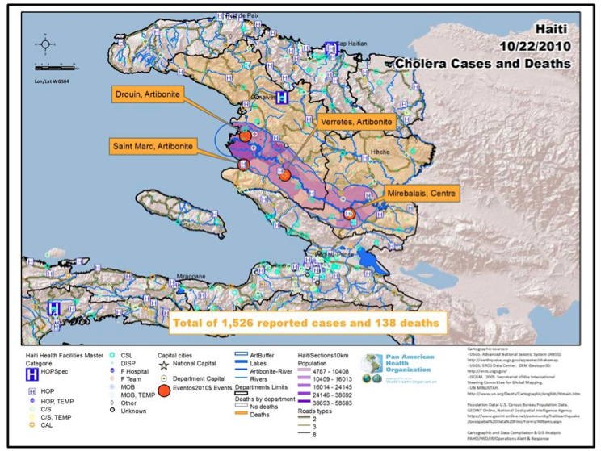

Slide 3
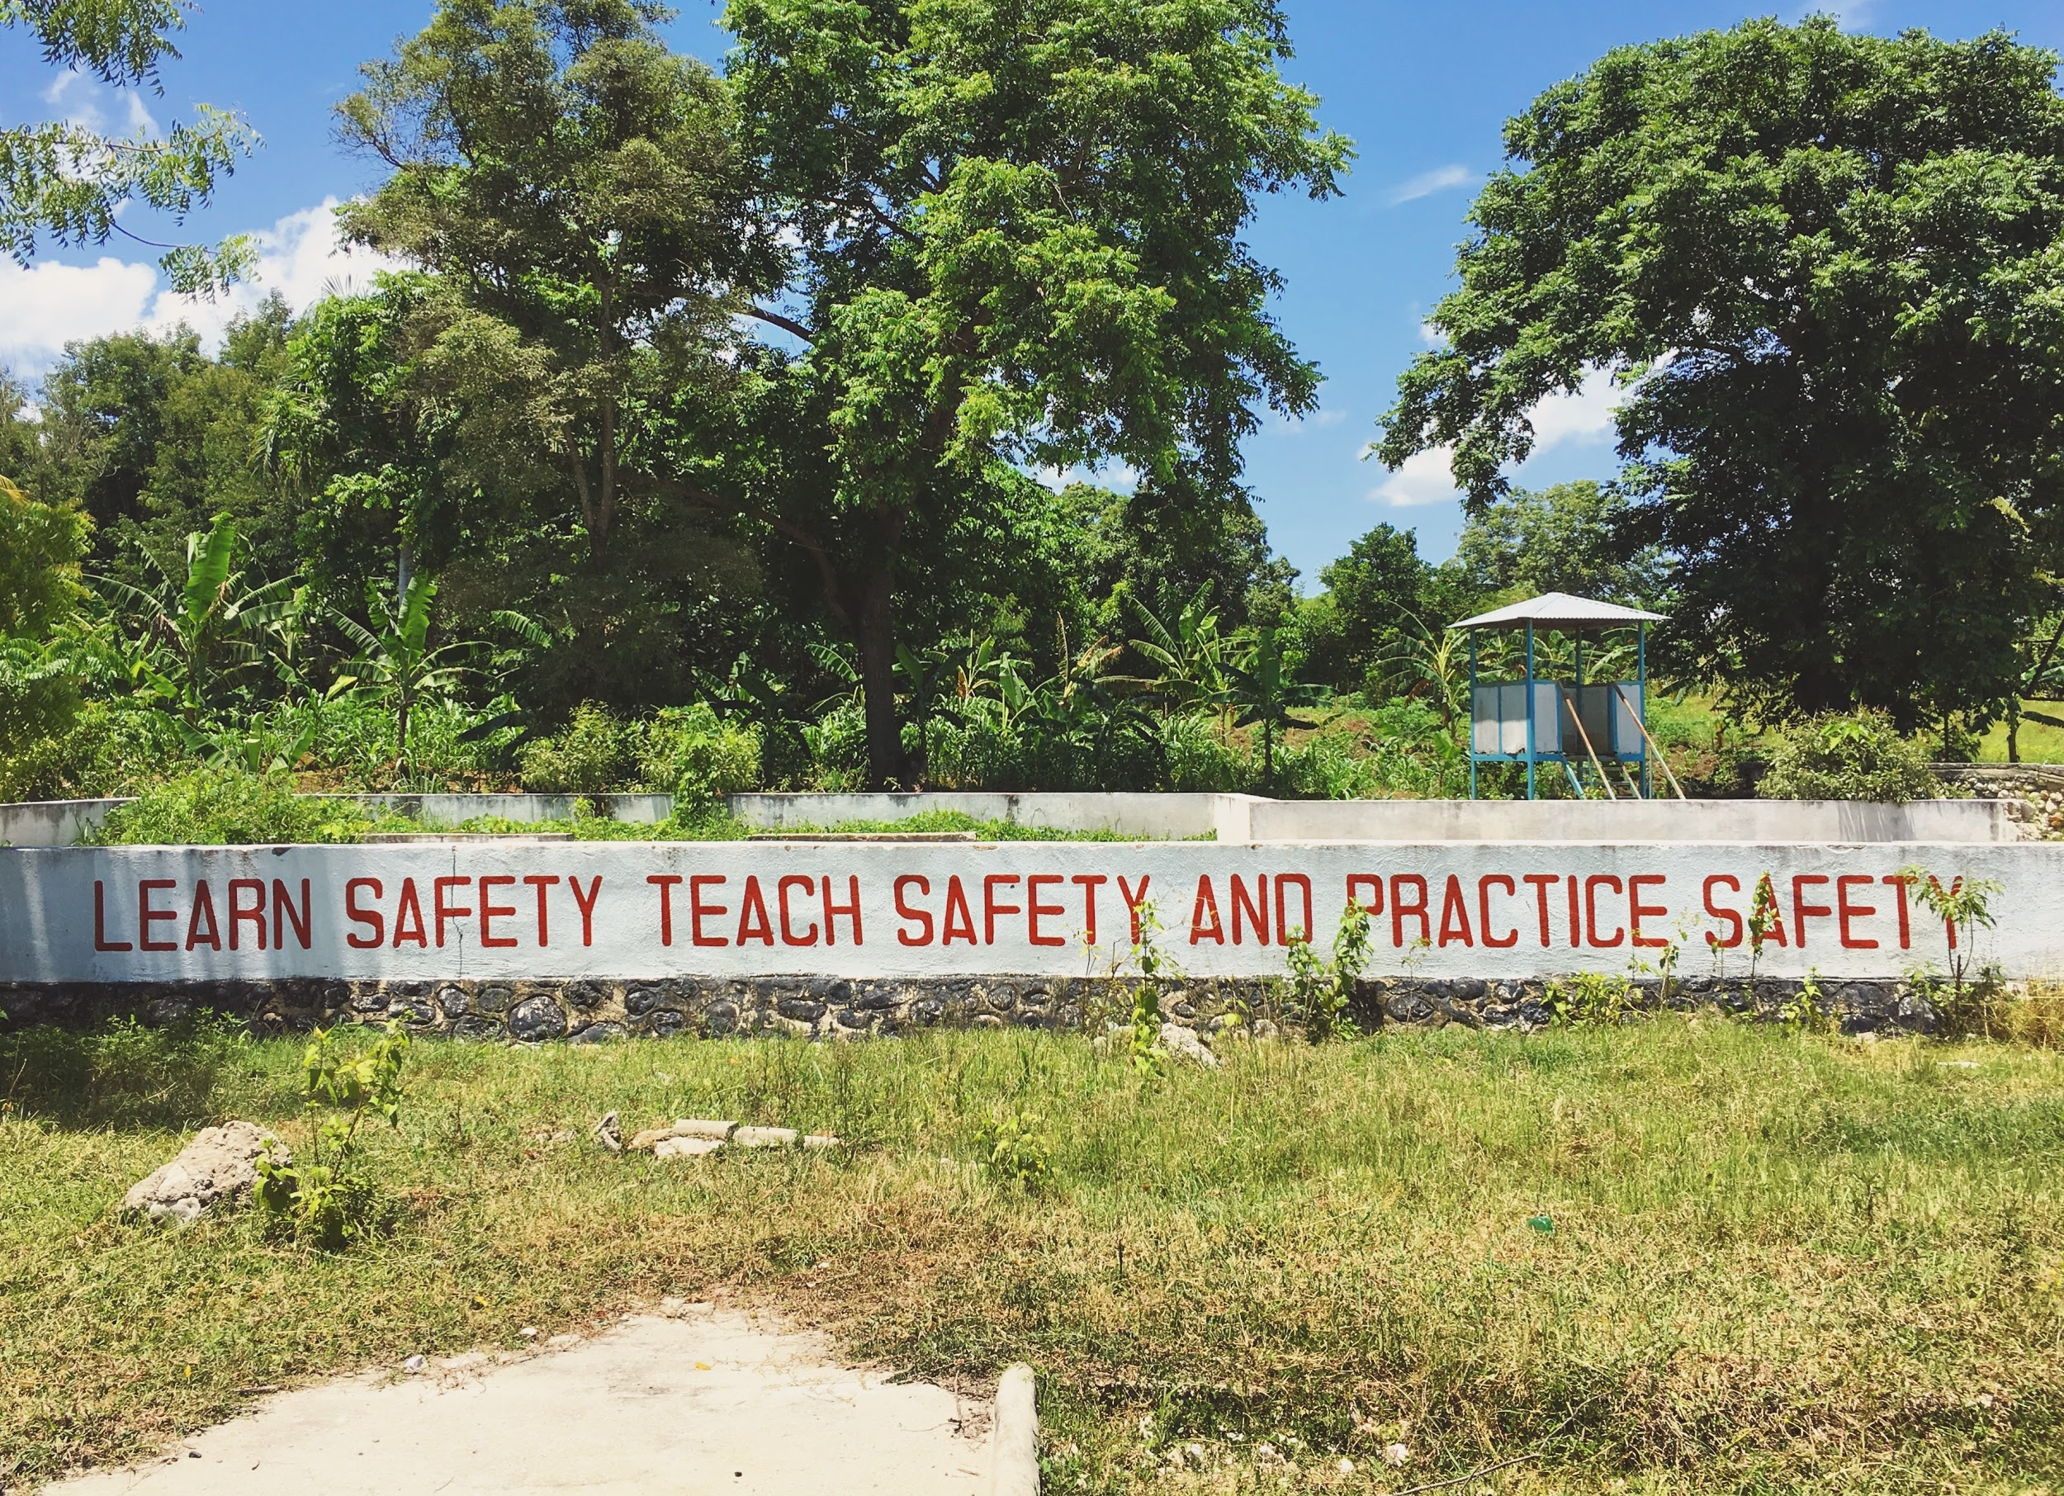

Slide 4
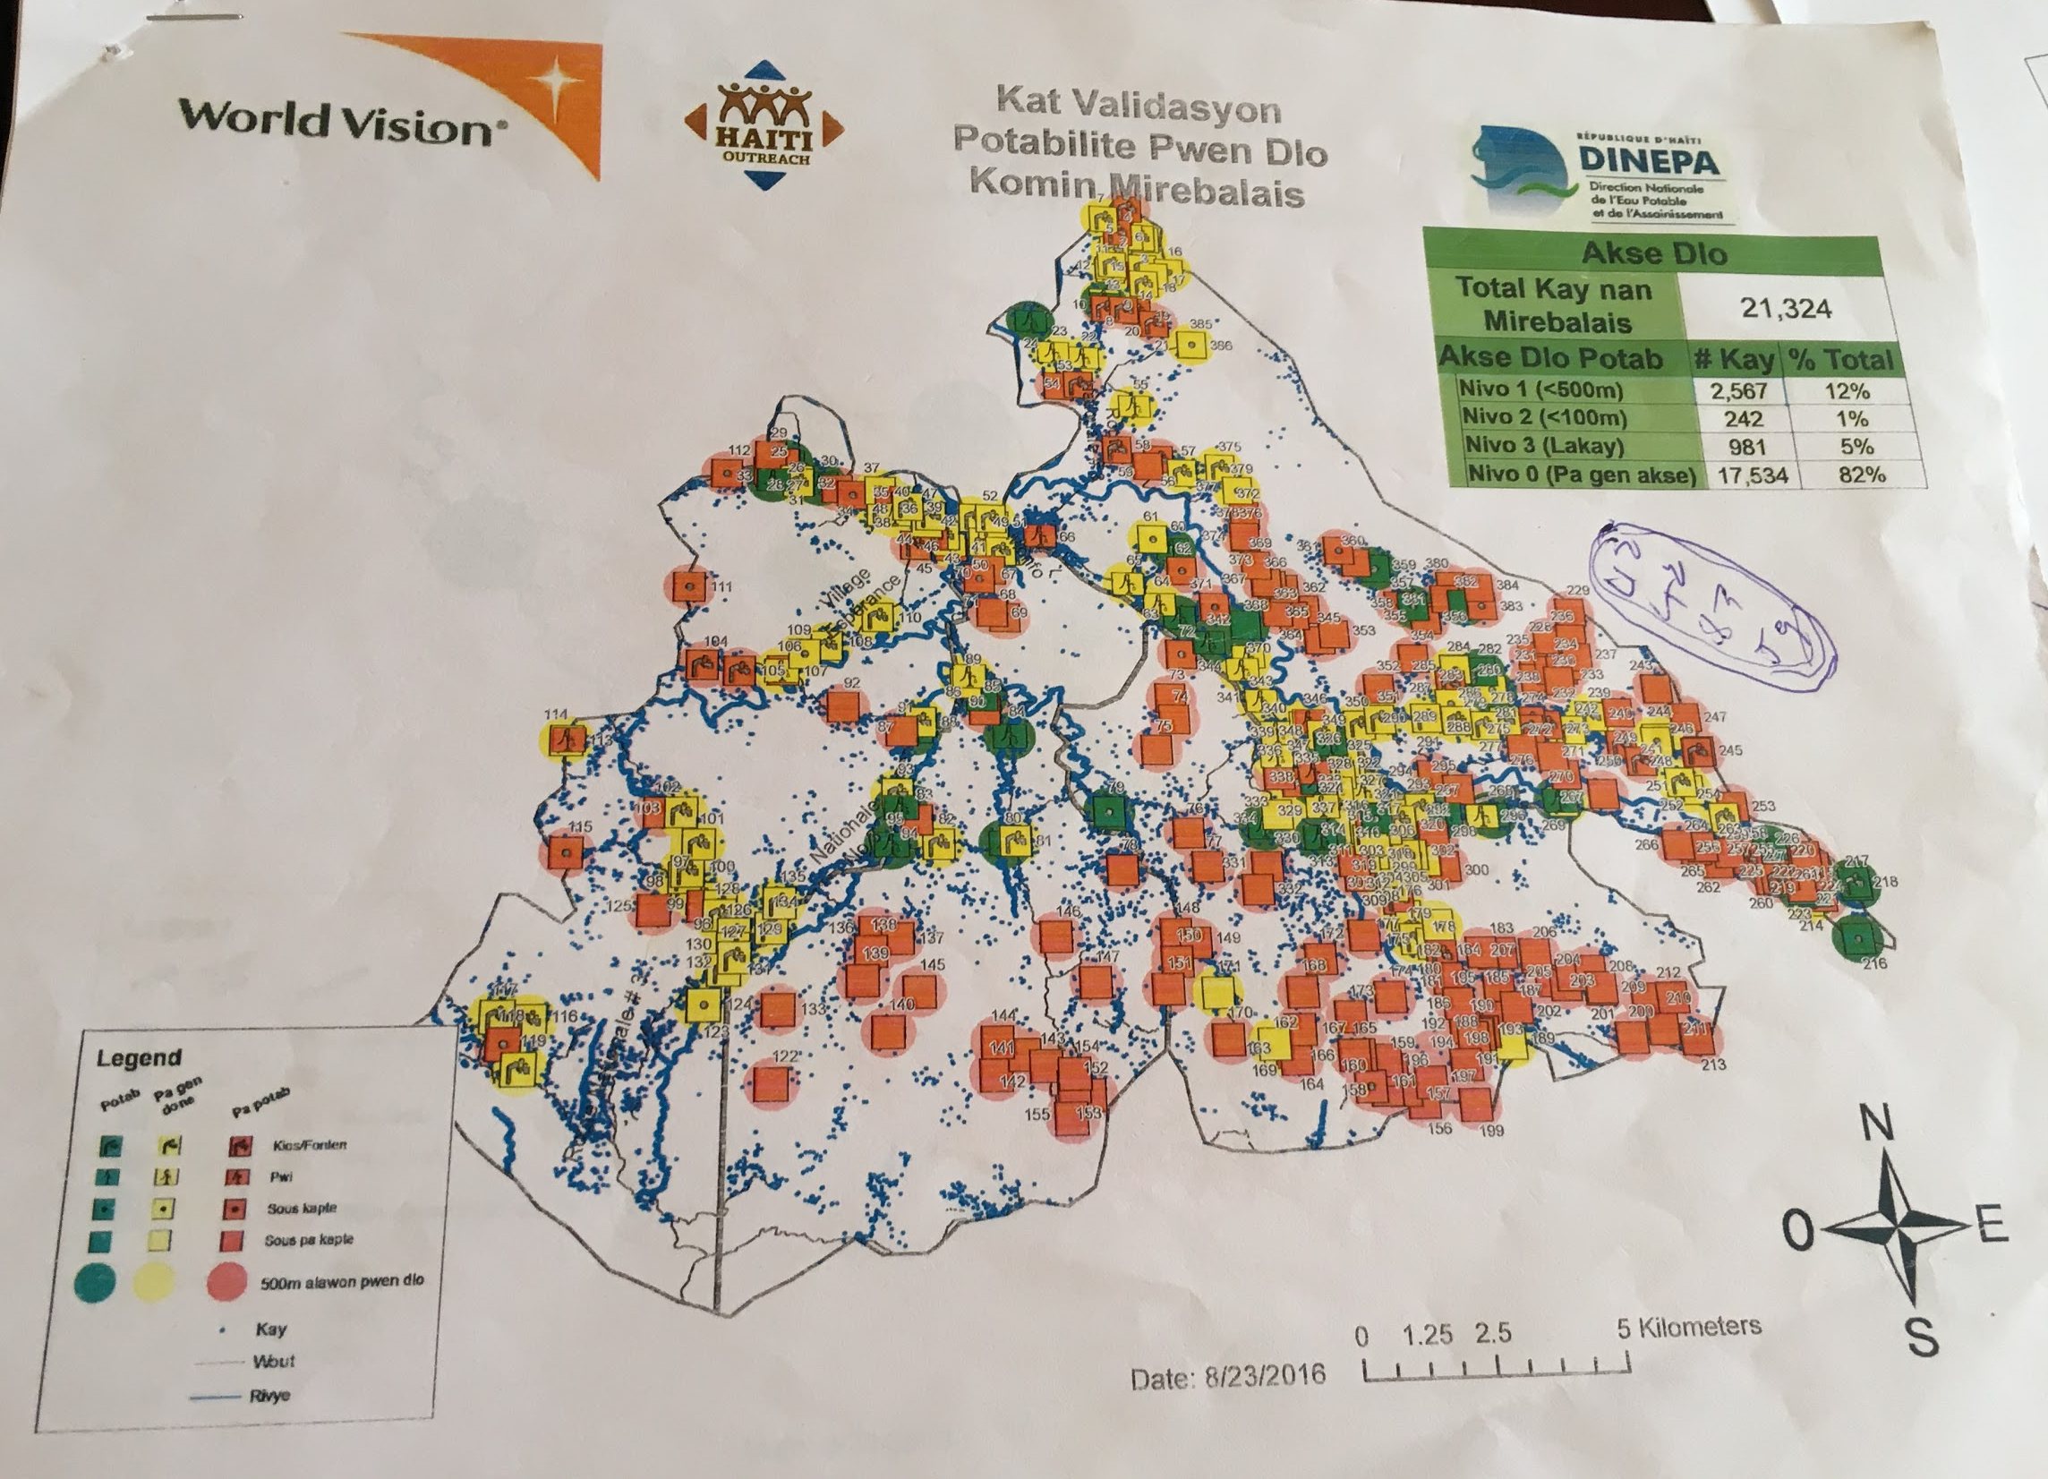

Slide 5
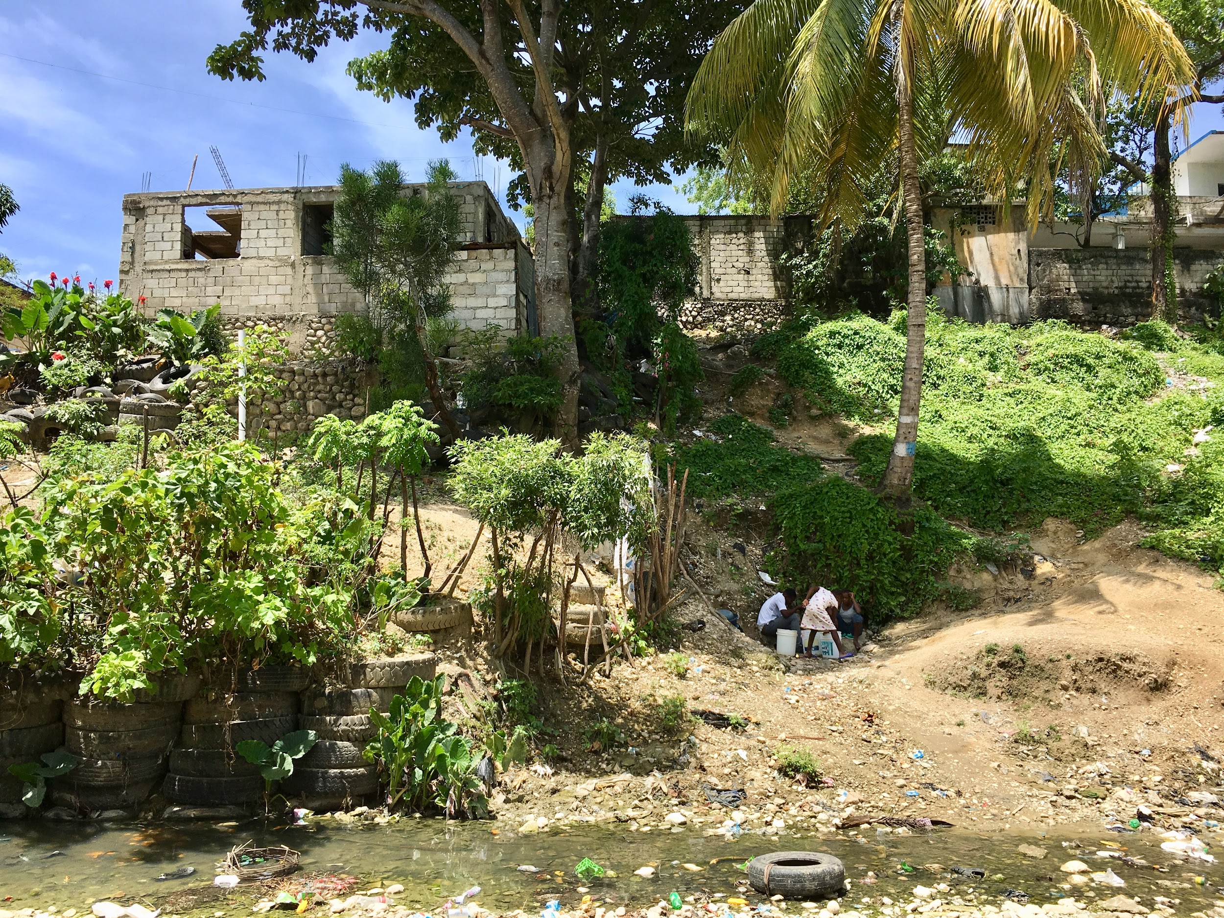

Slide 6
Water Justice for Health Equity
Guiding principles:
Solidarity
Mutual Aid
Direct Action
Goals:
Understand why water is particularly precarious in Haiti;
Advocate for the human right to clean water;
Support community-directed and -implemented intervention.

Slide 7
The Plan
Travel: February 26 - March 3
Lodging: the Mirebalais Cultural Center
Crew: Founa Louis, William Koski-Karell, myself
Filming: interviews (consent), follow 1-2 families, daily activities, scenery, joy & struggle
Editing: March-April, captions, score
Development: website, screenings, fundraising
Project: Crête Brûlée, Mirebalais, Haiti
Contractor: tbd (summer 2018)
Interview questions:
Where do you get your water from? How?
What do you think about the water in Mirebalais?
What needs to happen to improve water in Mirebalais? Haiti?
How has cholera changed the way you think about the water you drink?
Is water a human right, or a privilege for those who can afford it?

Slide 8
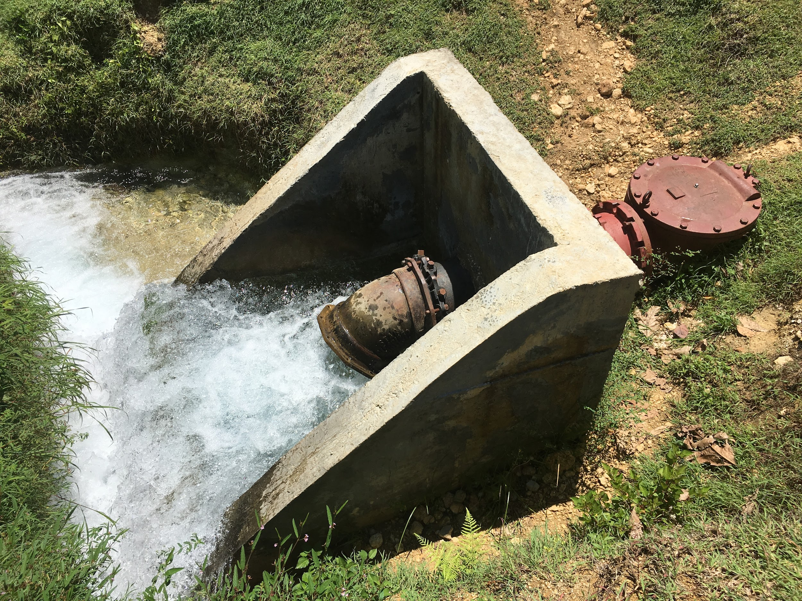
thank you!
questions?

