Slide 1
Submerged in Silence
Surrounding Sexual Violence
A Stop Motion Animation Project
Laura Magnusson
Library Mini Grant 2017/2018

Slide 2
“What the trauma survivor cannot articulate for herself is ironically set against the compulsion to tell, to capture the experience in thought, memory, and speech in order to make sense of the nonsensical, of an experience that defies reason or logic, and one that results in the shutting down of the self.”
Christina Liam

Slide 3
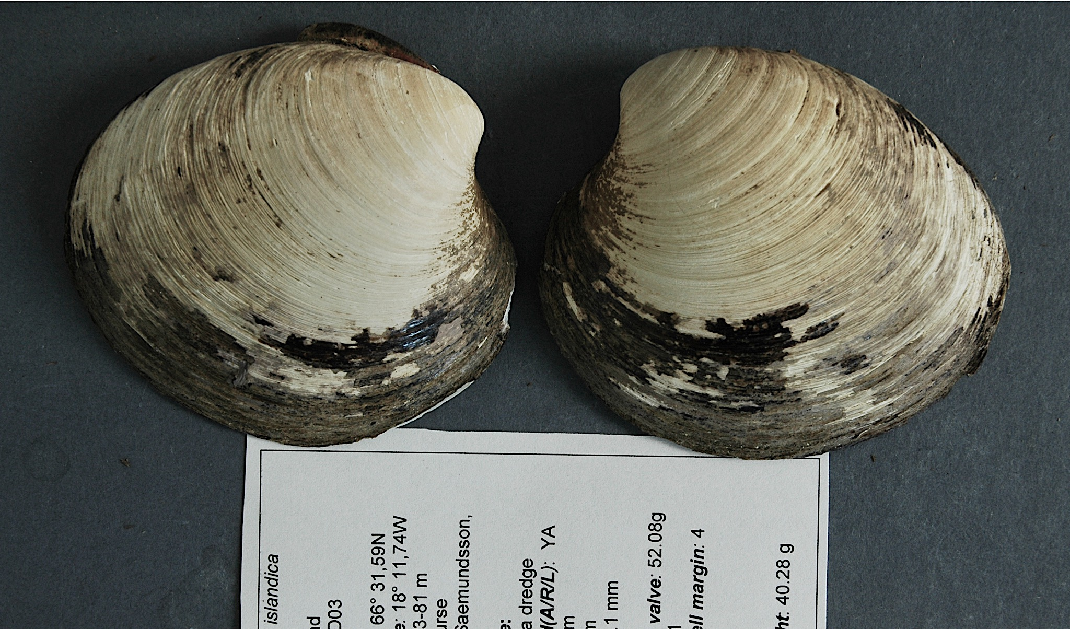

Slide 4
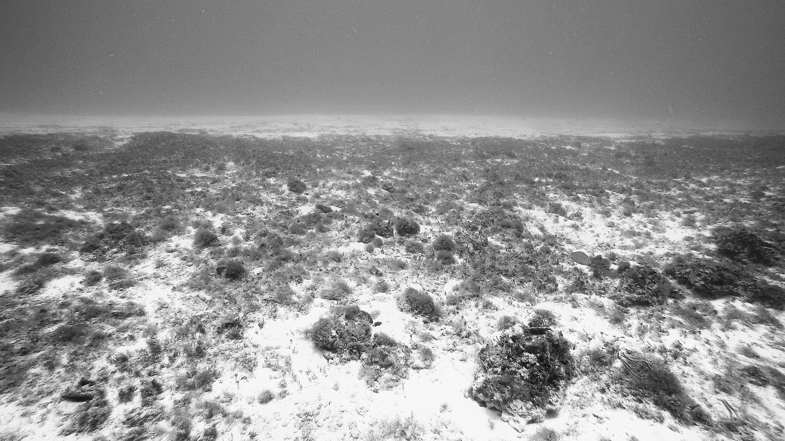

Slide 5


Slide 6
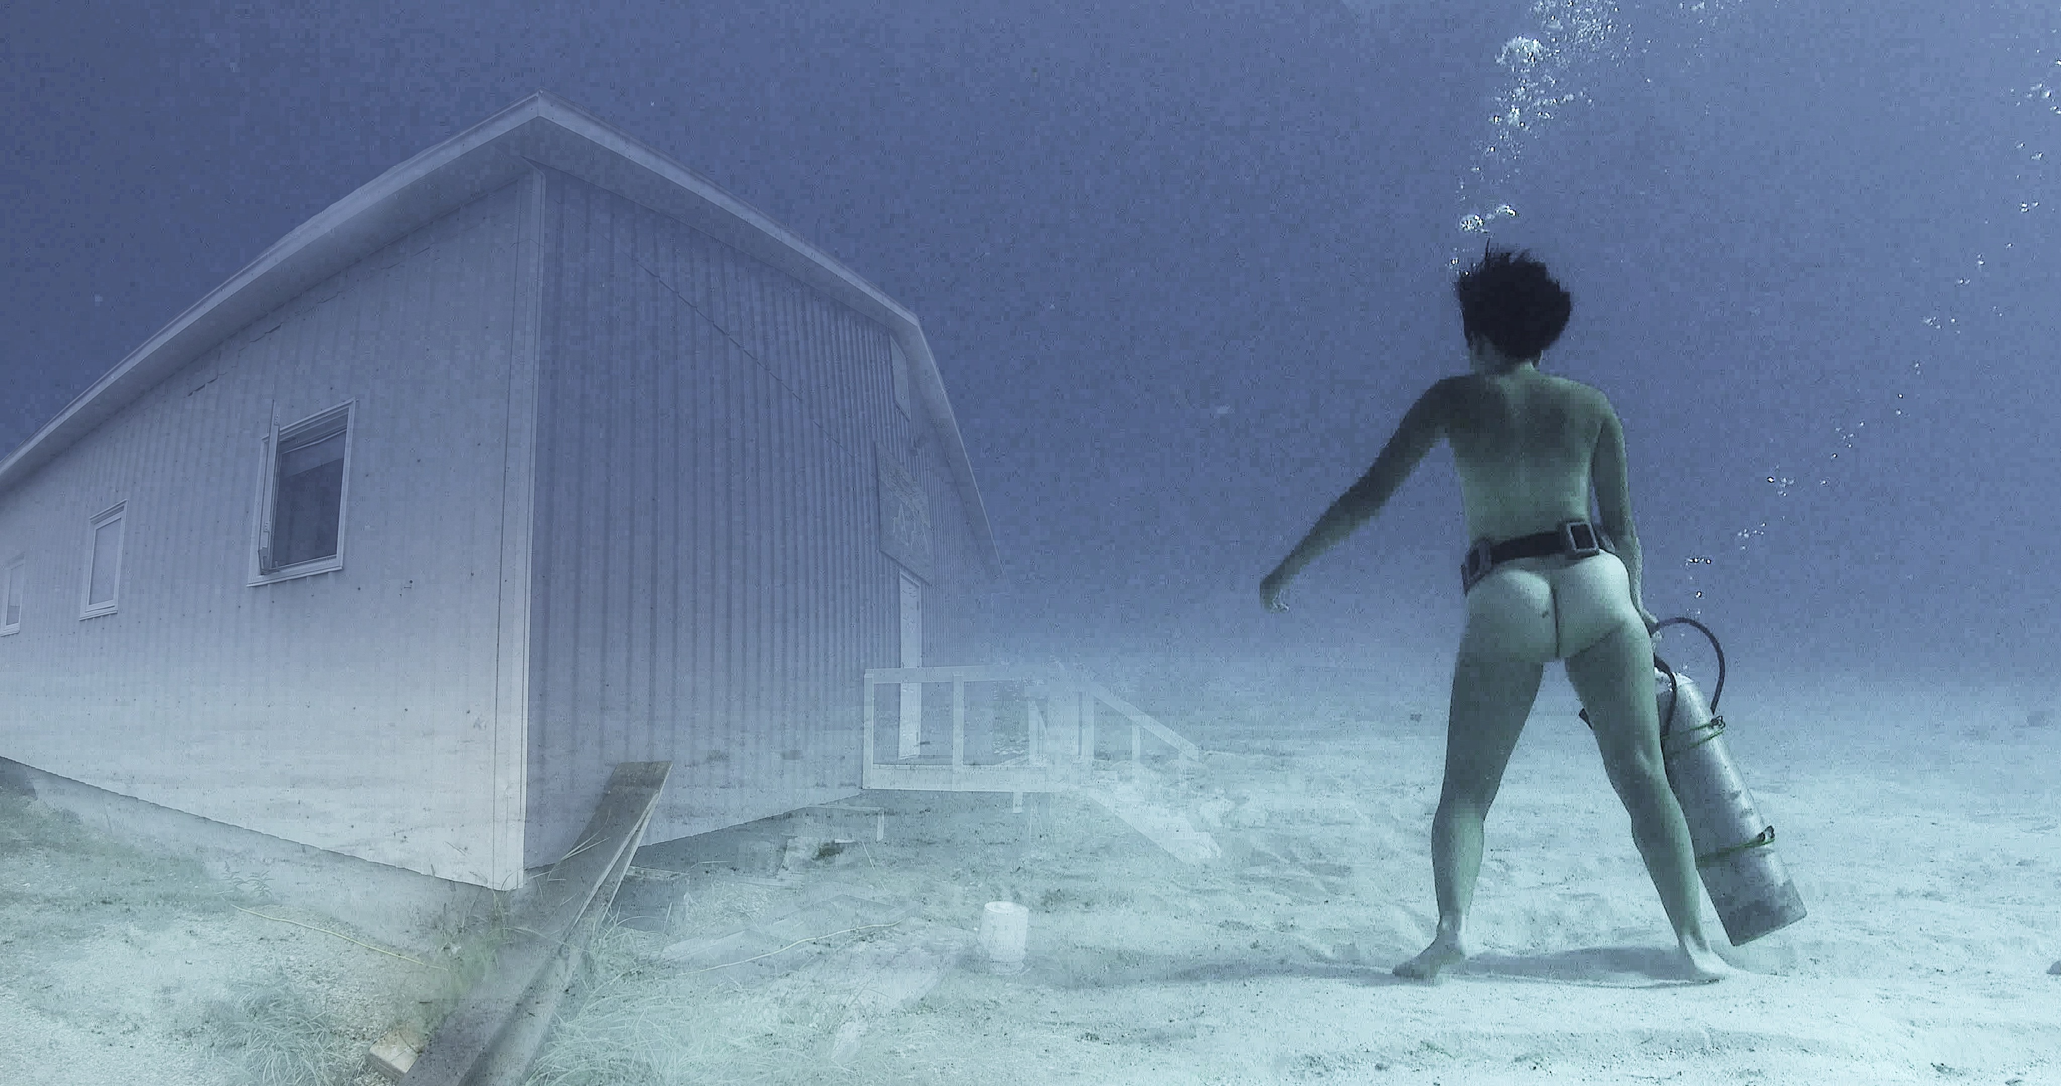

Slide 7
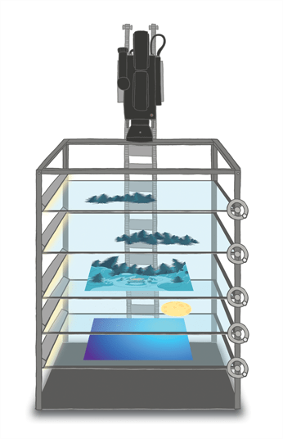
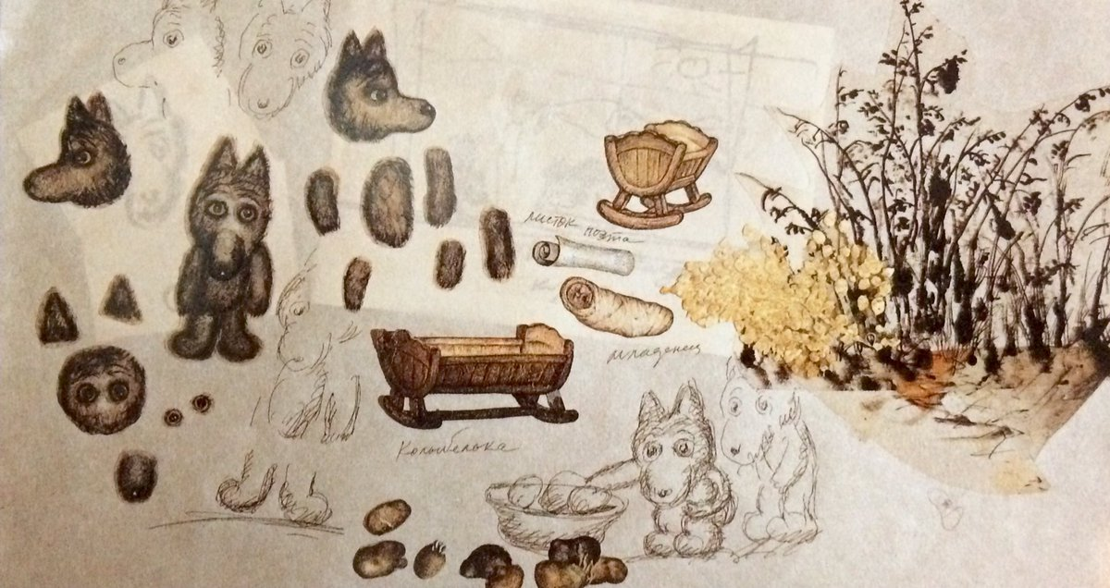
STOP MOTION ANIMATION
MULTIPLANE CAMERA

Slide 8
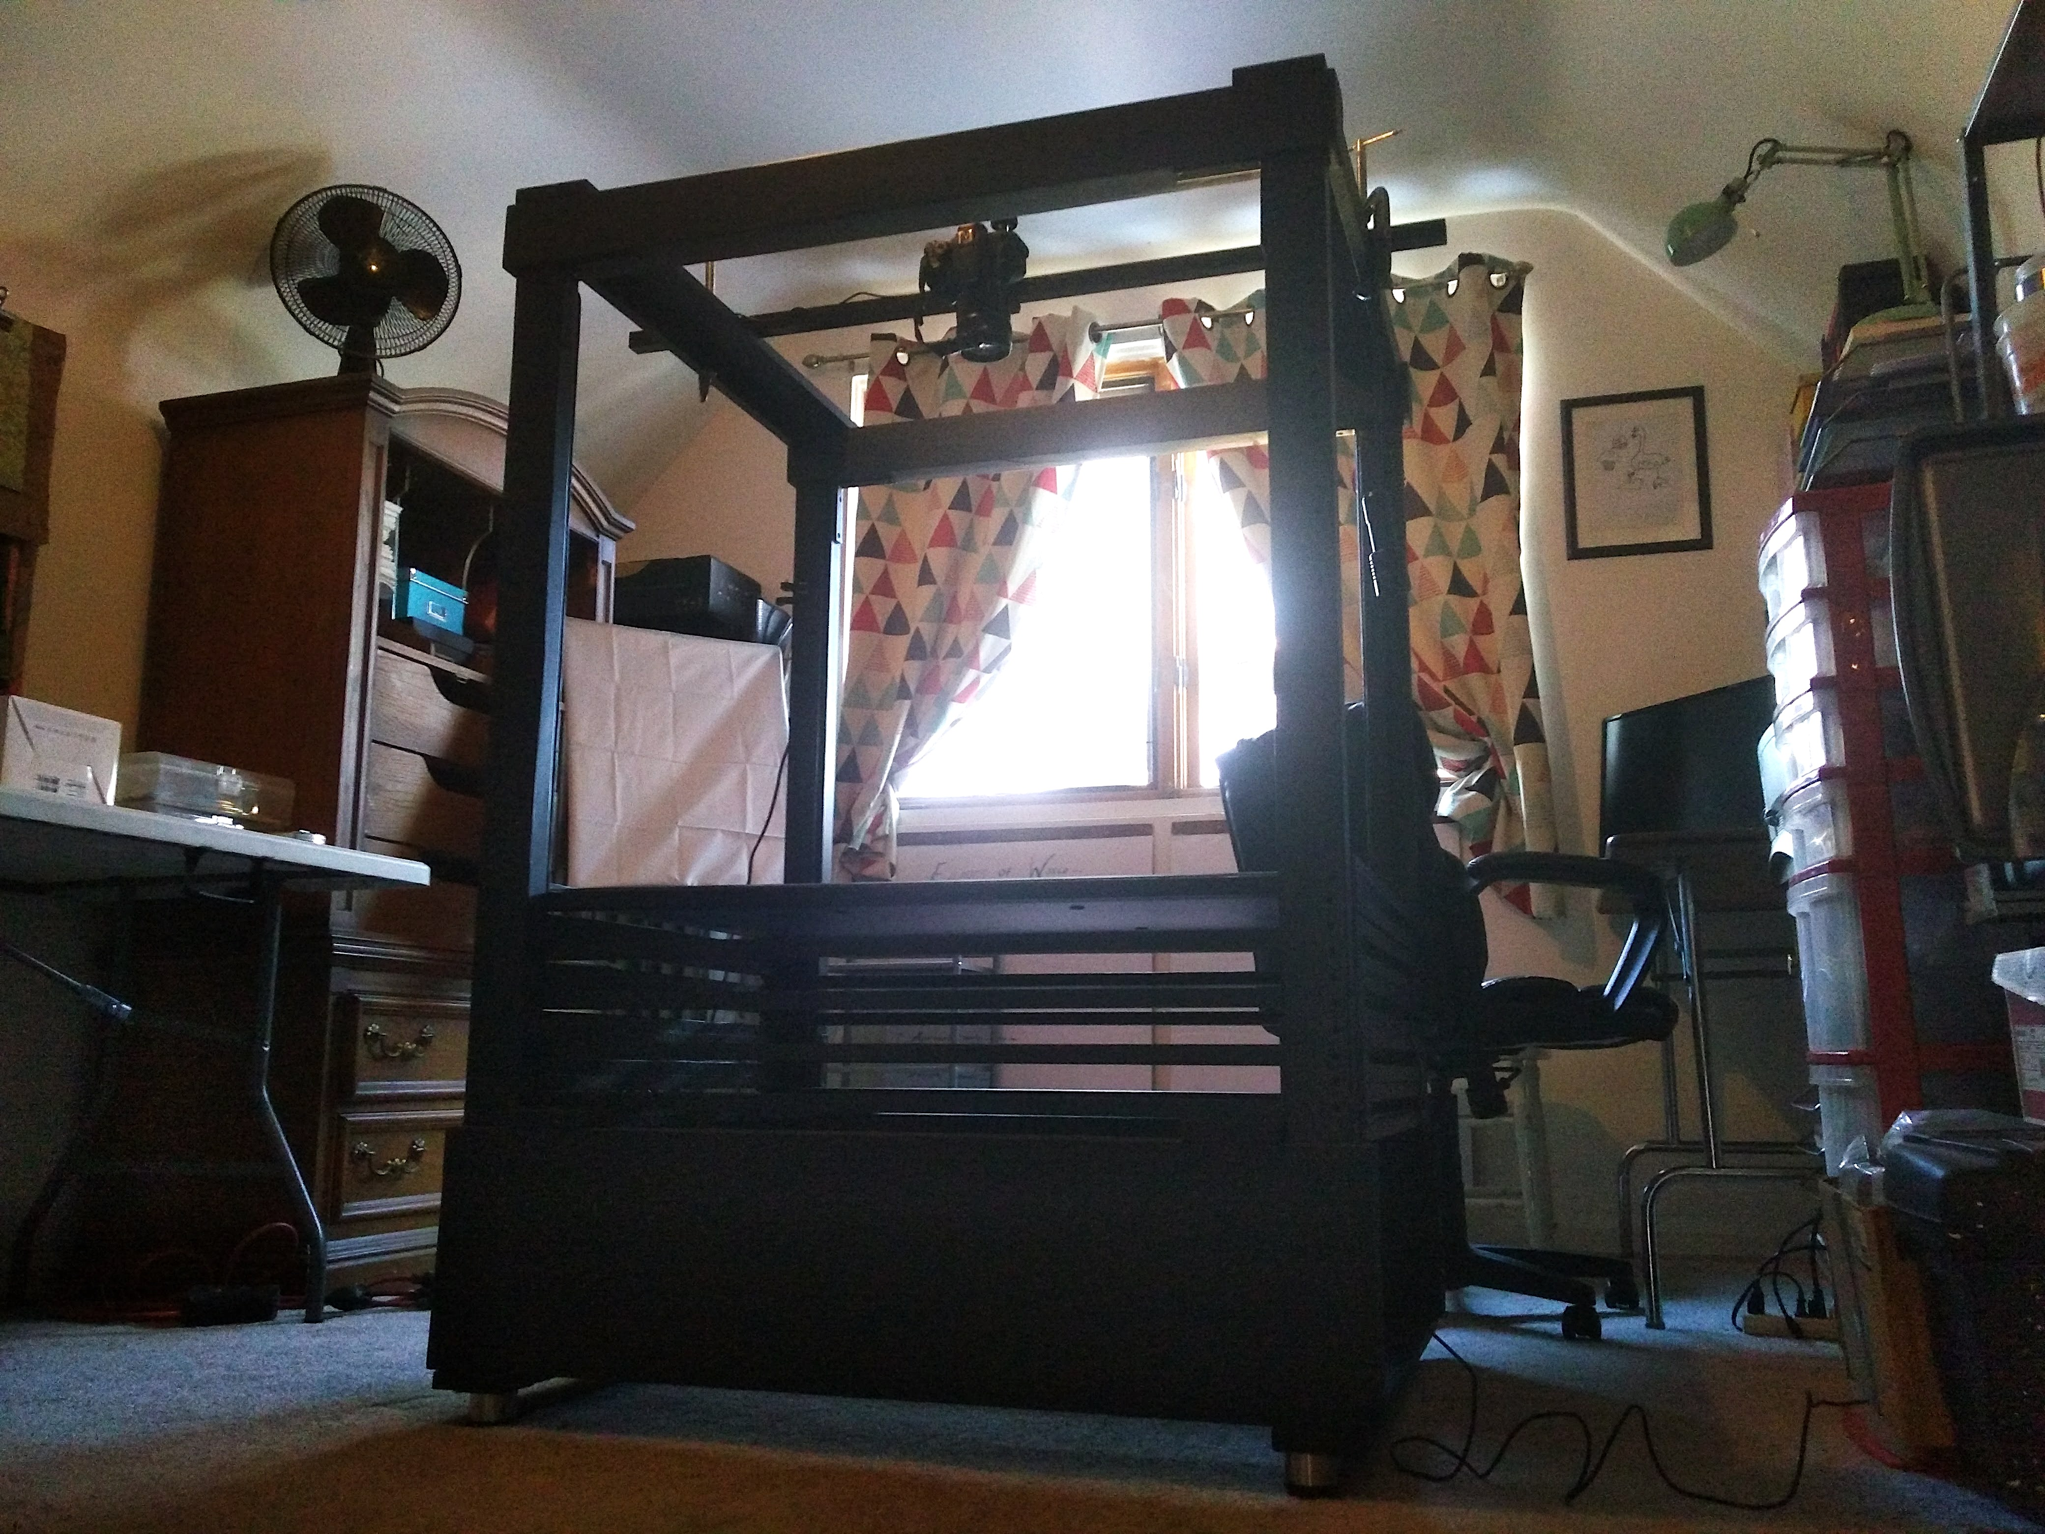

Slide 9
LIBRARY SUPPORT
Mentorship with Jamie Vander Broek
Connection with other librarians (Pablo Alvarez, Jeff Pearson, Meredith Kahn, Phil Hallman, Tim Utter)
Use of Askwith Media Library (animation references)
Use of Clark Library (visual representations of water, digitization on large format scanner)
Use of Groundworks (meetings with media specialists, skill acquisition, use of technology)
Use of AAEL Special Collections (artists’ books)
Use of Special Collections Library (illuminated manuscripts)
Supplies to carry out animation (building materials for stand, paper for cutouts, technical support)

