Slide 1
Digital Studies and Blackness
Black Research Roundtable (RIW)
Presenters: Eshe Sherley and Casidy Campbell

Slide 2
Why does Black Studies matter for Digital Studies?
Notes:
Folks think of digital studies as novel which it partly is for what it affords us, but it’s also important to investigate as a tool of power and its effects on marginalized groups.

Slide 3
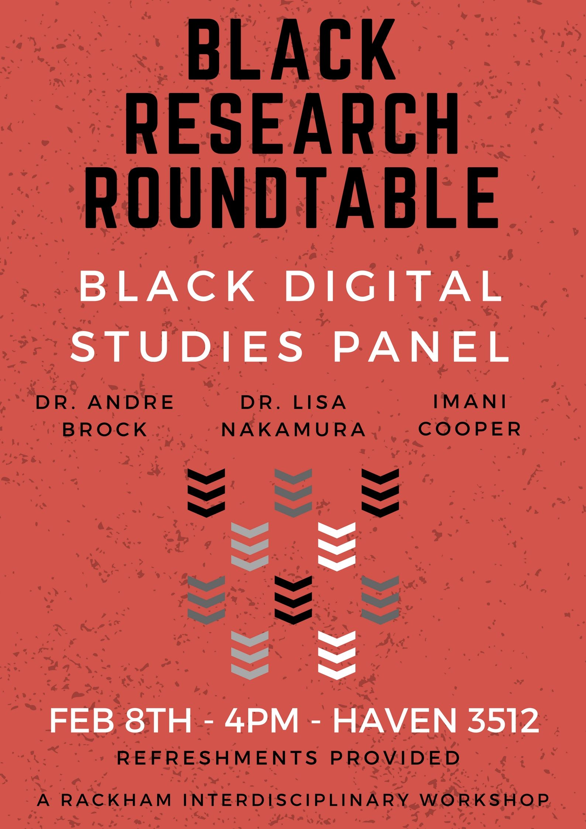
Goals
Access to skills for graduate students and professors
Open conversation about Digital Studies
Showcase work already being done
Notes:
Often their reaction to digital studies because htey see often unexamined progress narrative so what we wanted to try to do is a place where black and digital studies engage and see how its useful to them. And so our three main goals for this project are

Slide 4
Black Digital Studies Panel
For people curious about the intersection of digital studies and interdisciplinary work on the African diaspora and race. Explore what Digital Studies is and how it can be useful across disciplines.
Panelists discussed their own work at this intersection and engaged in a dialogue exploring its implications.
Explor the growing edge of Black Studies and think about how to incorporate these possibilities into research and professional work.
Notes:
Say verbally what we discussed

Slide 5

Next Steps
Digital Skills Workshop
Movie Screening

