Slide 1
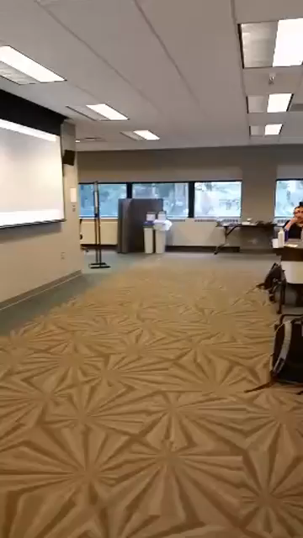
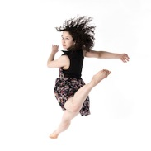

Research Trip to Brazil in Support of MFA Thesis and
Community Engagement Activities- Brazilian Zouk
Sydney Schiff
University of Michigan Library
Mini Grant Project 2018

