Slide 1
“Continuing the Commons Library”
A Comprehensive Presentation of the work done by Library Grant Recipient Erin Similuk

Slide 2
“Until I feared I would lose it, I never loved to read. One does not love breathing.”
-Harper Lee

Slide 3
Background

Slide 4
My Role
Senior nursing clinical at Chelsea Retirement Center
Weekly trips to visit and assist with the residents in Glazier Commons
Library for residents begun by Catherine Doman
  Sorted by Dewey Decimal System
  All books were donated
  Not many large print novels
Noticed the books did not fit the resident’s need

Slide 5
The Problem:
Many geriatric patients suffer from vision loss that can impair their ability to read
Font size is mass printed novels is too small
Needed large print novels for their library
Notes:
Studies have shown that this steady loss of vision can lead to an increase in depression and anxiety in the geriatric patient.
When reading is a large part of your life it can be stressing to lose the ability to do something you once used to love

Slide 6
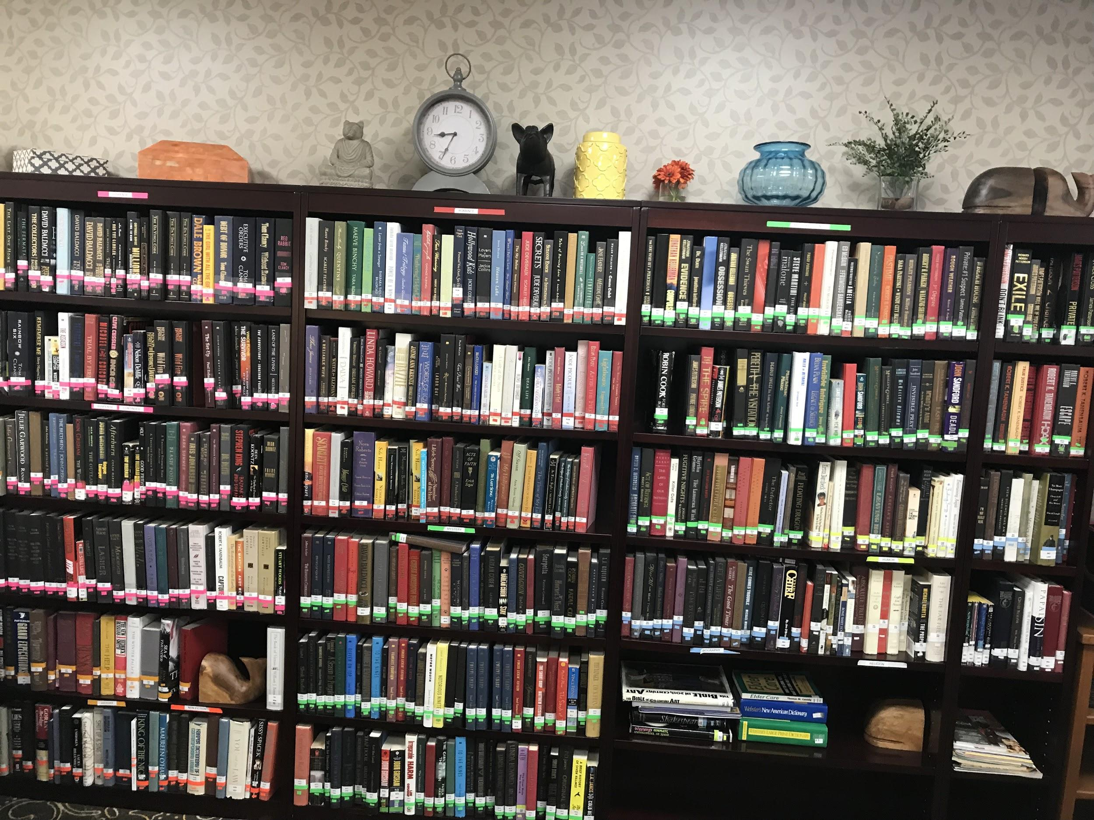
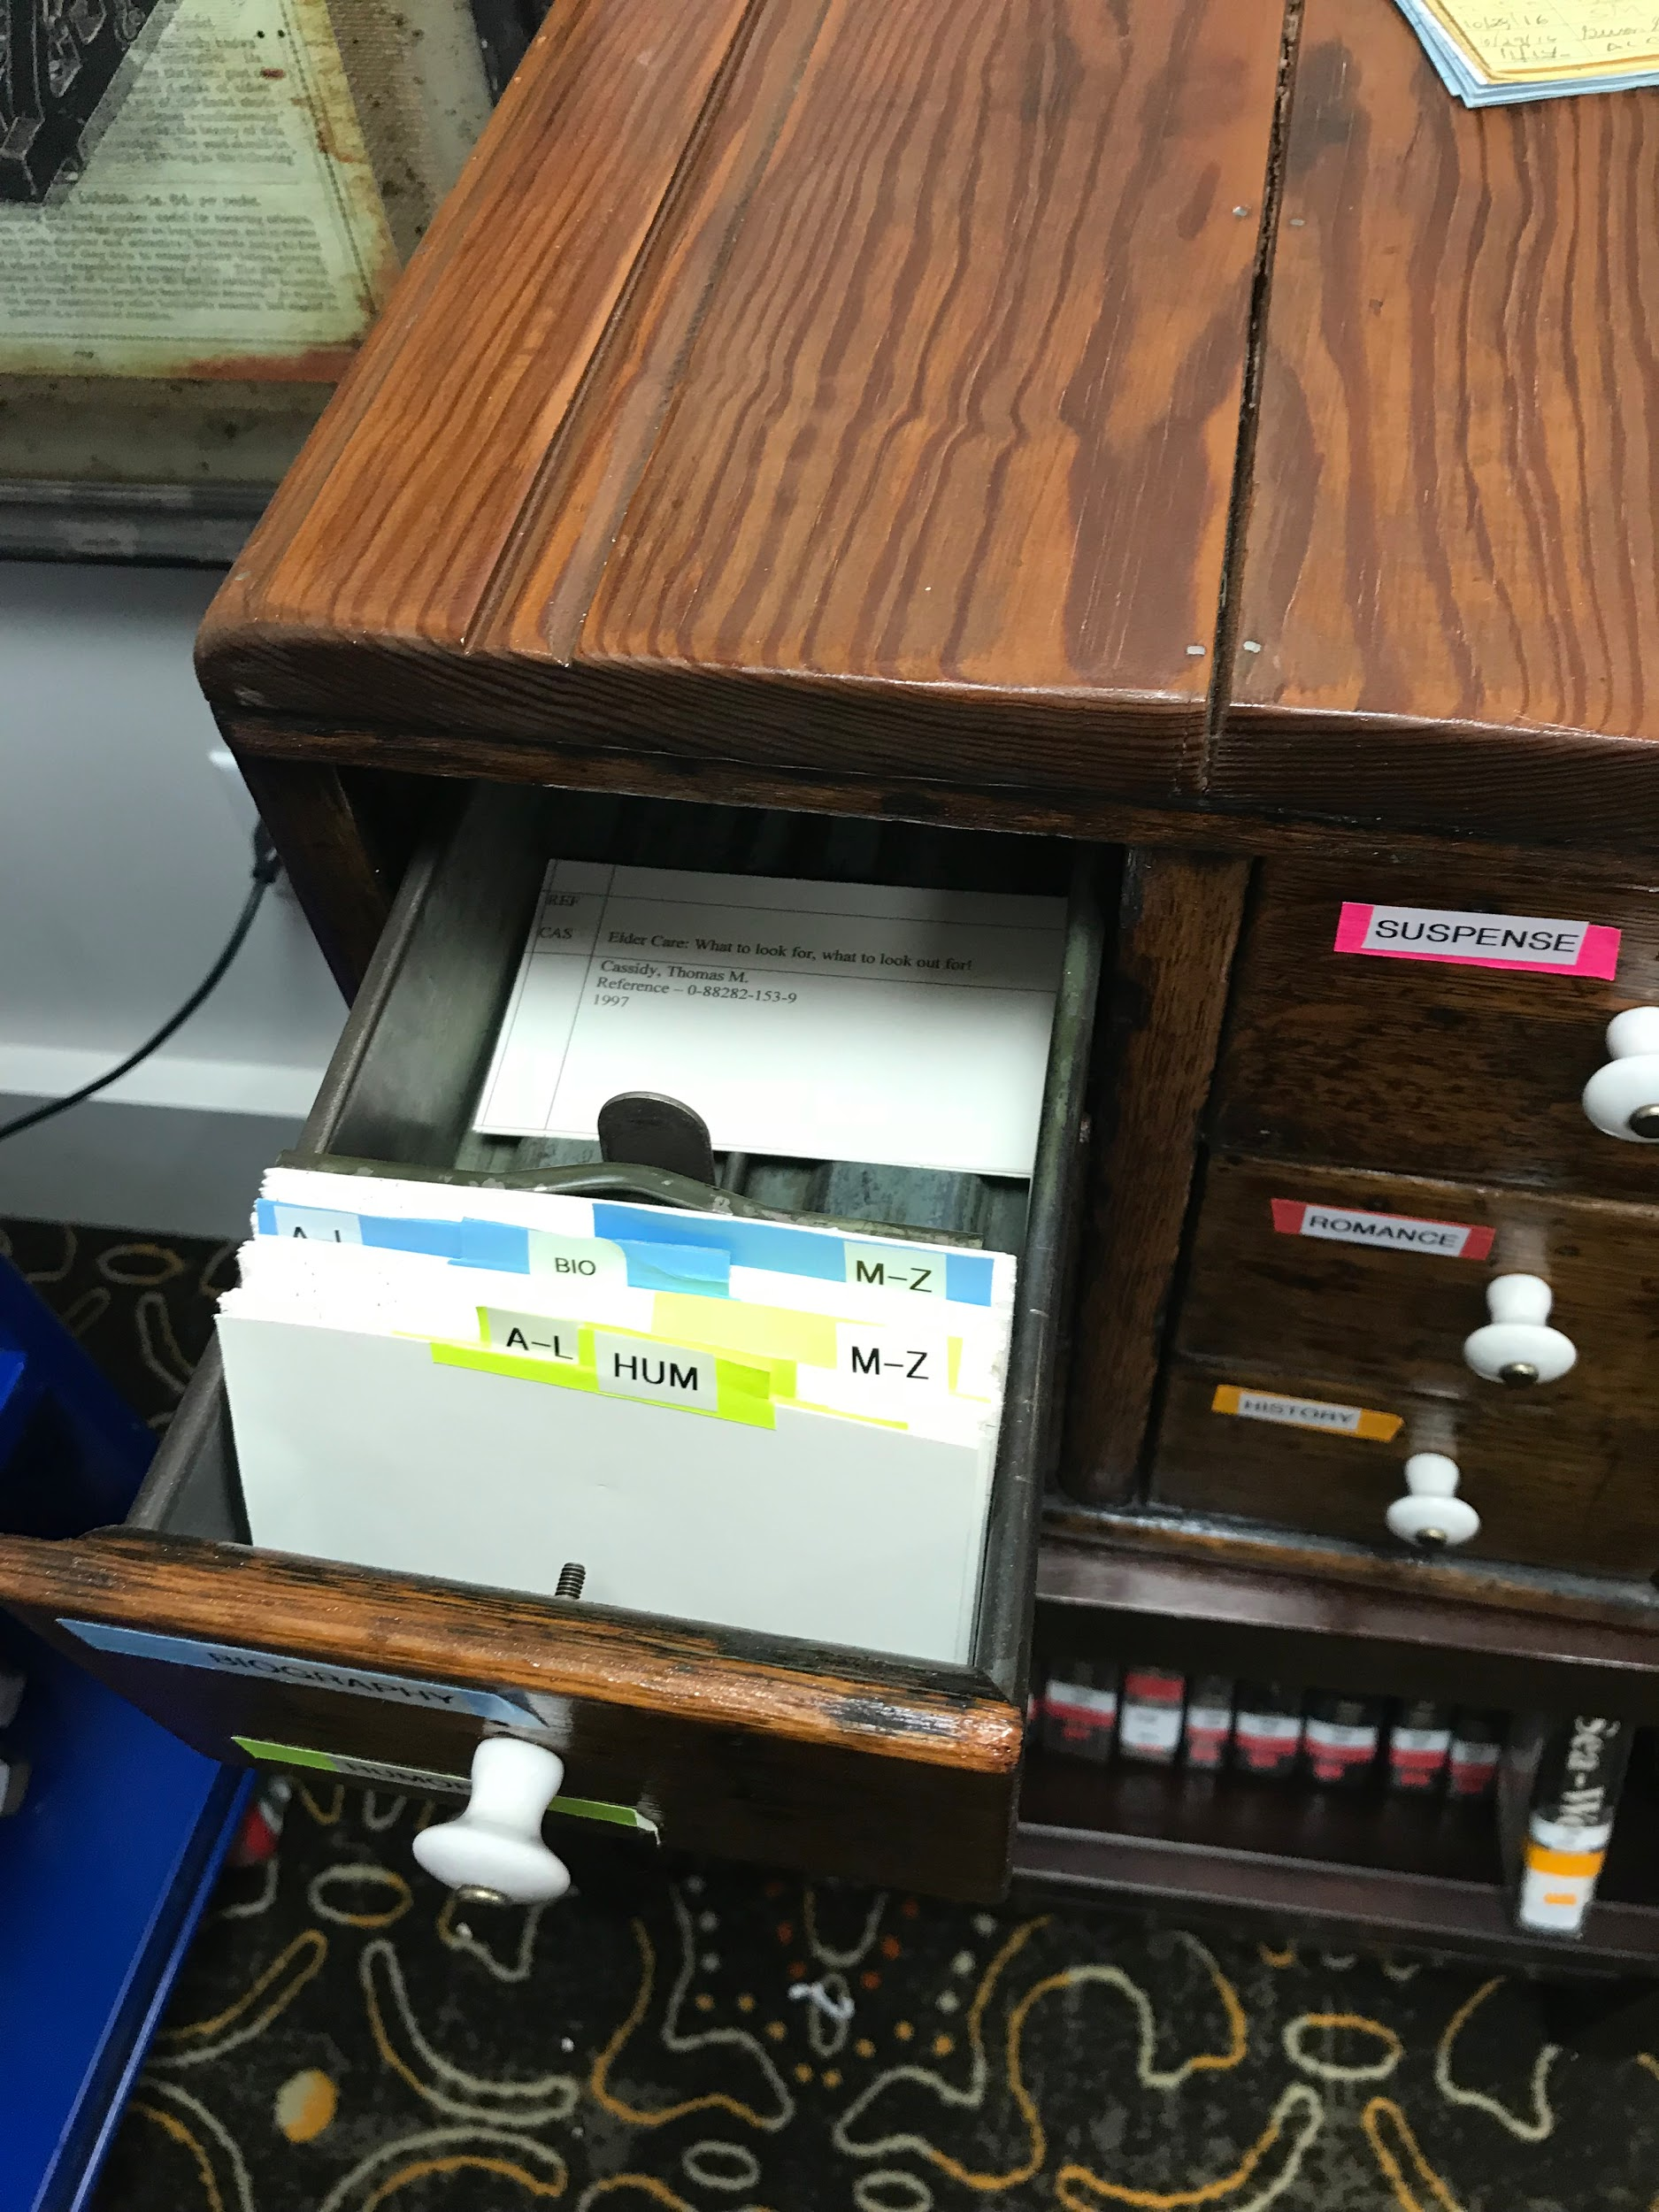
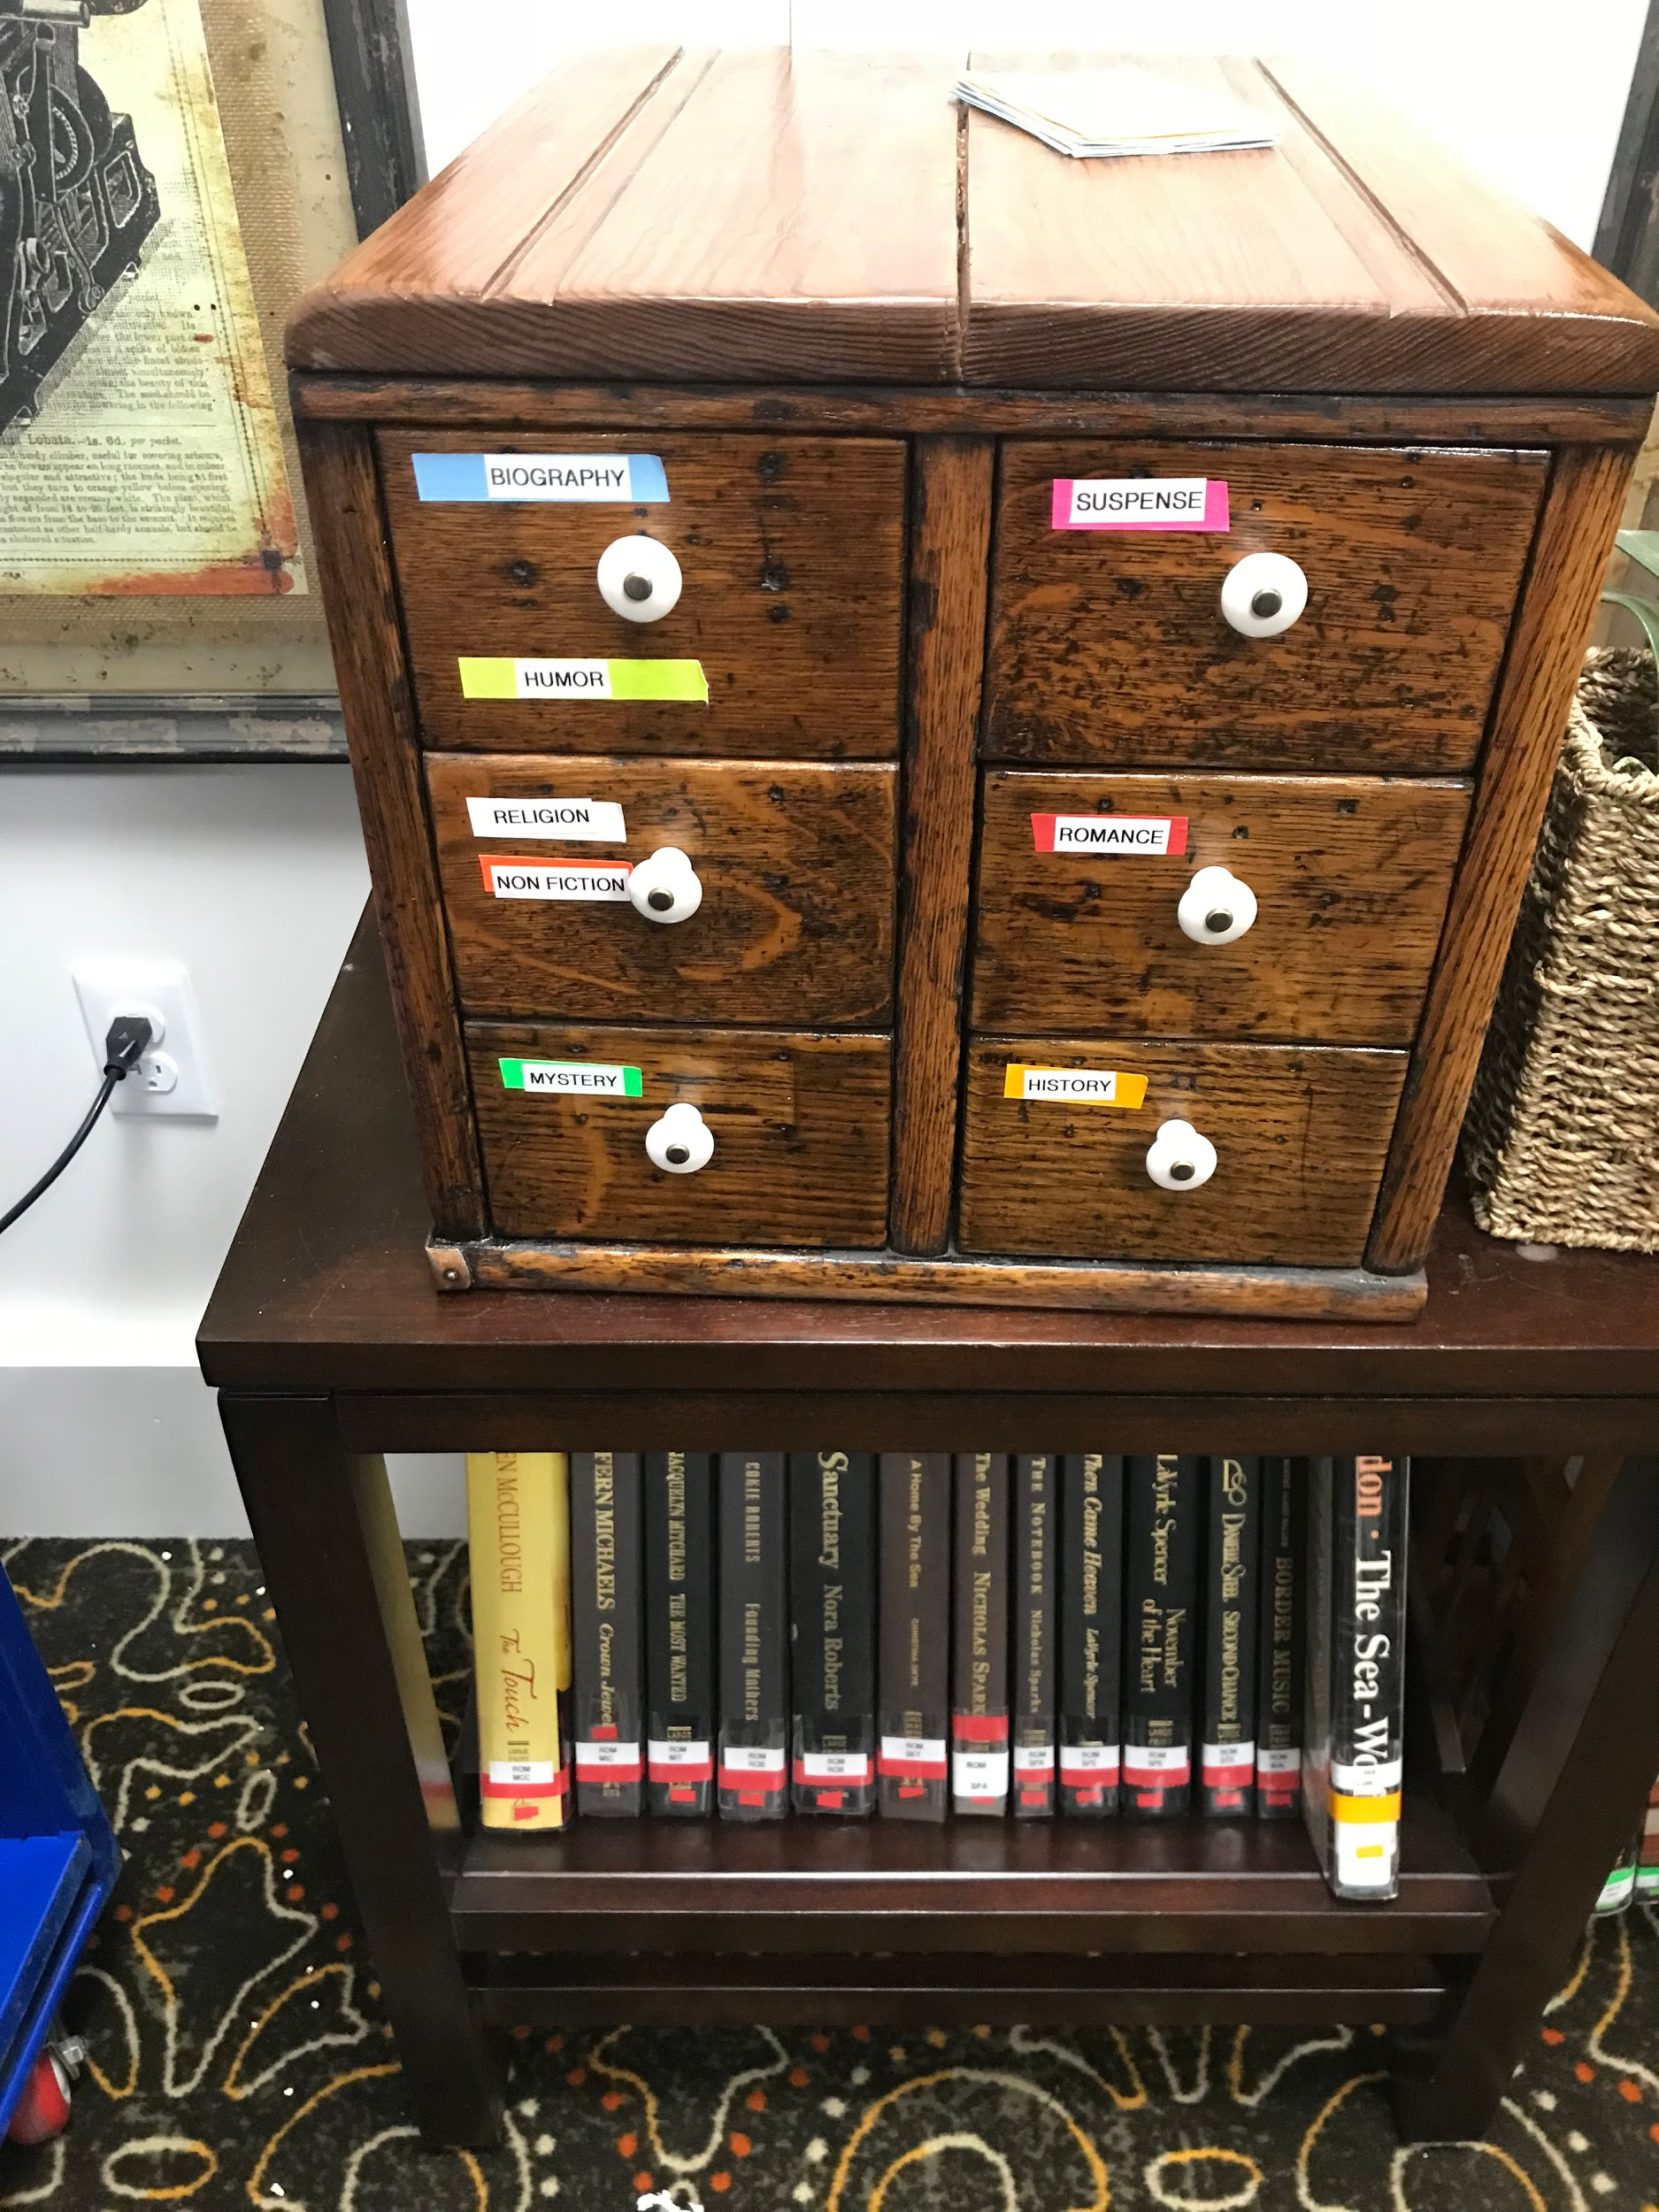
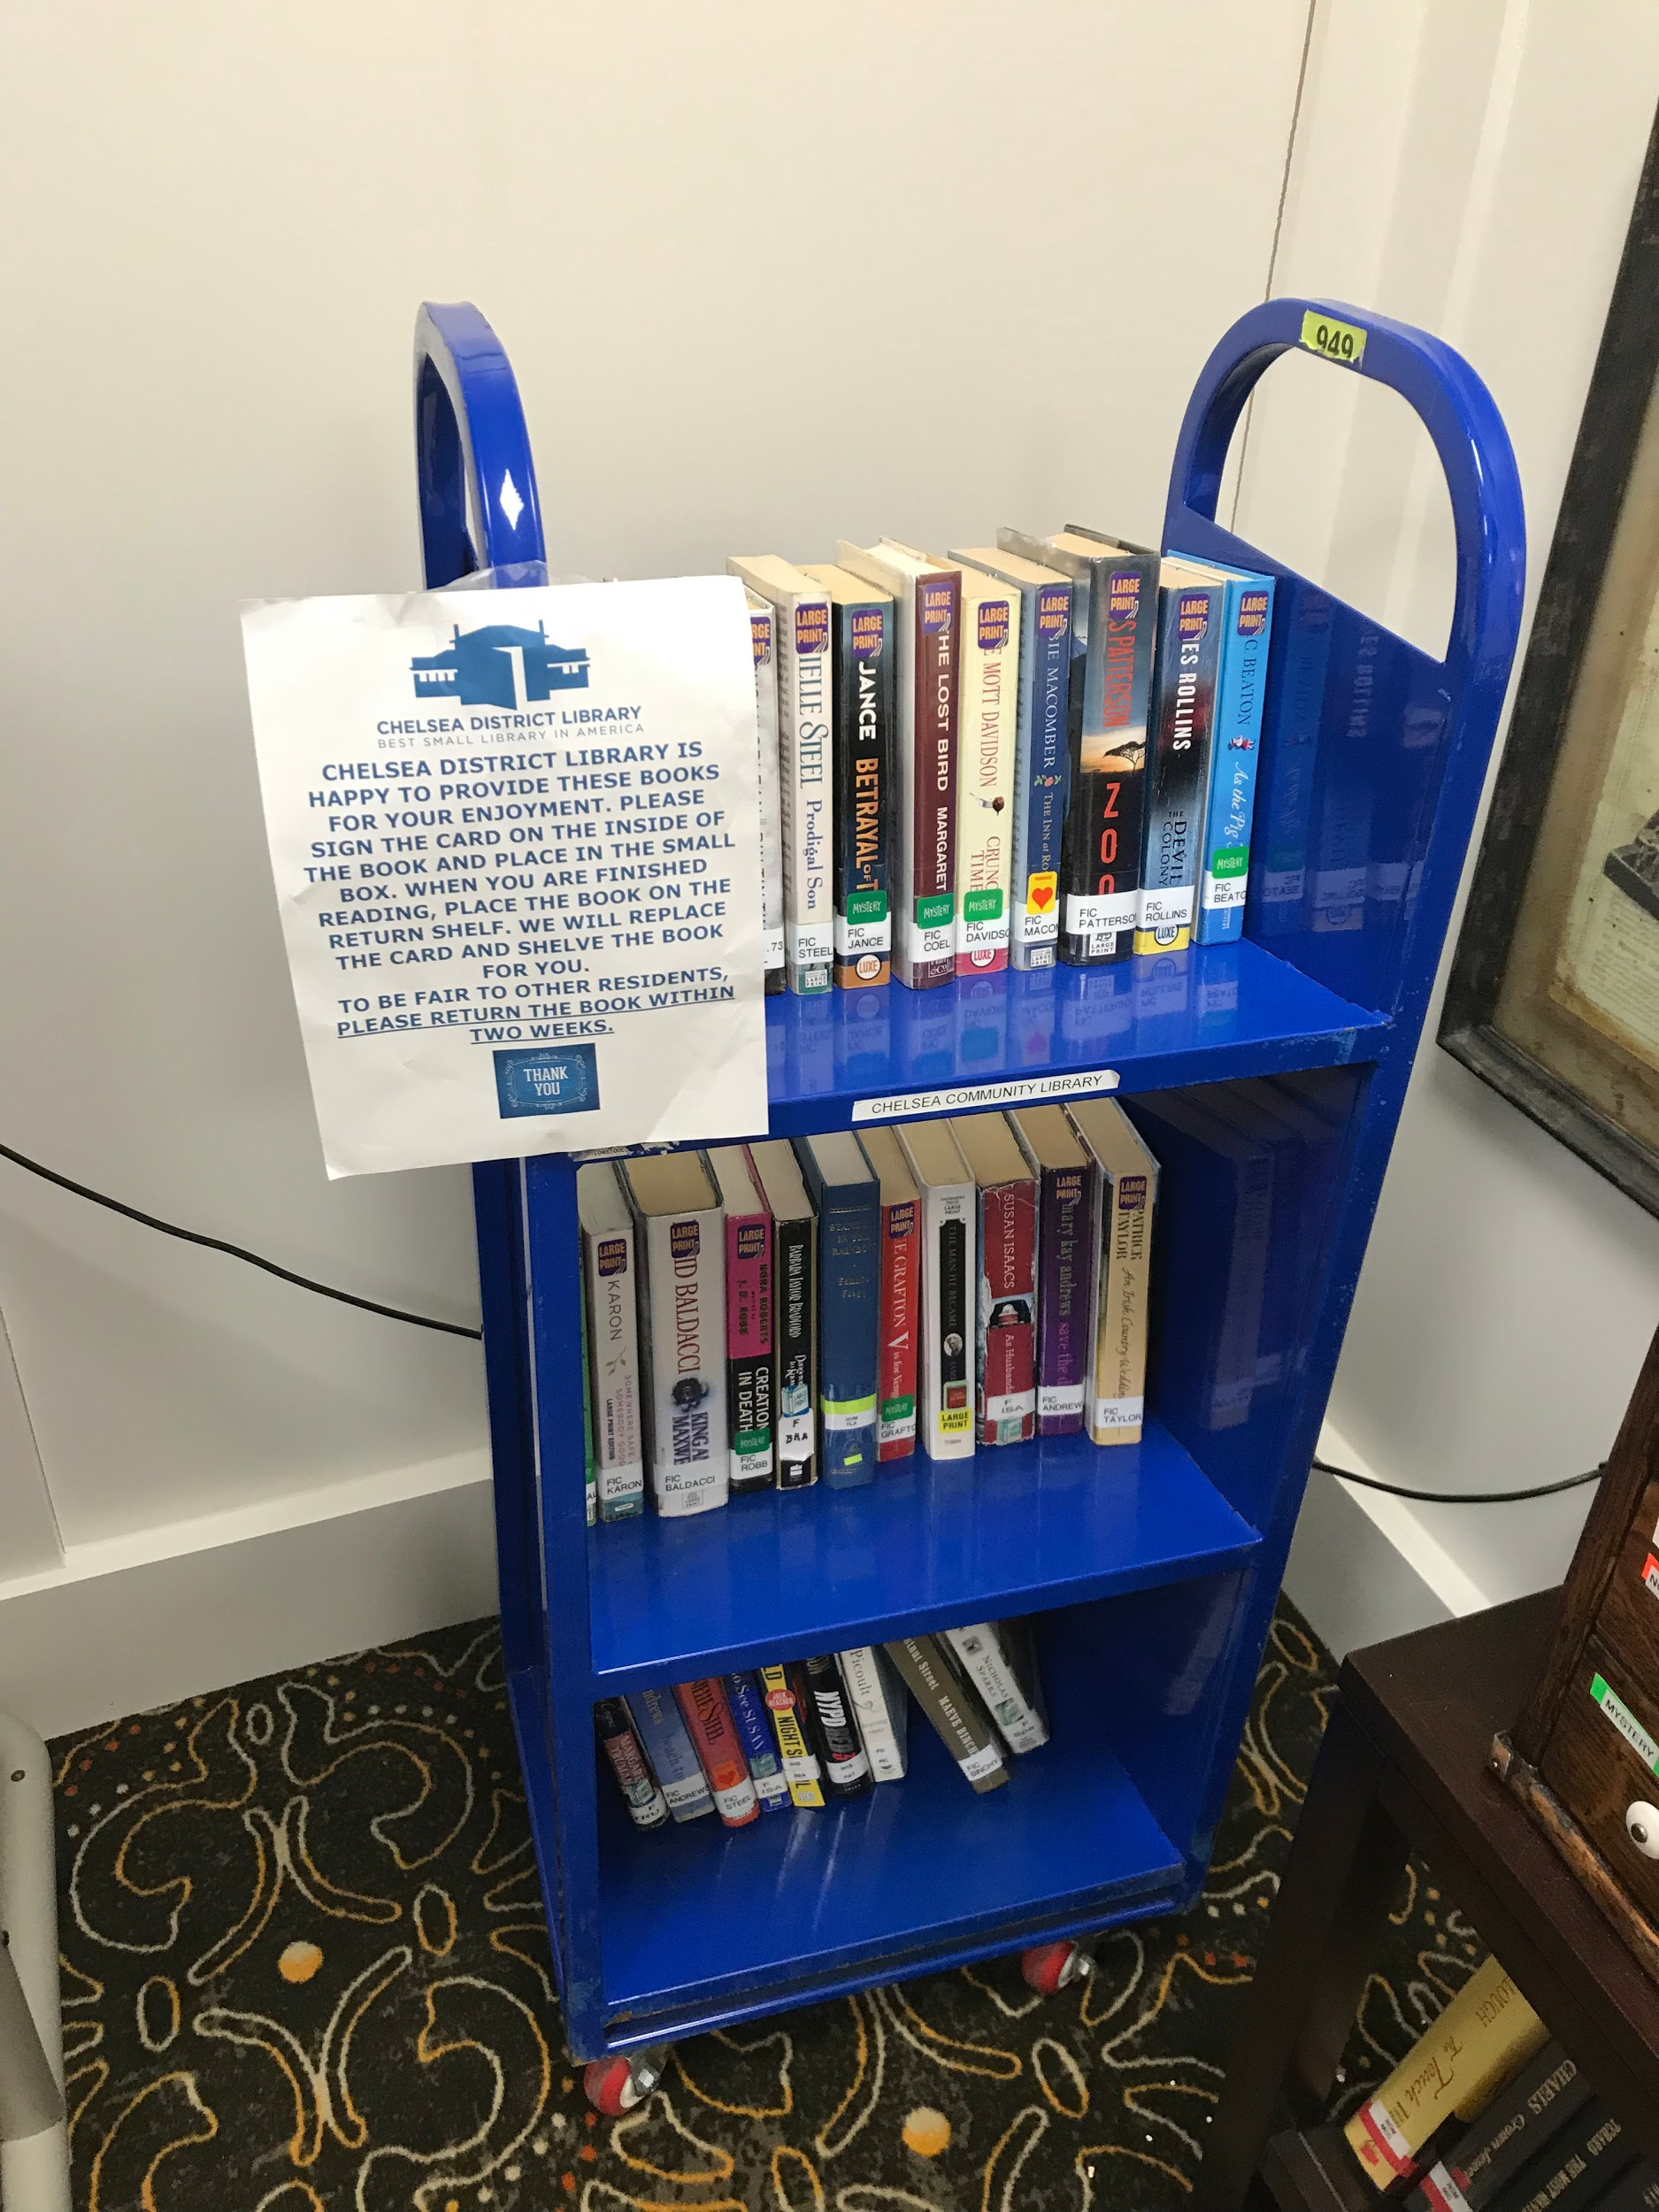
The Library Before...

Slide 7
The Project

Slide 8
Our Objectives
Buy enough large print novels to support a new library
Continue using the Dewey Decimal System to organize novels while also having colors for the residents to see
Sell old library books in a book sale to raise money for the library
Create an efficient check out process to keep track of books
Create a “Reading Buddies” program

Slide 9
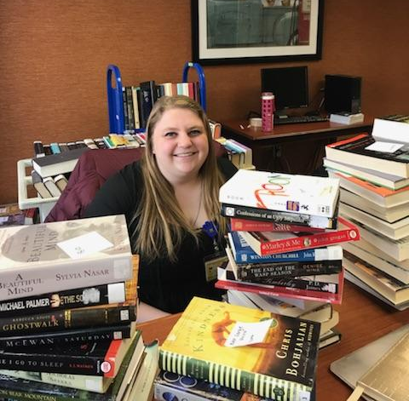
The Books
Used Thriftbooks.com
Bought 185 novels
Were able to categorize into 16 genres
Western
Thriller
Science Fiction
Romance
Mystery
Memoir
Historical Fiction
History
The entirety of our grant was used to purchase these novels
How do you buy enough books for a library?
Fiction
Fantasy
Nonfiction
Contemporary Fiction
Classics
Christian Fiction
Religion
Biography
Notes:
Over the span of a week in January I selected novels for the grant. Using different filters and suggestions from my librarian I was able to select 185 novels for the library. I also received some recommendations from residents about which genres they would like to see

Slide 10
The Next Steps

Slide 11
Reading Buddies
Creating a flyer to provide for volunteers outlining responsibilities
Reaching out to various University of Michigan clubs regarding this volunteer opportunity
  Circle K
  Companions Through the Ages
Reaching out to various groups in Chelsea, Michigan
  Church organizations
  Chelsea Public Library
  High Schools in the area

Slide 12
The Library
Anticipate adding the novels into the library in the next coming weeks
Implementing our check-out process
Official opening with the residents will be in March
Health Fair hosted by the nursing cohort
  Selling old library books
  advertising our work for the new library
  Sign up for “Reading Buddy” volunteers

Slide 13
Summary
With the help of the library staff and my clinical team we’ve been able to accomplish many of our goals and our making progress towards completing all we’ve set out to do with this grant
Bought 185 novels for the library
Are sorting and placing them in the actual location for use by the residents
They will be easily identified and kept track of with our Dewey Decimal and check out systems
“Reading Buddies” will start and become an opportunity to connect young adults with the older population of the residents at Chelsea Retirement Center

Slide 14
Acknowledgments
Catherine Doman- Without her, this library would not exist and be able to thrive as well as it has. She is an inspiration, and I will strive to be half the nurse that she is.
Pam McIntosh- Your support has not gone unnoticed and I thank you for all your help with finding resources and being successful.
Robert Bilsky- For his unwavering support with cataloging the novels and keeping me on track with everything I need to do.
The University of Michigan Libraries- For providing this grant and giving me the opportunity to work with a population near to my heart and provide them with the opportunity to continue reading.

