Slide 1
ICPSR Census Metadata Repository
Margaret Levenstein & Jared Lyle
NADDI 2018
Washington, D.C.
April 5, 2018

Slide 2
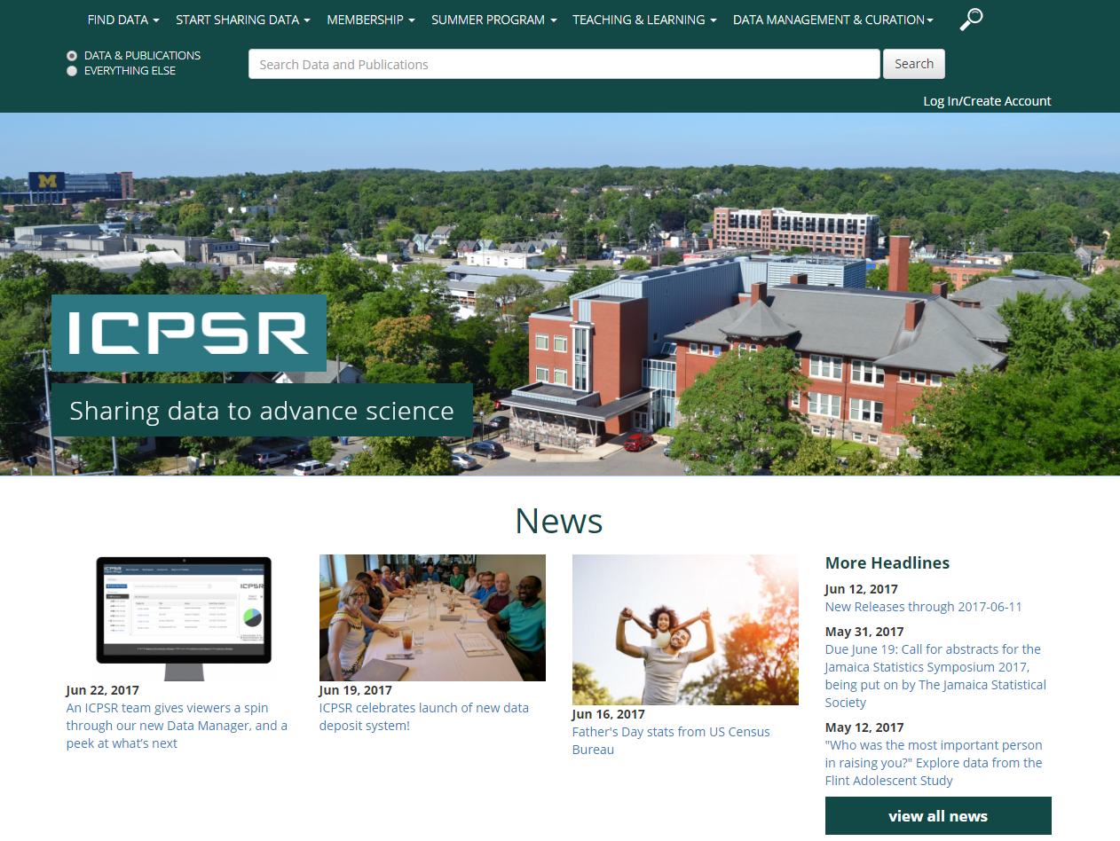
http://www.icpsr.umich.edu

Slide 3
ICPSR Today
750+ members around the world
  ~400 U.S. institutions
  40+ national memberships
Data dissemination for more than 20 federal and non-government sponsors
600,000+ Web visitors per year
10,000+ data collections

Slide 4
“I've been tasked with finding ways for us to share our survey instruments, specifications, data dictionaries, and more…”

Slide 5

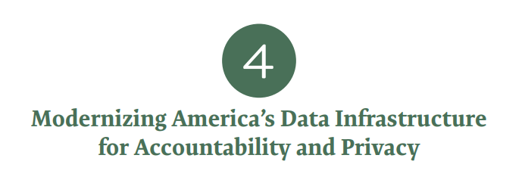
"The Office of Management and Budget should increase efforts to make information available on existing Federal datasets including data inventories, metadata, and data documentation in a searchable format.“
-Commission on Evidence-Based Policymaking (Recommendation 4-5)
Notes:
https://www.cep.gov/cep-final-report.html
“With robust metadata, researchers inside and outside government will be better able to identify which data are needed and useful for answering policy questions, conducting program evaluations, and reducing inefficient and unnecessary data requests. These metadata should be sufficient to allow users to assess quality and implement privacy-enhancing data matching technologies, such as Secure Multiparty Computation. The metadata must also allow the NSDS and OMB to assess the sensitivity of data in specific contexts and to determine access restrictions and privacy protection protocols as described in Recommendation 2-8. “

Slide 6
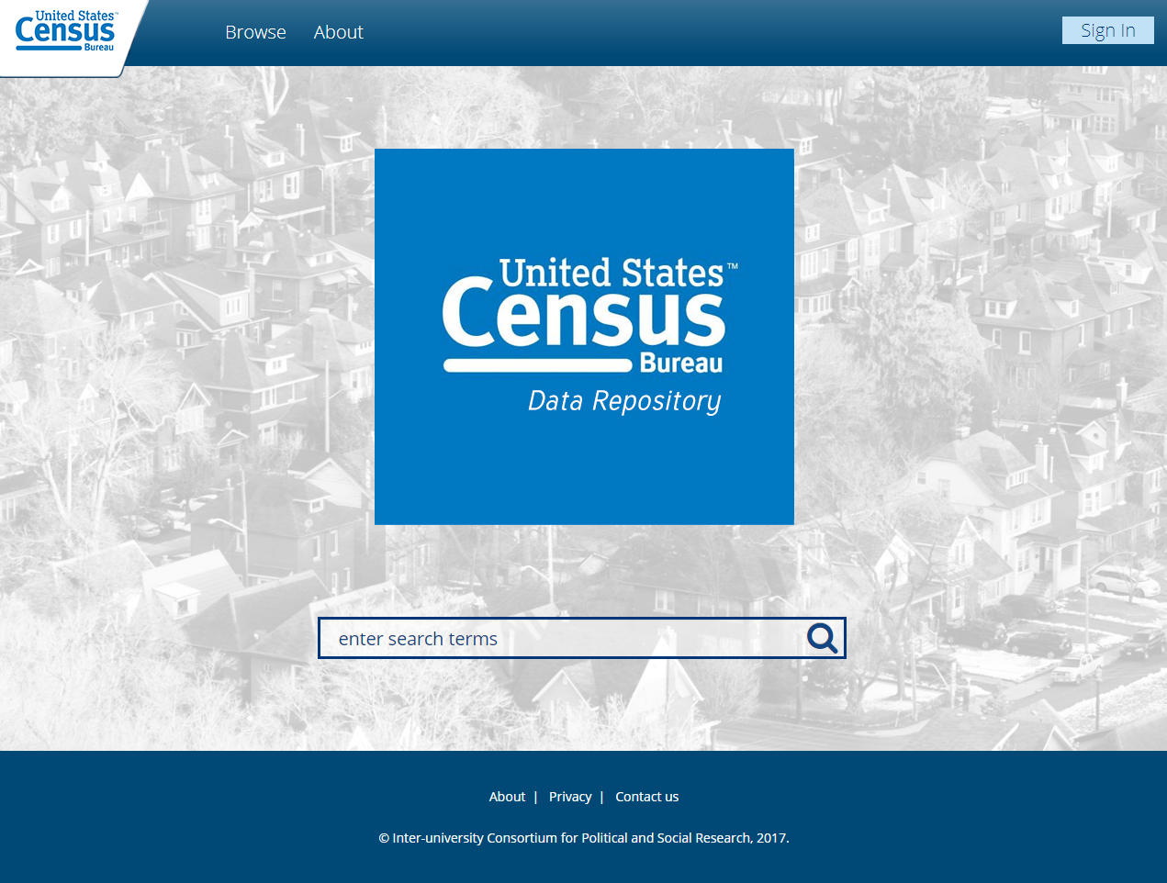
https://census.icpsr.umich.edu/
Notes:
https://census.icpsr.umich.edu/

Slide 7
Features
Deposit (transfer content to trusted repository)
Catalog record
  Descriptive information
  Citation
  Related publications
Discovery (search & browse)
Long-term preservation

Slide 8
Metadata based on DDI-Codebook

Slide 9
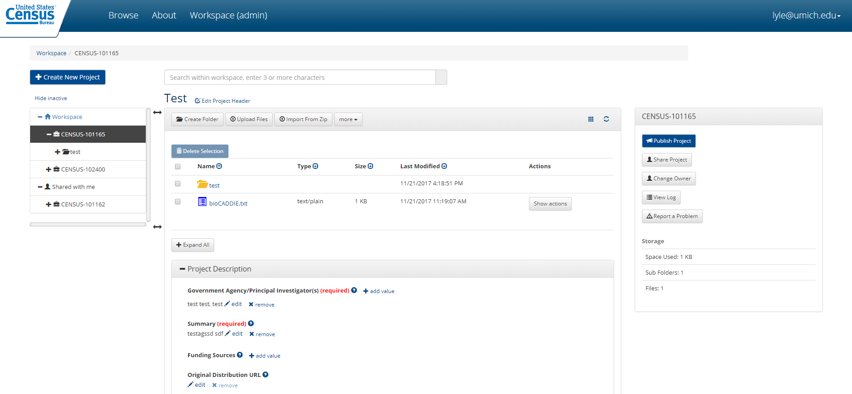
Deposit

Slide 10
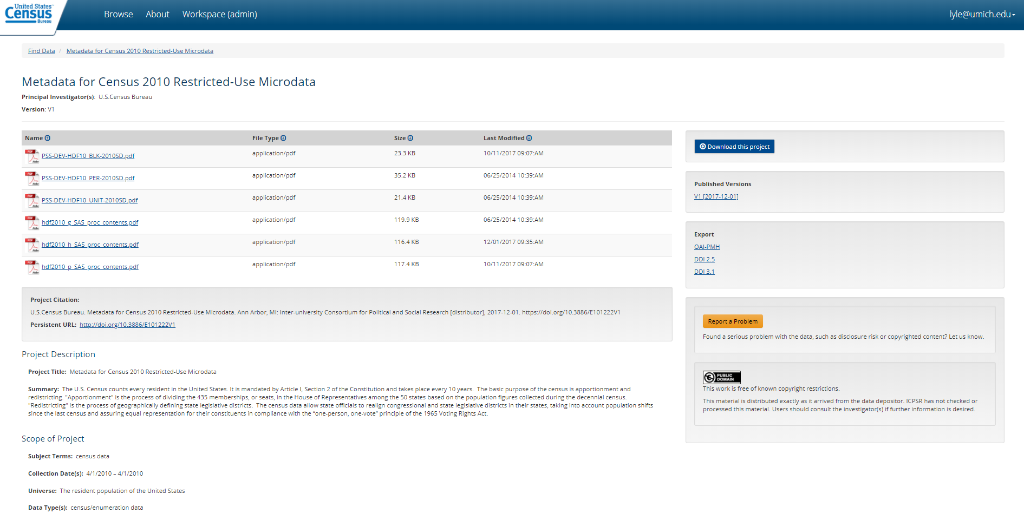
Catalog Record
http://doi.org/10.3886/E101222V1

Slide 11
Discovery

Slide 12
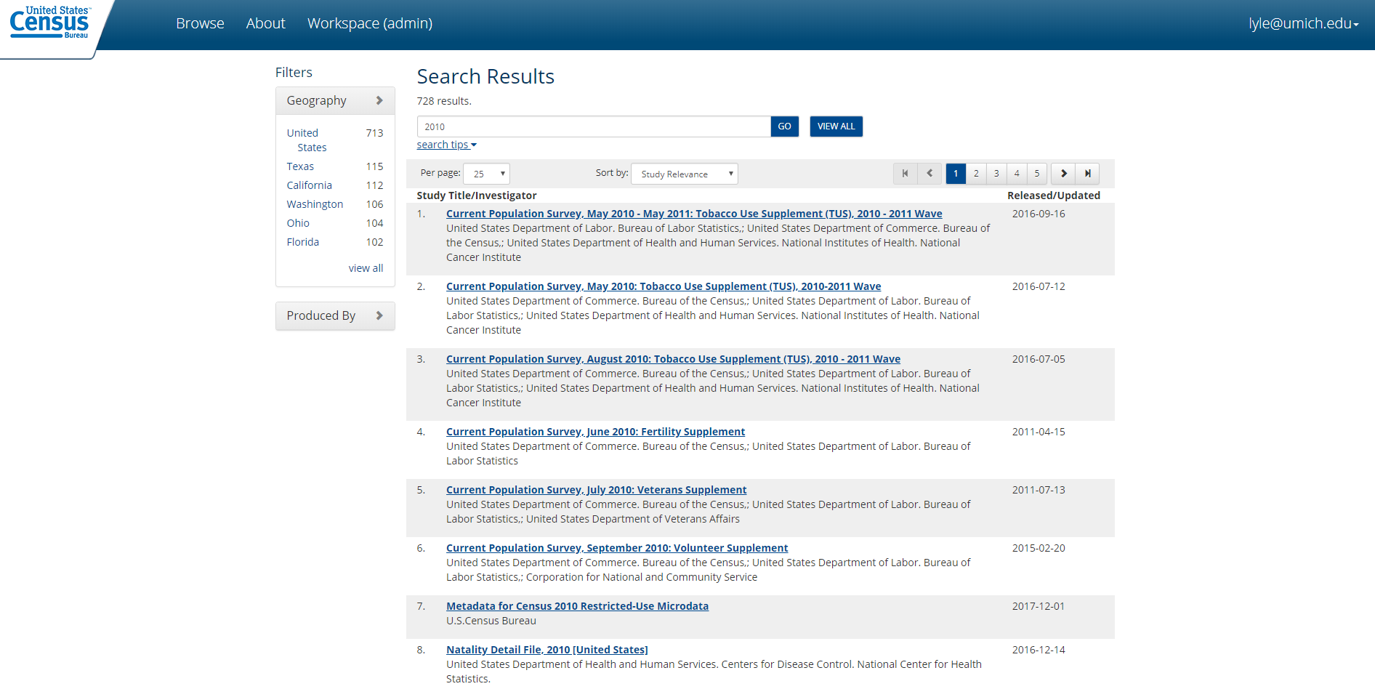

Slide 13
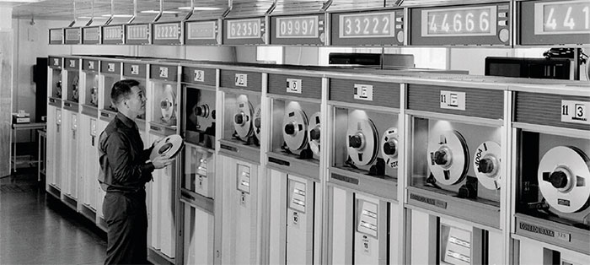
Long-term Preservation
http://images.iop.org/objects/ccr/cern/56/5/20/CCdat1_05_16.jpg

Slide 14
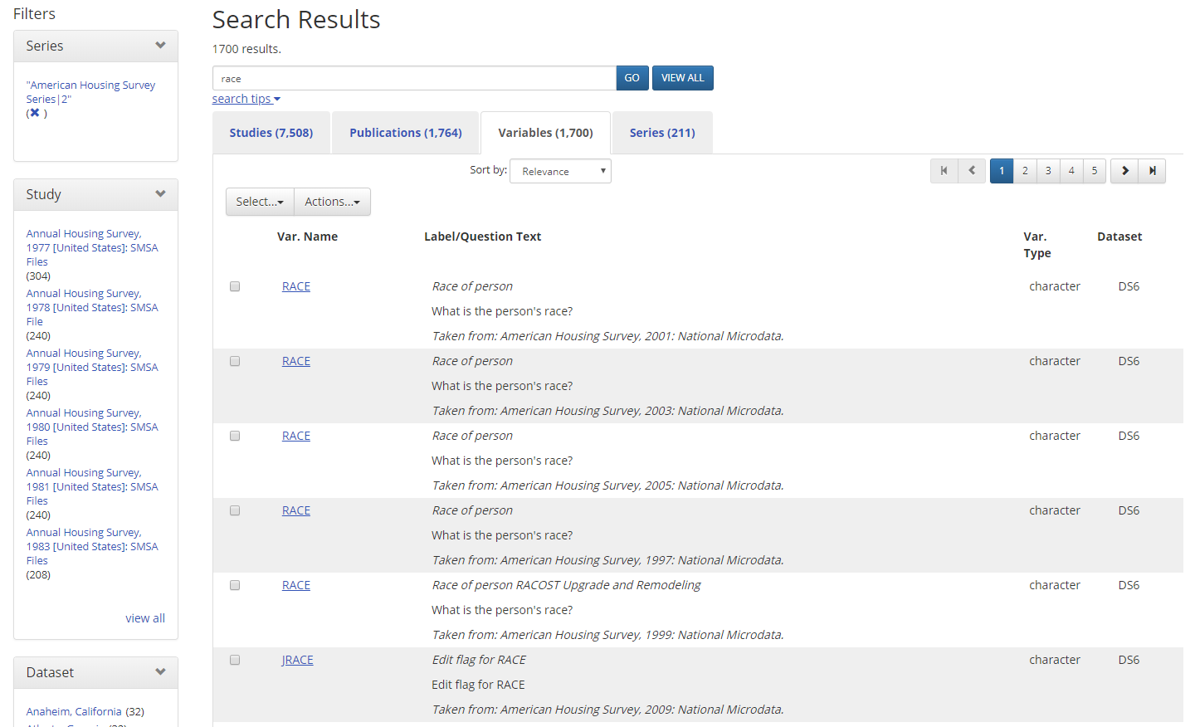
Variable-level Metadata

Slide 15
Future Collaboration

Slide 16
Thank you! maggiel@umich.edu lyle@umich.edu

