Slide 1
Optimizing data ingest:
Experiences from ICPSR
Jared Lyle
Abay Israel
Justin Noble
Notes:
Data ingest -- the process by which data and related materials are deposited with an archive -- is the crucial entry point upon which all subsequent curation, preservation, and dissemination activities rely. Ingest includes describing and transferring files, as well as obtaining legal permissions necessary to establish adequate legal and intellectual control over digital objects. This presentation discusses recent activities at ICPSR to optimize the data ingest process. By optimization, we mean making the process as easy and convenient for the depositor while gathering as much information about the data collection to enable reuse and preservation.
Specific discussion points will include (1) a brief history of ICPSR's data ingest process; (2) a comparison of other archives' data ingest processes; (3) recent improvements and enhancements to the ICPSR data ingest process, including from a major update in June 2017; and (4) lessons learned from the June 2017 update.
https://www.openconf.org/IASSIST2018/modules/request.php?module=oc_program&action=summary.php&id=167

Slide 2
Outline
Data ingest goals
Brief history of ICPSR's data ingest process
Ingest processes from other repositories
June 2017 improvements and enhancements
Lessons learned & future improvements

Slide 3
Data Ingest Goals
Transfer:
Content
Metadata
Legal permissions
Notes:
Acquisition, sometimes called deposit, enables depositors to transfer their material to an archive, through describing the data collection, sending the data and metadata, and approving legal permissions. The deposit form solicits information about the data collection, which can include: citation, summary, methodology, sampling, and relevant restrictions. An archive uses this information later in the process to complete the study description, or metadata, found in the online catalog.
For complex data or collections with significant disclosure risk, archives can add tailored plans. These plans outline suggested processing and dissemination strategies that reflect the target audience, the inherent confidentiality risks, and the proposed data discovery or dissemination tools.
What should the deposit process look like? One simple button that transfers content (ala Dropbox)? A form to also capture comprehensive metadata? Something in-between?

Slide 4
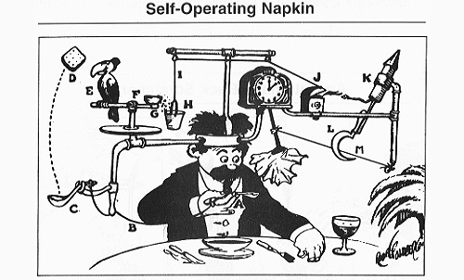
Content
http://www.gizmodo.com.au/2010/08/rube-goldberg-the-man-behind-the-machines/
Notes:
How easy or complex should your deposit process be?
Data can be acquired by an archive through an online deposit form and/or via mail. A Web portal allows instantaneous transfer, as well as quality checks to insure that data are not lost or corrupted during transmission. Mail submissions are slower and not as secure, although some data collections include hard-copy materials that require physical postage.
Deposit forms don’t need to be Rube Goldberg contraptions -- “deliberately over-engineered or overdone machine that performs a very simple task in a very complex fashion”.
A major consideration is how much information do you want the depositor to provide vs. how much your archive will collect yourself or behind the scenes?

Slide 5
Atari’s “Star Trek” instructions:
Insert Quarter.
Avoid Klingons.
-See Isaacson’s Steve Jobs
Notes:
Ideally, ingesting content should be as simple as Atari’s “Star Trek” instructions.
“These instructions were easily understandable by anyone and emphasized how wrong it was of the tech community to take an attitude of "if you don't get it, it's your own fault."” (source of this quote: https://www.slideshare.net/ProcessStreet/11-profound-influences-on-steve-jobs-design-philosophy)

Slide 6

Metadata
https://www.adn.com/arts/2017/01/20/artists-take-over-the-asylum-with-igca-member-show/
Notes:
What are incentives you can use to encourage depositors to do a thorough job?
I’ve noticed a tension in repositories between the library-side and the IT side. Librarians tend to want more and more metadata, and justifiably so. More metadata can mean richer description of collections, which can lead to better findability.
IT, though, prefers simplicity and elegance -- i.e., fewer questions. This is also a good thing since depositors’ attentions and time are limited.
How can we balance simplicity and thoroughness? And what incentives can we provide to straddle both needs?

Slide 7
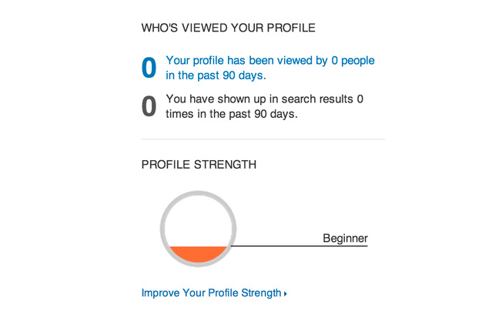
https://blog.kissmetrics.com/the-progress-bar/
Notes:
This example of incentives comes from LinkedIn.

Slide 8
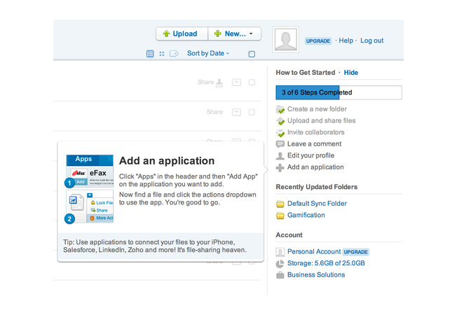
https://blog.kissmetrics.com/the-progress-bar/

Slide 9
Legal permissions
Do they have authority to deposit the content with you?
Can you then modify, reformat, preserve, describe, and redisseminate?
Are there any human disclosure issues?
Notes:
What legal issues do you address at deposit?
Legal permissions are also transferred upon acquisition. These permissions grant the repository rights to transform, preserve, and/or redistribute the data collection. One or more persons who owns the data or who has the authority to deposit the data provides a signature.
Legal issues that can arise: IPR, copyright, HIPAA.

Slide 10
Brief history of
ICPSR's data ingest process

Slide 11
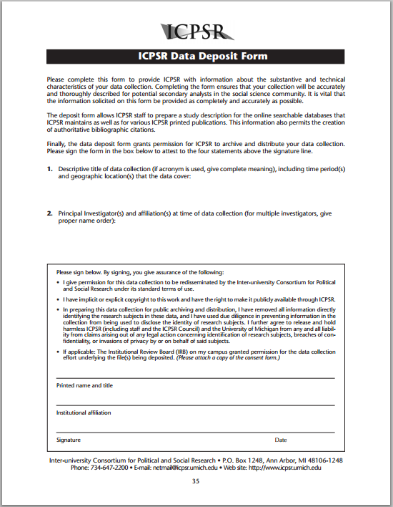
Pre-2007
Notes:
Pre-2007, deposits were accepted only via mail.

Slide 12
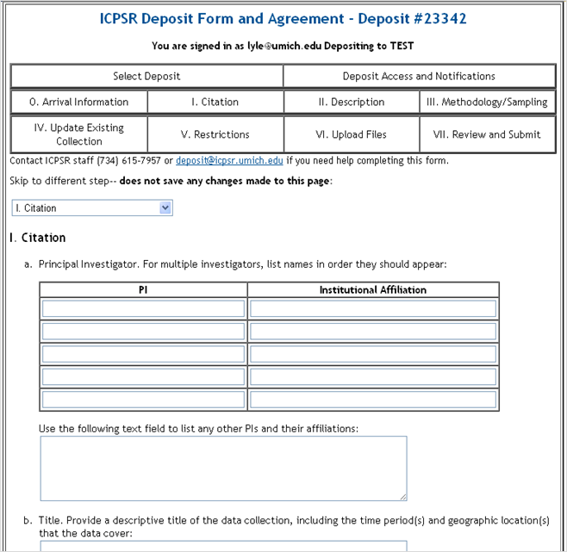
2007
Notes:
In 2007, we built an online form.

Slide 13
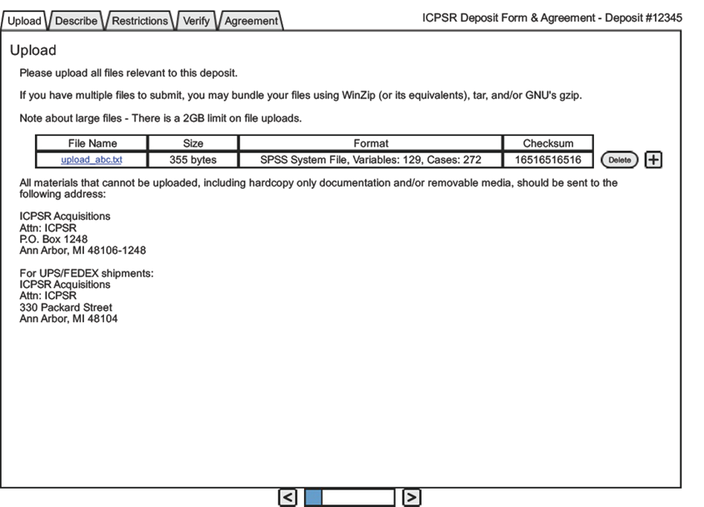
2010 Mock-up
Notes:
Issues to fix:
aa. "Too long and daunting"
a. Have two versions of form: quick version & long version.
b. Signature portion of form is confusing. Might explain why deposits don't get signed or linger for a while.
c. People don't understand what to do at the end of the form. Need more instructions at the front. More instructions, in general.
d. Data deposit link doesn't include access notification information, which was recently added.
e. Inventory notification doesn't mention the archive or authorized depositors.
f. Some people balk at the terms of use. Should clarify or simplify.

Slide 14
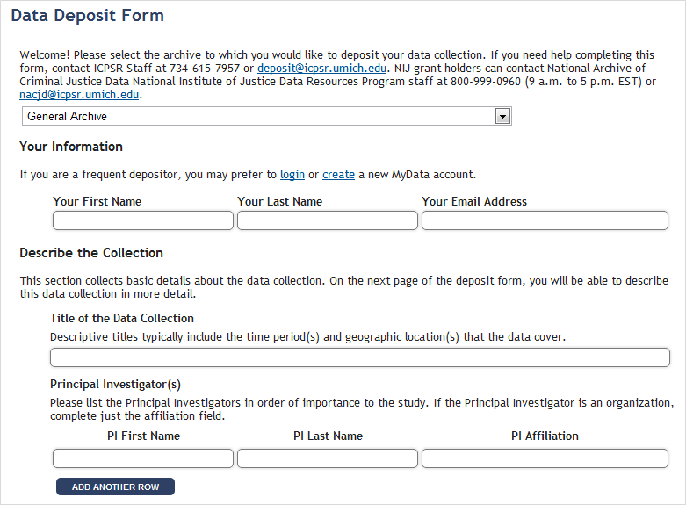
2012
Notes:
In 2012, we revised the form.

Slide 15
Ingest processes from other repositories

Slide 16
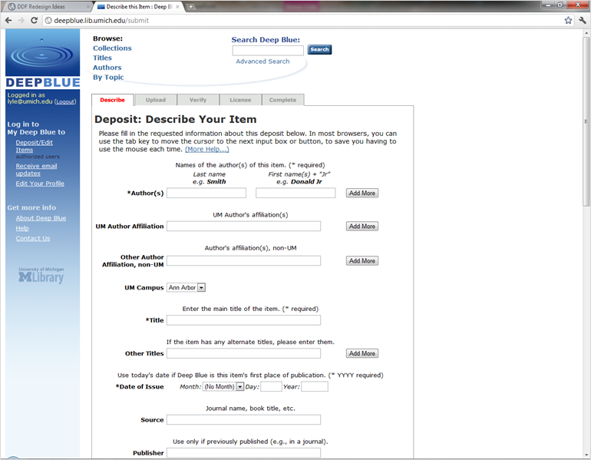
DeepBlue

Slide 17
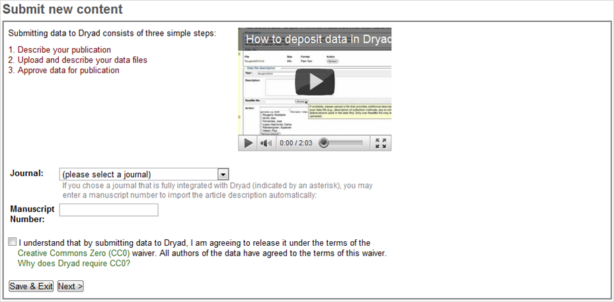
Dryad

Slide 18
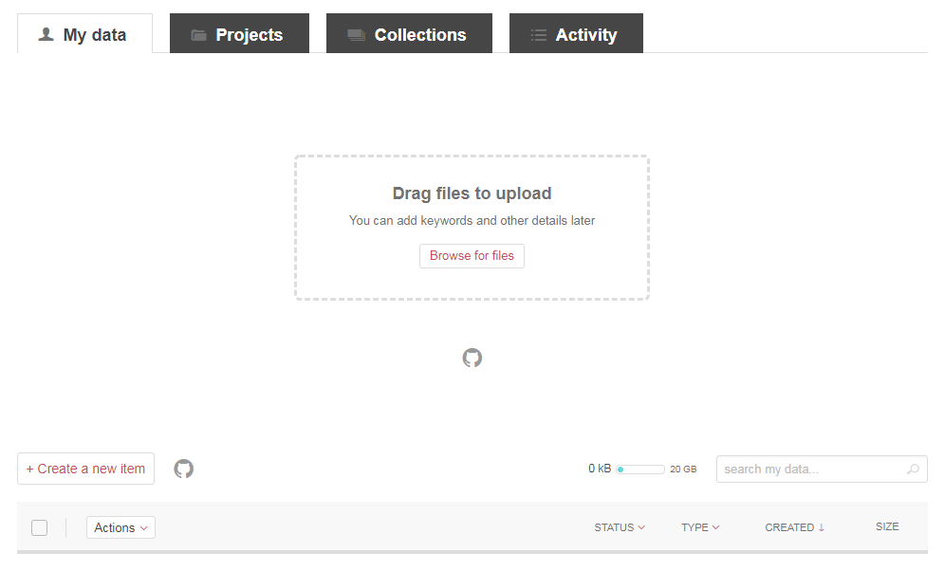
Figshare

Slide 19
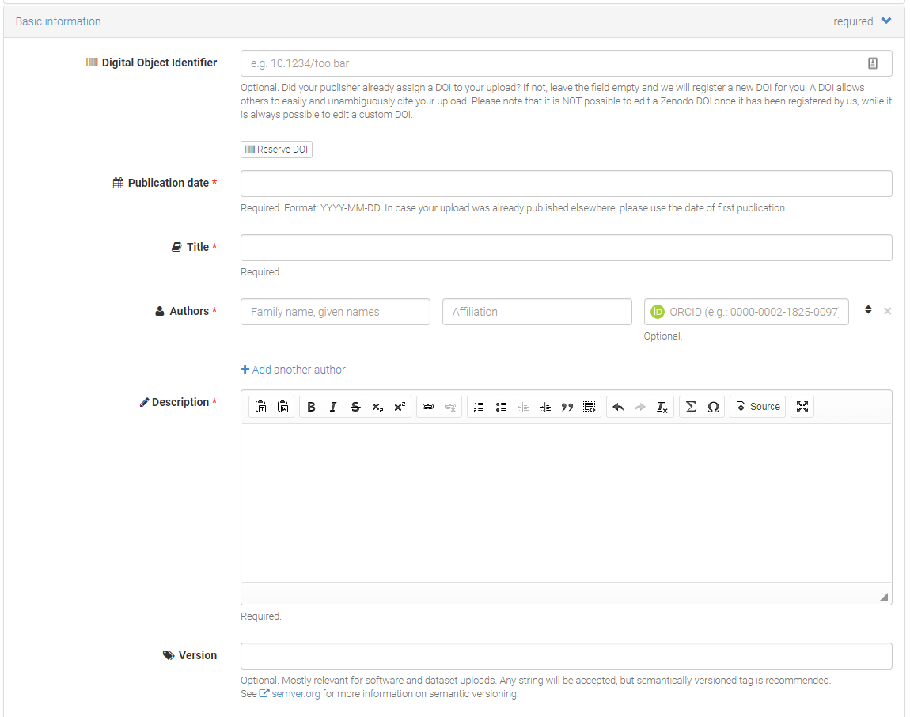
Zenodo

Slide 20
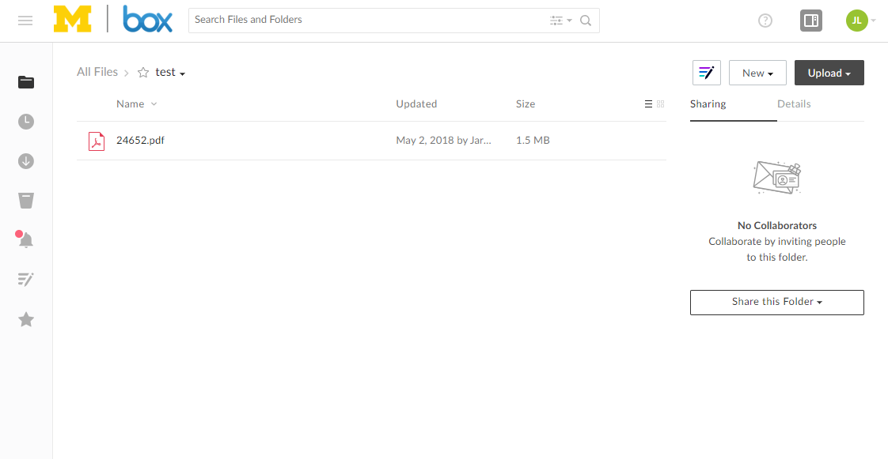
Commercial

Slide 21
June 2017 improvements and enhancements
Notes:
the main goals included:
Allowing for the ability to work on a deposit incrementally (workspace functionality allows saving so submission does not have to be done all at once like the previous DDF)
Making it easier to resupply data and provide additional files. (Project can be sent back to the original depositor for additional revisions, additions, etc. Previously, because we used a static web form, one would need to start from scratch when resupplying files which is time consuming as it involved duplicate data entry of fields like project title, PI name, other required fields.)
Increase communication with ICPSR -- creation of the Project Communication log allows for direct contact with ICPSR staff and this communication is stored with the submission. Help buttons for each metadata field were added to better communicate with our depositors the type of information we are requesting they complete.
Allow for customization -- Workspace allows for creation of folders, subfolders, etc. for organizing a data submission
File-level metadata -- Allow for both study-level and file-level metadata

Slide 22
Deposit workspace that allows depositors to
incrementally work on a submission as opposed to needing to upload and describe all files at once
Collaboration – Users can share projects with other collaborators and grant various permission levels to these collaborators. This allows for multiple researchers or PIs to easily collaborate on a submission of materials to ICPSR.
Notes:
Provides the depositor more control over how data and documentation files are presented to the ICPSR curation team and more communication regarding project status and updates. The new form is really a customizable deposit workspace providing depositors with:
A more intuitive approach and prompts to assist depositors in providing metadata that will aid in the discovery and reuse of their research data works
Ability to customize your project space in terms of folders and sub-folders.
Ability to prepare files and metadata at one’s leisure by coming back multiple times to refine the documentation, data files, and descriptions (metadata) prior to submitting the deposit package (no need to do this all in one session).
Ability to describe (provide metadata) at the file level.
Ability to recall a submission if edits are realized shortly after the information has been submitted to ICPSR.
Ability to communicate with ICPSR curation staff within the workspace at any point during the preparation and submission process and have those communications logged and available for reference.
Enhanced email communications and visualizations about the status of your submission.
Ability to see and monitor your project status after submission
Provides depositor with more flexibility in terms of accepted files types and sizes
Ability to preview files like images, pdfs, and statistical package files

Slide 23
Folder structure – For each project, a depositor has the flexibility to organize his/her submission into folders and sub-folders within the project workspace.
File-level metadata – When depositing materials,
researchers will be able to provide both study-level descriptive information and metadata as well as provide information to describe individual files within a submission.
Project communication log – Within each project, there is a project communication log that allows for the data depositor and ICPSR curators to send messages to each other about the data collection.
Notes:
Provides the depositor more control over how data and documentation files are presented to the ICPSR curation team and more communication regarding project status and updates. The new form is really a customizable deposit workspace providing depositors with:
A more intuitive approach and prompts to assist depositors in providing metadata that will aid in the discovery and reuse of their research data works
Ability to customize your project space in terms of folders and sub-folders.
Ability to prepare files and metadata at one’s leisure by coming back multiple times to refine the documentation, data files, and descriptions (metadata) prior to submitting the deposit package (no need to do this all in one session).
Ability to describe (provide metadata) at the file level.
Ability to recall a submission if edits are realized shortly after the information has been submitted to ICPSR.
Ability to communicate with ICPSR curation staff within the workspace at any point during the preparation and submission process and have those communications logged and available for reference.
Enhanced email communications and visualizations about the status of your submission.
Ability to see and monitor your project status after submission
Provides depositor with more flexibility in terms of accepted files types and sizes
Ability to preview files like images, pdfs, and statistical package files

Slide 24
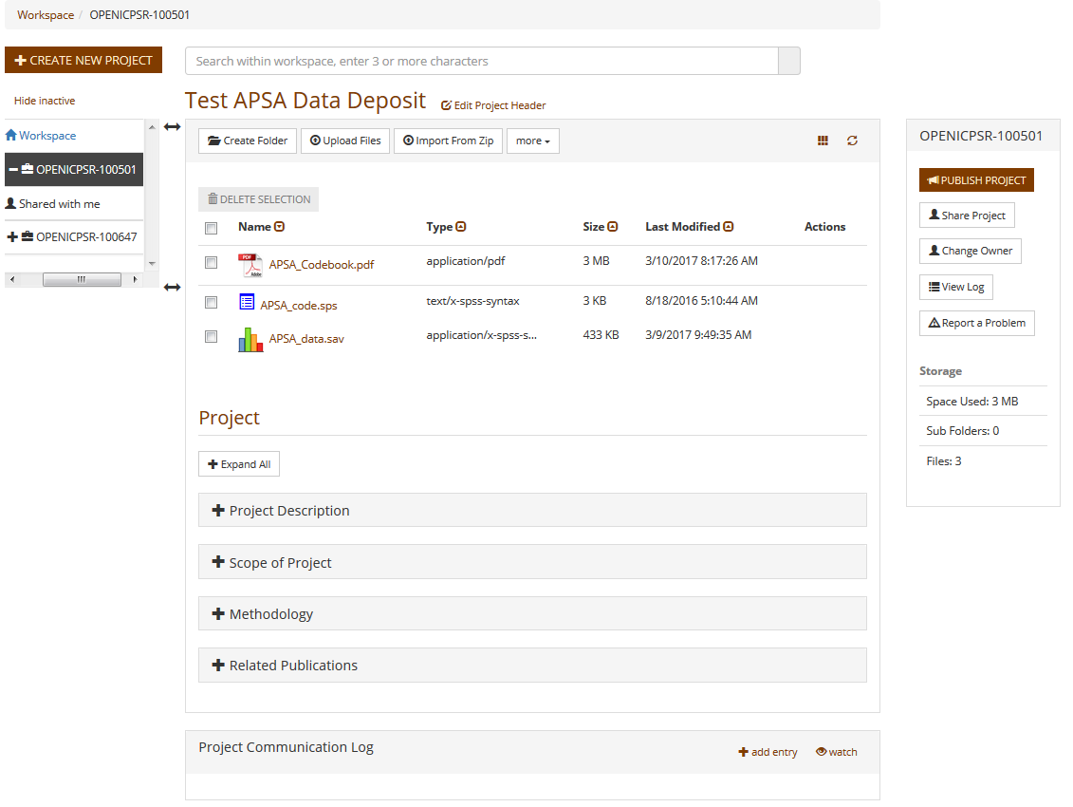

Slide 25
Deposit System improved other ICPSR technologies
openICPSR, DataLumos, Census
The Preview functionality on the study homepages
Help icons through all our pages
The future ICPSR Metadata editor

Slide 26

Constant Improvement:
The Iterative Process
Notes:
Feedback is very important to us
Image source: https://techcrunch.com/wp-content/uploads/2015/04/feedback.jpg?w=1390&crop=1

Slide 27
Internal and external feedback
Multiple methods to receive user feedback
  Targeted forms and surveys
  Website links (Report a problem/Give feedback)
  Use cases with examples and instructions
  Open forum and brainstorming sessions
Various audiences/users
  ICPSR Staff
  Depositors and Principal Investigators
  Researchers, Staff, and Students
  Experienced and novice users

Slide 28

Prioritization, Feasibility and Usability
Notes:
Image source: http://www.latize.com/wp-content/uploads/2018/03/Latize_Making_Sense_of_Chaos_through_Big_Data_1.jpg

Slide 29
Human Centered Approach
Building user stories to drive design
  As a [user], I would like [feature] so that [reason]
The user experience is a core component to any new feature
All improvements must be ADA compliant
Never underemphasize the need for proper testing!

Slide 30
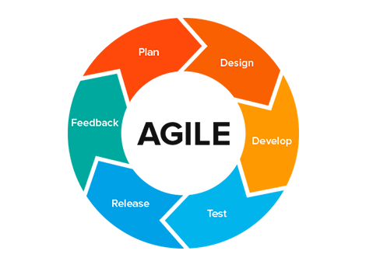
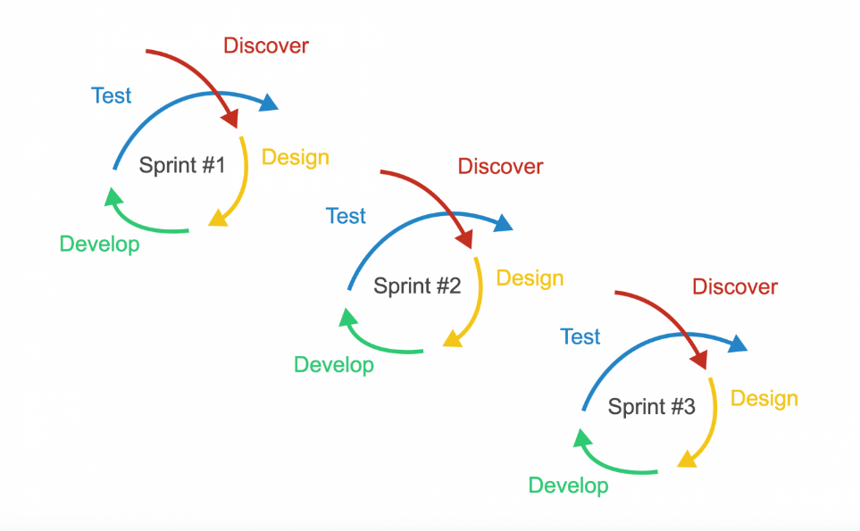
Agile Process at ICPSR

Slide 31
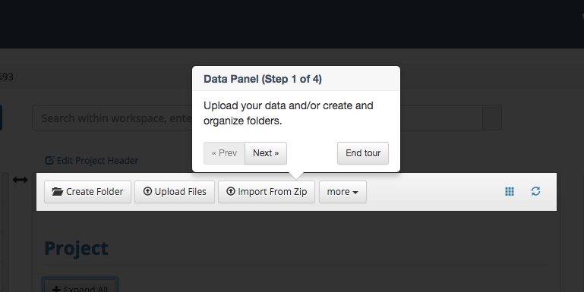
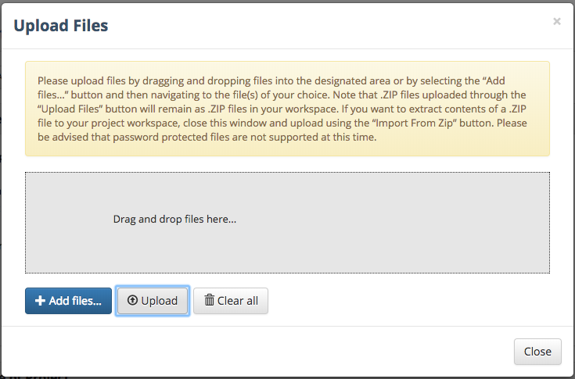
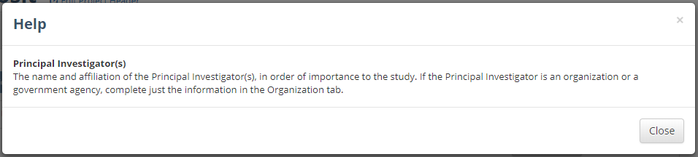
Feedback leading to new features
Notes:
Samples: Making options keyboard accessible; Guided tour; Standardizing help text

Slide 32
Lessons learned

Slide 33
Lesson 1
Positive enhancements can have unintended and sometimes negative consequences
Notes:
Workspace leading to navigation confusion:
-File-level metadata

Slide 35
Lesson 2
Importance of development based on user needs
Notes:
-Communication log
-The initial view of the project & metadata is overwhelming in deposit system. Users are unclear how to upload data and how to submit that data to ICPSR

Slide 37
Lesson 3
A thoughtfully developed, user-friendly data deposit system is great, but it's just one component of an repository’s acquisition strategy

Slide 38
Future improvements
Streamlined path from web site to deposit
Navigation improvements
Simplified workflow
Help text with detailed examples
Productivity enhancements
Notes:
Specific enhancements:
Uploading password protected files
Adding multiple affiliations for PIs
Possible “Lite” version with simplified workflow
Autofill capabilities

Slide 39
Thank you!
lyle@umich.edu

