Slide 1
ICPSR and the
Data Seal of Approval
Mary Vardigan
Jared Lyle
Polar Data Activities in Global Data Systems

Slide 2
Outline of Presentation
What is ICPSR?
Repository assessments undertaken at ICPSR
  Test audit
  TRAC self-assessment
  Data Seal of Approval
Process, effort, findings for each
Conclusions

Slide 3
What is ICPSR?
Repository of social science data established in 1962 for data sharing and preservation
Membership-based organization -- over 740 institutional members (colleges and universities) from around the world
Source for training in statistics and data curation through the Summer Program

Slide 4
Mission
ICPSR provides leadership and training in data access, curation, and methods of analysis for a diverse and expanding social science research community.

Slide 5
First Assessment Effort, 2005-2006
Center for Research Libraries proposed a test audit of ICPSR, along with Koninklijke Bibliotheek National Library of the Netherlands, Portico, and LOCKSS
Purpose: To test a methodology based on the RLG-NARA Checklist for the Certification of Trusted Digital Repositories
Precursor to current TRAC audit/certification processes
ICPSR Test Audit Report: http://www.crl.edu/sites/default/files/attachments/pages/ICPSR_final.pdf

Slide 6
Evaluation Criteria
Characteristics of the organization that might affect performance, accountability, business continuity
Technologies and infrastructure employed
Preservation processes and procedures

Slide 7
Effort and Resources Required
Completion of Audit Checklist
Gathering of large amounts of data about the organization – staffing, finances, digital assets, process, technology, security, redundancy, etc.
Hosting of audit group for two and a half days with interviews and meetings
Remediation of problems discovered

Slide 8
Findings
Taken as a whole, ICPSR appears to provide responsible stewardship of the valuable research resources in its custody. Depositors of data to the ICPSR data archives and users of those archives can be confident about the state of its operation, and the processes, procedures, technologies, and technical infrastructure employed by the organization.

Slide 9
Findings (continued)
Succession and disaster plans needed
Funding uncertainty (grants)
Acquisition of preservation rights from depositors
Need for more process and procedural documentation related to preservation
Machine-room issues noted

Slide 10
Changes Made
Hired a Digital Preservation Officer
Created policies, including Digital Preservation Policy Framework, Access Policy Framework, and Disaster Plan
Changed deposit process to be explicit about ICPSR’s right to preserve content
Continued to diversify funding (ongoing)
Made changes to machine room

Slide 11
TRAC Self-Assessment, 2010-present
Parceled out the 80+ TRAC requirements to committees across the organization
Gathered evidence demonstrating compliance for each guideline
Rated compliance on 0-4 scale
Digital Preservation Officer and Director of Curation Services reviewing evidence
Goal is to provide a report

Slide 12
Effort and Resources Required
Time of many individuals across the organization
Technology – Developed Drupal site for data entry
Time for high-level review and summarization
Time/technology most likely required to address areas for improvement

Slide 13
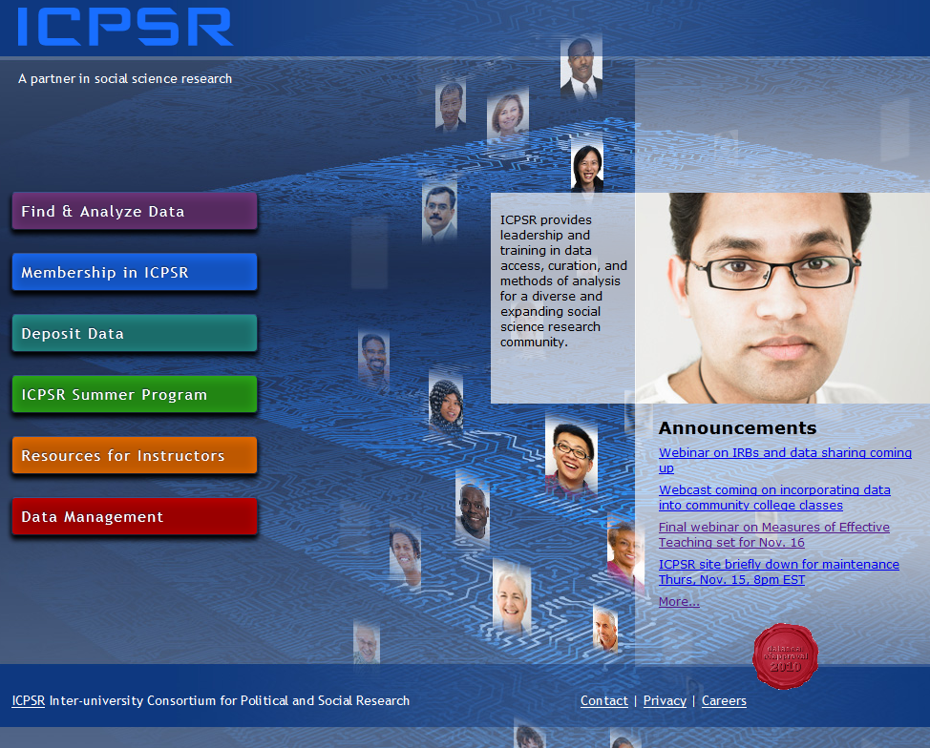
DSA Self-Assessment, 2009-2010
http://assessment.datasealofapproval.org/assessment_78/seal/pdf

Slide 14
Procedures Followed
Digital Preservation Officer and Director of Collection Delivery conducted the self-assessment, assembled the evidence, and wrote response
Attempted to provide a URL for each guideline
First peer review done offline with no manual to clarify intent of guidelines; second done using online tool – assessment modified

Slide 15
Effort and Resources Required
Mainly time of the Digital Preservation Officer and Director of Collection Delivery
Would estimate two days at most
Note: Next self-assessment should be more robust with greater amount of detail

Slide 16
Self-Assessment Ratings
Using the manual and guiding questions:
Rated ICPSR as having achieved 4 stars for all but Guideline 13, full OAIS compliance

Slide 17
Example of Evidence – Guideline 5
Reviewer stated: I would like to stipulate that this description addresses well the extended criteria of Guideline 5
Guideline Text: The data repository uses due diligence to ensure compliance with legal regulations and contracts including, when applicable, regulations governing the protection of human subjects.

Slide 18
Evidence
ICPSR is legally considered a part of the University of Michigan. The primary legal contracts/regulations that ICPSR handles are the Membership Form, Deposit Form, Terms of Use, and Restricted-Use Contracts. The Membership Form specifies responsible use of ICPSR data resources and prohibits the redistribution of data. The ICPSR Deposit Form stipulates that the depositor must have copyright in order to transfer to ICPSR the right to disseminate the data and obtains permission from the depositor for ICPSR to manage the data for purposes of distribution and preservation. ICPSR Terms of Use specify that data may not be redistributed and that users must not disclose the identities of research participants. The Terms of Use include information on penalties for noncompliance. ICPSR’s Restricted-use Contracts are agreements governing the use and protection of data that carry a risk of disclosure. These contracts use model language and are reviewed by legal counsel.

Slide 19
Evidence (continued)
ICPSR offers three levels of access to data: public-use, restricted-use available via contract, and restricted-use available only onsite at ICPSR under secure conditions. All data are reviewed for disclosure risk and, when necessary, modified in consultation with the investigator. ICPSR is in the process of implementing software that will provide a secure virtual data enclave for individuals using confidential data to ensure that they are in compliance with disclosure risk protocols. ICPSR staff are trained and certified in handling restricted-use data. Data are deposited and processed in a secure non-networked environment. Confidential data are stored in encrypted form in multiple locations.

Slide 20
Evidence (continued)
With respect to compliance with national laws under which ICPSR operates, in the United States there are several statutes and codes related to the privacy and protection of research participants. Of particular note is the federal regulation on Protection of Human Subjects (45 CFR 46). Institutions bear the responsibility for compliance with 45 CFR 46. Every university must file an “assurance of compliance” with the Office for Human Research Protections which includes “a statement of ethical principles to be followed in protecting human subjects of research.” University Institutional Review Boards (IRBs) review research to address these issues. Other relevant U.S. laws include the Family Educational Rights and Privacy Act (FERPA) and the Health Insurance Portability and Accountability Act (HIPAA). ICPSR requests from depositors copies of IRB approval, approved protocols, privacy certificates, and blank consent forms.

Slide 21
Evidence (continued)
Links provided to:
ICPSR Deposit Form
Terms of Use
Restricted Data Agreement

Slide 22
Findings and Changes Made
Recognized need to make policies more public – e.g., static and linkable Terms of Use (previously only dynamic)
Reinforced work on succession planning – now integrated into Data-PASS partnership agreement
Underscored need to comply with OAIS – now updating system

Slide 23
Comparison – Effort and Resources
Test audit was the most labor- and time-intensive
TRAC self-assessment involved the time of more people
Data Seal of Approval least costly

Slide 24
Comparison – Changes Made
Test audit was first experience – resulted in greatest number of changes made and greatest increase in awareness
Fewer changes made as a result of DSA assessment because many addressed in earlier test audit; also not as detailed
TRAC assessment will surface additional issues to address

Slide 25
Other Observations about DSA
Assessment is a static document -- URLs may change and links may break
Best not to integrate details about technology that may change
Organizations may want to establish a schedule to review their assessments (in addition to DSA prompts)

Slide 26
Conclusions: Benefits of DSA Approach
Lower bar, less “threatening“
Less labor- and time-intensive, less costly
Emphasis on raising awareness and transparency is great
More community- and peer-based rather than top down
Interaction with peer reviewer is meaningful
Seal carries meaning that is easily recognized

Slide 27

Thank you!
Questions?
vardigan@umich.edu
lyle@umich.edu

