Slide 1
At the Data Curation Table: Archival Intersections with Research Data Management
Heather Soyka and Jared Lyle
Notes:
http://sched.co/ABHJ
Friday July 28, 2017 2:00pm - 3:00pm
Oregon BR 203 Oregon Convention Center, 777 NE MLK, Jr. Blvd, Portland, OR 97232
See: https://docs.google.com/document/d/1qJ55cyAoWwWiPIbhLtNziE7g-FkG2dyKriJ3xLxGXnw/edit?ts=592332df

Slide 2
Outline
RDM History
Current state of RDM
Use, non-use, and misuse of archival standards in RDM
Where archivists and archival standards can help

Slide 3
RDM History
Notes:
Social science data archives (1960s)
https://doi.org/10.17723/aarc.72.1.eu7252lhnrp7h188
Ecology (1990s?)
http://onlinelibrary.wiley.com/doi/10.1890/0012-9623-91.1.14/full

Slide 4
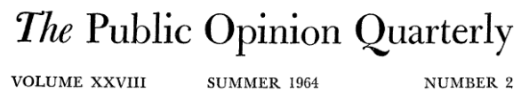
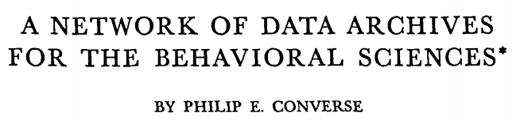
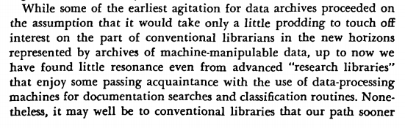
Notes:
“While some of the earliest agitation for data archives proceeded on the assumption that it would take only a little prodding to touch off interest on the part of conventional librarians in the new horizons represented by archives of machine-manipulable data, up to now we have found little resonance even from advanced “research libraries” that enjoy some passing acquaintance with the use of data-processing machines for documentation searches and classification routines.”
Source: Converse, P. (1964). A Network of Data Archives for the Behavioral Sciences. The Public Opinion Quarterly, 28(2), 273-286. Retrieved from http://www.jstor.org/stable/2746992

Slide 5

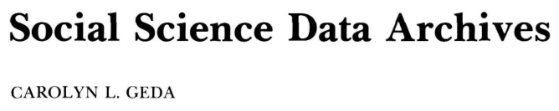
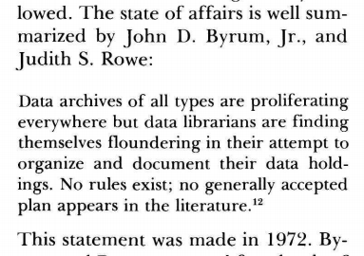
Notes:
“Data archives of all types are proliferating everywhere but data librarians are finding themselves floundering in their attempt to organize and document their data holdings. No rules exist; no generally accepted plan appears in the literature.”
Source: Carolyn Geda (1979) Social Science Data Archives. The American Archivist: April 1979, Vol. 42, No. 2, pp. 158-166.
https://doi.org/10.17723/aarc.42.2.f9428250uk700x41
Quoting: John D. Byrum, Jr., and Judith S. Rowe, "An Integrated, User-Oriented System for the Documentation and Control of Machine-Readable Data Files," Library Resources and Technical Services 16 (Summer 1972): 338-46.

Slide 6







Current state of RDM (3 min)
Disciplinary repositories
Institutional repositories
General repositories
Notes:
re3data returns 1894 results.

Slide 7
Use, non-use, and misuse of archival standards in RDM
Appraisal
Arrangement and description
Provenance
Preservation

Slide 8
Where archivists and archival standards can help
Notes:
Opportunities for archivists to help shape this conversation

Slide 9
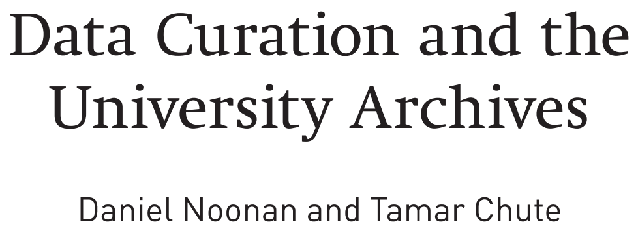
Notes:
In a survey of archivists at 116 ARL institutions surveyed, we received 64 responses of which 55 completed the whole survey. 57% of the respondents indicated that they are minimally involved, moderately involved, or fully engaged in the discussion of data curation at their institutions.

Slide 10
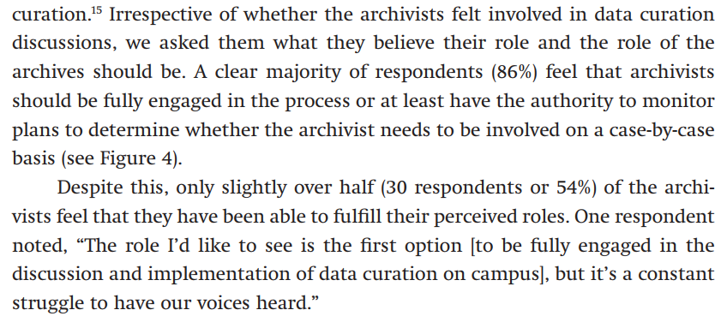
Notes:
.Irrespective of whether the archivists felt involved in data curation discussions, we asked them what they believe their role and the role of the archives should be. A clear majority of respondents (86%) feel that archivists should be fully engaged in the process or at least have the authority to monitor plans to determine whether the archivist needs to be involved on a case-by-case basis (see Figure 4). Despite this, only slightly over half (30 respondents or 54%) of the archivists feel that they have been able to fulfill their perceived roles. One respondent noted, “The role I’d like to see is the first option [to be fully engaged in the discussion and implementation of data curation on campus], but it’s a constant struggle to have our voices heard.”

Slide 11
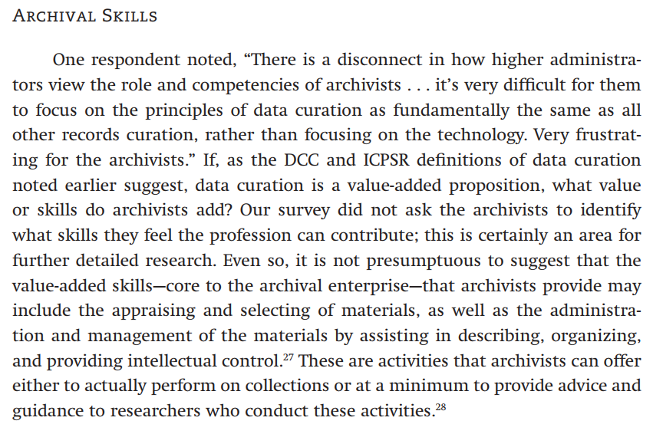

Slide 12
Where archivists and archival standards can help
Emphasis on recognizing research data as an important output of the research process, not a byproduct
Helping researchers and users to interpret data lifecycle models in ways that provide support for descriptive and preservation practices throughout the entirely messy life of the data
Overcoming barriers to donating, sharing, access, use
Supporting & evangelizing practices common to archival conversation such as LOCKSS, stable formats, stable media, and sustainable repository choices
Notes:
Opportunities for archivists to help shape this conversation

Slide 13





Opportunities for archivists to join conversations

Slide 14
For the panel...
How do data services fit into current organizational workflows?
How does your institution identify and connect with researchers who may need data management services?
How can we equip archivists with the necessary skills to ensure opportunities for leadership in this arena?

Slide 15
Panelists
John Bence, University Archivist, Emory University
Natalie Bond, Political Papers Archivist, University of Montana
Evelyn McLellan, President, Artefactual Systems
Ashley L. Taylor, Archivist, University of Pittsburgh

Slide 16
