Slide 1
Research Infrastructures: Ensuring trust and quality of data
Margaret C. Levenstein
Director, Inter-university Consortium for Political and Social Research
The initiatives described here are supported by the National Science Foundation (1744065 and 1525662) and the Sloan Foundation.

Slide 2
Data in the wild
Organic or non-designed (found) data create new challenges for quality and trust
  Not just increase in scale
Data changes in real time
  Requires snapshots, versioning
No survey instrument or documentation of study design to provide metadata for re-use or discovery
  Or even informed use of data the first time
  Requires development of standards (e.g., extend DDI)
  Citizen-scientist engagement

Slide 3
Research Infrastructures: ensuring trust and quality of data
Provenance
Preservation
Privacy
All more challenging in the new world of “found” data

Slide 4
Research Infrastructures: ensuring trust and quality of data
Provenance
Preservation
Privacy

Slide 5
Research Infrastructures: ensuring trust and quality of data
Provenance
  Adapting (and using) standards for new kinds of data
    Linked data
    Social media and web-based data
Preservation
Privacy

Slide 6
Research Infrastructures: ensuring trust and quality of data
Provenance
Preservation
Privacy

Slide 7
Research Infrastructures: ensuring trust and quality of data
Provenance
Preservation
  Tension between openness and preservation
    Feasibility
      Individual researchers and institutions
    Incentives
Privacy
Notes:
Individual researchers
Require guidance over data life cycle
Consent statements, data management plans, tools for standardizing and sharing data
Institutions (e.g., repositories, universities)
Train people, archive data and code, provide access
Standard citation
Bibliography
Usage statistics
Recognition of data as scientific output

Slide 8
Research Infrastructures: ensuring trust and quality of data
Provenance
Preservation
Privacy

Slide 9
Research Infrastructures: ensuring trust and quality of data
Provenance
Preservation
Privacy
  Safe data can be achieved in different ways
    Important to be able to use sensitive data in safe ways or sensitive subjects and vulnerable populations are ignored
  Match researchers to appropriate data and computing environment
  Sanitize (synthesize) data for less trusted users
    Critical for training purposes
  Secure computing environment and differential privacy of output for trusted researchers

Slide 10
ICPSR initiatives: ensuring trust and quality of data
LinkageLibrary
SOMAR
Researcher passport

Slide 11
Data linkage challenges
Linked data present challenges for both confidentiality and reproducibility
  Linkage more accurate with more detailed information
    Need standards for safe, ethical ways to enhance data with new linkages
  Linked data easier to re-identify, even after removing unique identifiers
    Need safe places to analyze linked data
  Linkage strategies introduce differences in datasets that are often not well documented

Slide 12
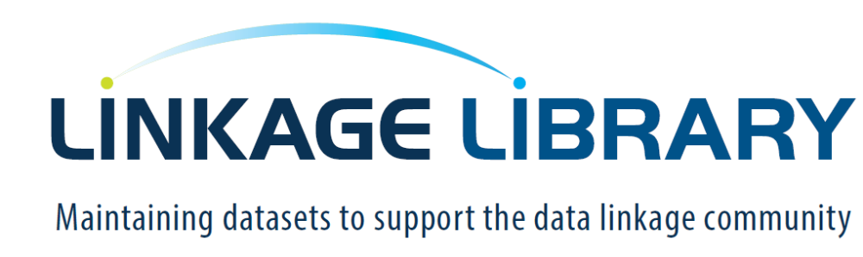

Slide 13
Encourage researchers to share linked (or linkable) data, and linkage strategies
  Algorithms, code
Compare approaches across projects, datasets, disciplines
  Improve linkage practices
  Improve transparency

Slide 14
SOMAR: Social Media Archive
Addresses 4 communities who:
  Study social media use specifically
  Leverage social media data to understand people and society
  Study social science methods
  Investigate new methods for curation, publication, confidentiality and quality assessment, and long-term management of research data
Archive enables historical and longitudinal analyses often missing from rapidly changing social medial platforms

Slide 15
SOMAR: Social Media Archive
Archive data where possible
Archive workflows and code where data sharing is prohibited
  Eg: Twitter IDs and code for rehydrating
Curation and metadata
  Provenance, dates, hashtags, confidentiality protection

Slide 16
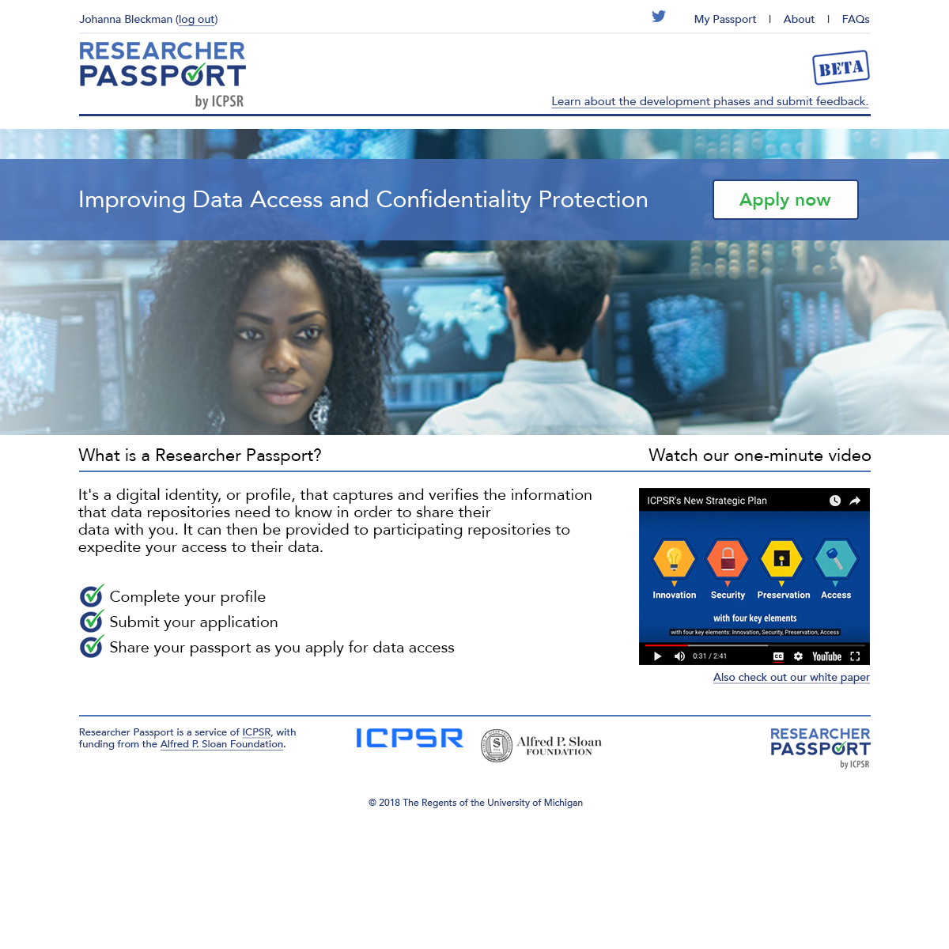
Researcher Passport
Establishing shared understanding of what it means to be a trusted researcher

Slide 17
Researcher Passport
Researcher Passport: Improving Data Access and Confidentiality Protection
  ICPSR’s Strategy for a Community-normed System of Digital Identities of Access
  https://deepblue.lib.umich.edu/handle/2027.42/143808
  Identifies inconsistent language and policies that impede access
  Facilitate sharing of proprietary data
Passports for safe people
  Verified identities, institutional affiliation, open badges
  Training
  Experience (good and bad)
Visas to control access
  Permission to “enter” (access) specific data specifying
    Passport holder
      Project, Place, Period

Slide 18
Questions
How do we solve coordination problems?
  Research across domains requires use of interoperable standards. How do we get that?
Openness is limited by paywalls, but without resources long term preservation and access are not sustainable.
  What’s the appropriate balance between openness and sustainable preservation?

Slide 20
More information
ICPSR help@icpsr.umich.edu
Researcher Credentialing
  Johanna Bleckman at Bleckman@umich.edu
LinkageLibrary
  Susan Leonard at hautanie@umich.edu
SOMAR
  Libby Hemphill at LibbyH@umich.edu
The initiatives described here are supported by the National Science Foundation (1744065 and 1525662) and the Sloan Foundation.

Slide 21
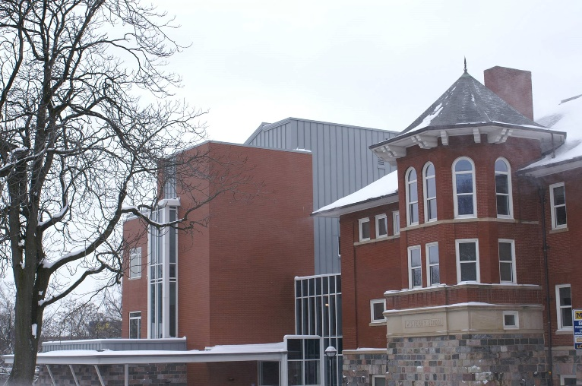
ICPSR
Founded in 1962 by 22 universities, now consortium of 800 institutions world-wide
Focus on social and behavioral science data, broadly defined
Current holdings
  10,000 studies, quarter million files
  1500 are restricted studies, almost always to protect confidentiality
  Bibliography of Data-related Literature with 75,000 citations
Approximately 60,000 active MyData (“shopping cart”) accounts
Thematic collections of data about addiction and HIV, aging, arts and culture, child care and early education, criminal justice, demography, health and medical care, and minorities

