Slide 1
Data Repository
Assessment & Certification: Experiences and Lessons Learned
Jared Lyle
Network of Asian Social Science Data Archives
Tokyo, Japan
January 25, 2019
Notes:
Thank you for inviting me to present at the Network of Asian Social Science Data Archives workshop. It’s a pleasure to be here. I want to especially thank Dr. Keisuke Kawata for the invitation and coordinating my visit.
For my presentation, I’m going to be discussing the experiences and lessons learned from going through repository self-assessments and formal certifications.

Slide 2
Acknowledgements
Mary Vardigan
Nancy McGovern
Notes:
I want to recognize two past ICPSR staff members who contributed to the information presented here: Mary Vardigan and Nancy McGovern.

Slide 3
Outline
Overview of ICPSR
Why assessment is important
Assessment and certification options
ICPSR’s experience with assessment, including effort and resources needed
ICPSR’s recent application to CoreTrustSeal
Benefits from assessment
Notes:
This is the outline of my presentation this afternoon….

Slide 4
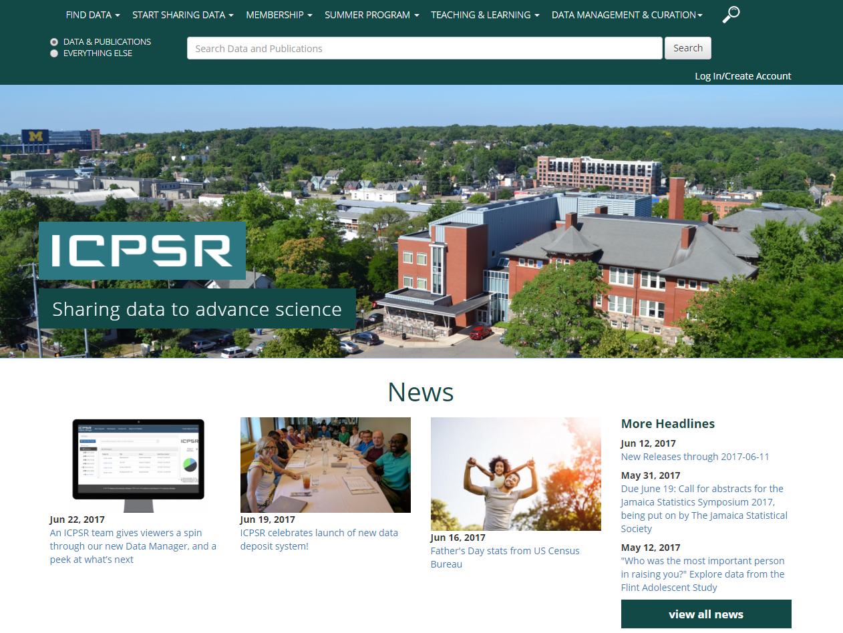
http://www.icpsr.umich.edu
Notes:
First, let me give some background on where I work, ICPSR.

Slide 5
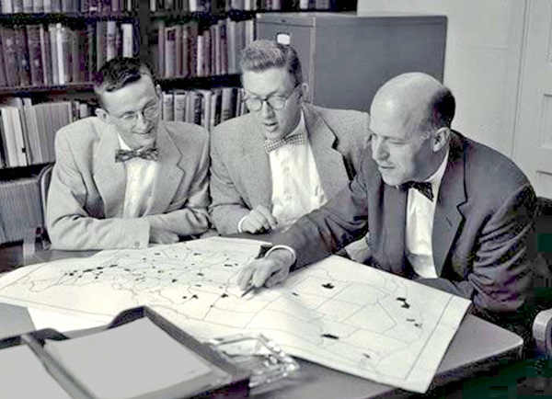
ICPSR
Established 1962
Originally 22 Members, now consortium of 776 world-wide
Originally Political Science, now all social and behavioral sciences
Philip Converse, Warren Miller, and Angus Campbell
Source: http://www.icpsr.umich.edu/icpsrweb/content/membership/history/timeline.html
Notes:
ICPSR stands for the Inter-university Consortium for Political and Social Research (ICPSR)…

Slide 6
ICPSR
Current holdings
  10,000+ studies, quarter million files
  1500+ are restricted studies, almost always to protect confidentiality
  Bibliography of Data-related Literature with 80,000 citations
Approximately 60,000 active MyData (“shopping cart”) accounts
Thematic collections of data about addiction and HIV, aging, arts and culture, child care and early education, criminal justice, demography, health and medical care, and minorities
Notes:
ICPSR has a large collection and user base…

Slide 7
ICPSR
Make data sharing feasible
  ICPSR’s General Archive
    Anyone can deposit
    Curated and preserved
  Guidance over data life cycle
    Templates for consent, Institutional Review Boards, Data Management Plans consistent with transparent and reproducible access
Incentivize data sharing
    Standard citation
    Bibliography
    Usage statistics
Notes:
At its core, ICPSR shares useful and meaningful data – both now and into the future….

Slide 8
Why Assessment is Important
Notes:
So why should we assess data repositories?

Slide 9
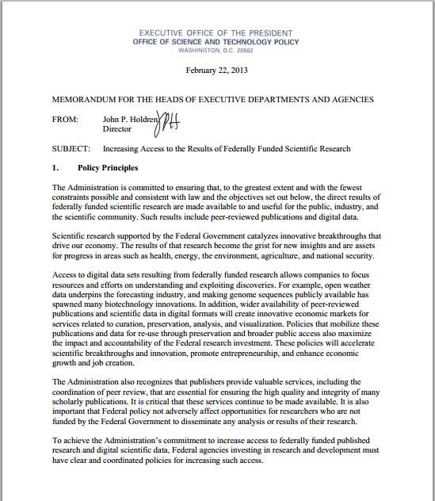
http://www.whitehouse.gov/sites/default/files/microsites/ostp/ostp_public_access_memo_2013.pdf
Notes:
Many governments, journals, and institutions are now requiring data be shared with the public. This is an example from the United States – a memo from the Executive Office of the President Office of Science and Technology Policy.

Slide 10
“Promote the deposit of data in publicly accessible databases, where appropriate and available…”
Notes:
This memo required many government agencies develop plans for sharing data, including using existing data repositories…
This is a very good development.

Slide 11
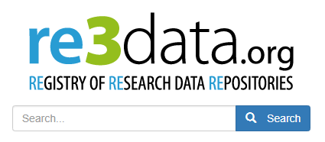
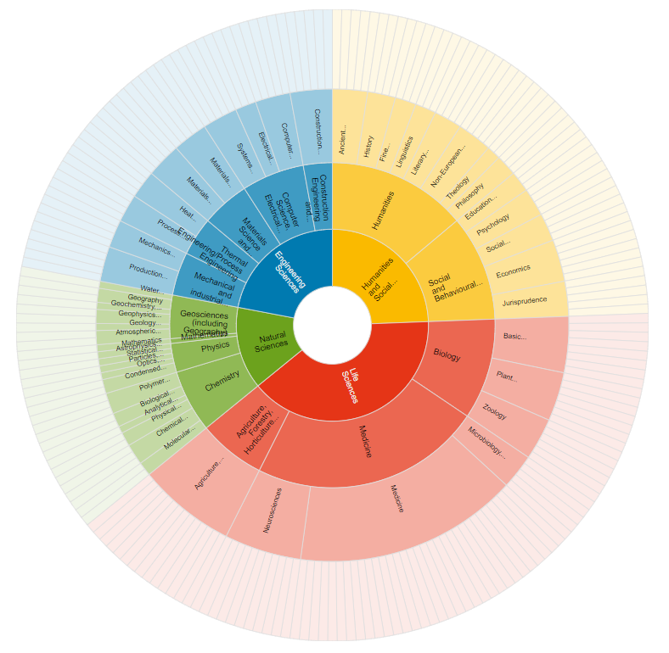
Notes:
There are now thousands of data repositories around the world. re3share is a registry of data repositories. Over 2,000 repositories are indexed. There are probably thousands more ‘in the wild.’

Slide 12
Forever!
Guaranteed!
We promise!
Notes:
Most repositories claim they will store data for the long term, using terms like these.
But can we trust what they say? Can we trust but also verify?

Slide 13
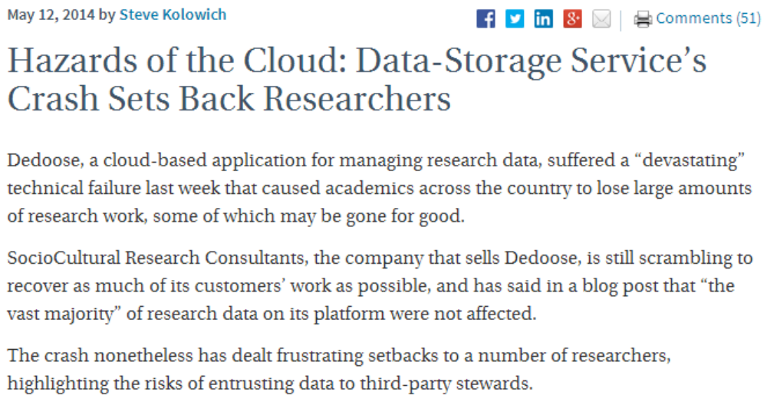
http://chronicle.com/blogs/wiredcampus/hazards-of-the-cloud-data-storage-services-crash-sets-back-researchers/52571
Notes:
This is especially important given examples of repository failures…

Slide 14
If we want to be able to share data, we need to store them in a trustworthy data repository. Data created and used by scientists should be managed, curated, and archived in such a way to preserve the initial investment in collecting them. Researchers must be certain that data held in archives remain useful and meaningful into the future.
“An Introduction to the Core Trustworthy Data Repositories Requirements”
https://www.coretrustseal.org/wp-content/uploads/2017/01/Intro_To_Core_Trustworthy_Data_Repositories_Requirements_2016-11.pdf
Notes:
This quote from “An Introduction to the Core Trustworthy Data Repositories Requirements” provides a good foundation for why repository assessment and certification is important…

Slide 15
Why Assessment is Important
Promote trust by funding agencies, data producers, and data users that data will be available for the long term
Provide transparent view into the repository
Improve processes and procedures
Measure against a community standard
Show the benefits of domain repositories
Dillo, I., & de Leeuw, L. (2018). CoreTrustSeal. Communications of the Association of Austrian Librarians, 71(1), 162-170. https://doi.org/10.31263/voebm.v71i1.1981
Notes:
Assessment is important for several reasons…

Slide 16
Assessment Options
Basic Certification
  CoreTrustSeal (replaces Data Seal of Approval and
  World Data System)
“Formal” Certification
  Trustworthy Repositories Audit and Certification (TRAC)/ISO 16363 (includes site visit)
Other alternatives
  Self-audits and peer reviews
  Digital Repository Audit Method Based On Risk Assessment (DRAMBORA)
  nestor-Seal DIN 31644
Notes:
Several assessment options exist…

Slide 17
Common Elements of Assessment
The Organization and its Framework
  Governance, staffing, policies, finances, etc.
Treatment of the Data
  Access, integrity, process, preservation, etc.
Technical Infrastructure
  System design, security, etc.
Notes:
These options share common elements…

Slide 18
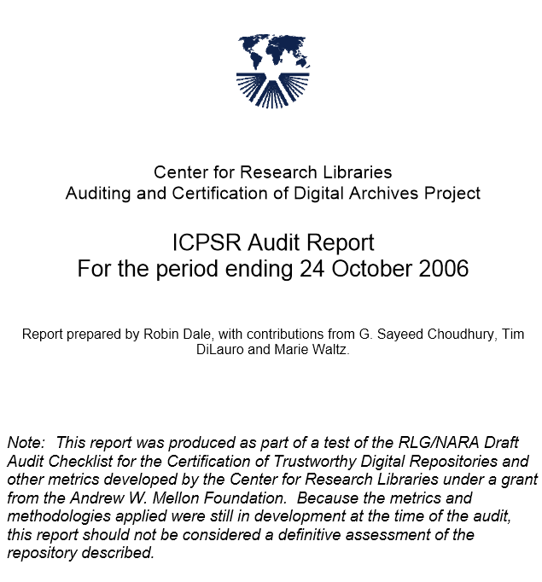
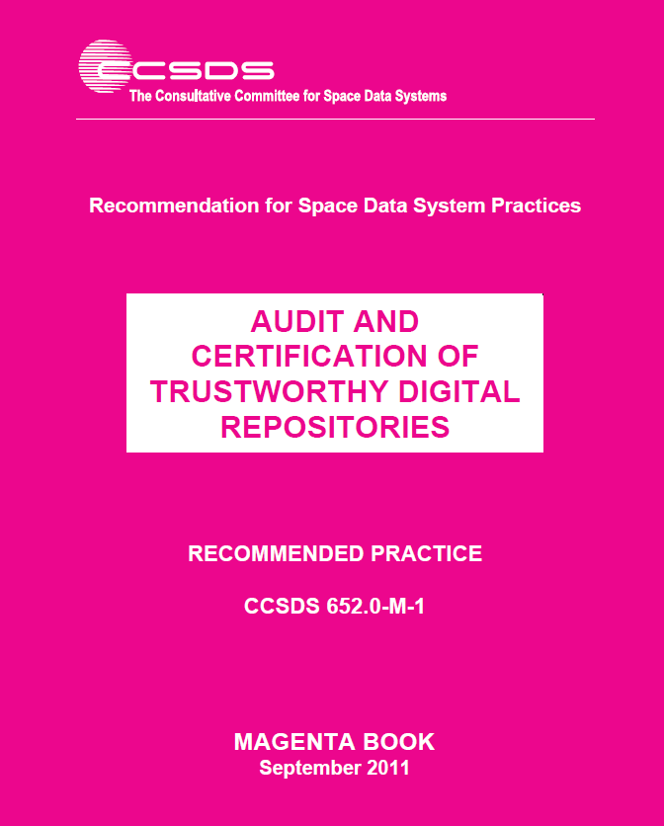
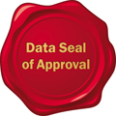


ICPSR Assessment Experience
2005-2006 CRL test audit (TRAC checklist)
2010-2012 TRAC/ISO 16363 self-assessment
2009-2010 Data Seal of Approval certification
2013 Data Seal of Approval (update)
2013 World Data System certification
2018-2019 CoreTrustSeal
Notes:
ICPSR has experience going participating in many of the assessment options. Let me tell you about these, including the effort and resources required, the assessment findings, and the changes we made as a result of the findings.
I’ve also included links to the assessment documentation we completed for each assessment – for your reference.

Slide 19
CRL Test Audit, 2005-2006
Test methodology based on RLG-NARA Checklist for the Certification of Trusted Digital Repositories
Assessment performed by an external agency (CRL)
Precursor to current TRAC audit/certification
ICPSR Test Audit Report: http://www.crl.edu/sites/default/files/attachments/pages/ICPSR_final.pdf
Notes:
Center for Research Libraries

Slide 20
Effort and Resources Required
Completion of Audit Checklist
Gathering of large amounts of data about the organization – staffing, finances, digital assets, process, technology, security, redundancy, etc.
Weeks of staff time to do the above
Hosting of audit group for two and a half days with interviews and meetings
Remediation of problems discovered

Slide 21
Findings
Positive review overall:
Taken as a whole, ICPSR appears to provide responsible stewardship of the valuable research resources in its custody. Depositors of data to the ICPSR data archives and users of those archives can be confident about the state of its operation, and the processes, procedures, technologies, and technical infrastructure employed by the organization.

Slide 22
Findings
Positive review overall, but…
Succession and disaster plans needed
Funding uncertainty (grants)
Acquisition of preservation rights from depositors
Need for more process and procedural documentation related to preservation
Machine-room issues noted

Slide 23
Changes Made
Hired a Digital Preservation Officer
Created policies, including Digital Preservation Policy Framework, Access Policy Framework, and Disaster Plan
Changed deposit process to be explicit about ICPSR’s right to preserve content
Continued to diversify funding (ongoing)
Made changes to machine room

Slide 24
TRAC self-assessment, 2010-2012
TRAC/ISO most rigorous method – 80+ requirements (100 in ISO)
OAIS orientation
Notes:
Certification Reports
To date CRL has certified five repositories.
Chronopolis Audit Report
CLOCKSS Report
Hathitrust Report
Portico Report
Scholars Portal Report
(see: http://www.crl.edu/archiving-preservation/digital-archives/certification-assessment)

Slide 25
Procedures Followed
Parceled out the 80+ TRAC requirements to committees across the organization
Set up Drupal system for reporting evidence
Gathered evidence demonstrating compliance for each guideline; rated compliance on scale
Digital Preservation Officer and Director of Curation Services reviewing evidence
Goal is to provide a public report

Slide 26
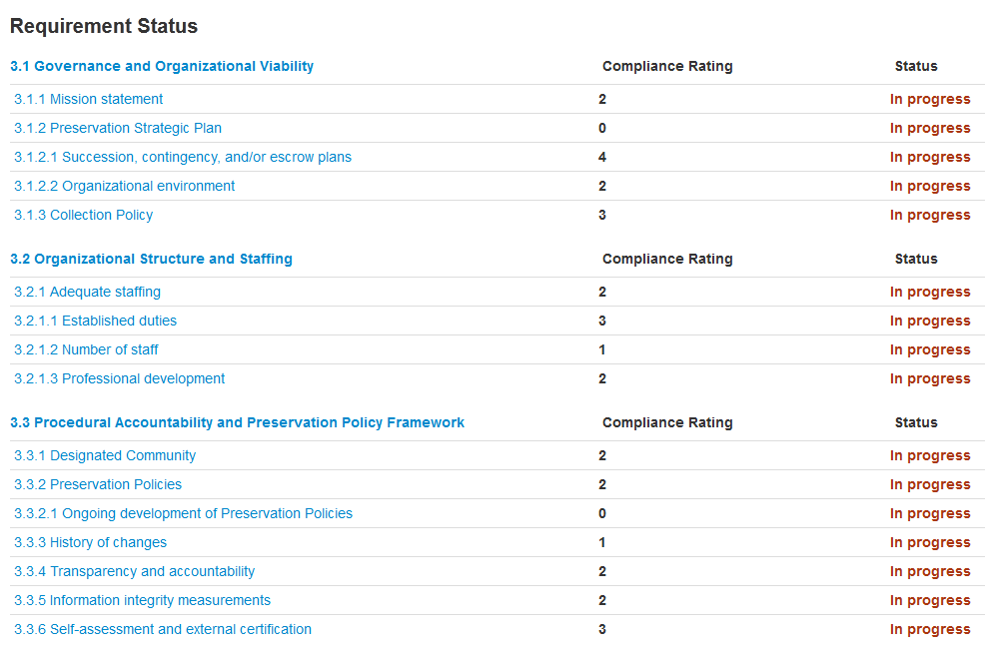
TRAC/ISO Drupal System
https://wiki.archivematica.org/Internal_audit_tool
Notes:
Drupal TRAC review tool
Developed by MIT in a project led by Nancy McGovern, Head of Curation and Preservation Services at MIT Libraries. Artefactual has permission to host this tool for community use.

Slide 27
Example TRAC/ISO Requirements
Documented process for testing understandability of the information content
Process that generates the requested digital object(s) is complete
Process that generates the requested digital object(s) is correct
All access requests result in a response of acceptance or rejection
Dissemination of authentic copies of the original or objects traceable to originals

Slide 28
Effort and Resources Required
Time of many individuals across the organization
Technology – Developed Drupal site for data entry
Time for high-level review and summarization
Time/technology most likely required to address areas for improvement

Slide 29
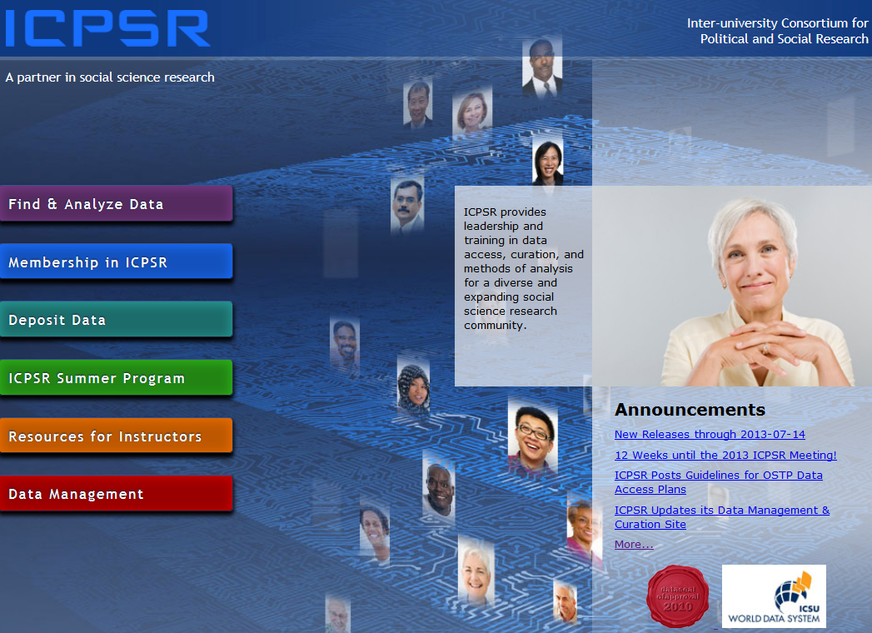
DSA Self-Assessment, 2009-2010
http://assessment.datasealofapproval.org/assessment_78/seal/pdf
http://hdl.handle.net/2027.42/144318

Slide 30
Data Seal of Approval
Started by DANS in 2009
The objectives of the DSA are to “safeguard data, to ensure high quality and to guide reliable management of data for the future without requiring the implementation of new standards, regulations, or high costs.”
http://www.datasealofapproval.org/en/information/about/
Notes:
In 2013, about 20 repositories had been certified.

Slide 31
Data Seal of Approval
16 guidelines – 3 target the data producer, 3 the data consumer, and 10 the repository
Example guideline: (7) The data repository has a plan for long-term preservation of its digital assets.
Self-assessments are done online with ratings and then peer-reviewed by a DSA Board member
Notes:
In 2013, about 20 repositories had been certified.

Slide 32
Procedures Followed
Digital Preservation Officer and Director of Collection Delivery conducted self-assessment, assembled evidence, completed application
Provided a URL for each guideline

Slide 33
Effort and Resources Required
Mainly time of the Digital Preservation Officer and Director of Collection Delivery
Would estimate two days at most
Less time required to recertify every two years

Slide 34
Self-Assessment Ratings
Using the manual and guiding questions:
Rated ICPSR as having achieved 4 stars for all but Guideline 13, which addresses full OAIS compliance

Slide 35
Findings and Changes Made
Recognized need to make policies more public – e.g., static and linkable Terms of Use (previously only dynamic)
Reinforced work on succession planning – now integrated into Data-PASS partnership agreement
Underscored need to comply with OAIS –building a new system based on it

Slide 36

DSA Self-Assessment, 2014-2015
https://assessment.datasealofapproval.org/assessment_114/seal/pdf/
http://hdl.handle.net/2027.42/144319

Slide 37
World Data System Certification,
June 2013
WDS is effort of the International Council of Science (ICSU)
Started in natural sciences -- similar to Data Seal of Approval
Membership and certification mechanisms

Slide 38
World Data System Certification,
June 2013
20+ criteria (guidelines)
Example criterion: The facility ensures integrity and authenticity of data sets during ingest, archival storage, data quality assessment and analysis, product generation, access, and delivery

Slide 39
Effort and Resources Required
Time of one individual – around two days
Five-stage process: Organization expresses interest; demonstrates its capabilities; if necessary, an on-site review may occur; accreditation; review every 3-5 years

Slide 40
Findings
ICPSR certified but members-only access questioned as WDS data is open access
Permitted comparison of WDS and DSA content and procedures
Resulted in WDS-DSA Working Group under the umbrella of the RDA Certification IG
WG assessed commonalities and potential to combine efforts, which resulted in the CoreTrustSeal Data Repository certification

Slide 41
CoreTrustSeal, 2018-2019

Slide 42
CoreTrustSeal
Developed by the DSA-WDS Partnership Working Group on Repository Audit and Certification, a Working Group of the Research Data Alliance
Merging of the Data Seal of Approval certification and the World Data System certification
16 criteria (guidelines)

Slide 43
Requirements
16 criteria (guidelines):
  Organizational Infrastructure (6)
  Digital Object Management (8)
  Technology (2)

Slide 44
Compliance level
0 – Not Applicable
1 – The repository has not considered this yet
2 – The repository has a theoretical concept
3 – The repository is in the implementation phase
4 – The guideline has been full implemented
“…applicants will be judged against statements supported by appropriate evidence; not against self-assessed compliance levels.”

Slide 45
Organizational Infrastructure
…has an explicit mission to provide access to and preserve data in its domain
…maintains all applicable licenses covering data access and use and monitors compliance
…has a continuity plan to ensure ongoing access to and preservation of its holdings
…ensures, to the extent possible, that data are created, curated, accessed, and used in compliance with disciplinary and ethical norms

Slide 46
Organizational Infrastructure
…has adequate funding and sufficient numbers of qualified staff managed through a clear system of governance to effectively carry out the mission
…adopts mechanism(s) to secure ongoing expert guidance and feedback (either in-house, or external, including scientific guidance, if relevant)

Slide 47
Digital Object Management
…guarantees the integrity and authenticity of the data
…accepts data and metadata based on defined criteria to ensure relevance and understandability for data users
…applies documented processes and procedures in managing archival storage of the data
…assumes responsibility for long-term preservation and manages this function in a planned and documented way

Slide 48
Digital Object Management
…has appropriate expertise to address technical data and metadata quality and ensures that sufficient information is available for end users to make quality-related evaluations
Archiving takes place according to defined workflows from ingest to dissemination
…enables users to discover the data and refer to them in a persistent way through proper citation
…enables reuse of the data over time, ensuring that appropriate metadata are available to support the understanding and use of the data

Slide 49
Technology
…functions on well-supported operating systems and other core infrastructural software and is using hardware and software technologies appropriate to the services it provides to its Designated Community
The technical infrastructure of the repository provides for protection of the facility and its data, products, services, and users

Slide 50
Example of Evidence – R5
Guideline Text: R5. The repository has adequate funding and sufficient numbers of qualified staff managed through a clear system of governance to effectively carry out the mission

Slide 51
Example of Evidence – R5
Guidance:
  The repository is hosted by a recognized institution (ensuring long-term stability and sustainability) appropriate to its Designated Community.
  The repository has sufficient funding, including staff resources, IT resources, and a budget for attending meetings when necessary. Ideally this should be for a three- to five-year period.
  The repository ensures that its staff have access to ongoing training and professional development.
  The range and depth of expertise of both the organization and its staff, including any relevant affiliations (e.g., national or international bodies), is appropriate to the mission.

Slide 52
ICPSR Response: R5
With more than 55 years of service to the social sciences, ICPSR is the largest archive of digital social and behavioral science data in the world. ICPSR is a unit within the Institute for Social Research at the University of Michigan and maintains its office in Ann Arbor. [1]
ICPSR’s diversified funding model offers stability and reliability. The three primary sources of revenue include grants and contracts, membership dues, and tuition [2]. ICPSR provides data archiving and dissemination services for more than 20 government agencies and foundations, including the Bureau of Justice Statistics, the National Science Foundation, the National Institutes of Health, the Alfred P. Sloan Foundation, the Laura and John Arnold Foundation, the Bill & Melinda Gates Foundation, and the Robert Wood Johnson Foundation [3]. Some of these partnerships have been in place for decades. Membership dues from ICPSR’s over 780 member institutions [4] and tuition from the Summer Program in Quantitative Methods [5] make up other revenue streams.

Slide 53
ICPSR Response: R5 (continued)
A 12-person Council whose members are elected by the ICPSR membership provides guidance and oversight to ICPSR. Members serve four-year terms, and six new members are elected every two years. The Council acts on administrative, budgetary, and organizational issues on behalf of all the members of ICPSR. [6]
ICPSR’s staff of over 100 perform a variety of functions to support ICPSR’s archival and training missions. The staff include data curators and managers, librarians, Web developers, communications specialists, user support specialists, administrative staff, and a small team of researchers, as well as software developers, programmers, system administrators, and desktop support specialists. Staff have expertise in digital archiving, data preservation, usability testing, Section 508 review for ADA Section 8 compliance, DOI registration, web traffic analytics, search engine optimization, storage and dissemination of sensitive data, restricted-use data agreements, and researcher credentialing. All staff are required to complete ongoing training related to data security and disclosure risk. [7]

Slide 54
ICPSR Response: R5 (continued)
ICPSR operates in accord with three organizational documents: a Constitution [8], Bylaws [9], and a Memorandum of Agreement with the University of Michigan and the Institute for Social Research [10]. The organization also maintains several policies that inform and guide its work as an archive, including an overarching Strategic Plan [11] that lays out the organization’s priorities for coming years. Other policies cover areas such as digital preservation [12], data access [13], collection development [14], and disaster planning [15].

Slide 55
ICPSR Response: R5 (continued)
References:
[1] ICPSR Web site, About the Organization: https://www.icpsr.umich.edu/icpsrweb/content/about/index.html (accessed 2018-10-04)
[2] ICPSR 2016-2017 Annual Report, Financial Reports: https://www.icpsr.umich.edu/files/ICPSR/about/annualreport/2016-2017.pdf (accessed 2018-11-08)
[3] ICPSR Web site, Thematic Data Collections: https://www.icpsr.umich.edu/icpsrweb/content/about/thematic-collections.html (accessed 2018-10-04)
[4] ICPSR Web site, List of Member Institutions and Subscribers: https://www.icpsr.umich.edu/icpsrweb/membership/administration/institutions (accessed 2018-11-06)
…

Slide 56
Effort and Resources Required
3-5 days of time by the Director of Metadata and Preservation
Less time required to certify every 3 years

Slide 57
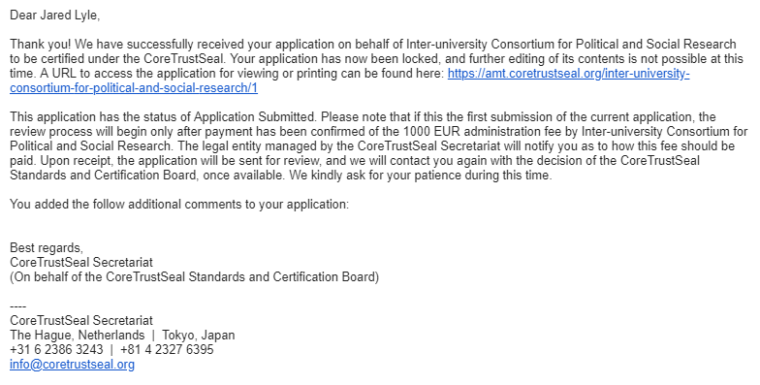

Slide 58
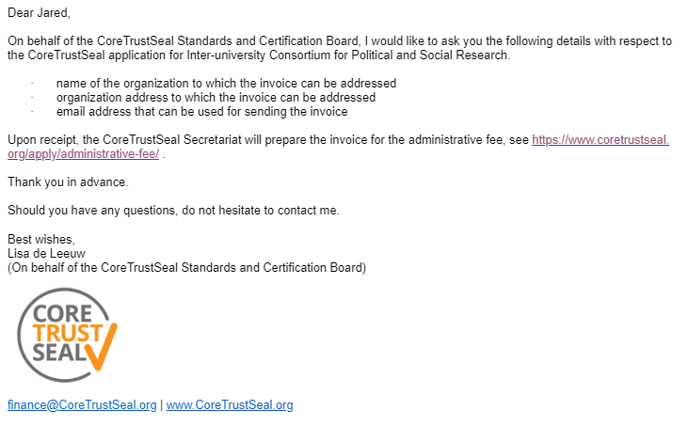

Slide 59
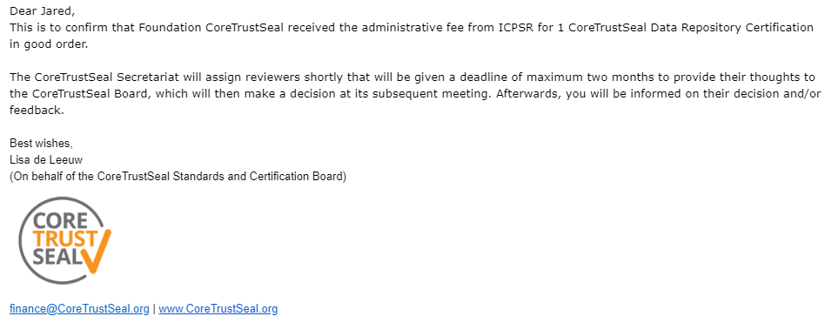

Slide 60
Findings and Changes Made
In progress -- CoreTrustSeal Secretariat will assign reviewers shortly
Some fine tuning:
  Selection decisions about individual files in deposits
  Specifying duration of preservation commitment
  Continued compliance with OAIS (e.g., file-level citations)

Slide 61
Comparison of Assessments – Effort and Resources
Test audit was the most labor- and time-intensive
TRAC self-assessment involved the time of more people
CoreTrustSeal (Data Seal of Approval and World Data System) certification least costly
Notes:
Additional observations:
-Try not to integrate details about technology that may change
-Schedule regular reviews of policies included in the assessments

Slide 62
Comparison of Assessments – Benefits
What did we learn and did the results justify the work required?
  Test audit was first experience – resulted in greatest number of changes, greatest increase in awareness
  Fewer changes made as a result of CoreTrustSeal (DSA and WDS); also not as detailed
  TRAC assessment has surfaced additional issues to address

Slide 63
Benefits continued
Difficult to quantify
  Trust of stakeholders
  Transparency
  Improvements in processes and procedures
  Use of community standards
  Greater awareness of benefits of domain repositories
Leadership dimension also important

Slide 64
Thank you!
lyle@umich.edu

Slide 65
Other References
Vardigan, M. and Lyle, J., 2014. The Inter-university Consortium for Political and Social Research and the Data Seal of Approval: Accreditation Experiences, Challenges, and Opportunities. Data Science Journal, 13, pp.PDA83–PDA87. DOI: http://doi.org/10.2481/dsj.IFPDA-14

Slide 66
Additional Observations
Try not to integrate details about technology that may change
Schedule regular reviews of policies included in the assessments

