Slide 1

Two Computational Models for Analyzing Political Attention in Social Media
ICWSM 2020
Libby Hemphill, Angela M. Schöpke-Gonzalez

Slide 2
goal: accountability
Notes:
A crucial step in holding public officials’ accountable is knowing what they’re up to. Every member of the U.S. Congress (or their office) uses Twitter, and they communicate their positions and activities. Their Twitter use provides data for us to use to hold them accountable by helping us know what they’re talking about, what they’re up to, and who they are talking to.

Slide 3

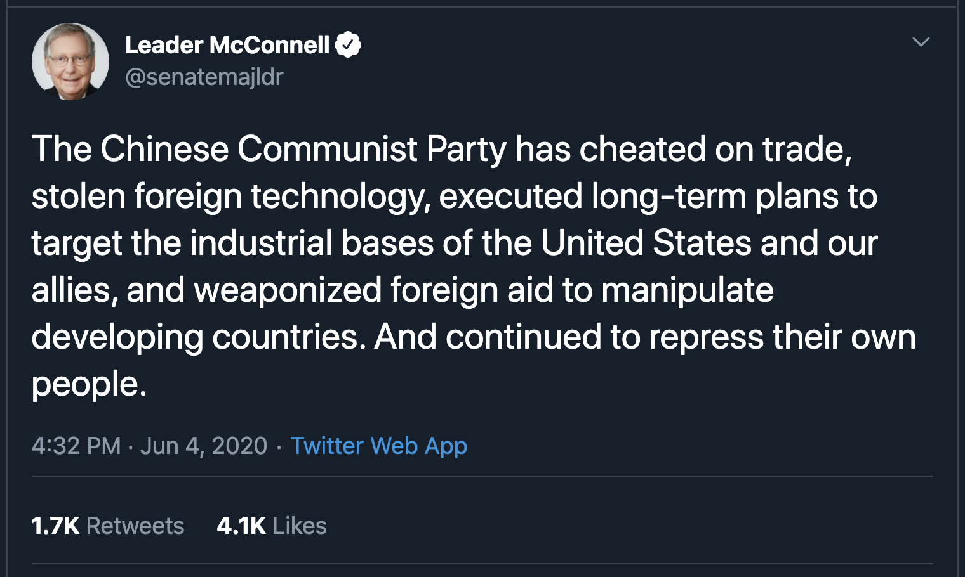
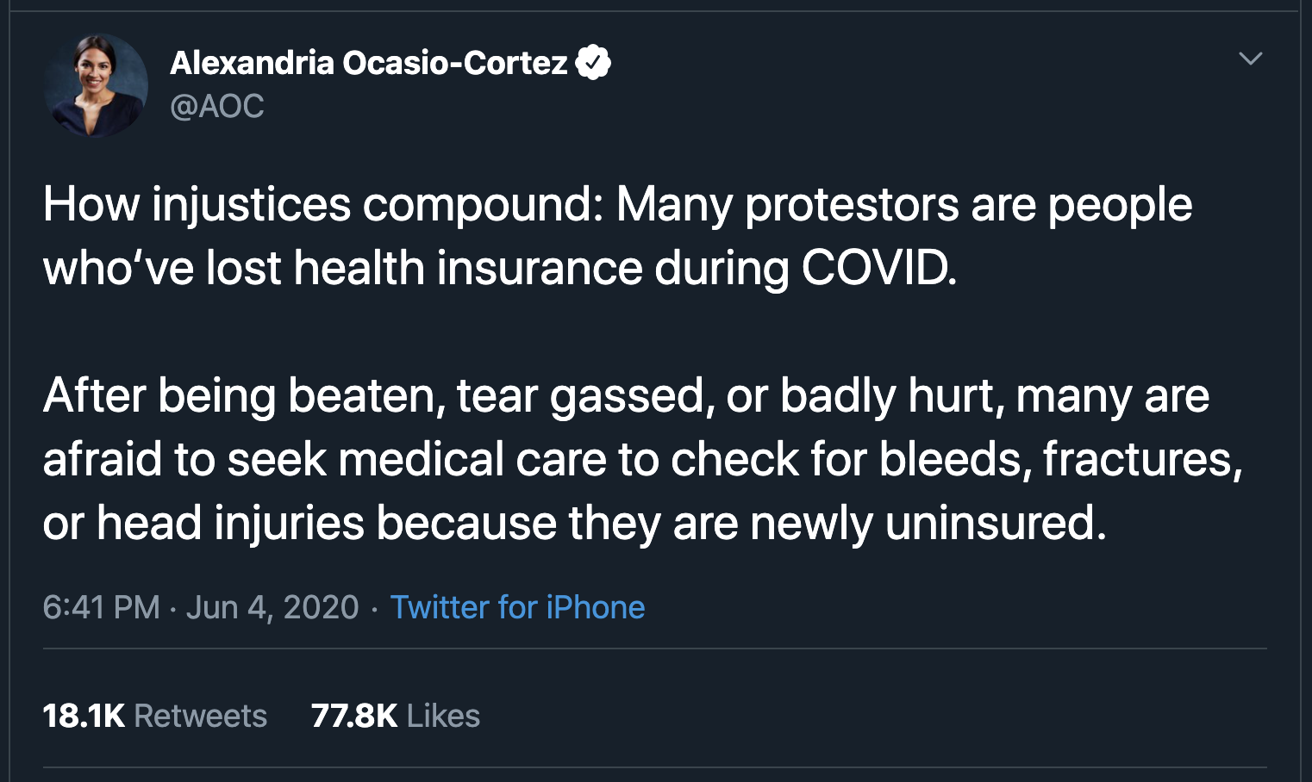
Notes:
From reading tweets, we know that they talk about policy issues like infrastructure and foreign affairs and health insurance, for instance. Reading tweets individually can tell us a lot about where they stand and what they’re up to, but, they make a lot of statements.

Slide 4
1,485,834
tweets per Congress
Notes:
In a single Congress (that’s a two-year period of governance), they generate nearly one-and-a-half million tweets. That’s 1.5 million statements about where they stand, who they’re talking to, and how they’re spending their time.

Slide 5
computational approaches
Notes:
What if we could “read” all the tweets? Recent advances in “text as data” approaches in computer science and political science make this possible, and we created two models that help us read texts as a distance or as a group and enable us to tell what politicians are talking about and whether it’s policy or something else. I’m going to introduce our two approaches for reading these tweets at scale and then show you what they can tell us about what the 115th Congress had to say.

Slide 6
supervised approach
Notes:
The first approach is a supervised model that labels tweets according to categories from the Comparative Agendas Project codebook. The codebook is widely used in political science to facilitate comparative politics research—labeling content with a standard codebook enables us to compare attention in one place like Congress with another like news media.

Slide 7
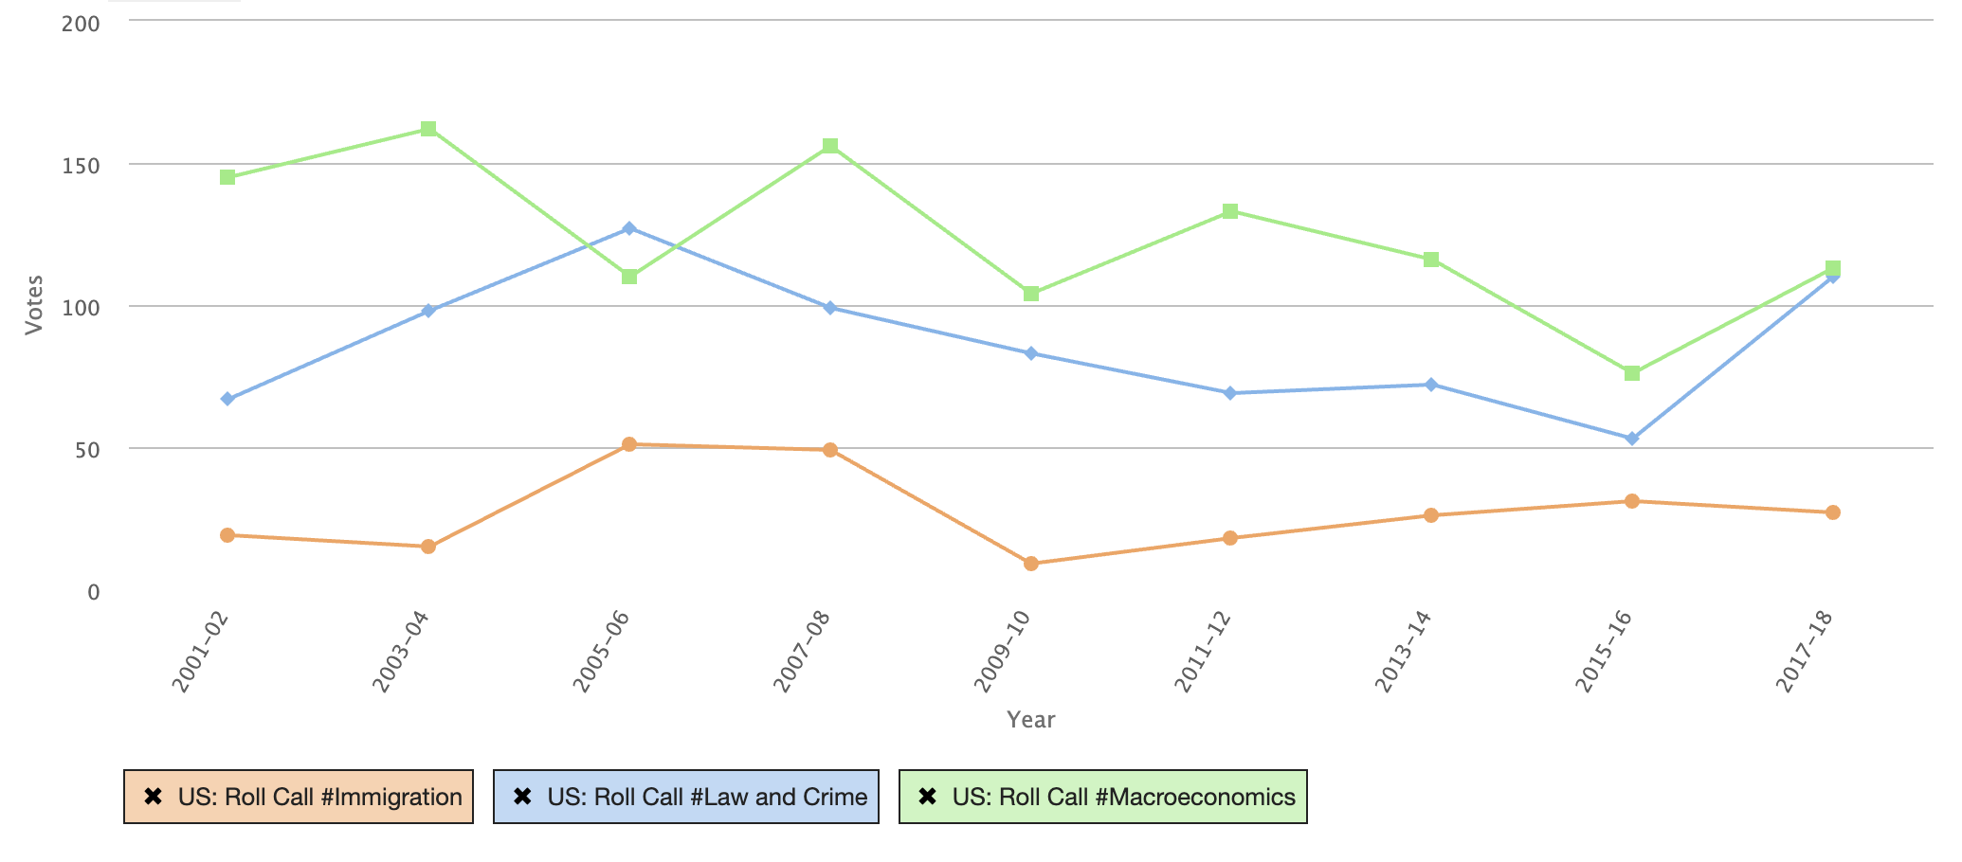
Supervised Model using Comparative Agendas Project classes
Notes:
Traditionally, the codebook has been applied to things like roll call votes, which are presented here, and bill text. Because members of Congress have widely adopted Twitter, we can use tweets as another text dataset. Annelise Russell at Kentucky labeled 68,398 tweets from Senators according to the CAP codebook, and we used those tweets as training data.

Slide 8
0.79
Logistic Regression F1=0.79, Precision=0.79, Recall=0.79
Notes:
We tried a bunch of different algorithms and found that a logistic regression model performed best. Our supervised model does two things: first, it classifies tweets as “about a policy issue” or “not about policy”. For tweets about policy, it assigns a “most likely” class from the CAP codebook.

Slide 9
unsupervised approach
Notes:
Our second approach was an unsupervised topic model. Russell and our supervised approach both found that Congress talks about things other than policy pretty often. Our unsupervised model is especially useful for understanding what’s going on in those “not about policy” tweets; it also is able to detect the categories found in the CAP codebook. It’s useful for studying things like communication style and particulars of the U.S. federal policymaking context like constituent service and veteran’s affairs that aren’t well-captured in the CAP codebook. Topic models don’t label topics themselves, but luckily our team includes a former Senate staffer and an experienced policy researcher; together we were able to interpret the topics and evaluate the models’ outputs.

Slide 10
115th Congress
Notes:
We labeled those 1.5 million tweets from the 115th Congress using both models. The 115th ran from January 2017 to January 2019. Republicans controlled both the House and Senate during the 115th. The period’s book ends were the Republicans’ attempts to repeal or replace the Affordable Care Act and Trump’s inauguration in January 2017; Senate confirmation of Brett Kavanaugh’s nomination to the Supreme Court and the Democrats regaining the house in the 2018 general election in the fall of 2018.

Slide 11
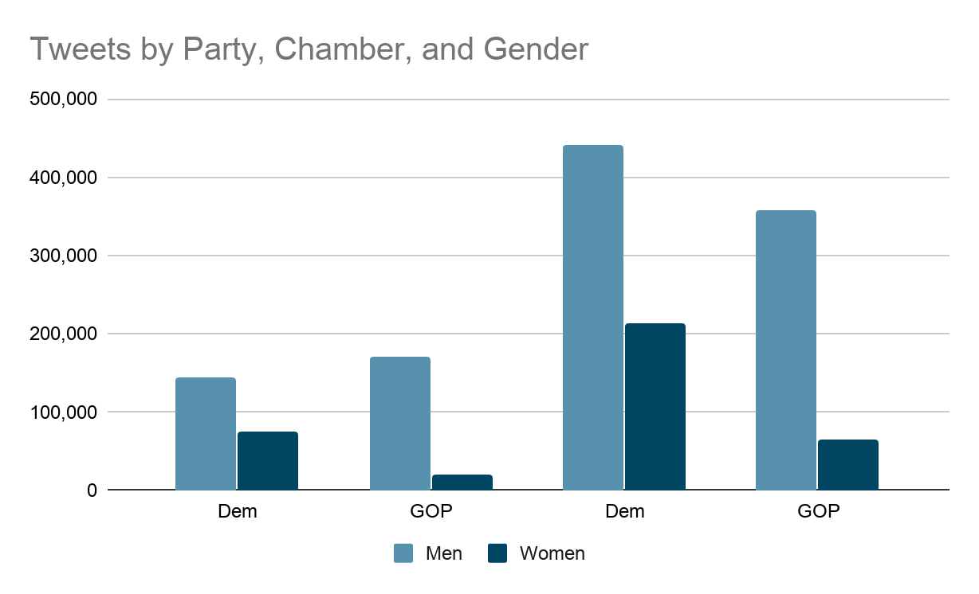
Notes:
Here you can see how many tweets from the parties, chambers, and genders we were able to collect and label. The Senate is on the left, the House on the right. Remember that women made up only 21% of Congress during the 115th, and the House is 4x as large as the Senate.

Slide 12
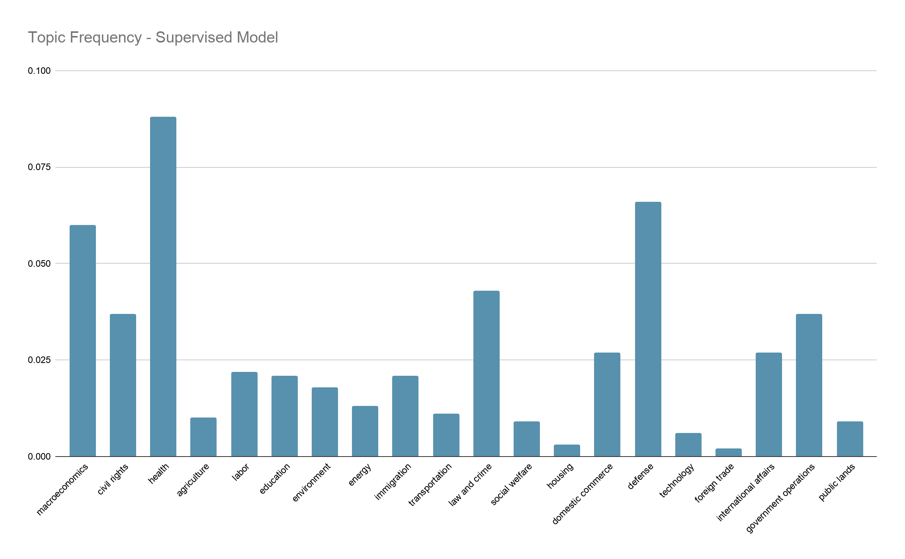
Notes:
The CAP codebook topics are visible here on the x-axis, and the bars show the frequency of tweets in each category. Health is clearly the most commonly discussed category, and that makes sense given the debates around the Affordable Care Act (also called Obamacare) throughout 2017. Other categories that received a lot of Congress’s attention included defense, macroeconomics (which includes budgets and taxes), and law and crime (which includes discussions about drug laws, courts, prisons, and criminal justice). Congress gave comparatively little attention to housing, foreign trade, technology, and social welfare.

Slide 13
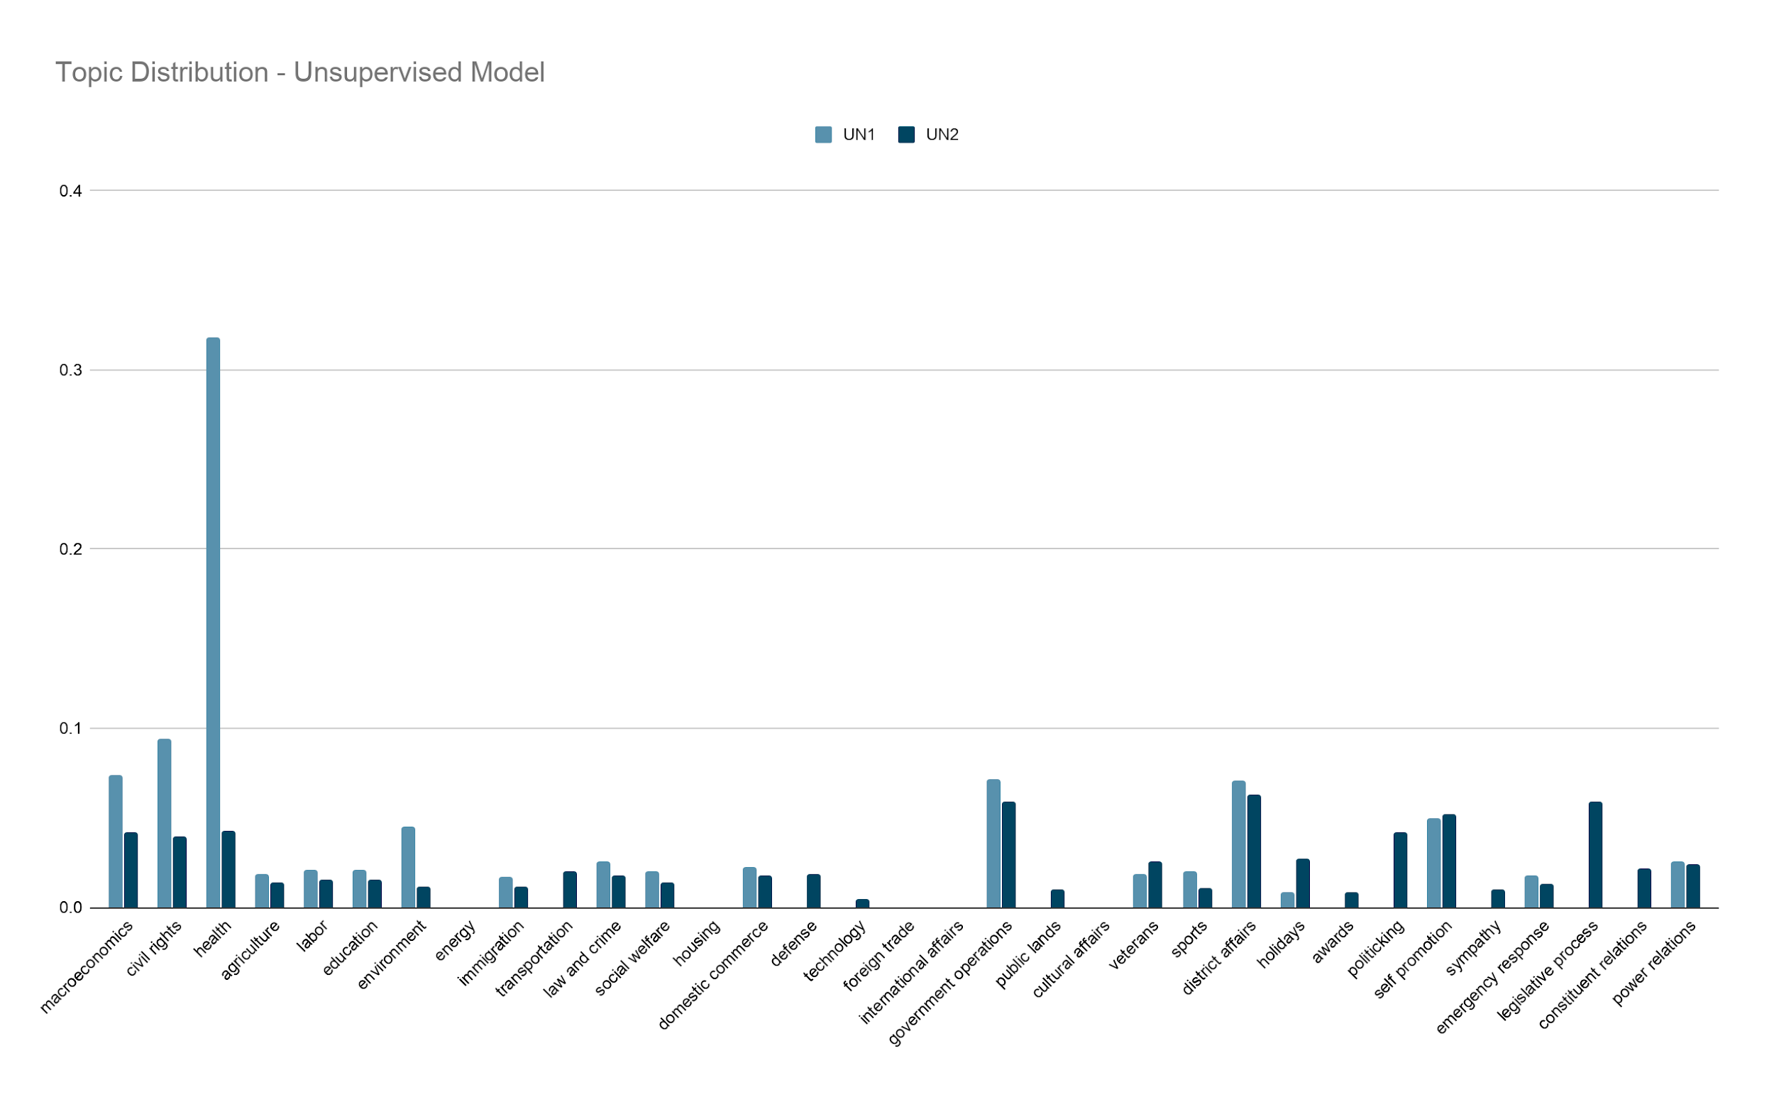
Notes:
The unsupervised classifier relaxes the “mutually exclusive” criteria and allows tweets to fall into more than one category. So here we show the topic distributions for both the most likely (UN1 or light blue) and second-most likely (UN2 or dark blue) topics. The distributions here are similar to the supervised model except that defense does not appear at all in the “most-likely” category.

Slide 14
Notes:
And the unsupervised model has all of these additional categories (those in the yellow box) that are not included in the CAP codebook. These categories include non-policy activities such as district affairs (relaying office hours and town hall details) and self-promotion (often encouraging followers to “tune in” to a media appearance). Because it allows tweets to fall in multiple categories, the unsupervised model enables us to find intersections such as self-promotion and health that include media appearances about ACA debates.

Slide 15
Research Applications
Supervised Model
Compare Congress’s topic attention in Twitter and elsewhere (e.g., news media, bill text)
Compare Congress’s topic attention with other governments (e.g., state legislatures, other countries)
Trends in attention over time
Unsupervised Model
Study communication style such as home style
Study non-policy discussions and activities such as media appearances and district visits
Studies that require models that allow tweets to fall into multiple classes or categories
Trends in attention over time
Notes:
Our paper has more specific recommendations for ways to use each model in research on political communication and social media. The supervised model is best suited for comparative analyses such as attention in Twitter and news media or in the U.S. Congress and other governing bodies. It is also useful for analyzing trends in attention over time. The unsupervised model is best suited for exploratory analysis or Congress-specific research. It enables studies of communication styles, non-policy discussions, and again trends over time. The unsupervised model also allows tweets to fall into multiple categories so is useful for studying the intersections of performance and policy.

Slide 16
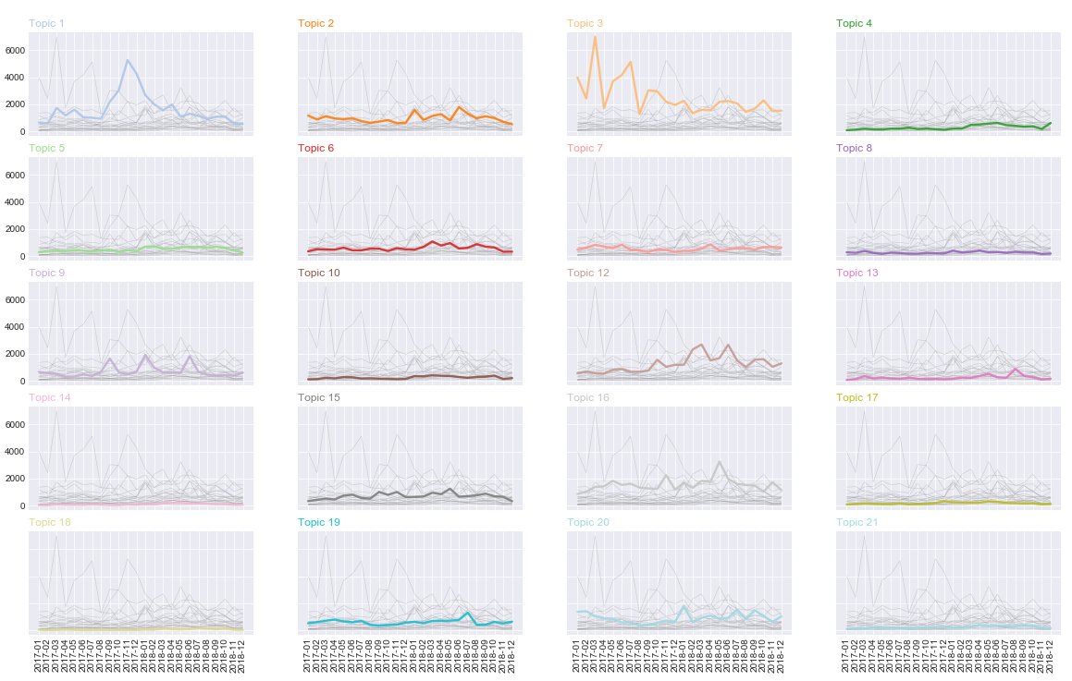
Notes:
We mentioned “trends in attention over time” as a potential use for each model. Here we provide mini time series graphs for each topic in the supervised model’s output. You can read more about our time series analysis in a paper in press at Policy & Internet (the link is on the next slide), but the idea is that using tweets as data allows us to look at trends in Congress’s attention in nearly real-time. Other measures of Congress’s attention like bill text and roll call votes take time to update and are often provided only at the end of Congressional sessions, often when it’s too late to hold members accountable or to engage or lobby them around an issue.

Slide 17
Contact
Libby Hemphill
@libbyh
libbyh@umich.edu
Angela M. Schöpke-Gonzalez
aschopke@umich.edu
School of Information
University of Michigan
Related paper:
Hemphill, L., Russell, A., Schöpke-Gonzalez, A.M. (in press) Policy & Internet article What Drives U.S. Congressional Members’ Policy Attention on Twitter? Policy & Internet. DOI:10.1002/poi3.245
Models:
https://github.com/casmlab/modeling-political-attention
Data:
https://www.openicpsr.org/openicpsr/project/118569/version/V2/view/
Notes:
We’re provided our data through openICPSR, a self-published repository at the world’s largest social science archive, and code for our models through GitHub. Thanks for your time and attention, and I look forward to talking about these models and their analytic utility.

