Slide 1
From Asking Questions to Sharing Data: A Look at Ethics in Social Research
Data: Powered By YOU
Data Fair 2018
Presenter, Lynette Hoelter, ICPSR

Slide 2
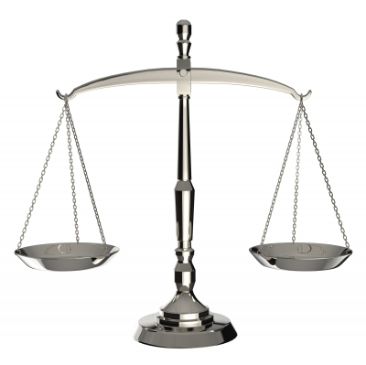
Overview
Brief overview of ethics
Thinking about ethics throughout the research process
  Study design
  Data collection
  Sharing
  Responsibilities of secondary users
  Ethics in publishing
Image courtesy of Kittisak at FreeDigitalPhotos.net
Notes:
In social science research, ethical issues may be more prominent throughout the research process than in other fields. Acknowledging the issues and making responsible decisions goes a long way toward “best practices” in data collection and management.

Slide 3

Typical “Standards”
Beneficence: obligation to do good and not cause harm
Justice: treating people fairly – select subjects equitably
Respect for persons: respect individuals’ choices, protect those with diminished autonomy to make choices (e.g., children)

Slide 4
Research Misconduct
“Intentional, knowing, or reckless behavior in research that is widely viewed as highly unethical and often illegal. Most definitions define research misconduct as fabrication or falsification of data or plagiarism, and some include other behaviors in the definition, such as interfering with a misconduct investigation, significant violations of human research regulations, or serious deviations from commonly accepted practices. Honest errors and scientific disputes are not regarded as misconduct.” (National Institute of Environmental Health Sciences Glossary of Commonly Used Terms in Research Ethics)

Slide 5
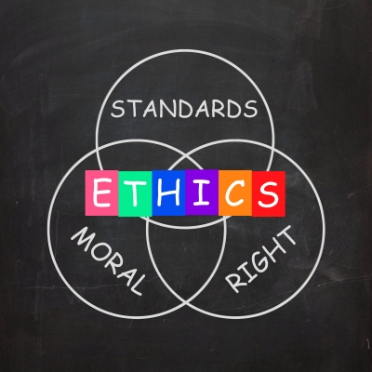
This presentation:
Not necessarily research misconduct (though some), but more generally “doing what’s right” … things to keep in mind
Mandates for data management plans and data sharing have focused primarily on informed consent, disclosure risk – here, thinking more broadly
Image courtesy of Stuart Miles at FreeDigitalPhotos.net
Notes:
Most people have heard about “big” cases – Milgram experiments after WWII, Tuskegee Syphilys Study, Stanford Prison experiment. Also, more recently Michael LaCour case…

Slide 6
Categories of Ethical Issues
Data collection and analysis
Treatment of human subjects
Responsibility to society
Note: These cut across the stages in the research process such that decisions reflecting any of the categories may occur at all points in the process.

Slide 7
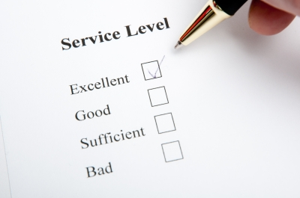
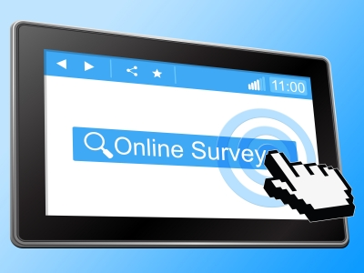
Data Collection and Analysis
Careful design of research
Findings reported accurately
Research transparency
Images courtesy of Stuart Miles (above) and Jeroen van Oostrom (right) at FreeDigitalPhotos.net

Slide 8
Treatment of Human Subjects
No harm to participants
Benefits of research outweigh the risks (beneficence)
Informed consent (respect)
Full disclosure
Assurances of anonymity/confidentiality

Slide 9
Responsibility to Society
Exploitation of some populations (justice)
Awareness of values inherent in the research process
Obligation to consider how findings might be used
Disseminate results to add to public knowledge and debate

Slide 10
Concerns Re: Research Design
Agenda-driven research
Falsification of data or results
Poor data quality
Plans for data storage and sharing
Impacts of incentives
Notes:
Push-polls; Selling Under the Guise of research, etc.
Question wording

Slide 11

Responsible Decisions Early
Design of study – does it match the research question?
Creation of survey instruments or observation protocols
Sampling frame
Training interviewers, observers, etc.
  Observation: to tell or not to tell…
Informed consent and instructions to respondents
Image courtesy of Master isolated images at FreeDigitalPhotos.net
Notes:
Method/study should be driven by the research question.
Avoid bias in question wording or questionnaire design. Be aware of differences in wording – more support shown for “assistance to the poor” and “dealing with drug addiction” than “welfare” and “drug rehabilitation.”
Make sure sampling frame and strategy is appropriate and will minimize disclosure when possible (e.g., keeping track of target indicators)
Poorly trained interviews could affect data quality (make it up, interpreting questions for respondents); similarly poorly trained observers may miss key information

Slide 12
Informed Consent
Should include:
  Participation is voluntary
  Ability to withdraw or skip questions
  General purpose of the study/procedures/topics
  Description of any potential discomfort or risk
  Confidentiality/anonymity
  Estimated time to complete
  How data will be used (including sharing!)
  Written consent for video or audio taping
Notes:
R should be given enough information to make an informed decision about participation, incentive and/or authority of originator should not be perceived as coercive.
Potential risk – no more than what would be experienced during a typical physical or psychological exam.
Balancing between full disclosure and jeopardizing results. (E.g., NSFG; “health behaviors.”)

Slide 13
Concerns Re: Analysis
Falsified data
Limited or inappropriate analyses
Overgeneralization
Lack of transparency
Misuse/misreporting by media

Slide 14
Once Data are Collected
Removal/separation of any identification
Proper handling and storage
If archiving/sharing data (required by NSF, NIH), use best practices
  Guidelines for researchers

Slide 15

Responsible Data Sharing
Defining data confidentiality and disclosure risk
Direct and indirect identifiers
Data dissemination
Use by secondary analysts

Slide 16

Disclosure Risk
The potential identification of an individual based on information in the data record
Concern: Allows information about the respondent to be revealed that would not otherwise be known
What if respondent wants to be identified?
Image courtesy of marcolm at FreeDigitalPhotos.net

Slide 17
Data Dissemination
May require recoding/collapsing or perturbing
  Pay attention to sub-populations
Levels of Access
  Public Use
  Restricted-Use Data
    available with agreement to abide by conditions of use and storage
  Enclave data
    Special class of restricted use – data never leave secure servers; output and notes vetted; in-person or virtual

Slide 18
Responsible Use of Secondary Data
IRB approval may be needed
Complete analyses in line with information in documentation and proper analysis strategies for the research question/data type
Be aware of sampling frame, weighting – don’t overgeneralize
Give credit to data producer/original investigators
Know rules about “re-sharing” and protecting data

Slide 19
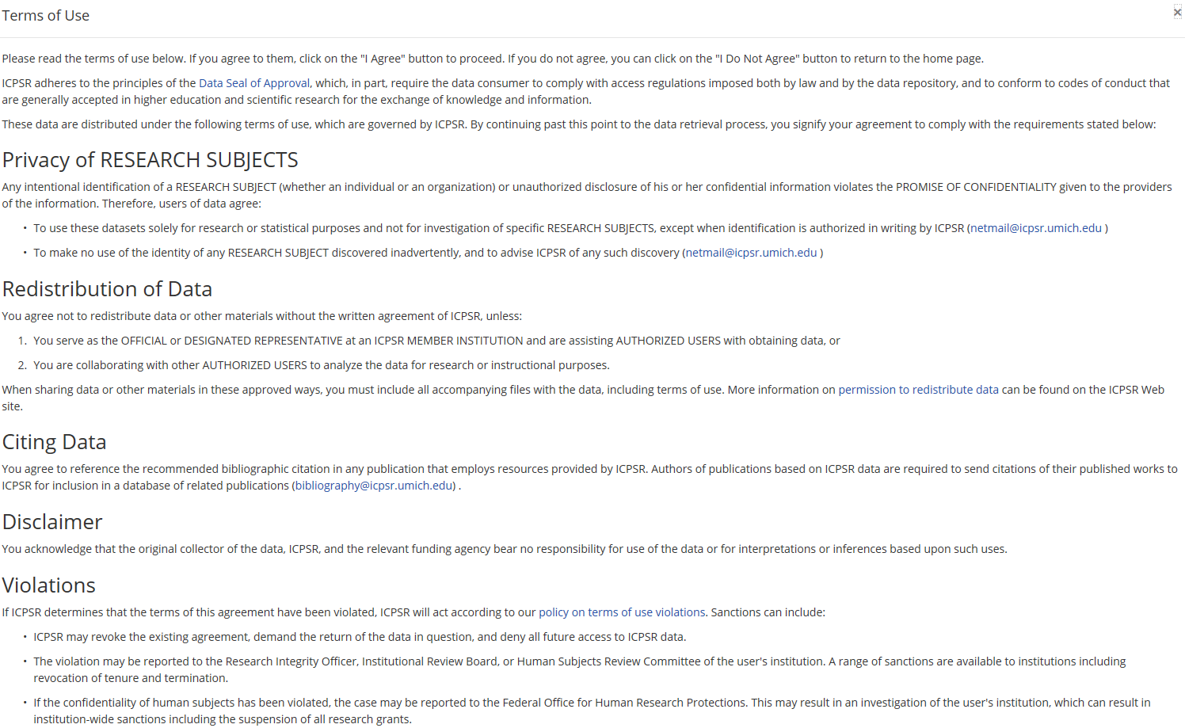
Example ICPSR Terms of Use
Notes:
Include discussion of why important to cite data

Slide 20

Presenting (& Publishing) Results
Who should be an author? All authors accept responsibility for content
Order of authorship
Citing other sources, including own
CITE THE DATA
Send to one journal at a time
Correct errors if found later
Don’t speak beyond expertise
Image courtesy of digitalart at FreeDigitalPhotos.net
Notes:
“If sociologists discover significant errors in their publication or presentation of data, they take reasonable steps to correct such errors in a correction, a retraction, published errata, or other media as appropriate.” (12.4.e. ASA Code of Conduct)

Slide 21
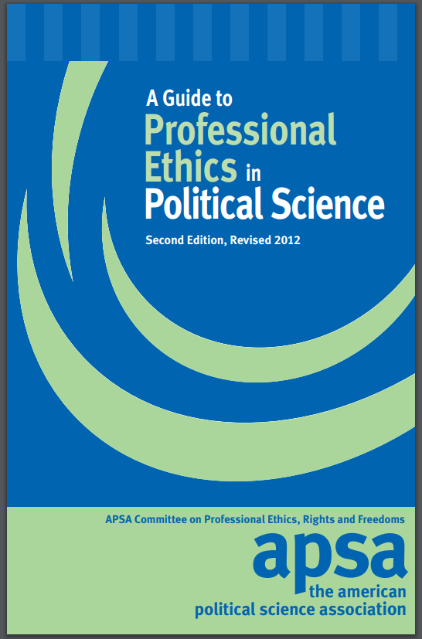
Still Interested?
Professional Associations’ Codes of Ethics
  American Association of Public Opinion Research
  American Political Science Association
  American Psychological Association
  American Public Health Association
  American Sociological Association
Notes:
Heavier focus on research transparency, mentoring than previously

Slide 22
Questions?? Comments??
Lynette Hoelter, lhoelter@umich.edu

