Slide 1
2019 Library Mini Grant Presentation
Notes:
How are you guys today? I cant hear u can I get a go blue?
Before I begin today, I want to take a moment to thank MHeal and Timmy Global Health for putting this incredible event together, Dr. Syaed and Dr. Po Tu for donating their valuable time and sharing their insights, and all of you for coming. The fact that we’re all here shows Michigan’s commitment to improving healthcare and changing the world and I want to take a moment to appreciate that.

Slide 2



Agenda
The Problem
The Solution
Accomplishments
Notes:
My name is Anurag… on behalf of blueprint for Pangaea. How many of you know or have heard about blueprints for Pangaea?
Today I’m here to raise awareness about a salient problem within healthcare, a solution to that problem, and some accomplishments along the way. and at the end we’ll talk about how you guys can be a part of solution too

Slide 3
The Problem
Notes:
Past Monday I collected supplies and got box of AirLife Nubulizer Cap
This item retails for $10 a piece and is used to administer medication as a mist for variety of conditions including asthma and cystic fibrosis.
Now what I want you guys to do is take a look at this item, what’s wrong with it?
While each one may retail for only $10, we received 50 in 1 box worth $500
The packaging is completely intact, it’s unused so why is it being thrown away?

Slide 4
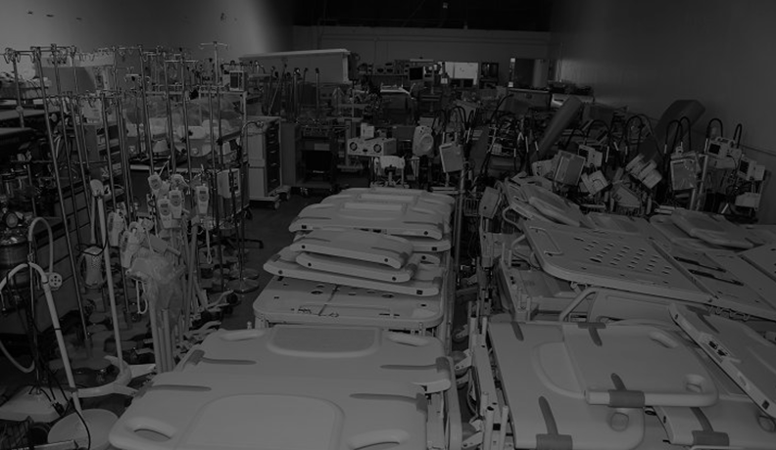
10+
BILLION
POUNDS
Less than 5% of unused waste is being diverted
Notes:
The U.S. healthcare system annually disposes of more than 10 billion pounds of unused, usable medical supplies and equipment valued on the order of billions of dollars. Furthermore, less than 5% of unused waste is being diverted. This waste contributes to healthcare’s standing as second-largest contributor to landfills nationally.

Slide 5
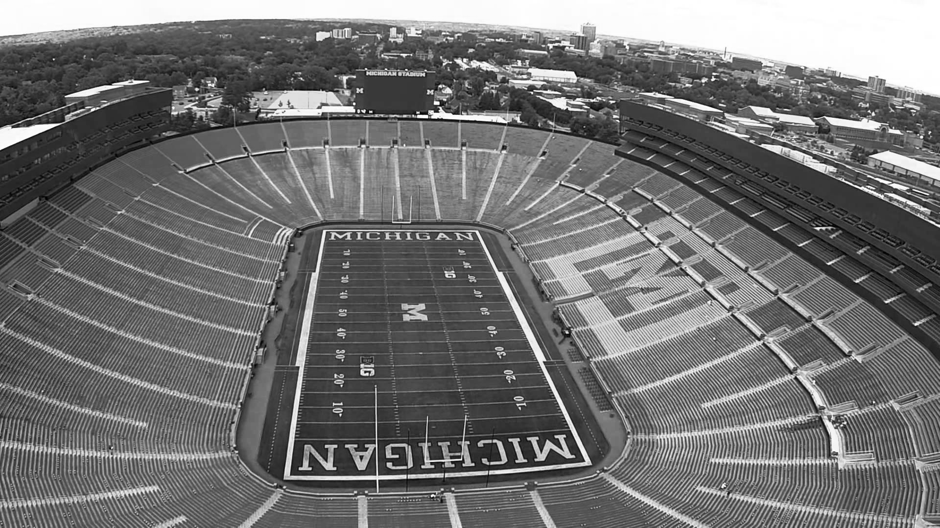
35 STADIUMS
Notes:
Hard to visualize 10 Billion, so let me use a more relatable metaphor. 10 Billion pounds equates to 35 M stadiums

Slide 6
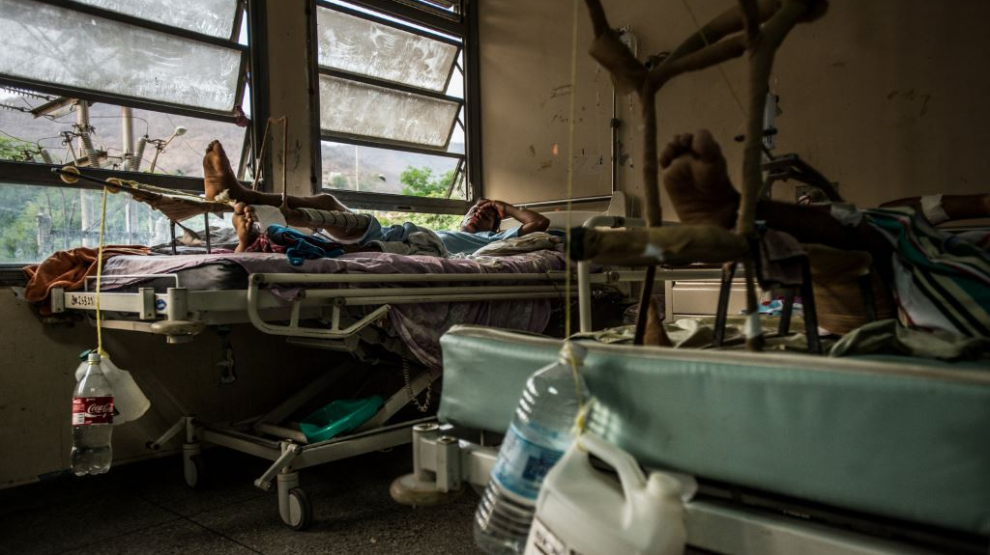
Notes:
Using jugs and soda bottles, doctors at Luis Razetti Hospital rigged devices to treat patients with broken legs
125 technically have it worse (195 countries total)
This clinic clearly showcases the lack of resources. Patients go through the healing process with makeshift apparatus incorporating plastic water bottles as opposed to sophisticated equipment. That’s the reality in other parts of the world. Maybe more alarming is the fact that this “average” clinic in Venezuela represents the 70th richest country in the world. What does that mean? That means that 125 countries technically have it wrose…

Slide 7
The Solution
Notes:
So what’s the solution? Background on foundation and why we all are still here; one student and now… Well, let me show you.

Slide 8



Our Business Model
PARTNERING
COLLECTING
VERIFYING
SHIPPING

Slide 9
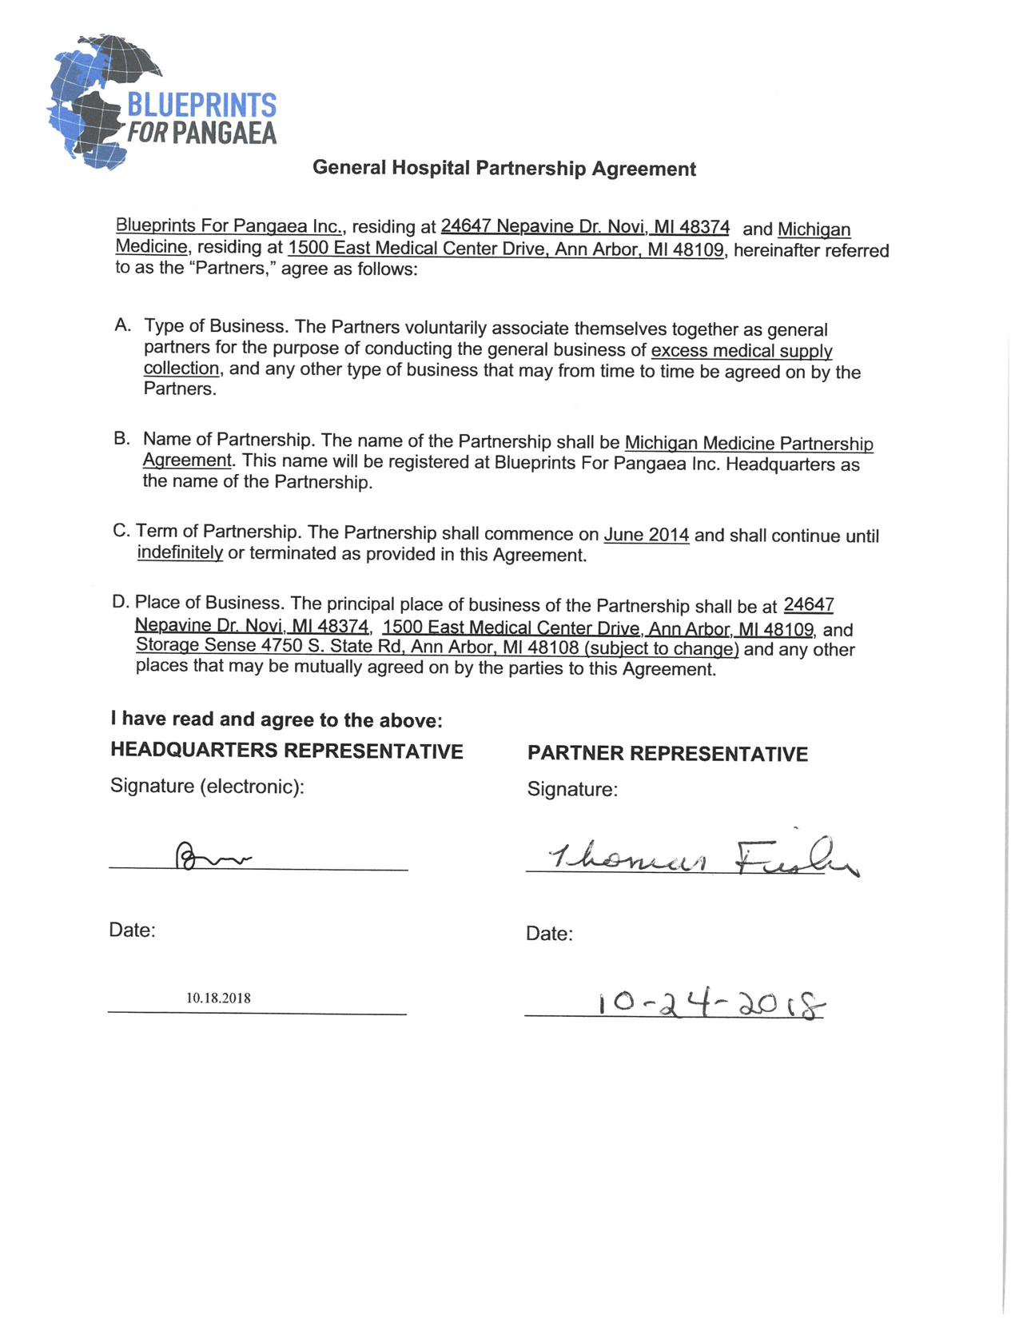
Partnering
Notes:
STEP 1: LOCAL PARTNERSHIPS
Blueprints For Pangaea chapters across the nation form partnerships
with affiliated University medical centers and work with hospitals to
establish a simple, efficient collection system to collect excess, unused
medical supplies. With fewer medical resources to process, our partner
hospitals are able to cut expenses and reduce their environmental
footprints while gaining community goodwill.

Slide 10
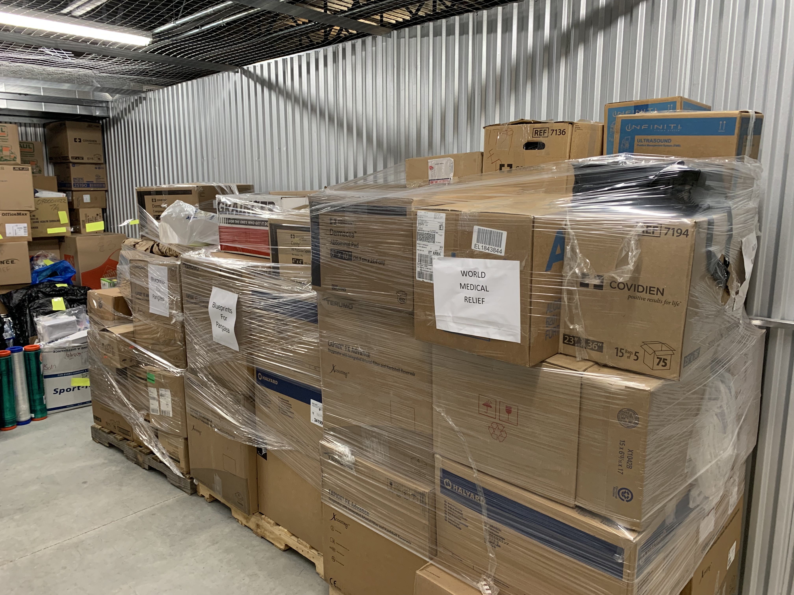
Collecting
Notes:
STEP 2: TRANSPORT AND STORAGE
These supplies are transported to our local, climate-controlled
storage warehouse. They are inventoried, packed into boxes, and
stored until enough supplies are collected to fill a 20- to 40-foot
shipping container.

Slide 11
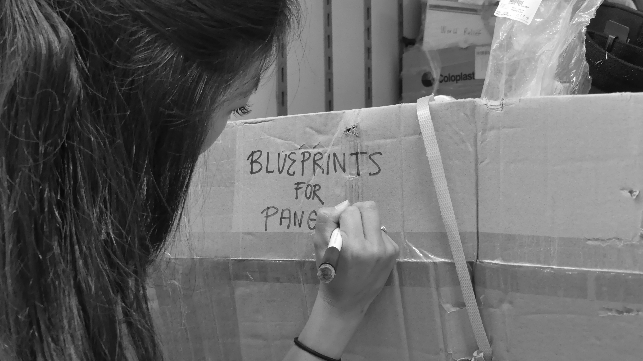
Verifying
Notes:
STEP 3: VERIFY
Blueprints For Pangaea works with nonprofit partners and distributors
to verify medical supply quality and integrity. Supplies are then further
sorted and prepared for shipment.

Slide 12



Shipping
Notes:
STEP 4: SHIP
Blueprints For Pangaea arranges for transport of supplies independently
or via our nonprofit partners. Our reputable distribution partners
diligently track their supplies. With additional follow-up from our
executive board, we work to ensure usable items reach communities all
over the world that truly need them.

Slide 13
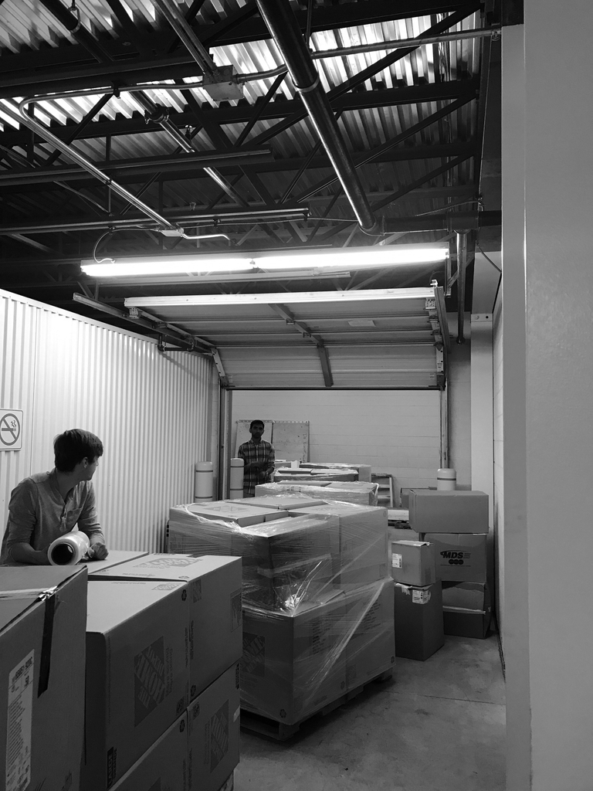
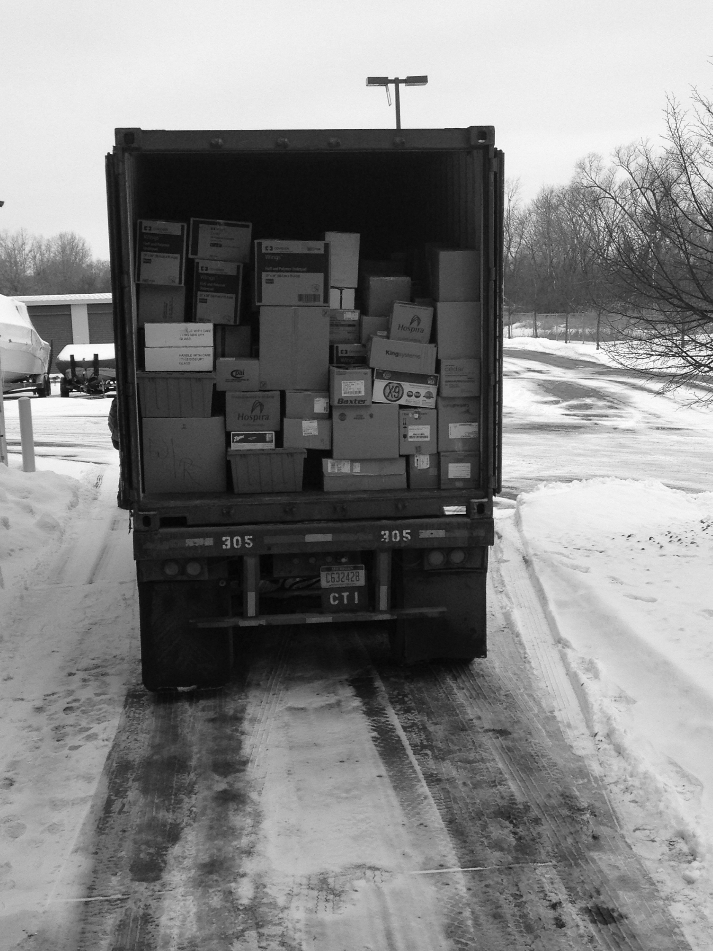
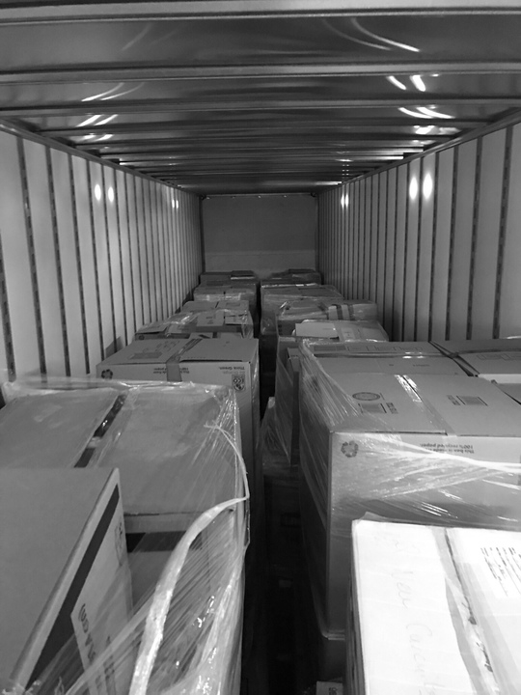
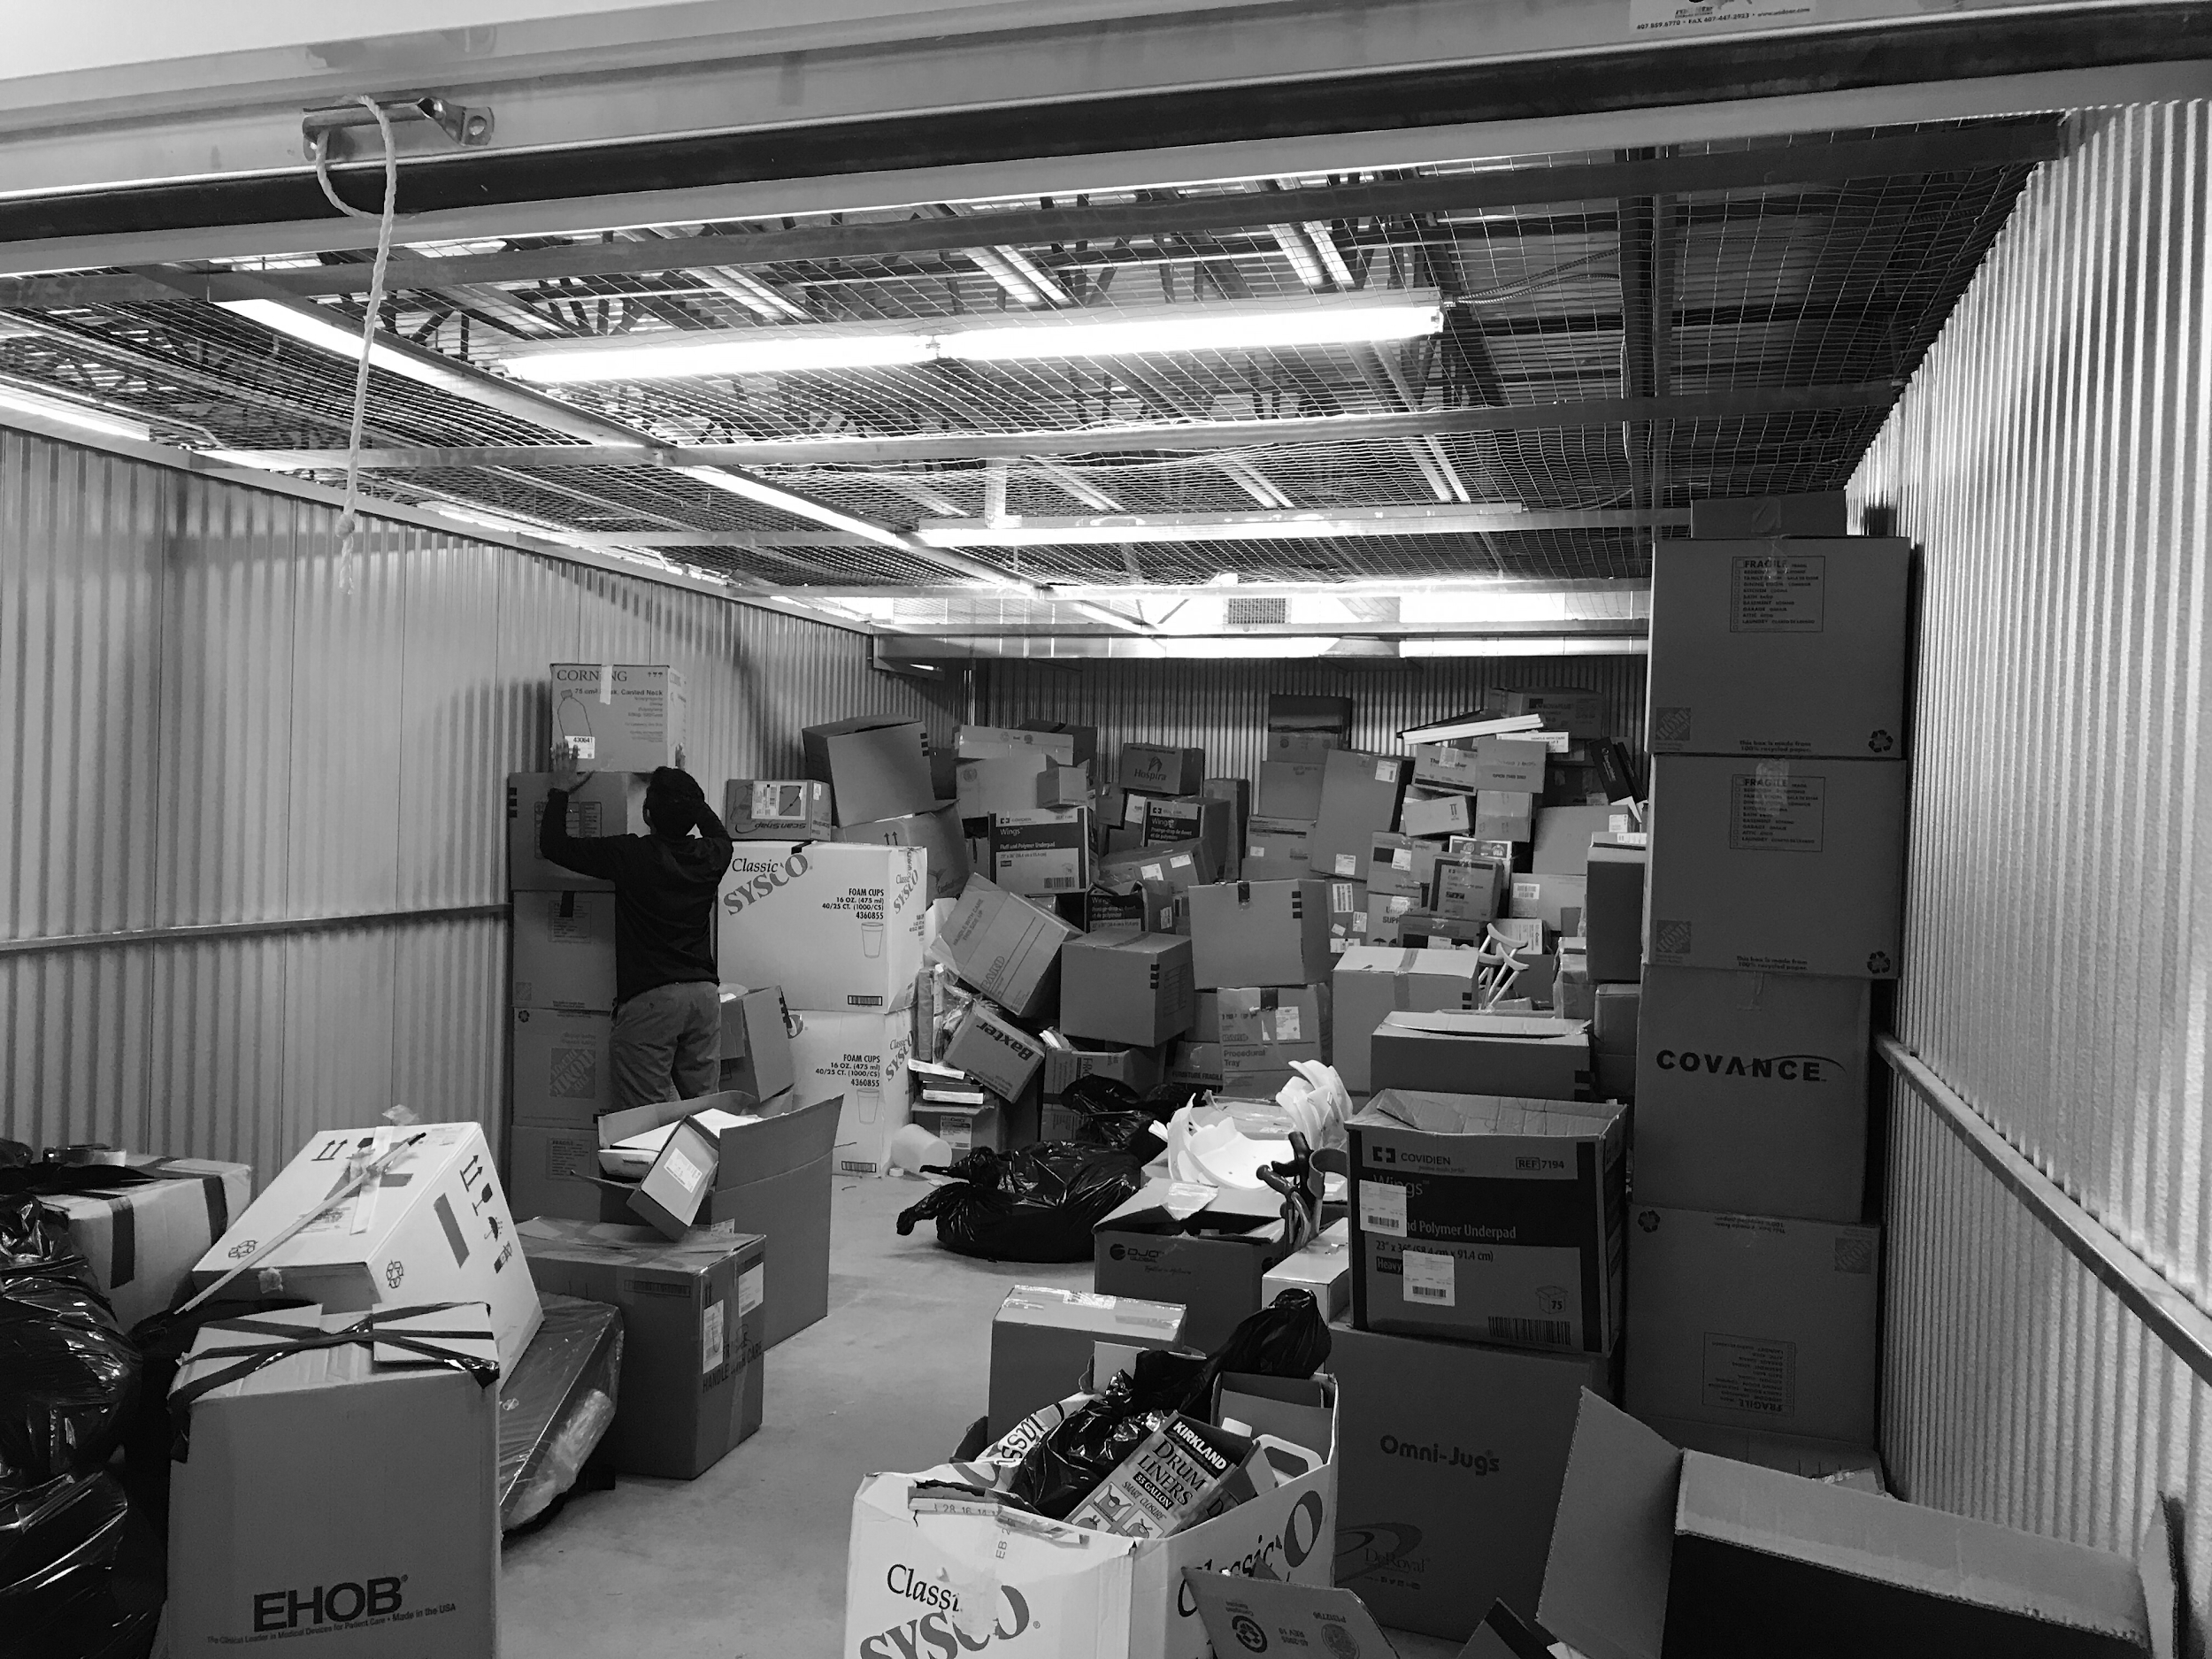
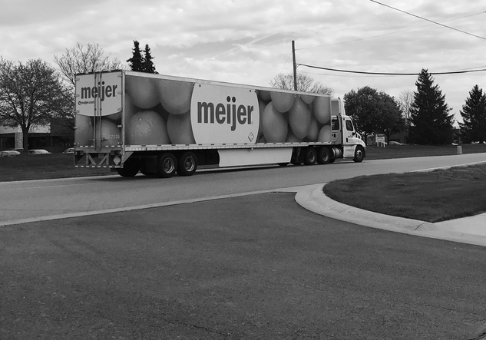
Our
Accomplishments

Slide 14
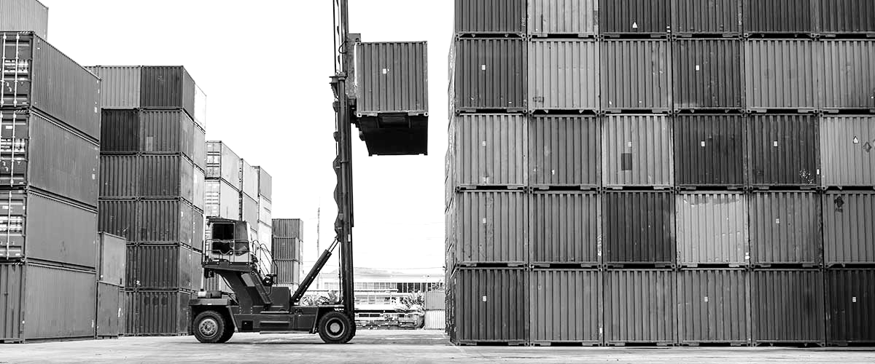
Our Impact
62,000+
$2M+
$60,000+
Pounds
Shipped
Shipments
Valuation
Money
Raised
Notes:
Past semester quantified

Slide 15
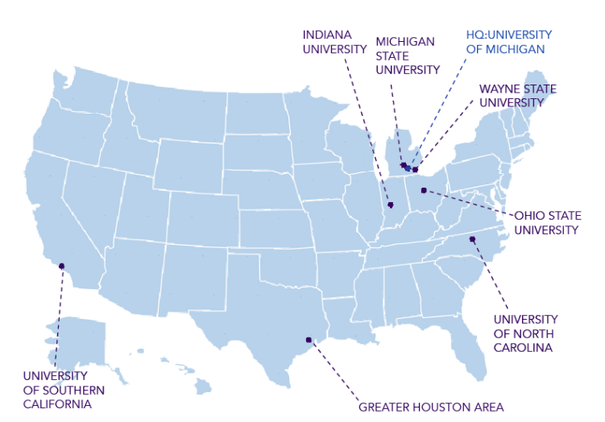
Our National Reach
Notes:
Since founded expanded to 6 active chapters
Geography centralization
Going forward

Slide 16
Independent Impact Spotlight
Dominican Republic
Cost: $1,790
Benefits: $286,000
Myanmar
Cost: $51
Benefits: $527
Jamaica
Syria
Cost: $0
Benefits: $X,XXX,XXX
Niger
Cost: $3,750
Benefits: $387,000
Notes:
We’ve had shipments to:
Jamaica
Myanmar; Marquette 10 boxes dental supplies $500
Syria; SAMS (1,400lbs)
Dominican Republic (1.5 M Infant Needles weighing 30,000 lbs and valued 286k)
Niger (7,000+ lbs valued at 387k)

Slide 17
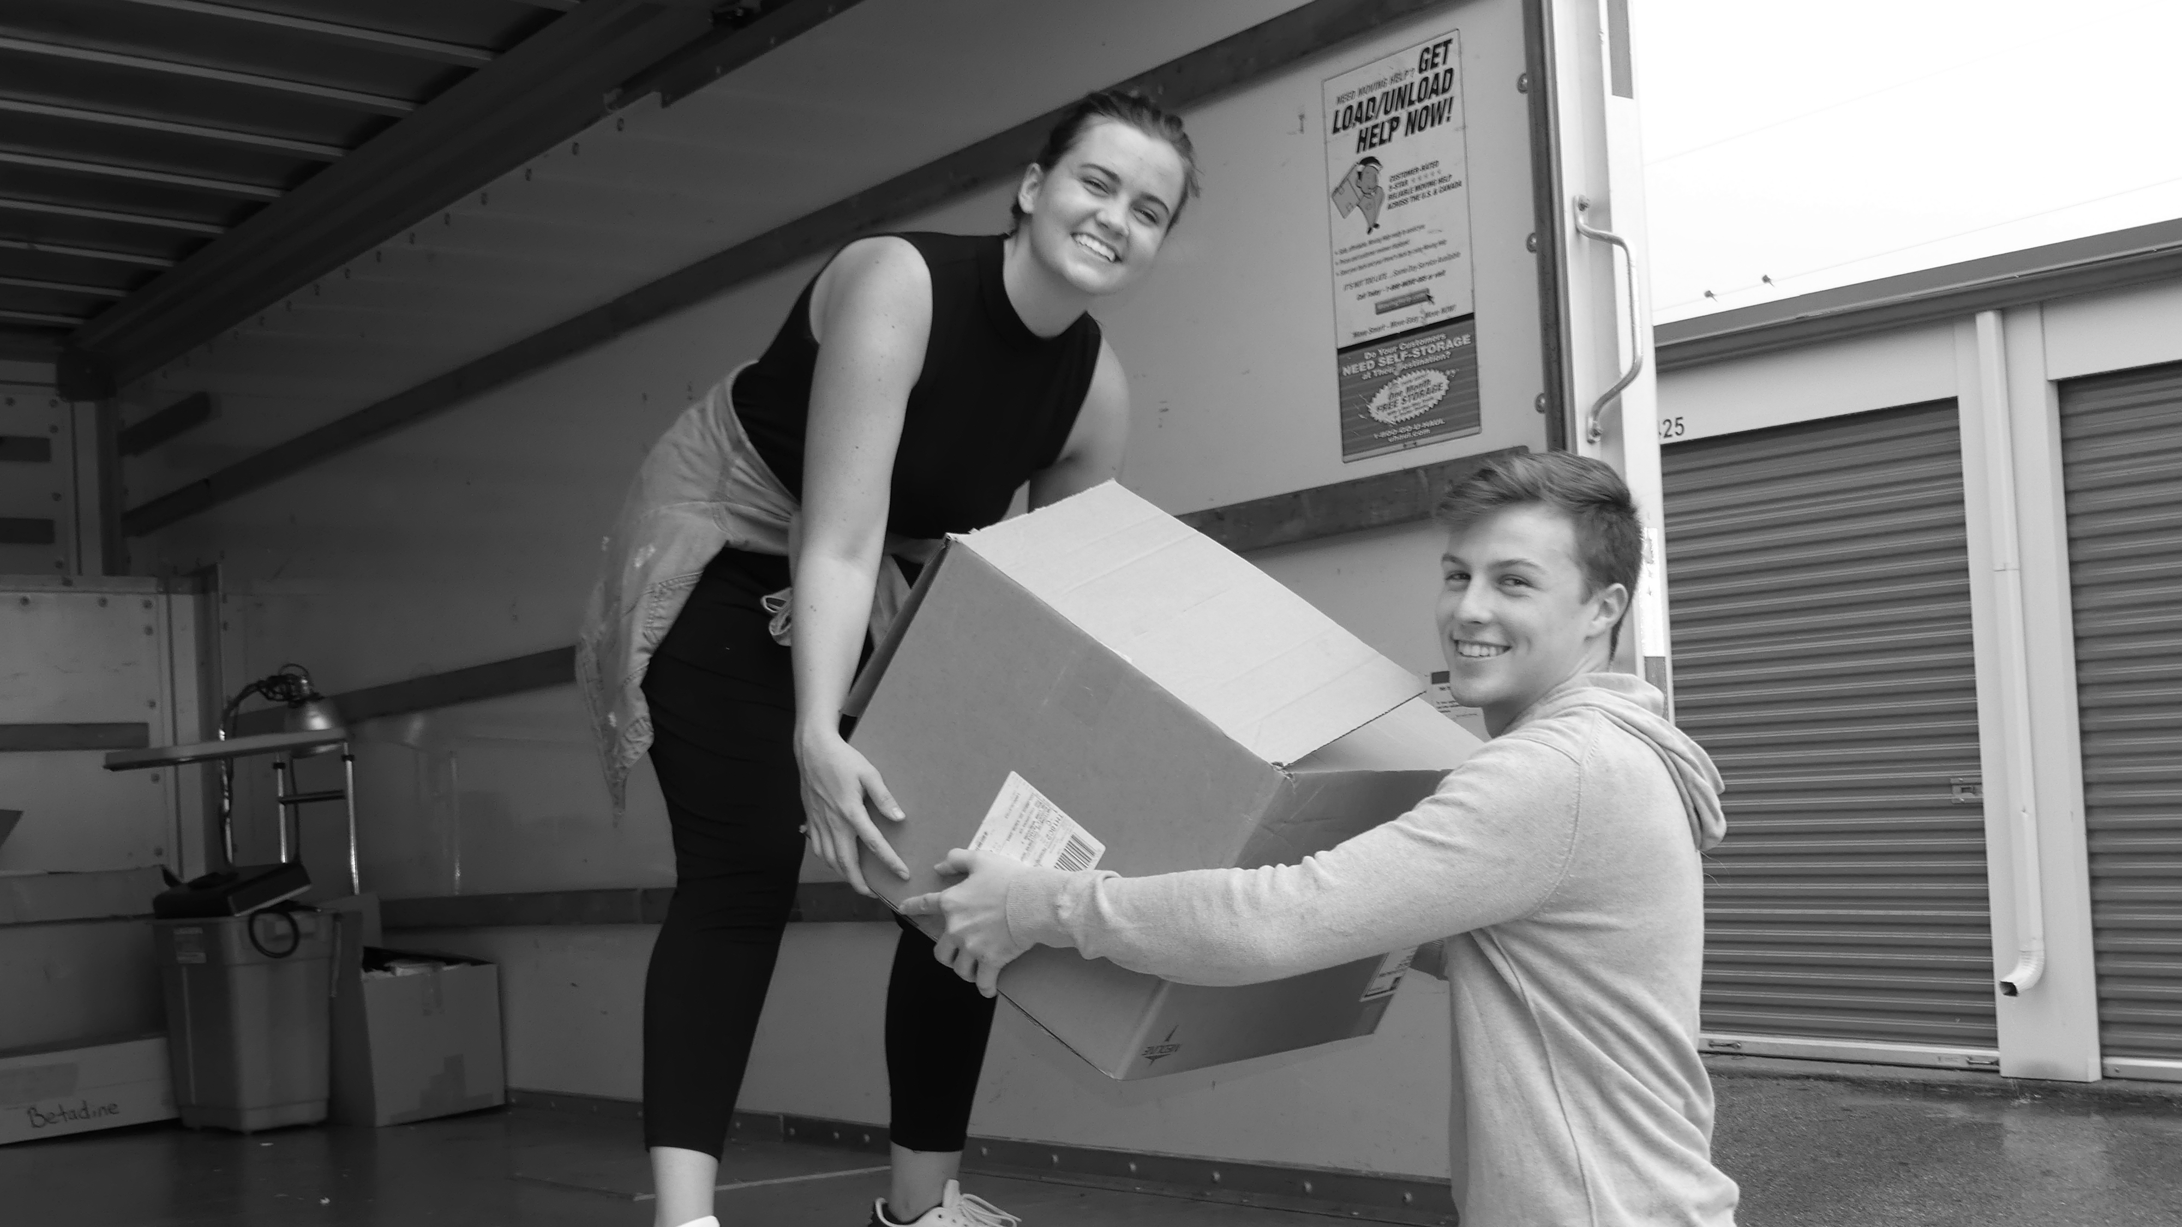
Independent Shipment this Saturday
Notes:
3 recruiting cycles:
Accept people of all disciplines from …

Slide 18
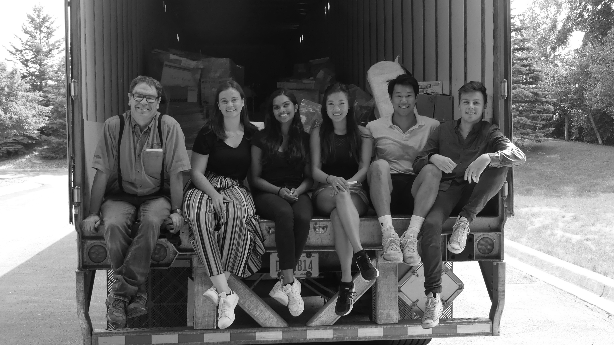
Questions?

Slide 19
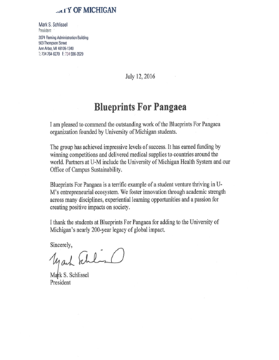
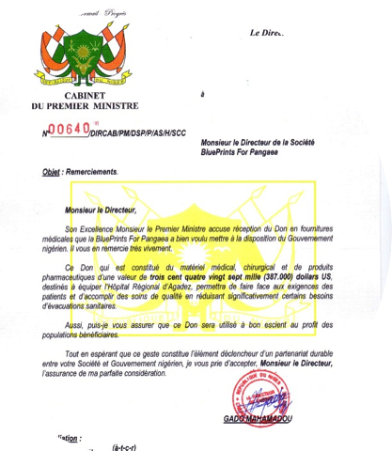
Recognition
Notes:
Efforts in Niger
Efforts overall (Mark Schlissel)

Slide 20
Our Impact
Notes:
Over past 5 years we’ve…

Slide 21

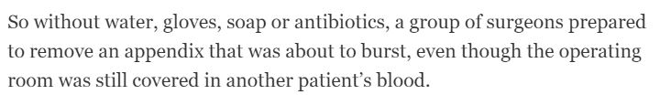

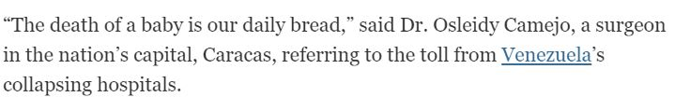
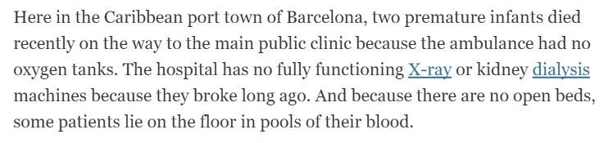

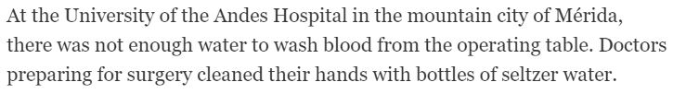

Notes:
A New York Times article published in 2016 focusing on a Venezuelan hospital really helps give perspective
We see that __
Source: http://www.nytimes.com/2016/05/16/world/americas/dying-infants-and-no-medicine-inside-venezuelas-failing-hospitals.html

Slide 22
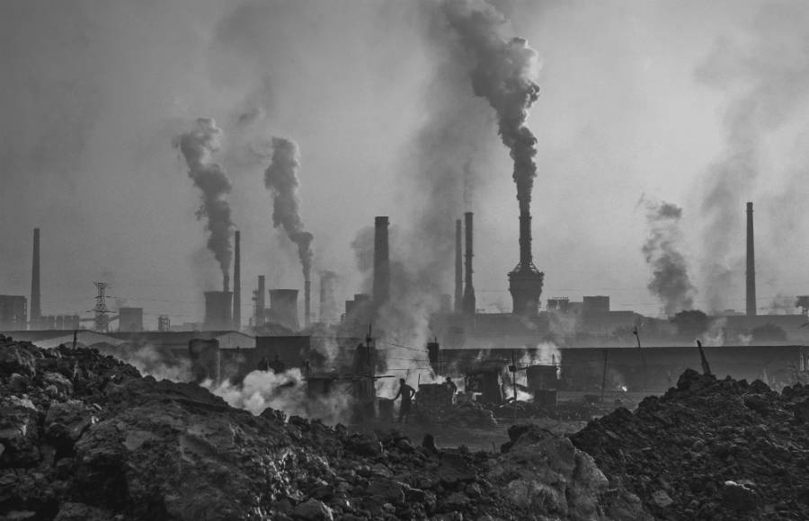
3
Trillion
Pounds
Notes:
In addition to the copious waste it produces, US healthcare produces 3 Trillion pounds of Co2 annually, accounting for 10% of US greenhouse gas emissions. If the US healthcare system was an independent country, it would rank somewhere between 7-13 for greatest carbon emissions globally
So while United States healthcare continues proliferating carbon emissions and adding to the already copious waste in landfills,

Slide 23
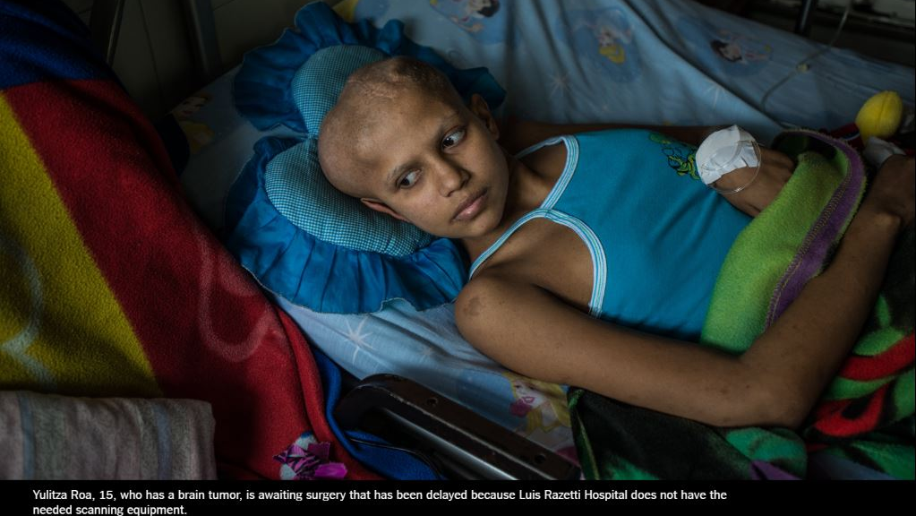
Notes:
there are children around the world like, Yulitza Roa, who are only 15, have serious health conditions with no readily available solution because hospitals have inadequate equipment.

