Slide 1


Slide 2
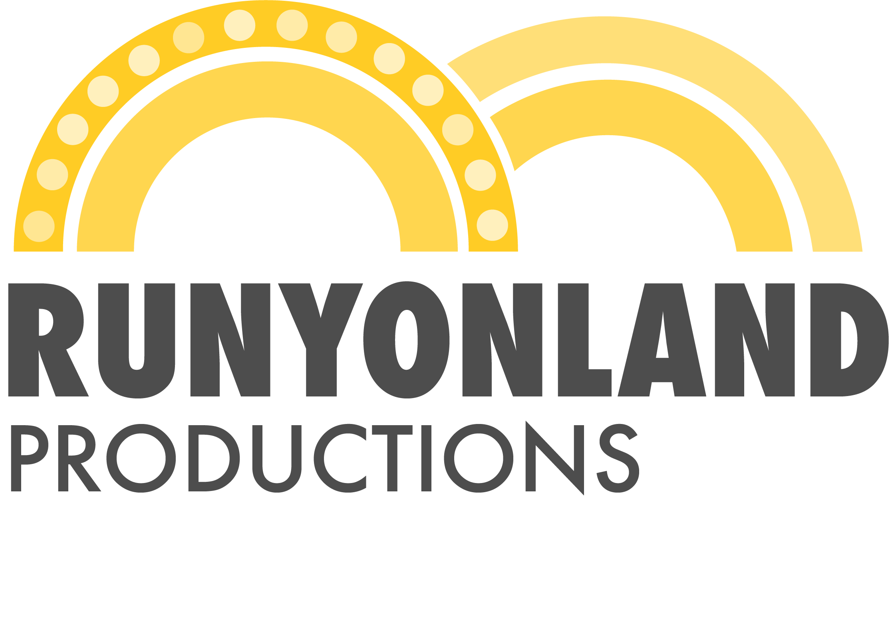
Myths & Hymns - Update
Our Start
Our Story
Myths & Hymns
Library Collaboration

Slide 3
Our Plan
An analytics-driven pipeline to Broadway.
Our stories…
Bold
Previously unheard
New mediums
An eye to history
Engage the community

Slide 4
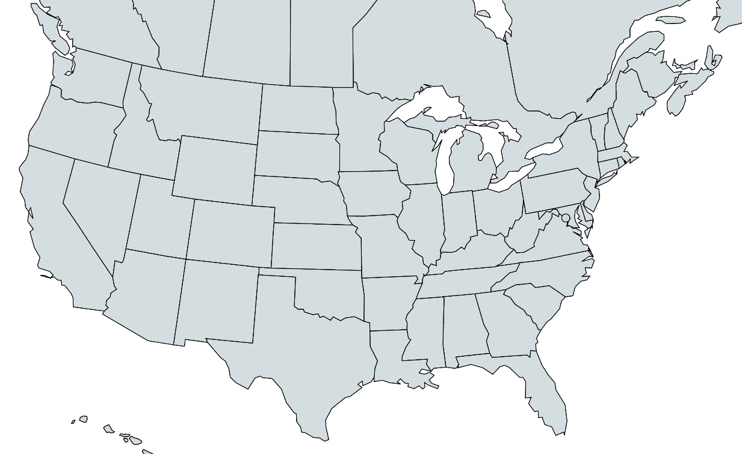
Our Plan
An analytics-driven pipeline to Broadway.
A Wealth of Stories
Communities will be able to share their stories
Strategy
New York based
Insular Producing Cells

Slide 5
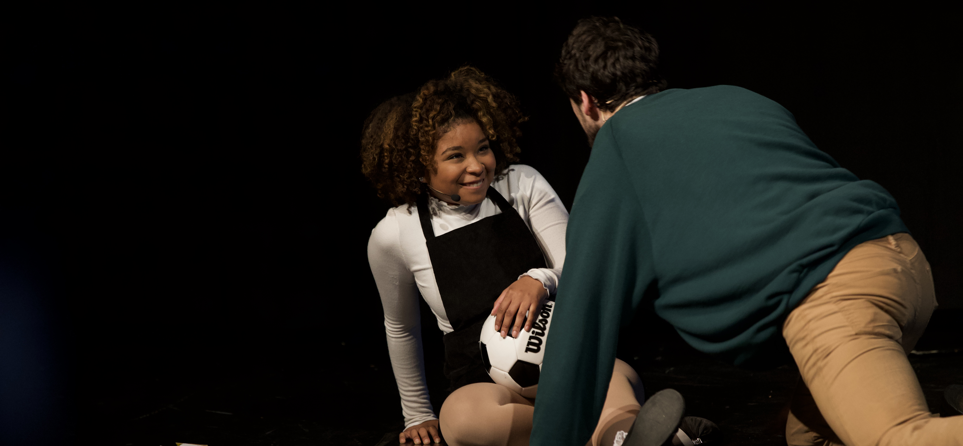
SHEL

Slide 6
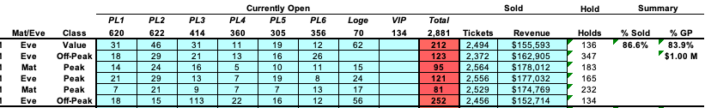
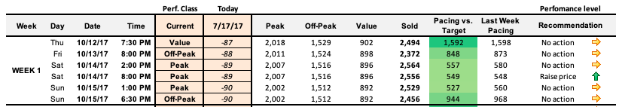
Our Methods
An analytics-driven pipeline to Broadway.
An analytics-driven pipeline to Broadway.
Analytics
Dynamic Pricing
Budget Optimization
New Presentation Mediums
Audience Development
Historical Data

Slide 7
Our Methods
An analytics-driven pipeline to Broadway.
Experience
Few shows on Broadway utilize dynamic pricing, and we’ve built the models for many of the ones who do

Slide 8

SHEL

Slide 9
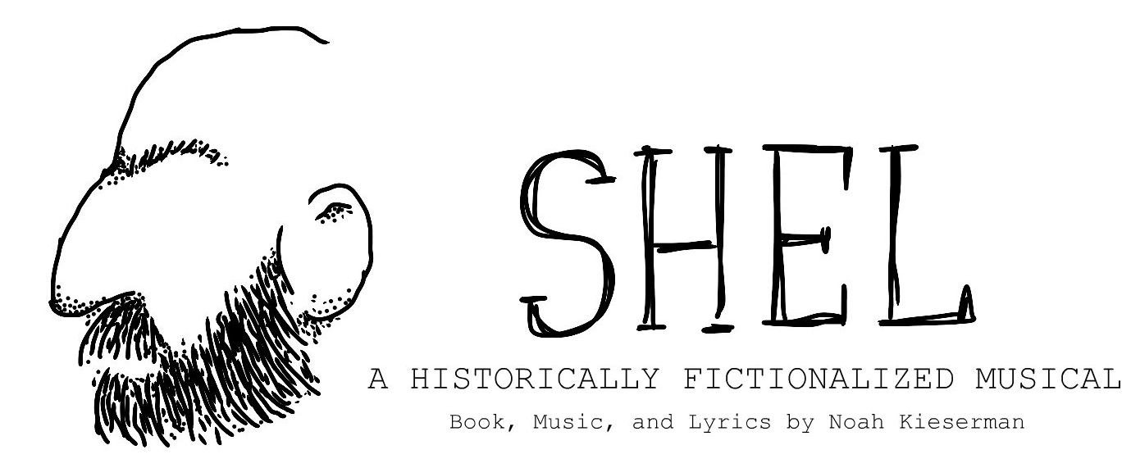

Proof of Concept
Our shows travel.
A Pipeline
Several of our shows have already been workshopped across the country, with Broadway readings set

Slide 10
What We Need
Mentorship
Funding
Research + Information

Slide 11


What We Need
A perfect partnership.
x
Research and Accountability
With the support of the UM Library system, Runyonland has the resources it needs to help form an accurate, informed narrative in the upcoming Night of Myths & Hymns

Slide 12
A Night of Myths & Hymns
Concept
A Night of Myths & Hymns centers around how different belief systems offer solace to human beings in crisis. A rabbi, imam, and a priest will each deliver passages in between music.

Slide 13
A Night of Myths & Hymns
A Story for Now
A Night of Myths & Hymns will tell a story of religious tolerance, coexistence, and understanding in a time where, we can all agree, that is sorely needed.

Slide 14
A Night of Myths & Hymns
Informed Storytelling
Through our partnership with the UM Library System, we are confident in our ability to tell a specific, informed story with sturdy research behind each element.

Slide 15
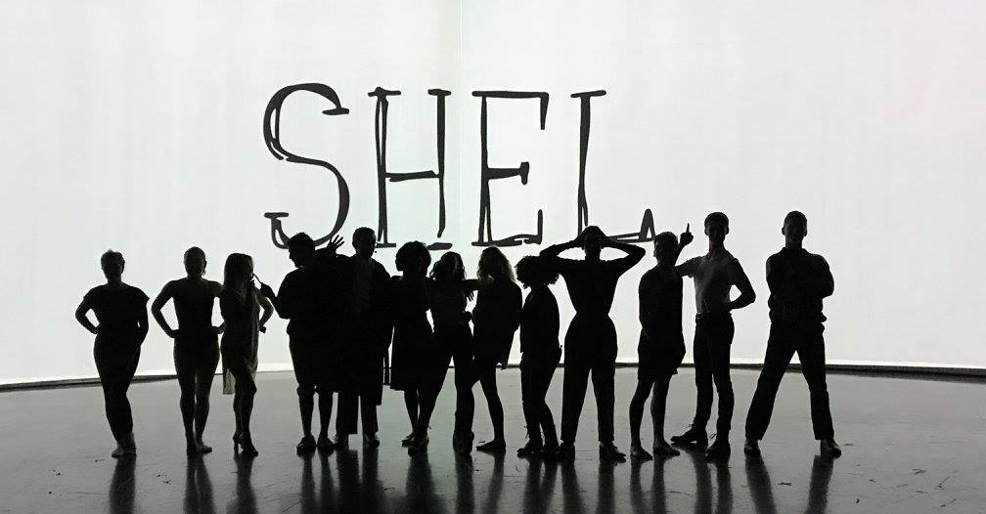
Questions
Questions?

Slide 16
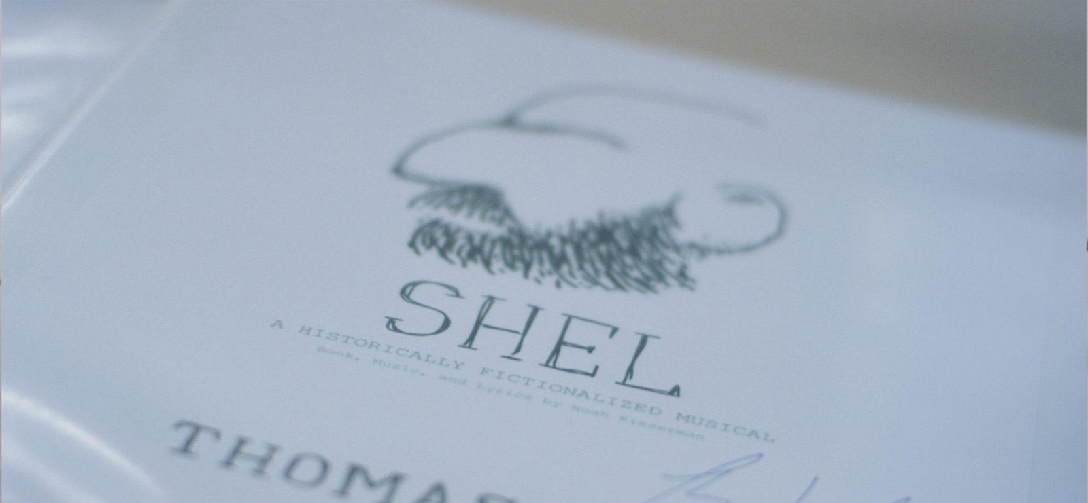
Thank You

