Slide 1

Welcome to Chest Imaging!
Jeannie Kochkodan, Dr. Perry Pernicano, & Dr. Cyril Grum

Slide 2
Thank you!
A huge thank you to Dr. Perry Pernicano for providing his time and many images to make this possible!

Slide 3
How this works
Welcome to wonderful world of Radiology and Chest Imaging!!
We will review the following findings and diagnoses:
This power point will walk you through each diagnosis and the subsequent powerpoint presentations (Quiz 1-3) will test your knowledge!
After this, you will be ready for the Internal Med CXR quiz!!
Cardiomegaly
Pulmonary edema
COPD
Cystic Fibrosis
Pleural Effusions
Pneumothorax
Pulmonary nodules
Lung Cancer
Lung Metastases
Sarcoidosis
Lobar Collapse
Pneumonia
TB
Lines & Tubes

Slide 4
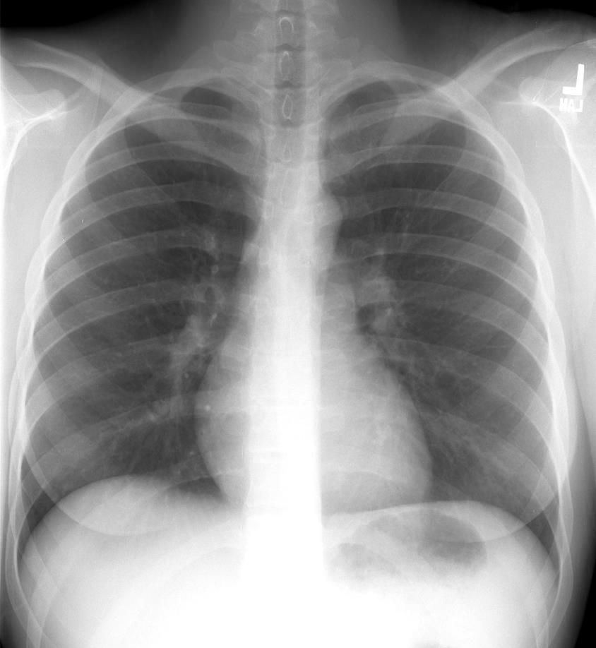
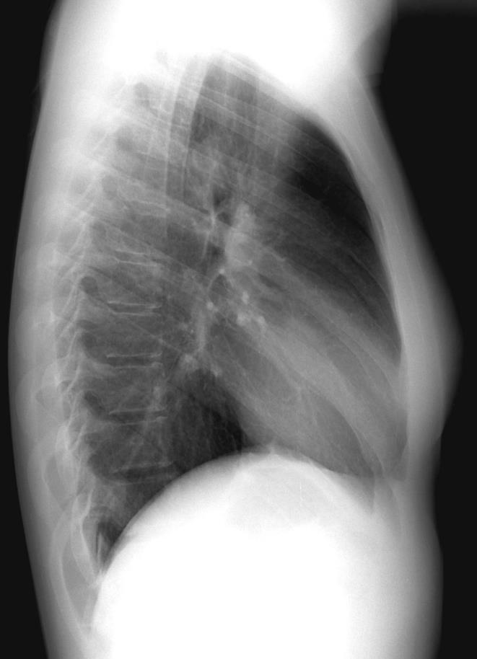
This is a normal chest radiograph. Click through to note the different structures
Trachea
Aortic Arch
Pulmonary Arteries
Right Ventricle
Left Atrial Appendage
Right Atrium
Costophrenic angle; sharp & well demarcated
Left Atrium
Left
Ventricle
Notes:
Change atrium/appendage** Which to do?

Slide 5
How to Read a CXR – Using the alphabet
A – Airway – midline, enlarged lungs
B – Bones – should see 10 posterior with normal inspiration
C – Cardiac – heart size, calcifications, pericardial effusion
D – Diaphragm – flat, free air below, sharp costophrenic angle
E – Extrathoracic soft tissue – masses, air
F – Lung Fields
G – Great Vessels & Gastric Bubble
H – Hila & mediastinum
I - Impression
B
Clavicle
1
A
2
A
3
4
E
G
E
F
5
F
F
6
H
H
H
7
8
C
C
9
F
D
Note – there is a great power point on Mbox “Chest Xray Overview, PSB” that provides a great general overview to approaching a CXR:
https://umich.instructure.com/courses/161355/files/4151211?module_item_id=250368/
10

Slide 6
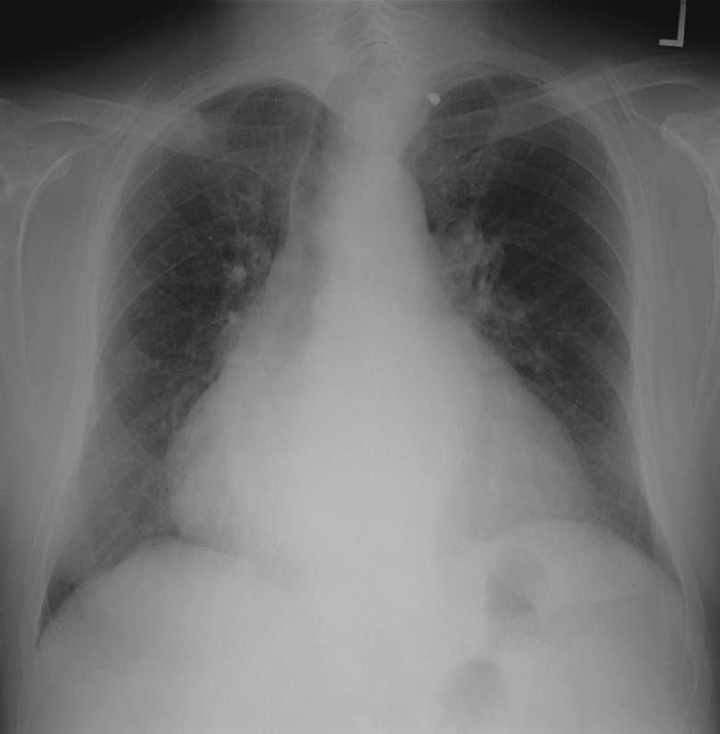
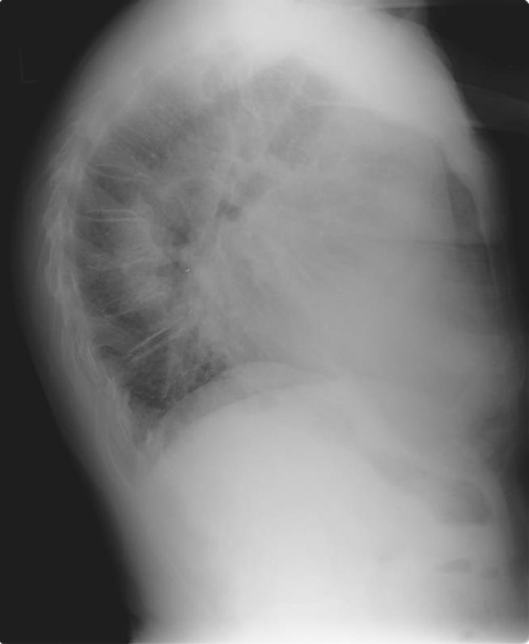
Cardiomegaly
Normally, the heart should only take up approx. ½ of the total diameter (cardiothoracic ratio of 50%) of the thorax.
On lateral, you can see half the heart pushed up against the sternum – in contrast to the normal CXR previously

Slide 7
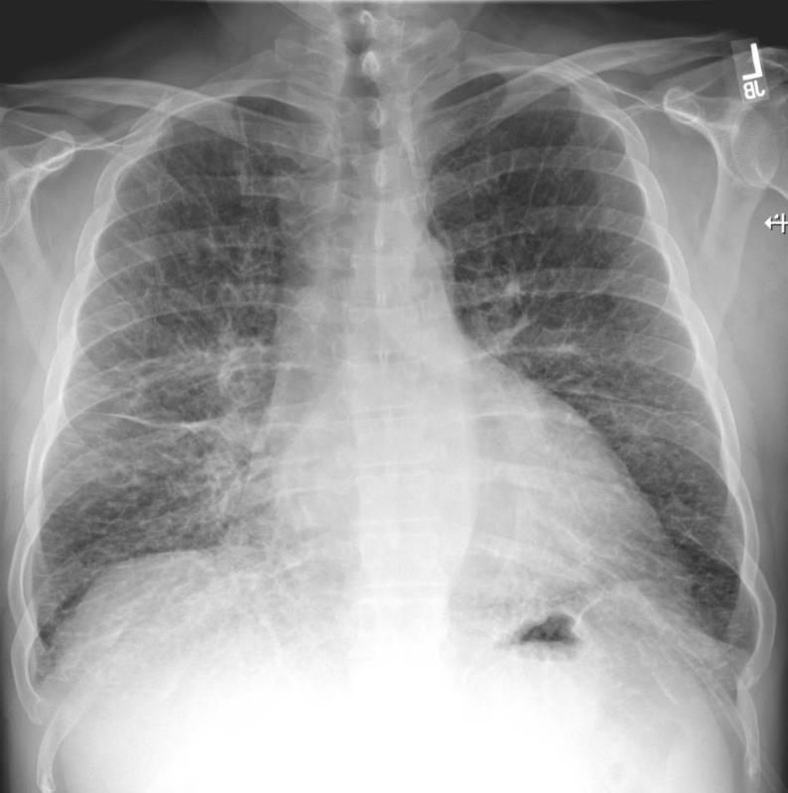
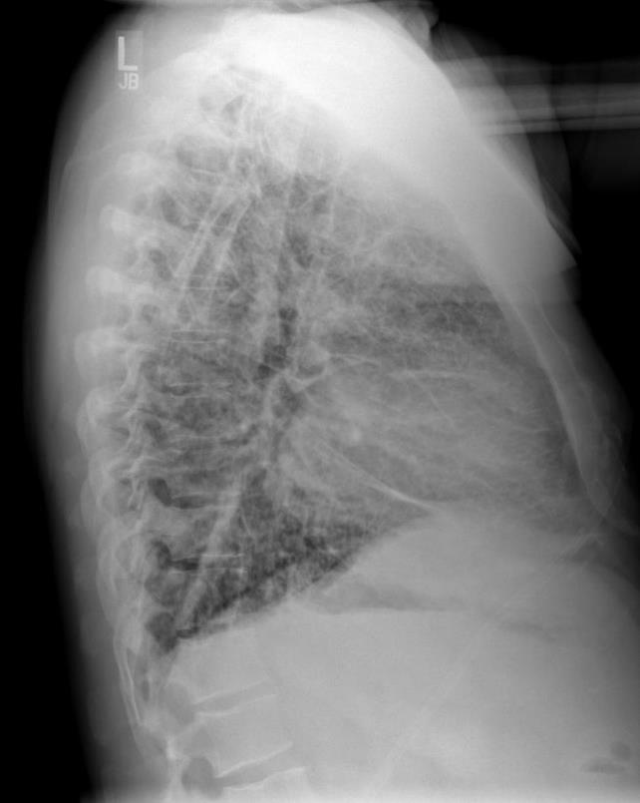
Pulmonary Edema
1. Increased air space opacity
2. Kerley B lines (thickened interlobular septa) at the lung edge
Notes:
Change The green

Slide 8
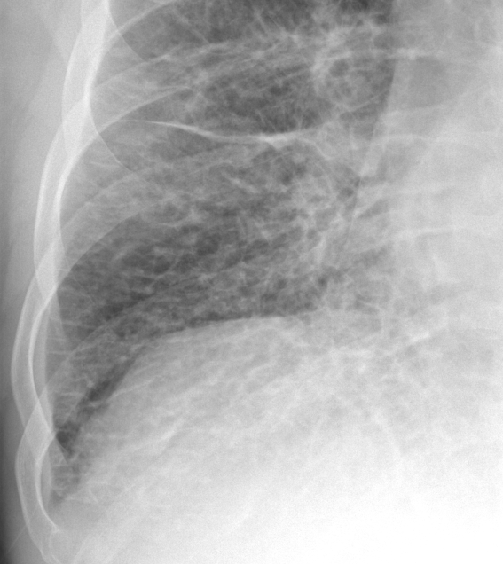
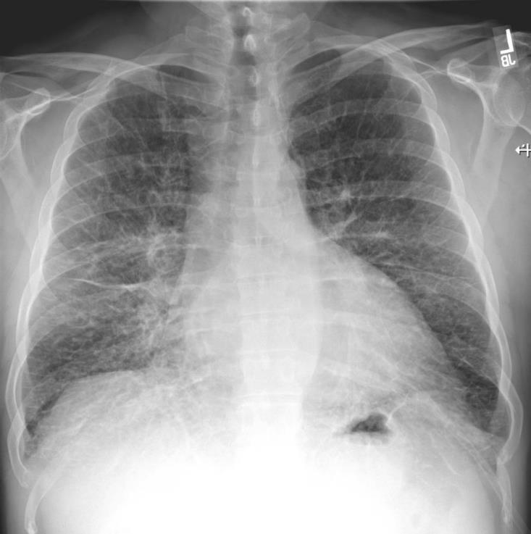
Pulmonary Edema
Kerley B lines – click back and forth to see where the yellow lines highlight the Kerley B lines.

Slide 9
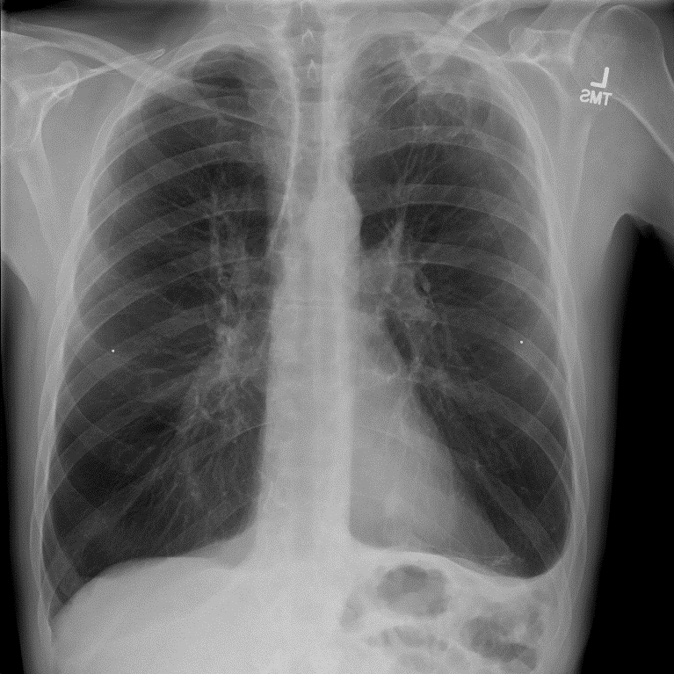
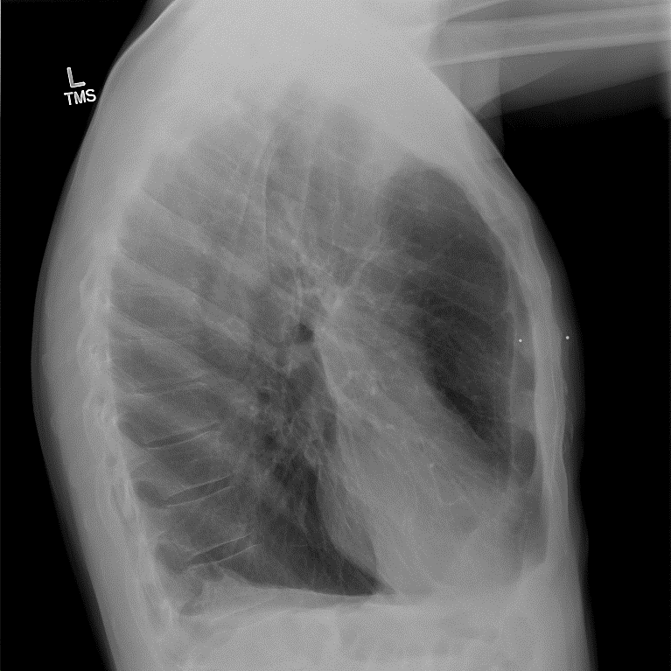
COPD
2
1. Hyperinflated lungs – can usually see more than the normal 10 ribs
2. Flattened diaphragm on lateral view
3. Heart can appear small
4. Increased AP diameter (Barrel Chested) on lateral view.
3
4
5
6
7
8
9
10
11

Slide 10
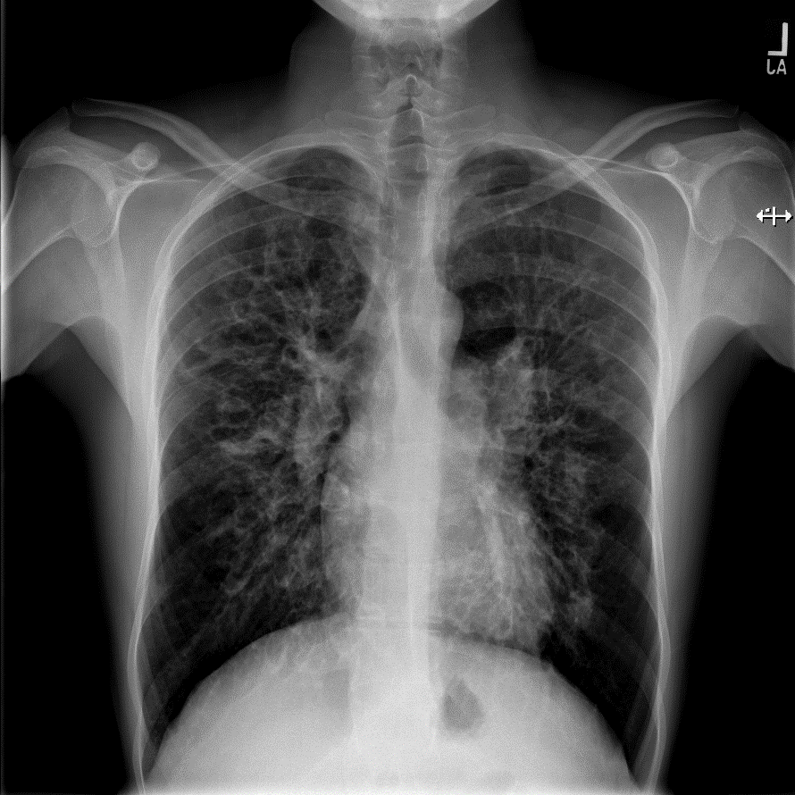
Cystic Fibrosis
1. Increased bronchial markings (sometimes even appreciating what appears to be thickened circles).
2. Can see some upper lung predominance.
3. Can also appreciate hyperinflation -increased lung volumes (bronchiectasis is a type of obstructive lung disease)
Look for a younger person, more common in Caucasians, with recurrent lung infections.

Slide 11
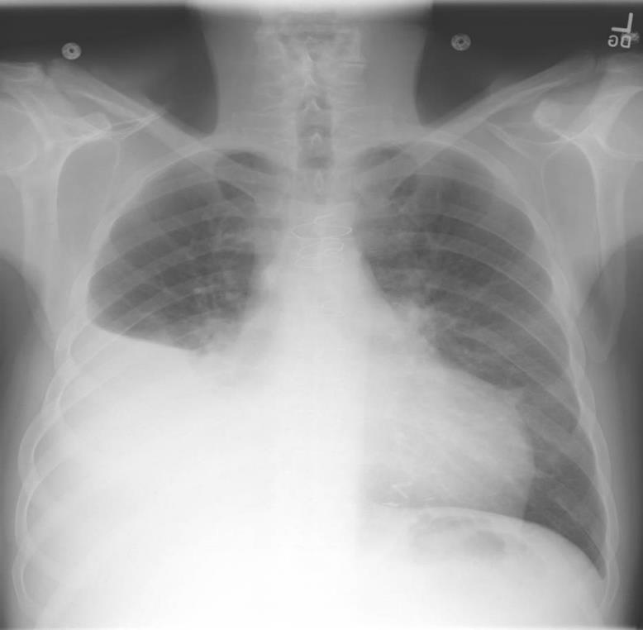
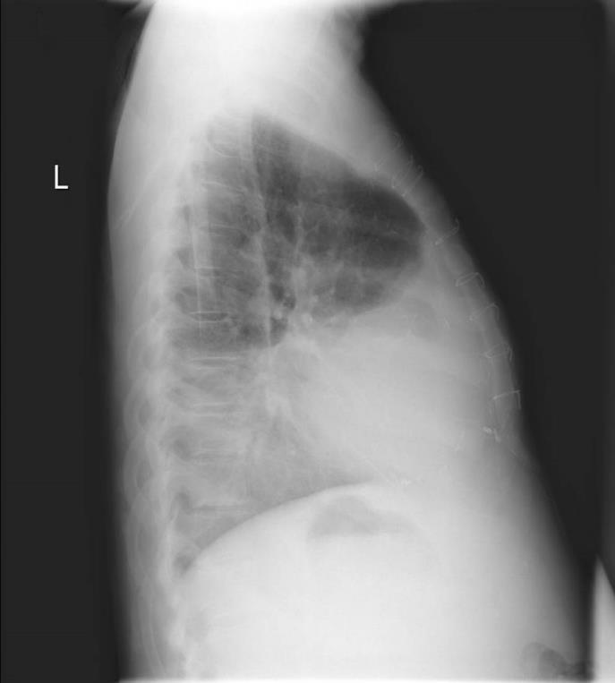
Pleural Effusion
1. Distinct fluid edge
2. Can note a loss of the diaphragm border (silhouette sign)
Notes:
urve blue line

Slide 12
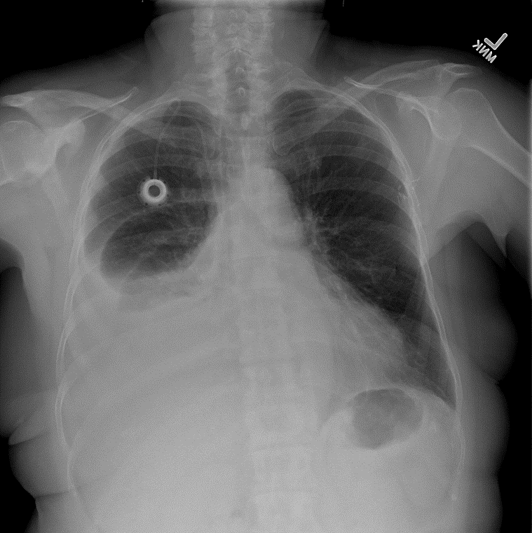
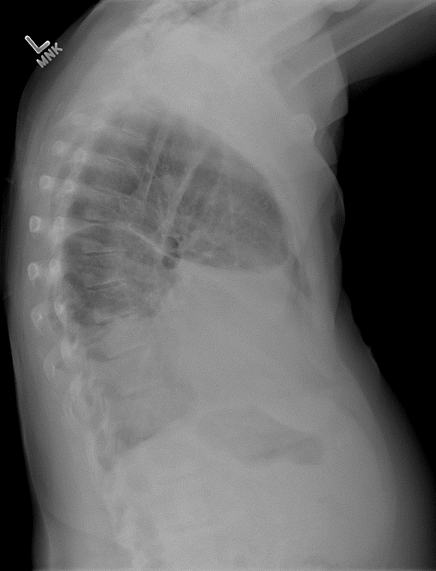

Pleural Effusion
1. You can sometimes appreciate a meniscus sign of the fluid level.

Slide 13
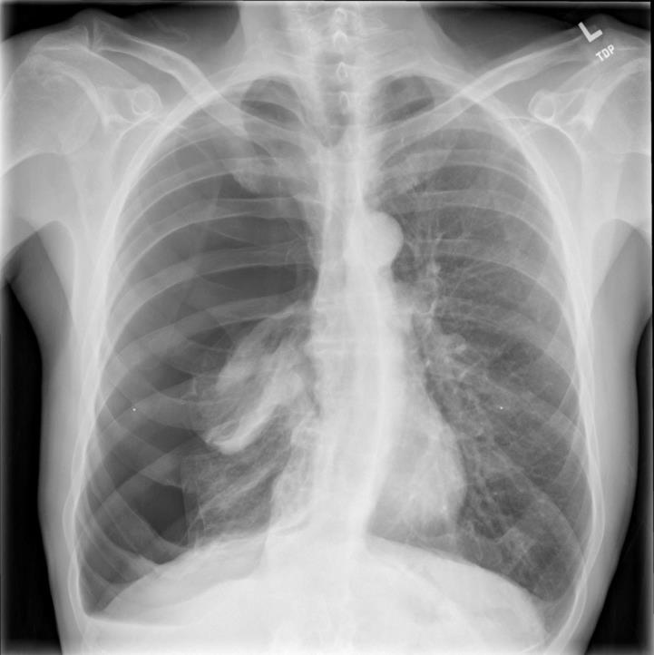

Pneumothorax
1. Loss of lung markings (bronchovascular structures) on affected side
2. Can sometimes see collapsed lung
3. In tension pneumothorax (from a penetrating trauma) will see thoracic contents/trachea pushed towards opposite side from air entering but not leaving the cavity.
Look for trauma (can be iatrogenic) or a tall slender male.
Notes:
Flip blue & green

Slide 14
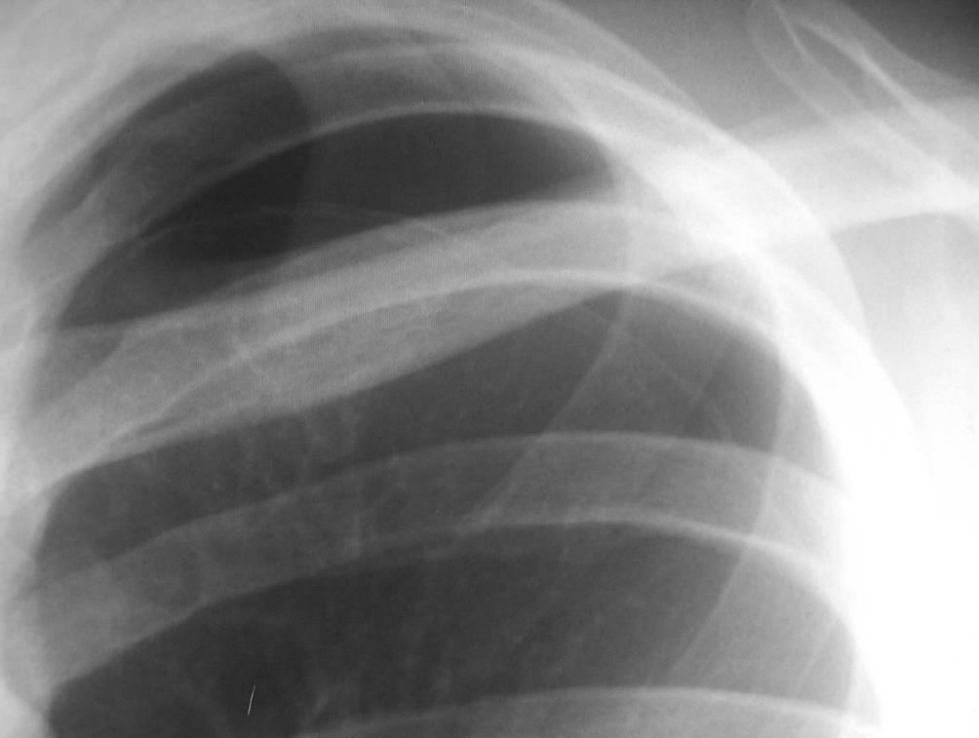
Pneumothorax
Be on the look out for subtle findings of pneumothorax along the apical portion of the lung or the lateral edges – note the pleural lining and still appreciate loss of lung markings
Notes:
Make blue & add the swiggle

Slide 15
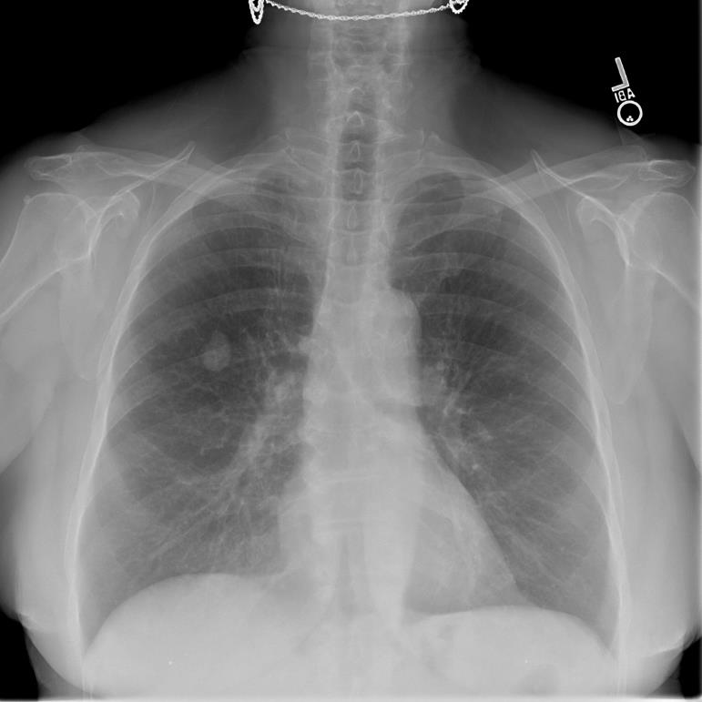
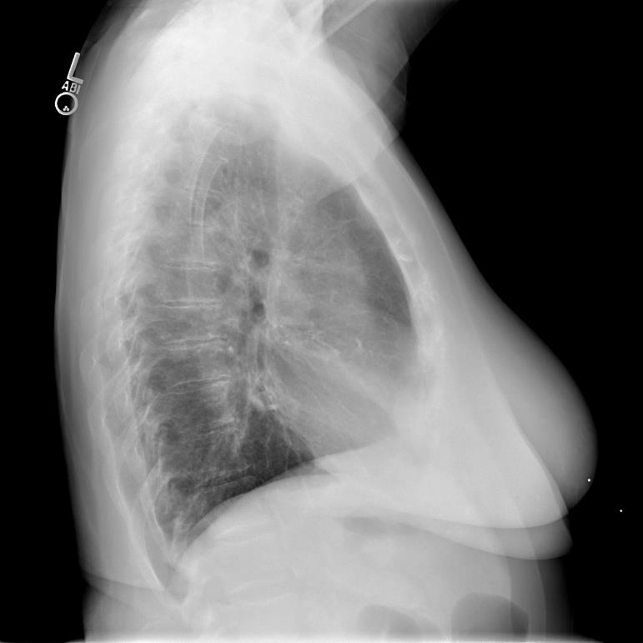
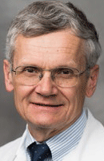
Pulmonary Nodule
Well circumscribed lesion
When Dr. Grum gives you this on the quiz, say “Thank you!”

Slide 16
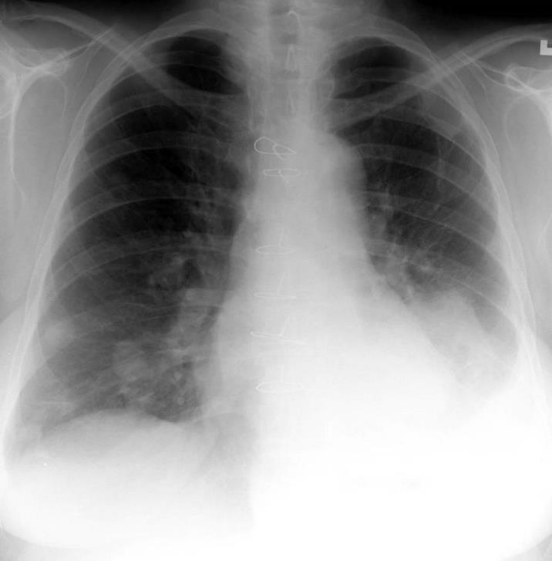
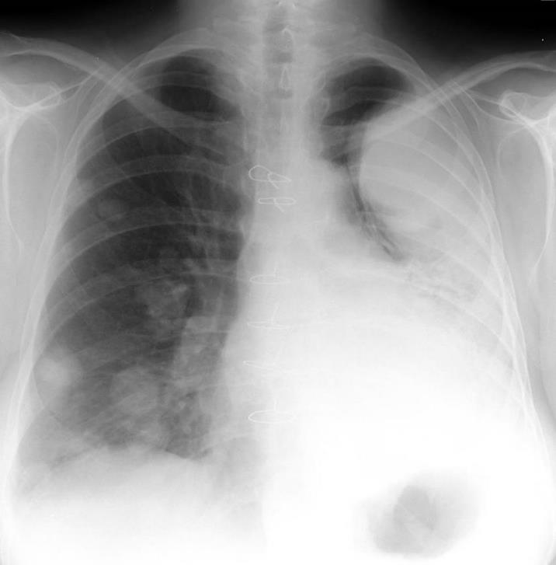
Lung Metastases
Multiple well circumscribed opacities.

Slide 17
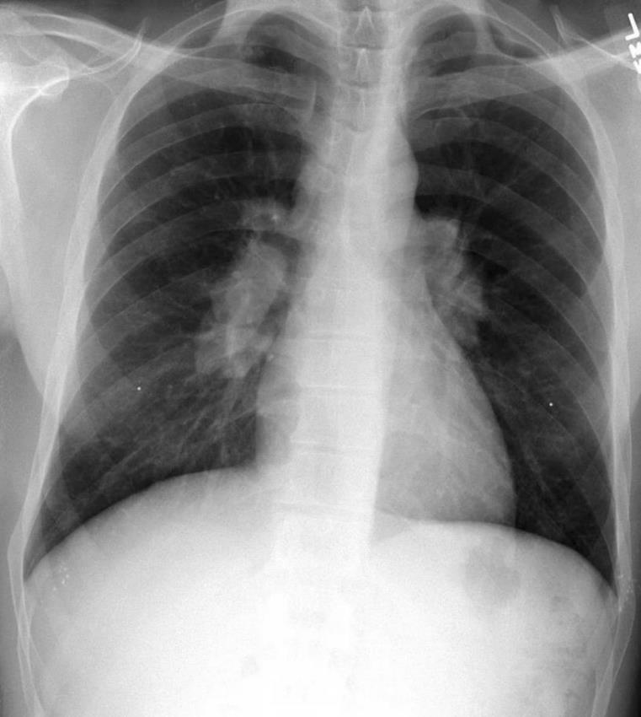
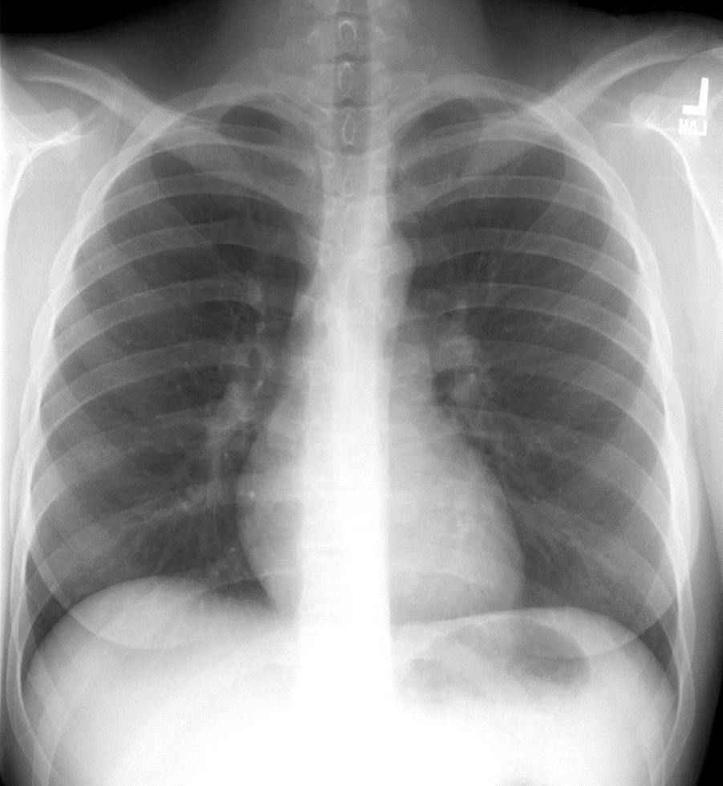
Sarcoidosis
Note the prominence of the hila on the left in comparison to this normal X-ray.
1. Mediastinal and bilateral hilar lymph node enlargement
2. If severe, can also see interstitial lung disease accompany the perihilar enlargement.
3. Classic case is an African American female.

Slide 18
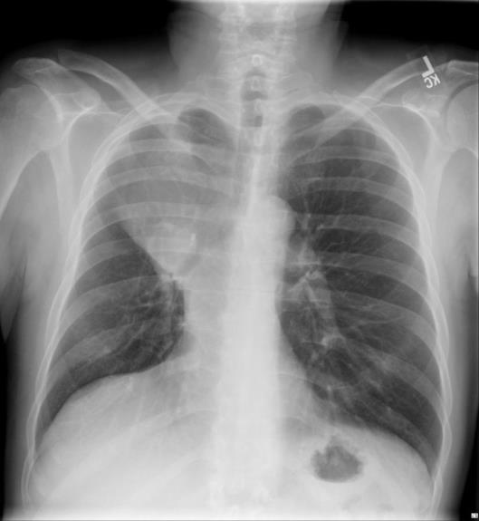
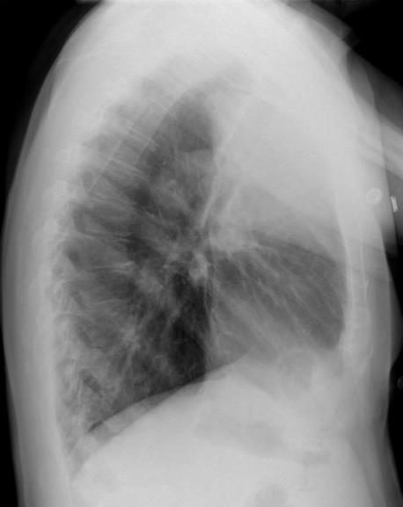
Lobar Collapse
1. Increased opacification
2. Hyperinflation of surrounding lung and displacement of normal fissure location
3. Can lose normal contours

Slide 19
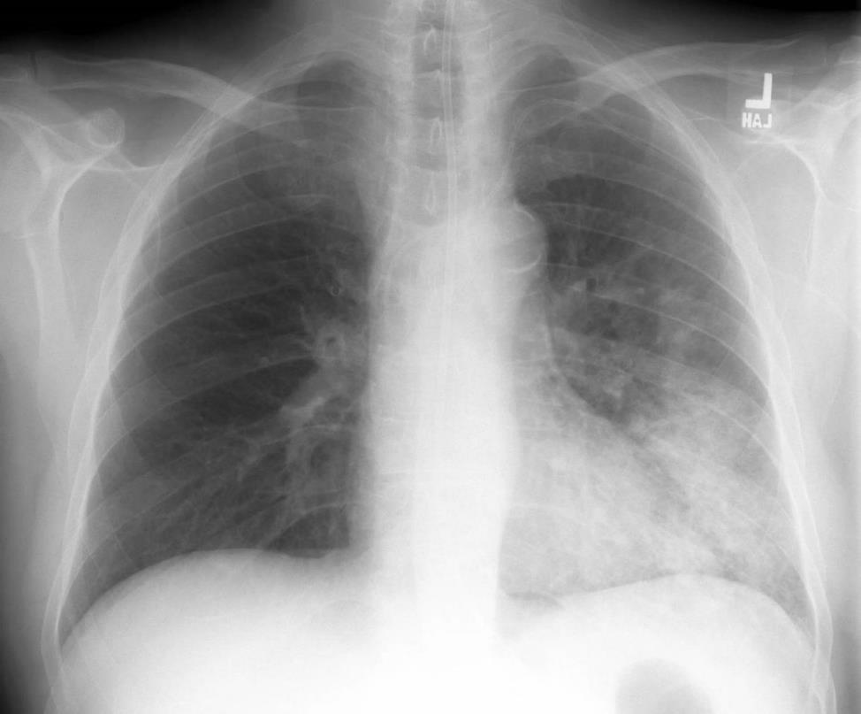
Pneumonia
1. Consolidation that can either be localized to one lobe or segment of the lung or multiple.
2. Lingular pneumonia pictured here.

Slide 20
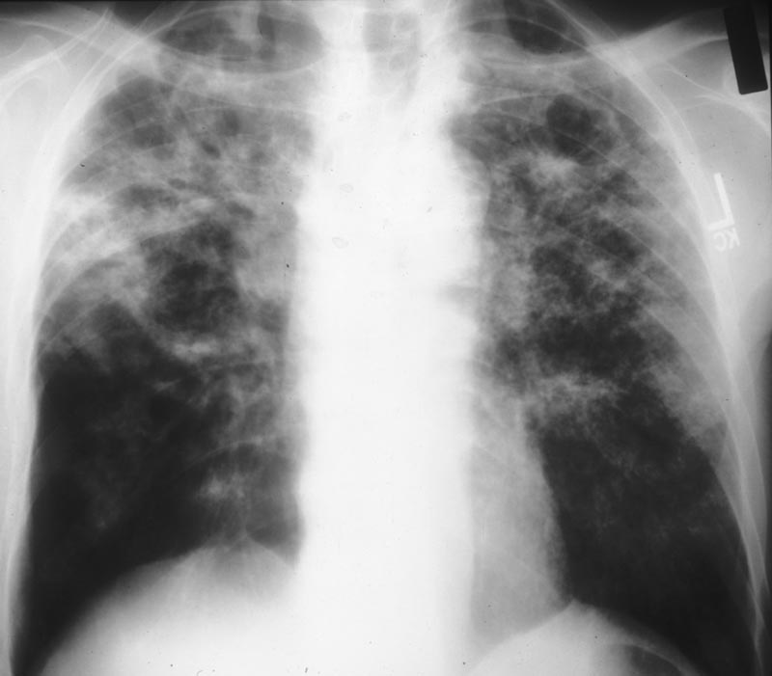
Tuberculosis
1. Consolidation
2. Cavitation – look in the upper lung lobes
Notes:
Can circle cavitation

Slide 21
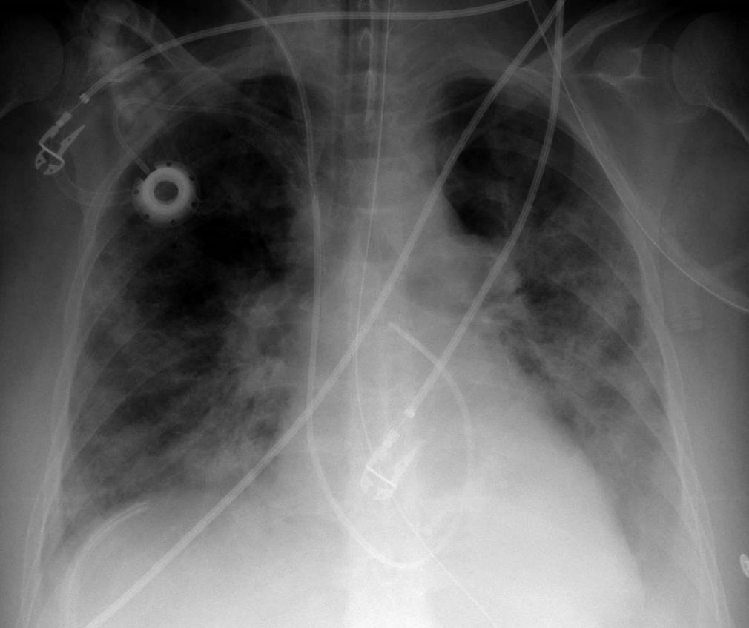

Lines & Tubes
1. Endotracheal tube
2. NG tube
3. Swan-Ganz
4. Chest Port
Flip back and forth
Notes:
Highlight the tube in the color.

Slide 22
What to do now
Now that you have the basic principles down, head on over to quizzes 1-3 to test your knowledge.
- Note: for the quizzes, you will absolutely see all of the findings at least once across all of the quizzes, but each quiz may test you on the same diagnoses more than once, not at all, etc. (Trust me, it is best for the real Internal CXR quiz!)

Slide 23
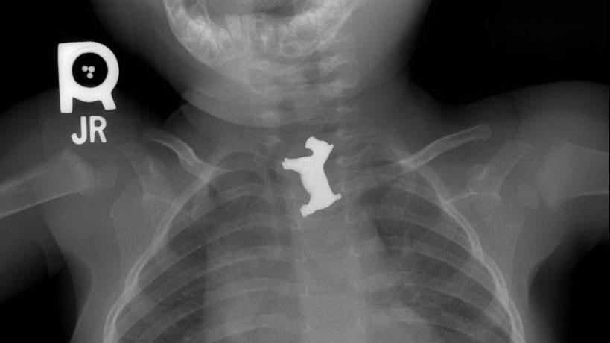

Monopoly, for ages 6 and up

