Slide 1
Sling Health Update: DR3

Slide 2
Agenda
Review Problem Area
Review Design Requirements
Updated Design
Risk Analysis
Potential Business Models and Consumer Survey Results

Slide 3
Needs Statement
“Contact lenses are medical devices, and failure to wear, clean, and store them as directed can increase the risk of eye infections” - CDC
Problem: A way to increase proper contact lens-care adherence…
Population: …for extended lens wearers (2-week to 1-month)…
Outcome: …that improves lens-wearing comfort, reduces hygiene-related infections, and saves time.

Slide 4
Non-adherence is dangerous and expensive
Huge patient population
  US: 45 million people in the US wear contacts, 65% use extended wear¹
  Globally: Est. 2.5 billion myopes in the world by 2020, many of whom will wear contacts⁴
Non-adherence is widespread²
  CDC: Approximately 99% of respondents reported at least one contact lens hygiene behavior previously associated with an increased risk of eye infection or inflammation
  CDC: Between 40%-90% of contact lens wearers do not properly follow the care instructions for their contact lenses
Large cost to consumers and the US health system³
  1 million visits for keratitis (inflammation of the cornea) annually, contact care = major risk factor
  Contact-related conditions cost health system $175 million dollars and 250,000 hours of clinical time
Hypothesis - Lens manufacturer’s revenues are impacted
  Large contact lens brands (J&J, Valeant, Novartis, Cooper) compete based on comfort – discomfort related to poor adherence may lead to consumers switching brands unnecessarily.
Notes:
1. www.clspectrum.com/issues/2018/january-2018/contact-lenses-2017
2. https://www.cdc.gov/contactlenses/fast-facts.html
3. https://www.cdc.gov/mmwr/preview/mmwrhtml/mm6345a3.htm?s_cid=mm6345a3_e
4. Optometry 2009

Slide 5
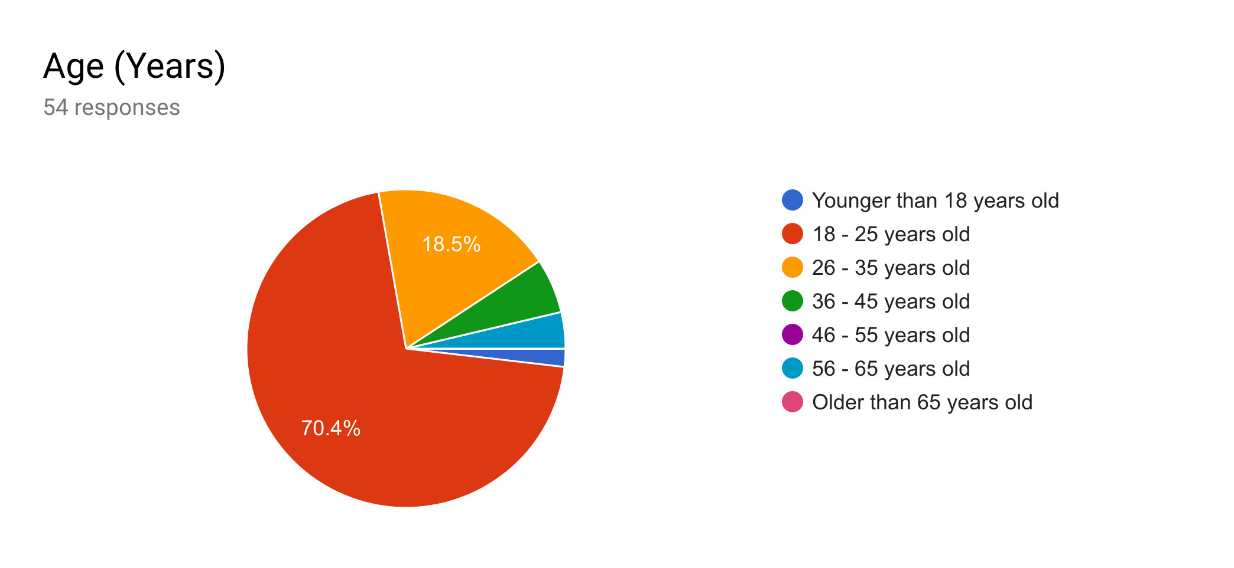
Consumer Survey Results
Age (Years), n = 54
50% men, 50% women
63% wore contacts 6+ days of the week, 20.4% wore contacts 3-5 days of the week
Only 16.7% wore daily disposable lenses

Slide 6
Consumer Survey Results
With the exception of storing lenses in water (~10%), our survey participants were not adherent to the CDC’s recommended behavior 34-85% of the time
  65.4% never “top off” their old solution
  14.8% never shower, bathe or swim in their contact lenses
Approximately 67% of responders reported having pain, eye redness, or blurred vision at least once a month
  The majority did not remove them right away
Notes:
35.2% sleep in CLs at least once a month, 51.9% forget to rub and rinse, 81.5% use CLs longer than recommended, 65.4% do not replace their CL case every 3mo

Slide 7
Consumer Survey Results
Most common reasons for non-adherence
  Inconvenience
  Amount of time required
  Expense
  Not feeling it is necessary or useful
Majority of respondents would pay between $10-50 for a device similar to ours
57.1% said they would switch from DD lenses to extended-wear if a device made cleaning and storing their lenses easier
Notes:
Majority report getting less comfortable near the end of the day/prescription time

Slide 8
Design Requirements
Bad Behavior | Design Requirement | Specification
Not performing “rub & rinse” of lenses | Mechanical method to remove proteins from lenses | Sonicate the lenses
“Topping off” contact lens solution | Regularly remove old contact lens solution | Drain the case through holes in the bottom
Not performing “rub & rinse” of the contact case | Mechanical method to remove proteins from case | Sonicate the inside of the case
Sleeping with lenses in | Encourage lens removal before bed | App notifications Incentivization of good behavior App-delivered education
Using the case for longer than 3 months | Incentivize case replacement
Not replacing contact lenses as recommended by physician | Incentivize lens replacement

Slide 9
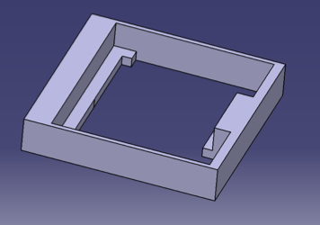
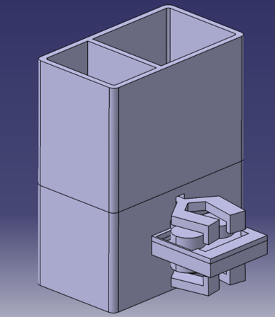
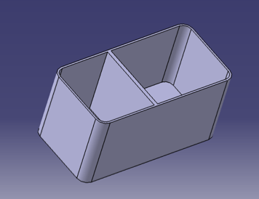
Final Design
Frame to hold the lens case
Final Design
Tank
Notes:
https://www.cdc.gov/contactlenses/show-me-the-science.html#habits

Slide 10
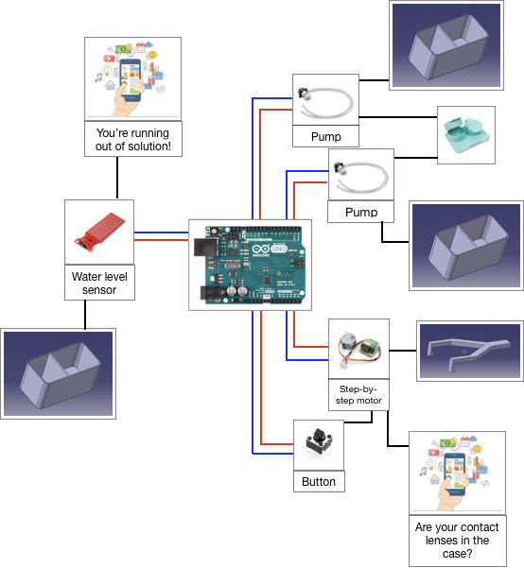
Electrical Diagram

Slide 11
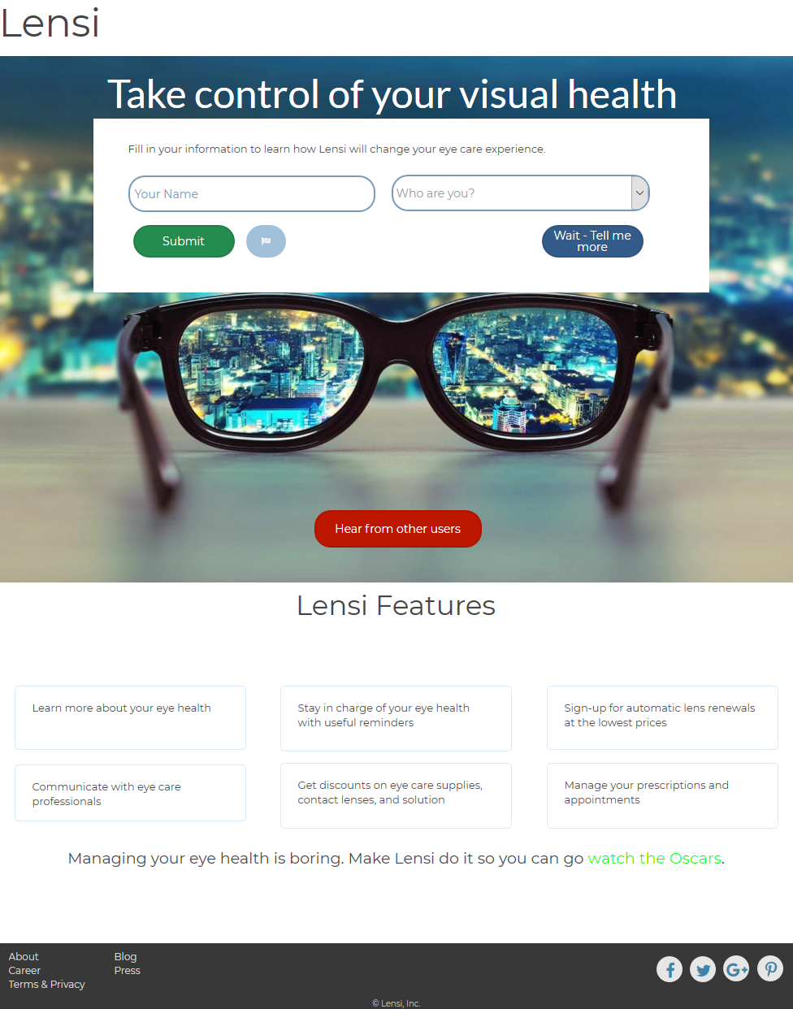
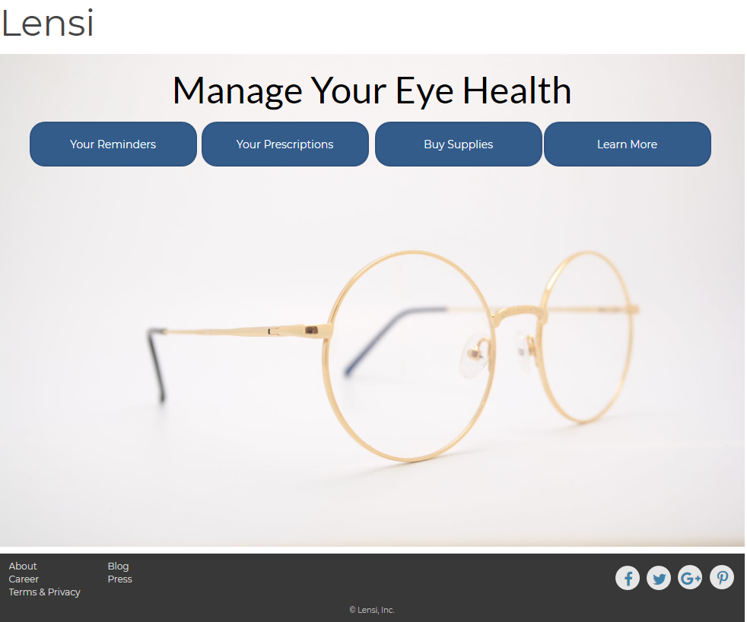
App Screenshots

Slide 12
Risk Analysis
Potential Negative Event | Harm Caused by Event | Severity of Event | Probability of Occurrence | How to Mitigate
Solution contamination | Eye infection | Moderate to High | Low | Make tank small enough that the solution can’t sit long enough to accumulate bacteria
Case disinfectant unintentionally gets on contact lenses | Eye Irritation | Low to Moderate | Low | Do not allow user to store lenses for a certain amount of time once the case disinfection setting is running
App doesn’t remind user of putting lenses in case/replacing case/replacing lenses on time | User forgets to follow good replacement and wear practices | Low | Low | Extensive testing of app to ensure that this won’t be a problem

Slide 13
Business Models to Consider
Sell direct to consumer
  Value based on increased comfort (to be proven) and reduced potential for infections
Sell through optometry, optometry takes margin
  Value to keeping patients healthier, satisfied with lenses and overall care
Partner with lens manufacturers
  Value in reduced unnecessary switching/increased engagement w/ brands and usage of contacts, leading to more regular lens renewals.
Notes:
https://www.cdc.gov/contactlenses/show-me-the-science.html#habits

Slide 14
Project Resources
Mentorship provided by Dr. Maria Woodward and Dr. Joseph Myers
No expenses related to development of non-physical prototype
Available 3D printer and material
We purchased actuators and sensors
Notes:
https://www.cdc.gov/contactlenses/show-me-the-science.html#habits

Slide 15
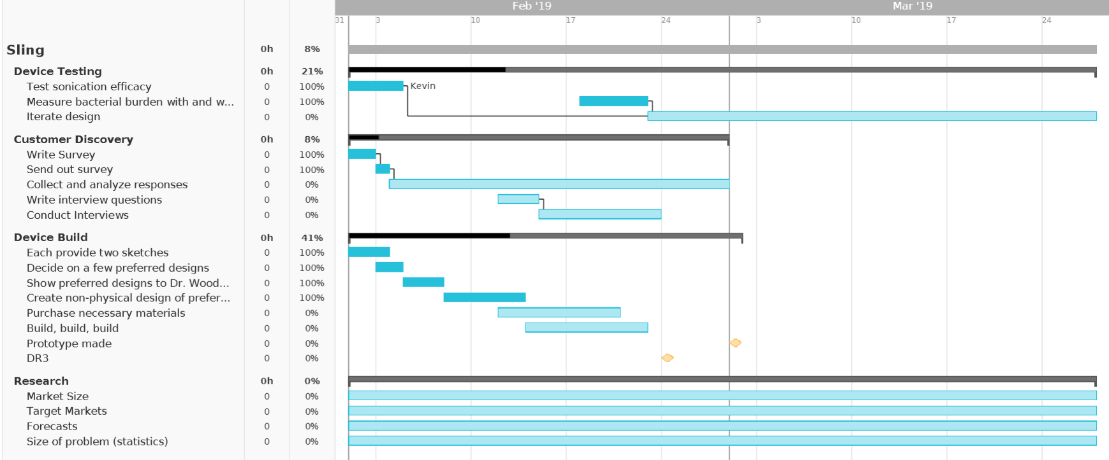
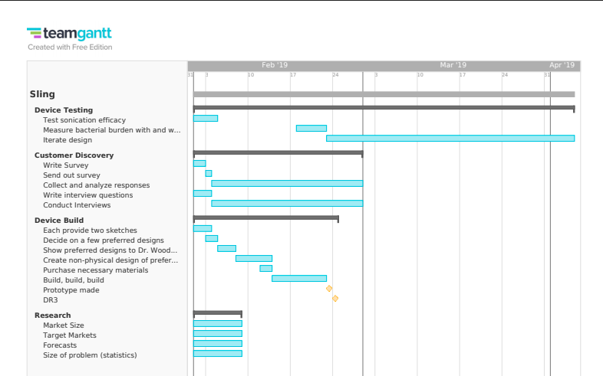
Gantt Chart

Slide 16
Appendix
Notes:
https://www.cdc.gov/contactlenses/show-me-the-science.html#habits
https://docs.google.com/forms/d/1ubLmNXuoqAKHPjBt0I3QBwgHr016LeFOHnGa-RDOMVY/edit#responses

Slide 17
Setting 1 - Clean & Store Lenses
User chooses “Clean & Store” button
User puts lenses in case while a 30 second timer is counting down
Top lids of device open
Top lids close
Lens sonication occurs
Chambers fill with contact lens solution
Bottom lids open to drain “dirty” solution
Bottom lids close
Chamber fills with clean solution
Device stores lens until “Use & Wear” setting is accessed
Notes:
https://www.healthcareitnews.com/news/telemedicine-poised-grow-big-time
https://www.grandviewresearch.com/press-release/global-medical-carts-market
https://www.grandviewresearch.com/press-release/global-ultrasound-device-market

Slide 18
Setting 2 - Use & Wear
User chooses “Use & Wear” button
10 minute timer keeps lids open while user is putting contacts in
Bottom lids open to drain solution
Top lids open
Chambers fill with fresh solution
Bottom lids close after initial drop of old solution
Chamber sonication occurs
Bottom lids open
Timer holds top and bottom lids open to allow case to air dry
Once set time passes, both lids close until user chooses “Clean & Store” setting
Notes:
https://www.healthcareitnews.com/news/telemedicine-poised-grow-big-time
https://www.grandviewresearch.com/press-release/global-medical-carts-market
https://www.grandviewresearch.com/press-release/global-ultrasound-device-market

Slide 19
Setting 3 - Case Disinfection
Case disinfection is activated (once per week at noon)
Chambers fill with disinfectant solution
Top and bottom lids open simultaneously
Chamber sonication occurs with disinfectant
Timer holds top and bottom lids open to allow case to air dry
Once set time passes, both lids close until user chooses “Clean & Store” setting
Notes:
https://www.healthcareitnews.com/news/telemedicine-poised-grow-big-time
https://www.grandviewresearch.com/press-release/global-medical-carts-market
https://www.grandviewresearch.com/press-release/global-ultrasound-device-market

Slide 20
Healthy Contact Lens Habits from the CDC
Behavior | Evidence
Manually rubbing contact lens to remove biofilm
Topping up old solution with new solution
Contact Lens case hygiene – ex. regularly rinse and air-dry | P-value of .003 as a risk factor for keratitis ¹ Sleeping in any type of contact lens increases by 6 to 8 times the risk of getting a serious type of corneal infection
Replace lens case less than every 6 months | P-value = .009 ¹
Overnight wear greater than 1/month | P-value = .022 ¹
Not replacing lenses on schedule
Storing contact lens in water
Did not visit eye doctor at least annually
Rinsing contact lens in water
Notes:
https://www.ncbi.nlm.nih.gov/pubmed/22521083
https://www.ncbi.nlm.nih.gov/pmc/articles/PMC5657667/

Slide 21
Adolescence
Ages 12-17
Sleeping/Napping in CL | 29.8%
Topping off CL Solution | 10.6%
Replacing lenses at intervals longer than prescribed | 23.7%
Did not visit eye doctor at least annually | 43.9%
Replacing CL case at interval longer than recommended | 22.8%
Storing CL in Tap Water | 9.5%
Rinsing CL with Tap Water | 7.1%
Swimming in CL | 27.2%

Slide 22
Young Adults
Ages 18-24
Sleeping/Napping in CL | 33.3%
Topping off CL Solution | 19.1%
Replacing lenses at intervals longer than prescribed | 52.4%
Did not visit eye doctor at least annually | 24.0%
Replacing CL case at interval longer than recommended | 40.5%
Storing CL in Tap Water | 11.0%
Rinsing CL with Tap Water | 12.1%
Swimming in CL | 28.1%

