Slide 1
High White Blood Cell Count Predicts Outcomes after Cardiac Surgery in Infants
Katie Gilbert, Ray Lowery, Sunkyung Yu, Lauren Retzloff, Cynthia Smith, Suzanne Welch, Donna Wilkin, Caren Goldberg, and John Charpie
Division of Pediatric Cardiology, Department of Pediatrics & Communicable Diseases, University of Michigan Medical School, Ann Arbor, MI
Notes:
Hi all, my name is Katie Gilbert and my project was looking at possible outcomes markers for infants undergoing cardiac surgery involving cardiopulmonary bypass. Specifically, we focused on the total white blood cell count as a marker for inflammation

Slide 2

Lecture objectives
What is cardiopulmonary bypass and how does it work?
Why does bypass cause an inflammatory response, and why do we care about this inflammatory response?
Our experiment: hypothesis, methods, results
Conclusions and future directions
Notes:
So, I’ve provided an outline of my talk

Slide 3
Lecture objectives
What is cardiopulmonary bypass and how does it work?
Why does bypass cause an inflammatory response, and why do we care about this inflammatory response?
Our experiment: hypothesis, methods, results
Conclusions and future directions
Notes:
And we’ll start with going over what cardiopulmonary bypass is, when it is indicated and how it works

Slide 4
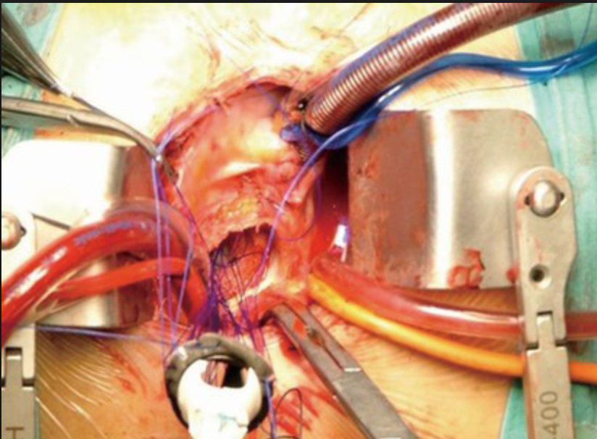
Background-Bypass
Cardiopulmonary bypass indications
  Cessation of the heart
  Manipulation or opening of the aorta
  Bloodless surgical field for open heart surgery
How bypass works
  Cannulation of the vena cava brings unoxygenated blood from the body to the machine
  Cannulation distal to aortic cross clamp returns oxygenated blood to body
Notes:
-Lots of congenital heart diseases do not require bypass, particularly as minimally invasive procedures have been explored more
-CPB indications: cessation of the heart, manipulation or opening of the aorta, a bloodless surgical field require cardiopulmonary bypass
-For bypass

Slide 5
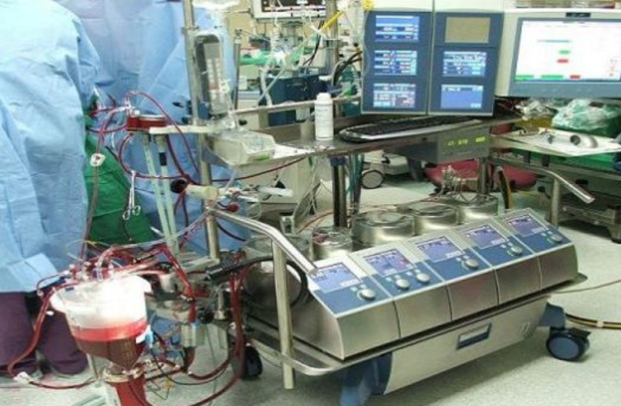
Background-Bypass
Notes:
-The blood is brought to the cardiopulmonary bypas machine which both removes carbon dioxide and oxygenates the blood.
-The CPB machine is operated by a perfusionist and they are present throughout the case

Slide 6
Lecture objectives
What is cardiopulmonary bypass and how does it work?
Why does bypass cause an inflammatory response, and why do we care about this inflammatory response?
Our experiment: hypothesis, methods, results
Conclusions and future directions
Notes:
And we’ll start with going over what cardiopulmonary bypass is, when it is indicated and how it works

Slide 7
Bypass and the inflammatory response
Bypass involves passing the blood through approximately ten feet of plastic tubing, causing activation of leukocytes, platelets, the clotting cascade, and dysregulation of inflammatory mediators
Bypass operates on a lower MAP than normal, leading to:
  Ischemic reoxygenation injury leading to reactive oxygen species
  Gut hypoperfusion, causing release of endotoxins
These contribute to cellular dysfunction leading to systemic inflammatory response^{1, 2}
Notes:
3 main contributors to the inflammatory response we see in patients undergoing bypass
So, as the slide states number one is that Bypass involves passing the blood through approximately ten feet of plastic tubing repeatedly, exposing the blood to foreign substances and causing activation of leukocytes, platelets, the clotting cascade, and dysregulation of inflammatory mediators
. Further, Bypass operates on a lower MAP than normal, leading to two issues. One is ischemic reoxygenation injury leading to reactive oxygen species, and the second is Gut hypoperfusion, causing release of endotoxins
The result is a well documented cellular dysfunction, leading to a systemic inflammatory response.

Slide 8
Systemic Inflammatory Response Criteria
Two or more of the following:
  Temp >38 or <35
  HR >90
  RR >20 or PaCO₂ <32
  Leukocytes >12,000 or <4000 or >10% immature
Notes:
-I’ve provided a definition of SIRS criteria here as a reminder
-I just want to reiterate that the patient is on bypass for the majority of the procedure, and can be as long as 12-15 hours. As you can imagine, this can amount to a significnt inflammatory reponse from the body for all the number of reasons we discussed on the previous slide.
-Often in an attempt to ameliorate or tempor the inflammatory response, 2U of blood will be drawn off prior to going on bypass and auto-transfused back after coming off the pump in order to give the patient healthy blood at the end of the procedure, almost acting as a dilution. I’m not sure if there is data to support that, but I mention it to highlight that the SIRS in response to bypass is well known, and we want to find a way to limit that response.

Slide 9
Inflammation markers and outcomes
Well documented that states of inflammation lead to worse outcomes
White blood cell (WBC) count is a biomarker of systemic inflammation
High pre-operative WBC count has been independently associated with poor outcomes in adult patients undergoing cardiac surgery with CPB^{1, 2}
The association between WBC and outcomes in infants undergoing cardiac surgery with CPB has not been studied
If an association between WBC and outcomes is identified, we can risk stratify patients and/or identify an intervention to improve outcomes
Notes:
Well documented that states of inflammation lead to worse outcomes.
A commonly used metric of inflammation is white blood cell
We know that patients will have an elevated inflammatory state post-operatively because of the cardiopulmonary bypass, but what about patients’ inflammatory status pre-operatively?
So this has been looked at in adults underoing cardiopulmonary bypass, with elevated pre-operative WBC count associated with poor outomces in this population, however this association in infants has not been studied
So the TL;DR of why we care: systemic inflammation plays an important role in patients undergoing bypass. While post-operative inflammation is somewhat of a given, we need to further understand the association of pre-operative inflammation and outcomes in infnats undergoing cardiac surgery, because if an association is found we may be able to perform an intervention to decrease inflammatory state pre-operatively and improve infants’ outcomes

Slide 10
Lecture objectives
What is cardiopulmonary bypass and how does it work?
Why does bypass cause an inflammatory response, and why do we care about this inflammatory response?
Our experiment: hypothesis, methods, results
Conclusions and future directions
Notes:
And we’ll start with going over what cardiopulmonary bypass is, when it is indicated and how it works

Slide 11
Hypothesis
High pre-operative WBC counts are associated with poor outcomes in infants undergoing cardiac surgery with CPB

Slide 12
Methods
Retrospective chart review of infants (< 365 days-old) with congenital heart disease undergoing cardiac surgery with CPB at the University of Michigan from 2010-2014
  Exclusion criteria: infection <48 hours pre-op, acquired heart disease, premature (<37 weeks gestation), primary outcome on day of index operation
Primary outcome: Composite outcome including mortality, cardiac arrest, or need for ECMO within 14 days of index operation
Secondary outcomes: Mortality and infection (positive culture or complete antibiotic course due to high clinical suspicion)
Demographic, laboratory and outcomes data obtained through search of Society of Thoracic Surgeons’ (STS) national database and University of Michigan EMR (MiChart), and stored in REDCap database

Slide 13
Data Analysis
WBC counts obtained pre-op and for initial 14 days post-op, and graphically presented as mean ± SD.
Receiver operator characteristic (ROC) curve analysis was used to determine the optimal cutoff of WBC count that provided the best discrimination for the composite outcome.
Univariate comparisons were made to examine the associations of WBC count, demographic and operative variables with outcomes.
Univariate and multivariable logistic regressions were used to evaluate the association between WBC count and composite outcome.

Slide 14
Univariate Analysis-Primary Outcome
 |  | All (n=805) | Poor Outcome (n=33) | Good outcome (n=772) | P value
DEMOGRAPHICS
Gender | Male | 438 (54.5%) | 16 (48.5%) | 422 (54.7%) | 0.49
 | Female | 367 (45.6%) | 17 (51.5%) | 350 (45.3%)
Race/Ethnicity (n=711) | Non- Caucasian | 124 (17.4%) | 7 (24.1%) | 117 (17.2%) | 0.33
WHITE BLOOD CELL COUNTS
Pre-op WBC (n=772) |  | 10.7 (8.5, 13.38) | 12.50 (9.85, 16.95) | 10.60 (8.50, 13.20) | 0.005
Pre-op WBC ≥ 15.4 x 10⁹/ L (n=772) | No | 666 (86.3%) | 20 (62.5%) | 646 (87.3%) | 0.001
 | Yes | 106 (13.7%) | 12 (37.5%) | 94 (12.7%)
Post-op day 1 WBC (n=796) |  | 11.05 (8.50, 13.90) | 12.30 (8.90, 17.23) | 11.00 (8.43, 13.90) | 0.07
.
Notes:
Here we have our univariate analysis. We can see that pre-operative WBC was statistically significantly associated with a poor outcome, and using ROC analysis we determine that Preoop WBC >15.4 was the best outcomes discriminator.

Slide 15
Univariate Analysis-Primary Outcome
 |  | All (n=805) | Poor Outcome (n=33) | Good outcome (n=772) | P value
HOSPITALIZATIONS AND INTRA-OPERATIVE
Hospital Length of Stay (days) |  | 15 (8-26) | 28 (16-53) | 15 (8, 24) | <0.0001
Age at Surgery(days) |  | 61 (6-142) | 10 (5, 116) | 65 (6, 142) | 0.12
STAT category (n=804)* | 1, 2 or 3 | 444 (55.2%) | 10 (30.3%) | 434 (56.3%) | 0.003
 | 4 or 5 | 360 (44.7%) | 23 (69.7%) | 337 (43.7%)
BSA (m^2) <50th percentile (.234m^2) (n=793) | No | 399 (50.3%) | 10 (32.3%) | 389 (51%) | 0.04
 | Yes | 394 (49.7%) | 21 (67.7%) | 373 (49%)
Circulatory Arrest |  | 236 (29.3%) | 18 (54.5%) | 218 (28.2%) | 0.001
Notes:
Pictured here are other characteristics we evaluated, with STAT category, BSA and deep hypothermic circulatory arrest in the procedure also being statistically significant. STAT cateogry describes surgical complexity, with STAT 1 being ASD/VSD repair and STAT 5 being a heart/lung transplant or a Norwood procedure. DHCA is when body is cooled to as low as 18 deg C and blood flow to the brain is interrupted. This primarily occurs with aortic arch surgeries where there is manipulation of the 3 vessels coming off of the arch, including L common carotid and R brachiocephalic.
STAT 1
ASD, VSD
STAT 2
Coarctation of aorta repair, tetralogy of Fallot repair
STAT 3
Arterial switch operation, atrio-ventricular septal defect repair
STAT 4
Double outlet right ventricle repair, interrupted aortic arch repair
STAT 5
Norwood procedure, heart and lung transplant

Slide 16
Notes:
To better visualize this WBC trend, here I have documented the mean pre-op and post-op WBC grouped by outcome. We can see that for both pre-op and post-op WBC are higher in their respective categories for patients in poor outcome, however there is a more significant difference in WBC value for the pre-operative WBC.

Slide 17
 | Unadjusted |  |  | Adjusted
Variables | OR | 95% CI | p | OR | 95% CI | p
Pre-op WBC ≥ 15.4 x 10⁹/L
Yes | 4.12 | 1.95, 8.71 | 0.001 | 3.32 | 1.45, 7.58 | 0.004
No | REF | -- | -- | REF | -- | --
STAT category
4-5 | 2.96 | 1.39, 6.31 | 0.003 | 1.61 | 0.52, 5.02 | 0.41
1-3 | REF | -- | -- | REF | -- | --
BSA below median (<0.234 m²)
Yes | 2.18 | 1.02, 4.70 | 0.04 | .83 | 0.31, 2.30 | 0.72
No | REF | -- | -- | REF | -- | --
Circulatory arrest | 3.05 | 1.51, 6.16 | 0.001 | 1.84 | 0.65, 5.19 | 0.25
For secondary outcome analysis, high pre-op WBC was associated with mortality alone (p=0.01) and trended towards infection (p=0.07)
Notes:
Here we have our secondary analysis, and we can see that “high” pre-operative WBC (again, as defined as greater than 15.4) was the only variable to remain statistically signficant for our adjusted multivariate regression
Thus this confirms that for our study and our population of interest (infants underoing cardiopulmonary bypass) that elevated pre-operative WBC correlates with worse outcomes

Slide 18
Lecture objectives
What is cardiopulmonary bypass and how does it work?
Why does bypass cause an inflammatory response, and why do we care about this inflammatory response?
Our experiment: hypothesis, methods, results
Conclusions and future directions
Notes:
And we’ll start with going over what cardiopulmonary bypass is, when it is indicated and how it works

Slide 19
Conclusions
High pre-operative WBC was associated with worse outcomes in infants undergoing CPB
  WBC ≥ 15.4 x 10⁹/L was optimal discriminatory value
  High pre-op WBC remained significantly associated with outcomes after controlling for BSA, STAT category and circulatory arrest times
High pre-op WBC (WBC ≥ 15.4 x 10⁹/L) was also associated with mortality alone, and trended towards an association with infection

Slide 20
Future Directions
Perform a prospective clinical trial to evaluate the discriminatory value of our high pre-op WBC value (≥15.4x10⁹/L) in a larger patient population
Examine the predictive value of the neutrophil lymphocyte ratio (NLR) and outcomes in our population of interest
  WBC count encompasses a variety of different cells, including neutrophils and lymphocytes
  Neutrophils are activated with inflammation; lymphocytes are activated with infection³
  An elevated NLR is predictive of outcomes in adult cardiovascular disease^{3,4}
Explore the relationship between NLR and infants undergoing cardiac surgery with CPB

Slide 21
References
1. Brix-Christensen, V., The systemic inflammatory response after cardiac surgery with cardiopulmonary bypass in children. Acta Anaesthesiologica Scandinavica, 45(6) 671–679 (2001).
2. Paparella, D., Yau, T.M., and Young, E. Cardiopulmonary bypass induced inflammation: pathophysiology and treatment; an update. Eur J Cardiothorac Surg 21:2 232-244 (2002).
3. Bhat, T., Teli, S., Rijai, J., Bhat, H., Raza, M., Khoueiry, G., Meghani, M., Akhtar, M., and Constantino, T. Neutrophil to lymphocyte ratio and cardiovascular diseases: a review. Expert Review of Cardiovascular Therapy. 11:1 55-59 (2013).
4. Tan, T.P., Arekapudi, A., Metha, J., Prasad, A., and Venkatraghavan, L. Neutrophil-lymphocyte ratio as predictor of mortality and morbidity in cardiovascular surgery: a systematic review. Anz Journal of Surgery. 85:6 414-419 (2015).

Slide 22
Questions?

