Slide 1
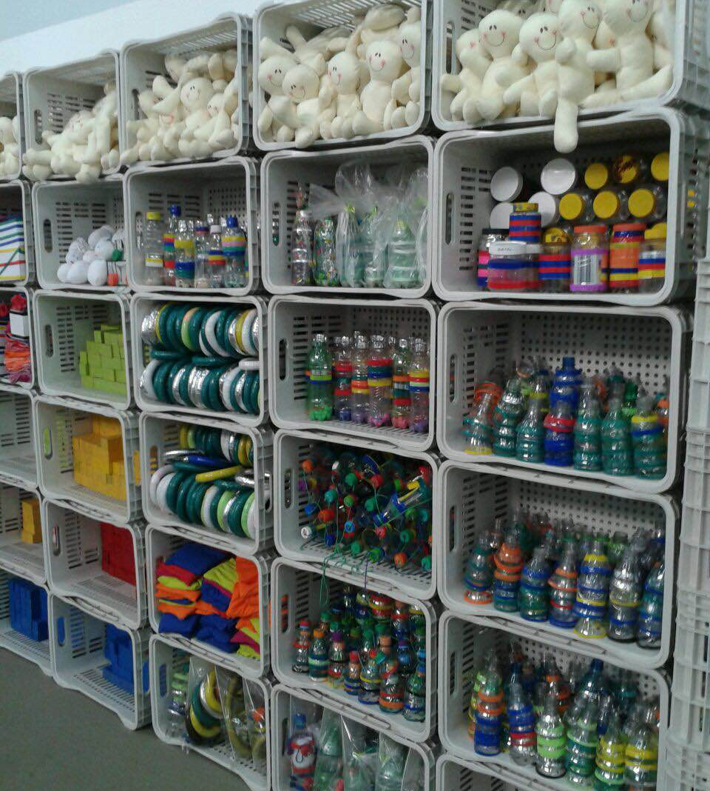
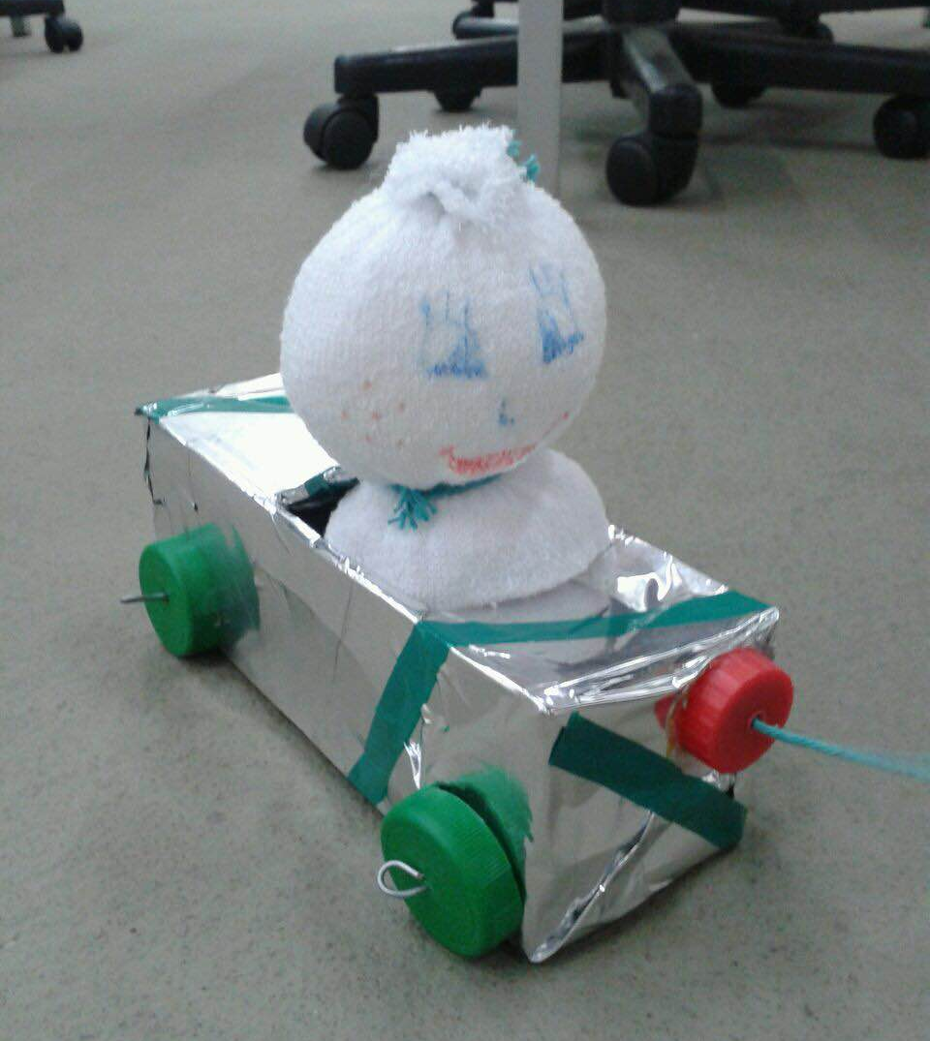
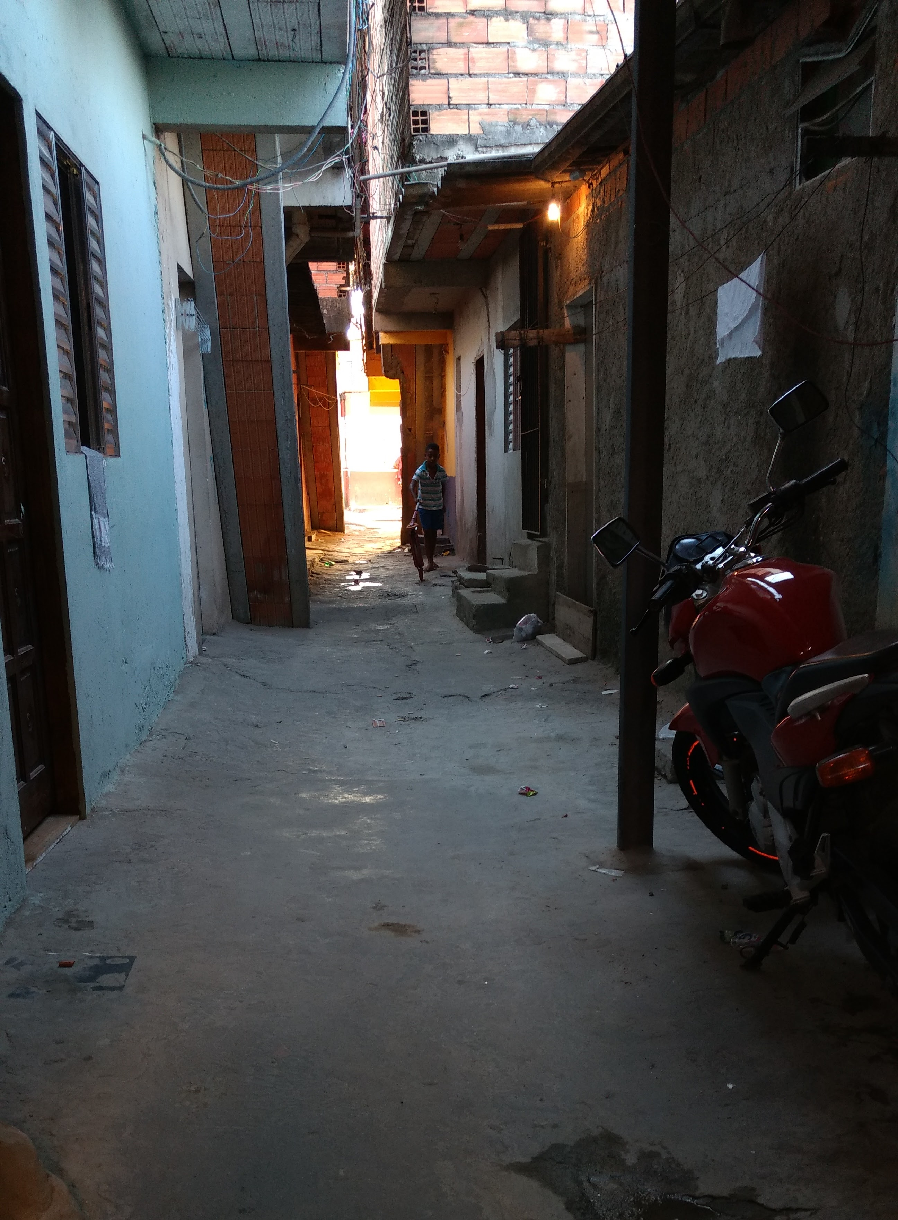
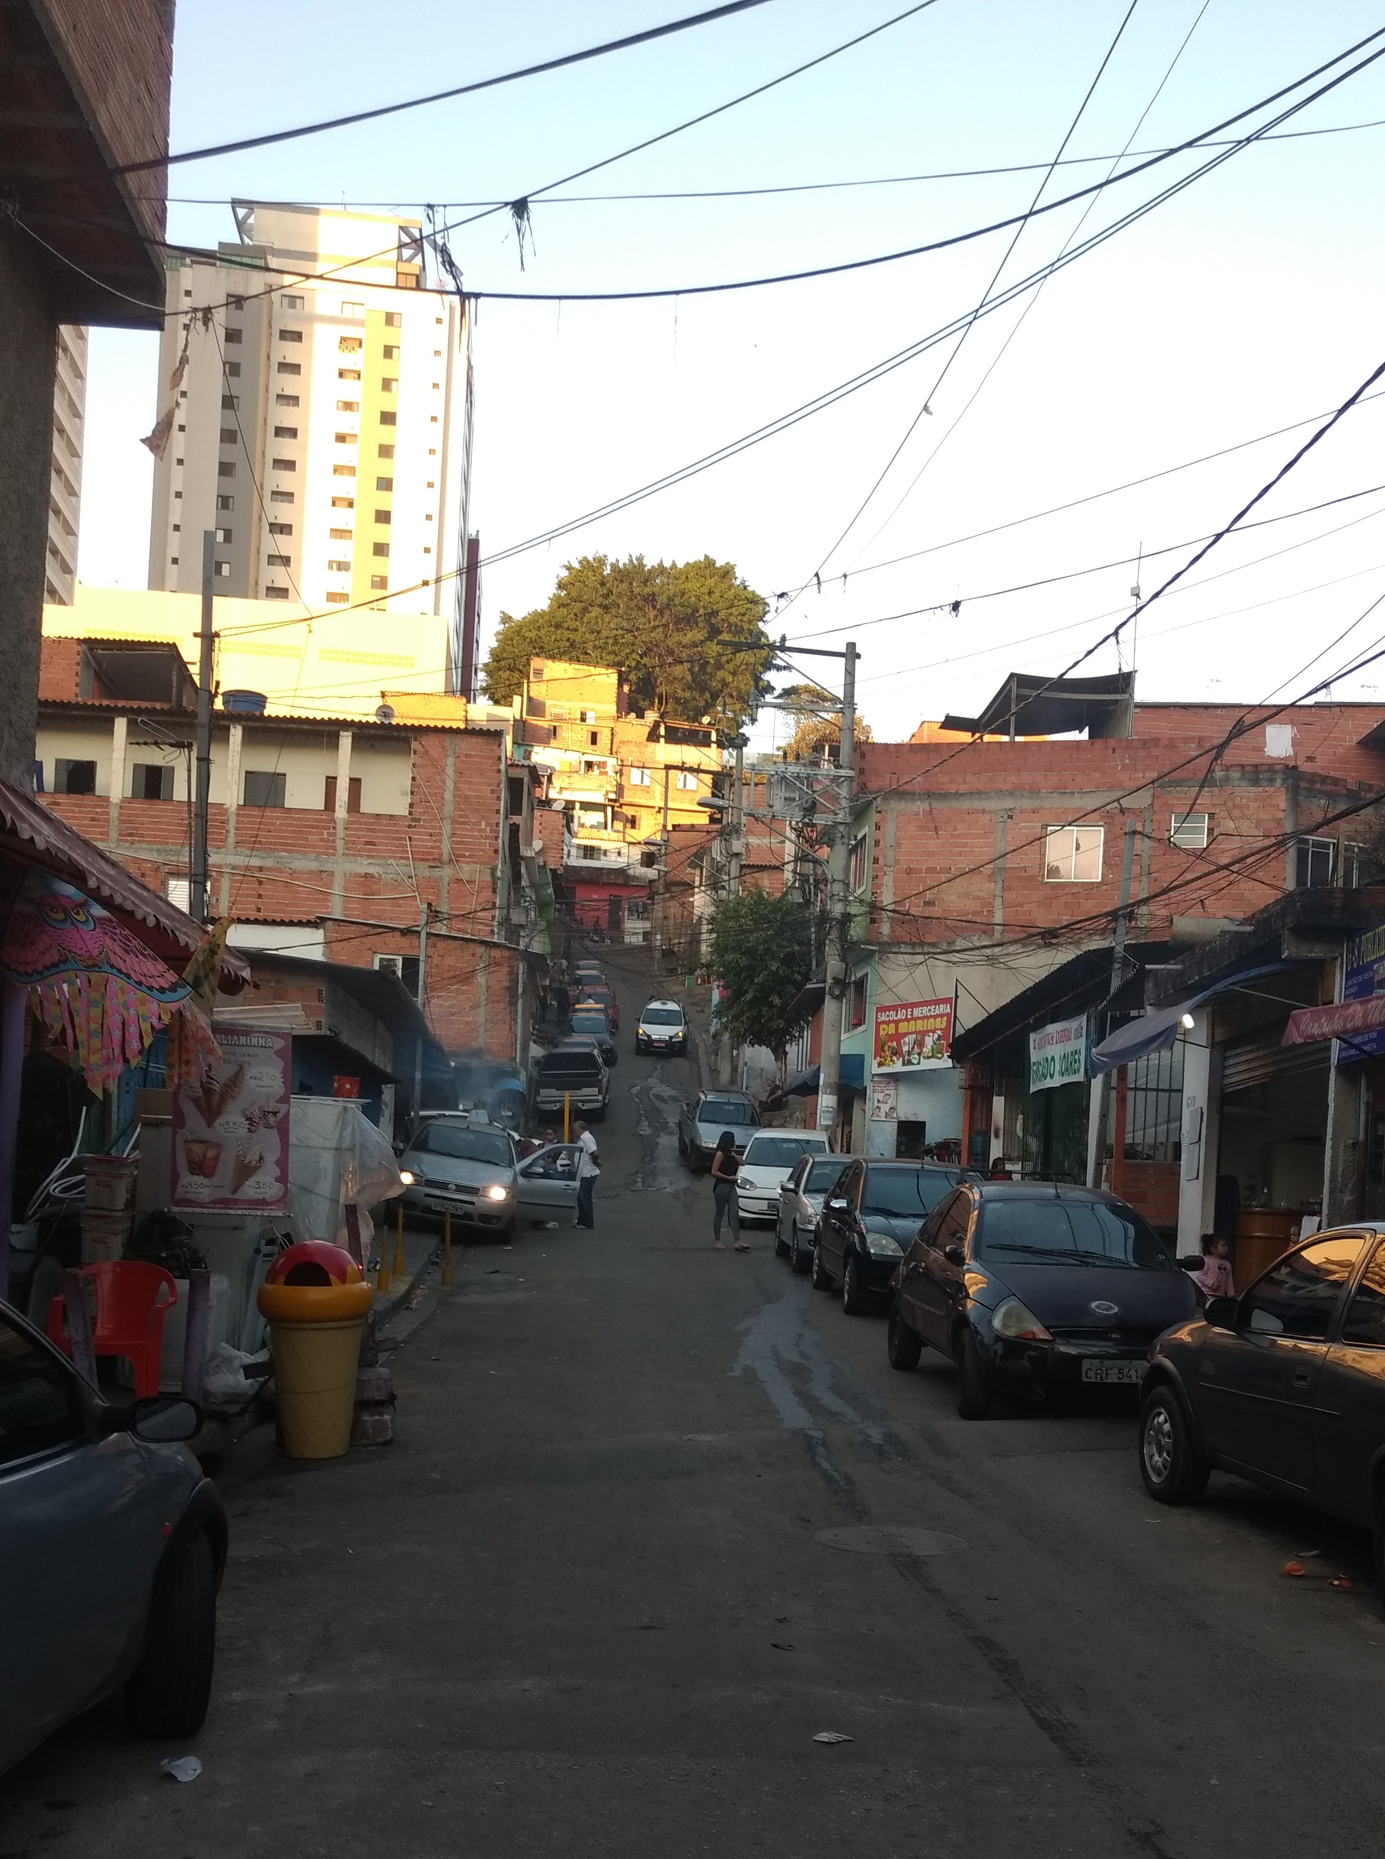
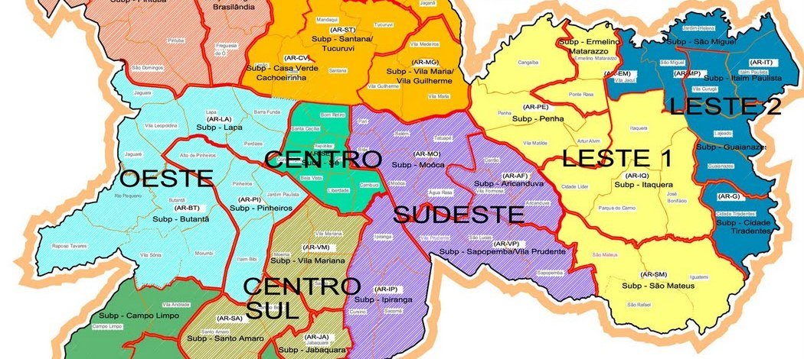

Qualitative impact evaluation of a
community health worker-led child development program in the Western Region of São Paulo, Brazil
Michael Ho¹ & Natalie Ziel¹, Alexandra Brentani², Fernanda Moura²,Michele Heisler¹
¹The University of Michigan, Ann Arbor, MI; ²University of São Paulo, São Paulo, Brazil
BACKGROUND
Low socioeconomic status (SES) families in São Paulo, Brazil often live in improvised communities with high levels of environmental pollution, violent crime, and that lack adequate utilities and sanitation.
Children in these communities often lack early stimulating activities and play necessary for early cognitive and motor development.
Historically, most Brazilian child intervention programs have been focused on public health and formal schooling, which begins at age six.
RESULTS
Figures 2 and 3. Program toys made by hand out of recycled material
Table 1. Quotes that illustrate main themes
Benefits the program brought to the child:
“[The program] stimulated my child to learn to speak, to know colors. But the most important thing was learning to speak.”
“I didn’t think she would pick things up so quickly, but I think it was through this development that she began growing and learning more.”
“And the things like the images of animals, that generally [my daughter] wouldn’t see, she learns. ‘What is a cow? Where is the cow?’ She learned through the book what a cow is. Now she knows.”
“I see the development of my daughter, this is the greatest [benefit for me].”
PURPOSE
The Saving Brains RCT evaluated the systematic delivery of age-appropriate (and cost-effective) toys and activities to help guide caregivers to stimulate toddlers’ early brain development. Home visits administered by two experimental groups: (1) specially-trained Child Development Agents (CDA) and (2) Community Health Agents (CHA) employed by the Family Health Strategy/Projeto de Saúde da Família (PSF) were compared with usual care.
We explored participating mothers’ experiences with the program as delivered by CDAs and CHAs and their perspectives on the program’s overall effects on child development, parenting, maternal wellbeing, and engagement with the healthcare system.
How the program changed parenting styles:
“I learned that we have to pay more attention [to our children] too. If you pay attention to your child, to his/her development, he/she grows. I learned that you always have to have a little time for them.”
“Now I talk to her. I didn’t used to converse with her like I do now. I explain what things are, what they mean, what they do. It wasn’t like that before.”
“I never told [stories] like that, I never played like that with [my children]. And this program showed me that I need to give them more attention.”
“I didn’t used to play very much, no. Now I have started to play more through these activities. … I enjoy playing with her, teaching more, and giving her more attention. I participate more with her.”
“Now I have more patience. When she calls me to play, I give her attention.”
CONCLUSIONS
Overall, participants’ experiences with the home visits by both CHAs and CDAs were positive.
Participants reported that CHWs’ modeling of ways to engage toddlers in play increased their own confidence about their parental skills and perceptions of improvements in their children’s cognitive and motor development.
Through these mechanisms, these programs may help to mitigate cognitive disparities in low SES children in Brazil that arise before entering the formal school system.
METHODOLOGY
June and July of 2016: We conducted semi-structured interviews with 23 women in low SES communities in the Western Region of São Paulo who had participated in the Saving Brains intervention.
Interviewees were stratified into groups of high, medium, and low program engagement.
All interviews were conducted in interviewees’ homes in Portuguese, recorded, transcribed, and coded in English for thematic analysis.
Observations of the Community Health Agent involved in the program:
“She is a lovely person. She was very attentive with [my son]; when she arrived he stayed rather distant from her. She was showing the toys to him and he was sitting with her playing, she was explaining, and it was at that time that I saw that she was patient. She was always good humored.”
“I also like the day that she came and we spoke about the program and she told me she was Evangelical. I think this helped develop [our relationship] as well. It helped me to trust her more.”
“The CHA from Savings Brains and the pediatrician are our biggest sources of support [for parenting guidance]. Since the pediatrician isn’t always at the clinic, we spoke with the CHA more frequently.”
“We were apprehensive at first [to have a stranger in our home]. I said that I would do one [visit], if I like it, I’ll continue and if I don’t, I’ll stop. I ended up liking it, so I continued.”
IMPLICATIONS
These mothers’ experiences of the program support the value of programs such as Saving Brains to improve parenting skills among low-income mothers.
Figures 4 and 5. An example of a community in the Western Region.
Figure 1. Map of the city of Sao Paulo’s regions. Research was conducted in the Região Oeste (Western Region).
Suggestions for improvement:
“I think more visits because they were few! How strange that the program already ended. ‘I won’t see her again?’ I thought it was strange.”
“Add more books, because my son only has 2 or 3.”
“We always need guidance about medical care that I sometimes don’t know how to access. But with the support of someone else, it gets easier. Like check in with us, talk to us about what kind of care we need, and communicate that to people who can help.”
“It would be good if [the program] had the agent schedule consults at the healthcare clinic.”
“Activities and designs to color. I think it’s interesting that they usually come with just a blank sheet for [the children] to draw on, but if they came with a page with designs I think they would learn to color as well.”
ACKNOWLEDGEMENTS
University of Michigan Medical School Global REACH
Faculdade de Medicine da Universidade de São Paulo (FMUSP) for housing, staff, and other resources through the Hospital Universitario (HU) and the Hospital das Clínicas (HC)
Elisa Duarte Teixeira for the wonderful Portuguese classes
Finalmente e mais importante, as moradores na Região Oeste em São Paulo
Notes:
Prior to the intervention, many participants -- especially first-time mothers, reported having few sources of external social support, little formal instruction on appropriate child development, and low levels of confidence in parenting aptitude.
Key ways that participants reported that the program positively impacted their experience as parents include:
(1) noticeable improvements in their child’s language and motor skills
(2) receiving helpful instructions from CHWs about parenting skills
(3) social support from CHWs that improved maternal confidence
(4) knowledge that empowered mothers to engage creatively with their child.
Few caregivers, however, reported experiencing positive effects in the following areas due to their participation with the intervention activities:
(1) maternal mental health
(2) stress level
(3) confidence in their ability to access healthcare.
The majority of families that received the home visits from the CDA group endorsed that the program succeeded in its original intent to guide mothers or other caregivers to stimulate early childhood development through cost effective toys and activities. Mothers who received visits from the CHA group reported lower engagement and fewer perceived benefits from the intervention.
The majority of families in both groups indicated that they would welcome a continuation of the program activities in order to streamline their children’s transition into formal schooling.

